Slide 2

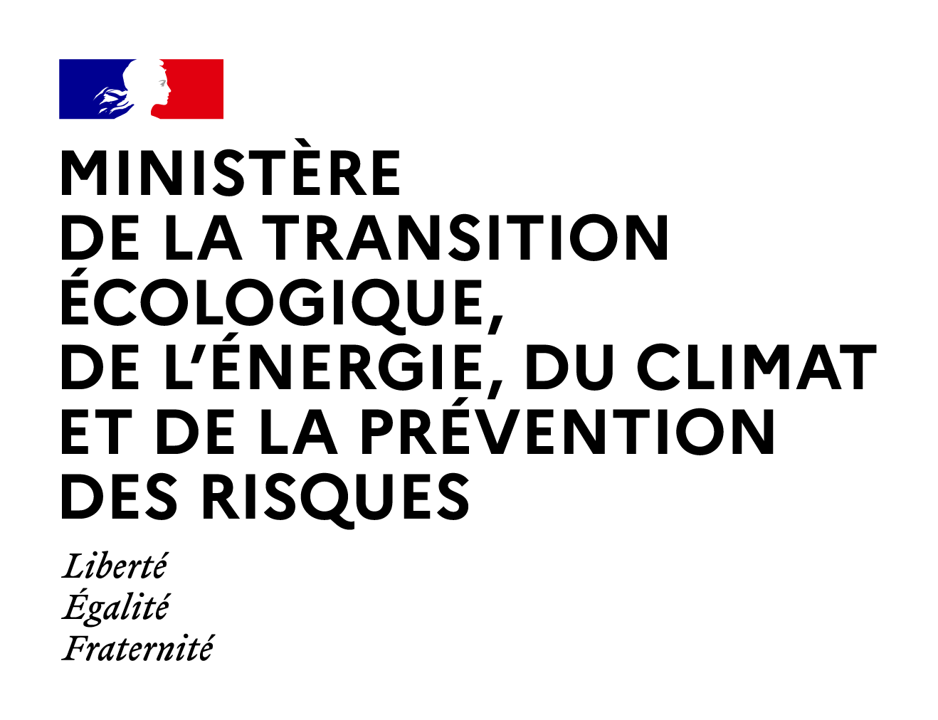
HOW TO APPLY
SECURITY BY DESIGN
TO SMRs
ILLUSTRATED
BY THE HISTORIC EXAMPLE OF THE
OPÉRA GARNIER (PARIS)
Antoine Malabirade, Nuclear Security Department
France

Slide 3
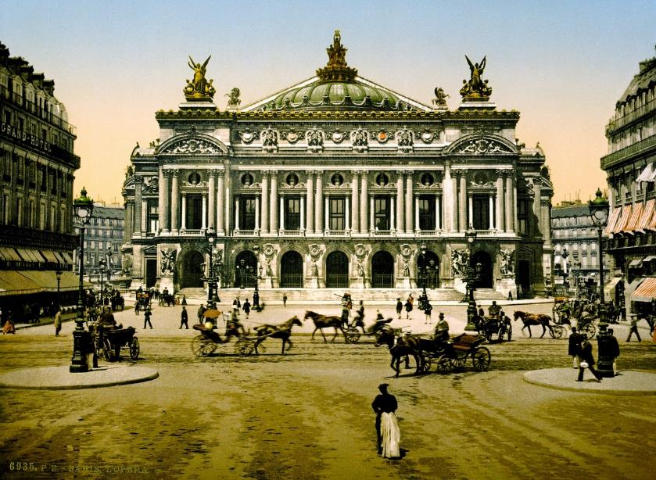
Opéra Garnier: an illustrative example
Is Security by design a novel concept ?
Who remembers today that security was one of the concerns of this building?
The Opera House, Paris, France ca. 1890-1900. Library of Congress.
3

Slide 4
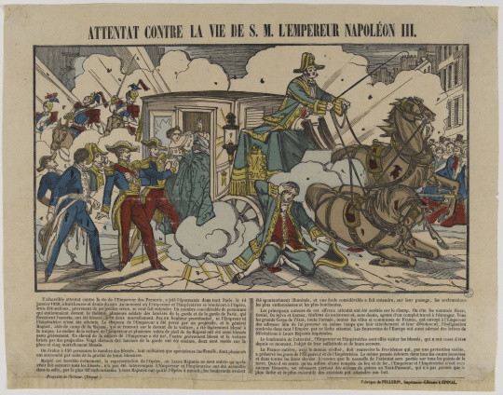


1. Origin of the Opéra design with security in mind
Security design starts with anticipation of threats
Opéra Garnier construction was decided after bomb attack on Emperor Napoleon III occurred in 1858, outside the previous opera house
For the design of the new opera house, security was an integral part of the planning process.
  Security by design starts from an early identification of risks
  Drives the need for an integrated design approach to minimize vulnerabilities
Attempt against the life of H.M. Emperor Napoleon III, print, 1858
© RMN-Grand Palais (MuCEM) / Franck Raux
4

Slide 5
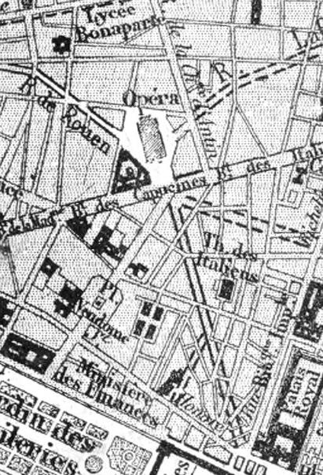
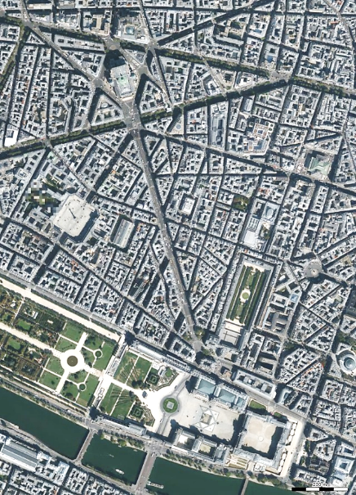

2. Siting, coming, exiting
Adapting to the environment / shaping the environment
Direct proximity to the Palais des Tuileries (at the Louvre), the Emperor’s residence, minimizing transportation duration
Creation of a wide Avenue de l’Opéra : allowing for U-turns and other maneuvers, giving clearer line of sight for security personnel.
Opéra
  Siting for SMR security :
    Effects on the attractivity of the facility for adversaries,
    Effects on the response capacities from the operator and the state
  Surroundings must be considered as early as possible to bring security by design to its best efficiency
Louvre
Detail of an 1869 map of Paris showing the projected route of the Avenue de l'Opéra
© IGN 2024
© CNES/Airbus 2024
5

Slide 6
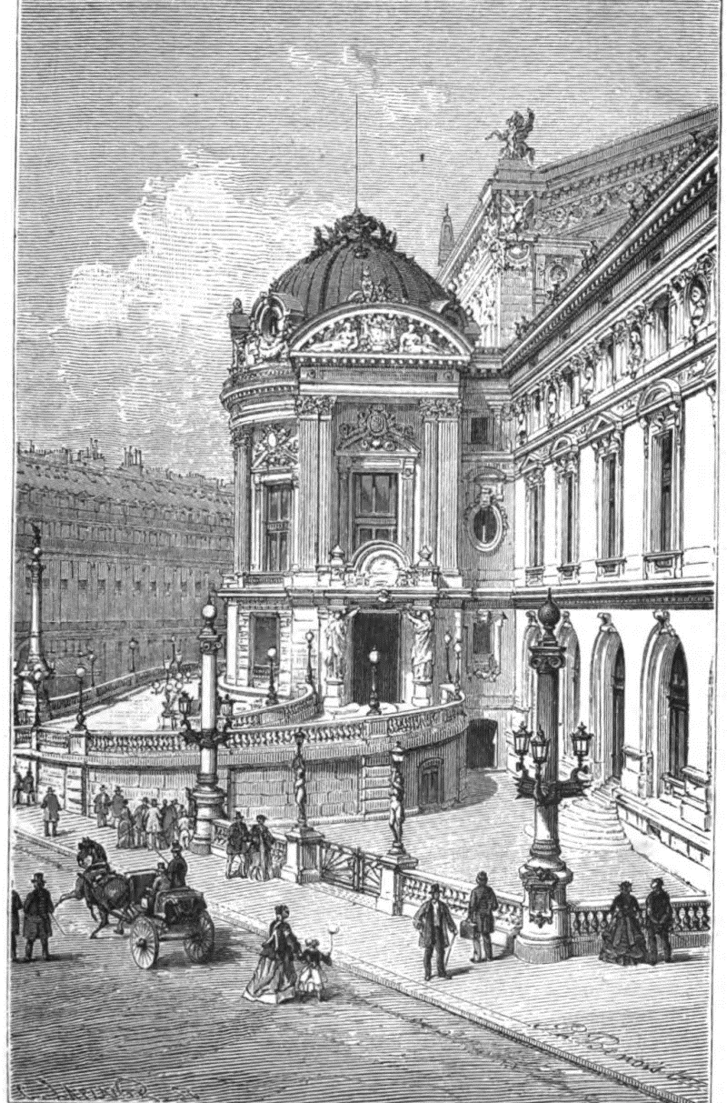
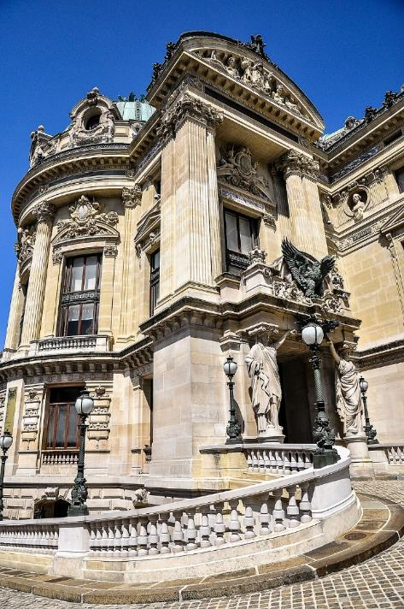
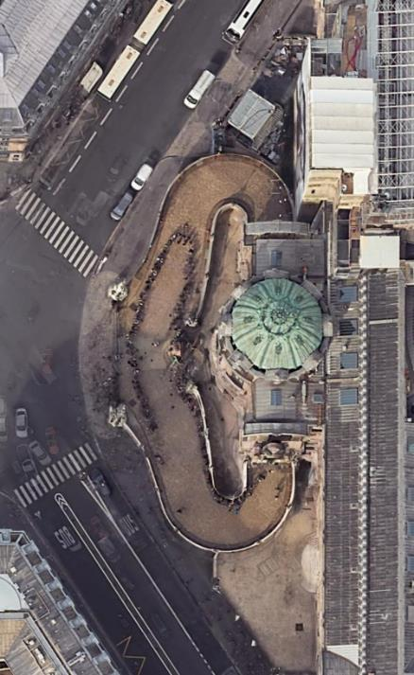
3. Exclusive access routes for security
Minimizing vulnerable access points in SMR designs
Private entrance known as “Rotonde de l'Empereur”, exclusively for Napoleon III.
Direct entrance with the Emperor’s carriage and underground passage reducing exposure to potential attacks or threats from external sources.
  Exclusive, protected access points to critical areas limit exposure to insider and external threats
  Minimizing vulnerable access points in SMR designs, protecting the facility using features such as underground structures
Rotonde de l’Empereur in 1875 (left) and today (right)
© CNES/Airbus 2024
6

Slide 7
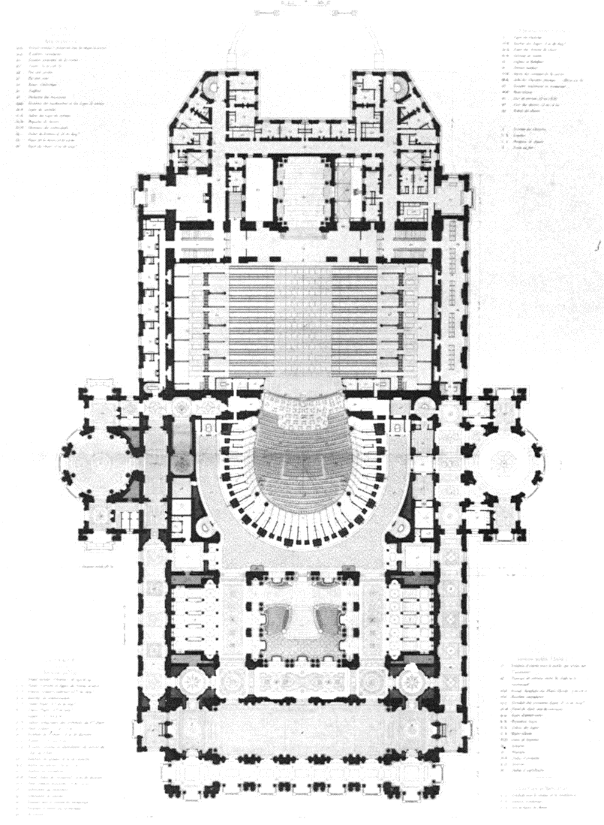
4. Minimizing public interaction to limit risk
Limiting access to sensitive areas through native segregating designs
Emperor’s entrance kept separate from main public entrances also to reduce unnecessary interactions with people who could pose security risks.
Isolate the vital target (the Emperor) from potentially dangerous environments while still allowing the building to function normally.
Subscribers
  Limiting access to sensitive areas to authorized personnel, reducing insider threat.
  Segregate the redundant safety and/or security organs from each other to reduce the likelihood of combined attack or damage
Emperor’s pathway
General audience
Garnier, Le Nouvel Opéra (1876–1880), folio I, plates 10–11.
7

Slide 8
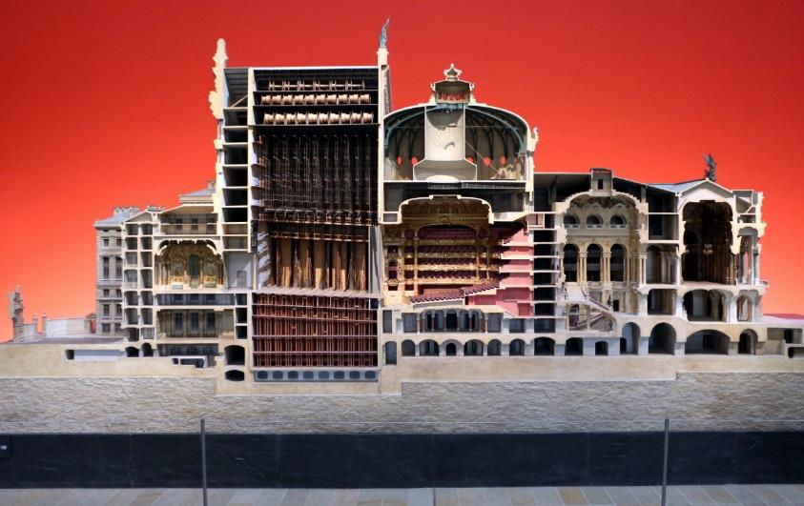
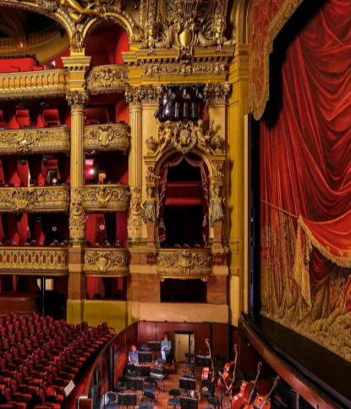
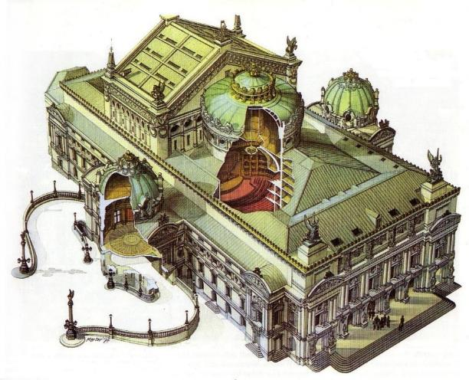
5. Design features to counter stand-off attacks
Embedding critical components behind robust and possibly multi-purposes barriers
Opera Garnier included protection against stand-off attacks in its design (snipers, bombing).
Emperor path to his box shielded from external views or access, by passive design
  Embedding critical components underground or behind robust physical barriers.
Emperor’s lodge
Ruchard Peduzzi, Model of the Opéra Garnier according to original Garnier plans, Collections of the Musée d'Orsay, 1986
©Romeo Balancourt
Wolf Stadler, Entwurfs- und Modellzeichnung der Opéra Paris, 1874
8

Slide 9
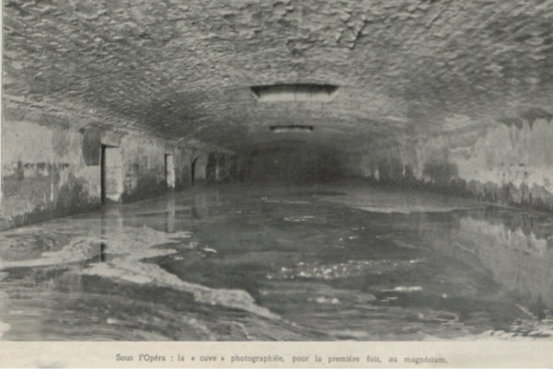

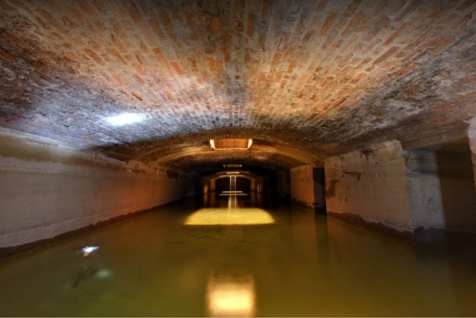
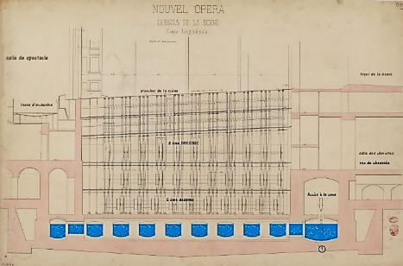
6. Kill two birds with one stone
Designing cost-effective multi-purposes barriers or systems
Underground water reservoir anchoring the building in a pre-existing swamp and distributing forces from the building to the ground, used in case of fire from accidental or malicious origins
  Designing multi-purpose defenses addressing both safety and security issues, when possible (e.g. underground structures resisting external aggressions)
Gaston Leroux novel from 1910, inspired by the water reservoir
©Wikimedia Commons / unknown circa 1900
Nouvel Opéra. Dessous de la scène. Coupe longitudinale. BNF
9
Ruchard Peduzzi, Model of the Opéra Garnier according to original Garnier plans, Collections of the Musée d'Orsay, 1986
©Google Art & Culture, 2021

Slide 10
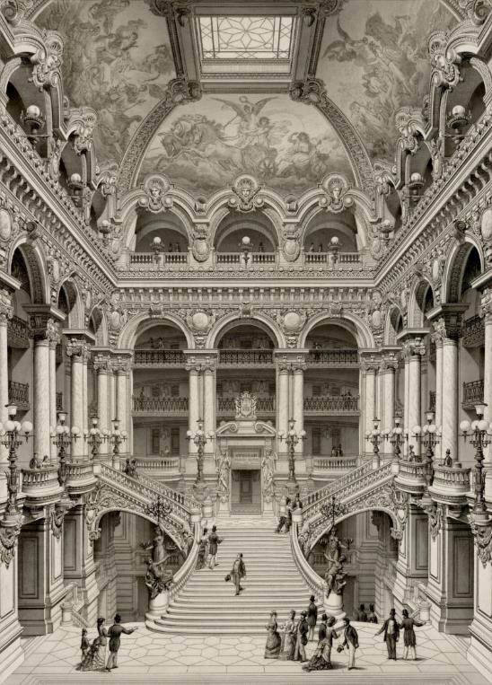
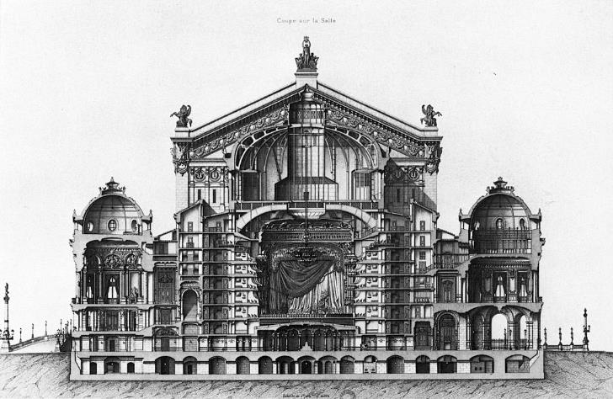
7. Integration of security without disrupting functionality
Avoiding the need for supplemental security measures later on
Security was a fundamental concern in the design but did not compromise the opera’s primary function
Security features (private passageways, strategic layout) were integrated seamlessly into the architecture, enhancing security while maintaining operational goals.
  Aligns with security by design in SMRs = security measures without compromising operational efficiency or safety.
  Incorporation of security features into the design minimizing external modifications or later additions of external protection systems
Charles Garnier & Jean-Joseph Sulpis
Monography of the new Paris Opera, 1880
©BnF
Charles Garnier & Jean-Joseph Sulpis
Monography of the new Paris Opera, 1880
©BnF
10

Slide 11
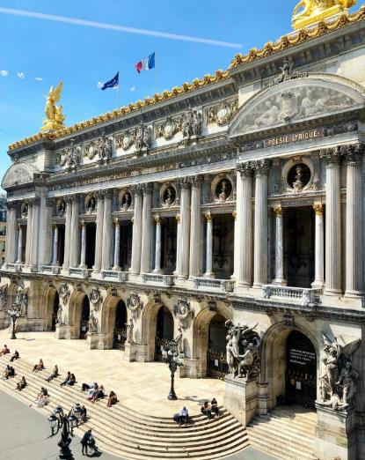
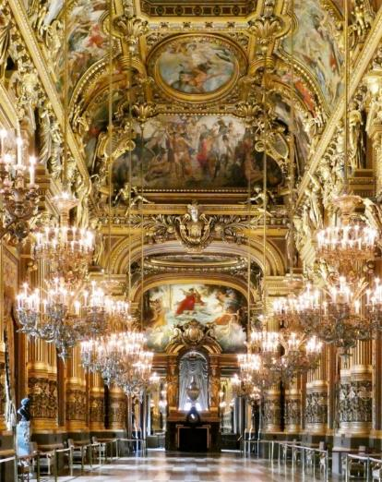
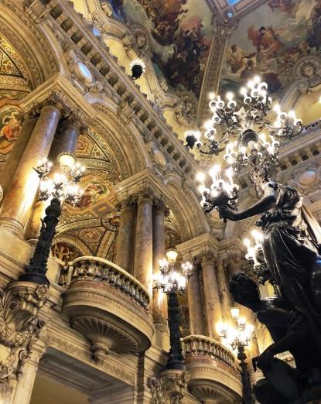
8. Adaptability to future threats
Allow flexibility, anticipate threat evolution
Design allowed for flexibility and adaptability to future security needs without requiring major modifications : enough space allocation, easy maintainability, wide surroundings…
Remained a rather secure facility even as threats evolved over time.
  Similarly, SMR designs must be adaptable to future threats.
  Security by design enables to anticipate changes in the threat landscape and to integrate flexible systems
11

Slide 12
What is Security by Design?
Integrating transport logistics for NM from the design phase
Operational designs mitigating risks like Loss of Coolant Accidents (LOCA) or segregating targets from maintenance intensive equipment
Security needs should align with operational requirements to streamline operations
Reducing radioactive releases through modular SMR designs
Intrinsically secured design
Integrating security into the architecture
Early identification of nuclear security requirements
Anticipating vulnerabilities
Address vulnerabilities and insider threats as early as possible
Using materials resistant to fire, corrosion, aggressions
Optimize layout for security needs (e.g., access control and zone separation).
Reducing the number of targets and mitigating vulnerabilities using redundancy and defence in depth
Restricting NM category and optimizing fuel management
12

Slide 13
National legislative and regulatory obligations
National expectations
Designers
Have a good knowledge and understanding of L&R frameworks in target countries
One issue may concern national DBT (protected information)
International framework
Legally binding (CPPNM)
Non-legally binding (NSS)
National Authorization Process
National framework
Performance based and/or
Prescriptive framework
&
DBT
States
Would additional or specific regulations be necessary to consider SMR?
How could national DBT apply to SMR?

Slide 14
Design Basis Threat (DBT) and Flexibility
Adapting to threats over time:
Example threats (e.g., drones, armed attacks, cyber threats) are crucial for SMR designs as information sharing is limited
Designers must ensure some minimal flexibility for future upgrades in security features as threats evolve
  Margins, future additional security systems, evolutions…
Cyber-attacks
Insider threat scenario
Armed commando attack – Paris, 2015
Example of threats given to designers in the French SMR guide
Airliner (9/11)
Drones
VBIED – Oklahoma City, 1995
14

Slide 15
Is the regulation adapted to SMRs ?
For France, there is no reason to assume that SMRs do not pose the same nuclear security challenges as other nuclear installations. SMRs are no exception.
SMRs require fuel fabrication and/or enrichment facilities, nuclear material transport, used fuel and waste processing, just like the rest of the nuclear sector.
SMRs particularities can be taken into account applying “graded approach” principle through performance-based assessment.
French performance-based approach:
  Allows for great flexibility
  Requires rigorous demonstrations
15

Slide 16
Implementing an efficient Security by Design
Security
Need for cross-functional collaboration and security training for designers to better integrate Security in every aspects of the project.
Safety
Safeguards
Operations
16

Slide 17
Conclusion
Anticipation: Early integration of security reduces costs and enhances both security and operability.
Flexibility: SMRs need robust, flexible designs to adapt to evolving threats.
Efficiency: Cross-functional collaboration is key to achieving effective security designs, especially between safety, security and operation oriented designers and experts.
Regulatory challenge: early-on dialog between designers, operators and regulatory bodies is crucial for delivering viable projects.
SMRs are no exception to nuclear security: threats and potential consequences must be addressed.
17

Slide 18

Thank you
antoine.malabirade@developpement-durable.gouv.fr
+33 1 40 81 77 60
By the way… Napoléon III never attended any Opera in the Opéra Garnier,
as the 3rd empire disappeared in 1870, 5 years before completion !

