Slide 1
Session: 11.1 [Paper No. 176]
Navigating the Regulatory Landscape: Strategic Approaches to SMRs Security

Slide 2

Transitioning Regulatory Oversight: Moving from Prescriptive to Performance-Based Approach for Addressing Security Challenges in Indian Small Modular Reactors (SMRs)
Date: October 22, 2024
Venue: IAEA, Vienna
Kaushik Ghoshal
Nuclear Controls and Planning Wing
Department of Atomic Energy
India

Slide 3
Disclaimer
The presentation reflects my understanding and perception in individual capacity and do not reflect the views of the organization that I am affiliated with.

Slide 4
Outline
Introduction
The Prescriptive Model of Nuclear Security Regulations
Transitioning to Performance-Based Security Measures
Security Risks of SMRs in Urban Landscapes
Adoption of “Security by Design” Approach
Methodology
Key Design Considerations
The Pitfalls of Prescriptive Security Regulation Models
Proposed Strategy
Conclusion

Slide 5
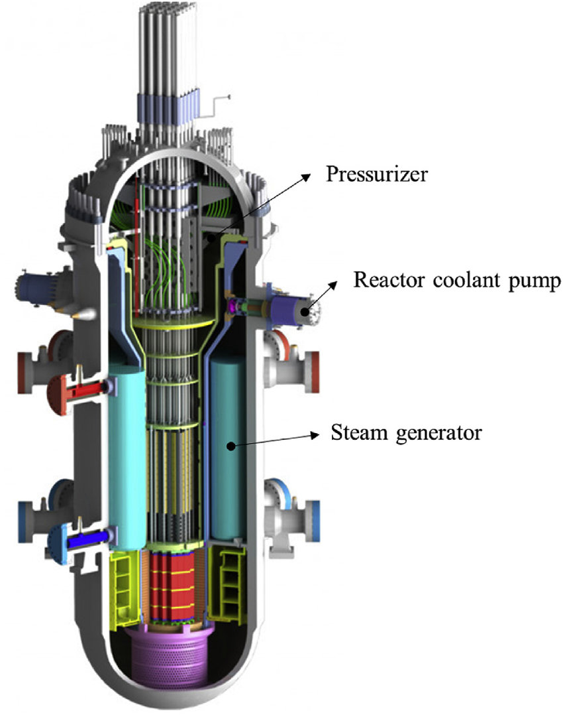
Introduction
India's nuclear sector is set for significant expansion with small modular reactors (SMRs) emerging as a key solution for rising energy demands.
SMRs are being considered for deployment at decommissioned large commercial thermal power plants and within major industrial complexes.
Potential industrial sites also include integrated steel plants and aluminium smelters with aging captive power plants facing high operational costs and rising fossil fuel prices.
SMRs offer a solution to these challenges but pose unique security concerns in urban settings.
Unlike traditional reactors that require a minimum exclusion zone of 1 km, SMRs may lack sufficient spatial buffers.
This proximity to densely populated areas heightens security risks.

Slide 6
Security Risks of SMRs in Urban Landscapes
Urban deployment of small modular reactors (SMRs) introduces unique security challenges
Their compact size increases the risk of sabotage or theft, facilitating unauthorized access.
Reduced or absent exclusion zones heighten the risk of radiological releases from attacks.
Such releases could lead to Unacceptable or High Radiological Consequences, threatening public safety.
Limited buffer zones intensify the impact on nearby populations and the environment.
Absence of substantial exclusion zones hampers emergency response effectiveness.
Timely deployment of emergency measures may be impeded, worsening breach consequences.
Robust security protocols and tailored response strategies are essential for urban SMRs.

Slide 7
The Prescriptive Model of Nuclear Security Regulations
India's nuclear security regulations follow a prescriptive model with three concentric security boundaries.
The innermost Operating Island (OI) boundary features double fencing and includes critical safety systems.
The Main Plant Boundary (MPB) encompasses all essential systems and structures.
The outer Exclusion Zone extends up to 1.6 kilometre, with strict public access restrictions.
The details parameters like boundary distances, construction materials, and surveillance equipment.
Access control at multiple Entry points: Exclusion Zone, MPB (LAA), OI (PA), and Vital/ Inner Areas.
Stringent credential verification ensures only authorized personnel access sensitive areas.
This layered security approach significantly enhances protection against potential intrusions.

Slide 8


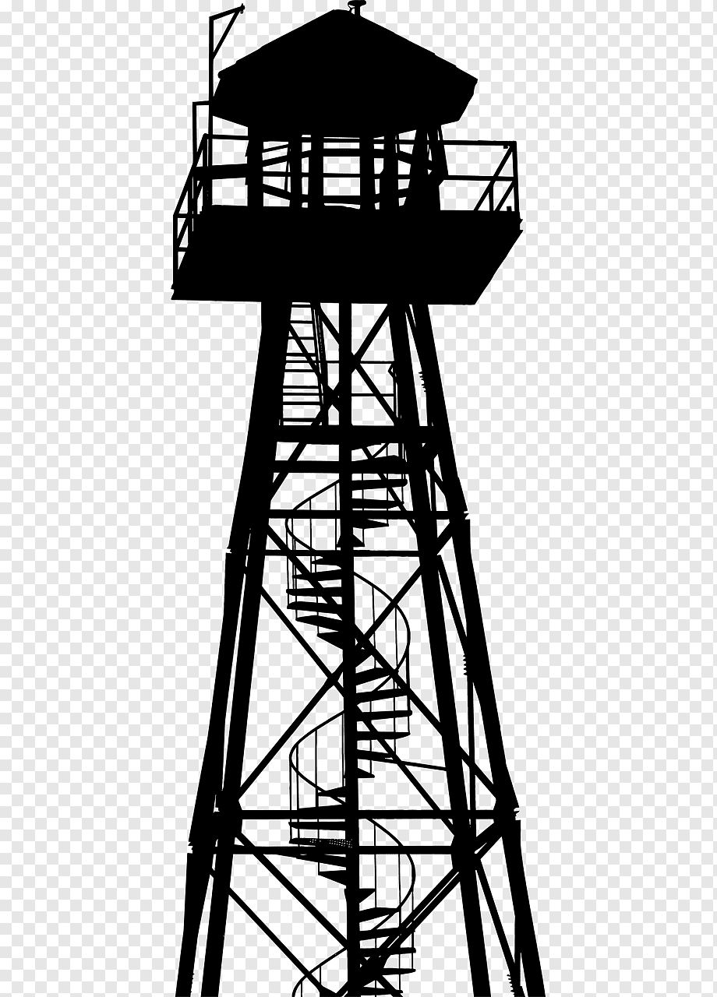

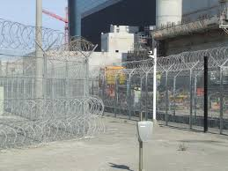
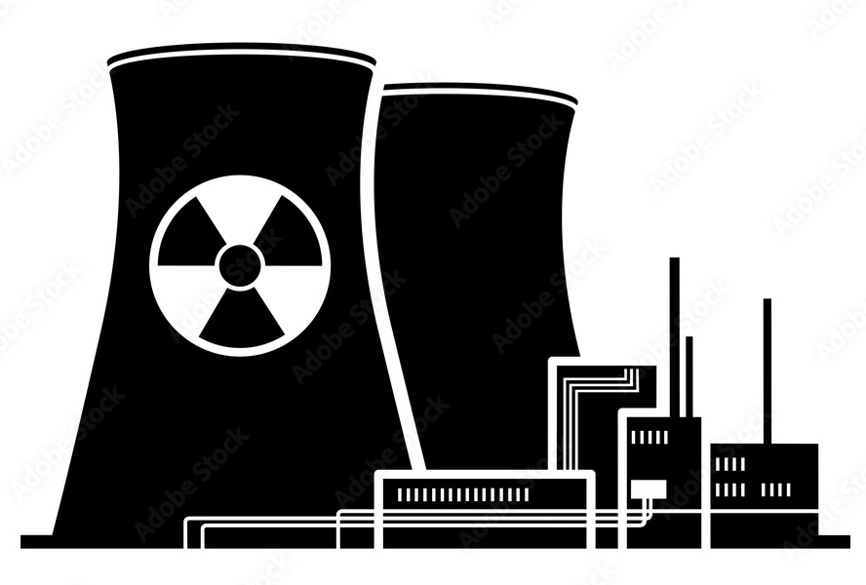
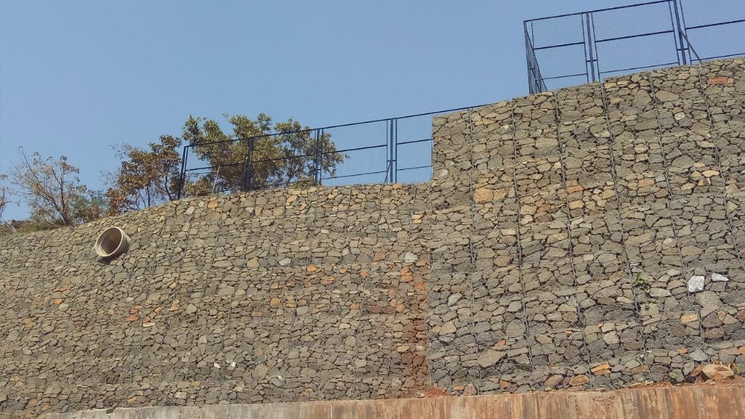
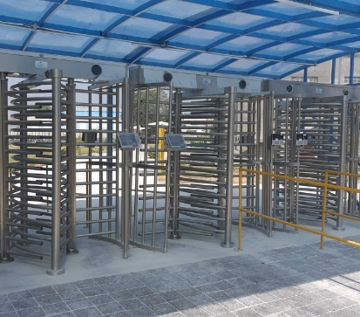

Exclusion Zone Boundary
Exclusion Zone Boundary
[Min. 1 KM]
Distance Requirements of Various Zones within Exclusion zone of NPPs
Distance Between MPB & OI
[Min. 400 Mt.]
Main Plant Boundary (MPB)
Operating Island Entry Portal & CAS
OI Boundary with Isolation Zone
Main Guard House
OI Double Fencing with Isolation Zone
Exclusion Zone Entry
RRM Wall
Distance Between MGH & OI Entry Portal [Min. 500 Mt.]
* Not in True Scale
Access Control System; MGH &OI

Slide 9
Space Utilization Metrics for Conventional NPPs
Exclusion Zone (EZ) Boundary
Sl. No. | Description | (Sq. KM)
1. | Total area within Exclusion Zone Boundary | 3.142
2. | Total area within Main Pant Boundary | 0.8700
3. | Total area within outer fence of OI Boundary | 0.0314
It is assumed that the area within the outer fence of the operating island is circular, with a diameter of 200 meters.
Main Plant Boundary (MPB)
OI Boundary with Isolation Zone
Coverage: PPS applies to 30-40% of the total Nuclear Power Plant area.
Buffer Zone: The remaining 60-70% operates with less stringent security measures.
Function: Acts as a buffer to enhance overall security.
Patrols: Scheduled foot and vehicle patrols in the buffer zone.
Natural Barriers: Features uneven terrain, water bodies, and dense forests that deter unauthorized access.
Secured Access: Buffer zone protected by an RRM wall; entry to the Exclusion Zone (EZ) controlled via a monitored gate.
Overall Impact: The buffer zone significantly enhances the effectiveness of the plant's security system.
* Not in True Scale

Slide 10
The Pitfalls of Prescriptive Security Regulation Models
Space Constraints
Urban landscapes present significant limitations for traditional security measures
Extensive areas required for concentric security layers are often impractical in densely populated settings.
Impact on Security Integrity
The need to maintain distances between security layers is compromised.
Unique site-specific configurations must be developed to effectively integrate SMRs into urban environments.
Dynamic Layout Requirements
Each Small Modular Reactor (SMR) layout is inherently distinct, tailored to its unique urban context.
This variability challenges the feasibility of applying uniform prescriptive security measures across different facilities.
Flexible Security Solutions
The rigid nature of Prescriptive Security Regulation Models is incompatible with the diverse spatial constraints of urban deployment.
There is a pressing need for adaptable security strategies that can accommodate varying land use scenarios while ensuring safety and operational integrity.

Slide 11

Space Utilization Metrics for SMRs
Main Plant Boundary (MPB)
OI Boundary with Isolation Zone
* Not in True Scale

Slide 12
Adoption of “Security by Design” Approach
Key Principles
Holistic Integration: Collaborate with engineering and cyber security experts from the outset.
Inherent Security: Embed security measures in the design's foundation.
Passive Defence: Reduce reliance on active measures, enhancing overall resilience.
Adaptive Responsiveness: Maintain flexibility to address evolving threats.
Practical Applications
Mitigation of Malicious Acts: Critical areas underground to reduce sabotage risks.
Threat Response:
Armed security posts for rapid responses.
Fortified positions against ballistic threats.
Multi-purpose Central Alarm Stations (CAS) for surveillance and emergency management.
Comprehensive IT Security Management System for sensitive information handling.

Slide 13
Transitioning to Performance-Based Security Measures
Performance-Based Approach:
Focus: Achieve predetermined security outcomes rather than rigid layouts.
Flexibility: Tailored security measures for unique urban vulnerabilities.
Key Components of Effective Physical Protection Systems (PPS):
Comprehensive Security Assessment
  Identify potential threats (Design Basis Threat - DBT)
  Define critical targets
PPS Design Elements
  Detection: Identify unauthorized access.
  Delay: Thwart potential breaches.
  Response: Act to mitigate threats.
Evaluation & Optimization
  Use computer simulations to assess vulnerabilities.
  Redesign based on findings.
Risk Assessment:
Quantification: Assess overall risk against potential attack consequences.
Normalization: Assign numerical values (0-1) for consequence severity.
Decision-Making: Informs acceptability of residual risk.

Slide 14
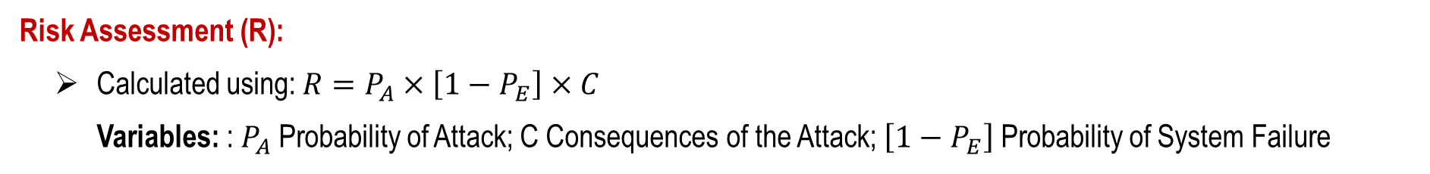
Methodology
PPS Effectiveness (PE):
Defined as: $P_{E}=[P_{I}×P_{N}]$ Where: $P_{I}$Probability of Interruption; $P_{N}$Probability of Neutralization
Risk Assessment (R):
Calculated using: $R=P_{A}×\left[1−P_{E}\right]×C$
Variables: ​: $P_{A}$Probability of Attack; C Consequences of the Attack; $\left[1−P_{E}\right]$Probability of System Failure
Probabilistic Approach:
Evaluates PPS functions concerning Response Force Time (RFT).
Multiple adversary pathways analyzed with different protection layers.
Key Components:
Inputs for Adversary Sequence Diagram (ASD):
  Probability of Detection (P_{D})
  Mean Delay Time (t_{D})
  Probability of Communication (P_{C})
Critical Detection Point (CDP): Determined by RFT.
Target Effectiveness:
Aim for $P_{E}$≥ 0.8
Achievable with $P_{I}$ and $P_{N}$​ of at least 0.9 each

Slide 15
Key Design Considerations
To ensure the safe and secure operation of SMRs in such environments, a comprehensive approach to security is essential. This includes the implementation of various remedial measures aimed at mitigating security risks and safeguarding both the reactor facilities and surrounding communities.
Enhanced Physical Protection Systems
Cybersecurity Safeguards
Redundant Safety Systems
Continuous Risk Assessment and Adaptation

Slide 16
Proposed Strategy
Enhanced Security Infrastructure for Dynamic Defence
Multi-layered Security: Integrates various security layers for robust protection.
Advanced Surveillance Technologies: Utilizes cutting-edge cameras and sensors.
Robotic Security Patrols: Deploys autonomous units for monitoring and response.
Cybersecurity Integration: Merges physical and digital security measures.
AI & Machine Learning: Enhances threat detection and analysis.
Real-time Threat Assessment: Enables immediate response to emerging threats.
Drone Detection & Countermeasures: Safeguards against unauthorized aerial incursions.
Resilient Physical Infrastructure: Fortifies facilities against physical and cyber threats.

Slide 17
Proposed Strategy [Cont.]
Redundant Safety Systems in Small Modular Reactors (SMRs)
Importance of Redundancy
Essential for safety in densely populated areas.
Types of Redundant Safety Systems:
Inherent Safety Features: Built-in mechanisms for immediate safety.
Engineered Safety Systems: Designed systems to back up inherent features.
Key Examples:
Multiple Emergency Shutdown Systems: Ensures quick reactor shutdown.
Diverse Decay Heat Removal Systems: Multiple cooling methods for residual heat.
Multiple Containment Barriers: Layers of protection against radioactive release.
Redundant Filtration Systems: Multi-stage filters for air and water safety.

Slide 18
Conclusion
Pivotal Shift: Move from prescriptive to performance-based regulations.
Proactive Approach: Emphasizes adaptability and efficiency in security.
Tailored Security Measures: Customizes strategies to the unique SMR landscape.
Enhanced Effectiveness: Focus on performance metrics optimizes resource allocation.
Compliance and Improvement: Aligns with evolving security standards and fosters resilience.
Innovation Leadership: Positions India at the forefront of nuclear security advancements.
Sustainable Development: Supports safe and sustainable nuclear energy growth for the future.

Slide 19


