Slide 2
SECURING SMALL MODULAR REACTOR DEVELOPMENT IN REMOTE AREAS:
Case Studies and Cultural Analysis in Indonesia
Alfitri Meliana
alfitri.meliana@brin.go.id
National Research and Innovation Agency
INDONESIA

Slide 3
Outline
Introduction
Indonesia’s Energy Sources Background
SMR Deployment in Remote Area
Indonesia’s Society and Culture
Mitigation Strategies
Conclusion

Slide 4
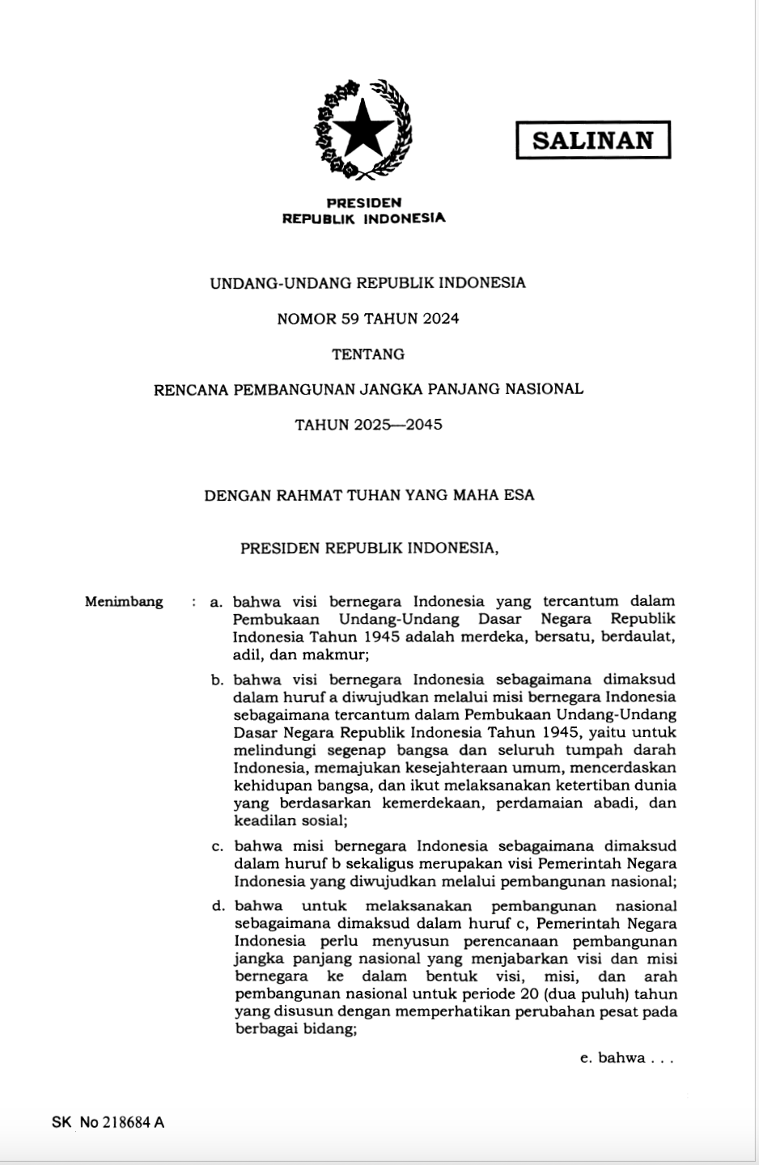
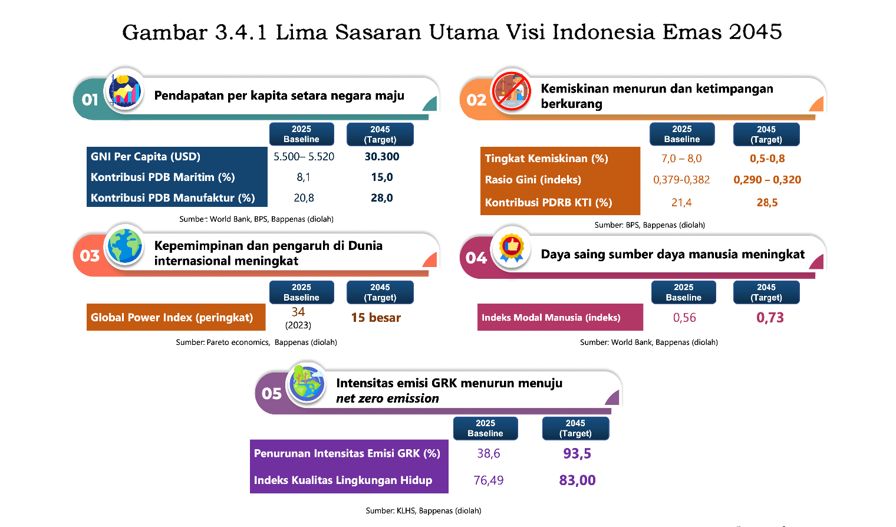
Introduction
Five Main Targets of Indonesia Emas 2045
per capita income equivalent to developed countries
poverty decreases and inequality decreases
Leadership and influence in the international world increases
the competitiveness of human resources increases
Human Capital Index (index)
GHG emission intensity decreases towards net zero emissions
reduction in GHG emission (%)
environmental quality index

Slide 5
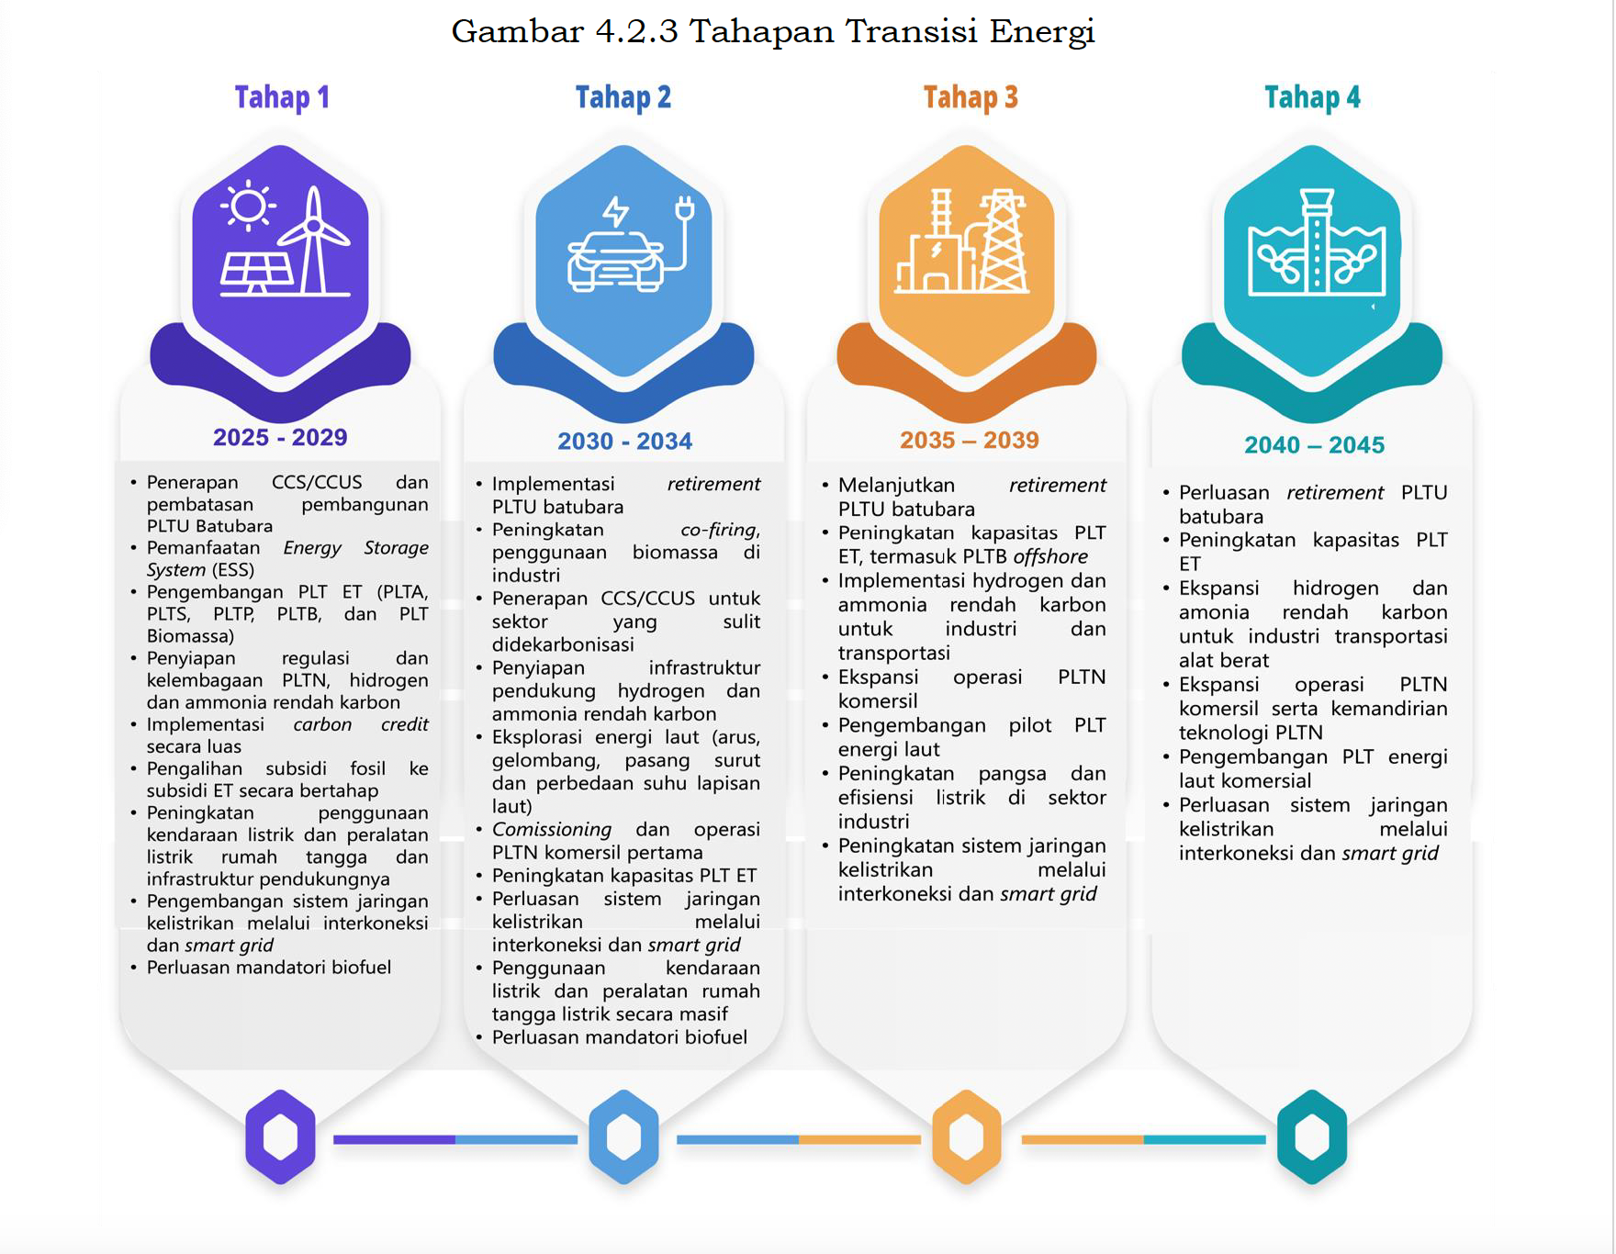
Introduction
Indonesia’s energy transition related to NPP
2025 - 2029
Preparation of NPP regulations and institutions
2030 - 2034
Commissioning and Operation first commercial NPP
2035 - 2039
Expansion of commercial NPP operations
2040 - 2045
Expansion of commercial NPP operations and independence of NPP

Slide 6
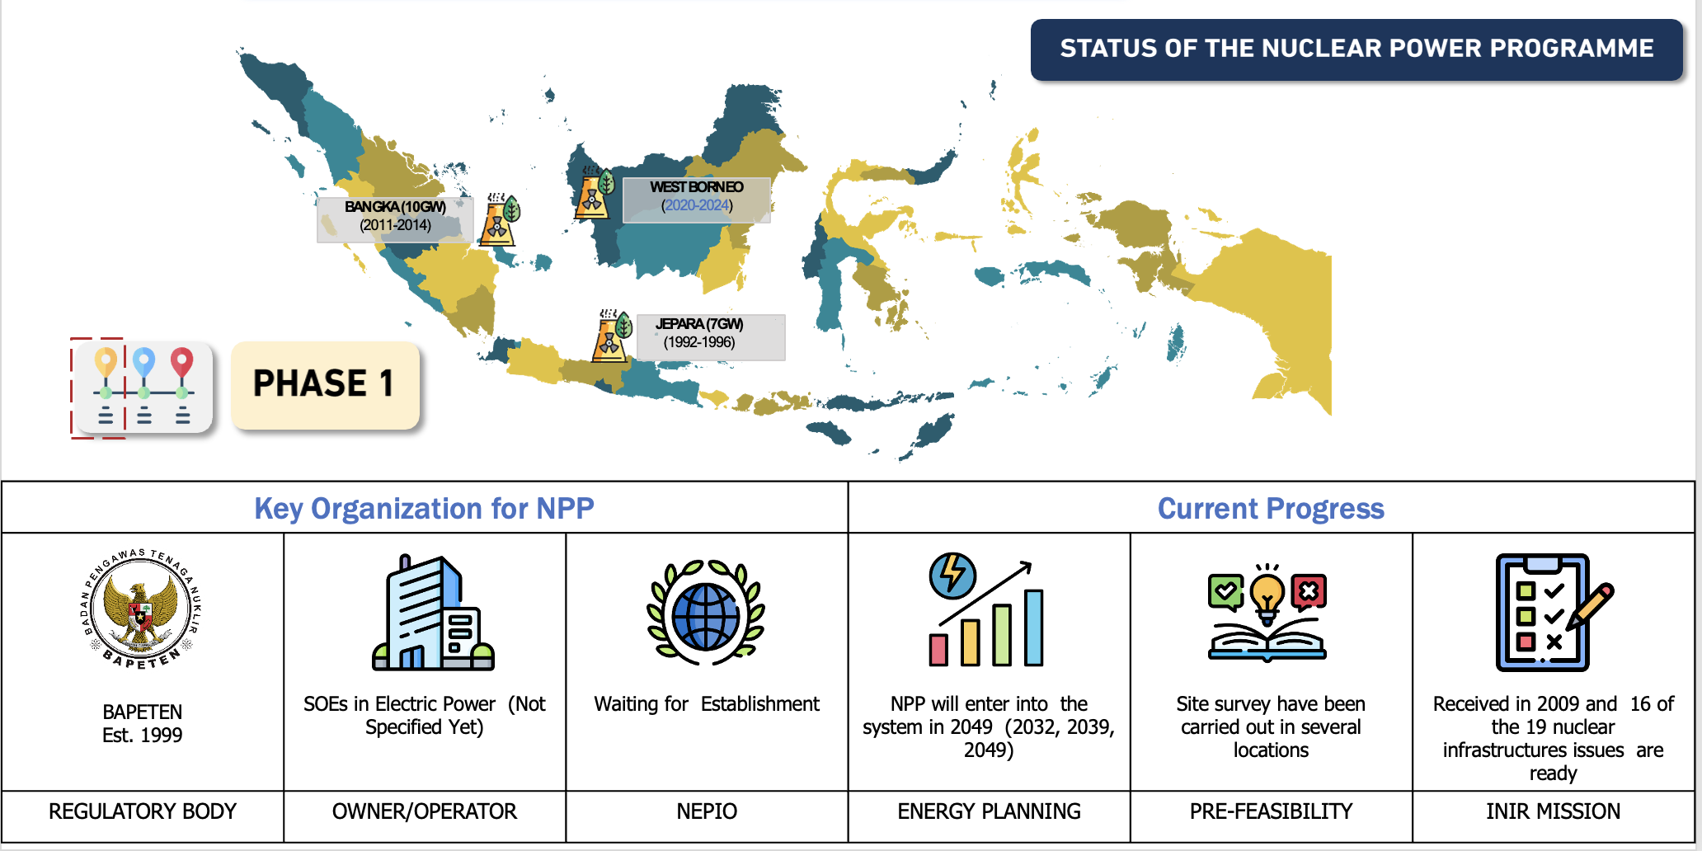
Introduction

Slide 7
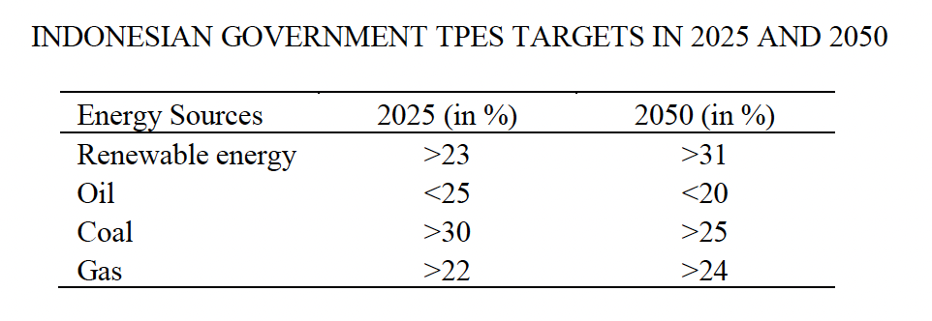
Indonesia’s Energy Sources
Why SMR is suitable for Indonesia?
Reduce construction time and costs
Flexible
Can be deployed in remote area

Slide 8
Remote SMR Deployment
Type of threat for remote area SMR deployment
Physical threats
Sabotage, theft, attack on infrastructure
Cybersecurity threats
Hacking, phising, manipulating control system
Societal threats
Public opposition, local cultural dynamics, potential civil unrest, lack of nuclear trust

Slide 9
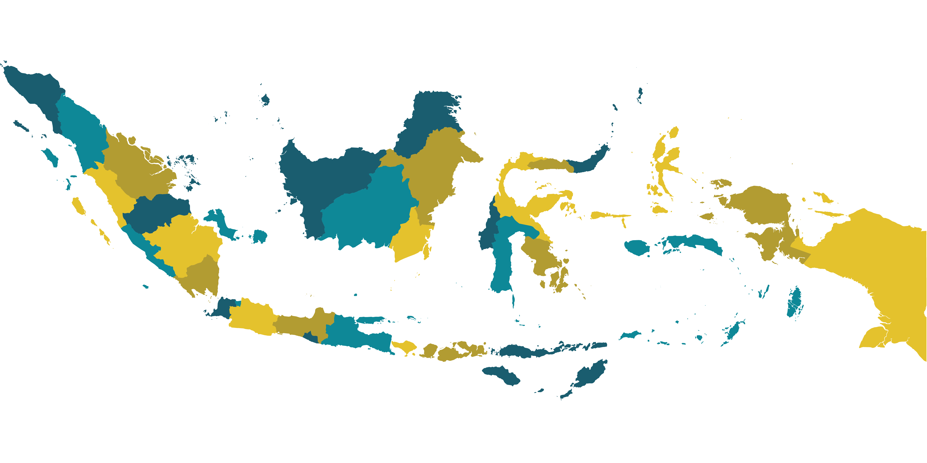
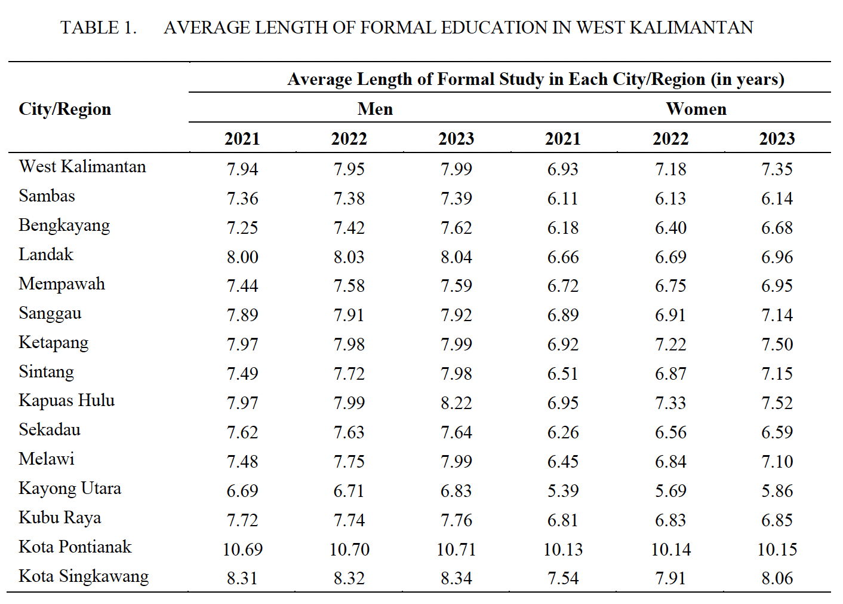

Indonesian Society and Culture
West Kalimantan population consist of 5 million people
Ethnic group in West Kalimantan consist of Dayak, Malay, Chinese, Javanese, and Madurese which has different cultural values and social structures that influence their perceptions and acceptance of new technologies, including nuclear energy
Strategies for community engagement should include culturally sensitive communication, addressing specific concerns of each ethnic group and mindful with the education background.

Slide 10
Mitigation Strategies
Community Engagement
Educational Campaign
Ensure that the concerns of local communities are heard and addressed by engaging them in regular consultations, town hall meetings, and participatory decision-making processes.
The safety, benefits, and environmental impact of nuclear energy should be accurately communicated through these campaigns. A broader audience can be reached by utilizing a variety of media channels, such as social media, local radio, and community seminars.

Slide 11
Conclusion
Indonesia's energy needs and sustainable growth can be transformed by Small Modular Reactors (SMRs).
SMRs' flexibility, safety, and adaptability for remote areas make them ideal for Indonesia's diversified energy and geographic setting
The highlighted physical, cybersecurity, and societal security risks require multifaceted security methods
Community engagement and education are needed to overcome nuclear energy fears and misconceptions.
Local community participation in decision-making builds trust and acceptability, which SMR initiatives need to succeed
The West Kalimantan case study shows how specialized tactics can solve regional and demographic obstacles, benefiting future deployments

Slide 12
Thank You!
Alfitri Meliana
alfitri.meliana@brin.go.id
National Research and Innovation Agency
INDONESIA

