Slide 2

Initiatives to build a harmonized regulatory framework for new technologies in Brazil
DIRECTORATE OF NUCLEAR SAFETY AND RADIATION PROTECTION

Slide 3
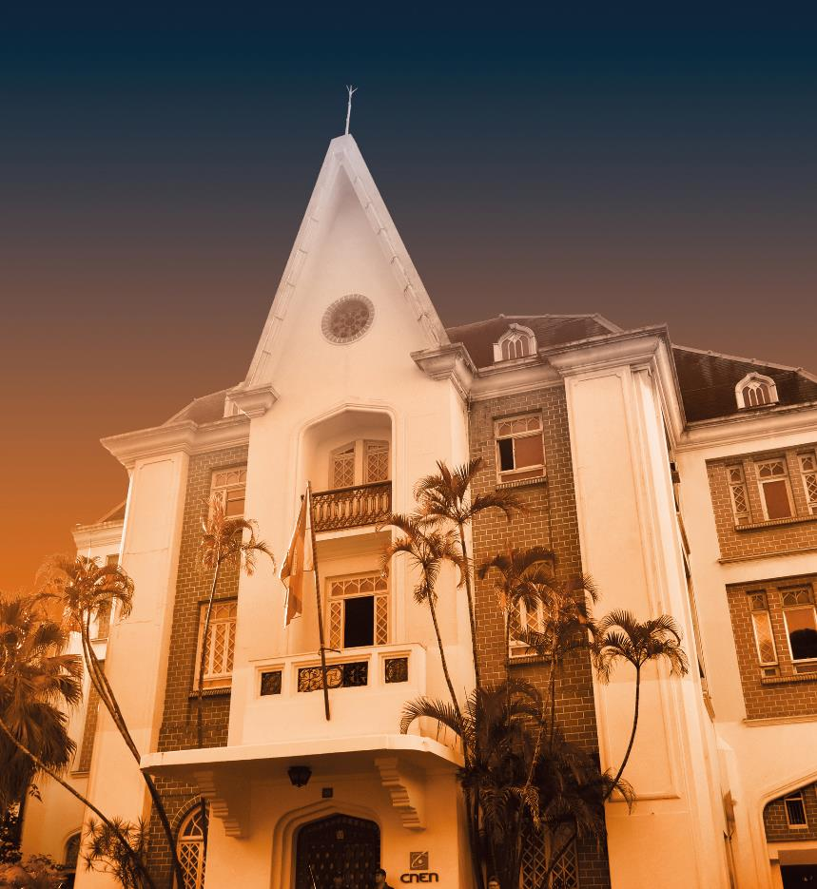
CNEN’S Mission
The commitment to ensure the safe and peaceful use of nuclear energy, develop and make available nuclear and related technologies, aiming the welfare of the population.

Slide 4
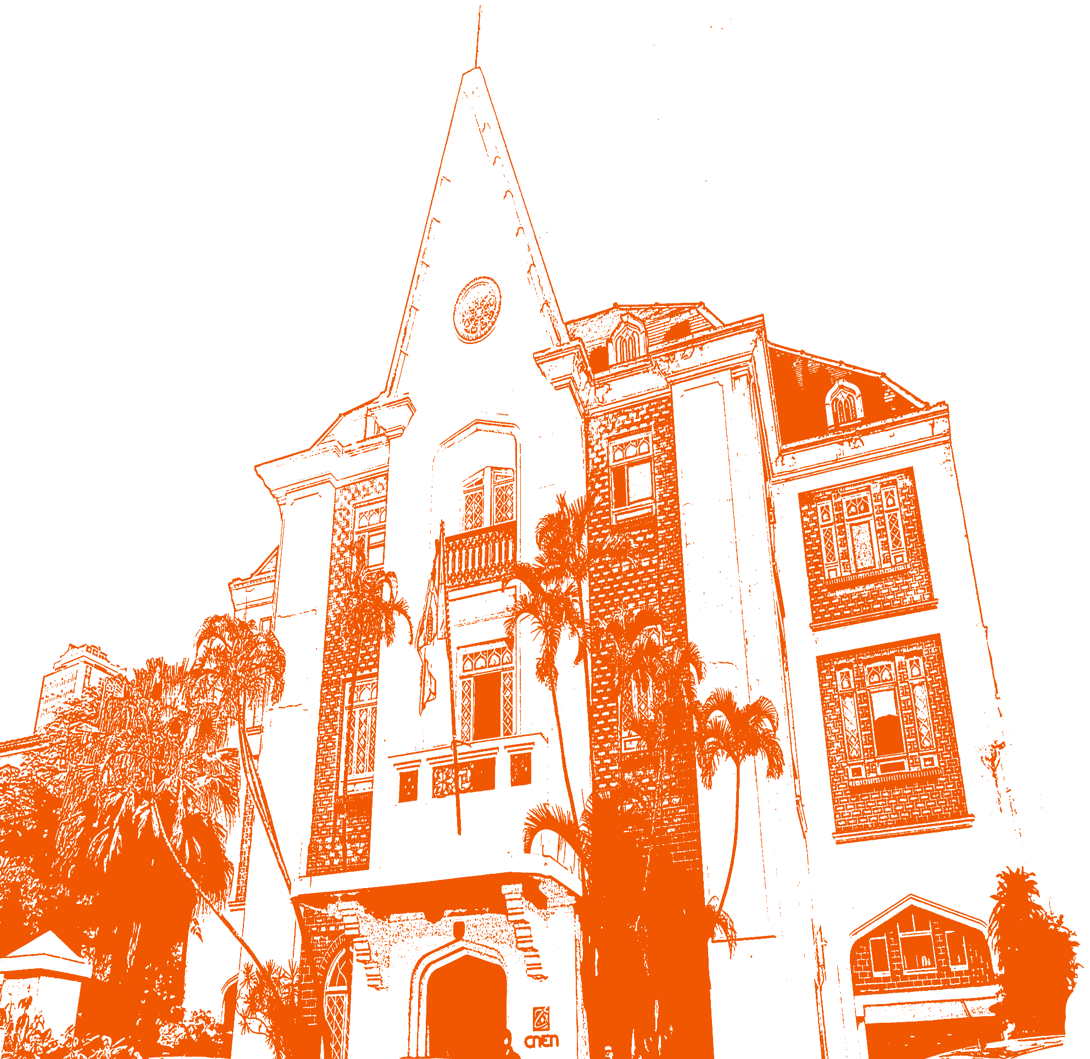
Our Mandate
Regulate the use of nuclear energy and materials to protect health, safety, security and the environment.
Implement Brazilians international commitments on the peaceful use of nuclear energy.
Disseminate objective scientific, technical and regulatory information to the public.
OVER 62 YEARS OF REGULATORY EXPERIENCE
Our Mandate

Slide 5
The Brazilian Nuclear Energy Programme Organization
Development Committee of the Brazilian Nuclear Program - CDPNB
Protection System for the Brazilian Nuclear Program - SIPRON
The key Organization
Supply chain for NPPs
National Nuclear Energy Commission -CNEN
Other organizations

Slide 6







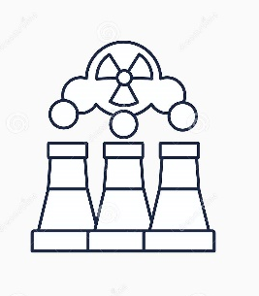
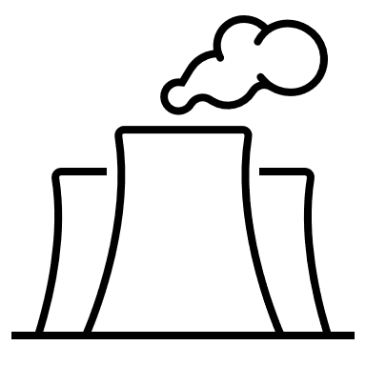

Nuclear Facilities and Activities in Brazil
Energy Sector
U-235
URANIUM MINING
NUCLEAR MEDICINE
ENRICHMENT & CONVERSION
GAMMA IRRADIATION
FUEL FABRICATION
EQUIPMENT MANUFACTURING
RESEARCH REACTORS
NPP DESIGN, ENGINEERING
& CONSTRUCTION
ISOTOPE PRODUCTS
NPP OPERATION & MAINTENANCE
APPLIED SCIENCE
Non-Energy Sector

Slide 7

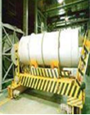
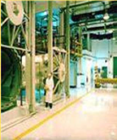

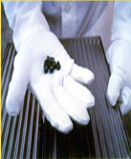
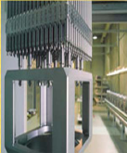
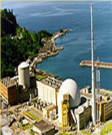
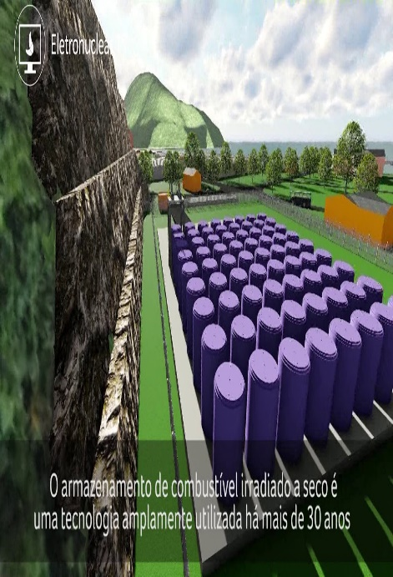
The Brazilian Nuclear Power Industry Program
Mining &
Processing
Conversion
Enrichment
UO₂ powder
Pellets
Fuel
Elements
Power
Generation
Dry cask
Storage
Large uranium reserves
Fuel cycle technology
PWR technology
Non-proliferation
Safeguards
A synergic mix of

Slide 8
CNEN Responsibilities: Focus is on Safety
Set safety requirements, inform licensees, verify compliance
Base regulatory action on the level of risk — graded approach
Ensure society that the licensee's responsibilities are properly fulfilled
Make independent, objective and risk-informed decisions

Slide 9
Hierarchical Regulatory Structure
Principal Requirements
CNEN Standard CNEN-NE-1.04 Licensing of Nuclear Installations (Under revision)
Detailed Requirements
CNEN Standard CNEN-NE-1.26 Safety in the Operation of Nuclear Power Plants
Pratice specific requirements or guidance
CNEN Standard CNE- NE 1.19 Qualification of Calculation Programs for Analysis of Coolant Loss Accidents in Pressurized Water Reactors (CNEN Resolution 11/85)
CNEN Standard CNEN-NN-1.16 - Quality Assurance for Safety in Nuclear Power Plants and Other Facilities
CNEN Resolution 09/69 Norms for Choosing Locations for Installing Power Reactors (Under revision) CNEN Standard CNEN-NN-1.03
CNEN Standard CNEN-NN-2.01 Physical Protection of Nuclear Materials and Installations (CNEN Resolution 253/19)
CNEN Standard CNEN-NN- 2.02 Control of Nuclear Materials (CNEN Resolution 11/99)

Slide 10
The Licensing Process Conducted by CNEN
Licensing Process (Lei n.º 6.189, de 16 de dezembro de 1974, com as alterações introduzidas pelo Decreto- Lei n.º 2.464, de 31 de agosto de 1988 e pela Lei n.º 7.781, de 27 de junho de 1989.)
Site Approval
Construction License Total or Partial
Nuclear Material Utilization License-AUMAN
Initial Operation License – AOI
Permanent Operation License – AOP
Life Extension / Lic. Renewal
Authorization for Decommissioning
Site Report
Preliminar Safety Analysis Report - PSAR
Final Safety Analysis Repot - FSAR
Periodic Safety Review
Renewal Evaluation
FSAR Addition
Decomm Plan

Slide 11
Regulatory Decision-Making
Decisions made by the Commission take into consideration:
Regulatory requirements
Analyses and recommendations from CNEN staff, based on their assessment of both licensee and stakeholder submissions to the Commission
Best available information, arising from regulatory research or credible research by third parties
Public input, through the hearing process
Understanding risks and mitigating those risks play a significant role in the decision-making process

Slide 12

Current Challenges
Actions in The Legal Framework
(i) outsourcing of activities
(ii) modular design approach
(iii) strong decentralization of design and safety analysis activities
(iv) total capacity over time
(v) off-site construction and commissioning
(vi) loading with fuel at the manufacturer
(vii) transportation of loaded reactors
The current licensing process conducted by CNEN does not adequately address certain aspects related to parts of the potential SMR's life cycle.
To address these issues in a new licensing process, it will often be necessary to modify the legal and licensing framework.
Part of the discussions of these modifications are affected by guidelines under the responsibility of the Ministry of Mines and Energy.

Slide 13
Current Challenges
Actions in The Licensing Framework
Large number of innovative designs (first of kind)
Unproven technology
  Comprehensive analyses, simulations, including code validation and testing needed to close knowledge gaps
  New design philosophy
  New materials
  New safety systems strategies
Lack of operational experience
Regulatory processes need to be adapted, as appropriate
  Rules and Regulation
  Safety Requirements and Guides
  licensing model that contemplates the new practice and that is in line with 3S approach
Technical competence to provide subsidies to other government instances that comprise the Brazilian Nuclear Program.

Slide 14



Initiatives Toward A Licensing Process For SMR in Brazil
Identify
Plan
Execute
Stage 3 – Execute - the Plan to guide successfully the SMR Deployment.
Stage 1 - Identify - current situation to guide successfully the SMR Deployment
Stage 2 - Plan - CNEN highlights key factors to guide successfully the SMR Deployment

Slide 15



Knowledge Trail To Build Competence
2022
TM on Safety Assessment in the Design of Nuclear Power Plants
Nuclear Harmonisation and Standardisation Initiative
2023
IW on Education, Training Tools and Knowledge Transfer for SMRs
Harmonisation and Standardisation Initiative
2024
ITC on Safety aspects of small Modular Reactors (SMRs)
W Safety of Fuel Manufacturing for Advanced Reactors
TM on Generic User Requirements and Criteria of SMR Technologies for Near Term Deployment
EW on Regulatory Challenges in Small Modular Reactors
Safety and Licensing
Support of Developing, and Enhancing the Safety Infrastructure
IW on Safety, Security and Safeguards by Design
IW on Safety Analysis for Small Modular Reactors
IW on the development of Taxonomy for Small Modular Reactors (SMRs) and Micro-reactors (MRs)
International Conference on Small Modular Reactors and their Applications
NHSI Regulators WG

Slide 16
Alignment with Government actions
The Ministry of Mines and Energy (MME) has requested the creation of a technical group to evaluate aspects for the selection of new nuclear sites for the construction of new plants, obtaining its reference from the National Energy Plan 2050, which estimates an expansion of 3.4 to 23.4 GW in the supply of nuclear energy over the next 30 years and the signalling of the construction of a new nuclear power plant in the Ten-Year Energy Expansion Plan 2031.
The CBDPN, through Resolution CBDPN 28/12/2023, has outlined guiding principles for selecting new nuclear sites for the construction of future thermonuclear power plants in Brazil

Slide 17
Resolution CBDPN 28/12/2023
Resolution CBDPN 28/12/2023, has outlined guiding principles for selecting new nuclear sites for the construction of future thermonuclear power plants in Brazil.

Slide 18
Actions for CBDPN Guidelines Nº 5
In compliance with guideline number 5, a new standard for SITE APPROVAL FOR NUCLEOELECTRIC POWER PLANTS, which sets out the criteria and requirements applicable to Site Approval for Nuclear Power Plants and the content of the Site Report, expands the field of application, making it possible to implement advanced SMR-type reactors.
Issues such as the certification of the project in modules, incremental licensing, the licensing approach in terms of safety analysis, and its coupling to the various modules are the scope of the discussions on the CNEN guidelines, more specifically in the guidelines 5 and 6, which have been guiding the development of stage 2.

Slide 19
Actions for CBDPN Guidelines Nº 6
Updating and revising the regulatory framework for site identification regarding nuclear safety, radiological protection, and physical protection
CNEN-NE-1.01: Licensing of nuclear reactors operators
Establishes the requirements necessary for licensing nuclear reactor operators of licensed units
CNEN-NE-1.04: Licensing of nuclear installations
Establishes the licensing process for nuclear facilities applied to activities related to the location, construction and operation of such facilities.
CNEN-NN-1.16: Quality assurance for nuclear power plants
determines the requirements to be adopted in the establishment and implementation of Quality Assurance Systems for nuclear power plants, nuclear facilities and, as applicable, also for radioactive facilities.
  Expands its scope to explicitly cover reactors used for power and heat generation, as well as modular reactors up to 300 MW per module. It also includes requirements for the use of a gradual approach
  In principle, there is no need for a review
  In principle, there is no need for a review

Slide 20
Actions for CBDPN Guidelines Nº 6
CNEN-NE-1.25: In-service inspections in nuclear power plants
Establishes the minimum requirements applicable to in-service inspections at nuclear power plants and applies to individuals and organizations carrying out such inspections;
Need revision to accommodate the main characteristics of advanced reactors
CNEN-NN-1.26: Safety in operation of nuclear power plants
Sets the minimum requirements applicable to activities related to the commissioning and operation of the plant necessary to ensure that these activities do not entail undue risk to the health and safety of the population as a whole and to the environment
CNEN-NE-1.27: Quality assurance in acquisition, designing and manufacturing of fuel elements
Sets requirements for Quality Assurance Programs (QAP) applicable to the work of individuals or organizations involved in the acquisition, design and manufacturing of fuel elements for nuclear power plants
Need revision to accommodate the main characteristics of advanced reactors
  In principle, there is no need for a review
  In principle, there is no need for a review

Slide 21
Actions for CBDPN Guidelines Nº 6
CNEN.NE-2.01: Physical protection of operational units of nuclear installations
Provides for the principles and requirements of physical protection applicable to nuclear materials and facilities.
CNEN-NN-2.02: Nuclear material control and safeguards
It establishes the general principles and basic requirements demanded by CNEN for the control of nuclear material and is applicable to all activities involving nuclear material that take place in the national territory.
CNEN-NE-2.03: Fire protection in nuclear power plants
Establishes the general criteria and requirements for Fire Protection during the design, construction and operation phases of nuclear power plants, aiming to prevent the occurrence, neutralize the action and minimize the consequences of a fire, in order to maintain the safety functions of the plant.
CNEN-NE-5.02: Transport storage and handling of nuclear fuels
Establishes the requirements for the safe transportation, receipt, storage and handling of fuel elements from Nuclear Power Plants, applied to the work of the individual or organization that participates in such activities.
Although it is applicable to the increased enrichments, fuel forms and fuel elements expected from advanced nuclear reactors, in the future this will be subject to review depending on the technology chosen
Need revision to accommodate the main characteristics of advanced reactors
  In principle, there is no need for a review
In the future, it will need to be revised depending on the choice of technology.

Slide 22
Actions for CBDPN Guidelines Nº 6
Development of new CNEN Standards
  New Standard about Cyber Security for Nuclear Facilities - considering that SMR can be operated remotely, it is essential to establish requirements to prevent cyber threats.
  New Standard about Probabilistic Safety Assessment to establish numerical objectives and acceptance criteria for use in the Risk informed decision making.
  New Standard about Severe Accident Management Program that considers the SMR modularity and physical separation.

Slide 23
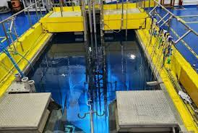
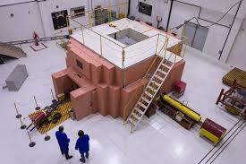
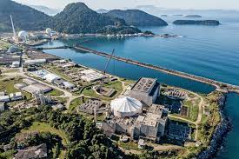
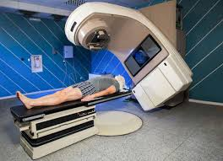
Exchange of Information through National Cooperation
National cooperation between DRS and DPD through a Focus Group to encourage the exchange of information and expand technical discussions.
    Nuclear scientific and technological research
    Development of nuclear applications
    Specialized training for the Nuclear Sector
The Research and Development Board participates in the international SMR forums sponsored by the IAEA to become familiar with the evolution of SMR technologies proposed by the different designing countries, seeking to identify the possible uses of these reactors both for future electrical generation, as well as supporting the operation of large industrial and mining companies throughout the country.

Slide 24
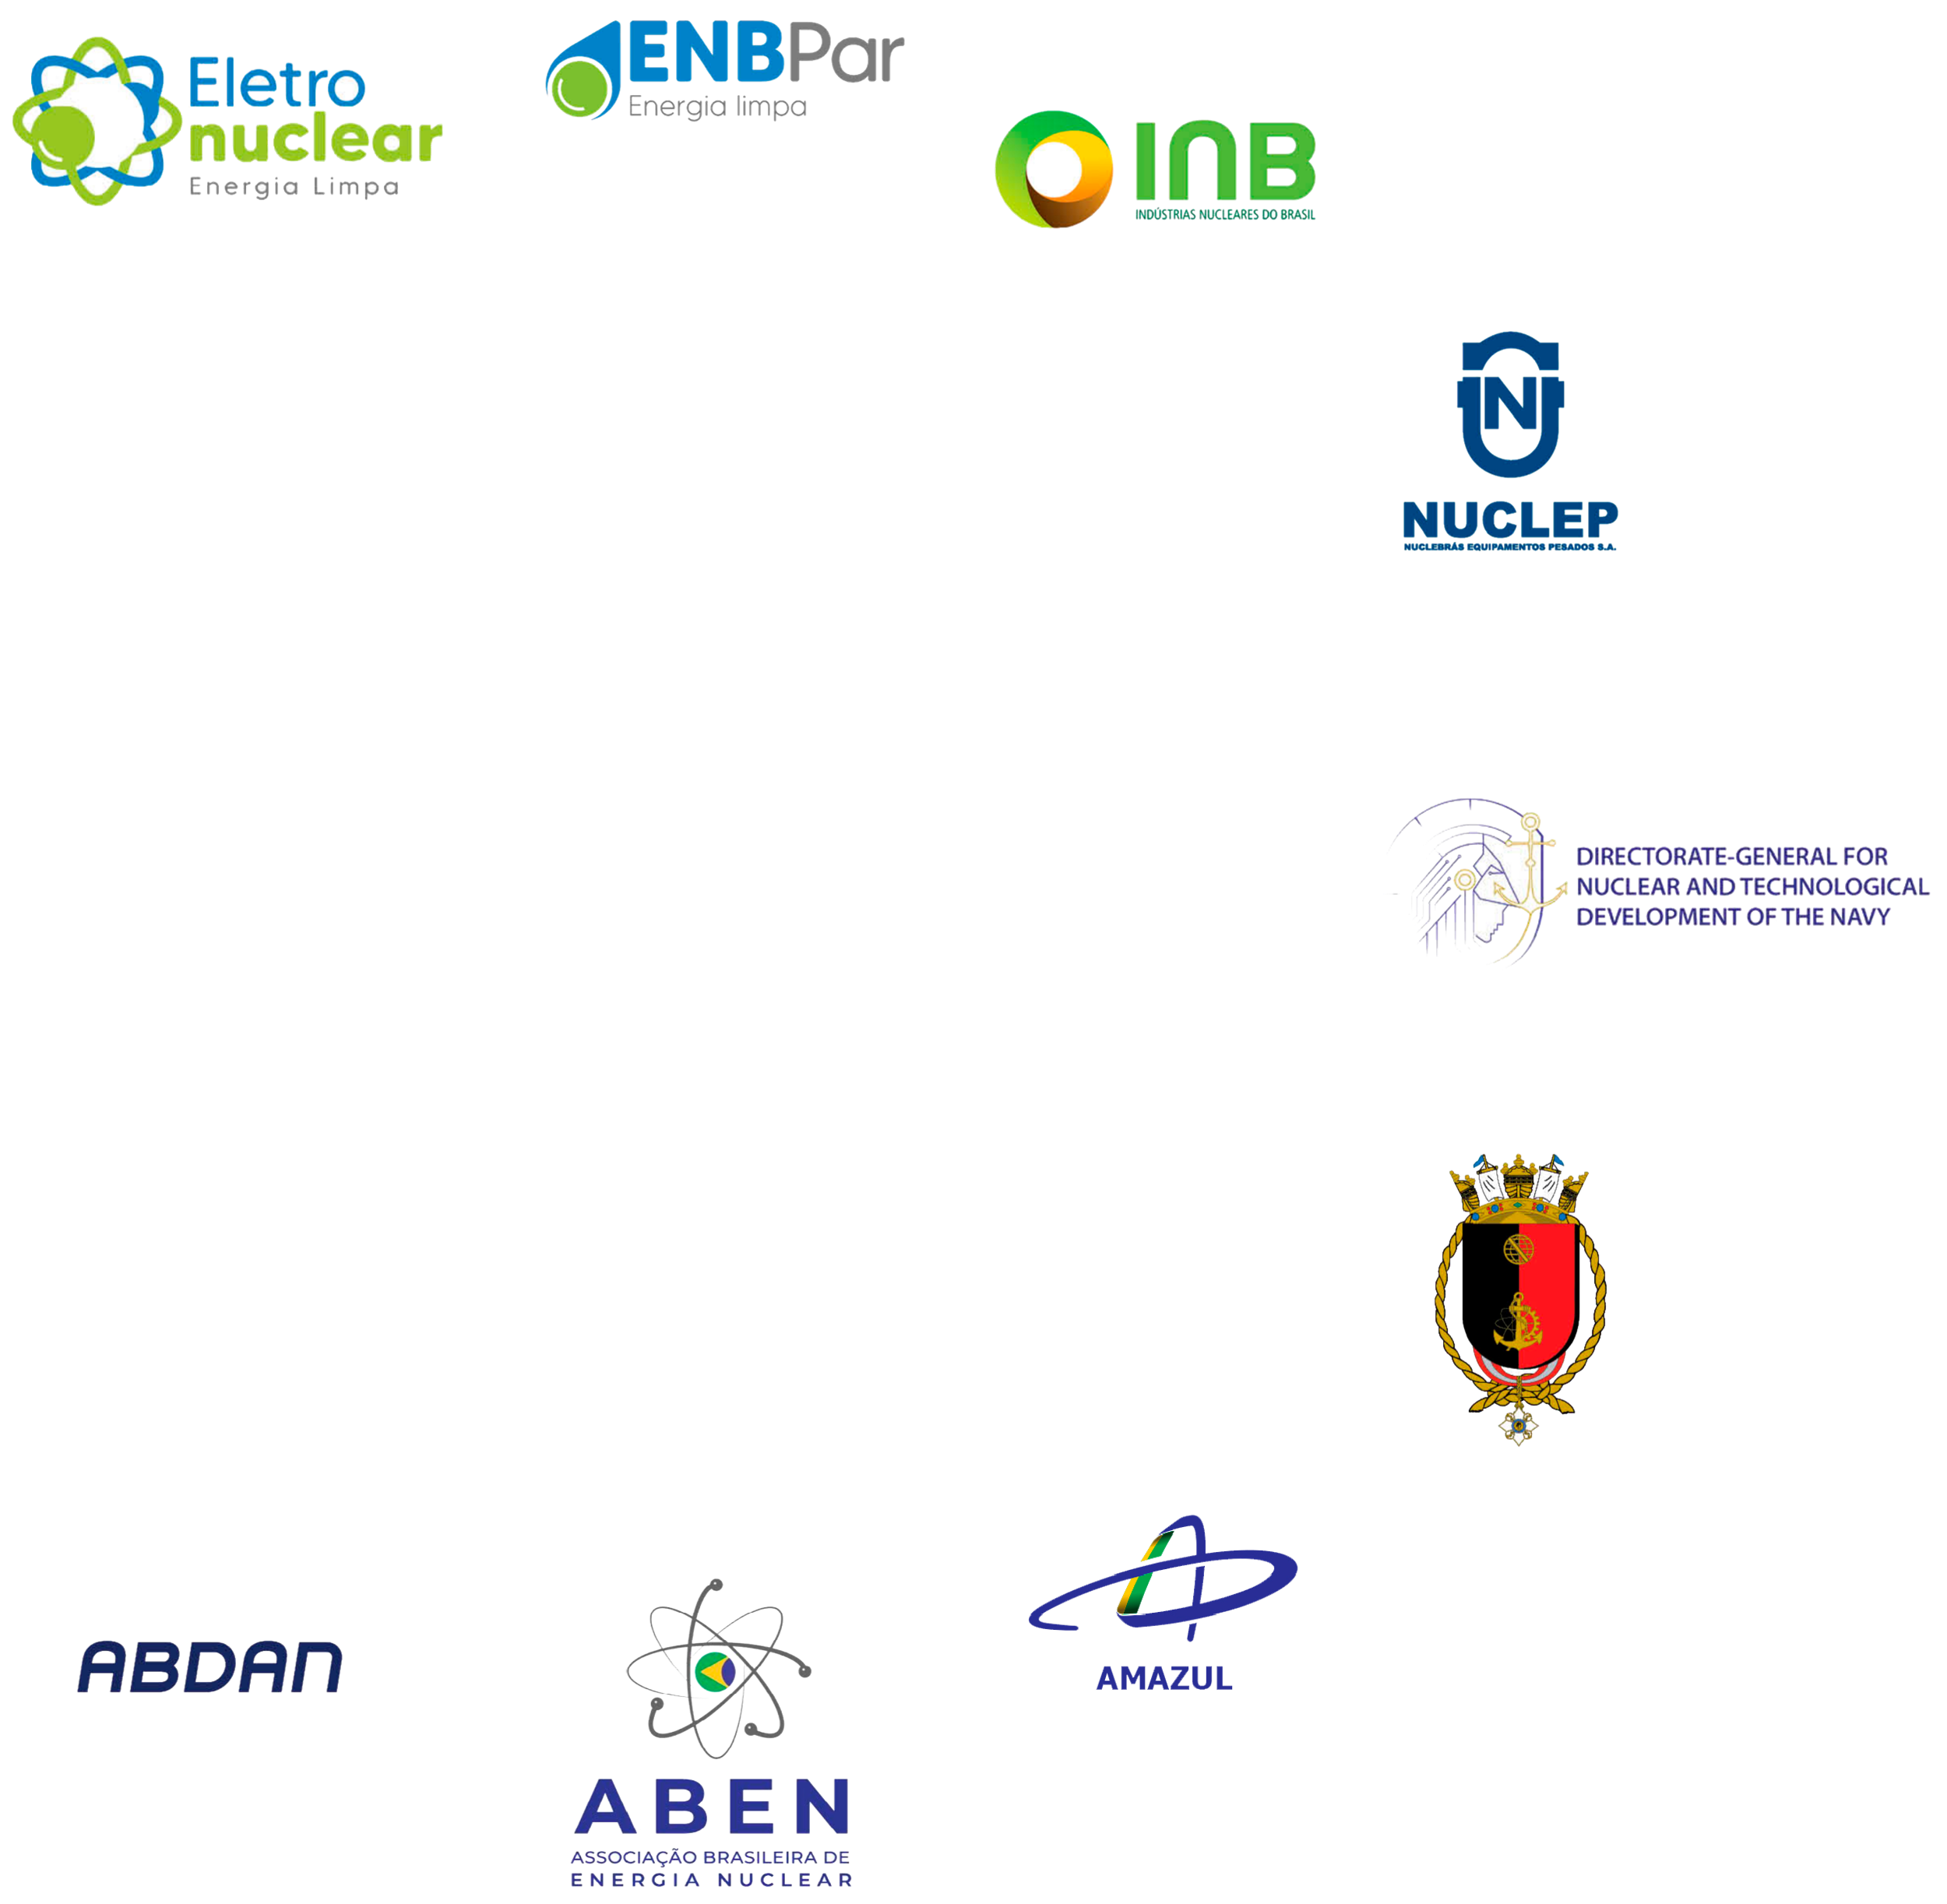
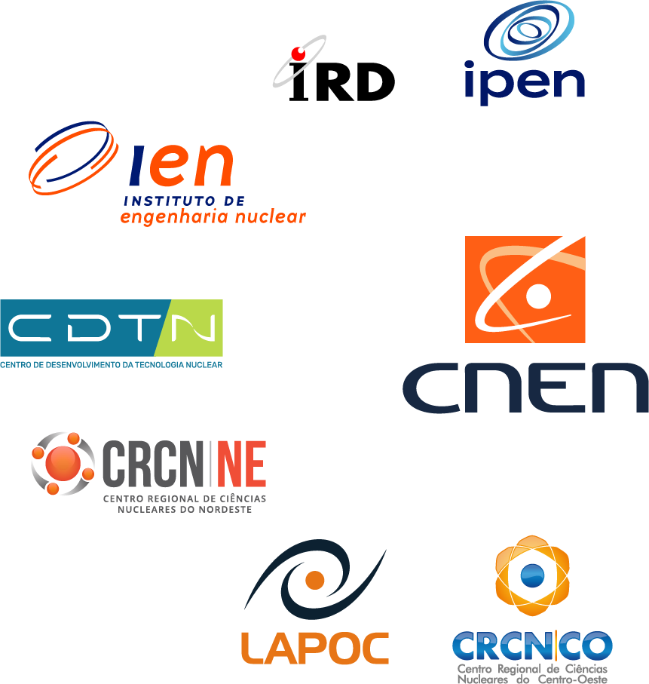

Exchange of Information through National Cooperation
Promotion Actions for the Development of the National SMR Network
  The network is proposed by CNEN to establish a Federal Government platform to promote scientific and technological advancement by coordinating the activities of groups working in areas related to the future implementation of SMR.
  The network aims to establish and coordinate dialogue between the various actors such as the supply chain; vendors; designers; operators and regulators.

Slide 25

Engagement with Regulators Internationally
CNEN high level management is part Nuclear Harmonization and Standardization Initiative
  2nd phase of NHSI Regulatory Track
Technical Cooperation with Argentina CNEN / ARN (in progress)
Technical Cooperation USA CNEN / NRC (Mutual understanding of the convenience desirability of cooperation)
Multinational Design Evaluation Programme MDEP - (Mutual understanding of the convenience desirability of participation)

Slide 26

Conclusions
At this point, the most important lesson is the exchange of information with stakeholders and anticipation.
Additionally, it is important to invest in a cultural change that is driven by lessons learned in the past, such as:
  The nuclear power sector has adopted a strong focus on safety. Often this focus on safety has resulted in conservative decision-making and a risk-adverse culture;
  Nuclear legal and regulatory regimes need to evolve to simultaneously maintain responsible nuclear and radiation safety regulation while facilitating advantageous technological innovation;
  The history of the deployment of large reactors demonstrates that regulatory frameworks and licensing processes have an impact on commercialization costs, project schedules and budgets; and

Slide 27
Anna Leticia Barbosa de Sousa
anna.sousa@cnen.gov.br
Nelbia da Silva Lapa
nelbia.silva@cnen.gov.br
Thank you

