Slide 2
Experimental Investigation and Modeling of Passive DHRS with Plate-Type Compact Steam Generator
A. Missaglia, A. Bersano, C. Lombardo, M. Caramello, A. Alemberti, S. Lorenzi, M. E. Ricotti

Slide 3
Contents
Overview of ELSMOR facility
Role of Compact Heat Exchangers in SMR designs
Overview of Selected Experimental Tests
Methodology
Results & Discussion
Conclusions

Slide 4
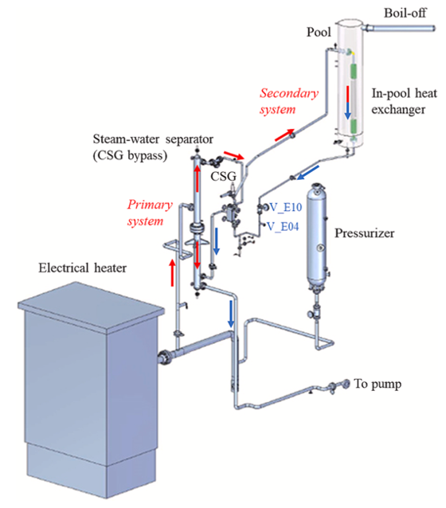
Overview of the ELSMOR facility
Objective
Assess safety of Light Water Small Modular Reactors through experimental and analytical methodologies. [1]
Primary System: Either single-or two-phase water under forced convection.
Secondary System: Two-phase natural circulation, driven by heat from the CSG.
Tertiary System: A pool at atmospheric pressure serving as the heat sink through an in-pool heat exchanger.
Facility
Designed and built at SIET (Piacenza, Italy) to study a passive decay heat removal system in natural circulation conditions.
Key Feature
Plate-type Compact Steam Generator as heat source.
CSG = Compact Steam Generator
FIG. 1 Overview of ELSMOR facility [1].

Slide 5
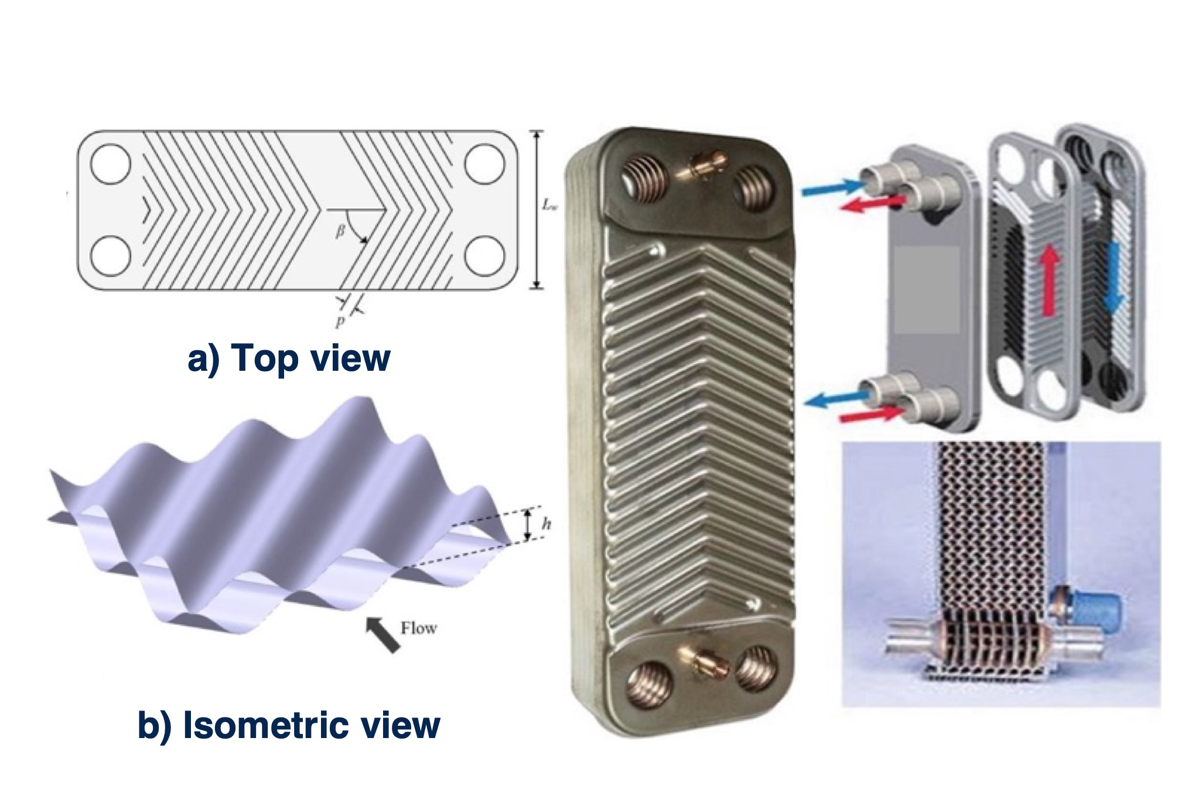
Role of Compact Heat Exchangers in SMR designs
Benefits
Small footprint, high power density, reduced costs.
Industries
Key in transportation, energy, oil refining, and hydrogen production. [2]
Application in SMRs
Space optimization: Essential for space efficiency in integral SMRs.
Competitiveness: Lower manufacturing cost, helping SMRs compete with traditional reactors benefiting from economies of scale.
Challenges: Limited use in liquid-boiling applications; need for established correlations for two-phase flow in nuclear conditions. [2]
FIG. 2 Chevron-type compact heat exchagners

Slide 6
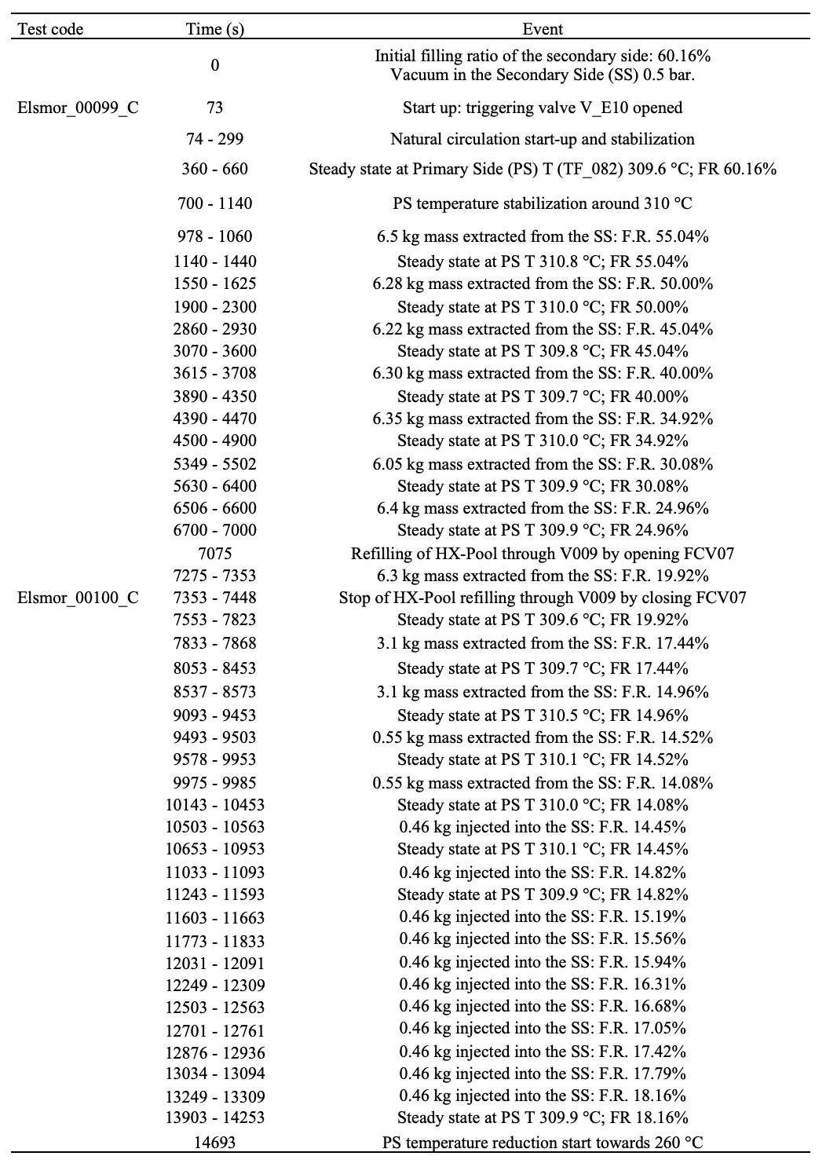
Overview of Selected Experimental Tests
The experimental test matrix consists of 81 tests in 7 groups.
Main goal: Assess the effects on the operation of a decay heat removal system of primary pressure, temperature, secondary side Filling Ratio (FR), and non-condensable gases. [1]
Two selected tests to investigate the stability of the Decay Heat Removal System:
  Test 00099_C. FR reduced from 60.16% to 19.92%, at constant temperture.
  Test 00100_C. FR dropped below 14.96%, causing mass flow oscillations, then increased to 18.16% for stability.
The impact of FR was significant, as highlighted in both pre-test calculations and experimental results.
FIG. 3 Events timing of ELSMOR_00099_C and ELSMOR_00100_C tests.

Slide 7
Methodology
The RELAP5/mod3.3 code employed for the post-test analysis of the ELSMOR facility, building on SIET and ENEA's expertise from the SPES3 facility. [3]
Nodalization composed by three hydrodynamic systems
The primary system (including the separator and CSG)
The secondary system (with the CSG and in-pool heat exchanger)
The surrounding pool.
The systems are thermally coupled, and adjustments to pressure loss coefficients and heat transfer factors were made to align with expected operational conditions.
Key modifications on the model were made to improve predictions.
FIG. 4 RELAP5 nodalization of the ELSMOR facility.

Slide 8
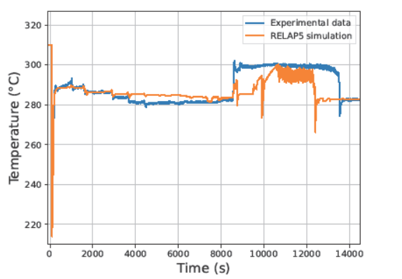
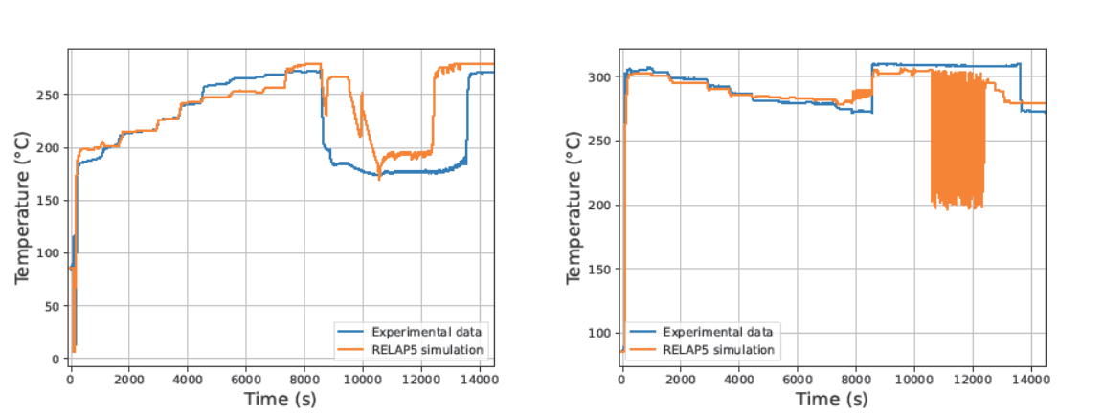
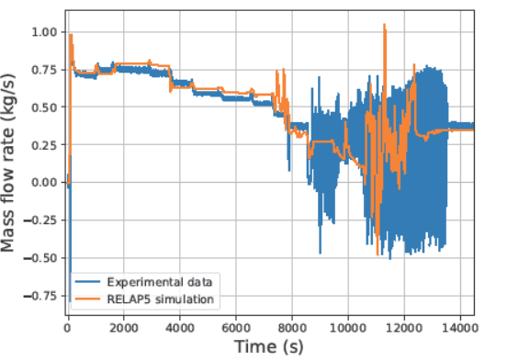
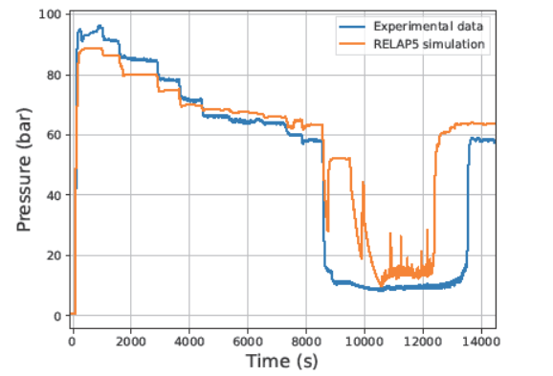
Results & Discussion I
Test 00099_C
The code well predicts the experimental data, with minor discrepancies.
FIG. 5 Left) Primary CSG outlet temperature. Right) Secondary CSG inlet temperature.
Test 00100_C
The code helps to understand the phenomenology behind the onset of the NC instability, with some discrepancies.
FIG. 6 Left) Secondary mass flow rate. Right) Secondary pressure.

Slide 9
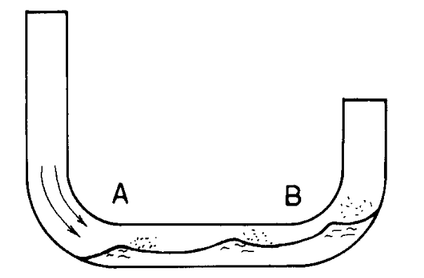
Results & Discussion II
The phenomenology behind the onset of the natural circulation instability
HX = Heat Exchanger
Below FR = 14.96%, liquid phase no more entering the CSG.
In the loop seal at the entrance of the CSG, two-phase stratified flow:
Liquid in lower portion of the pipe
Vapour phase entering alone in the CSG.
Superheated vapor exiting the CSG: no more generation of condensate in the in-pool HX.
Fig. 7. Inclined stratified water level in a loop seal. From Ref. [4]
Enough momentum transfer to cause oscillations in mass flow rate, as the returning liquid, unable to enter the CSG, reverses its flow.
As the vapor passing through the cold leg, insufficient momentum transfer to allow the liquid to enter the CSG.
FIG. 5 Left) Primary CSG outlet temperature. Right) Secondary CSG inlet temperature.
In the RELAP5 simulation, the higher vapor velocity results in slug flow, pushing liquid into the CSG.
Reason behind
discrepancies
The experimental data are a result of a stratified two-phase flow in the loop seal.
FIG. 6 Left) Secondary mass flow rate. Right) Secondary pressure.
Spikes in the exchanged power, secondary pressure and the oscillations of temperatures, not found in the experimental data.
When the stability is re-established, increasing the FR above 14.96%, RELAP5 well predicts the experimental data.

Slide 10
Conclusions
The ELSMOR project significantly advanced the licensing of light water SMRs through experimental and analytical efforts. A key achievement was the design and construction of a facility at SIET to study the performance of a passive decay heat removal system, featuring a plate-type compact steam generator as the heat source.
Key findings from tests ELSMOR 00099_C and 00100_C
The RELAP5 code successfully predicted experimental results both qualitatively and quantitatively.
Some discrepancies were noted in secondary side pressure, temperatures, and exchanged power during two-phase instability.
These discrepancies are attributed to uncertainties in the internal geometry of the heat exchanger, heat transfer behavior, and pressure losses in the system.
Future Work
Refine the ELSMOR facility RELAP5 model, exploiting the unexplored ELSMOR experimental database.
Develop specific correlations for plate-type heat exchangers.
Performing separate effect tests on two-phase flows.

Slide 11
References
[1] Ferri, R., Achilli, A., Congiu, C., Marciano, S., Gandolfi, S., Marengoni, M., Bersani A. and Passerin D’Entreves, A. (2023). ELSMOR European Project: Experimental Results on an Innovative Decay Heat Removal System Based on a Plate-Type Heat Exchanger. Science and Technology of Nuclear Installations, 2023.
[2] Zohuri B. Compact heat exchangers. Cham, Switzerland: Springer; 2017.
[3] Bersano, A., Falcone, N., Bertani, C., De Salve, M., Meloni, P., & Mascari, F. (2021). Qualification of RELAP5-3D code condensation model against full-scale PERSEO Test 9. Progress in Nuclear Energy, 139, 103891.
[4] Tuomisto, H., & Kajanto, P. (1988). Two-phase flow in a full-scale loop seal facility. Nuclear Engineering and Design, 107(3), 295-305.

Slide 12
Thank you for your kind attention!
Questions?

