Slide 2
Resilient Energy Systems as a Goal for Risk-Informed Approaches
Adding resilience features in new reactor designs to adequately fulfil nuclear safety principles
Johanes Narasetu Widyatmanto

Slide 3
Structure of the presentation
Small Modular Reactors (SMRs) development around the world
Resilient energy system as a bridge between experts and the public
SMRs policy relevance of using ESR
Concluding remarks

Slide 4
1. SMRs development around the world
Some general statistics

Slide 5
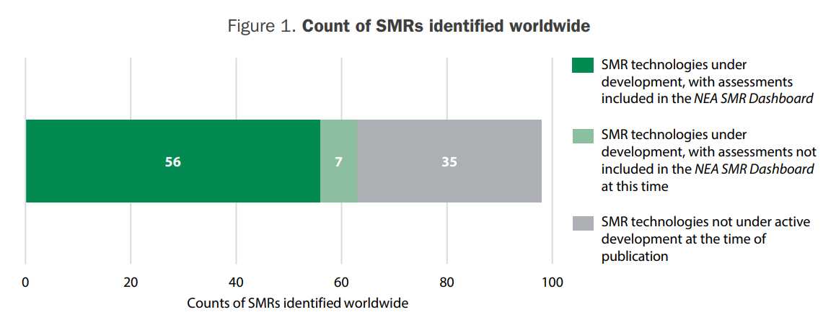
SMRs development around the world
Source: NEA (2024), The NEA Small Modular Reactor Dashboard: Second Edition, OECD Publishing, Paris

Slide 6
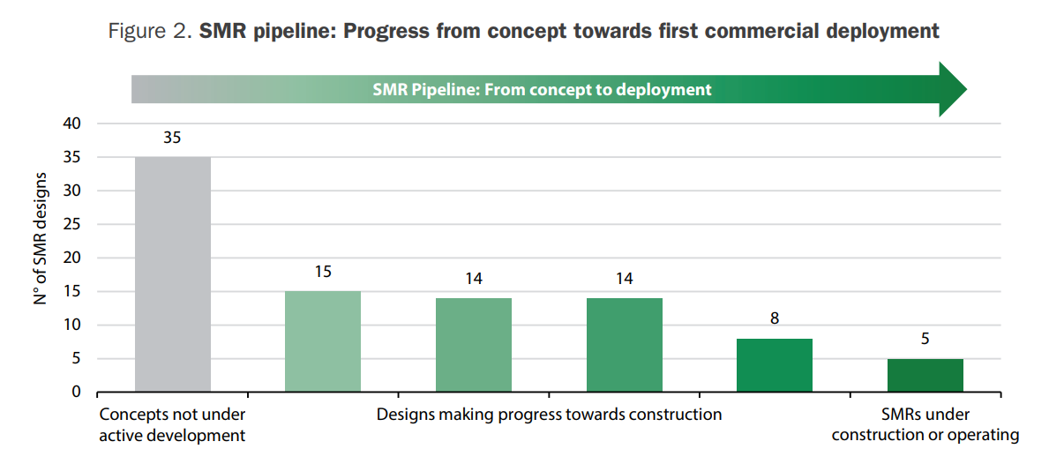
SMRs development around the world
Source: NEA (2024), The NEA Small Modular Reactor Dashboard: Second Edition, OECD Publishing, Paris

Slide 7
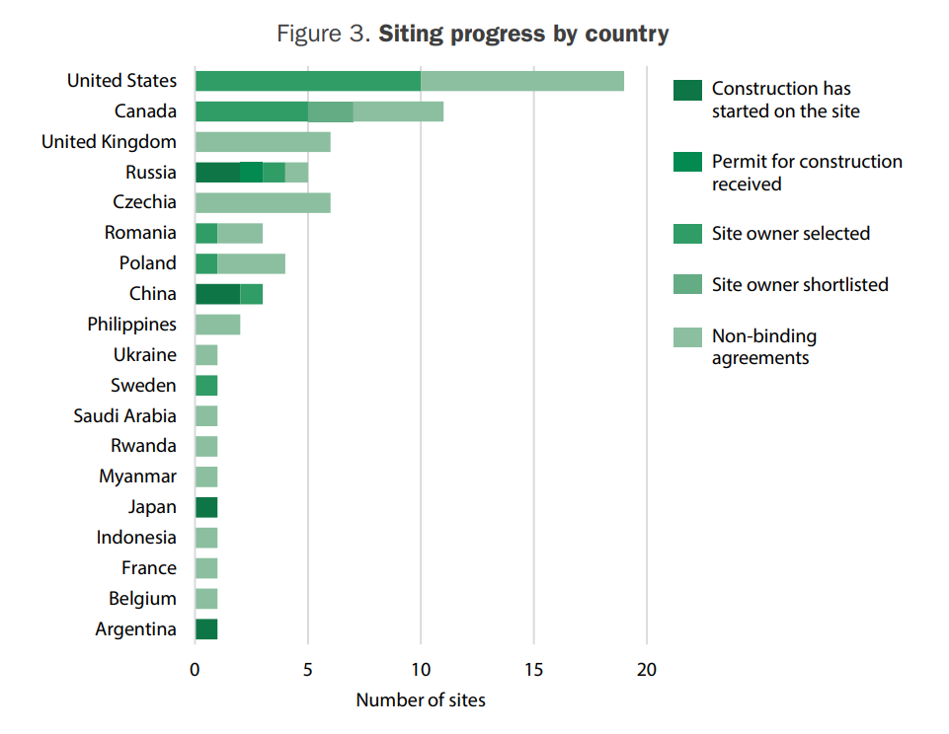
SMRs development around the world
Source: NEA (2024), The NEA Small Modular Reactor Dashboard: Second Edition, OECD Publishing, Paris

Slide 8
SMRs development around the world
They are emerging technologies (also called EID, evolutionary and innovative design) in the nuclear energy sector.
Commercial use is expected in the next decade.
Some potential adopters are new to nuclear energy.

Slide 9
2. Energy System Resilience (ESR) as the Bridge between Experts-Business Practicioners and the Public
Picturing human lives in SMRs policy

Slide 10
What is ESR?
ESR: the readiness of an energy system to bounce forward amidst disruptions, anticipated or not, in order to provide sufficient and stable energy via reliable engineering technique, efficient management, and conducive social institutions (Widyatmanto, under review).

Slide 11
Why is ESR important for RIAs?
Contextualising the diffusion of risk-information regarding SMRs into broader unanticipated disruptions within energy systems at large.
Connecting the issue of stable electricity supply at reactors level in SMRs to energy system level.
Integrating mostly techno-economic considerations on risk at the reactor level into social aspects at energy system level.

Slide 12
ESR provides a people-centred common goal for RIAs
Techno-economic questions of SMRs from RIAs
Normative goal from ESR
What are the design risks and benefits from X type of SMRs (modularity, choice of coolant, moderator, fuel, etc.)?
How would implementing X type of SMRs affect electricity price in the given context?
What makes such design risks acceptable to people living around the SMRs site?
Who are affected by such changes in electricity price due to SMRs‘ presence and in what way?

Slide 13
In other words…
By adding the achievement of resilient energy systems as a goal, techno-economic analysis on SMRs’ risks and its information distribution to people at large gain a larger societal perspective by framing the question of ‘what risks?’ and ‘who should be informed of risks?’ with an umbrella question: would the diffusion of information about risks from SMRs at hand lead to a more resilient energy system overall?

Slide 14
4. Relevance of ESR in SMRs policymaking
What would SMRs policy level look like with ESR as the conceptual bridge?

Slide 15
ESR in SMRs policymaking
Emphasis mainly on nuclear policymaking
Policymakers need a virtue of practical wisdom (Poiesis) to connect techno-economic risks to societal aspects such as well-being, capabilities-vulnerabilities, etc.
In SMRs, policymakers need to regard ESR from a societal perspective, i.e. by evaluating the acceptability of SMRs‘ techno-economic risks from their potential effect on societal capability-vulnerability associated with the said SMRs.

Slide 16
Evaluating risks to achieve ESR
Techno-economic aspects (non-exhaustive examples)
Social-normative aspects (non-exhaustive examples)
Quantifying probabilities of radioactive accidents
Accounting the technical reliability and price of SMRs technologies
Visualising the stability of the market (thorium, uranium, generated electricity, etc.)
Evaluating the fairness of radioactive risk distribution
Envisioning larger job opportunities & training competent, responsible engineers
Allowing people access to stable, sufficient, and affordable electricity

Slide 17
Example case 1: Thorium SMRs in the developed vs developing countries
Developed countries (or any NPP-experienced countries)
Developing countries (or any NPP new joiners)
ESR focuses on energy system‘s ability to withstand shock
Already energy rich society should enjoy improved stability from SMRs
SMRs are evaluated based on their contribution to system‘s stability
ESR focuses on energy system‘s ability to reach full electrification ratio
Energy poor society should gain access to abundant-affordable electricity from SMRs
SMRs are evaluated based on the rise of electrification ratio per money spent

Slide 18
Example case 2: X-type SMRs for AI datacentres
Consideration among experts
Consideration for the public
How stable are these SMRs?
How much is the building and maintenance cost?
How much is the installation capacity needed to keep the datacentre running?
What accident scenarios is the public facing?
Which part of the public is well-informed about SMRs‘ risks and benefits?

Slide 19
5. Concluding remarks
The novelty of SMRs and different experience in their adopting nations require consideration on societal aspects in nuclear policymaking
Societal aspects for SMRs can be provided by conceptualising case-specific ESR
It means that policymakers need to have practical wisdom to see how SMRs techno-economic risks and benefits improve/aggravate societal capability/vulnerability associated with energy systems

Slide 20
References
Source: NEA (2024), The NEA Small Modular Reactor Dashboard: Second Edition, OECD Publishing, Paris.
Technology Roadmap for Small Modular Reactor Deployment. in Nuclear Energy Series, no. NR-T-1.18. Vienna: INTERNATIONAL ATOMIC ENERGY AGENCY, 2021. [Online]. Available: https://www.iaea.org/publications/14861/technology-roadmap-for-small-modular-reactor-deployment
I. S. Kim, S. K. Ahn, and K. M. Oh, ‘Deterministic and risk-informed approaches for safety analysis of advanced reactors: Part II, Risk-informed approaches’, Reliab. Eng. Syst. Saf., vol. 95, no. 5, pp. 459–468, May 2010, doi: 10.1016/j.ress.2009.12.004.
B. Taebi, ‘Intergenerational Risks of Nuclear Energy’, in Handbook of Risk Theory, S. Roeser, R. Hillerbrand, P. Sandin, and M. Peterson, Eds., Dordrecht: Springer Netherlands, 2012, pp. 295–318. doi: 10.1007/978-94-007-1433-5_12.
R. Hillerbrand, ‘The role of nuclear energy in the future energy landscape: energy scenarios, nuclear energy, and sustainability’, in The Ethics of Nuclear Energy, Cambridge: Cambridge University Press, 2015.
C. Kermisch, C. Depaus, and P.-E. Labeau, ‘A contribution to the analysis of equity associated with high-level radioactive waste management’, Prog. Nucl. Energy, vol. 92, pp. 40–47, Sep. 2016, doi: 10.1016/j.pnucene.2016.05.010.
C. Kermisch, ‘Can today’s decisions really be future-proofed?’, Nature, vol. 530, no. 7591, pp. 383–383, Feb. 2016, doi: 10.1038/530383a.
Experience in Applying IAEA Principles for Design Safety to New Nuclear Power Plants. in TECDOC Series, no. 2021. Vienna: INTERNATIONAL ATOMIC ENERGY AGENCY, 2023. [Online]. Available: https://www.iaea.org/publications/15262/experience-in-applying-iaea-principles-for-design-safety-to-new-nuclear-power-plants
International Atomic Energy Agency - IAEA, ‘Energy and electricity demand forecasting for nuclear power planning in developing countries. A reference book’. Vienna, 13-Dez-11

Slide 21
THANK YOU

