Slide 1

The Role of Regulatory Oversight in SMR Implementation
Edward Mayaka
Kenya Nuclear Regulatory Authority

Slide 2
Energy is a Key Enabler for Kenya’s Development
Kenya Vision 2030
A globally competitive and prosperous nation with a high quality of life by 2030
A sustained economic growth.
Economic
To maintain a sustained economic growth of 10% p.a. over the next 25 years
Social
A just and cohesive society enjoying equitable social development in a clean and secure environment
Political
An issue-based, people-centered, result-oriented, and accountable democratic political system
Key Enabler:
A vibrant power sector that meets electricity required to drive flagship projects and programmes

Slide 3
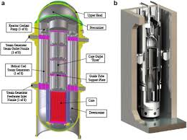
Introduction to SMRs
Definition by Nuclear Energy Agency:
Power output between 10 MWe and 300 MWe
Higher modularization and standardization
Factory-based construction for economies of series
Transportable modules for on-site assembly
Predictable and shorter construction times

Slide 4
The Role of Regulatory Oversight in SMR Implementation
Small Modular Reactors (SMRs) are transforming nuclear technology
Enhanced safety, cost efficiency, and adaptability
Over 80 designs recognized by IAEA worldwide
Viable low-carbon alternative for future energy systems
Strategic fit for middle-income countries like Kenya

Slide 5
Why SMRs Are Likely to be Widely Adopted
Compact size, scalability, and flexibility
Suitable for remote industrial operations
High-temperature outputs for industrial applications
Enhanced safety features
Reduced emergency planning zones
Potential for closer siting to urban areas
Notes:
Examples : theft, sabotage, unauthorized access, illegal transfer or other malicious acts
Glossary definition.
- Historically, the term ‘physical protection’ has been used to describe what is now known as “Nuclear Security of Nuclear Material and Nuclear Facilities.” In NSS 13 the term ‘physical protection’ continues to be used throughout the publication.¹
Nuclear Security is a more broad term that includes topics such as:
Nuclear Security Culture
Information Security
Cyber Security
Personnel Security
¹NSS 13, Introduction, footnote page 1

Slide 6
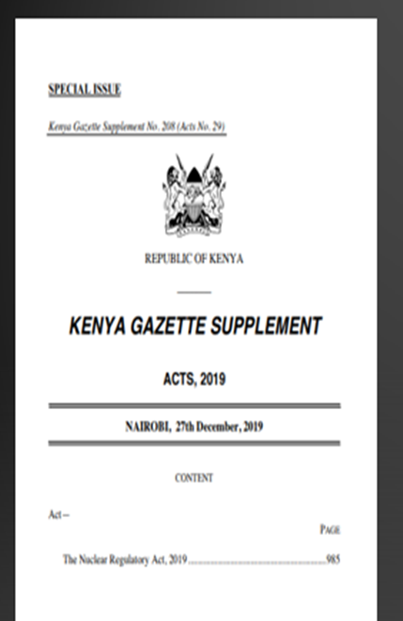
Current Regulatory Landscape
Nuclear Regulatory Act, Cap 243 (2019) in Kenya
Frameworks designed for large-scale reactors
SMRs challenge existing regulatory approaches
Need for adaptation to new technologies and deployment strategies
SMRs implicitly covered under current definition of nuclear facility

Slide 7
Graded Approach in Regulation
IAEA definition: Stringency of control measures commensurate with risk
Challenges in systematic application across Member States
Need for streamlined licensing processes for SMRs
Adaptation of safety standards for new reactor technologies
Implicit provision in Kenyan regulatory framework

Slide 8
Regulatory Challenges
Novelty of SMR technology
Shorter construction time compared to traditional plants
Regulatory lag behind industry innovations
Need for harmonization of international standards
Nuclear waste management for new technologies
Focus on water-cooled designs for near-term deployment

Slide 9
Opportunities in Deploying SMRs
Harmonized international standards
Risk-informed regulation
Collaborative regulatory platforms
International cooperation through IAEA initiatives

Slide 10
Benefits of International Cooperation
Access to IAEA technical expertise and guidance
Training and capacity-building programs
Peer review programs for regulatory framework assessment
Knowledge-sharing and collaboration on SMR projects
Staying abreast of global trends in nuclear energy

Slide 11
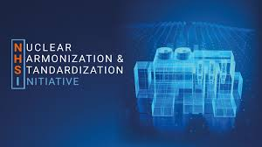
Harmonized International Standards
Global consensus on SMR standards
Streamlined international deployment
Reduced complexity and cost for regulatory framework development
Enhanced cross-border cooperation
Attraction of foreign investment
Accelerated nuclear energy goals

Slide 12

Risk-Informed Regulation
Optimized licensing process for SMRs
Focus on specific risks posed by SMRs
Avoidance of unnecessary or overly stringent requirements
Streamlined approval and oversight processes
Balance between safety and innovation
Promotion of faster and safer SMR deployment

Slide 13
International Cooperation through IAEA Initiatives
Access to IAEA technical expertise and guidance
Alignment with international standards
Training and capacity-building programs
Peer review programs for regulatory framework assessment
Knowledge-sharing and collaboration on SMR projects
Staying abreast of global trends in nuclear energy

Slide 14
Conclusion
Proactive regulatory innovation is crucial for harnessing the full potential of SMRs in the global energy mix, addressing challenges while advancing nuclear governance practices. This approach will be key to:
Ensuring safe and secure adoption of SMRs
Accommodating innovative nuclear technologies
Advancing deployment of SMRs
Positioning SMRs as a cornerstone of sustainable energy strategies in emerging economies

Slide 15

Questions?

