Slide 2

The ARCHEOS heat unit to decarbonize the heat market with proven technologies
Franck MORIN
Clément LIEGEARD, Laura MATTEO, Thierry CADIOU, Paolo OLITA, Philippe AMPHOUX CEA
IAEA – October 22 2024
IRESNE/DER/SESI/LCOS

Slide 3
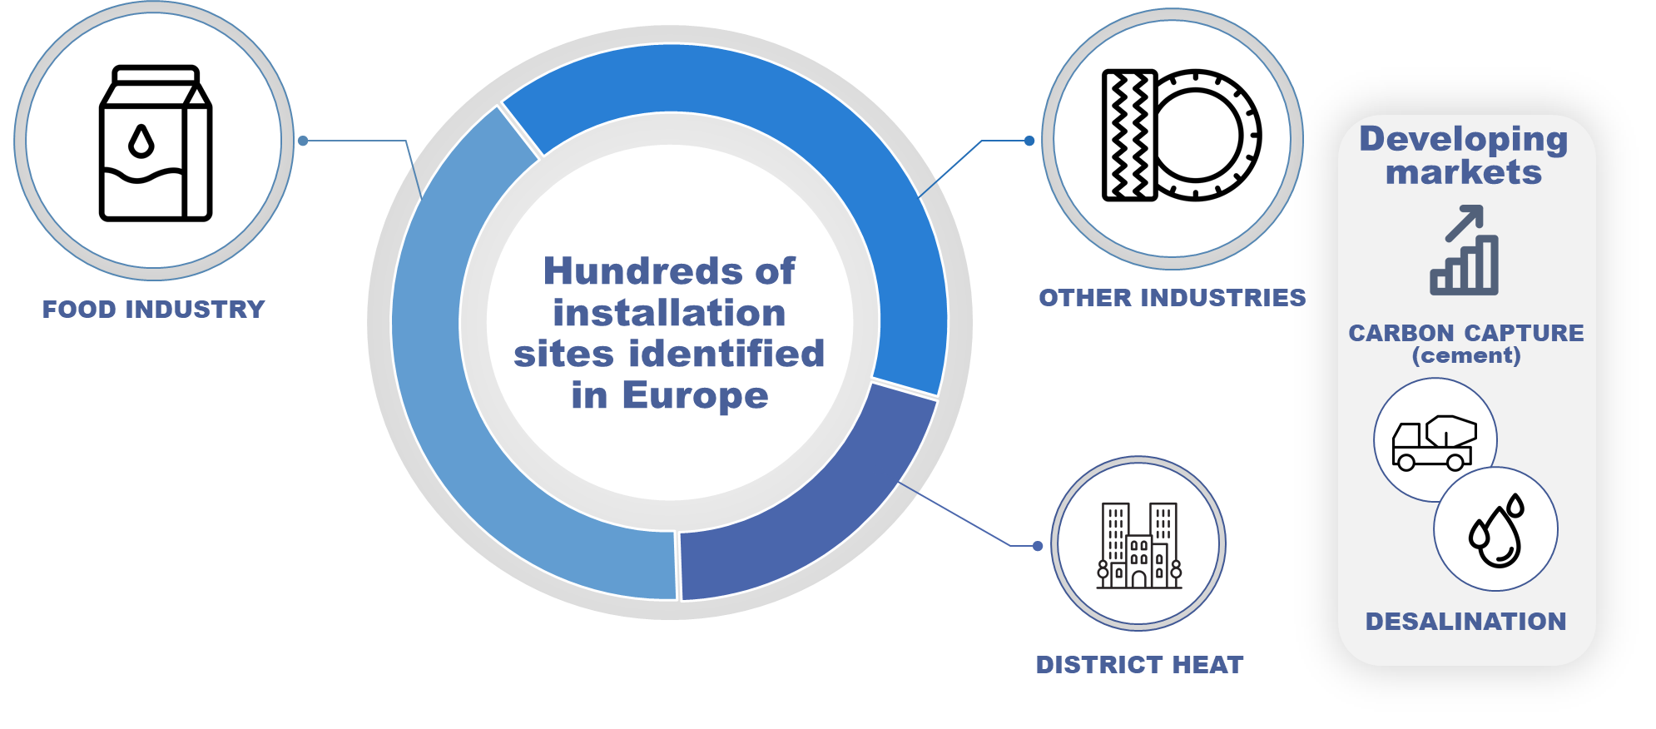
GENERAL DESIGN
High-level needs
Address the heat market
Limit the time-to-market
Create a competitive solution
                Design of a LW-SMR dedicated to
                heat markets < 150°C
IRESNE/DER/SESI/LCOS
3

Slide 4
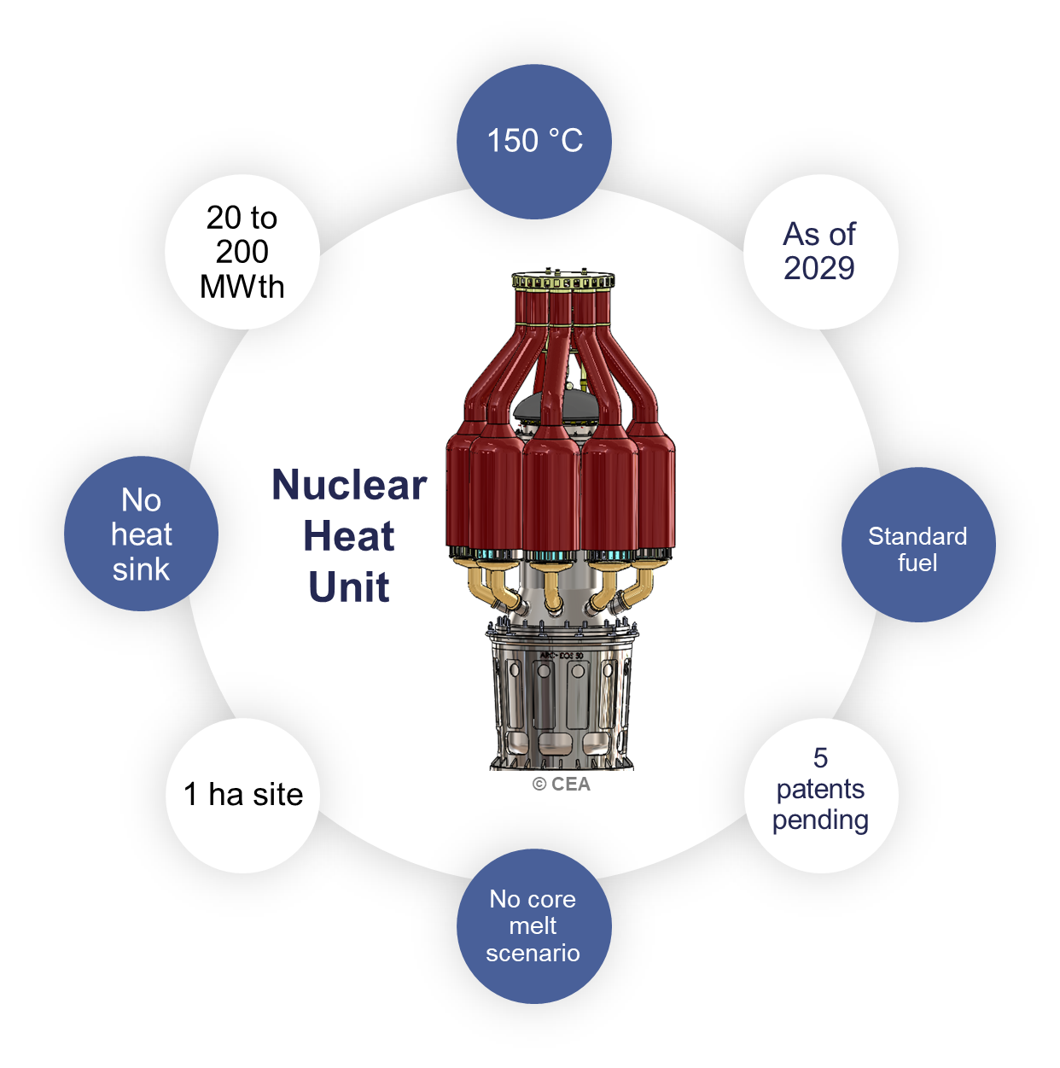
GENERAL DESIGN
Inherent safety
Simplicity
Speed
Ease
IRESNE/DER/SESI/LCOS
4

Slide 5
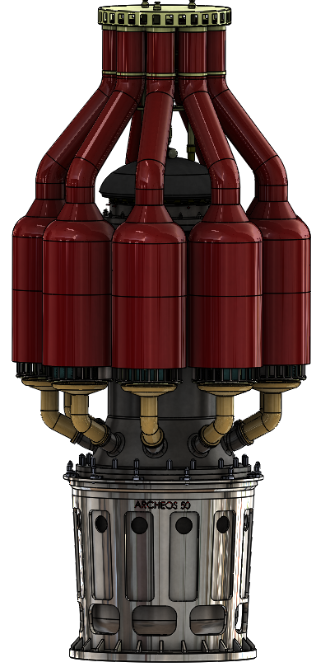
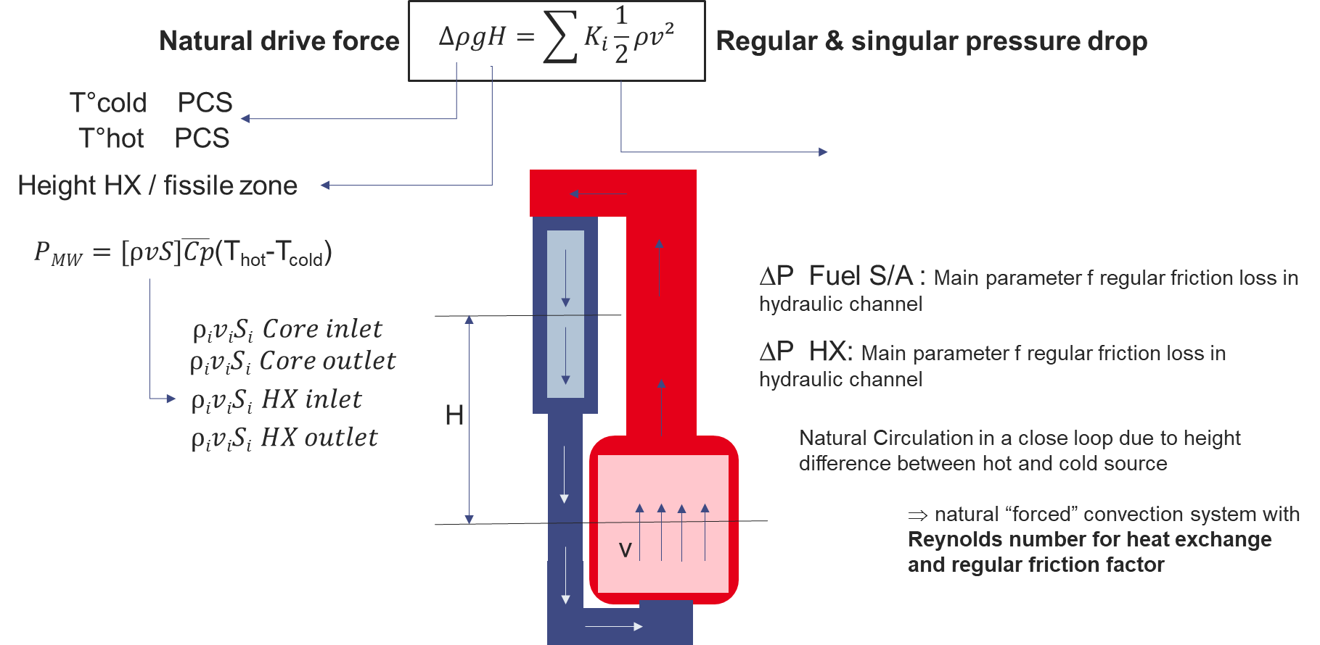
THERMAL-HYDRAULICS
A primary circuit in natural circulation mode
COPERNIC
Pre-design code
Natural circulation
Circuit | Hot temperature (°C) | Cold temperature (°C) | Pressure (bar)
Primary | 175 | 135 | 14
Secondary | 155 | 115 | 14.5
Tertiary | 150 | 110 | Depending on the network

Slide 6
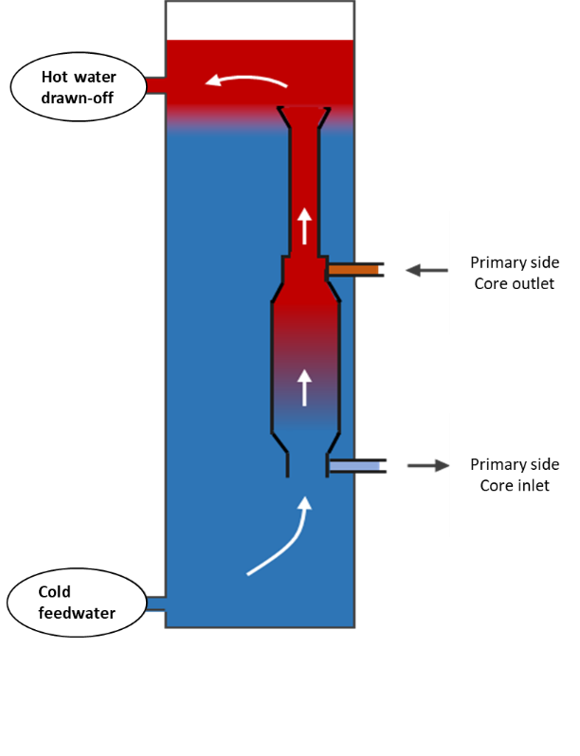
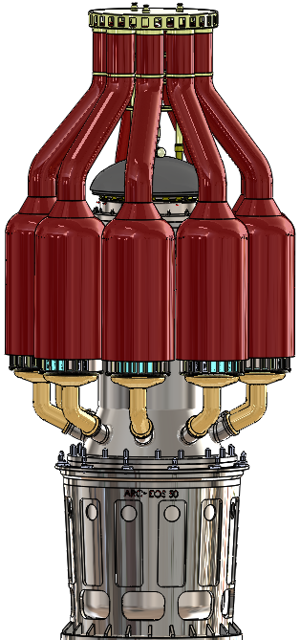
THERMAL-HYDRAULICS
In an innovative natural / forced mix secondary circuit
COPERNIC
Pre-design code
Secondary natural convection between the HX and the thermocline
Forced convection to supply heat to a secondary/tertiary HX and freeze the thermocline position

Slide 7
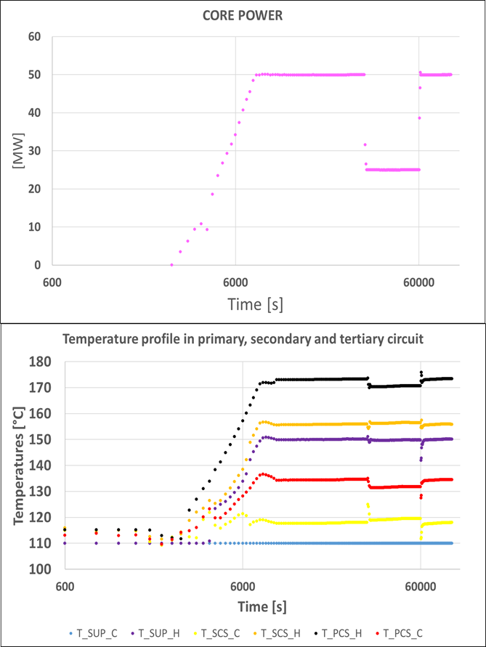
THERMAL-HYDRAULICS
Validation of the operation with CATHARE…
CATHARE
Nuclear startup and load following
Appropriate behavior of the primary and secondary circuits
Continuity of customer temperature supply

Slide 8
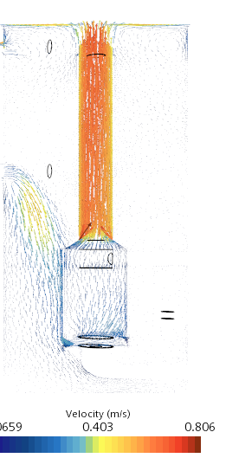
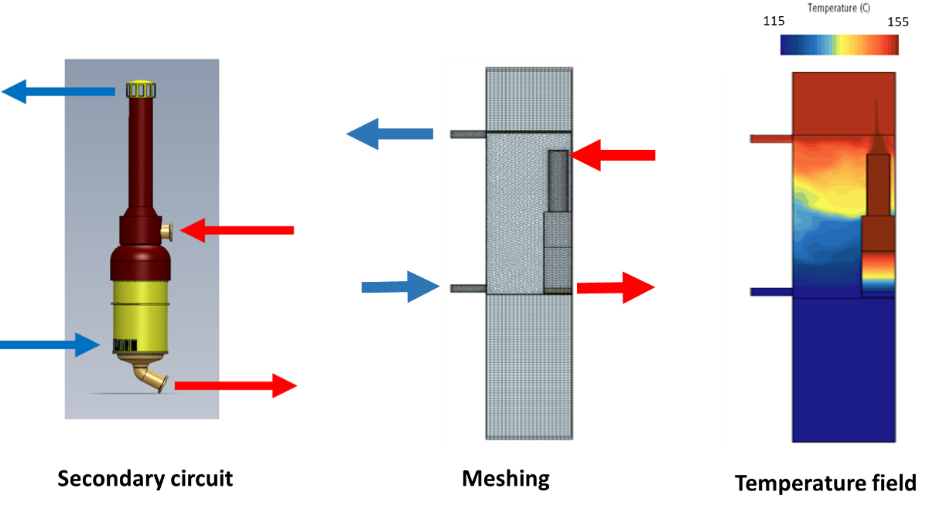
THERMAL-HYDRAULICS
... And then with CFD
(waiting for CATHARE/CFD coupling in a next step)
STAR-CCM+
3D phenomena in the secondary vessel
Natural and forced circulation speed field

Slide 9
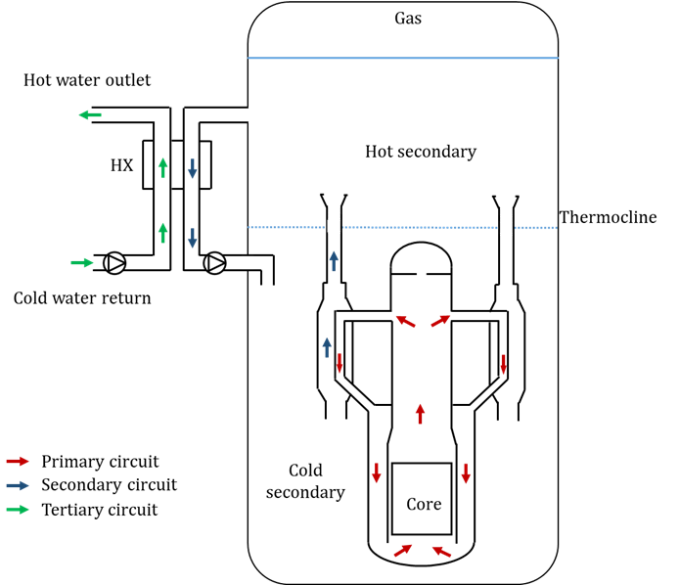
SAFETY APPROACH
Designed to reduce impact of any postulated initiating event
Main AOO events have little or zero impact due to the very large secondary volume thermal inertia
Autonomy for residual power extraction, in case of Loss Of Offsite Power is almost infinite
No risk of uncovering the core in case of a loss of coolant accident
No reactivity insertion due to a steam line rupture event or a clear water core insertion, no ejection grape possibility event
Much longer time to decide on the cooling sequence after reactor shutdown than classic PWR electricity process , without any primary circuit pressure and temperature increase
Extended margins of time for unprotected transient incidents
No Postulated Initiating Event, or combination of events, with penalizing additional case, is likely to lead to a realistic probability of occurrence of a severe accident scenario

Slide 10
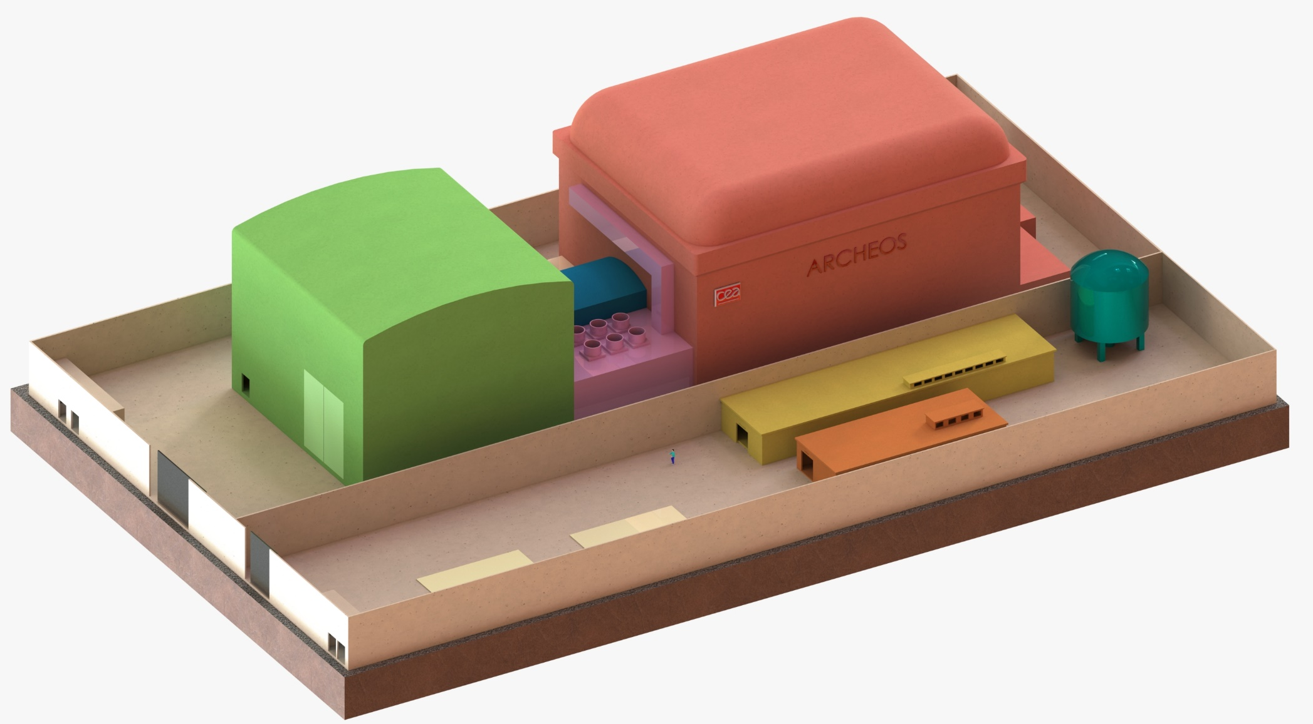
SITE
< 1 ha site
Red : Reactor Building
Green : Auxiliary building
Pink : HVAC
Blue : Transfer sas
Yellow & Orange : Supply client station and chemistry and control fluids station

Slide 11
THANK YOU FOR YOUR ATTENTION
CONTACT
Clément LIEGEARD : Clement.liegeard@cea.fr
Philippe AMPHOUX: Philippe.amphoux@cea.fr
Franck MORIN: Franck.morin@cea.fr
IRESNE/DER/SESI/LCOS

