Slide 2
Nuclear Liability for
Small Modular Reactors
Zeynep Melissa SAVAS
Nuclear Regulatory Specialist
Nuclear Regulatory Authority

Slide 3
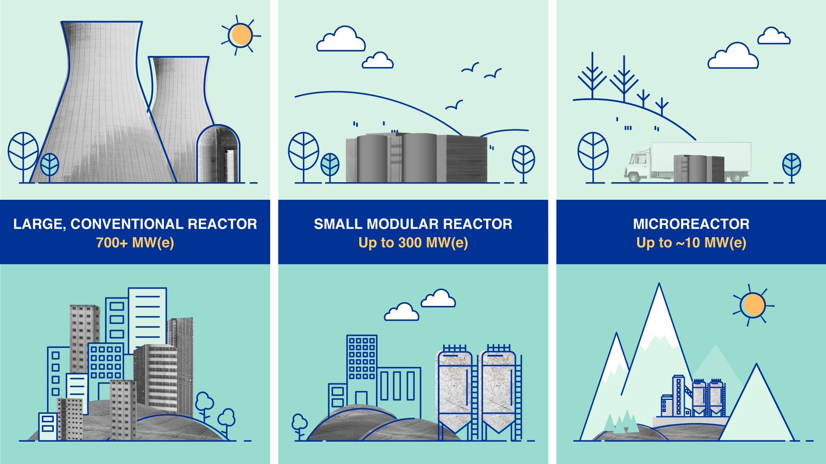
Small Modular Reactors
IAEA classifies any nuclear reactor with a power output of more than 700 megawatts (MWe) as large reactors, and those with outputs between 300 and 700 MWe are considered as medium-sized reactors.
And SMRs are defined as newer generation nuclear reactors which designed to be modular and generate electric power between 10 and 300 megawatts.
So far, SMRs are operational only in Russia and China, but more than 80 SMR designs are currently at different stages of development and deployment in 18 countries according to the IAEA ARIS.
NASA announced plans to support the space bases which it aims to establish on Moon and Mars with mini nuclear reactors. In this context, it is obvious that the interest in nuclear energy and SMRs is at a high level in future planning for either our Earth, Moon and neighboring planet Mars

Slide 4
Advantages and Disadvantages of SMR’s
Advantages | Disadvantages
Shorter construction period (Modularization) | Legal issues (Cross-border licensing and liability issues)
Site flexibility (facilitating access to nuclear energy in remote locations) | Operability and maintainability
Fitness for smaller electricity grids | Supply Chain problems
Lower the potential for unsafe releases of radioactivity | Radioactive Waste disposal
Require less frequent refueling | Regulatory infrastructure
Lower upfront capital cost (better affordability) | Physical Security
Easier financing scheme | Institutional issues and public acceptance

Slide 5
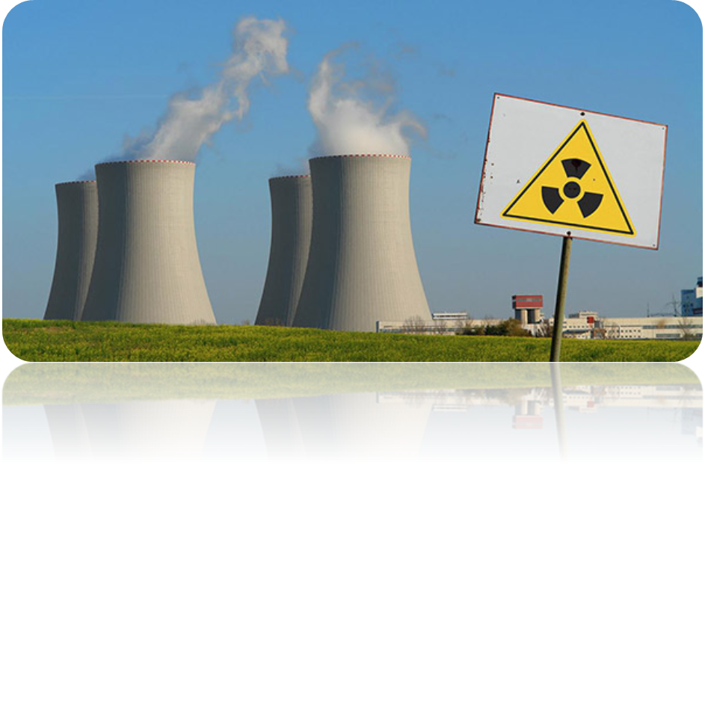
Nuclear Liability
Nuclear energy brings many risks as well as its advantages. Protecting people, property and the environment from the hazardous effects of ionizing radiation is the main goal of both national regulatory bodies and international organizations in this field.
Nuclear liability system creates a liability regime for operators of nuclear facilities that requires them to provide adequate insurance or financial security to compansate possible nuclear damages suffered by third parties due to a possible nuclear accident.

Slide 6
Existing Nuclear Liability Conventions
In order to ensure that the consequences of nuclear incidents can be compensated for third parties who suffer from these accidents, nuclear liability regimes have been developed, and these regimes have been regulated by international conventions.
These international conventions governing nuclear third-party liability are:
Paris Convention on Third Party Liability in the Field of Nuclear Energy (Paris Convention and Revised Paris Convention)
Vienna Convention on Civil Liability for Nuclear Damage (Vienna Convention and Revised Vienna Convention)
Convention on Supplementary Compensation for Nuclear Damage (CSC)

Slide 7
Nuclear Installation
Nuclear Installation
Reactors other than those comprised in any
means of transport; factories for the
manufacture or processing of nuclear
substances
Factories for the separation of
isotopes of nuclear fuel
Installations for the disposal of nuclear
substances
Any such reactor, factory,
facility or installation that is in the course
of being decommissioned
Such other
installations in which there are nuclear fuel
or radioactive products or waste as the
Steering Committee shall determine
Factories for the
reprocessing of irradiated nuclear fuel
Facilities for the storage of nuclear
substances other than storage incidental to
the carriage of such substances

Slide 8
APPLICABILITY OF THE EXISTING LIABILITY CONVENTIONS FOR SMR’S
Under the existing liability conventions, the definitions provided for nuclear installation, are quite similar and cover all land-based reactors.
The “Exposé des Motifs” of Paris Convention states that “Nuclear installations are defined as reactors, other than those which are used or incorporated for use in a means of transport as a source of power for any purpose”.
Similar to the Paris, Vienna Convention states that cases in which the nuclear reactor is used as a source of power, whether for the propulsion of the means of transport or for any other purpose, are not covered by the convention.
Within this scope, definitions in existing liability conventions clearly show that land-based SMRs are included in the definition of nuclear installation provided in the liability conventions, which covers “reactors other than those comprised in any means of transport”.
Existing liability conventions applies to SMRs except the ones used in air or sea transportation, and the ones used for military purposes.

Slide 9
TRANSPORTABLE NUCLEAR POWER PLANT
A transportable nuclear power plant (TNPP) is a factory manufactured, transportable and relocatable nuclear power plant which, when fuelled, is capable of producing final energy products such as electricity and heat.
Most experts concur on the view that the conventions do cover SMRs located on ships that are anchored or otherwise fixed in a specific place and are used exclusively for generating power for external consumption, as long as these reactors are not intended to propel the platform but are to be operated once the ship is anchored at shore and immobilised. In such a case, the ship would be viewed as a floating platform on which the reactor is located and not as a nuclear ship that is excluded from the application of the conventions

Slide 10
Basic principles of nuclear liability
Strict liability of the operator
Exclusive liability of the operator
Establishing a minimum amount of liability for the operator
Limitation of the operator’s liability in time
Compulsory financial security for the operator
Exclusive jurisdiction
Non-discrimination
Equal treatment

Slide 11
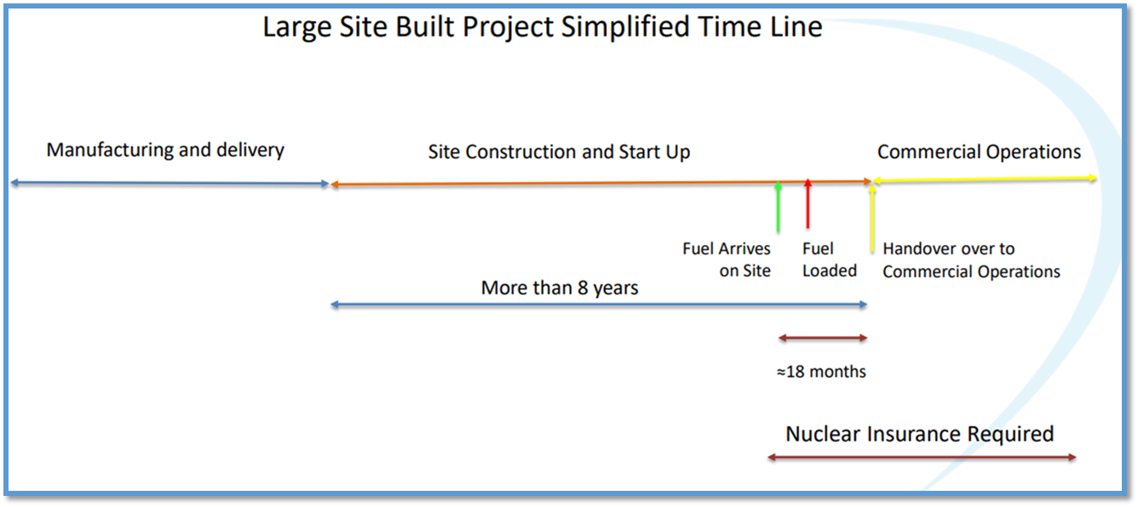
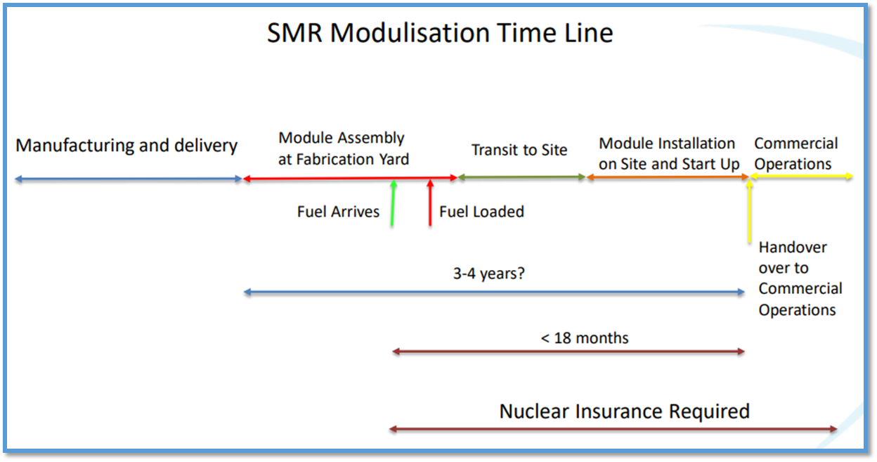
Insurance for sure. But when?

Slide 12
LIABILITY AMOUNTS IN EXISTING LIABILITY CONVENTIONS
Vienna Convention | USD 5 million based on USD gold value on 29 April 1963 (approximately USD 262 million today)
Revised Vienna Convention | SDR 300 million
Paris Convention | SDR 15 million
Revised Paris Convention | EUR 700 million
Convention on Supplementary Compensation for Nuclear Damage(CSC) | SDR 300 milyon

Slide 13
REDUCED LIABILITY AMOUNTS IN
EXISTING LIABILITY CONVENTIONS
Vienna Convention | USD 5 million based on USD gold value on 29 April 1963 (approximately USD 262 million today)
Revised Vienna Convention | SDR 5 million
Paris Convention | SDR 5 million
Revised Paris Convention | EUR 70 million
Convention on Supplementary Compensation for Nuclear Damage(CSC) | SDR 5 million

Slide 14
Conclusion
It is considered that existing nuclear liability conventions cover SMRs in principle. This issue is clearly understood from the explanatory documents of the conventions.
Reduced liability limits are determined for low-risk activities in existing liability conventions. These reduced liability limits can also be applied to SMRs. States may decide a liability amount between the reduced liability amount and the minimal liability amount for SMRs.
In the final stage, this is a national decision that must be made. When the lower liability limit is determined, the remaining nuclear damage that will be compensated by the countries and the difficulty of predicting the damage related to SMRs is a regulatory challenge for countries.

Slide 15
Click to editThank you.
Contact information: zeynepmelissa.sahin@ndk.org

