Slide 1

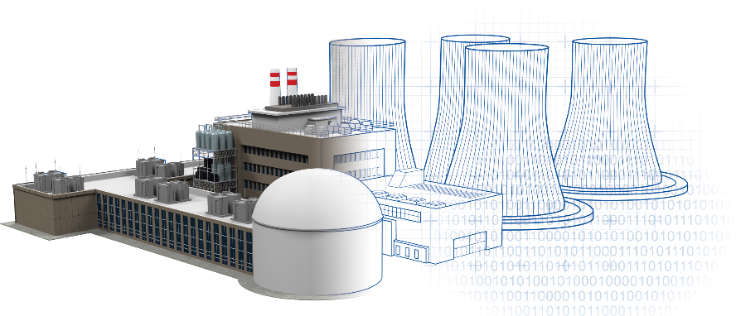
Use of Physical Protection Modeling and Simulation (M&S) Tools to Optimize Security for New Reactors
Lead Author: Albert Tardiff
Presenter: Raj Iyengar
United States Nuclear Regulatory Commission
The views expressed are those of the authors and do not reflect the views of the U.S. Nuclear Regulatory Commission. This material is declared a work of the U.S. Government and is not subject to copyright protection in the United States. Approved for public release; distribution is unlimited.

Slide 2
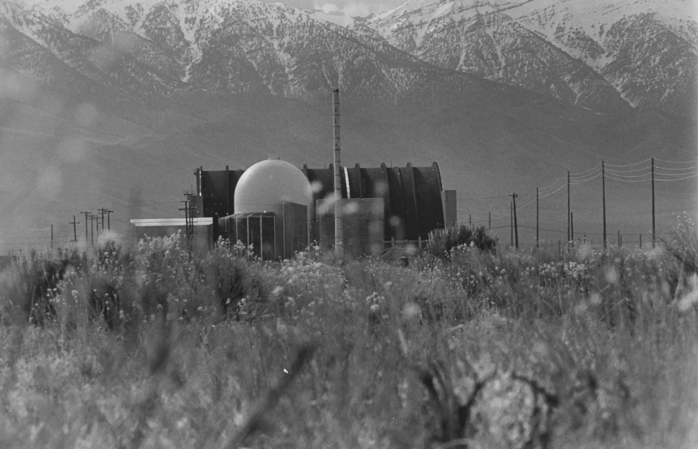
History
Most nuclear reactors in the U.S. predate current physical security requirements.
  Security features needed to be incorporated after-the-fact.
In 2008, the NRC emphasized the consideration of physical security with safety during reactor design.
Modeling and simulation (M&S) tools have been developed to support security design.

Slide 3
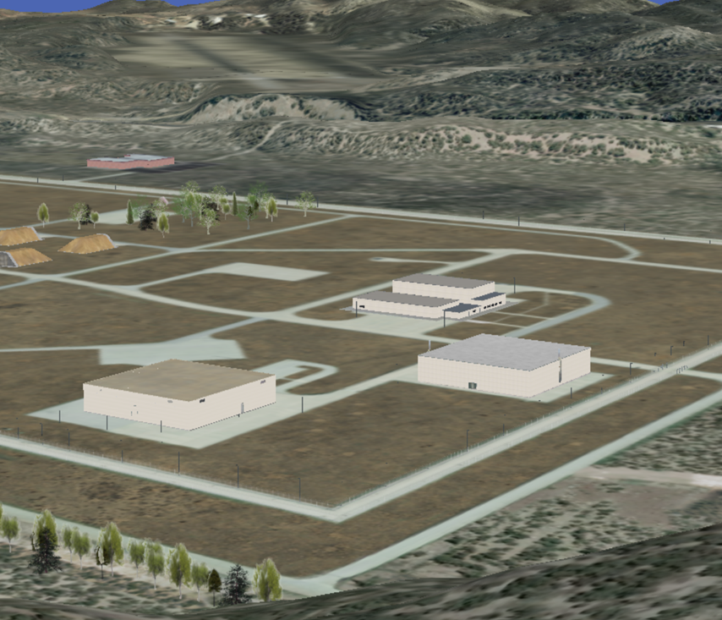
Modeling and Simulation
Advanced reactor vendors have begun using M&S to support the design of physical protection systems.
M&S tools can calculate potential adversary pathways and responses to adversary actions.
Effectiveness (P_{E}) determined based on probability of intercepting adversaries (P_{I}) and probability of neutralization (P_{N})

Slide 4
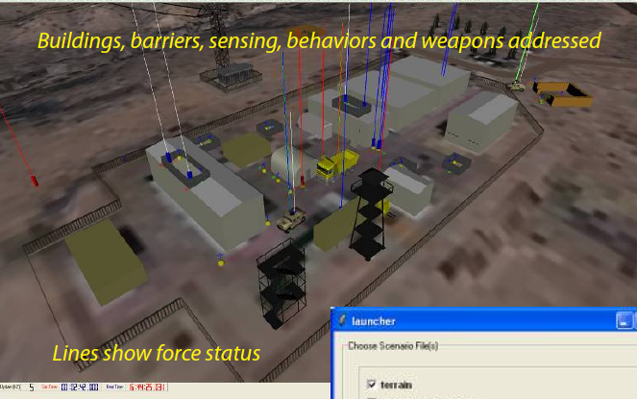
Advantages of M&S
Ability to perform many assessments quickly
Evaluation of security features before incorporating them into reactor facility designs
Supports consistency and efficiency in reviews of licensee submittals
Reduced need for retrofits

Slide 5
M&S Elements for SMRs/Advanced Reactors
Facility Characterization
Pathway Analysis
Combat Simulation

Slide 6
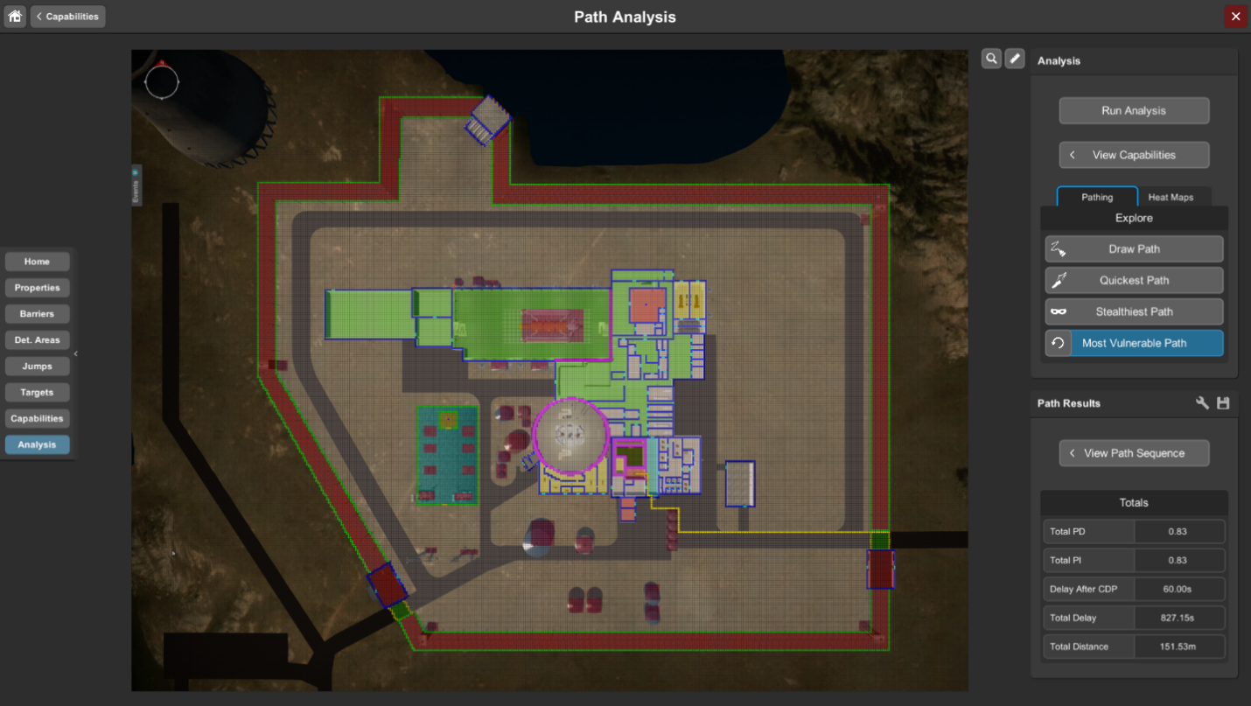

Probability of System Effectiveness Calculation
Evaluates how well a protection strategy achieves its performance objectives
A realistic value of P_{E} is always less than one
A regulatory authority can establish a value for P_{E} for nuclear facilities to achieve
$$P_{E}=P_{I}×P_{N}$$

Slide 7
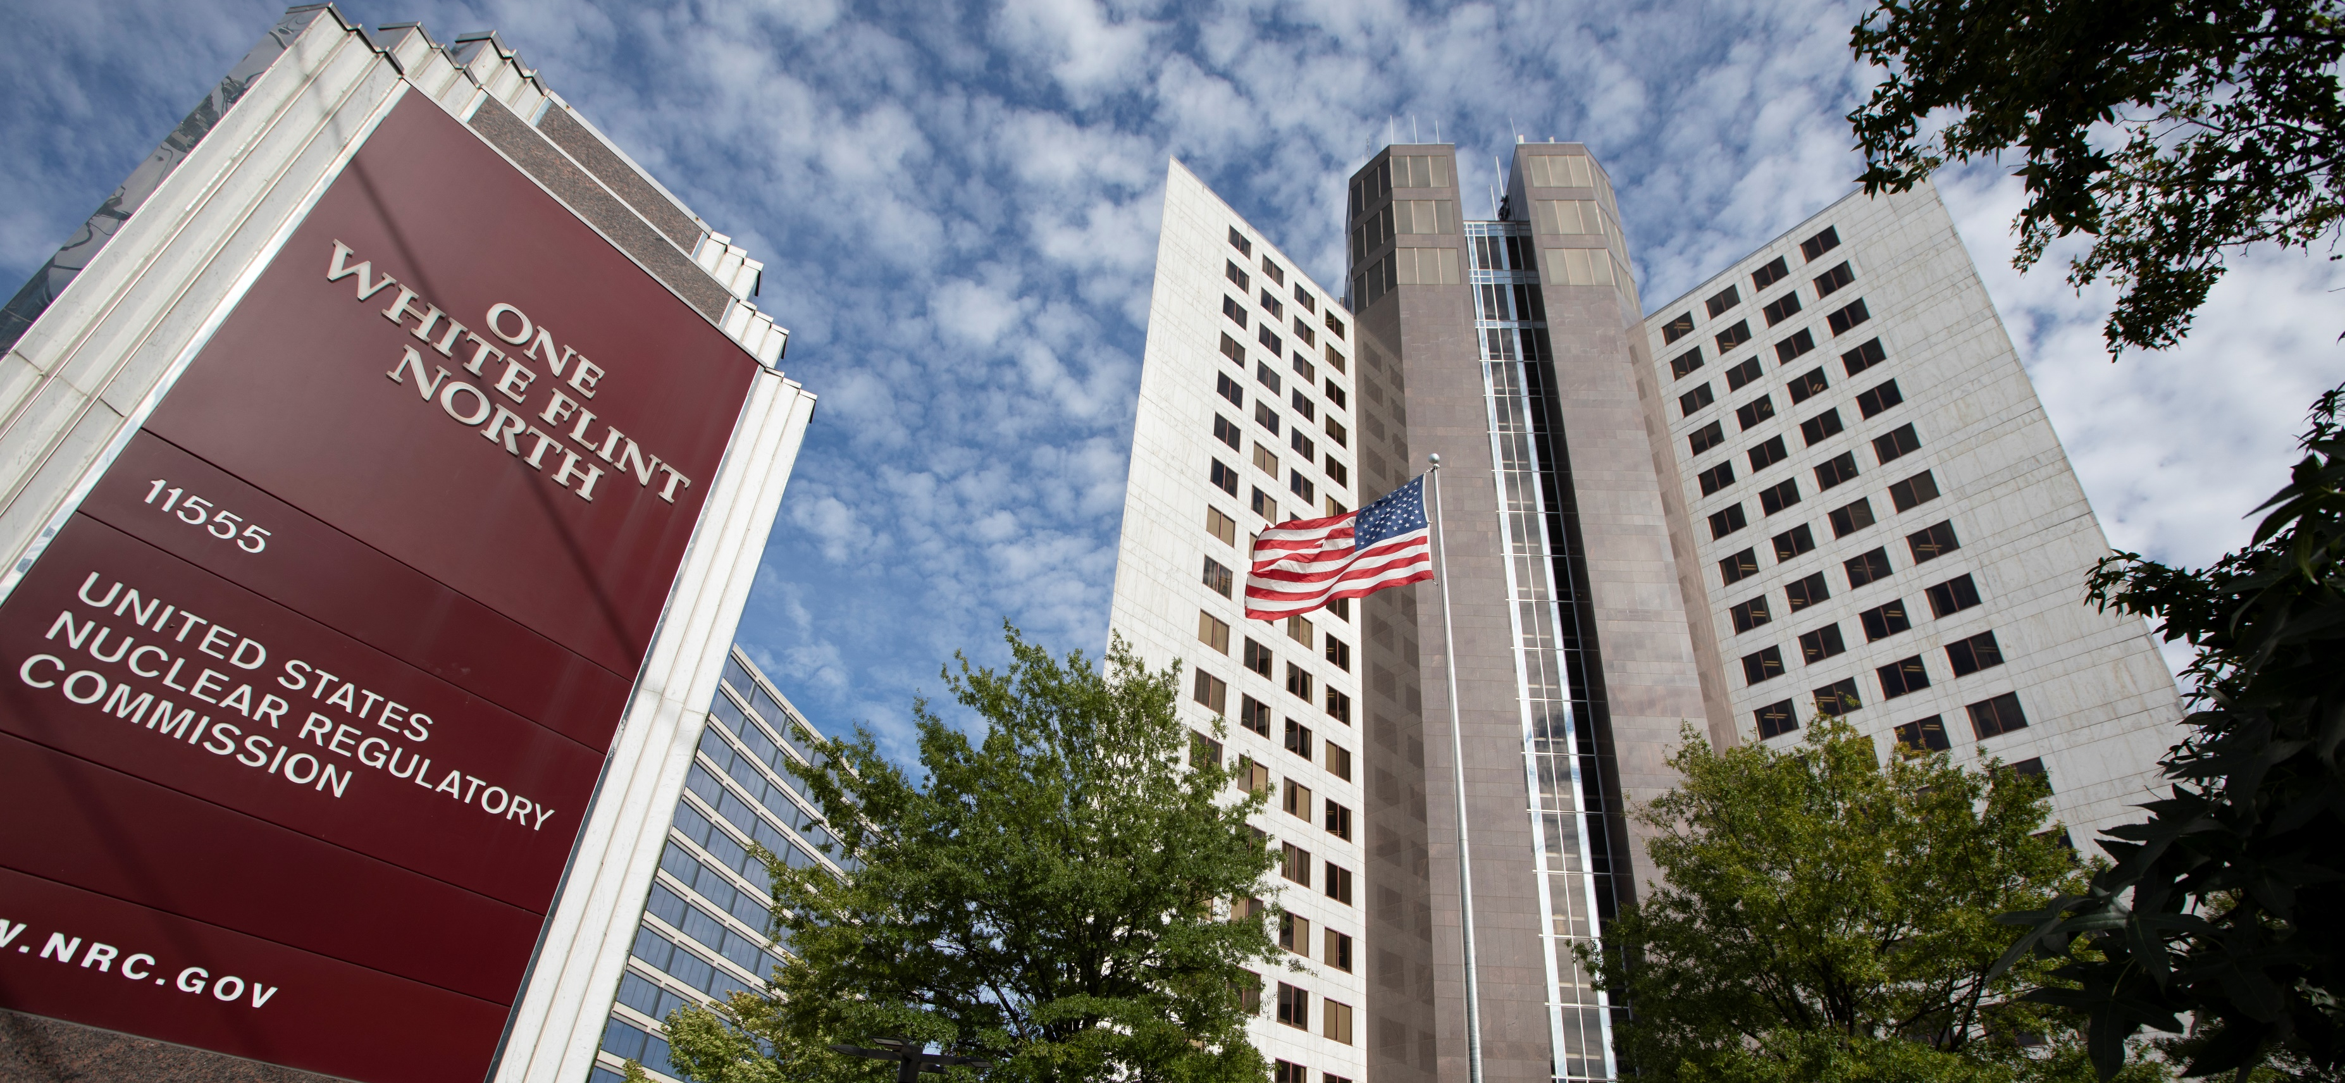
Policy and Guidance Development
The NRC is developing guidance that will describe acceptable methods and best practices for applicants.
Status: (Projected)
Q2 FY25 — draft RG ready for public comment
Q2 FY26 — RG issued

Slide 8
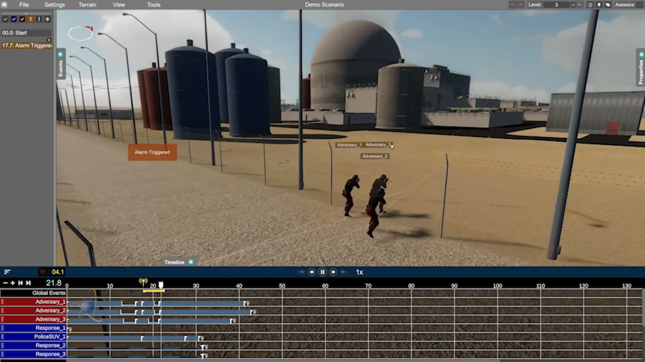
Innovation at the NRC
Physical Security Modeling and Simulation

Slide 9
Thank you
Raj Iyengar – raj.iyengar@nrc.gov
Al Tardiff – al.tardiff@nrc.gov

