Slide 1

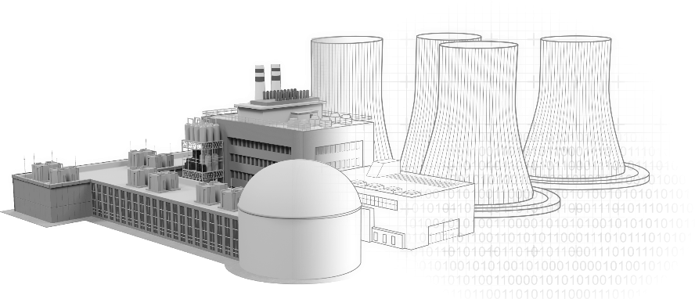
Regulatory Implications of Advanced Technologies for Component Condition Monitoring in Nuclear Energy Systems
J. Matrachisia, T. Scarbrough, R. Iyengar
Presenter: Raj Iyengar
Office of Nuclear Regulatory Research
U.S. Nuclear Regulatory Commission
The views expressed are those of the authors and do not reflect the views of the U.S. Nuclear Regulatory Commission. This material is declared a work of the U.S. Government and is not subject to copyright protection in the United States. Approved for public release; distribution is unlimited.

Slide 2
OBJECTIVES
Demonstrate the application of digital twins (DT) for mechanical system condition monitoring in nuclear power plants (NPPs)
  Relevance to ASME OM and OM-2 code requirements
Gain knowledge and confidence
  Modeling and simulation for digital twins
Obtain insights
  Support future regulatory application reviews and develop guidance, as needed

Slide 3
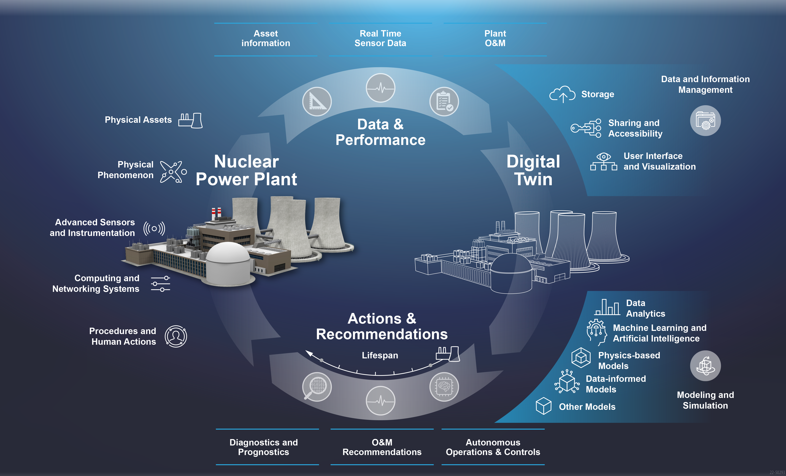
DIGITAL TWIN SYSTEM
NPP SCENARIO
Main elements to an NPP-DT system
  An NPP
  A Digital Twin (DT)
  Sensor and performance data flowing from NPP to DT
  Actions and recommendations flowing from DT to NPP

Slide 4
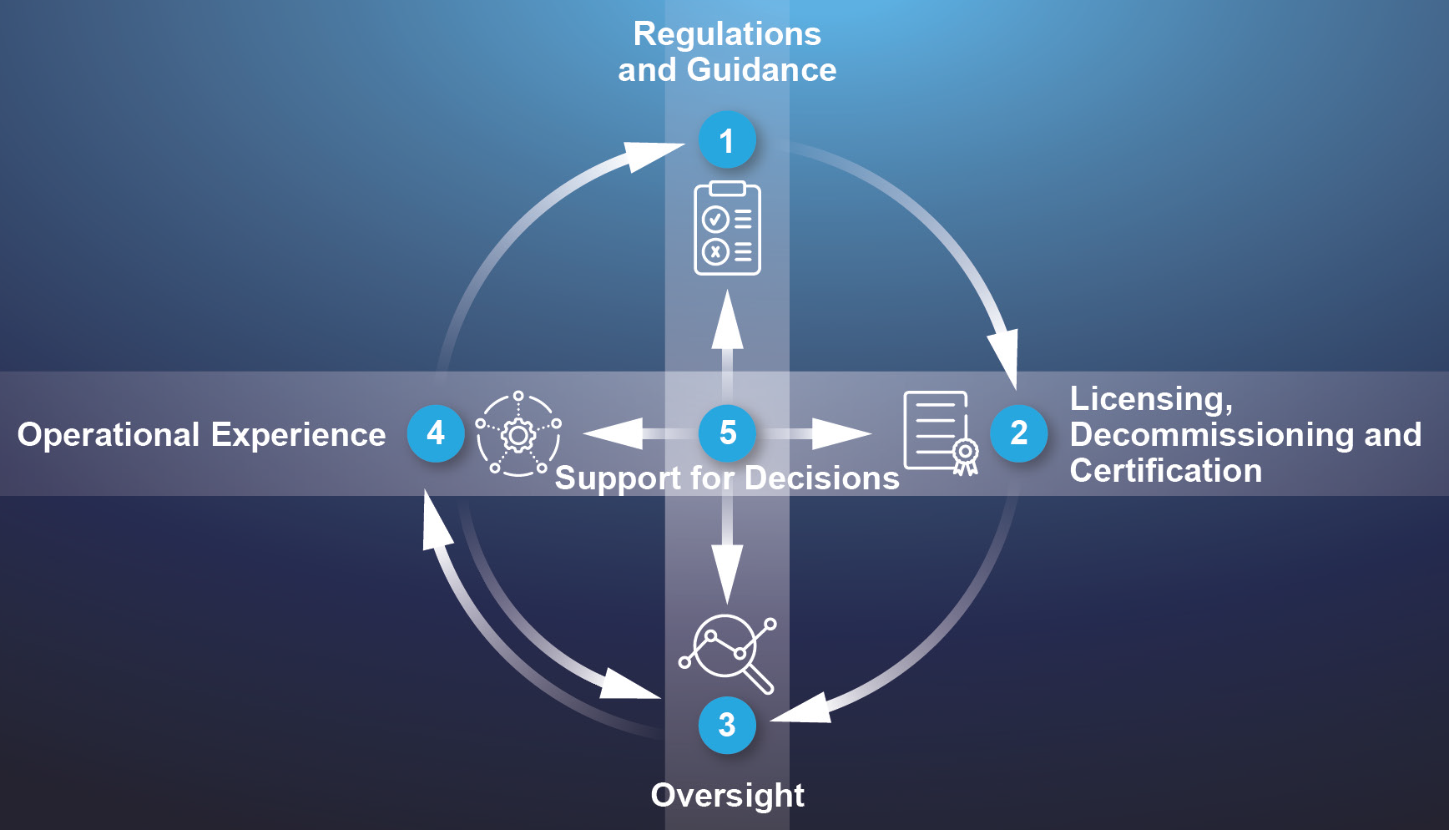
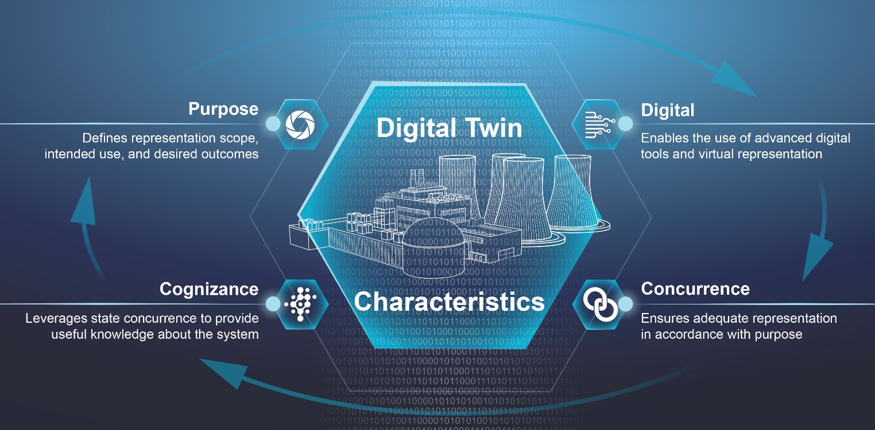
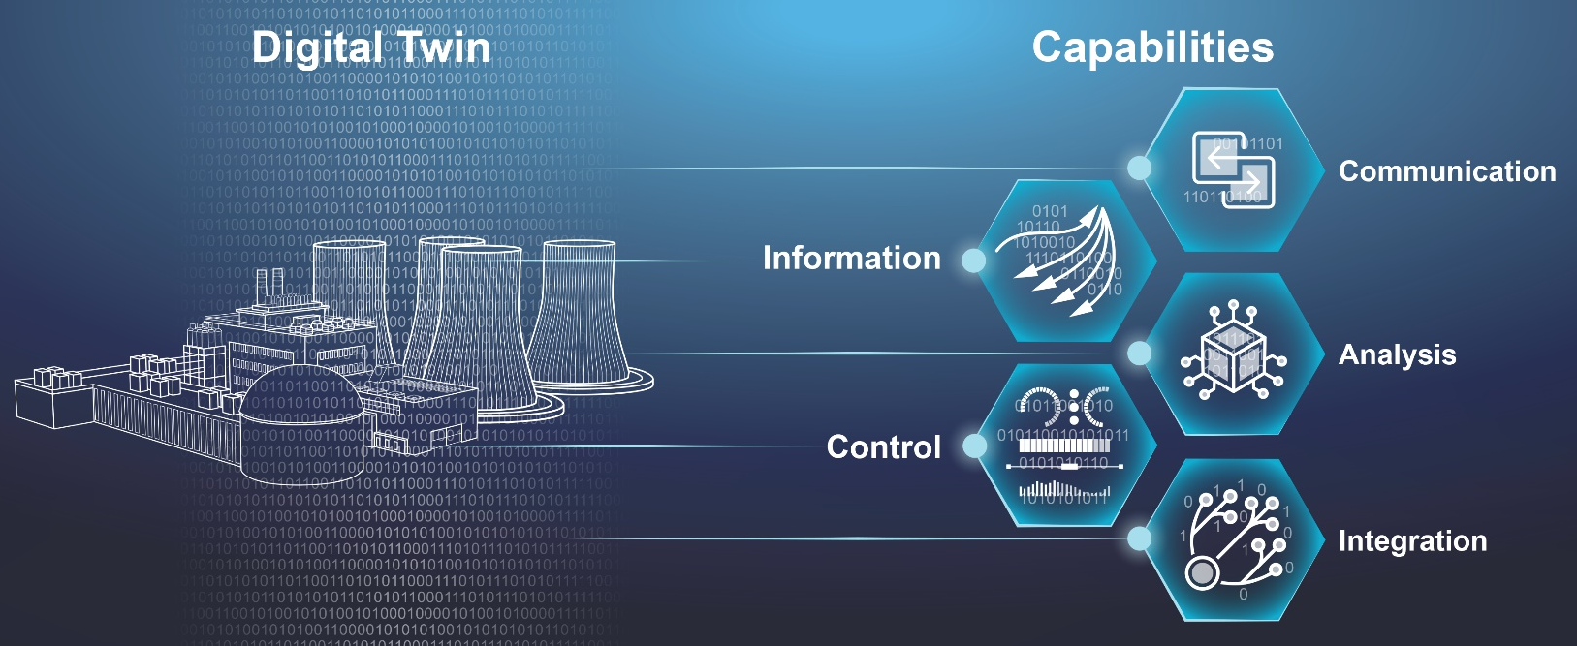
DIGITAL TWIN CHARACTERISTICS & CAPABILITIES

Slide 5
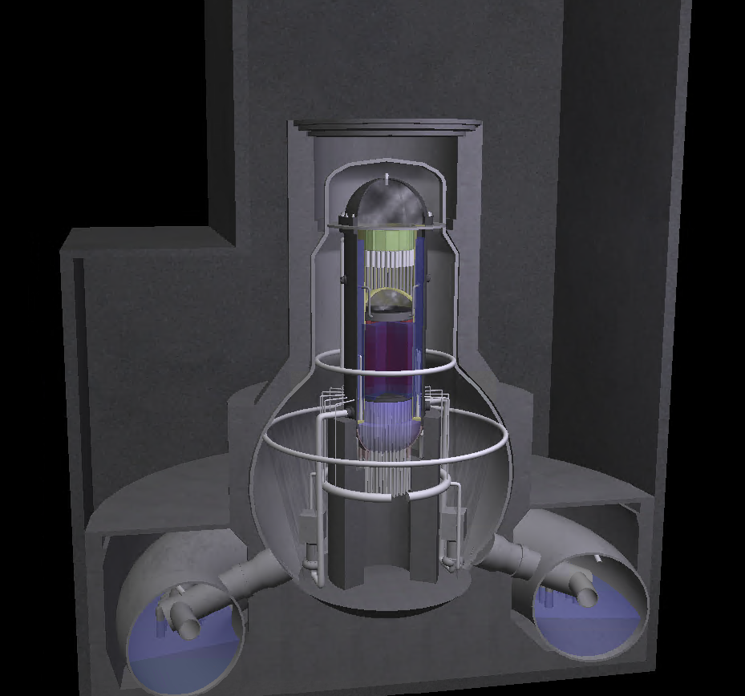
ANOMALY DETECTION CASE STUDY
Simulator Synthetic data
Full scope BWR: Represents the full set of plant components and operations
Physics-based model: Parameters are calculated using first principles
Real-time data: Operates in real time just like an actual plant
Initial conditions: Can set the initial conditions of the plant
Malfunctions: Variety of malfunctions that can be inserted at a specified time and severity
Output: Records time-series data of selected plant parameters and malfunctions
Probabilistic Safety Assessment and Management (PSAM) 2023 Topical Conference on Artificial Intelligence (AI) and Risk Analysis, October 23‐25, 2023.
https://www.ideals.illinois.edu/items/128985

Slide 6
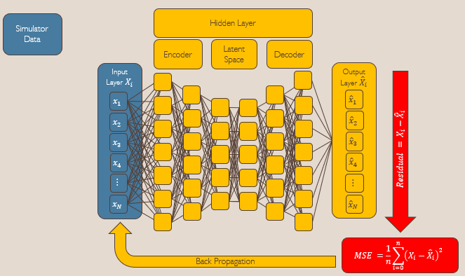
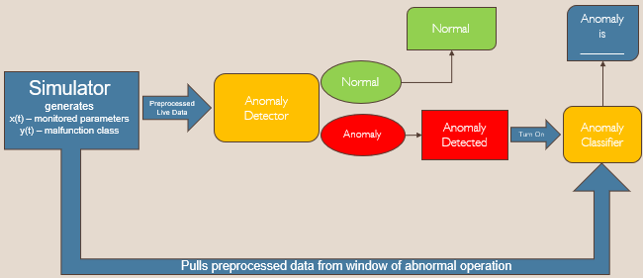
ANOMALY DETECTION CASE STUDY
Trained LSTM Autoencoder
Probabilistic Safety Assessment and Management (PSAM) 2023 Topical Conference on Artificial Intelligence (AI) and Risk Analysis, October 23‐25, 2023.
https://www.ideals.illinois.edu/items/128985

Slide 7
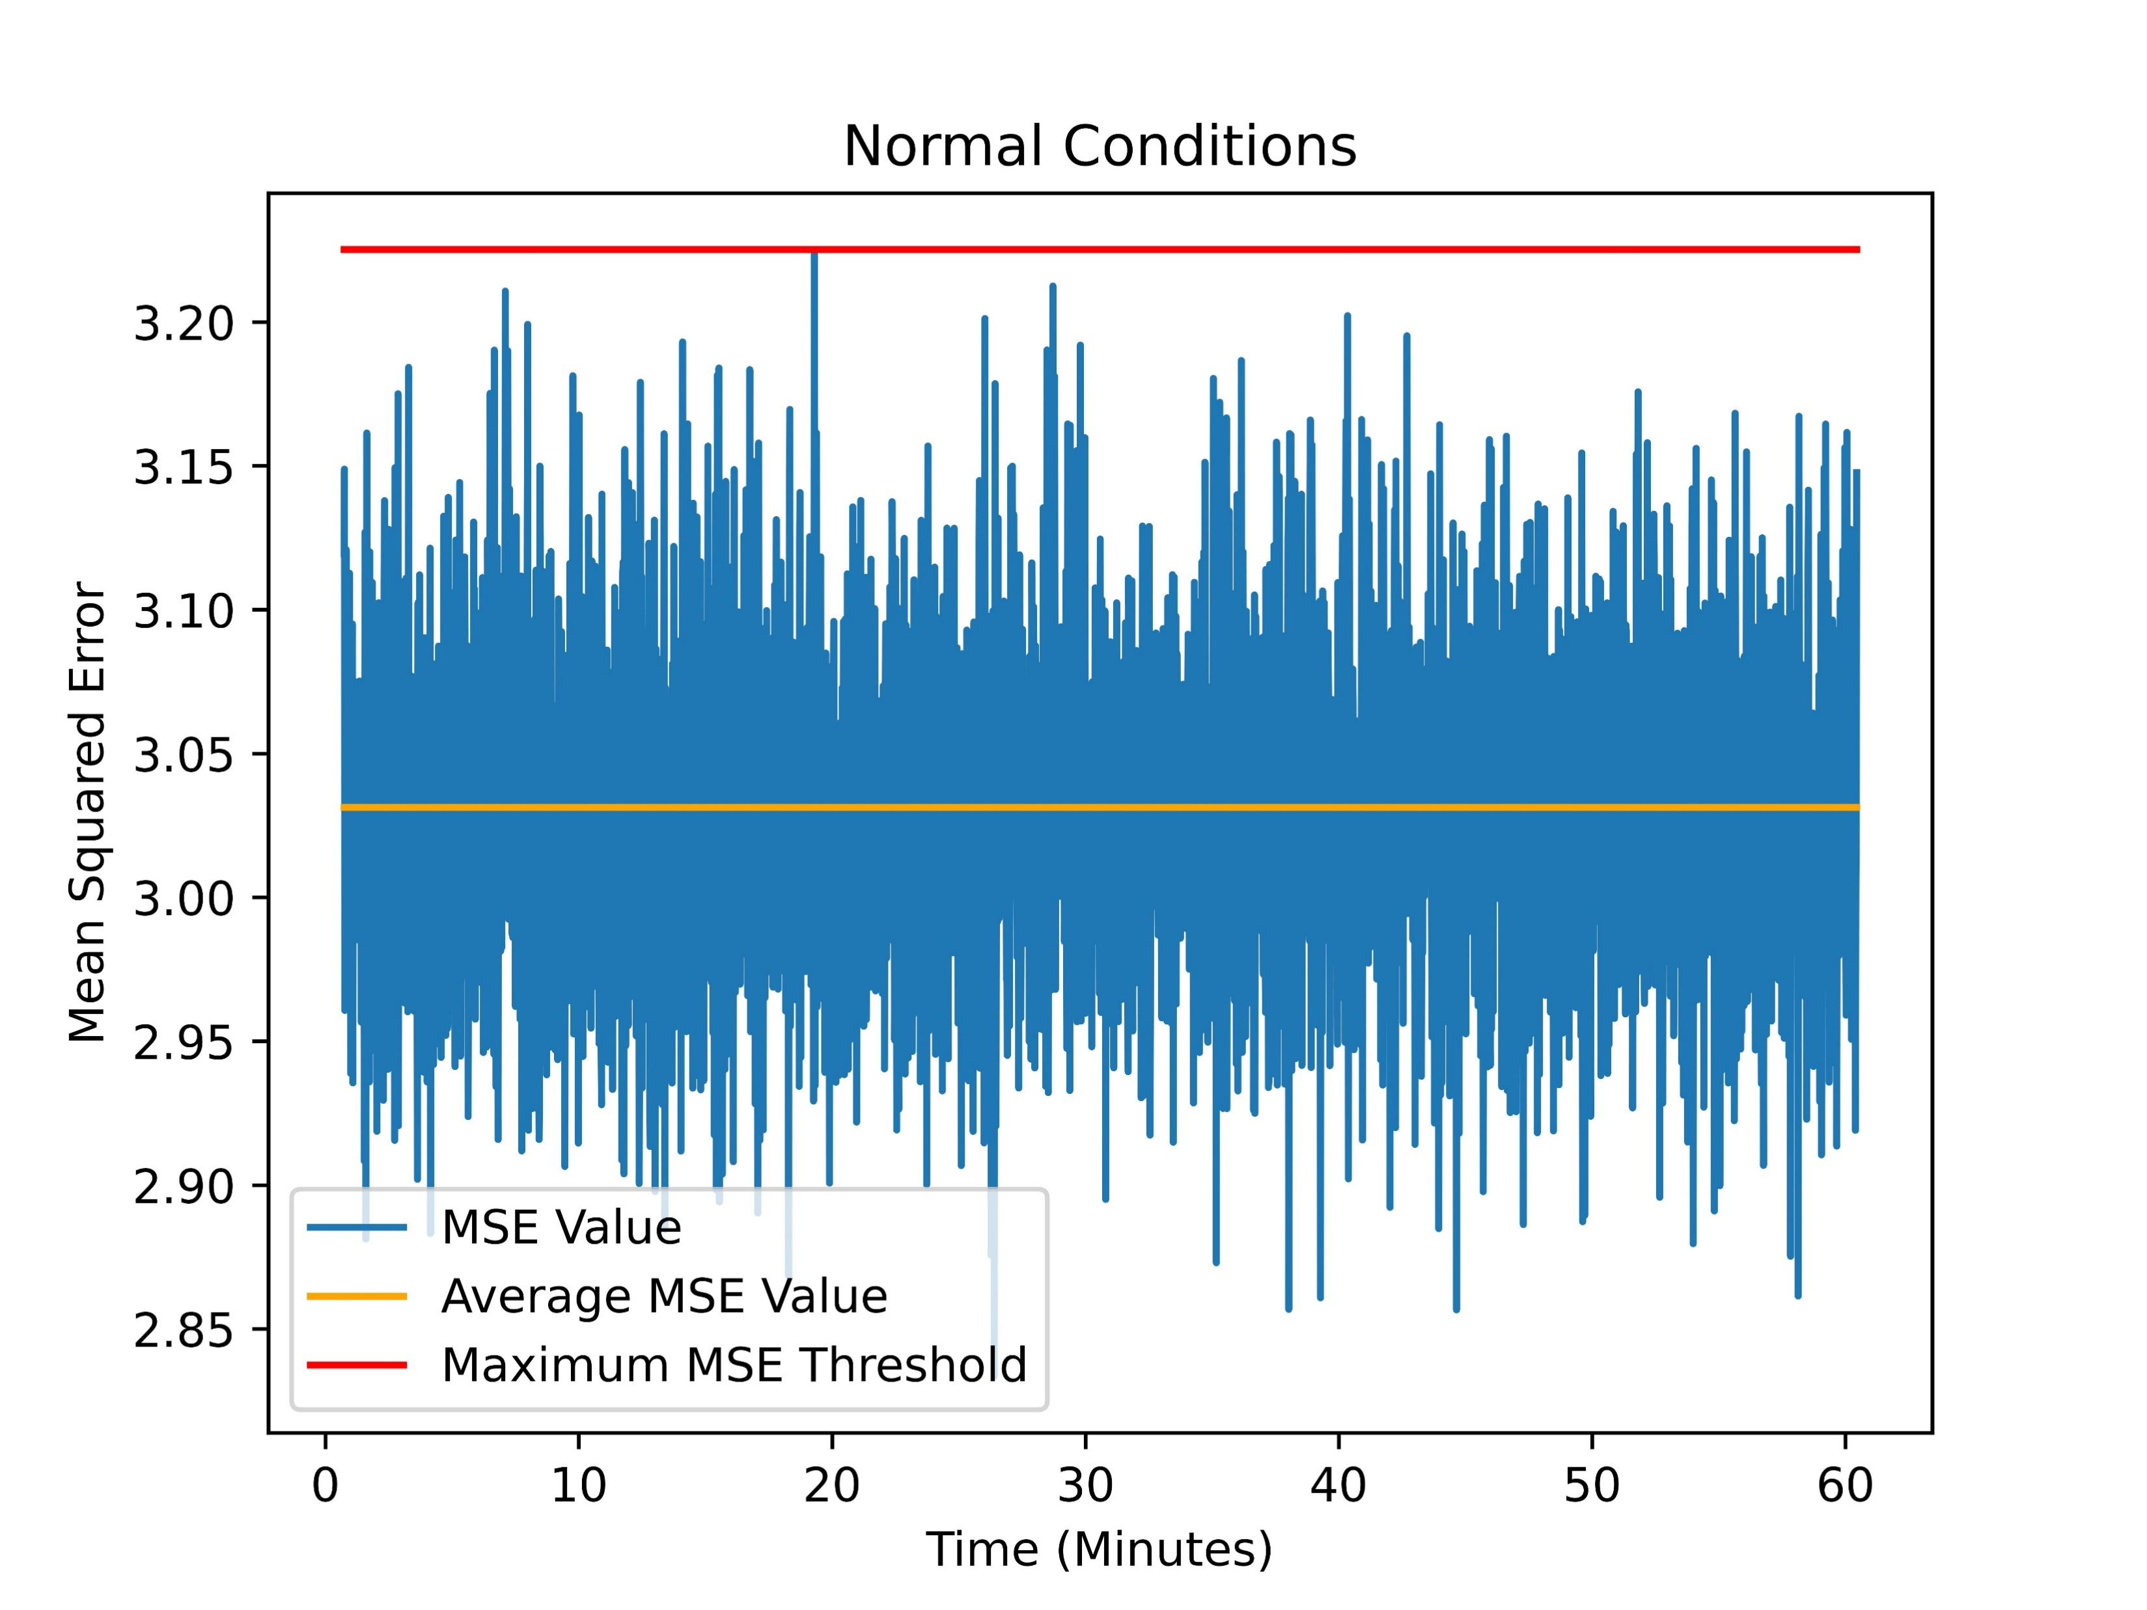
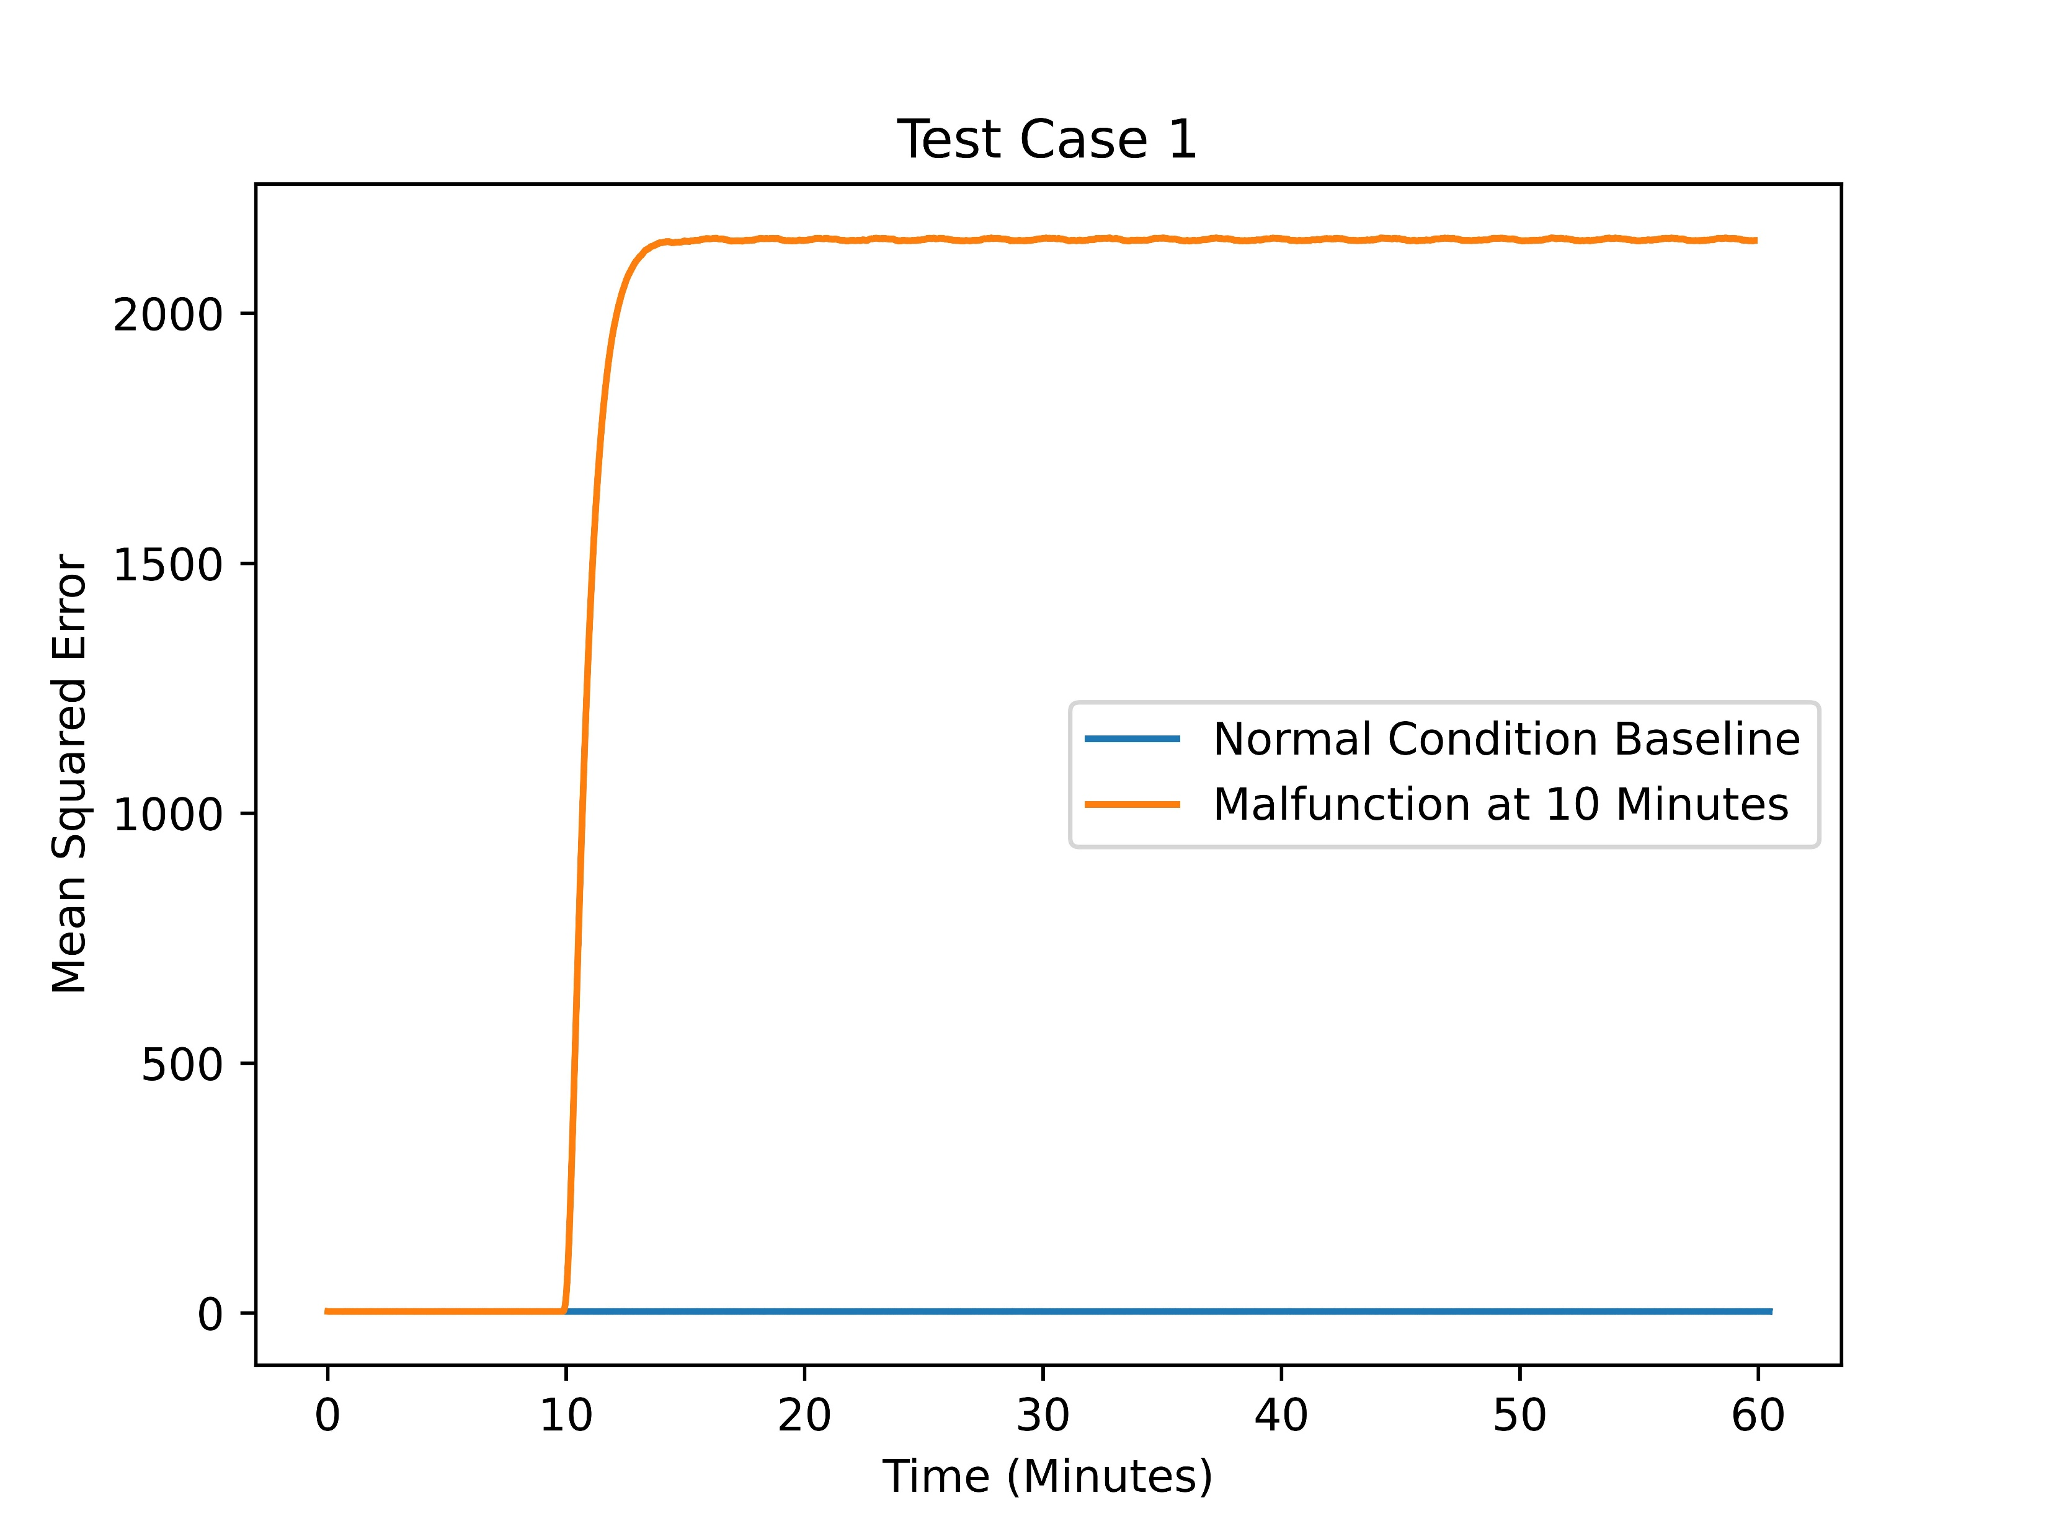
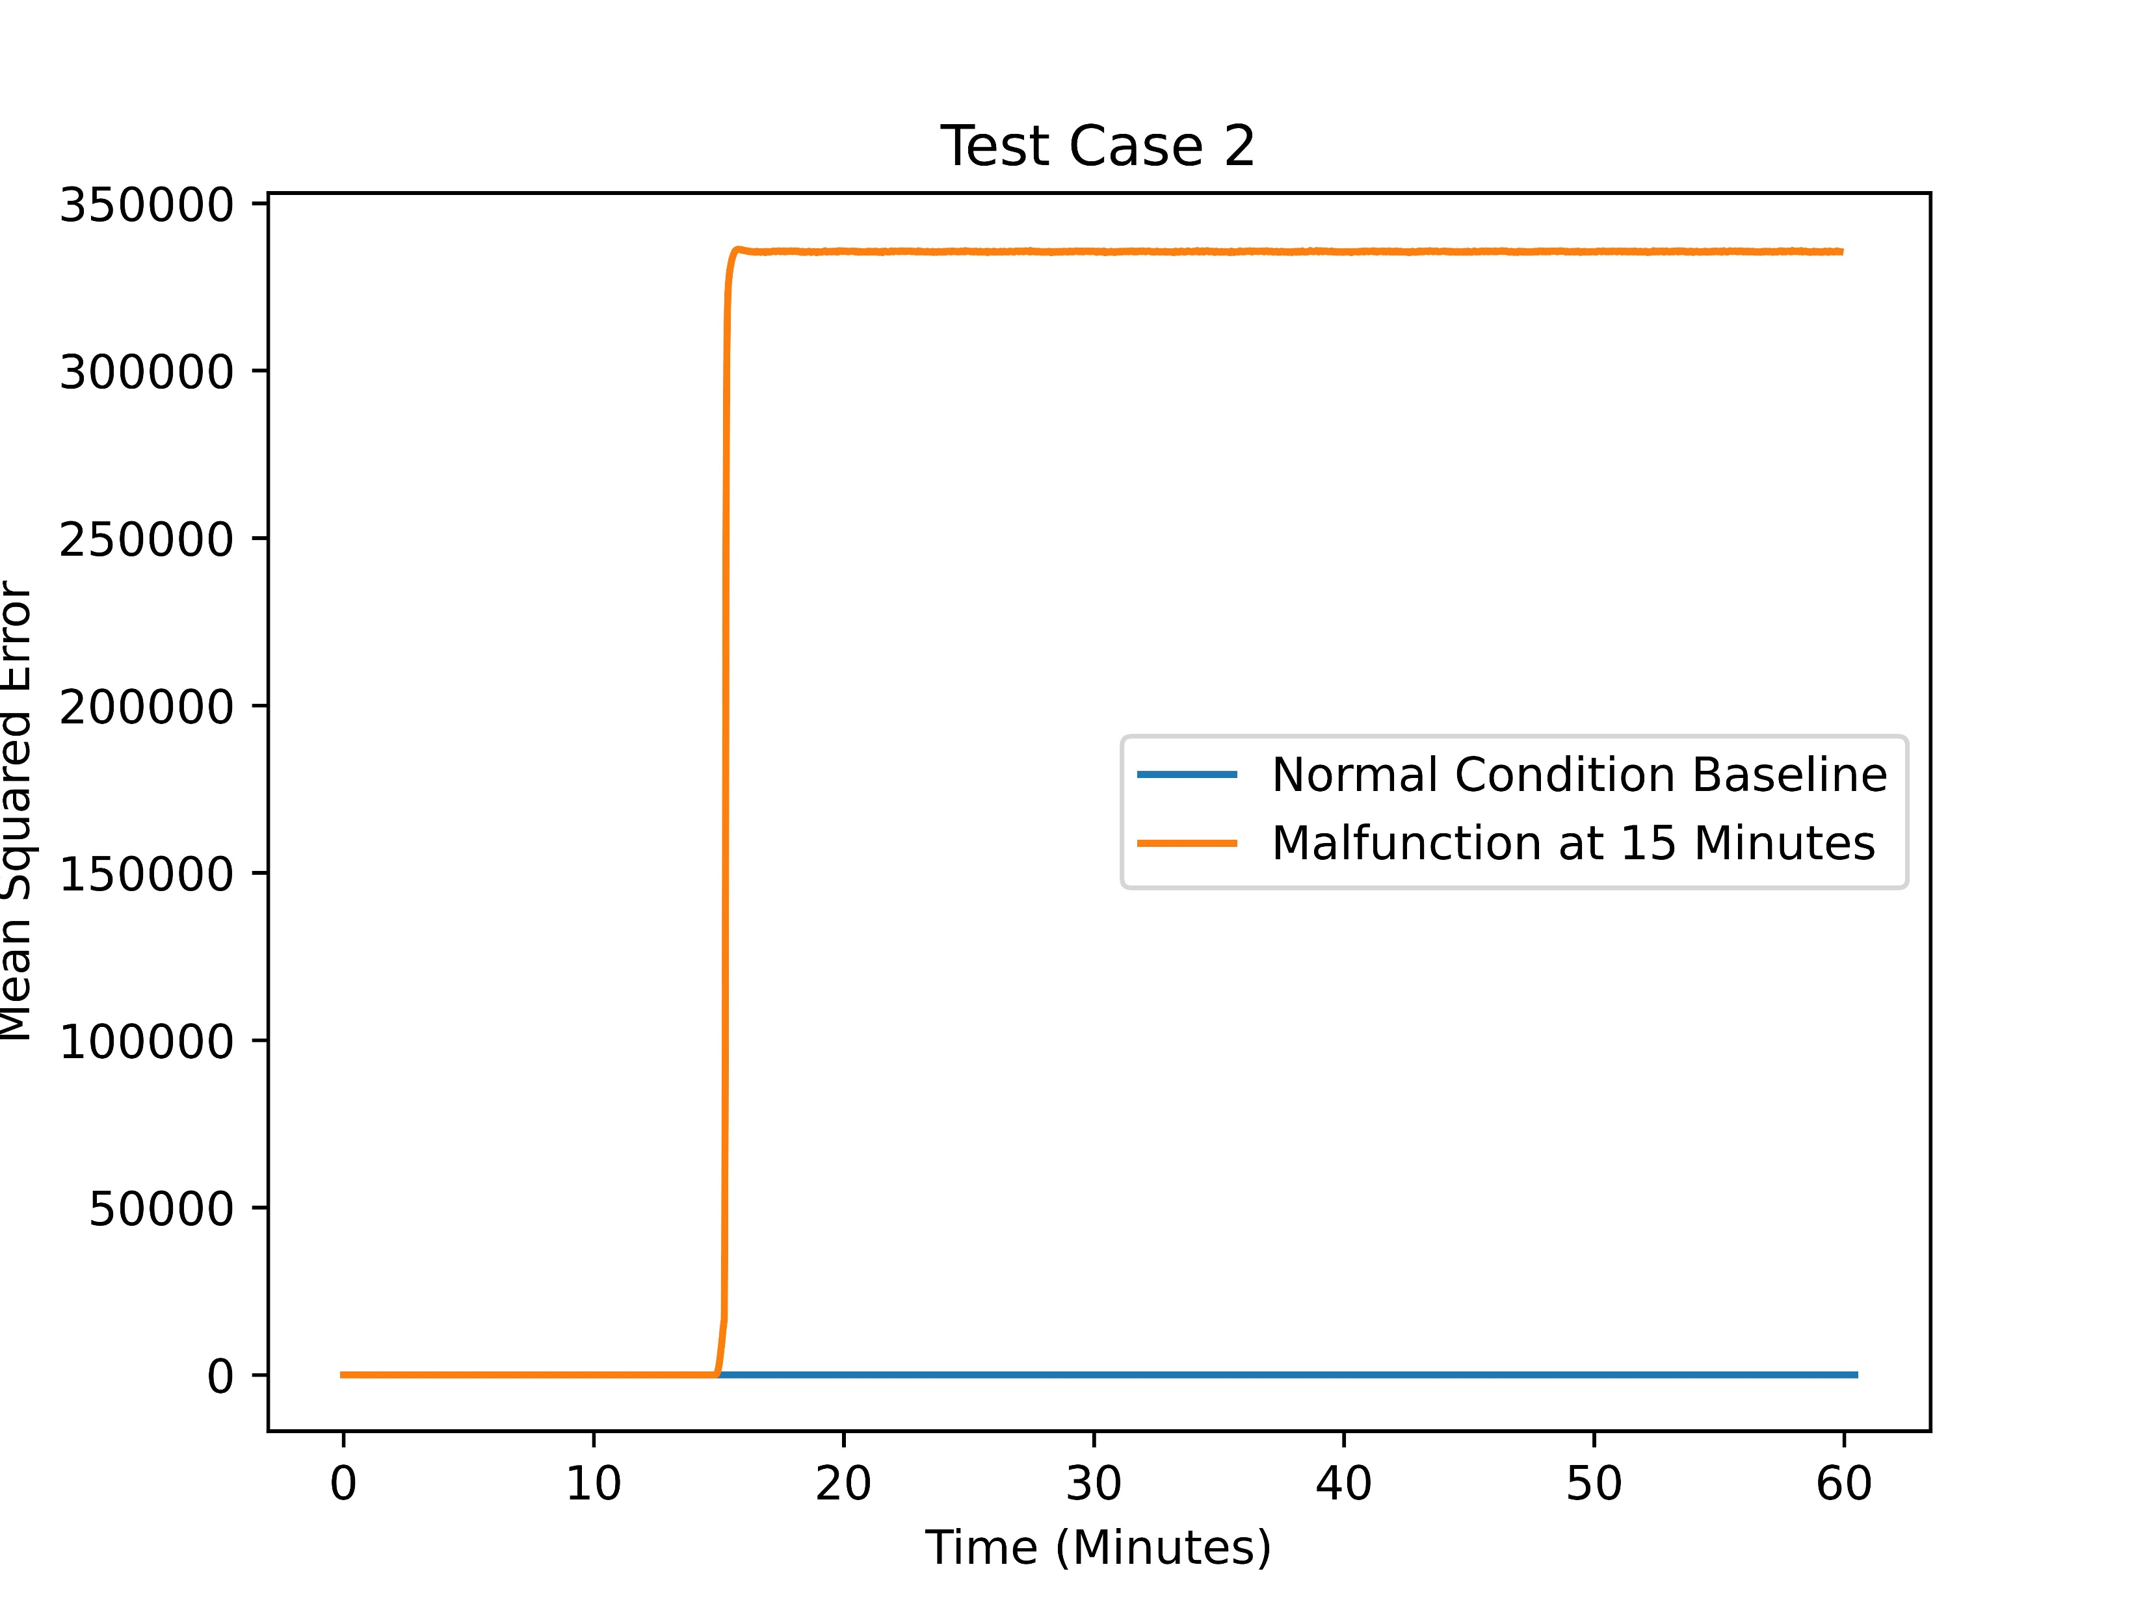
ANOMALY DETECTION CASE STUDY
Identified Inserted Anomalies
Malfunctions Modeled
Recirc Pump A Runaway
Recirc Pump B Runaway
Recirc Pump A Seal #1 Failure
Recirc Pump B Seal #1 Failure
Recirc Pump A Seal #2 Failure
Recirc Pump B Seal #2 Failure
RBCCW Heat Exchanger Tube Leak
Probabilistic Safety Assessment and Management (PSAM) 2023 Topical Conference on Artificial Intelligence (AI) and Risk Analysis, October 23‐25, 2023.
https://www.ideals.illinois.edu/items/128985

Slide 8
CONDITION MONITORING CASE STUDIES
Case studies for condition monitoring of mechanical systems and components
  Reactor coolant pump (RCP)
  Heat Pipe
AI/ML explainability
  Influence of input features to model output
INL/EXT-20-60782
Insights from these case studies will help prepare NRC staff to evaluate applications of condition monitoring to meet IST requirements
INL/EXT-17-43212

Slide 9
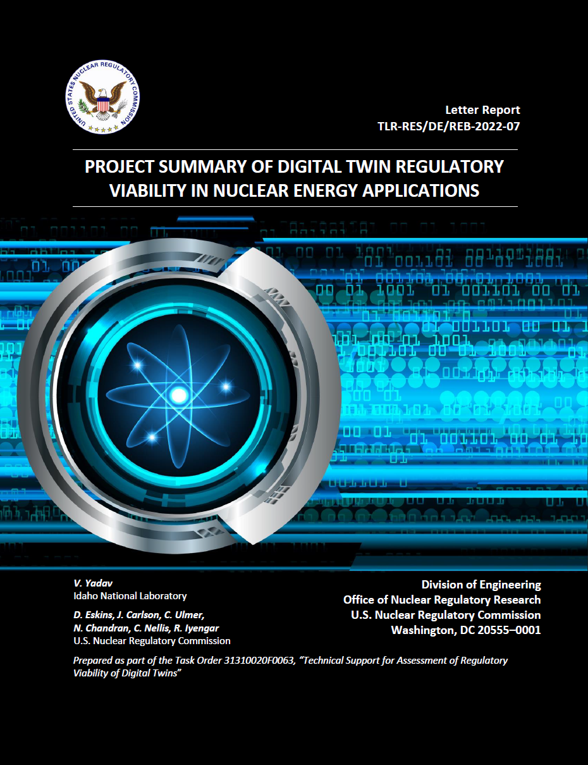
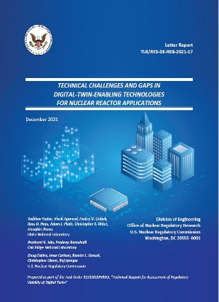
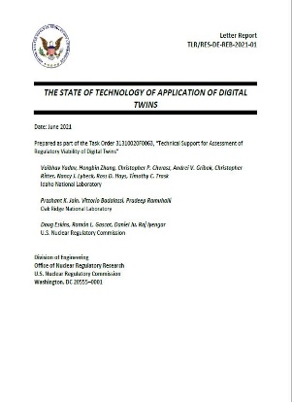
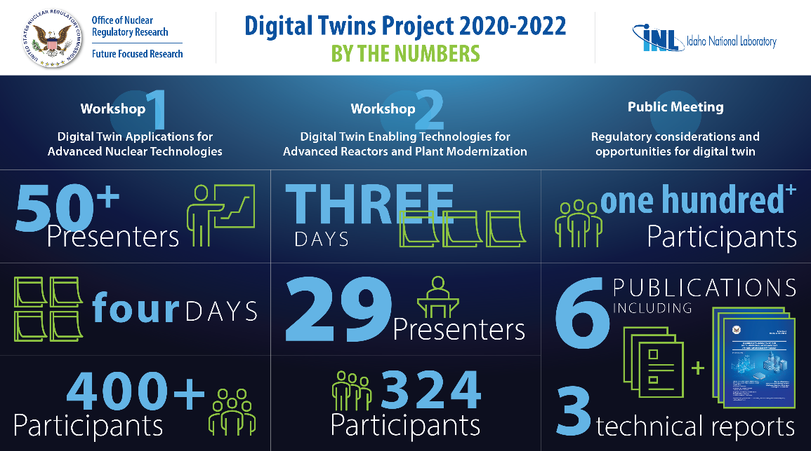
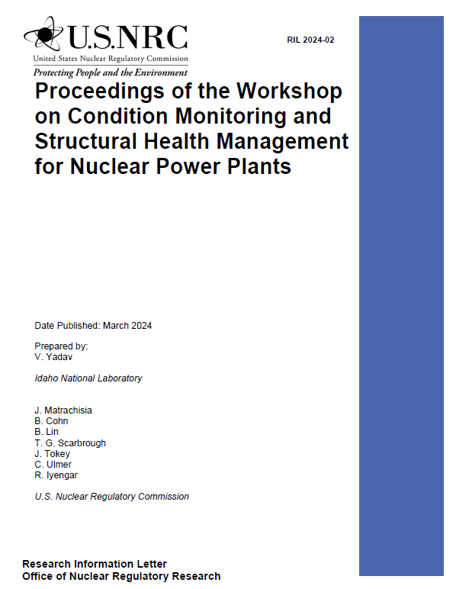
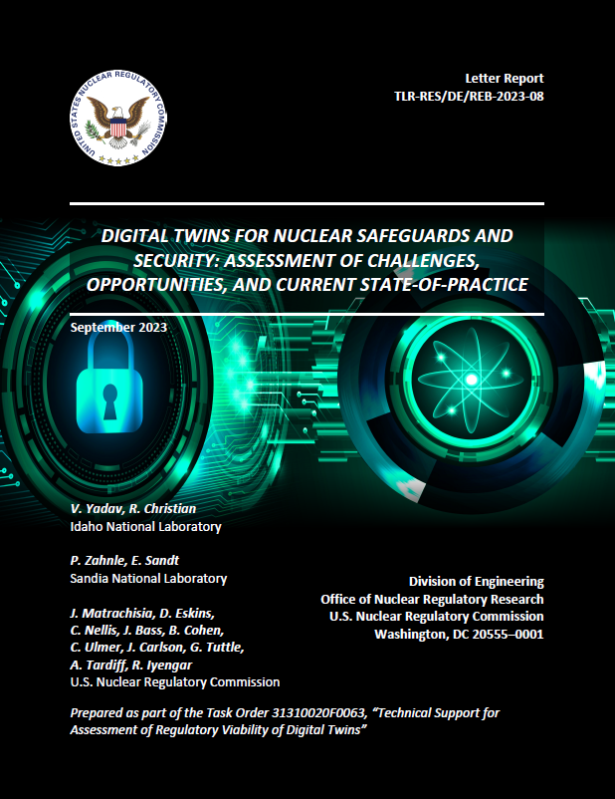
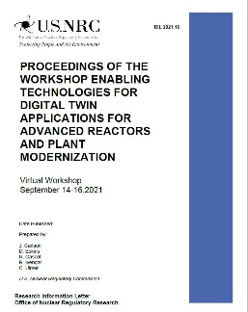
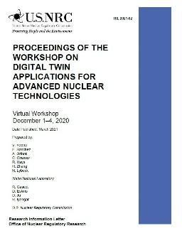
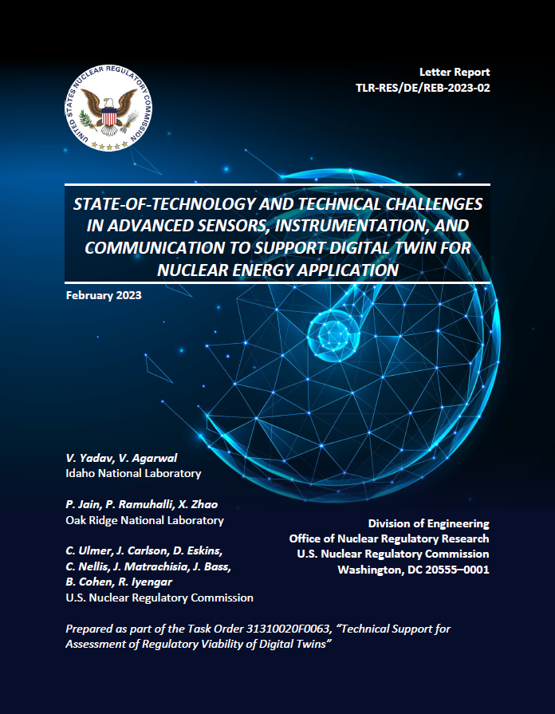
DIGITAL TWINS PROJECT ACCOMPLISHMENTS
Future Focused Research Project
6 Technical Letter Reports
2 Public workshops
Ongoing research
Technical Letter Reports
ML22235A643
ML21361A261
ML21160A074
ML22192A046
ML24065A049
ML23271A055
8
Information Letters
Follow-on Report
6
ML2108A132
ML21348A020
ML23058A085

Slide 10

INNOVATION AT THE NRC
Digital Twins for Condition Monitoring

Slide 11


THANK YOU
https://www.nrc.gov/reactors/power/digital-twins.html

