Slide 2

Aerosol Evolution in a Typical SMR Containment Under Hypothetical Accidental Conditions
S. Anand, Jayant Krishan, Archana V, Manish Joshi, Arshad Khan, M. S. Kulkarni
Bhabha Atomic Research Centre, Mumbai. India

Slide 3
Introduction
Objective:
To analyze the aerosol evolution in a typical Small Modular Reactor (SMR) containment under accident conditions.
The study focuses on aerosol behavior, including deposition processes (gravitational settling, diffusional deposition) and coagulation effects during hypothetical accidents such as Loss-of-Coolant Accidents (LOCA).
Relevance:
SMRs, designed for enhanced safety, still require a thorough understanding of aerosol dynamics during accidents to mitigate potential radiological risks​.
The research aims to improve prediction of aerosol behavior and radioactive source term in nuclear accidents.
The experimental outcomes are utilized for the validation and development of aerosol modules of severe reactor accident codes.

Slide 4
Introduction
SMRs Overview
Small - Capacity up to 300 MW(e)
Modular – Modular construction
Reactor – Nuclear reactor; fission reaction leads to production of energy
Advanced reactors with smaller footprints and modular capabilities
SMR
Advantages: Enhanced safety features, modular scalability, and suitability for diverse energy needs.
Challenges: Aerosol behavior during severe accidents is less well understood, necessitating research on containment dynamics​
  Highlight the importance of containment (last barrier before activity is released to environment) and the source term (including radioactive aerosols)
  Understanding of aerosol behavior in the SMR containment is crucial
  The radioactive aerosols transported to the containment will determine the source term and the associated radiological consequences in public domain

Slide 5
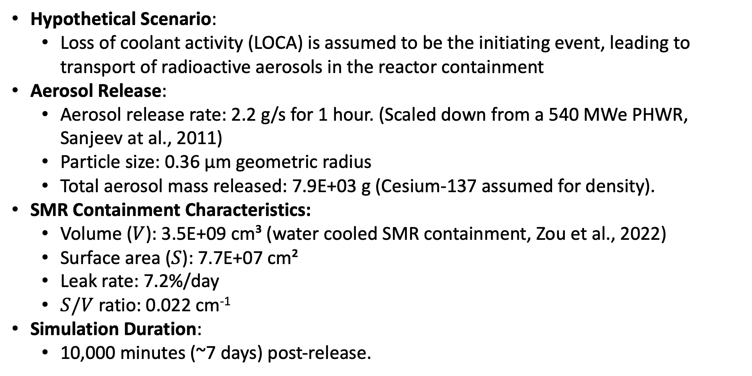
Scenario
Hypothetical Scenario:
  Loss of coolant activity (LOCA) is assumed to be the initiating event, leading to transport of radioactive aerosols in the reactor containment
Aerosol Release:
  Aerosol release rate: 2.2 g/s for 1 hour. (Scaled down from a 540 MWe PHWR, Sanjeev at al., 2011)
  Particle size: 0.36 µm geometric radius
  Total aerosol mass released: 7.9E+03 g (Cesium-137 assumed for density).
SMR Containment Characteristics:
  Volume ($V$): 3.5E+09 cm³ (water cooled SMR containment, Zou et al., 2022)
  Surface area ($S$): 7.7E+07 cm²
  Leak rate: 7.2%/day
  $S/V$ ratio: 0.022 cm⁻¹
Simulation Duration:
  10,000 minutes (~7 days) post-release.

Slide 6
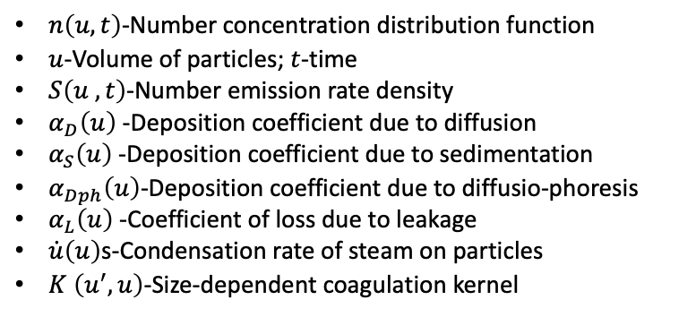
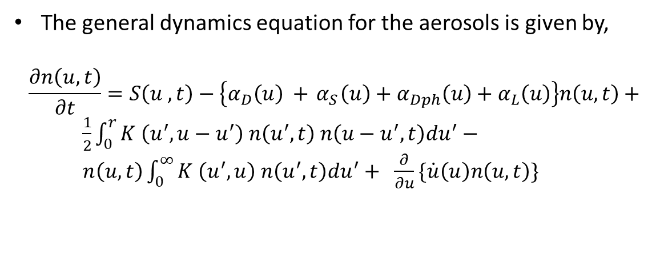
Numerical Simulation Codes
NAUA Code:
A computational tool to simulate aerosol behavior in SMR containment under accident conditions.
Models processes such as coagulation, cond./evap., grav. settling, diffusio-phoresis & diffusional deposition.
Provision to introduce shape factors to account for non-sphericity of aerosol particles.
NAUA uses stand alone list of thermodynamic parameters
NAUA assumes uniform mixing in the containment & includes modifications to incorporate thermophoresis​.
PRABHAVINI Code:
An integral accident analysis code for Design Basis Accidents (DBA) and Beyond Design Basis Accidents (BDBA).
Simulates both vapor & aerosol transport and includes processes like aerosol microphysical processes, & I₂ mass transfer.
PRABHAVINI integrates multiple modules (PARIRODHAN, PARIVAHAN, RASAYAN) to model complex interactions
The general dynamics equation for the aerosols is given by,
$$\frac{∂n\left(u,t\right)}{∂t}=S\left(u ,t\right)−\left\{α_{D}\left(u\right) +{ α}_{S}\left(u\right)+α_{Dph}\left(u\right)+α_{L}\left(u\right)\right\}n\left(u, t\right)+$$
$\frac{1}{2}\int_{0}^{r}{K \left(u^{′},u−u^{′}\right) n\left(u^{′},t\right) n\left(u−u^{′},t\right)du^{′}}−$
$n\left(u,t\right)\int_{0}^{∞}{K \left(u^{′},u\right) n\left(u^{′},t\right)du^{′}}+ \frac{∂}{∂u}\{\dot{u}\left(u\right)n\left(u, t\right)\}$
$n\left(u, t\right)$-Number concentration distribution function
$u$-Volume of particles; $t$-time
$S\left(u ,t\right)$-Number emission rate density
$α_{D}\left(u\right)$-Deposition coefficient due to diffusion
$α_{S}\left(u\right)$-Deposition coefficient due to sedimentation
$α_{Dph}\left(u\right)$-Deposition coefficient due to diffusio-phoresis
$α_{L}\left(u\right)$-Coefficient of loss due to leakage
$\dot{u}\left(u\right)$s-Condensation rate of steam on particles
$K \left(u^{′},u\right)$-Size-dependent coagulation kernel

Slide 7
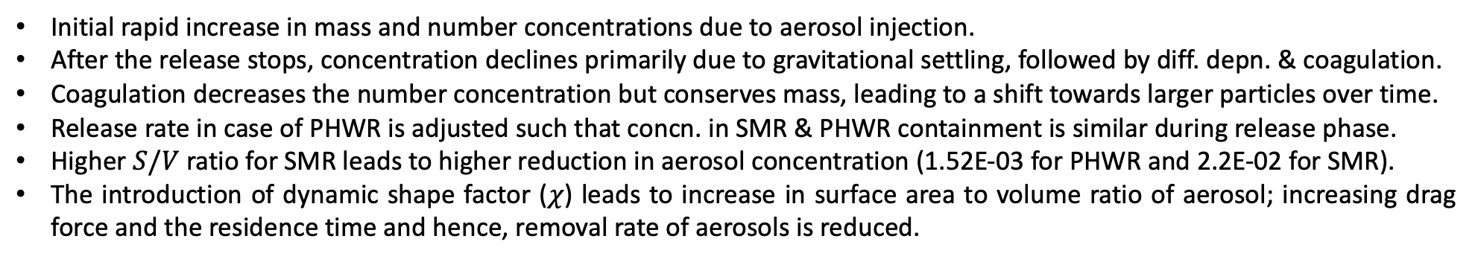
Temporal Evolution of Aerosols
Initial rapid increase in mass and number concentrations due to aerosol injection.
After the release stops, concentration declines primarily due to gravitational settling, followed by diff. depn. & coagulation.
Coagulation decreases the number concentration but conserves mass, leading to a shift towards larger particles over time.​
Release rate in case of PHWR is adjusted such that concn. in SMR & PHWR containment is similar during release phase.
Higher $S/V$ratio for SMR leads to higher reduction in aerosol concentration (1.52E-03 for PHWR and 2.2E-02 for SMR).
The introduction of dynamic shape factor ($χ$) leads to increase in surface area to volume ratio of aerosol; increasing drag force and the residence time and hence, removal rate of aerosols is reduced.

Slide 8
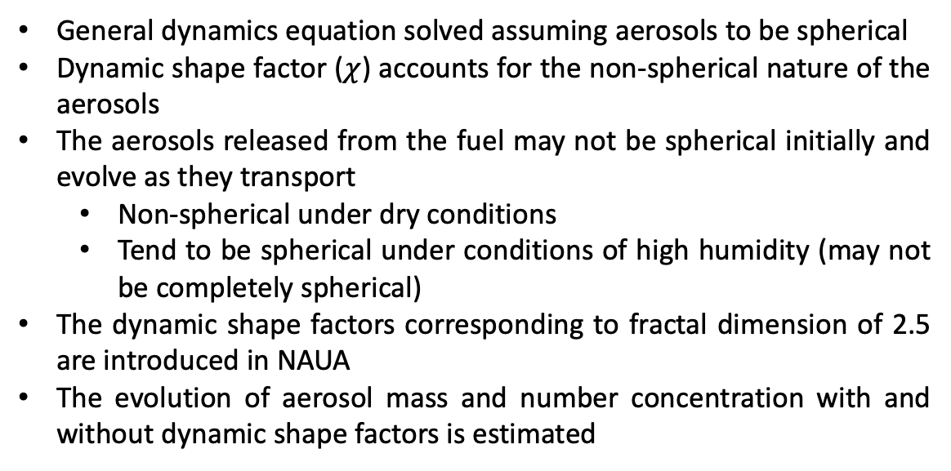
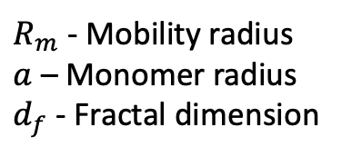
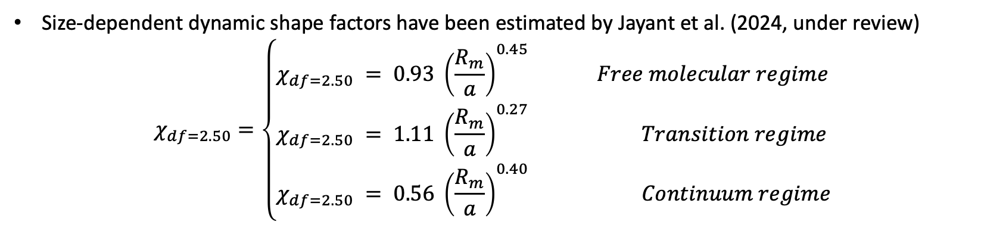
Aerosol Shape and Dynamics
General dynamics equation solved assuming aerosols to be spherical
Dynamic shape factor ($χ$) accounts for the non-spherical nature of the aerosols
The aerosols released from the fuel may not be spherical initially and evolve as they transport
  Non-spherical under dry conditions
  Tend to be spherical under conditions of high humidity (may not be completely spherical)
The dynamic shape factors corresponding to fractal dimension of 2.5 are introduced in NAUA
The evolution of aerosol mass and number concentration with and without dynamic shape factors is estimated
Size-dependent dynamic shape factors have been estimated by Jayant et al. (2024, under review)
$$χ_{df=2.50}=\left\{\begin{aligned}&χ_{df=2.50} = 0.93 {\left(\frac{R_{m}}{a}\right)}^{0.45} Free molecular regime \\ &χ_{df=2.50} = 1.11 {\left(\frac{R_{m}}{a}\right)}^{0.27} Transition regime \\ &χ_{df=2.50} = 0.56 {\left(\frac{R_{m}}{a}\right)}^{0.40} Continuum regime\end{aligned}\right.$$
$R_{m}$ - Mobility radius
$a$ – Monomer radius
$d_{f}$ - Fractal dimension

Slide 9
Decontamination factor due to deposition
Decontamination factor is defined as the ratio of aerosol mass concentration at initial time to aerosol mass concentration at any time
Removal due to gravity dominates the removal process

Slide 10
Comparison of NAUA and PRABHAVINI Results
Observations:
Both NAUA and PRABHAVINI codes produce similar aerosol concentration profiles during the injection phase.
Removal due to Gravity, Diffusion, Diffusio-phoresis & Leakages
Differences arise in the removal phase due to NAUA’s standalone approach versus PRABHAVINI’s coupled boundary condition handling (​thermodynamic conditions)
Conclusion:
NAUA’s simplified model shows good agreement with the more complex PRABHAVINI code but lacks some thermodynamic detail

Slide 11
Coupled fluid-particle dynamics (CFPD)
NAUA and PRABHAVINI give insight of evolution of aerosol metrics but assume uniform distribution of the aerosol concentration in the given volume.
Due to complex boundary conditions during such an accident scenario, thermal gradients may lead to spatial heterogeneity in containment environments and hence stratification of aerosol concentration profile (Sapra et al., 2008).
CFPD based tools are required in order to capture such inhomogeneity and improve the prediction of aerosol behavior (Kelm et al., 2021*; EPRI reports, 2018, 2021**).
The simulation for chamber at NATF is carried out using Aerosolved (v 2.0, CFPD code, Lucci et al., 2022) based on open-source library, OpenFOAM.
*containmentFOAM; **iPWR;

Slide 12
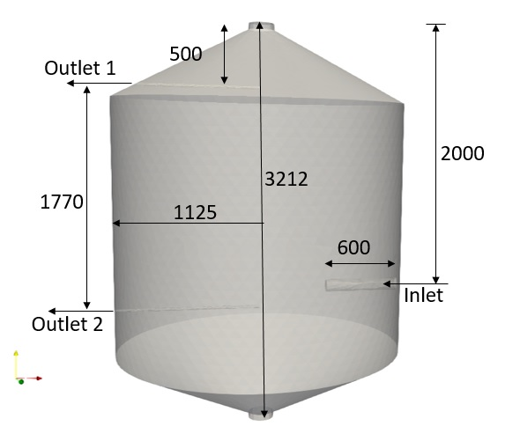
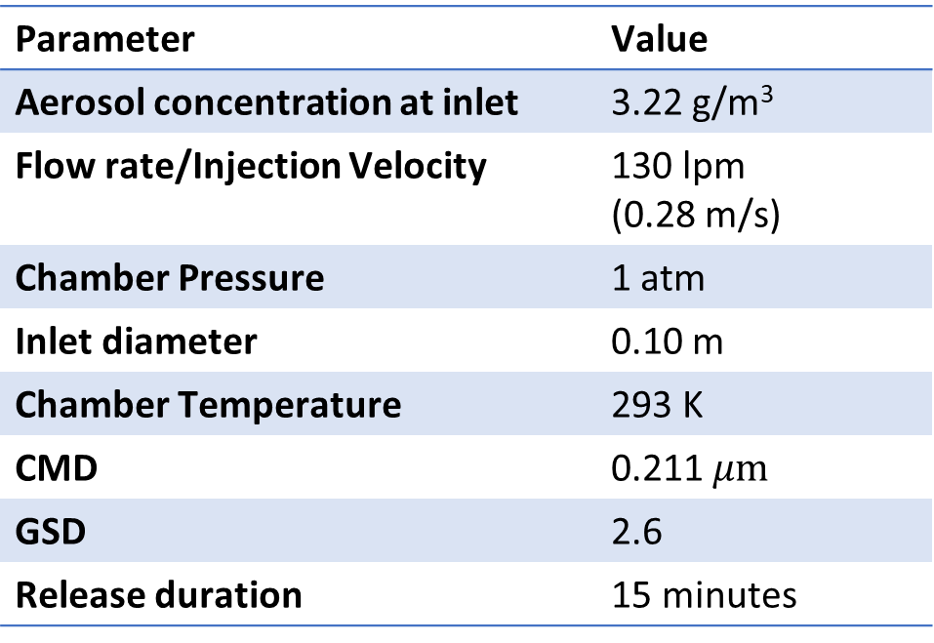
Input parameters/conditions – CFPD code
Parameter | Value
Aerosol concentration at inlet | 3.22 g/m³
Flow rate/Injection Velocity | 130 lpm (0.28 m/s)
Chamber Pressure | 1 atm
Inlet diameter | 0.10 m
Chamber Temperature | 293 K
CMD | 0.211 $μm$
GSD | 2.6
Release duration | 15 minutes
All dimensions are in mm
Parameter | Value
Nodes | 322559
Cells (Tetrahedra) | 233092
Max non-orthogonality | 66.4349
Max skewness | 0.786171
Process Activated:
Condensation
Coagulation
Wall deposition (gravity, diffusion)
Computation time:
220 h for 1000 min of simulation run on 600 processors

Slide 13
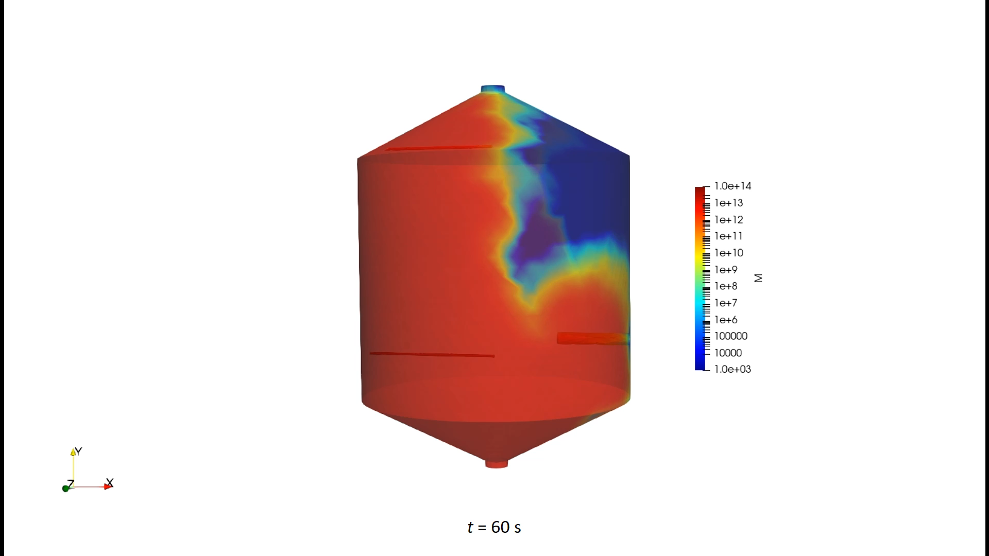
CFPD results
M represents the total aerosol number concentration (#/m³)

Slide 14
Comparison of CFPD results with experiments and NAUA results
Depletion profile of aerosol mass concentration is captured by CFPD code
The predicted rate of reduction of the concentration is higher as compared to the experimental observations
The difference in the results may be due to
  Uncertainties in the aerosol release parameters
  Assumption of spherical shape of aerosols against non-spherical
In order to mimic the experimental inputs, the solver is modified further to include the expressions for the size dependent dynamic shape factor
  The simulations are being carried out

Slide 15
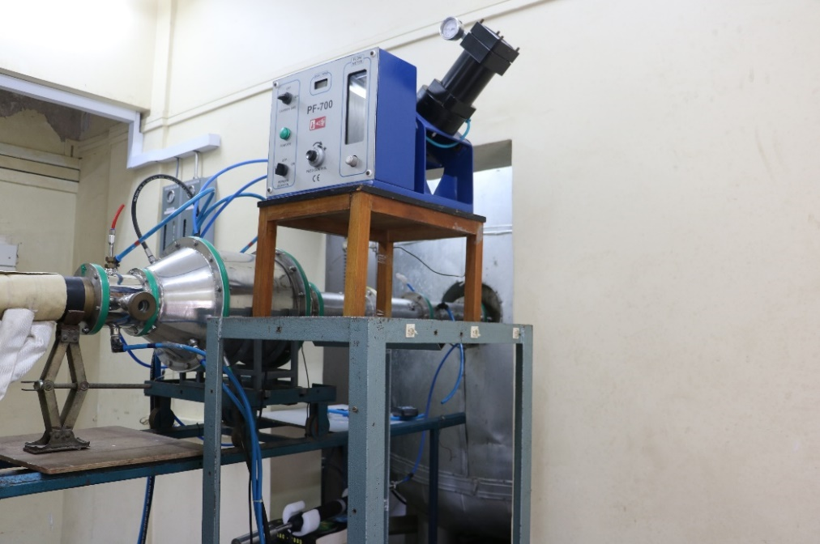
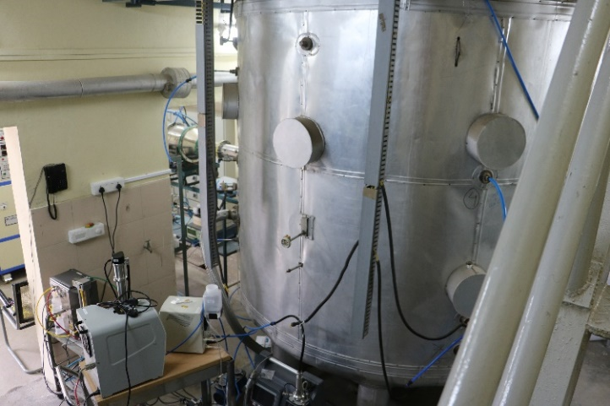
Experimental Results – Relevance to SMR Conditions - 1
Cylindrical Chamber (10 m³)
Powder Feeder
Inlet Plenum
Aerosol Instruments
Inlet Plenum
Cylindrical Chamber (10 m³)
PTAG

Slide 16
Experimental Results – Relevance to SMR Conditions - 2
Key Findings:
  Measured aerosol number concentrations in the facility were in the range of 10⁶–10⁷ particles/cm³, with a significant fraction of ultrafine particles (<100 nm).
  These measurements confirm the facility's suitability for SMR-scale simulations​.
Particle Shape Observations:
  Microscopy images show non-spherical particles, emphasizing the need for shape factor corrections in simulations​.

Slide 17
Conclusion
Key Insights:
Gravitational settling is the predominant aerosol removal mechanism.
Coagulation & condensation influence particle size distribution, leading to faster removal of larger particles.
Dynamic shape factors and more realistic input conditions (particle size, density, shape) significantly improve the predictive capabilities of aerosol models​.
Implications:
Results contribute to better accident analysis and containment design​
The findings shed light on crucial aspects of aerosol behavior, including particle size distribution, agglomeration dynamics, and spatial dispersion patterns.
Insights gained from this investigation can inform the design & implementation of safety protocols, emergency response strategies, and containment systems optimization for SMRs, ultimately contributing to the advancement of nuclear safety engineering.
Future Research Directions (Areas for Improvement):
Extend the study to more complex accident scenarios (e.g., steam generator tube rupture).
Explore the potential of machine learning to improve prediction capabilities and model optimization​

Slide 18
Thank you for the attention..
S. Anand,
Head, Radiation Safety & Environmental Safety Section,
Health Physics Division
Bhabha Atomic Research Centre, Mumbai. India.
E-mail: sanand@barc.gov.in

Slide 19
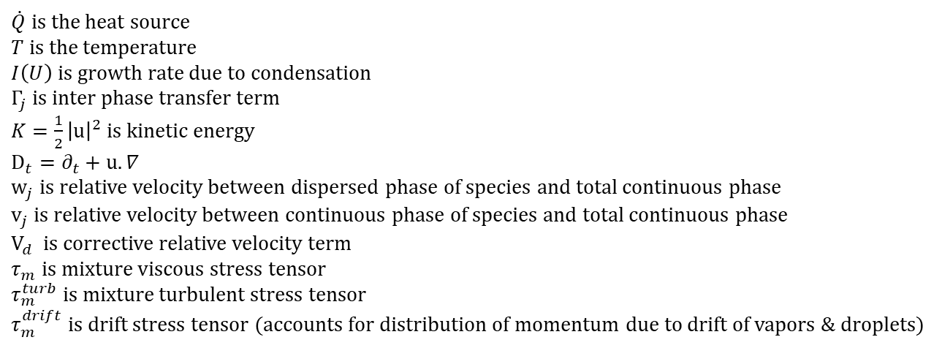
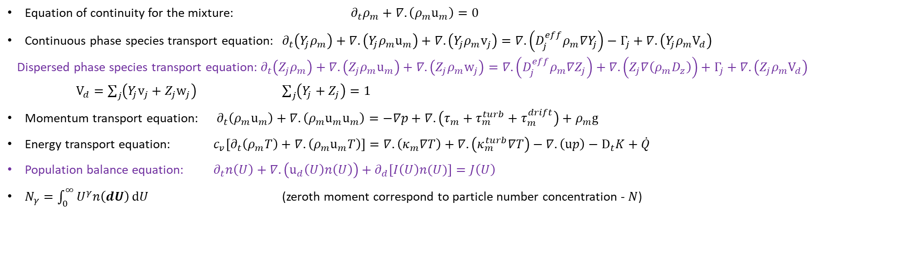
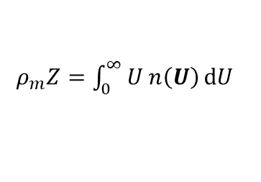
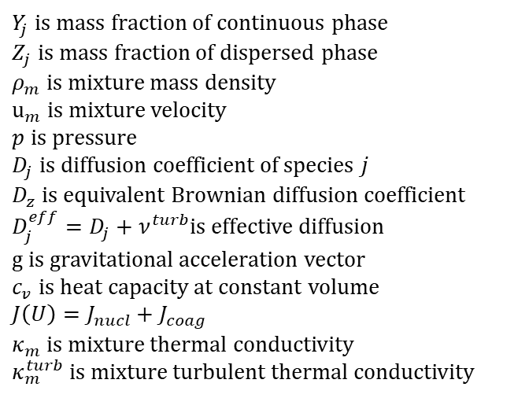
Governing Equations - CFPD
Equation of continuity for the mixture: $∂_{t}ρ_{m}+∇.\left(ρ_{m}u_{m}\right)=0$
Continuous phase species transport equation: $∂_{t}\left(Y_{j}ρ_{m}\right)+∇.\left(Y_{j}ρ_{m}u_{m}\right)+∇.\left(Y_{j}ρ_{m}v_{j}\right)=∇.\left(D_{j}^{eff}ρ_{m}{∇Y}_{j}\right)−Γ_{j}+∇.\left(Y_{j}ρ_{m}V_{d}\right)$
  Dispersed phase species transport equation: $∂_{t}\left(Z_{j}ρ_{m}\right)+∇.\left(Z_{j}ρ_{m}u_{m}\right)+∇.\left(Z_{j}ρ_{m}w_{j}\right)=∇.\left(D_{j}^{eff}ρ_{m}{∇Z}_{j}\right)+∇.\left(Z_{j}∇\left(ρ_{m}D_{z}\right)\right)+Γ_{j}+∇.\left(Z_{j}ρ_{m}V_{d}\right)$
  $V_{d}=\sum_{j}{\left(Y_{j}v_{j}+Z_{j}w_{j}\right)}$ $\sum_{j}{\left(Y_{j}+Z_{j}\right)}=1$
Momentum transport equation: $∂_{t}\left(ρ_{m}u_{m}\right)+∇.\left(ρ_{m}u_{m}u_{m}\right)=−∇p+∇.\left(τ_{m}+τ_{m}^{turb}+τ_{m}^{drift}\right)+ρ_{m}g$
Energy transport equation: $c_{v}\left[∂_{t}\left(ρ_{m}T\right)+∇.\left(ρ_{m}u_{m}T\right)\right]=∇.\left(κ_{m}∇T\right)+∇.\left(κ_{m}^{turb}∇T\right)−∇.\left(up\right)−D_{t}K+\dot{Q}$
Population balance equation: $∂_{t}n\left(U\right)+∇.\left(u_{d}\left(U\right)n\left(U\right)\right)+∂_{d}\left[I\left(U\right)n(U)\right]=J\left(U\right)$
$N_{γ}=\int_{0}^{∞}{U^{γ}n\left(dU\right)}dU$ (zeroth moment correspond to particle number concentration - $N$)
$ρ_{m}Z=\int_{0}^{∞}{U n\left(U\right)}dU$
$Y_{j}$ is mass fraction of continuous phase
$Z_{j}$ is mass fraction of dispersed phase
$ρ_{m}$ is mixture mass density
$u_{m}$ is mixture velocity
$p$ is pressure
$D_{j}$ is diffusion coefficient of species $j$
$D_{z}$ is equivalent Brownian diffusion coefficient
$D_{j}^{eff}=D_{j}+ν^{turb}$is effective diffusion
$g$ is gravitational acceleration vector
$c_{v}$ is heat capacity at constant volume
$J\left(U\right)=J_{nucl}+J_{coag}$
$κ_{m}$ is mixture thermal conductivity
$κ_{m}^{turb}$ is mixture turbulent thermal conductivity
$\dot{Q}$ is the heat source
$T$ is the temperature
$I\left(U\right)$ is growth rate due to condensation
$Γ_{j}$ is inter phase transfer term
$K=\frac{1}{2}{\left|u\right|}^{2}$is kinetic energy
$D_{t}=∂_{t}+u.∇$
$w_{j}$ is relative velocity between dispersed phase of species and total continuous phase
$v_{j}$ is relative velocity between continuous phase of species and total continuous phase
$V_{d}$ is corrective relative velocity term
$τ_{m}$ is mixture viscous stress tensor
$τ_{m}^{turb}$ is mixture turbulent stress tensor
$τ_{m}^{drift}$ is drift stress tensor (accounts for distribution of momentum due to drift of vapors & droplets)

Slide 20
Dynamic Shape Factor for Aggregate with Fractal Dimension 1.8
Variation of shape factor as a function of particle radius

Slide 21
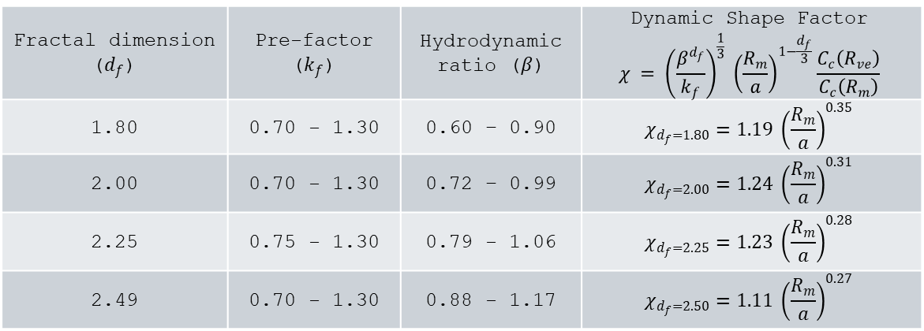
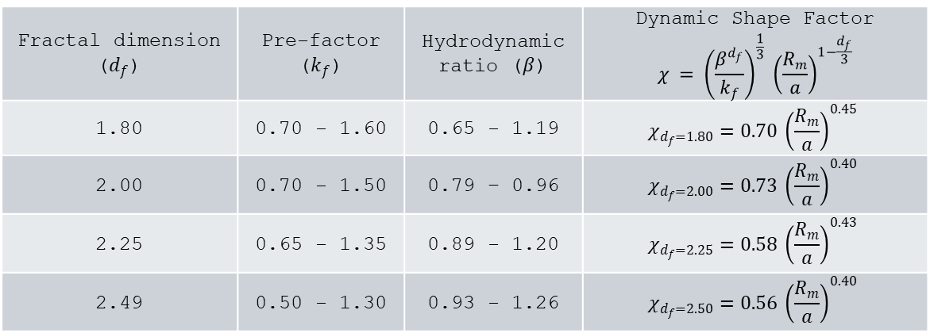
Expressions for dynamic shape factors
Shape factors for different d_{f}
Fractal dimension ($d_{f}$) | Pre-factor ($k_{f}$) | Hydrodynamic ratio ($β$) | Dynamic Shape Factor $${χ = \left(\frac{β^{d_{f}}}{k_{f}}\right)}^{\frac{1}{3}} {\left(\frac{R_{m}}{a}\right)}^{1−\frac{d_{f}}{3}}$$
1.80 | 0.70 - 1.60 | 0.65 - 1.19 | $$χ_{d_{f}=1.80}=0.70 {\left(\frac{R_{m}}{a}\right)}^{0.45}$$
2.00 | 0.70 - 1.50 | 0.79 – 0.96 | $$χ_{d_{f}=2.00}=0.73 {\left(\frac{R_{m}}{a}\right)}^{0.40}$$
2.25 | 0.65 - 1.35 | 0.89 - 1.20 | $$χ_{d_{f}=2.25}=0.58 {\left(\frac{R_{m}}{a}\right)}^{0.43}$$
2.49 | 0.50 - 1.30 | 0.93 - 1.26 | $$χ_{d_{f}=2.50}=0.56 {\left(\frac{R_{m}}{a}\right)}^{0.40}$$
Continuum regime
Fractal dimension ($d_{f}$) | Pre-factor ($k_{f}$) | Hydrodynamic ratio ($β$) | Dynamic Shape Factor $${χ = \left(\frac{β^{d_{f}}}{k_{f}}\right)}^{\frac{1}{3}} {\left(\frac{R_{m}}{a}\right)}^{1−\frac{d_{f}}{3}}\frac{C_{c}\left(R_{ve}\right)}{C_{c}\left(R_{m}\right)}$$
1.80 | 0.70 - 1.30 | 0.60 – 0.90 | $$χ_{d_{f}=1.80}=1.19 {\left(\frac{R_{m}}{a}\right)}^{0.35}$$
2.00 | 0.70 - 1.30 | 0.72 – 0.99 | $$χ_{d_{f}=2.00}=1.24 {\left(\frac{R_{m}}{a}\right)}^{0.31}$$
2.25 | 0.75 - 1.30 | 0.79 - 1.06 | $$χ_{d_{f}=2.25}=1.23 {\left(\frac{R_{m}}{a}\right)}^{0.28}$$
2.49 | 0.70 - 1.30 | 0.88 - 1.17 | $$χ_{d_{f}=2.50}=1.11 {\left(\frac{R_{m}}{a}\right)}^{0.27}$$
Transition regime

Slide 22
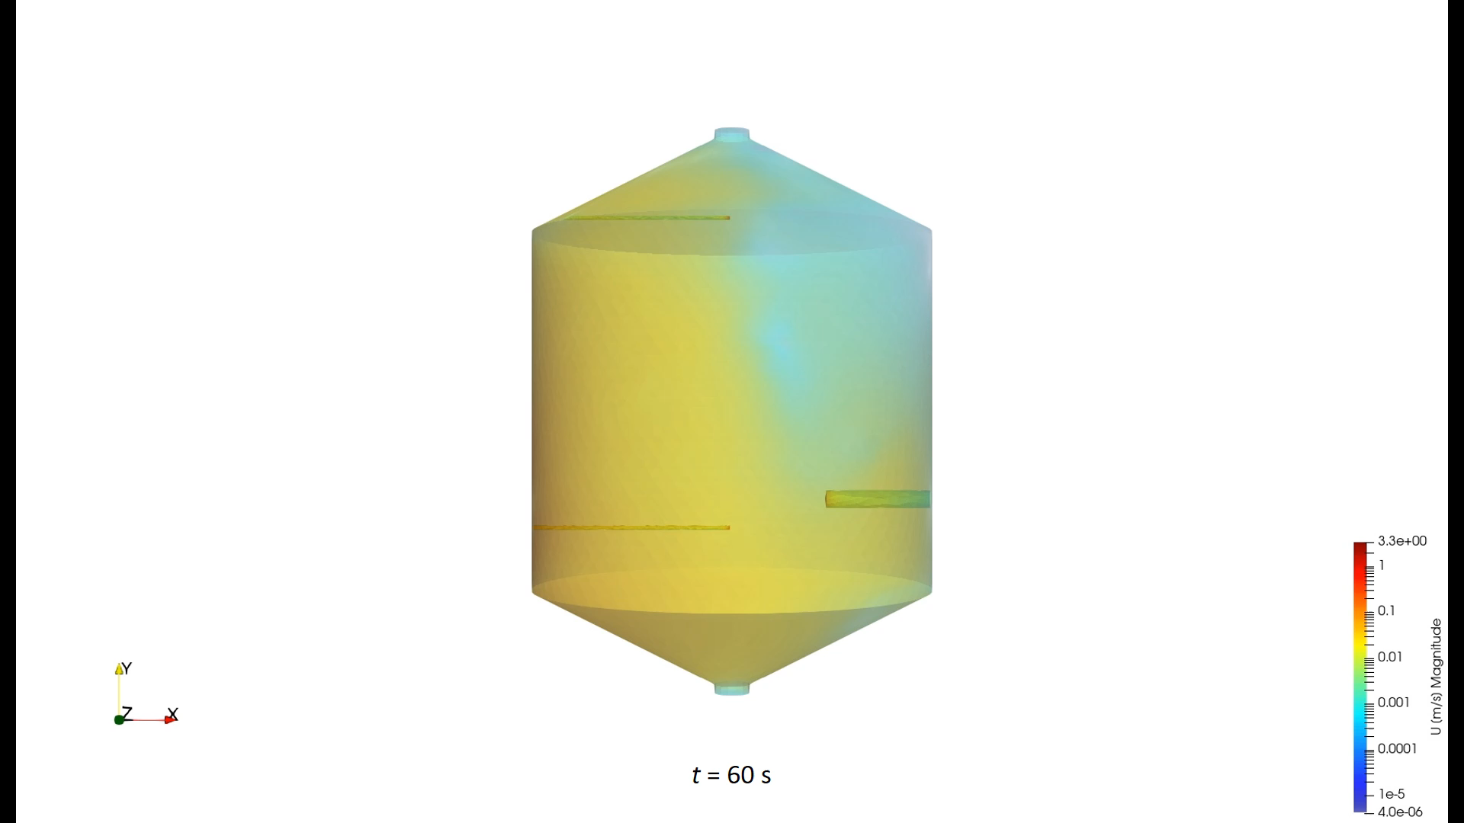
Temporal variation of velocity component

