Slide 2

Context of single failure criterion (SFC) application for small modular reactors (SMR)
Ivica BAŠIĆ, Ivan VRBANIĆ
APoSS d.o.o.Zabok, Croatia
https://aposs.hr/
Email: basic.ivica@kr.t-com.hr, ivan.vrbanic@zg.t-com.hr

Slide 3
Single Failure Criterion and SMR
Similar definition of SFC through various regulatory framework (IAEA, USA NRC, WENRA, EUR, national regulation,...)
IAEA SSR-2/1 rev.1:
  The single failure is a failure that results in the loss of capability of a system or component to perform its intended safety function(s) and any consequential failure(s) that result from it.
5.39. Spurious action shall be considered to be one mode of failure when applying the concept to a safety group or safety system.
5.40. The design shall take due account of the failure of a passive component, unless it has been justified in the single failure analysis with a high level of confidence that a failure of that component is very unlikely and that its function would remain unaffected by the postulated initiating event.
3

Slide 4
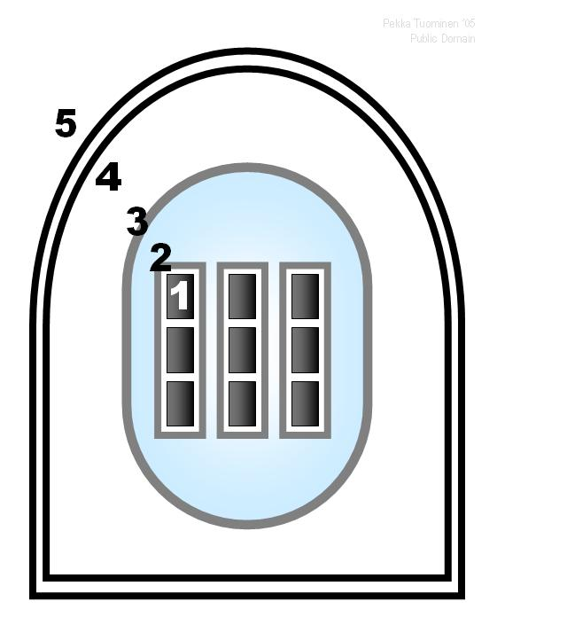
Safety Demonstration – Single Failure
Safety Limits and Limiting Conditions for Operation
    Peak cladding temperature (PCT)
    Departure of nucleate boiling (DNB)
    Negative Reactivity Coefficient
    Primary and secondary pressures
    Hydrogen production
Adequate Safety Margins
Safety Functions
    Reactor Trip
    Decay Heat Removal
    Subcriticality
Single Failure Criteria
    Redundancy
    Diversity
    Reliability
Human-Machine Interface
    Procedure
    Training (simulators)
DiD demonstration required
4

Slide 5
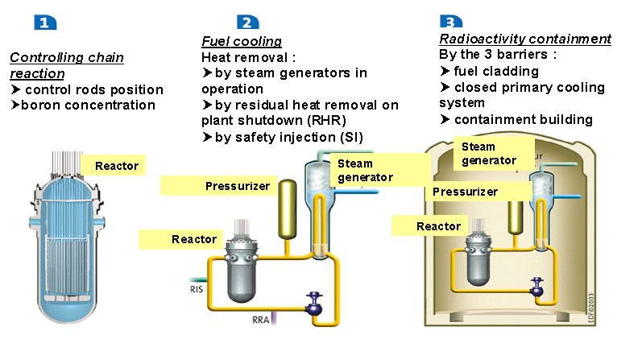
Safety Demonstration – Diversity
Example
Diversity:
ensuring fuel cooling with SI or RH system
5

Slide 6
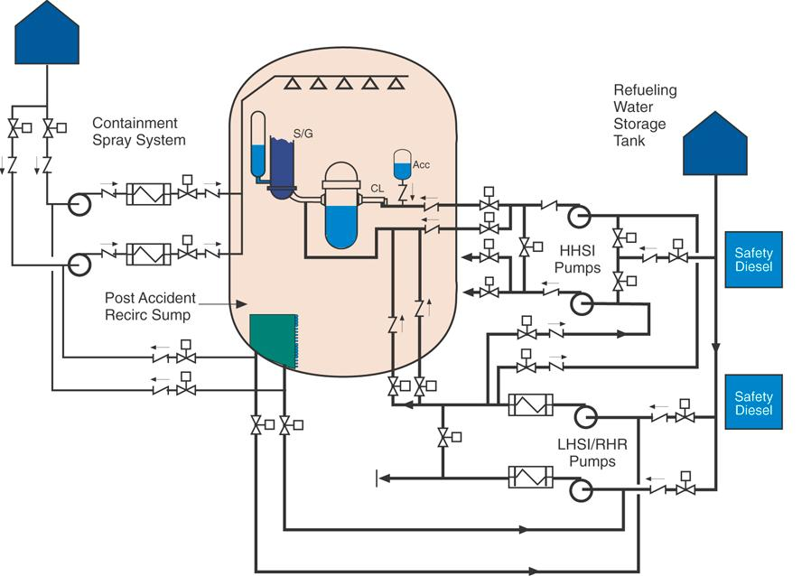
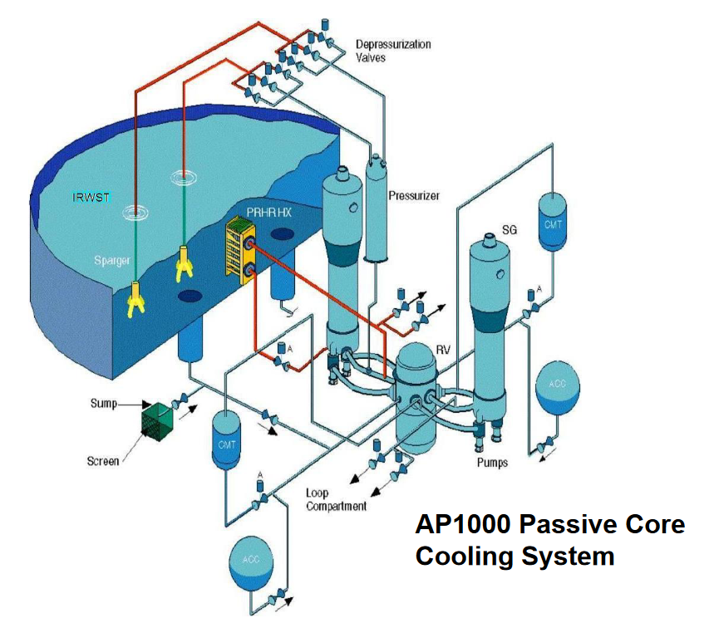
Safety Demonstration – Redundancy and Separation
Systems diversity (ensuring the same protective function - removal of residual heat and flooding of the core)
Redundancy inside one system!
Separation inside one system!
Separation between two systems!
Supporting Systems?
Component cooling?
SR pump rooms HVAC?
Redundancy inside passive systems!
6

Slide 7
Safety Demonstration – SMRs
IAEA definitions:
Small-sized reactors: < 300 MW(e)
Medium-sized reactors: < 700 MW(e)
Upper power limit may change as the current Large-sized reactors are being designed for up to 1700 MW(e).
IAEA requirements is applicable for SMRs
For design valid SSR 2/1, 2/2 and associated SSGs (e.g. 56(RCS), 53(containment), 61 (SAR), 88 (DEC and practical elimination)... SRS-46 DiD)
Importance of PSA including SSG-3 and SSG-4
Usage of DSA covered by SSG-2
For safety assessment and demonstration: GSR Part 4
.....TECDOCs.... (references are given in paper)
WENRA, USA NRC, EUR, CNSA,.. similar discussion but not fully harmonized
7

Slide 8
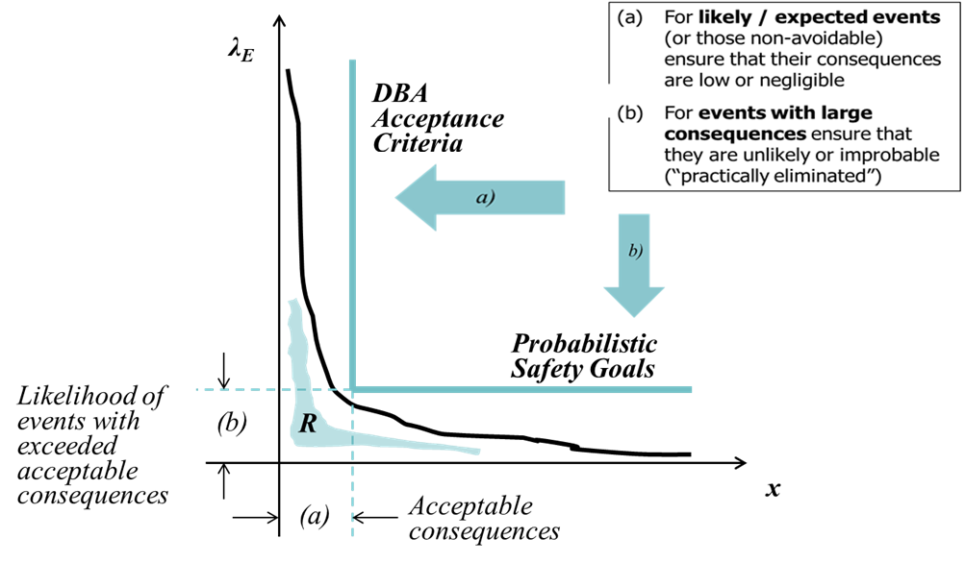
Safety Demonstration – SMRs Probabilistic vs Deterministic Approach
Safety assessment / verification: Two complementary types of analyses
Design basis analyses: verification of safety margins
Risk analyses (PSA): verification of acceptable residual risk
DEC and practical elimination?
8

Slide 9
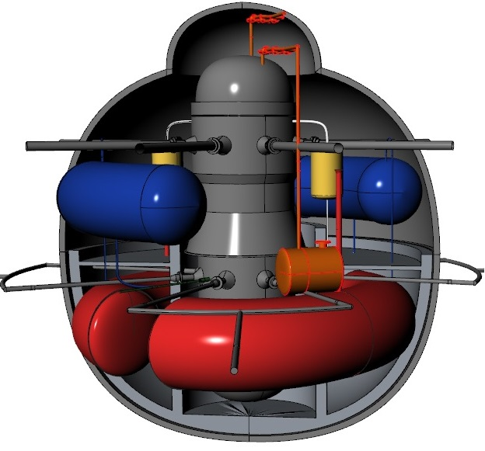
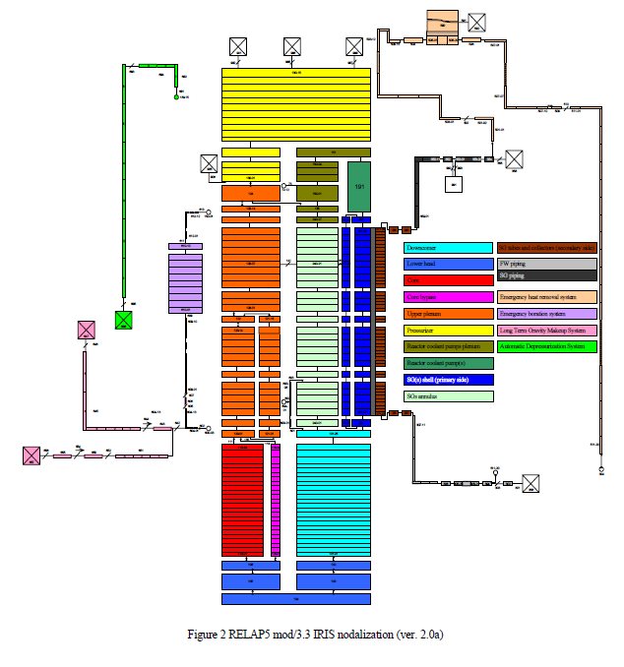
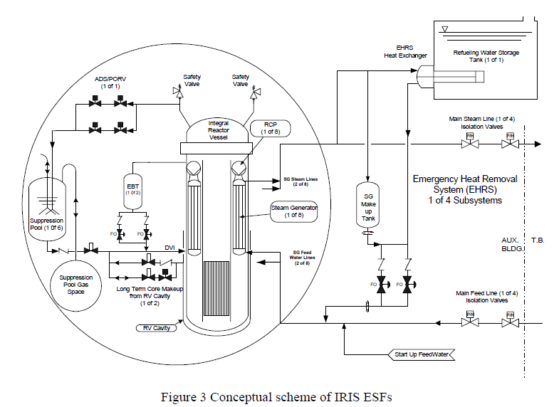
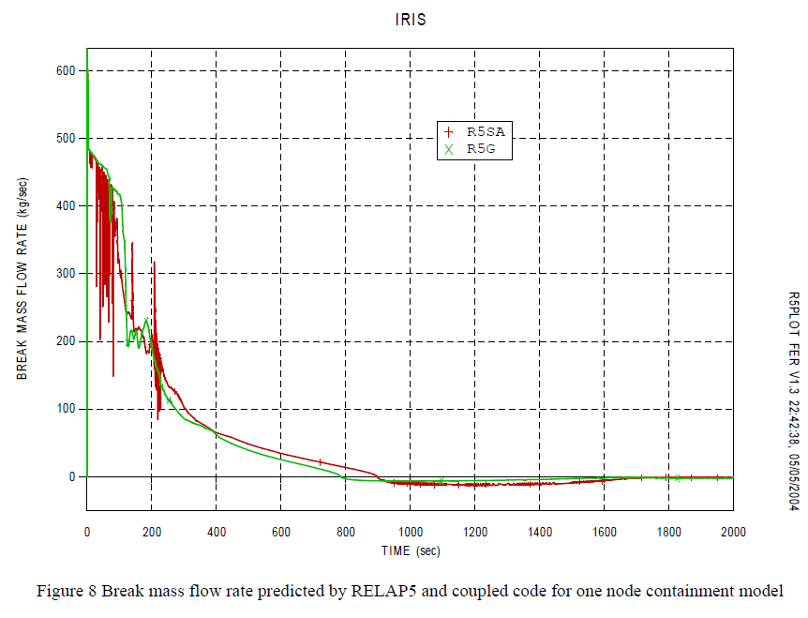
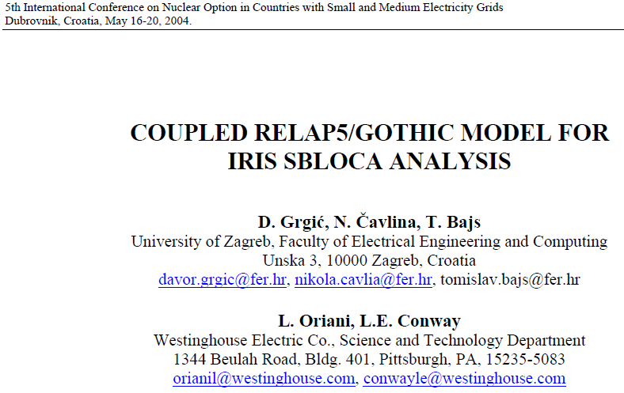
Safety Demonstration – SMRs Deterministic Approach?
Example
Nuclear Steam Supply
System Model
Plant
Analyses
Plant Layout
9

Slide 10
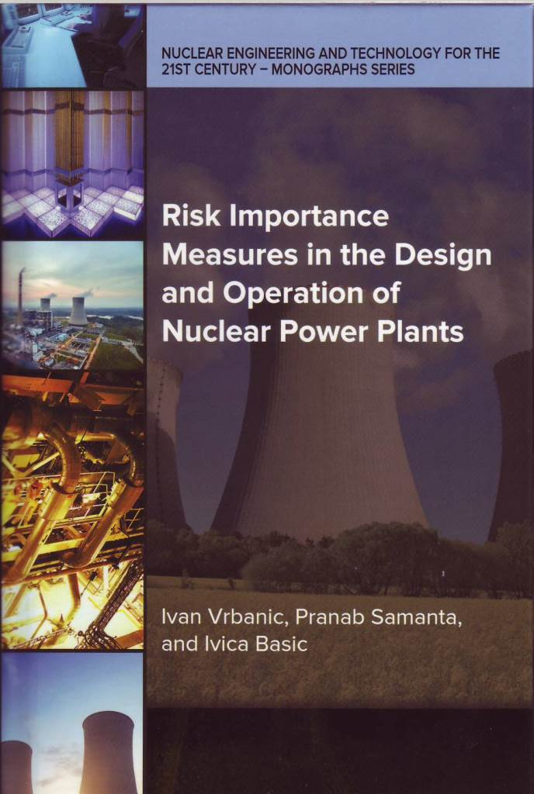
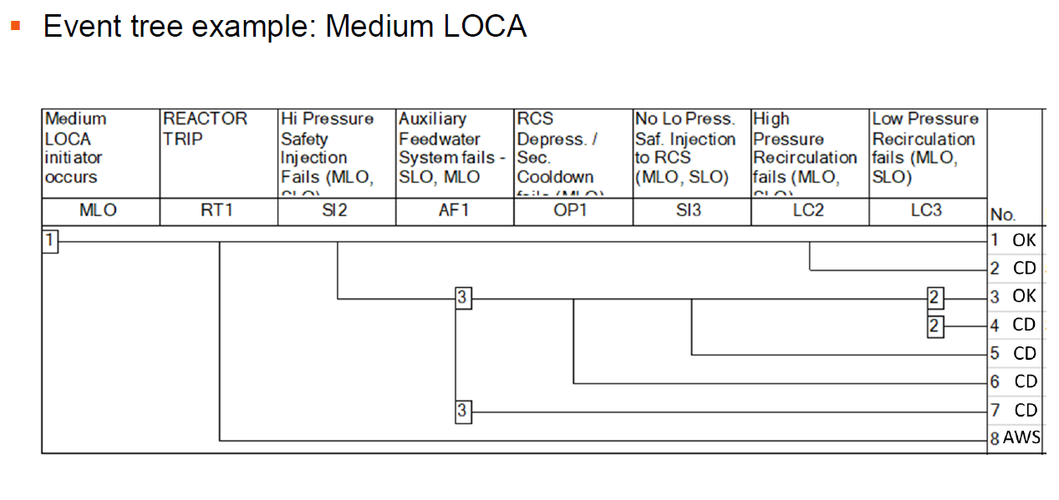
Safety Demonstration – SMRs Probabilistic Approach?
Diversity increases reliability of safety function!
10

Slide 11
Concluding remarks
The nuclear industry and regulation applications either to SFC or/and DiD are still not very well harmonized in the international practice.
Additional effort is advisable to be made in order to establish more strict and harmonized design requirements with regard to either SFC or DiD to improve safety of nuclear installations in future.
Past experience with application of SFC which was gained over the period of time stretching over half of a century points out to some weaknesses in rigid application of traditional SFC rules. Those include failing to establish reliability of the functions important to safety which would be commensurate with frequencies of challenges to them.
11

Slide 12
Concluding remarks
It has been many times repeated that traditional design basis analyses (DBA) are conservative because they assume failure of single train.
It has been rarely pointed out that the same analyses may be optimistic because they assume that complementary train will succeed for granted. Necessity for realistic PSA study.
It seems to be advisable to continuosly assess SFC approach by DSA and PSA for application to the new reactor designs including SMRs.
12

