Slide 1

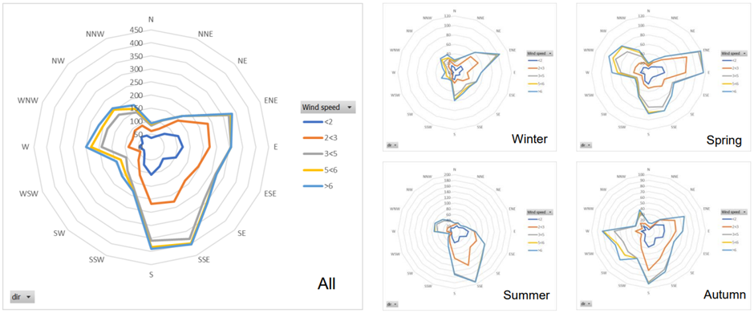
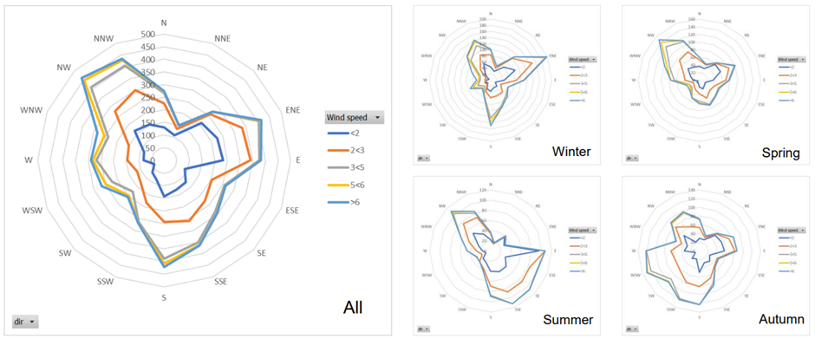
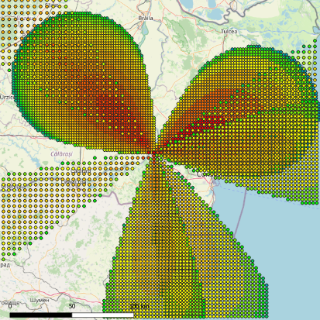
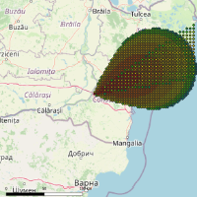
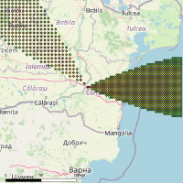
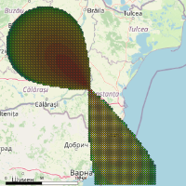
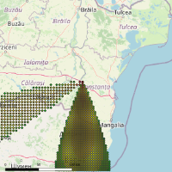
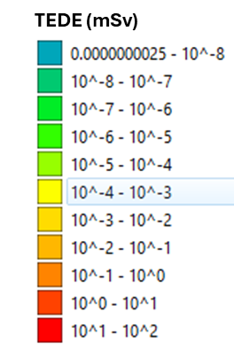
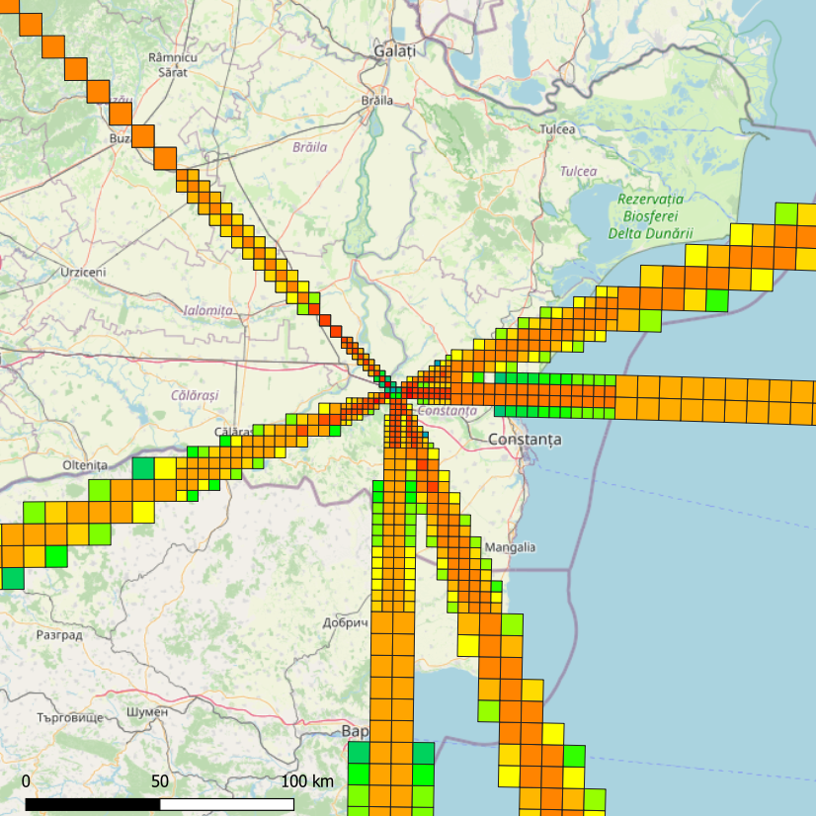
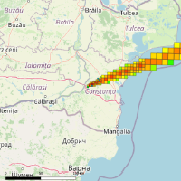
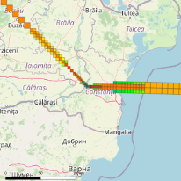
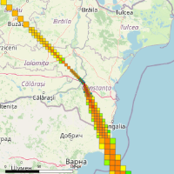
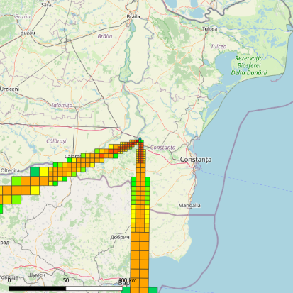

ON SOME SAFETY ASPECTS IN SMALL MODULAR REACTORS
P.C. Min⁽¹⁾, B.I. Vamanu⁽²⁾, D. Serbanescu⁽³⁾, V.T. Acasandrei⁽²⁾, A. Pavelescu⁽²⁾
⁽¹⁾ National Commission for Nuclear Activities Control (CNCAN), Bucharest, Romania (email: petre.min@cncan.ro)
⁽²⁾ Horia Hulubei National Institute for R&D in Physics and Nuclear Engineering, IFIN HH, Magurele, Romania
⁽³⁾ Division of Logic and Models in Science, CRIFST, Romanian Academy, Bucharest, Romania
IAEA-CN-327-327
THE RATIONALE
Next-generation nuclear reactors enhance efficiency, fuel use, and safety, adhering to the ALARA principle for balancing safety with performance. The rise of Small Modular Reactors (SMRs) necessitates evaluating their benefits and challenges. This study focuses on Emergency Preparedness and Response (EPR) for three different SMR types, assessing the potential environmental impacts of major accidents.
OBJECTIVES
Assess environmental and human impacts of SMRs (types A, B, and C) based on risk criteria and safety margins.
Evaluate expected risk values for future SMR generations.
Conduct Level 3 Probabilistic Risk Assessment (PRA) from a regulatory and siting perspective.
Simulate accident impacts using JRodos and CBRNE-Software under average meteorological conditions and reference source terms.
Apply findings to Cernavoda NPP and define protective action zones (PAZ).
METHODOLOGY
Pre-process meteorological data / Determine the dominant weather regime at location and compute the dominant Pasquil stability classes.
Determine a Source Term for each of the reactor types,
Perform dose-projection simulation for all the cases,
Post-process the results and identify the risk-limits,
Aggregate the results, get the findings and perform inter-comparison,
THE ASSESSMENT
Impact Assessments Conducted:
Performed for all reactor types (source terms).
Evaluated across different seasons and day/night regimes.
Resulted in 24 cases for each run using JRodos and CBRNE Software.
Impact Indicators Used:
CBRNE Software: Total Effective Dose Equivalent (TEDE).
JRodos: Total Potential Effective Dose (TPED).
Data Aggregation:
Individual results from the assessment platforms were aggregated within a QGIS information system for unified visualization and analysis of the results.
Data Analysis:
Protective action Zone (PAZ) and Urgent Protective Zone (UPZ) have been selected as 100mSv (the threshold for deterministic effect) and 10 mSv (the threshold for stochastic effect).
The PAZ and UPZ radii have been determined for all the considered cases and regimes, and the maximum of each zones has been selected as reference value (conservative approach).
RESULTS
In any of the considered cases and under the assumptions taken, the 5km radius for PAZ and 25km radius for UPZ were never exceeded.
Results indicate no potential deterministic effects for SMR type "B" and similar EPZs for SMR types "A" and "C" despite technological differences.
CONCLUSION
This study introduces a structured framework aimed at establishing Emergency Planning Zones (EPZ) for Small Modular Reactors (SMRs) during the installation of new plants. It highlights the need for a comprehensive approach that incorporates safety analyses for both Design Basis Accidents (DBA) and severe accident scenarios, known as Beyond Design Basis Accidents (BDBA). The proposed model aligns with the fifth level of Defence in Depth, ensuring robust management of off-site consequences and enhancing overall emergency preparedness for SMRs.
Type A
(Water SMR)
Type B
(Gas SMR)
Type C
(Molten Salt SMR)
FIG. 1 Wind-rose per day-night regime and season
Day-regime (up); Night-regime (down)
TABLE 1. dominant meteorological data
# | ID | Name | Stability class | Stability class % | Wind to | Wind to | Wind from | Avg. wind speed | Avg. ws %
1 | dnr | Winter-1 | C | 70.87% | ENE | 67.5 | 247.5 | 5 | 6.33%
2 | dnn | Winter-2 | F | 54.77% | ENE | 67.5 | 247.5 | 2 | 5.94%
3 | dnr | Spring-1 | C | 57.02% | E | 90 | 270 | 3 | 4.37%
4 | nnr | Spring-2 | F | 37.50% | NW | 315 | 135 | 5 | 4.23%
5 | dnr | Summer-1 | C | 50.81% | SSE | 157.5 | 337.5 | 3 | 8.20%
6 | nnr | Summer-2 | F | 62.04% | NW | 315 | 135 | 2 | 4.92%
7 | dnr | Autumn-1 | C | 62.96% | S | 180 | 0 | 3 | 5.12%
8 | nnr | Autumn-2 | D | 37.10% | WSW | 247.5 | 67.5 | 5 | 4.49%
TABLE 2. source terms
 | Nuclides | Activity (Bq) | Initial Source
Case A | 54 | 2.12E+14 | Probabilistic Risk Assessment and Severe Accident Evaluation
Case B | 20 | 8.90E+15 | Initial Calculations for Source Term of Molten Salt Reactors
Case C | 51 | 2.32E+16 | Expert judgement
winter
spring
summer
autumn
winter
spring
summer
autumn
FIG.2 Impact maps of effective doses (mSv) for Case A, QGIS representation.
CBRNE Software results – TEDE (up), JRodos results - TPED (down)
TABLE 3. EPZ RADII (km) WITH 20% BUFFER ZONE
Case | PAZ (computed) | PAZ | UPZ (computed) | UPZ
Case A | 1.5 | Approx. 2 | 8.6 | Approx. 10
Case B | N/A | N/A | 9 | Approx. 11
Case C | 2.6 | Approx. 3 | 16.8 | Approx.20

