Slide 2
Probabilistic safety analysis of the first level of small modular reactors using the example of the SHELF-M RF
Shiverskiy E.A., Pokidov G.P, Elistratov P.V., Andreev S.S.
NIKIET JSC

Slide 3
Introduction
Main objectives:
perform a probabilistic safety analysis of the SHELF-M RF to determine the frequency of a severe accident (fuel damage in the core above the maximum design limits),
determine the dominant risk contributors and ways to improve the safety of the facility.
PSA is necessary to verify probabilistic safety criteria:
P(A) ≤ 1.00E-05 1/year

Slide 4
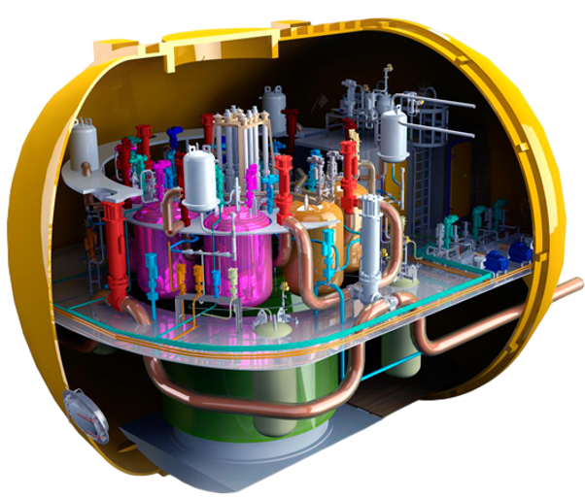
Brief description of the SHELF-M reactor facility
The SHELF-M reactor facility is designed to operate as part of the SNPP to supply power to facilities for various purposes in remote and hard-to-reach areas with decentralized power supply.
As part of the RF, an integral type reactor is used, which ensures the compactness of equipment and media, and also increases the reliability of the facility due to the reduction of communications under the pressure of the primary coolant.
The coolant and moderator of the reactor facility is high-purity water with ammonia additive to generate hydrogen in it to prevent the generation of corrosive oxidative products of radiolysis.
The SHELF-M RF has a thermal capacity of 35.2 MW and an 8-year refueling period.

Slide 5
Analysis of the reliability of the SHELF-M RF systems
The reliability analysis of reactor facility systems is performed to determine probabilistic safety indicators of the plant and, if necessary, to develop a set of measures to change (or refine) the design of the systems in order to ensure the required safety with minimal costs.
The reliability analysis of the systems of the power unit with the SHELF-M RF showed that the dominant contributors to the unreliability of the facility are: hydraulic accumulator of the hydraulic distributor system, makeup system valves, ECCS valves, check valves of the makeup system, valves of the equipment cooling system.
Item number | System | Safety function | Reliability indicator
1 | Primary circuit system | 1) Reactor scram and keeping it subcritical 2) Retention of radioactive elements within the primary circuit by means of isolation valves 3) RF protection against overpressure in the reactor vessel | Q = 7.38E − 03 1/req W = 1.99E − 06 1/h
2 | Secondary circuit system | Reactor emergency cooldown by the secondary circuit | Q = 1.38E − 04 1/req W = 4.52E − 08 1/h
3 | Reactor unit emergency cooling system | Coolant loss compensation (small, medium and large leaks) | Q = 7.56E − 06 1/req
4 | Reactor emergency cooldown system | Emergency reactor cooldown via ECS | Q = 7.57E − 07 1/req
5 | Equipment cooling system | - | W = 2.84E − 07 1/h
6 | Makeup and Emergency Absorber Insertion System | 1) Reactor emergency outage and maintenance in subcritical state 2) Compensation of coolant loss (small, medium and large leaks) | Q = 4.89E − 06 1/req
7 | Steam generator and ECS intermediate heat exchanger overpressure prevention system | RF protection against overpressure in the reactor vessel | Q = 1.47E − 08 1/req
8 | SV and overpressure protection system | Protection of the SV and containment against overpressure | Q = 3.44E − 03 1/req

Slide 6
Analysis of initiating events
As part of the IE analysis, events were considered, the potential consequences of which can cause the release of radioactive substances from nuclear fuel located within the location of the ASMM.
The following groups of events were considered as IE:
1. Internal IE:
1.1 Group of IEs leading to unauthorized reactivity change,
1.2 Group of IEs leading to the loss of heat removal from the core,
1.3 Group of IEs leading to the loss of heat removal by secondary circuit,
1.4 IE group leading to the loss of the primary circuit coolant,
1.5 IE group involving the loss of the system power,
1.6 IE group leading to the loss of nuclear fuel handling;
2. Onsite IEs caused by indoor fires;
3. External IE of natural and cosmic nature (meteorite fall, hurricane wind, extreme weather conditions (including precipitation), sand and snow storms).

Slide 7
Examples of accidents: Reactor vessel break
As part of the above analysis, the RF end states were postulated which are involved in the emergency scenarios for the initiating events under consideration and reflect the extent of damage to nuclear materials within the NPP site:
1) State S – successful completion of the emergency scenario,
2) State A – core damage (severe accident).

Slide 8
Examples of accidents: PCECP malfunction (disconnection, jamming, speed reduction)

Slide 9
Results of calculating the severe accident probability
The severe accident probability (SAP) for internal IEs, onsite impacts caused by fires and flooding, and external impacts excluding seismic impacts, and the overall risk value for reactor core damage were estimated in the process of calculating the PSA model for a power unit with the SHELF-M reactor facility.
The predominant contributors to the SAP in the event of the maximum design limits being exceeded for the fuel cladding and fuel temperature are initiating events:
- leading to the loss of primary coolant,
- leading to the loss of heat removal by the secondary circuit.
P(A) = 5.59E-05 1/year > 1.00E-05 1/year
Group of IEs | SAP (Category A) prior to proposed changes, 1/year | SAP (Category A) prior to proposed changes, 1/year
1. Internal IEs
1.1 Group of IEs leading to unauthorized reactivity change | 4.13E-07 | 4.13E-07
1.2 Group of IEs leading to the loss of heat removal from the core | 2.25E-07 | 2.25E-07
1.3 Group of IEs leading to the loss of heat removal by secondary circuit | 1.96E-06 | 1.00E-06
1.4 Group of IEs leading to the loss of the primary circuit coolant | 5.02E-05 | 6.33E-06
1.5 Group of IEs involving the loss of system power | 3.29E-10 | 3.29E-10
1.6 Group of IEs leading to the loss of nuclear fuel handling | 1.65E-11 | 1.65E-11
2. Onsite IEs
2.1 IEs caused by indoor fires | 8.66E-08 | 8.66E-08
3. External IEs
3.1 IEs of natural origin | 8.27E-10 | 8.27E-10
Total PSA estimate | 5.59E-05 | 8.06E-06

Slide 10
Result’s analysis and conclusion
The analysis made it possible to identify the predominant risk contributors and the key components of the RF systems that contribute to the unreliability of the facility under consideration, and to develop the following recommendations for improving the reliability at the system level and the safety of the facility as the whole:
1) additional check valves should be installed at the reactor outlet in the direction of the coolant movement through the circuit to reduce the frequencies of initiating events of the “Coolant loss” type associated with the check valve failures,
2) possibility should be provided to ensure redundancy for the hydraulic drives of the shutoff valves,
3) possibility should be considered for redundancy to be provided for the hydraulic accumulator of the distribution valve system.
Frequency after modification:
P(A) = 8.06E-06 1/year < 1.00E-05 1/year

Slide 11
Thank you for yours attention!

