Slide 2

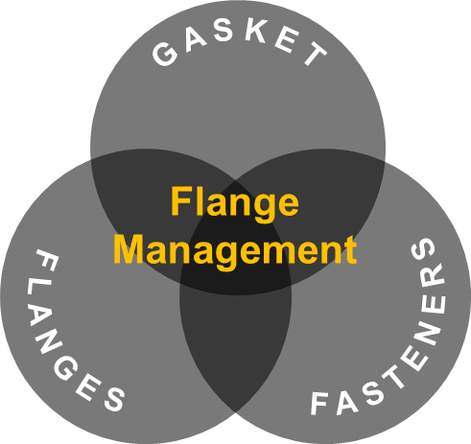
FLANGE MANAGEMENT APPROACH FOR RELIABLE
SMR REACTOR VESSEL INTEGRITY
GARY BRIGGS
James Walker Sealing Products & Services
Woking, Surrey, UK
gary.briggs@jameswalker.biz
MARTIN COULTHARD
James Walker & Co. Limited
Cockermouth, Cumbria, UK
martin.coulthard@jameswalker.biz
Gary Briggs
Technical Director
Gaskets & Fasteners

Slide 3
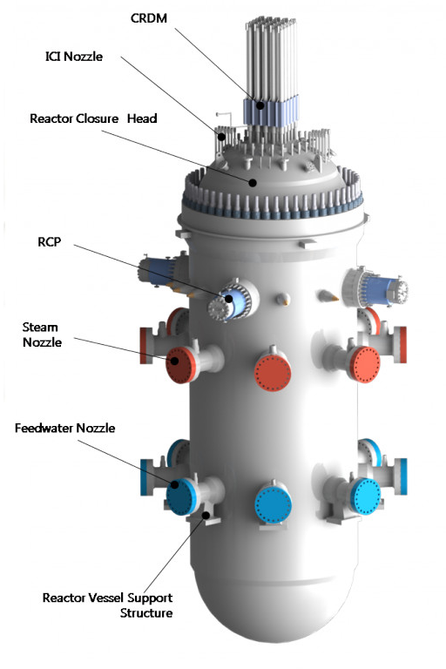
Background
  Influences on joint integrity
  Flange design
    Under designed flanges (flange geometry not rigid)
    Under - or over bolted flange connections (bolt area too small/too large for flanges or gasket)
    Rapid increase of bolt load when in service due to differential linear thermal expansion bolt vs flange material
    Excessive flange rotation and load losses in cyclic service
    Flange/gasket stress distortion due to temperature gradients (Delta T) across the joint
    Incorrect gasket configuration or bolt material selection for service (old m&y factors)
    Wrong bolt load/torque value selection for joint (too low/too high)
  Component quality
    Gaskets quality, resulting in additional gasket relaxation/creep
    Fastener quality, resulting in additional bolt relaxation/creep or fatigue failure
    Damaged or misaligned flange facings
  Execution
    Gasket installation
    Poor flange alignment
    Load losses due to excessive piping loads
    Bolt tightening process not followed
  Target bolt load not achieved after the tightening cycle
    Inaccuracy of tightening method
CRDM
CRDM
ICI Nozzle
Reactor Closure Head
RCP
Steam Nozzle
Feedwater Nozzle
Reactor Vessel Support Structure

Slide 4
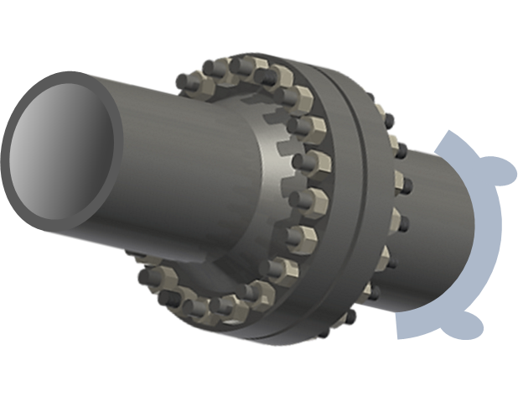
Gasket m&y Factors
Used only for the design of bolted flange connections to meet code requirements
Uses generic gasket data
Does not represent performance in the field
Gasket selection and suitability is generally influenced by the following…
Permeability of the gasket
Nature of containment (explosive, corrosive, carcinogenic etc.)
Configuration of the joint
Bolt materials
Method of tightening
Flange materials
Flange surface finish
In-service gasket stress to maintain ‘tightness’
Chemical resistance
Heat resistance
Crush strength
Seating stress
Resilience (stiffness/recovery)
Creep characteristics
Thermal conductivity of the gasket
The configuration of the gasket
Contained pressure (liquid or gas)

Slide 5
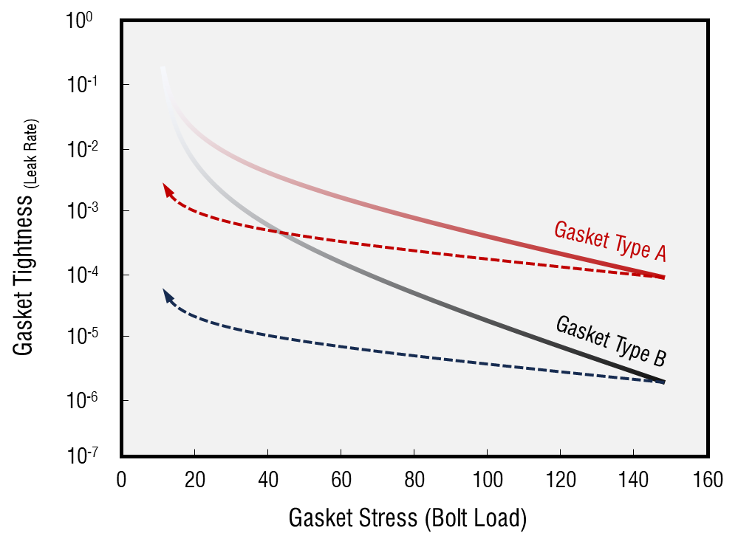
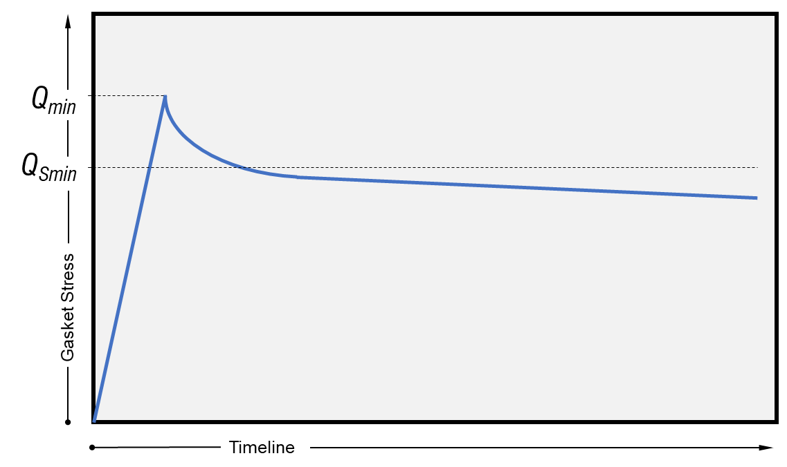
Modern Gasket Characteristics (EN13555)
Critical performance characteristics
Q_{min(L)} (Minimum surface pressure at assembly)
Q_{Smin(L)} (Minimum surface pressure during operation)
Assembly & Operation
Defined behaviour characteristics
Elastic modulus (assembly & operation)
Creep / Relaxation (assembly & operation)
Maximum surface stress (crush stress)
Operational tightness behaviour
Outcomes
Defines expected gasket behaviours
Leads to improved seal selection criteria
Considers ‘lifetime’ expectations from the gasket perspective
Joint Lifecycle

Slide 6
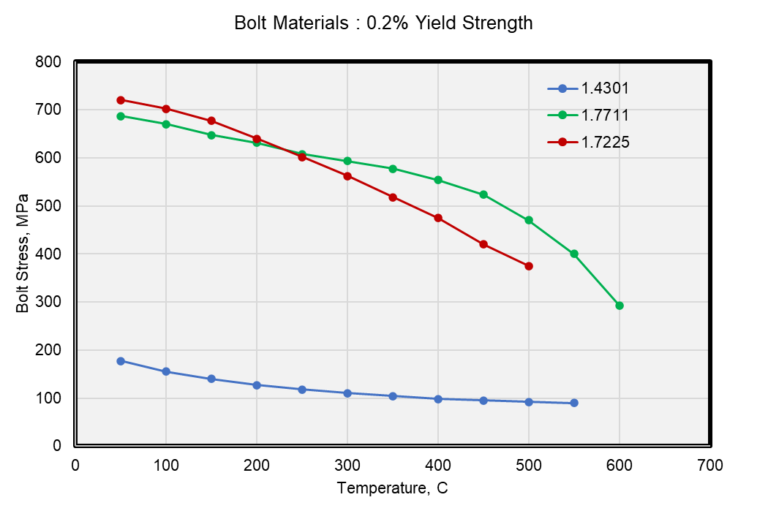
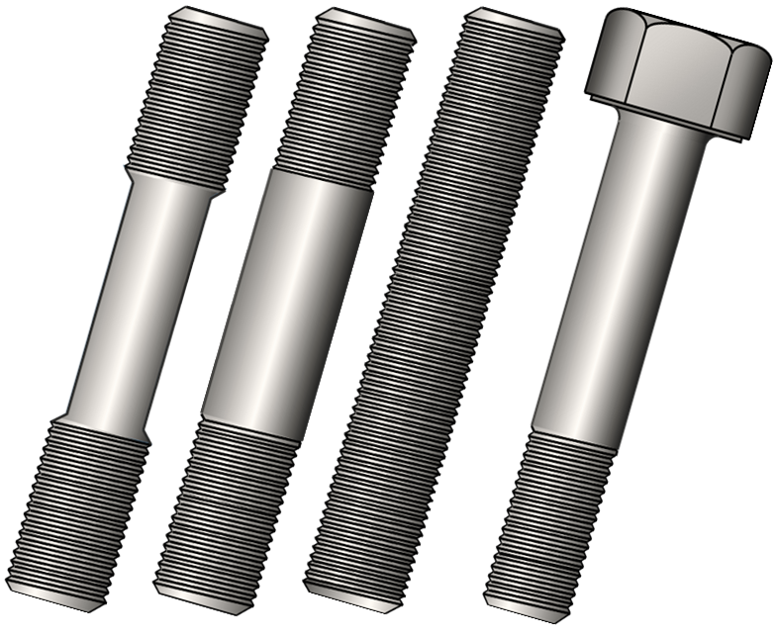
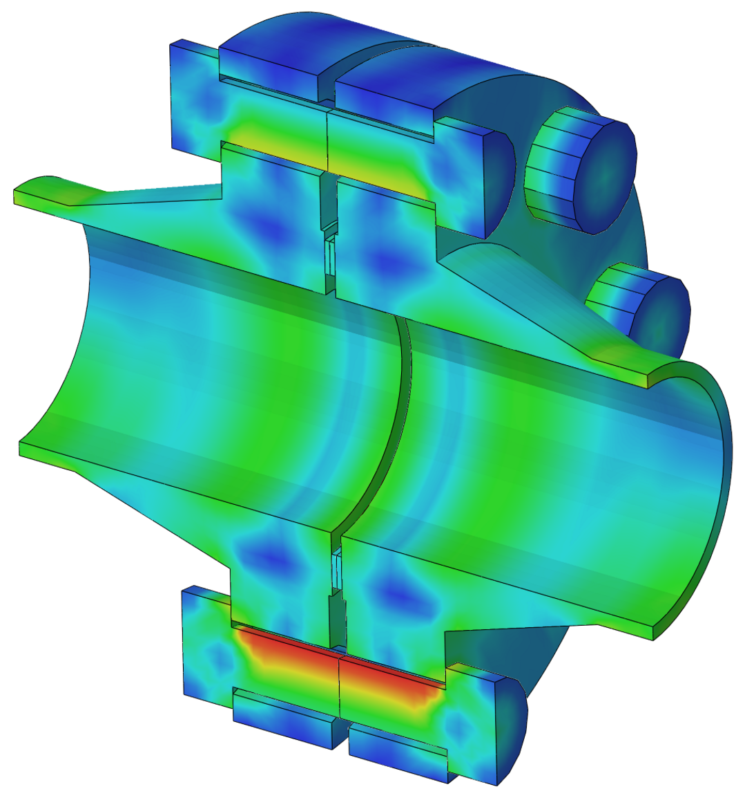
Fasteners
Critical performance characteristics
Strength & load retention properties (Creep)
Bolt geometry (Diameter & Grip Length)
Washers
Thread form & condition
Loading method

Slide 7
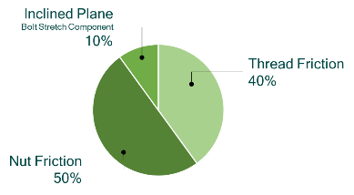
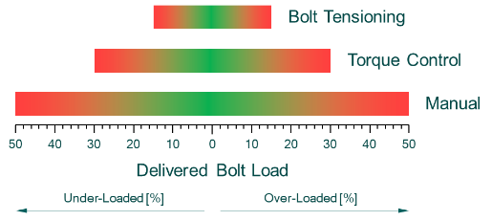
Fasteners : Theoretical into Applied
Relative magnitudes of torque if the three reaction torques which oppose the input torque are applied to a nut (typical)
30 or 40 variables…
Hardness of parts
Surface finish
Types of materials
Plating (thickness, condition, contamination etc.)
Speed of tightening
Fit between threads
Washers
Cut vs Rolled threads…
Let’s say…
Nut friction increases +10% (50% to 55%)
Scoring, embedment, alignment… taken alone not a big problem
This impacts at the inclined plane
Taking 5% from the inclined plane component reduces the bolt load by 50%
A very bad “leverage” situation

Slide 8
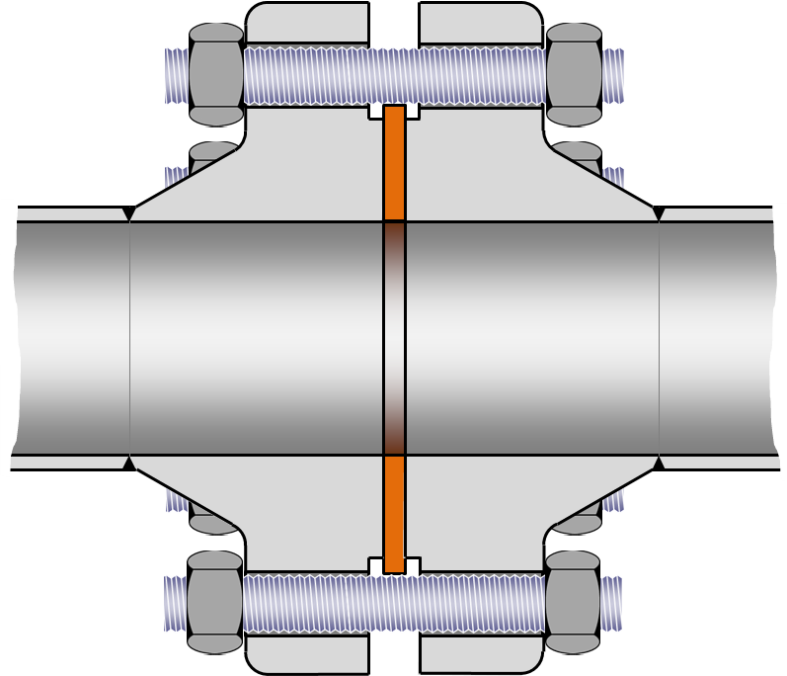
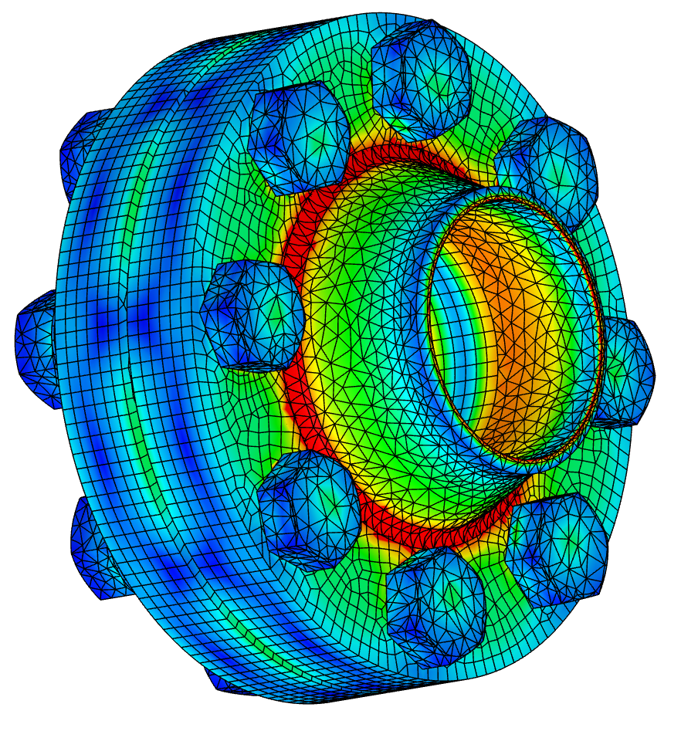
Flanges
Assembly
Bolt tension applied & flanges loaded
Complex interactions within the joint take place…
  Flange rotation
  Stress build-up
  Gasket loaded
Flange Rotation

Slide 9
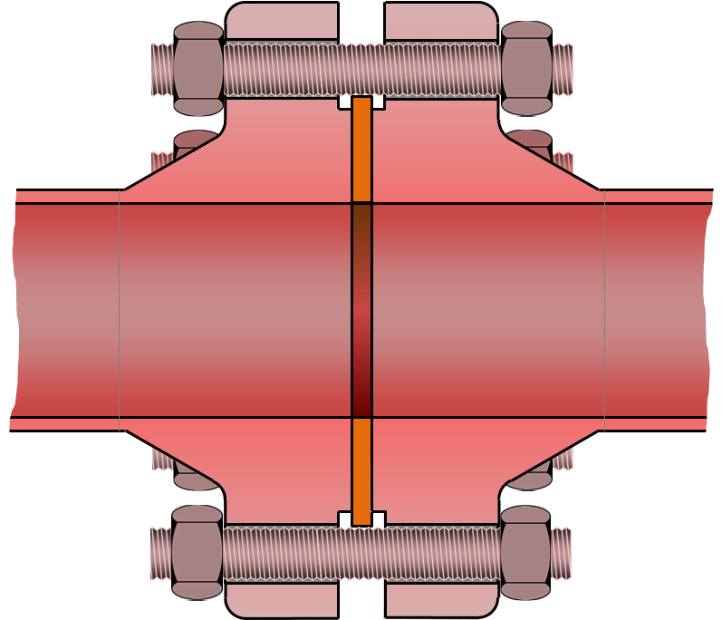


Flanges
Assembly
Bolt tension applied & flanges loaded
Complex interactions within the joint take place…
  Flange rotation
  Stress build-up
  Gasket loaded
Operation
Hydraulic unloading
Stress relaxation (all components)
External loading issues
Thermal transients
Internal Pressure
Process Temperature

Slide 10
Flange Joint Analysis : Inputs
Flanges
Gasket
Fasteners
Pressures
Temperatures
Process
Conditions

Slide 11
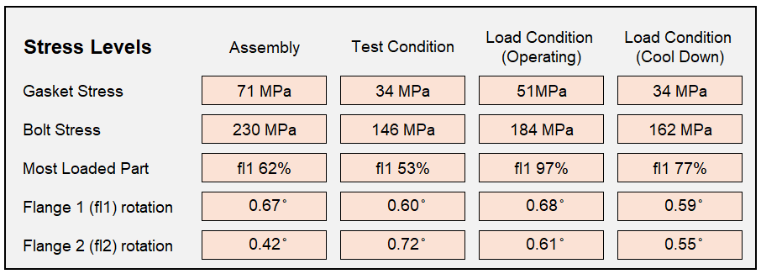
Flange Joint Analysis : Outputs
Outputs
Assessment based on limiting factors with targeted assembly bolt loading
Predicated outcomes covering internal and external factors
Joint lifetime behaviour expectations

Slide 12
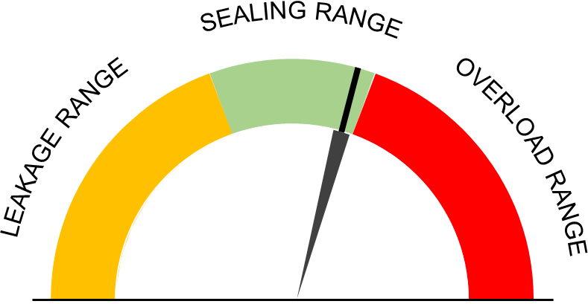
Bolted Flange Joint Analysis
Tension + load indicating fastener
Outputs
Installed bolt tension target defined
Bolt loading method

Slide 13
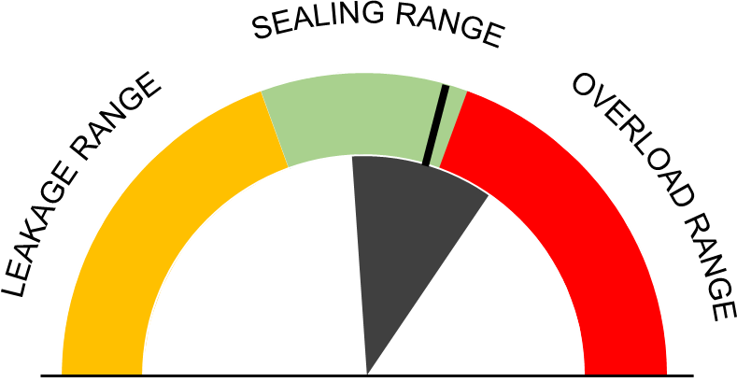
Bolted Flange Joint Analysis
Tension + load indicating fastener
Outputs
Installed bolt tension target defined
Bolt loading method
Torque

Slide 14




Foundations of Bolted Flange Integrity
Foundation 4
Is the design bolt tension achieved & maintained after the tightening cycle ? ☑
Foundation 1
Flange geometry ☑
Material & Gasket selection ☑
Flange calculation ☑
1. Design
4. Installed
Bolt Tension
2. Component
Quality
Foundation 3
Management procedure ☑
well documented, understood & implemented
Foundation 2
Do all supplied materials meet the design criteria ? ☑
3. Execution Quality

Slide 15

Foundations of Bolted Flange Integrity
The ZEN of Bolted Joints…
Balance…
Flanges, Gaskets & Fasteners
vs
Pressure, Temperature & Media
Technical requirements defined, evaluated, checked & approved
Execution : deliver the expected outcomes
15

Slide 16
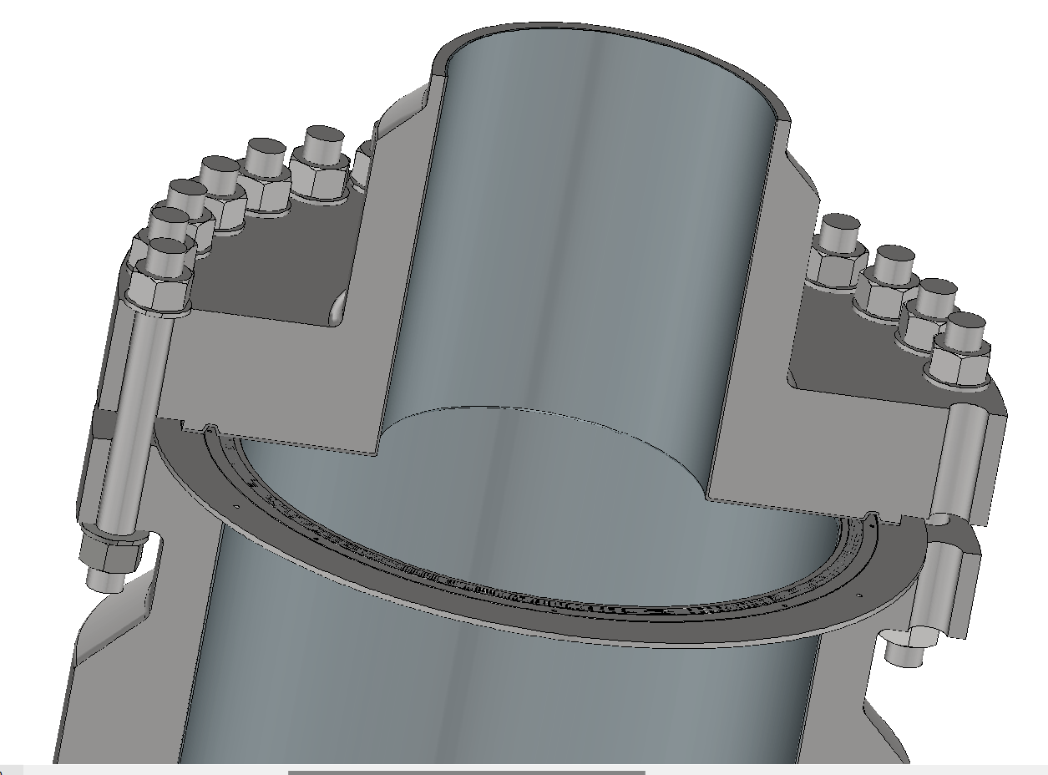
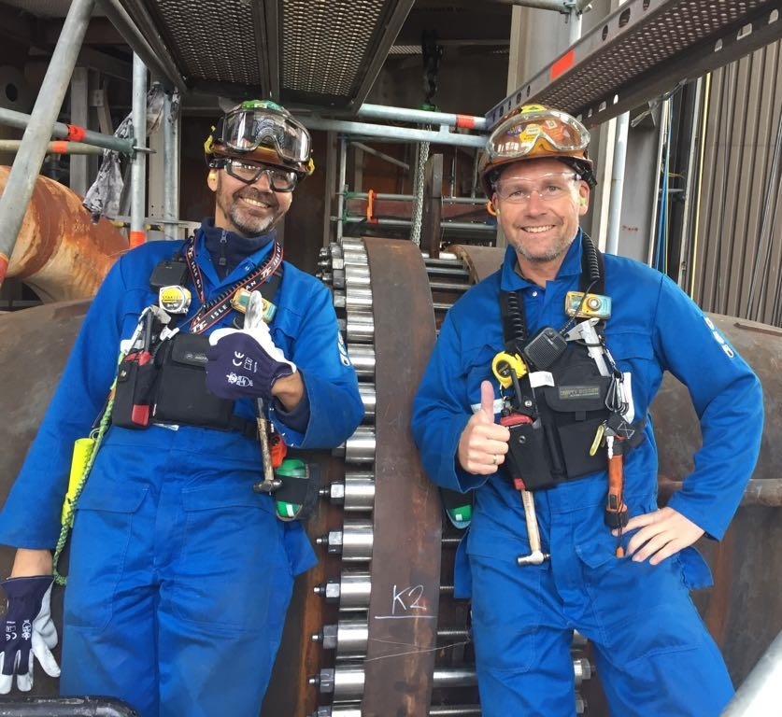
Summary
Configuration of components
  Components analysed to code
    Analysis of overall joint integrity outcomes
      Delivery program defined
        Installation & joint assembly
Configuration of components
Components analysed to code
Outcomes determined
Delivery process
Installation & execution
OEM Stream
End-User
Contractor

Slide 17
FLANGE MANAGEMENT APPROACH FOR RELIABLE
SMR REACTOR VESSEL INTEGRITY
GARY BRIGGS
James Walker Sealing Products & Services
Woking, Surrey, UK
gary.briggs@jameswalker.biz
MARTIN COULTHARD
James Walker & Co. Limited
Cockermouth, Cumbria, UK
martin.coulthard@jameswalker.biz
Gary Briggs
Technical Director
Gaskets & Fasteners

