Slide 1



International Conference on small modular reactors and their applications
IAEA, 21-25 October 2024, Vienna, Austria
NUCLEAR SAFETY AND
DEFENCE IN DEPTH IN CAREM25
M. GIMÉNEZ, P. ZANOCCO, D. QUIROGA, M. GRINBERG, F. MEZIO
NUCLEAR SAFETY GROUP / COMISIÓN NACIONAL DE ENERGÍA ATÓMICA (CNEA) / CENTRO ATÓMICO BARILOCHE / ARGENTINA

Slide 2

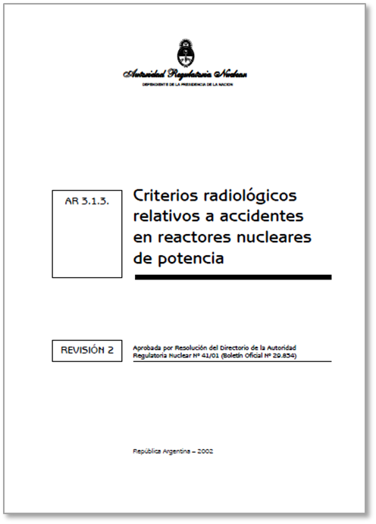
DEFENSE IN DEPTH (DiD) INTEGRATION IN CAREM25 DESIGN
Project goals
High level technological decisions
Regulatory Body requirements
IAEA standards
DiD in the Design:
Conceptual definition of technological strategy
Deterministic Safety Assessment
Probabilistic Safety Assessment
SSCs
Safety Classification

Slide 3
DID TECHNOLOGICAL STRATEGY ADOPTED IN
CAREM DESIGN
Project goal
High level technological decisions
Regulatory Body requirements
IAEA standards
DiD in the Design:
Conceptual definition of the technological strategy to cope with events and mitigate severe accidents

Slide 4
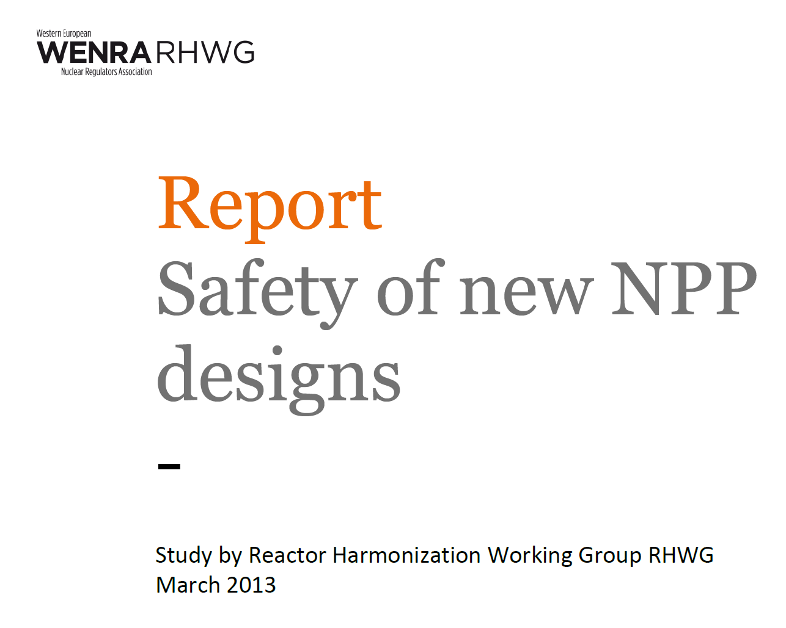
CAREM HAS ADOPTED WENRA PROPOSAL for DiD LEVELS (applied for REACTOR and FFEE POOL)
“The phenomena involved in accidents with core/fuel melt (severe accidents) differ radically from those which do not involve a core melt. Therefore core melt accidents should be treated on a specific level of Defence-in-Depth.”
LEVEL | ASSOCIATED PLANT CONDITION CATEGORIES | OBJECTIVE
1 | Normal operation | Prevention of abnormal operation and failures
2 | Anticipated operational occurrences (AOO) | Control of abnormal operation and failures
3A | Postulated single initiating events (PSIE) | Control of events to avoid core damage
3B | Postulated multiple failure events (PMFE)
4 | Postulated core damage accidents | To limit off-site releases
All levels included in CAREM Design Envelop
IAEA: DEC A equivalent to Level 3B, DEC B to Level 4

Slide 5
CAREM CONCEPTUAL STRATEGY FOR DiD LEVELS 2, 3 & 4:
REACTIVITY CONTROL FUNCTION (SHUTDOWN AND SUBCRITICALITY)
  DiD LEVEL
  Interlocks, Monitoring Control System and the control rods
  L2 (AOO)
Controlled State
  Single stage
  L3A (PSIE)
  MAIN LINE OF PROTECTION
  FRPS +First Shutdown System (rods)
Safe State
  L3B (PMFE) DIVERSE LINE OF PROTECTION
  SRPS + Second Shutdown System (boron injection, passive)
  L4 (PCMA)
NORMAL OPERATION
POSTULATED INITIATING EVENT
  TIME

Slide 6
CAREM CONCEPTUAL STRATEGY FOR DiD LEVELS 2, 3 & 4:
REACTOR and CONTAINMENT HEAT REMOVAL CONTROL FUNCTION
  DiD LEVEL
  Interlocks, enhanced process and control systems
  L2 (AOO)
Controlled State
  Initial stage: Grace Period
  (72 hs -1oo2 redundancies)
  Final stage
  L3A (PSIE)
  MAIN LINE OF PROTECTION
  Passive Safety System
  Final Safe State Systems (active)
Controlled State
Safe State
  L3B (PMFE) DIVERSE LINE OF PROTECTION
  Depressurization System
  Flex systems
  transfer to inventory control function
Controlled State extension and recovery actions
  L4 (PCMA)
  Severe Accident Systems
Severe Accident management
NORMAL OPERATION
POSTULATED INITIATING EVENT
  TIME

Slide 7
CAREM CONCEPTUAL STRATEGY FOR DiD LEVELS 2, 3 & 4:
REACTOR INVENTORY CONTROL FUNCTION (LOCA )
  DiD LEVEL
  Interlocks, enhanced process and control systems
  L2 (AOO)
Controlled State
  Initial stage: Grace Period
  (36h -1oo2 redundancies)
  Final stage
  L3A (PSIE)
  MAIN LINE OF PROTECTION
  Passive Safety System
  Final Safe State Systems (active)
Controlled State
Safe State
  L3B (PMFE) DIVERSE LINE OF PROTECTION
  Flex systems
Controlled State extension and recovery actions
  L4 (PCMA)
  Severe Accident Systems
Severe Accident management
NORMAL OPERATION
POSTULATED INITIATING EVENT
  TIME

Slide 8
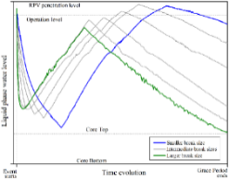
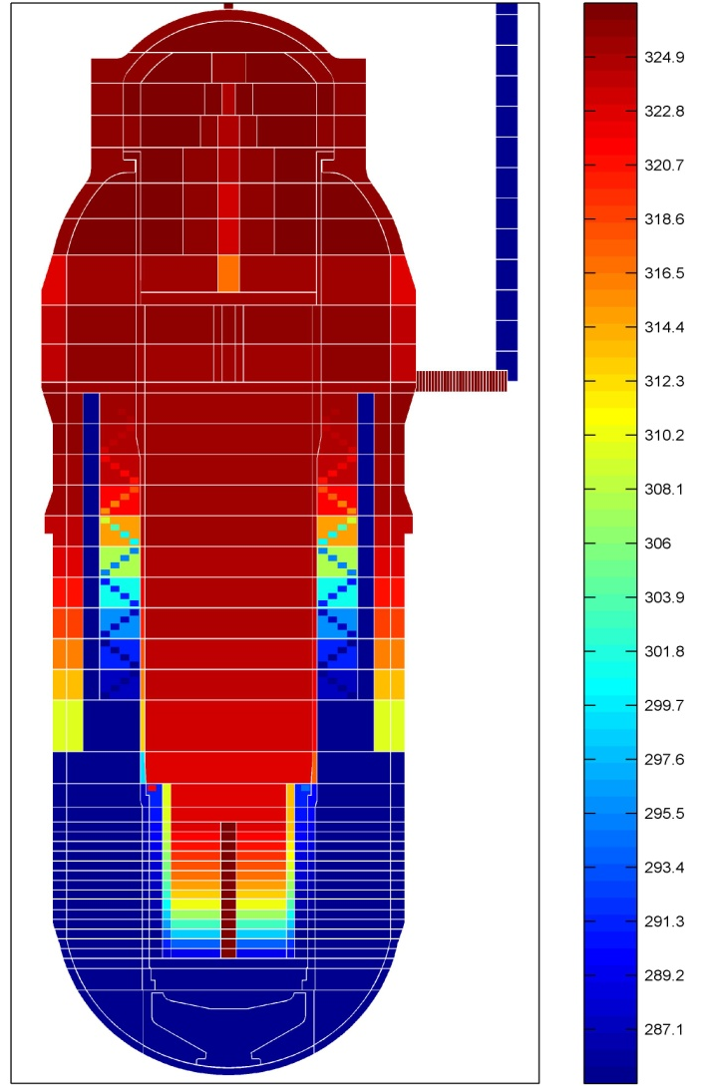
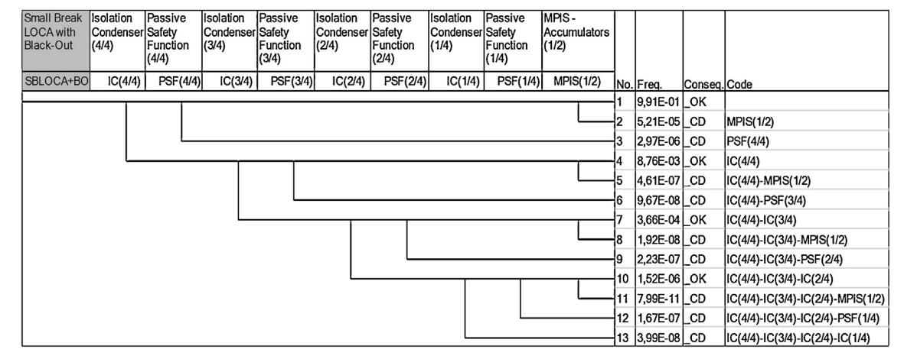
DSA AND PSA TO SUPPORT DiD ASSESSMENT IN CAREM DESIGN
Project goal
High level technological decisions
Regulatory Body requirements
IAEA standards
DiD in the Design
Definition of the technological strategy to cope with events and severe accidents
DSA
To verify DiD strategy and allocated systems by evaluating the fulfilment of the acceptance criteria
PSA
To detect DiD vulnerabilities, to assess DiD balanced integration and systems design, by their impact on CDf
Design feedback:
L2: CVCS: LOCA and LOHS.
L3: PSSs functional reliability calculation in case of LOCA: SIS set point increased to achieve a reliability target.
L3: RPV depressurization system to move from a LOHS to a LOCA in case of the PRHRS failure.

Slide 9
SSCs SAFETY CLASSIFICATION CRITERIA BASED ON DiD STRATEGY
Project goal
High level technological decisions
Regulatory Body requirements
IAEA standards
DiD in the Design
Definition of the technological strategy to cope with events and severe accidents
DSA
Consequence if a function is not fulfilled
PSA
Frequency of the required function
SSCs Safety Classification:
based DiD Levels and plant states

Slide 10

DiD - SSCs SAFETY CLASSIFICATION
A process was developed (2010) compatible with IEC-61226, 2009 (NPP – Instrumentation and control important to safety – Classification of instrumentation and control functions), to apply graded safety requirements to SSCs according to their safety function significance.
Coherent with IAEA SSG-30, that was published four years later (2014):
SSG-30 is based on “high-level classification criteria” that requires to rank the severity of consequences if the function is not performed (high, medium, low).
We can observe:
  Those criteria are not suitable for direct use in the design process involving engineers from different fields.
  Need of senior safety analysts to decode those general criteria.
  Proposal: to develop new additional criteria as a connection with the “high-level” ones.

Slide 11
DID - SSC SAFETY CLASSIFICATION
The process has required to develop:
Technology-specific criteria to categorize safety functions (actuation and monitoring ones). They are based on functions significance to safety, and directly related with the defined strategy for DiD levels 1 to 4, (risk profile: DSA+PSA), 3 categories.
Criteria to classify SSCs: 3 classes, related with the function category. Class reduction allowed, for example for the SSCs belonging to the diverse line of protection (lower probability to be demanded). The concept of Safety Functional Group is used.
Graded engineering requirements: to guarantee SSCs functional capability, reliability and robustness, stated on “DiD Level - Function category - SSC class”.

Slide 12
DID - SAFETY CLASSIFICATION:
EXAMPLE OF CRITERIA ESTABLISHED FOR FUNCTIONS CATEGORIZATION AND SSCs CLASS ALLOCATION
  DID LEVEL
  Interlocks, enhanced process and control systems
  L2 (AOO)
L2 - C-3
Controlled State
  Initial stage: Grace Period
  Final stage
  L3A (PSIE)
  MAIN LINE OF PROTECTION
A-1
B-2
Safe State
Controlled State
  L3B (PMFE) DIVERSE LINE OF PROTECTION
  Flex systems
A-2
Controlled State extension and recovery actions
B-3
  L4 (PCMA)
Severe Accident management
L4 - C-3
NORMAL OPERATION
POSTULATED INITIATING EVENT
  TIME

Slide 13
FINAL REMARKS
The early definition of DiD technological strategy has enabled the engineering development, providing clear requirements to SSCs.
DiD levels 1 to 4 are finally and thoroughly integrated within the design once the Safety Classification process is completed and graded requirements allocated to SSCs.
DSA and PSA, as complementary tools, have provided a valuable feedback on plant design, conducting a robust evaluation of DiD principle.
Finally, the integral design process, with DiD as the core, has proven to be a highly effective tool for achieving a balanced design, while optimizing costs from the safety point of view.

Slide 14

THANK YOU
FOR YOUR ATTENTION
argentina.gob.ar/cnea/carem
marcelogimenez@cnea.gob.ar

