Slide 2
THE QUALITATIVE RELIABILITY STUDY OF THE TMSR500 PASSIVE COOLING DESIGN
AND DESIGN REQUIREMENTS APPLICABILITY
By
Diah Hidayanti Sukarno
Nuclear Energy Regulatory Agency (BAPETEN)
Indonesia

Slide 3
Background
Aims
Passive Cooling Design of TMSR500 NPP
Qualitative Reliability Study
Design Requirements Applicability
Outline

Slide 4
Background
Advanced reactors (SMRs) are currently developed to make nuclear a more accessible, safer and sustainable low carbon energy option.
Heat removal systems in advanced reactors have passive features that do not rely on support systems (e.g., electrical power).
The assessment of the reliability of passive heat removal systems is a challenge in the design of advanced reactors.
The TMSR500 is a new non-water-cooled-SMR (molten salt reactor) design which is developed by ThorCon Power Indonesia Ltd. and producing 500 MWe of electric power.
From the regulatory body’s point of view, the applicability of standards and regulations to new reactor designs is important. The rapid development of advanced reactor designs should be followed by the improvement standards, regulations, and guidances.

Slide 5
Aims
This study aims to conduct a qualitative reliability study, by using the failure modes approach, on the passive cooling system of the TMSR500 NPP design.
This study discusses the applicability of the existing safety design requirements to the TMSR500 passive cooling system.

Slide 6
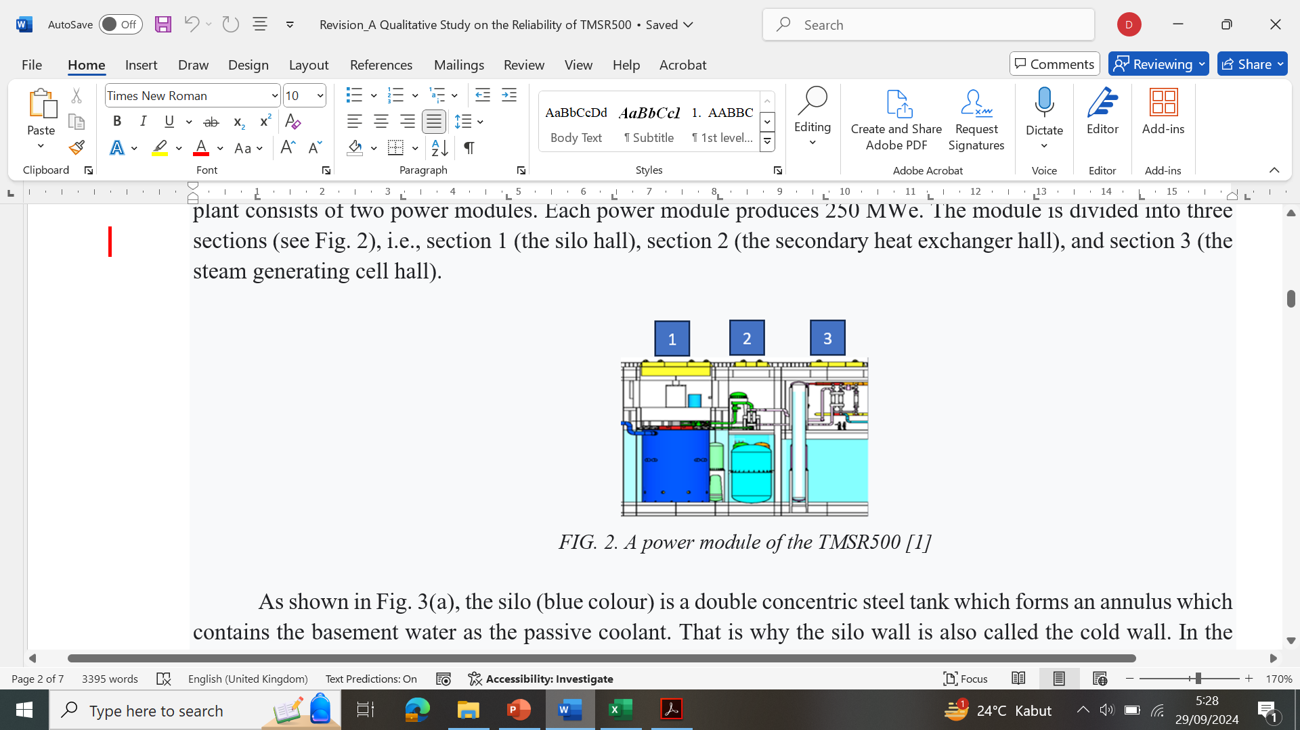
Design of TMSR500
2 power modules (2 x 250 MWe)
Silo (blue colour):
a double concentric steel tank which forms an annulus containing the basement water as the passive coolant.
Silo wall is also called cold wall.
All three sections in a power module have basements flooded by water.
Basement water acts as the coolant which removes the decay heat by natural convection process.
1 Power Module
Section 1: Silo hall
Section 2: Secondary heat exchanger hall
Section 3: Steam generating cell hall

Slide 7
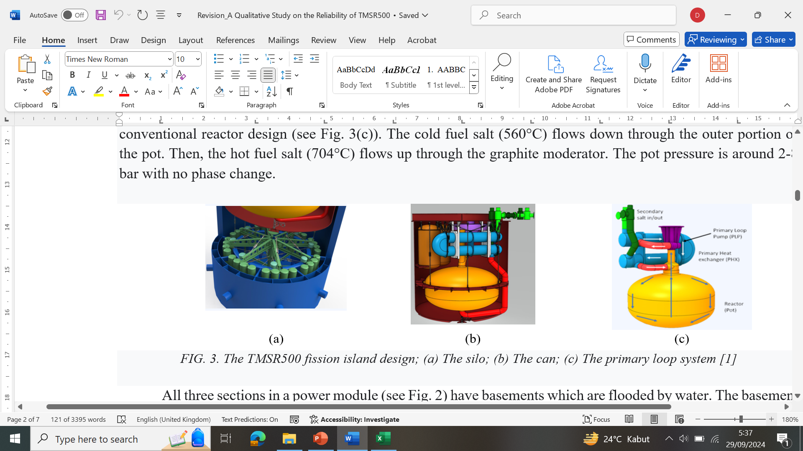
Silo Hall Components
Steel Can
(red colour)
One power module has two cans: 1st can in power operation, 2nd can in cooldown mode.
After 4 years, the cooled can is removed & replaced with a new one.
Fuel Drain Tank
(green colour)
Silo (blue colour)
Reactor Core or Pot
(yellow colour)

Slide 8
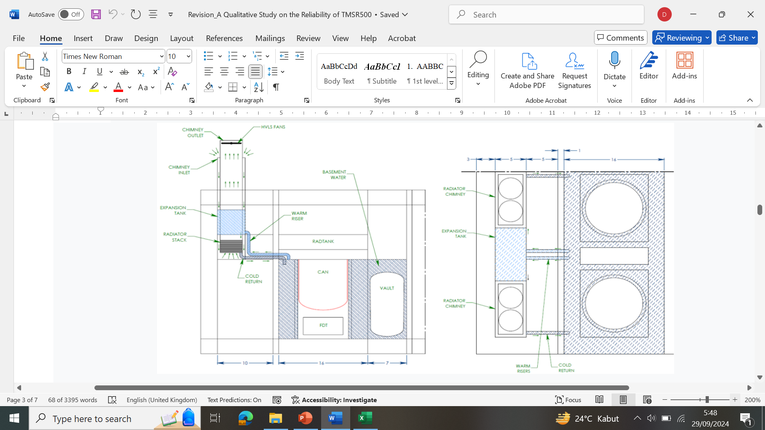
Passive Cooling Design (1)
Top view
Fully passive cooling in shutdown and accident conditions
FWD hall
Silo hall

Slide 9
Passive Cooling Design (2)
Natural convection of water (in the silo hall)
After the reactor shutdown, the fuel salt drops from the pot to the fuel drain tank.
Decay heat is radiated from fuel drain tank to the water in the cold wall.
Cold wall water naturally circulates up to expansion tank and down to radiators, then back down to basement.
Cold wall water, basement water and spent fuel storage (vault tank) water are connected.
Natural convection of air (in the FWD hall)
Full passive air cooling utilizing dry radiators, 2 draft towers (chimneys) with an expansion tank in between, and 2 fans for each chimney.
In the dry radiator, the decay heat is transferred from the cold wall water to the air which comes from the chimney inlet.
The hot air naturally circulates into the atmosphere through the chimney outlet. The fan assists in decreasing the air temperature.
Passive air cooling is designed to prevent the basement water from boiling even at full decay heat with no fan operation.
There are also no valves that must be realigned by either the system or the operator.

Slide 10
Qualitative Reliability Study (1)
Step 1
Identification of parameters affecting the operation
Step 2
Identification of key parameters which may cause the failure
Step 3
Root diagnosis to find the deviation of key parameters for causing system failure (using fault trees)
Step 4
Evaluation of system reliability
The purpose is to provide a preliminary appraisal of the system’s unavailability
Using failure modes approach

Slide 11
Qualitative Reliability Study (2)
Step 1: Identification of parameters affecting the operation
Cold wall inlet water temperature
Step 2: Identification of key parameters which may cause the failure
Cold wall inlet water temperature
Cold wall pressure
Presence of non-condensable gas
Flow resistances in the system
Cold wall pressure
Presence of non-condensable gas
Flow resistances in the system
The flow resistances in the system disturb the natural convection of water in the cold wall and air in the dry radiator.
The pressure increase in the annulus caused by the increase of basement water pressure will support the buoyancy force in the cold wall.
The probability of the presence of non-condensable gas (e.g. Kr, Xe) outside the silo is small. The gas released in the core will bubble out in the header tank due to their low solubility & finally removed.
The increase of basement water temperature entering the cold wall decreases natural convection heat transfer in the annulus/cold wall.

Slide 12
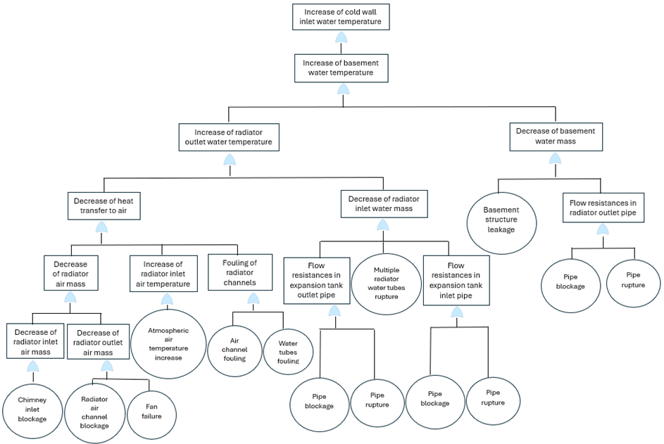
Step 3:
Root diagnosis (using fault trees) to find the deviation of key parameters which causes system failure
Qualitative Reliability Study (3)

Slide 13
Qualitative Reliability Study (4)
Step 4: Qualitative evaluation of system reliability
The root causes of the increase of the cold wall inlet water temperature:
the system rupture (the basement structure, the expansion tank inlet pipe, the expansion tank outlet pipe, the radiator outlet pipe, and the radiator water tubes);
the failure of fans; and
the increase of atmospheric air temperature.
- the flow resistances (blockage and fouling) in the system (in the chimney inlet, the radiator channels and tubes, the expansion tank inlet pipe, the expansion tank outlet pipe, and the radiator outlet pipe);

Slide 14
Qualitative Reliability Study (5)
Step 4: Qualitative evaluation of system reliability
The mechanical SSCs (basement, expansion tank, dry radiator, chimney, system piping, etc.) shall be designed to withstand the loads caused by the external hazards in the site. They shall be designed, manufactured and fabricated with suitable quality requirements.
To monitor the mechanical system integrity and the flow resistances, additional features, such as leak detector, flow rate meter, or basement water level indicator, should be available. The appropriate interconnections and isolation capabilities are also needed.

Slide 15
Design Requirements Applicability (1)
- Applicability of Requirements 51-53 IAEA SSR-2/1 (Rev. 1) concerning Passive cooling system operation in shutdown state and accident condition
- IAEA SRS No. 123 states that Req. 51-53 are generally applicable to evolutionary and innovative designs.
In general, Req. 51-53 are applicable to the TMSR500 passive cooling system design.
Several minor gaps are identified:
- the integrity of the fuel needs to be interpreted to the integrity of the primary loop;
- the reactor coolant pressure boundary needs to be interpreted to the reactor coolant boundary; and
- in the shutdown state and accident condition, the decay heat is located in the fuel drain tank, not in the reactor core (pot).

Slide 16
Design Requirements Applicability (2)
Requirement 51: Removal of residual heat from the reactor core
“Means shall be provided for the removal of residual heat from the reactor core in the shutdown state of the NPP such that the design limits for fuel, reactor coolant pressure boundary & structures important to safety are not exceeded.“
TMSR500 passive cooling system works to remove the decay heat in the fuel drain tank
Cold wall and dry radiators → channels for natural circulation heat transfer;
Chimneys and fans → heat transfer from the plant to the atmosphere;
Expansion tank → accommodate non-condensable gas & expansion of the heated basement water;
Basement → store the water as the passive coolant.
Off-gas heat removal → the off-gas is stored in secondary HE hall until the decay heat is tolerable for cold traps.
Large margin between operating T (± 700°C) & boiling T (1430°C) of fuel salt to ensure fuel design limit is not exceeded.
Bubbles creation induces positive void reactivity & jeopardizes tank’s integrity due to pressure increase.
The integrity of primary coolant boundaries (pot, fuel drain tank, primary pump, primary HE) & structures important to safety (can, silo hall) shall be maintained to ensured the reliability of passive cooling system.
“Reactor coolant pressure boundary” → “Reactor coolant boundary” (primary loop pressure 2-8 bar)

Slide 17
Design Requirements Applicability (3)
Requirement 52: Emergency cooling of the reactor core
“Means of cooling the reactor core shall be provided to restore & maintain cooling of the fuel under accident conditions at the NPP, even if the integrity of the primary coolant system’s pressure boundary is not maintained.”
TMSR500 passive cooling system works in shutdown state and accident condition.
Accident analysis is needed to ensure that the passive cooling system can remove the decay heat for a sufficient time. There is no need for operator intervention in the passive cooling system operation until 3000 days.
In case of the fuel salt fails to drop, features to ensure the fuel subcriticality in the core & the decay heat removal from the core, should be available.
The fuel drain tank integrity shall be ensured at the worst high T of the fuel salt due to the possible chemical reaction between fuel salt & fuel drain tank material at high T.
In case of the primary loop boundaries integrity cannot be maintained, the passive cooling system shall be able to cool the fuel in the next physical barriers (can & silo hall).

Slide 18
Design Requirements Applicability (4)
Requirement 52: Emergency cooling of the reactor core
The passive cooling features shall be designed with adequate reliability for each postulated initiating event.
The mechanical integrity of the system and the flow resistances in the system are important in ensuring the reliability of the TMSR500 passive cooling system
additional design features (leak detection system, flow rate meter, basement water level indicator, & sufficient isolation) should be provided to maintain the passive cooling system reliability.
Suitable redundancy and diversity should be provided to fulfil the expected system reliability (e.g. 2 chimneys & 2 fans for each chimney in a power module)
Requirement 52 does not account for the overcooling possibility of the fuel salt → the effect on the mechanical integrity of the tanks or pipes.

Slide 19
Design Requirements Applicability (5)
Requirement 53: Emergency cooling of the reactor core
“The capability to transfer heat to an ultimate heat sink shall be ensured for all plant states.”
The TMSR500 passive cooling system removes the decay heat to the atmosphere (ultimate heat sink). The air enters the plant through the chimney inlet and leaves through the chimney outlet.
2 chimneys in each power module → 2 accesses to the atmosphere
Fault tree analysis shows that the access to the ultimate heat sink/atmosphere (chimney inlet & outlet) is significantly important to ensure the passive cooling reliability.
The chimney regions (inlet and outlet) shall be designed to protect against ice buildup & to prevent foreign objects/debris from entering the airflow path. Periodic visual verification should be performed to ensure that no obstruction to airflow.
The chimney region integrity shall withstand external hazards more severe than those considered for design. The chimney’s position on top of building may make the chimney vulnerable to external human-induced hazards (aircraft crash & sabotage).
The fission island is covered by a 3 m wide double bottom, double roof, & double sides. The double sides & roof are filled with concrete. This strong structure cannot be penetrated by a Boeing 777 engine in a perpendicular impact at 400 knots.

Slide 20
Conclusion
A qualitative reliability study can be applied as the initial step to investigate contributing factors or parameters in maintaining the expected reliability level.
The flow resistances in the system and the mechanical integrity of the system become key factors in ensuring the reliability of the TMSR500 passive cooling system.
In general, the requirements of the IAEA Safety Standard No. SSR-2/1 (Rev. 1) are applicable, with several minor gaps, to the TMSR500 passive cooling design.

Slide 21
Thank You
d.hidayanti@bapeten.go.id
BAPETEN, Jl. Gajah Mada 8 Jakarta Pusat, Indonesia

