Slide 2

Evolving PSA Methodologies: Towards Dynamic Reliability in SMR Passive Systems
Dr. Masood Akmali
Notes:
Goog afternoon everyone, My name is Masood Akmali and todayI ll be discussing advancments in probablistic safety assessment methodologies. Specifically we ll look at how dynamic reliability techniques are enhancing safety for small modular reactor’s passive systems.

Slide 3
Contents
Introduction and motivations
Dynamic Fault Trees
Introduction to SAFEST
Case study
Results
Remarks and Conclusion
Notes:
“Here’s a quick overview of the presentation structure. I’ll start with the motivations behind our work, then move into Dynamic Fault Trees, an introduction to the SAFEST tool, a case study on the BWRX-300 reactor, and finally our results and conclusions..

Slide 4

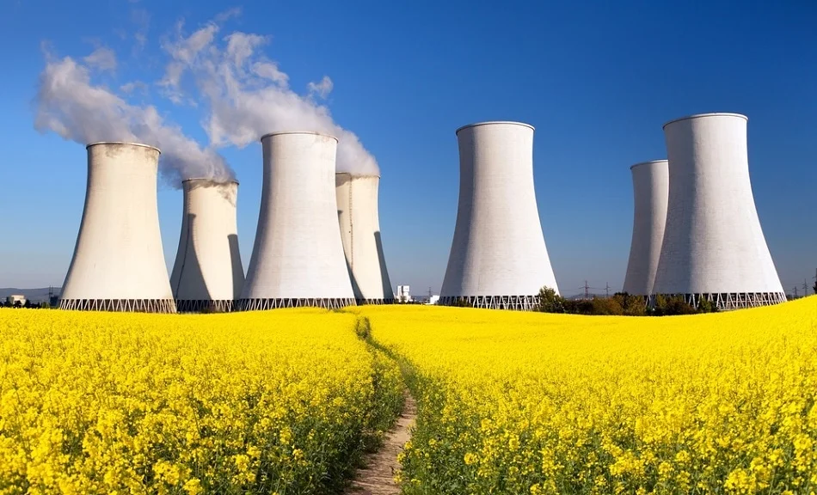


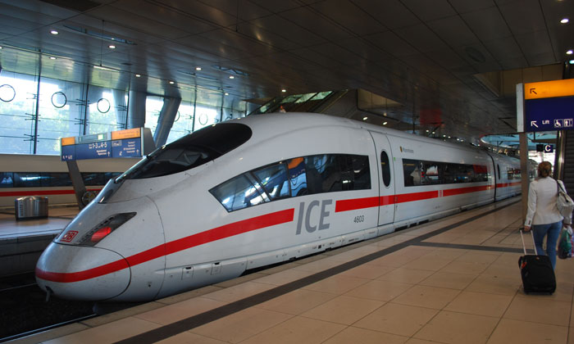
Why Risk Assessment?
To ensure that our critical assets operate within a defined risk level
Notes:
“Risk assessment is crucial because it ensures our critical assets, such as nuclear reactors, operate within safe, acceptable risk limits. In high-stakes environments, understanding and mitigating risks is essential to prevent catastrophic outcomes and protect public safety.”

Slide 5










Traditional Probabilistic Risk Assessment (PRA) Steps
Step 1
Identify Failures (Accidental Events)
Step 2
Compute Likelihood
Step 3
Identify Consequences
Step 4
Compute Losses
Notes:
“The traditional Probabilistic Risk Assessment, or PRA, follows a sequence of steps: first, we identify potential failure events, calculate their likelihood, analyze the consequences, and finally, compute potential losses. While these steps form the foundation of safety assessments, static methods may fall short in capturing time-dependent or dynamic risks adequately.”

Slide 6
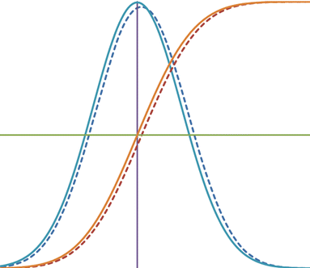

Static Fault Trees & Event Trees in PRA
Failed
Event 1
Event 2
Outcome 1
Y
Y
N
Outcome 2
Outcome 3
N
Y
Y
Outcome 4
N
Y
Outcome 5
Vot
N
Y
N
Outcome 6
1
2
3
4
5
6
7
Outcome 7
N
Y
N
Outcome 8
Step 1
Build Failure Models using Static Fault Trees
Step 2
Compute Failure Prob.
Step 3
Build Consequences Models using Event Trees
Step 4
Compute Freq./Prob./losses
Notes:
In traditional PRA, we use fault trees to model failure pathways and event trees to model consequence pathways. The issue is that these models assume that failure probabilities and events remain static over time, which isn’t always realistic for complex systems like reactors where conditions can change rapidly.”

Slide 7
Limitations of Static Fault Trees (SFT)
Simplicity
  Too simple to model realistic scenarios faithfully
Lack common dependability patterns
  Spare management (Cold, Warm, Hot)
  Functional dependencies – common cause failure (CCF)
  Event sequencing – restricting event to occur in a sequence
  Order-dependent failure – failure can only occur if events occur in an order
Static behaviour
  Top-level event only depends on set of failed events.
Many variants:
  state-event fault trees, Boolean-logic driven Markov processes, SD fault trees, PANDORA fault trees, Dugan’s dynamic fault trees

Slide 8

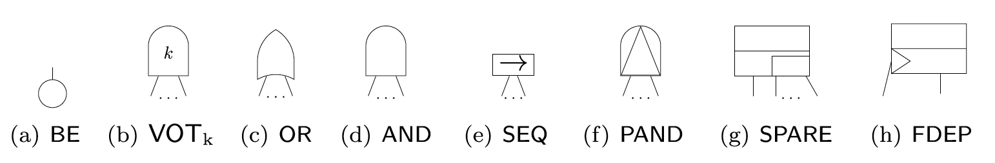
Dynamic Fault Trees (DFT) [Dugan et al, 1992]
Dynamic fault tree is a SFT with additional gates to model:
  Spare management -- hot, cold and warm spares,
  Functional (probabilistic) dependencies like common cause failure CCF, and
  Temporal failure ordering
Prof. Joanne Bechta Dugan
Electrical & Computer Engineering
Static Gates
Dynamic Gates

Slide 9












Probabilistic Risk Assessment Tool
Static & Dynamic Fault Trees
Reward/loss Event Trees Embedded with Fault Trees
Optimal-Decision in Probabilistic Environment
Loss Quantification (e.g. Expected Casualties)
www.safest.dgbtek.com
Joost-Pieter Katoen
Falak Sher
Mariëlle Stoelinga
Matthias Volk

Slide 10


Analysis of Dynamic Fault Trees
Dynamic
Translate
Static
Markov model
Dynamic Fault Tree
System
Results
BDD
Reliability Metric
Probabilistic Model-checking
Reliability Analysis (SAFEST Toolchain)
Notes:
This methodology uses **Dynamic Fault Trees (DFTs)** and **Probabilistic Model Checking** to evaluate the reliability of complex, time-dependent systems. It begins by modeling potential failure paths in a system with DFTs, which account for both static and dynamic interactions between components. The DFT is then divided into static parts, analyzed using **Binary Decision Diagrams (BDDs)**, and dynamic parts, analyzed using **Markov models** to capture time-sensitive failure probabilities.
The combined model is processed through probabilistic model-checking, which calculates the likelihood of various failure outcomes. Tools like Storm integrate with this process to manage and analyze the dynamic aspects efficiently. The output provides reliability metrics, which highlight high-risk components and critical failure sequences, guiding design improvements and risk mitigation efforts for enhanced system reliability and safety.

Slide 11
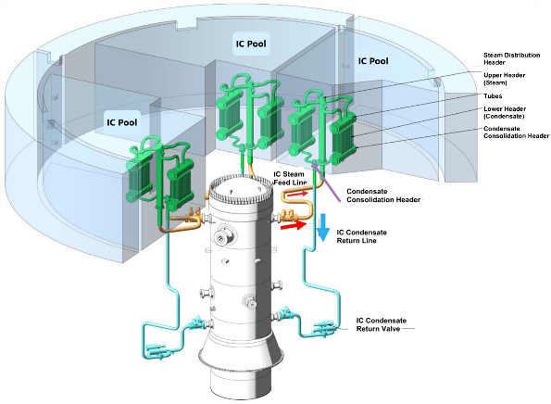
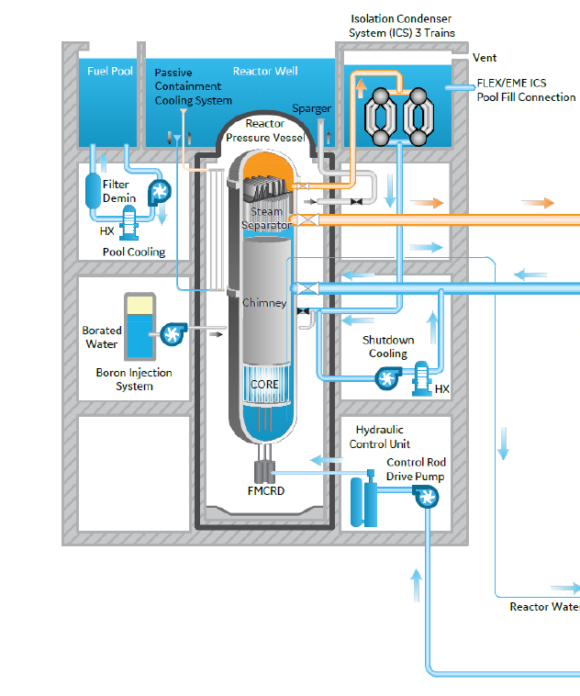
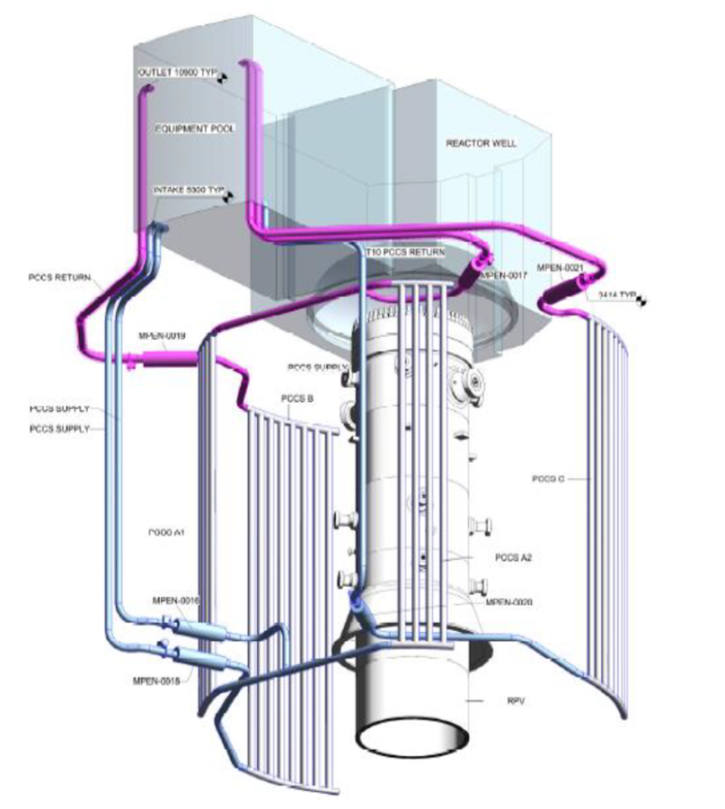
Case Study: BWRX-300 SMALL MODULAR REACTOR
Two passive cooling systems
Isolation Condenser System (ICS)
Containment Cooling System (CCS)
BWRX-300 Diagram of the Isolation Condenser System*
The DFT of RIS and ICS systems is built based on the static fault tree from Hitachi* and later is extended with additional dynamic features.
GE Hitachi Nuclear Energy, ESBWR ,005N9751, Revision F 2023
GE Hitachi Nuclear Energy, ESBWR CERTIFICATION PROBABILISTIC RISK ASSESSMENT, NEDO-33201 Revision 6. GE-Hitachi Nuclear Energy Americas LLC, 2010. Accessed: May 26, 2023.
Notes:
the ICS provides for residual heat removal and emergency pressure control for the BWRX-300. It consists of three independent loops, each with a 100% capacity for decay heat removal. This is accomplished by transferring heat through natural circulation from steam in the RPV head to a condenser pool, where it will condense and return to the vessel. Water in the condenser pool will evaporate, discharging to the atmosphere, which is the ultimate heat sink. The combined capacity of the IC pools ensures heat removal capability for 7 days and may do so indefinitely if water is replenished.
The Passive Containment Cooling System (PCCS) relies on natural circulation to transfer heat from the containment to the equipment pool to maintain containment pressure and temperature within the design limits during accident conditions or loss of active containment cooling. Supply and discharge connections from the pool are connected to closed loop piping within containment. Heat transfer occurs from the containment to the PCCS by natural circulation and condensation. The PCCS consists of three independent trains of LP HXs that transfer heat from the containment to the equipment pool which is located above the PCS and is filled with water during normal operation.

Slide 12
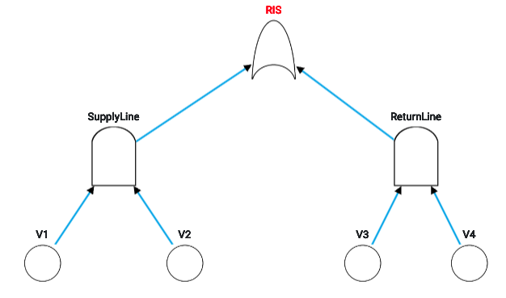
Static Fault Tree of Reactor Isolation (RI) System *
Without Important aspects like
Failure to open (failure on demand – FOD) of V1, V2, V3 & V4
Common cause failure (CCF) of V1 & V4 as well as V2 & V3
Addition of failure modes (AFM) e.g. valve rupture rates of V1, V2, V3 & V4 once LOCA occurs
* GE Hitachi Nuclear Energy, ESBWR CERTIFICATION PROBABILISTIC RISK ASSESSMENT, NEDO-33201 Revision 6. GE-Hitachi Nuclear Energy Americas LLC, 2010

Slide 13
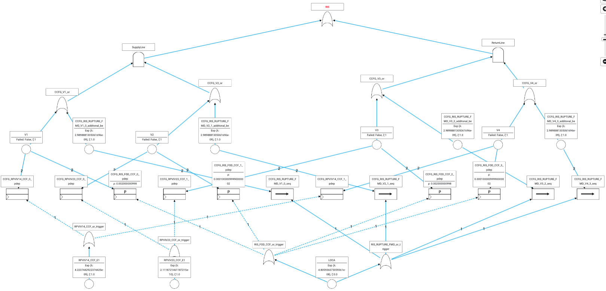
Dynamic Fault Tree of Reactor Isolation (RI) System
DFT of RIS after incorporating FOD, CCF and AFM in static fault tree

Slide 14
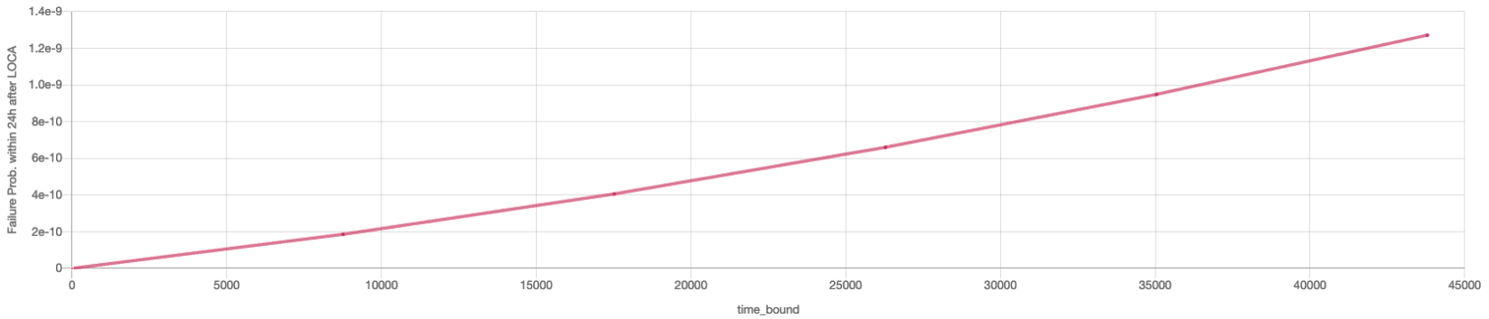
Probability of failure of Reactor Isolation (RI) within 24h with
varying occurrence timings of LOCA (in years)
Our analysis covers both pre–LOCA and post-LOCA phases simultaneously
Notes:
The probability of failure in the Reactor Isolation System over a 24-hour period, particularly under varying timings of a Loss of Coolant Accident (LOCA). Analyzing both pre- and post-LOCA phases provides a comprehensive understanding of how failure probabilities evolve over time.”Graph Interpretation: “In the graph, we can see specific intervals where the failure probability is higher, indicating critical points where intervention or monitoring would be most effective.”

Slide 15
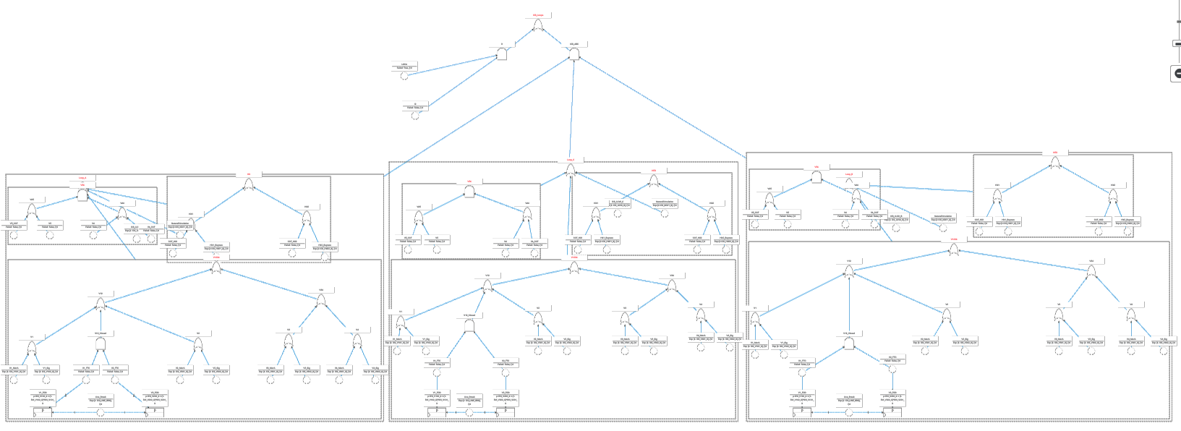
Fault Tree of Core Cooling System (CC)

Slide 16
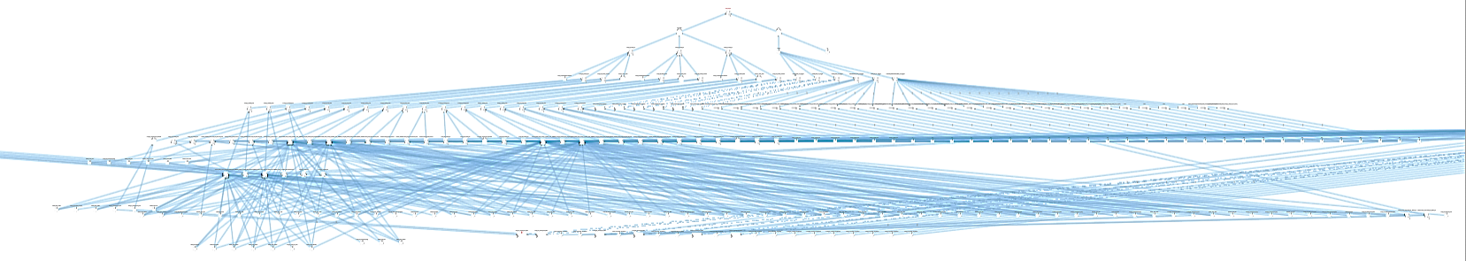
Dynamic Fault Tree of Core Cooling System (CC) System
DFT of CC after incorporating FOD, CCF and AFM in static fault tree
Failure to open (failure on demand – FOD) of V1, V2, V3 & V4
Common cause failure (CCF) of V1 & V4 as well as V2 & V3
Addition of failure modes (AFM) e.g. valve rupture rates of V1, V2, V3 & V4 once LOCA occurs

Slide 17
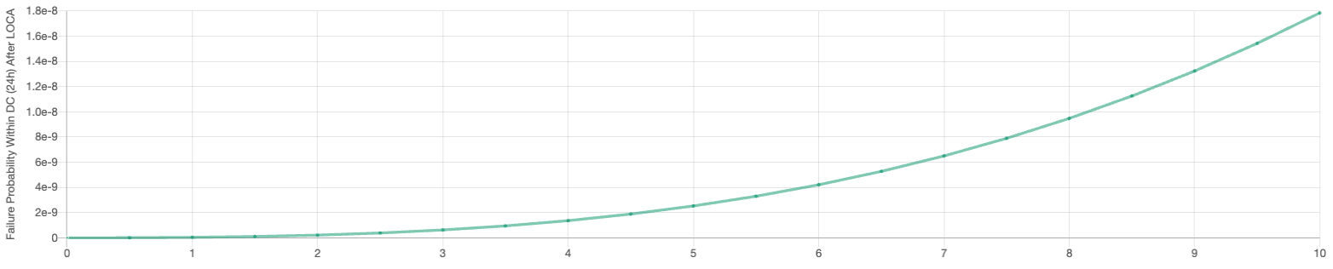
Probability of failure of Core Cooling Systems (CC) within 24h with
varying occurrence timings of LOCA (in years)
Time bound

Slide 18
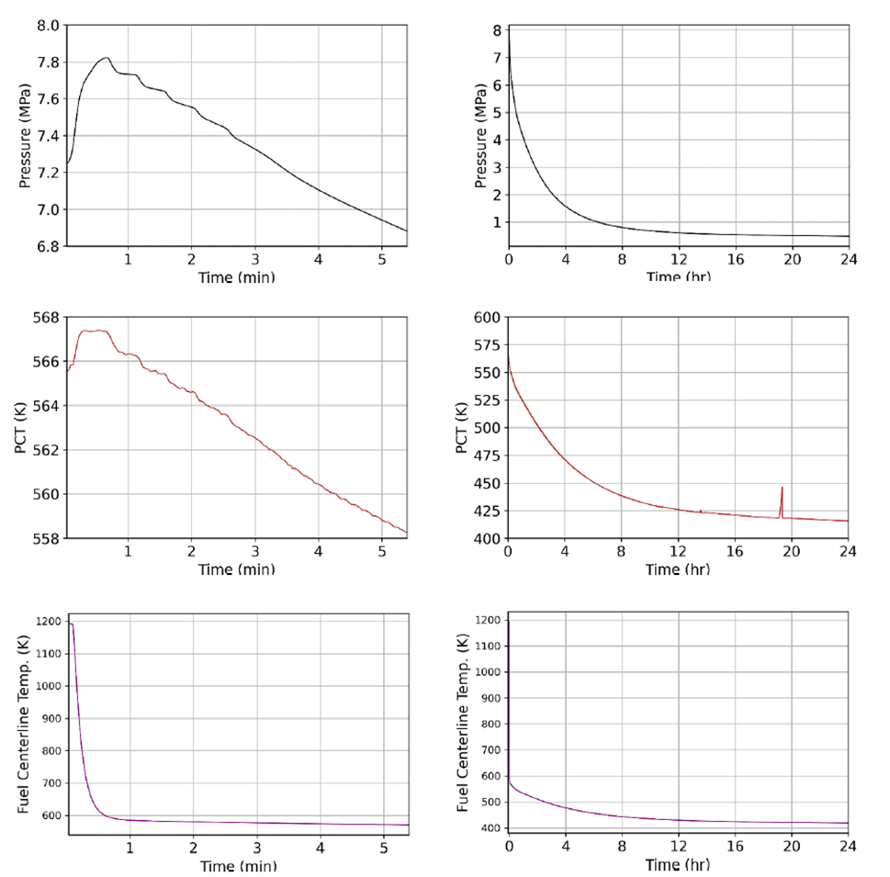
Failure Rates for Valves and Heat Exchangers Due to Transient Parameters
The reliability of valves and heat exchangers can be significantly affected by transient operational parameters like temperature and pressure
Failure Rate Model for Heat Exchangers
$λ_{0}$: The original failure rate. $Δ$T: The absolute deviation from the steady-state (optimal) temperature. $Δ$P: The absolute deviation from the steady-state (optimal) pressure. T_{steady}: The steady-state temperature. P_{steady}: The steady-state pressure. k_{T}: Sensitivity factor for temperature changes k_{P}: Sensitivity factor for pressure changes.
Failure Rate Model for Valves
$λ_{0}$The base failure rate. E_{a}: Activation energy, indicating the sensitivity of the failure rate to temperature changes. k: Boltzmann's constant. T_{ref}: The reference temperature. T: The operating temperature. α: Sensitivity factor for pressure changes. $Δ$P: The relative pressure change calculated as
Transient performance of core parameters for a BWRX-300 reactor trip (by TRACE) *.
Please refer to the paper for more information
*GRAEME TRUNDLE, Reliability Assessment of Passive ICS in an SMR as part of the PSA Analysis, SH204X, 2023
Notes:
focuses on failure rate models for critical components like valves and heat exchangers. In nuclear reactors, these components experience transient conditions—fluctuations in temperature and pressure—that significantly impact their reliability.”Failure Rate Models: “We use models that incorporate factors like activation energy, which measures the sensitivity of a failure rate to temperature changes, and sensitivity factors for pressure variations. This allows us to predict the likelihood of component failure under varying operational conditions.”Application to Reactor Safety: “By modeling these rates, we can assess whether components are likely to fail under specific LOCA scenarios. This information is essential for proactive maintenance planning and ensuring reliable operation under stress.”

Slide 19
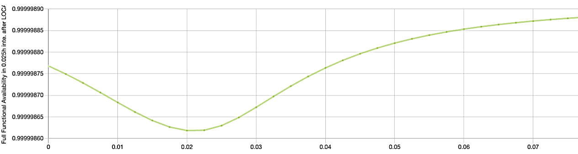
Full Functional Availability of Core Cooling System After LOCA
in Intervals (assuming constant Temperature & Pressure)
Assumptions:
System is fully available at the beginning of intervals – no component is failed.
Temperature/Pressure is constant in intervals

Slide 20
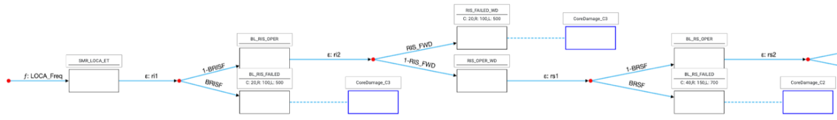
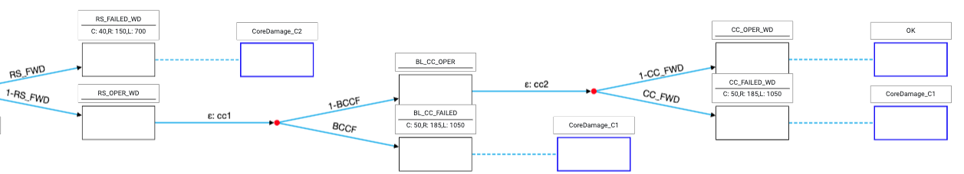
Reward/Loss Event Tree of LOCA

Slide 21
Probabilities of Consequences
The results of the LOCA analysis.
In comparison:
Consequence | Expected Frequency (yr ⁻¹)
CoreDamage_minor | 1.34E-8
CoreDamage_moderate | 5.13E-13
CoreDamage_severe | 6.55E-9
The results from the traditional Probabilistic Safety Assessment (PSA) performed using the RiskSpectrum tool for the BWRX-300, yield a total core damage frequency (CDF) of 1.23E-07 per year*.
Our dynamic PSA approach, estimates a total core damage frequency of ~1.996E-08 per year, provides a more granular analysis.
Although our analysis did not include all potential initial events such as transients or vessel rupture, it did incorporate the failure rates of valves and heat exchangers due to transient parameters.
Losses | Expected Value
Casualties | 8.01E-7 Lives
Radionuclide | 3.14E-6 Million Curries
Contaminated Land | 1.74E-5 Sq miles
Consequence Frequencies (Duration of LOCA: 1year and its freq: 0.000421).
*GRAEME TRUNDLE, Reliability Assessment of Passive ICS in an SMR as part of the PSA Analysis, SH204X, 2023

Slide 22
SAFEST, A Probabilistic Risk Assessment Toolchain
Scalable Static & dynamic fault trees (DFTs)
Scalable Reward/loss event trees with non-deterministic choices at nodes
Parametrized fault/event tree models
Importing/exporting models in JSON, Galileo, Latex
Importing/exporting models parameters in Excel
(Empirical and mix) failure distributions templates
Multipage hierarchical fault/event trees
Mirror images of fault tree elements
Graphical, tabular, (parametric) Galileo views
SysML v2 to (dynamic) fault trees
CCF groups
  Alpha, Beta, Multi Greek, Binomial-model
Probabilistic dependencies
  Failure-on-demand
  Dynamic addition of new failure modes
Initial condition sets
  Failure evidence
Rich set of measures in CSL Logic
Scalable analysis of DFTs via BDDs & Model-checking
Birnbaum Index, Criticality Importance, RAW, RRW, Diagnostics Imp. Factor, BAGT+, BAGT- measures
Boolean equations on state labels
Interactive graphical simulation (Multipage)
Automatic modules detection
Automatic simplification of fault trees
Multi-attributes/colors tagging to elements
Integration of fault trees into event trees
Exact and approx. sound analysis of DFTs
Graphs on CSL measures
Finding optimal sequence of decisions in event trees to minimize risk
Quantify expected losses e.g. casualties
Extensive filters, group find & replace
Duplicate fault/event trees
Group deletion, update of elements
MCS for static fault trees
Links of manuals can be attached with elements
Easy integration with AI/ML/NLP technologies
Technology stack (Angular, Python)

Slide 23
Remarks & Conclusions
Dynamic PSA Methodology Benefits
Integrates time-dependent failure rates and system responses, enhancing traditional PSA for comprehensive safety assessment.
Impact of Transient Conditions
Analyzing parameters like temperature and pressure on critical components (e.g., valves, heat exchangers) provides insight into potential system failures and core damage risks.
Low core damage frequency observed, but significant increase in component failure rates during initial phases of LOCA.
Sensitivity to Initial Conditions
Reliability of ICS is influenced by initial pressure and temperature changes post-LOCA, underscoring the need to account for dynamic factors in assessments.
Comparative Analysis with Traditional PSA
Dynamic models show reduced core damage frequency vs. static models, revealing vulnerabilities overlooked by traditional methods.
Future Research Directions
Emphasis on sensitivity analysis and uncertainty quantification for enhanced confidence in results and identification of vulnerabilities.
The Dynamic Probabilistic Safety Assessment (DPSA) methodology enables a more realistic evaluation of system reliability, especially under transient conditions in SMRs.

Slide 24


Slide 25
Supporting Slides

Slide 26
Embedding of Fault Trees within Event Trees
Outcome 1
Outcome 2
Outcome 3
Outcome 4
Accidental event
Outcome 5
Outcome 6
Failed
Outcome 7
Outcome 8
Vot
Safety System 1 Failure
Safety System 2 Failure
Safety System 3 Failure
1
2
3
4
5
6
7
1
2
3
4
1
2
3
4
1
2
3
4
Notes:
Here, we see an embedded approach combining fault and event trees. This embedded structure allows for a more thorough failure analysis. It’s particularly useful for representing the sequence and interaction of failures, which helps us predict system outcomes more accurately

Slide 27
Analysis of Event Trees Embedded With Fault Trees
1 - P3
Outcome 1
1 - P2
P3
Outcome 2
Step1: Analyze fault trees to compute failure probabilities
A1 = Failure Prob. of Accidental Event
P1 = Failure Prob. of Safety System 1
P2 = Failure Prob. of Safety System 2
P3 = Failure Prob. of Safety System 3
Step2: Analyze event tree to compute probabilities of outcomes
1 - P1
1 - P3
Outcome 3
P2
P3
Outcome 4
A1
Outcome 5
1 - P3
1 - P2
P3
Outcome 6
P1
1 - P3
Outcome 7
P2
P3
Outcome 8

Slide 28
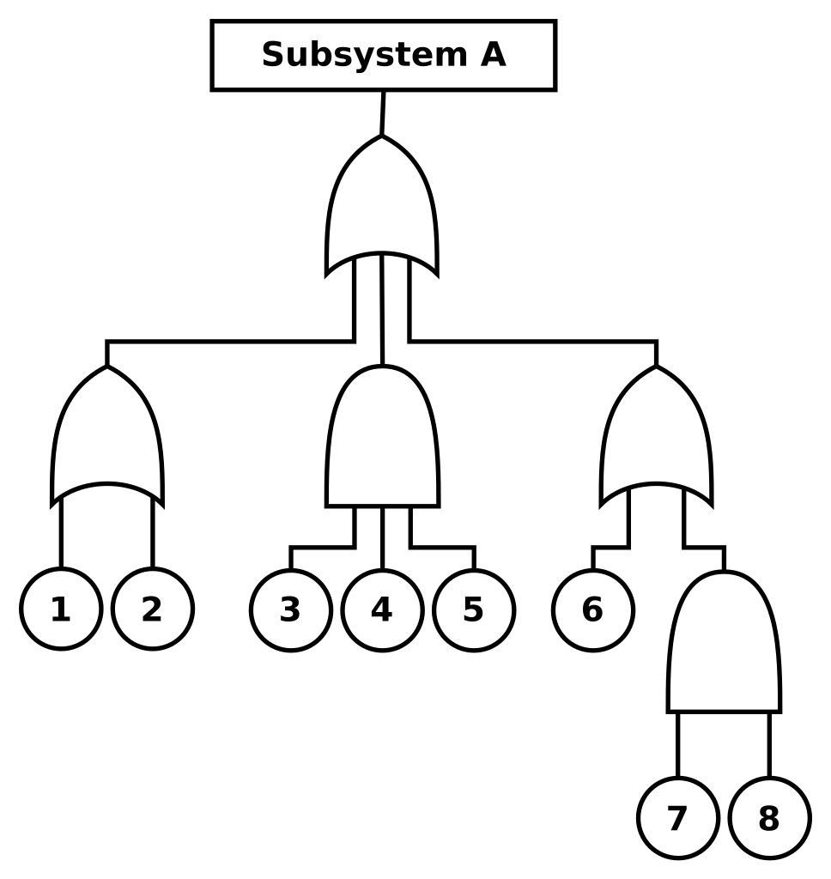
Static Fault Trees (SFT) [Watson, 1961-62]
Static fault tree is a directed acyclic graph with two types of nodes: circles & gates.
Circles model basic failure (BE) events in systems.
Gates model intermediate (compound) failure events
Failure probabilities of basic events is well-defined.
Intermediate events failure probability is computed from other (child) events.
Tree root, called top level event (TLE), models a system failure.
Notes:
Overview of Static Fault Tree Shortcomings: “Static Fault Trees (SFTs) are foundational in PRA, but they have limitations in modeling realistic, complex systems. They lack mechanisms to model dependencies between components, order-specific failures, and time-dependent risks.”Key Limitations: “SFTs cannot account for factors like spare management, event sequencing, or functional dependencies. For instance, they assume that a system’s failure depends solely on whether certain components have failed, not on the order or timing of those failures.”Motivation for Dynamic Fault Trees: “These limitations have driven the development of DFTs, which add dynamic gates and dependency modeling to more accurately reflect real-world systems, especially under changing operational conditions.”

Slide 29
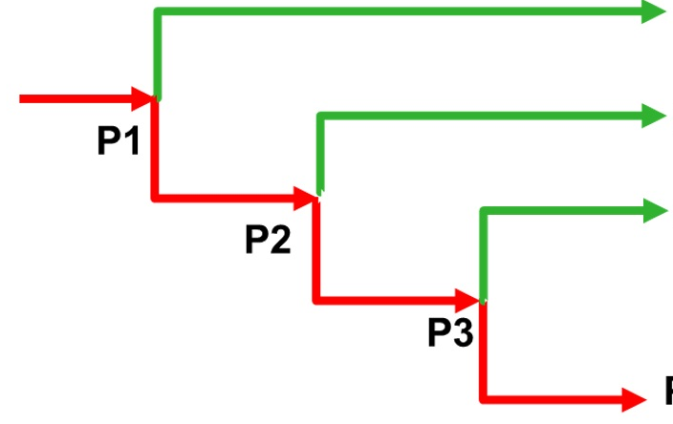
Analysis of Reward Event Trees (RFTs)
Translate
MDP
Markov model
Event Tree
System
Result
Metric
(Prob.)
Probabilistic model-checking
Notes:
This methodology uses **Reward Event Trees (RFTs)** and **Markov Decision Processes (MDPs)** to analyze the reliability and potential outcomes of complex systems. The process starts by mapping possible event sequences and outcomes in a reward event tree, assigning probabilities to each path. The tree is then translated into a Markov model, which captures the dynamic, time-dependent behavior of the system. Using probabilistic model-checking tools like **Storm**, the methodology calculates the probability and impact of different outcomes, providing a comprehensive risk and reward profile. This analysis guides decision-making by highlighting high-risk scenarios and optimizing system reliability and safety.

Slide 30
PRA for Dynamic Systems with Dynamic Fault Trees & Reward Event Trees
Modeling Steps
Build Failure Models using Dynamic Fault Trees (DFTs)
Build consequence models with Reward/Loss Event Trees (RETs)
  Model decision-making
  Specify values of quantities e.g. # of casualties
Embed DFTs in RETs
Outcome 1
decision 1
Outcome 2
5 casualties
Outcome 3
2 casualties
decision 2
Outcome 4
8 casualties
Outcome 5
Outcome 6
Accidental event
Analysis Steps
Analyze Dynamic Fault Trees (DFTs)
Replace branch probabilities in RETs
Analyze RETs to compute:
  Outcome probabilities
  Expected values of quantities
Outcome 7
Outcome 8
1
2
3
5
6
7
Safety System 1 Failure
Safety System 2 Failure
Safety System 3 Failure
4
8
9
1
2
3
5
6
7
1
2
3
5
6
7
1
2
3
5
6
7

