Slide 1
CIEMAT’s Contribution to the
Research of SMR Safety and Design
L.E. Herranz*, M. Garcia, J. Fontanet
*luisen.herranz@ciemat.es
Unit of Nuclear Safety Reseach
Departament of Nuclear Fission
CIEMAT
International Conference on Small Modular Reactors and their Applications
Vienna (Austria), 21-25 October, 2024.

Slide 2
Contents:
01
Context
02
CIEMAT’s Activities
03
HTGRs
04
SFRs
05
LW-SMRs
06
Conclusions

Slide 3
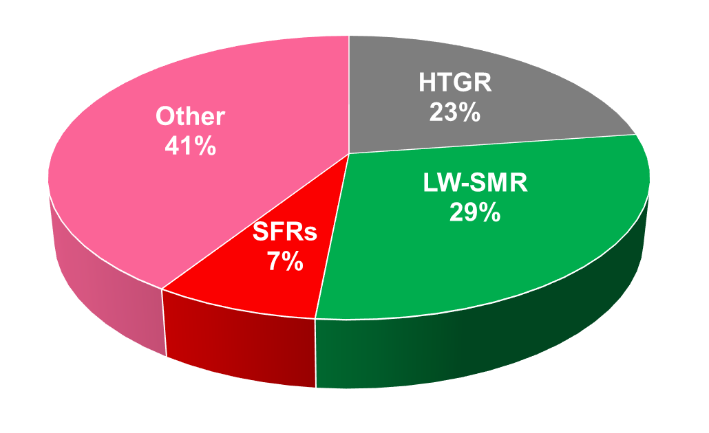
Context
CIEMAT has committed for more than a decade to research on safety of advanced reactors with a direct projection to Small Modular Reactors
The technologies addressed (HTGRs, SFRs & LW-SMR) represent a significant fraction of SMRs design reactors
Data source: aris.iaea.org/TechnicalData

Slide 4


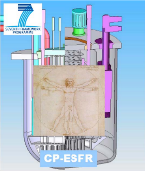

CIEMAT’s Activities
2007
2008
2009
2010
2011
2012
2013
2014
2015
2016
2017
2018
2019
2020
2021
2022
2023
2024
2025
2026
PBMR
PBMR-CIEMAT agreement
01/06/2007 – 31/10/2007
03/06/2008 – 31/12/2009
RAPHAEL
FP6-EURATOM-NUCTECH
15/04/2005 – 14/04/2010
CP-ESFR
FP7-EURATOM-FISSION
01/01/2009 – 30/06/2013
JASMIN
FP7-EURATOM-FISSION
01/12/2011 – 31/05/2016
ESFR-SMART
EURATOM
01/09/2017 – 31/08/2022
SASPAM-SA
EURATOM
01/10/2022 – 30/09/2026

Slide 5
HTGRs
2007
2008
2009
2010
2011
2012
2013
2014
2015
2016
2017
2018
2019
2020
2021
2022
2023
2024
2025
2026
PBMR
PBMR-CIEMAT agreement
01/06/2007 – 31/10/2007
03/06/2008 – 31/12/2009
RAPHAEL
FP6-EURATOM-NUCTECH
15/04/2005 – 14/04/2010
CP-ESFR
FP7-EURATOM-FISSION
01/01/2009 – 30/06/2013
JASMIN
FP7-EURATOM-FISSION
01/12/2011 – 31/05/2016
ESFR-SMART
EURATOM
01/09/2017 – 31/08/2022
SASPAM-SA
EURATOM
01/10/2022 – 30/09/2026

Slide 6
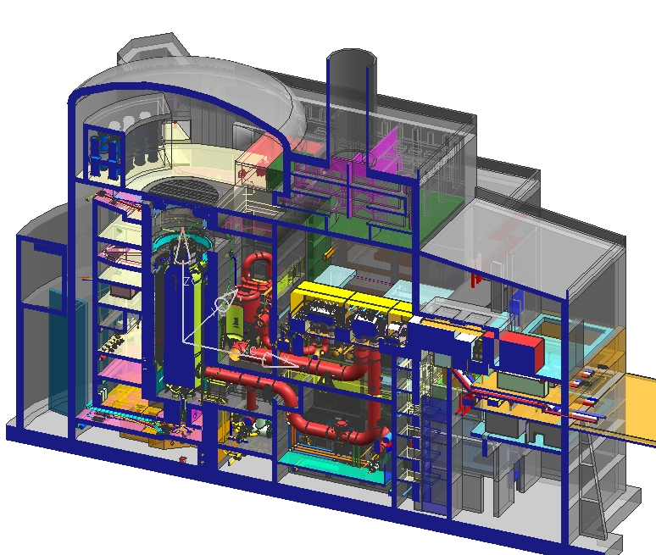
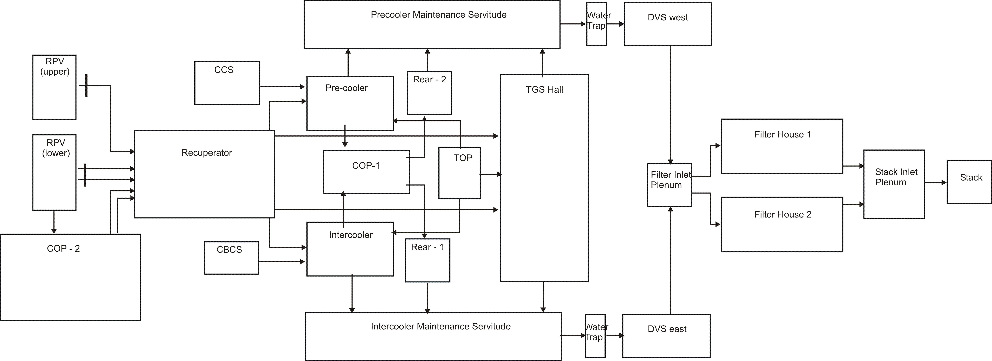
HTGRs
Plant model
Filter chambers
(~ 8000 m³)
Depres. Vent Shaft
(~ 4000 m³)
Sequence description
Reactor building
(~ 3000 m³)
Sequence | Accident type | Diameter | Dpz time | Injected dust
Small break (SB) | AOO | 10 mm | 5000 s | 5 %
Large break (LB) | DBA | 230 mm | 100 s | 20 %
Very large break (VLB) | BDBA | 1000 mm | 55 s | 30 %
Power Conversion Unit
(~ 25000 m³)

Slide 7
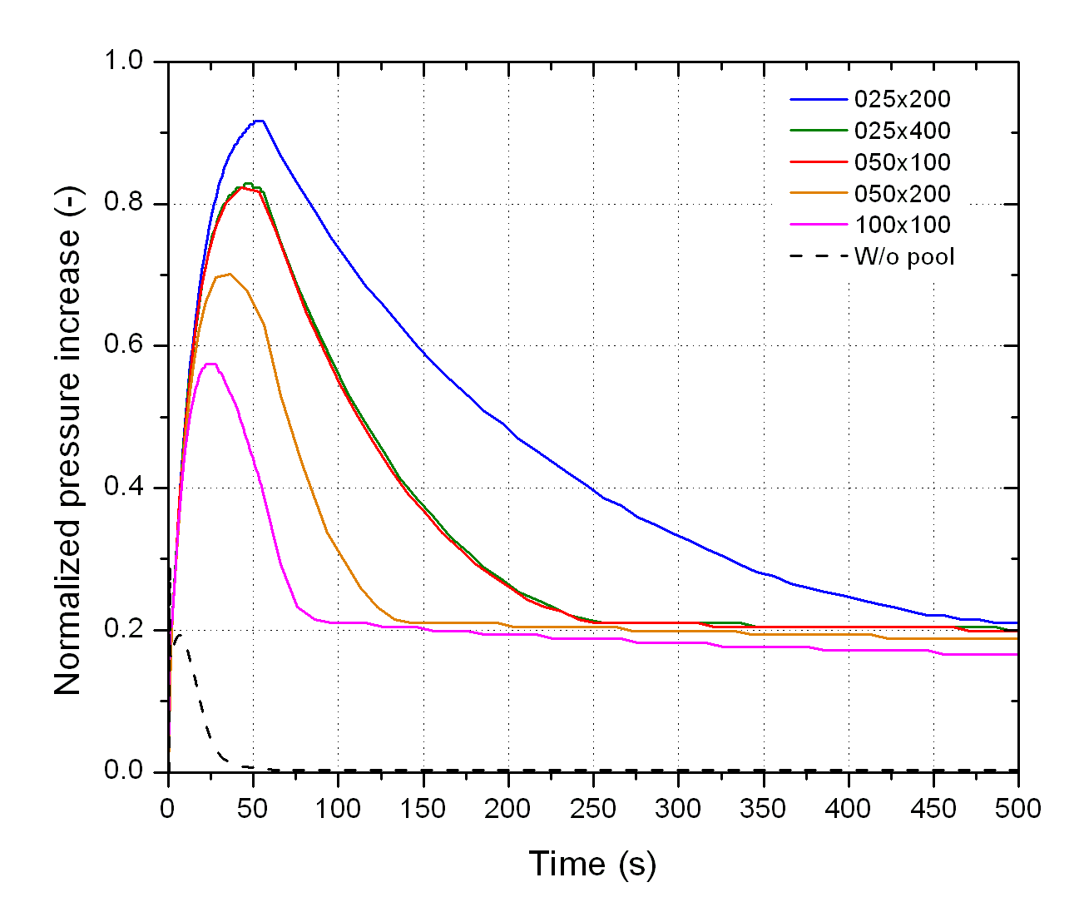
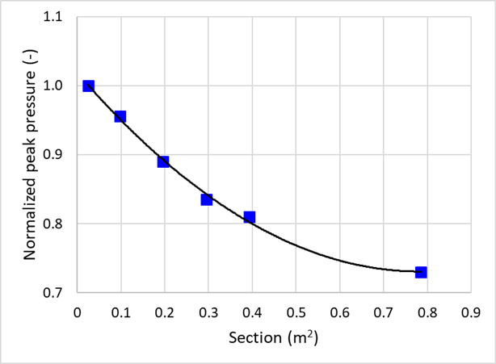
HTGRs
Pool effect on pressure
Pool characteristics
Pressure evolution on PCU
(Deep pool)
Diameter (mm) | Number of tubes | Total tubes cross section (m²)
25 | 200 | 0.098
 | 400 | 0.196
50 | 100 | 0.196
 | 200 | 0.393
100 | 100 | 0.785
Deep : 4.25 m
Diameter (mm) | Number of tubes | Total tubes cross section (m²)
25 | 50 | 0.025
 | 200 | 0.098
 | 600 | 0.295
50 | 50 | 0.098
 | 100 | 0.196
Pressure peak
Shallow: 2.25 m

Slide 8
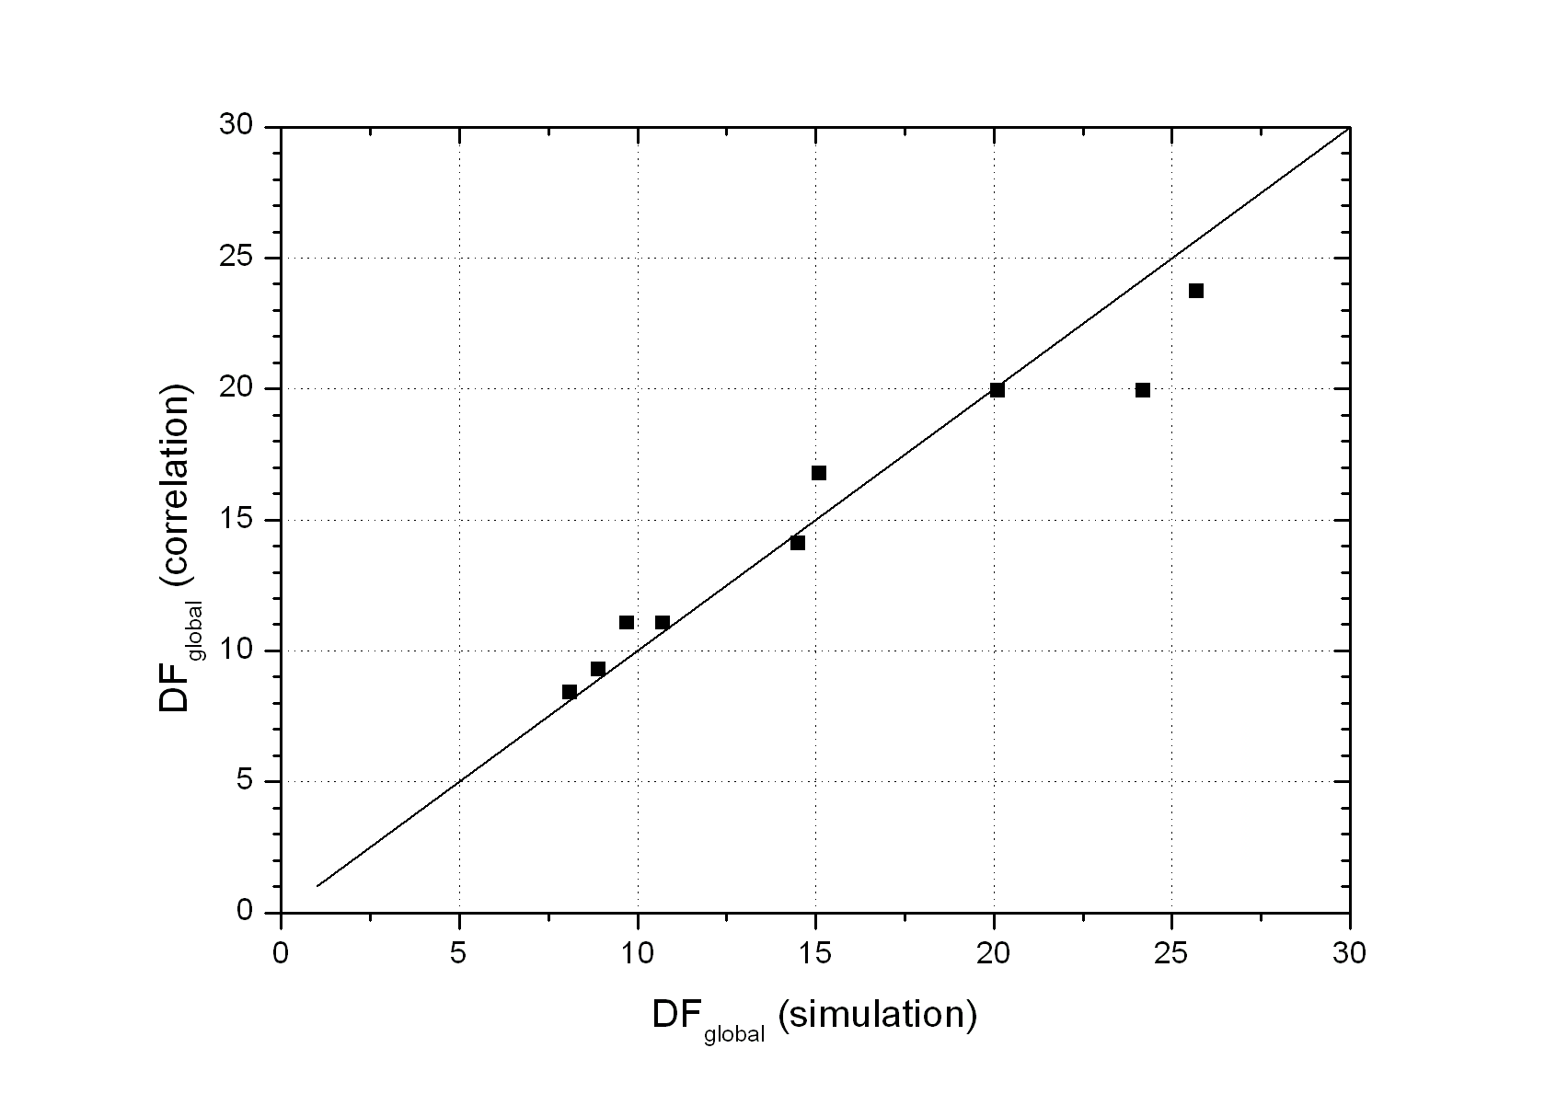
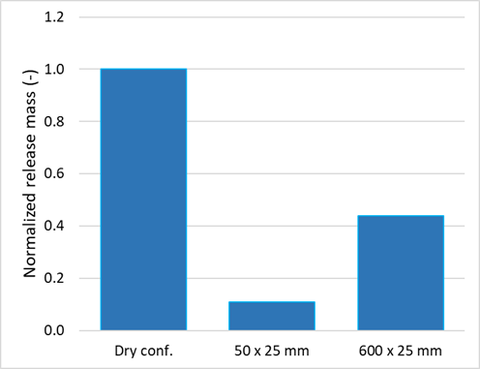
HTGRs
Aerosol behaviour
Aerosol retention in pool
Aerosol release to environment
Correlation developed for global DF (Decontamination Factor)
Source term reduced a factor of 10 compared with dry confinement

Slide 9
SFRs
2007
2008
2009
2010
2011
2012
2013
2014
2015
2016
2017
2018
2019
2020
2021
2022
2023
2024
2025
2026
PBMR
PBMR-CIEMAT agreement
01/06/2007 – 31/10/2007
03/06/2008 – 31/12/2009
RAPHAEL
FP6-EURATOM-NUCTECH
15/04/2005 – 14/04/2010
CP-ESFR
FP7-EURATOM-FISSION
01/01/2009 – 30/06/2013
JASMIN
FP7-EURATOM-FISSION
01/12/2011 – 31/05/2016
ESFR-SMART
EURATOM
01/09/2017 – 31/08/2022
SASPAM-SA
EURATOM
01/10/2022 – 30/09/2026

Slide 10
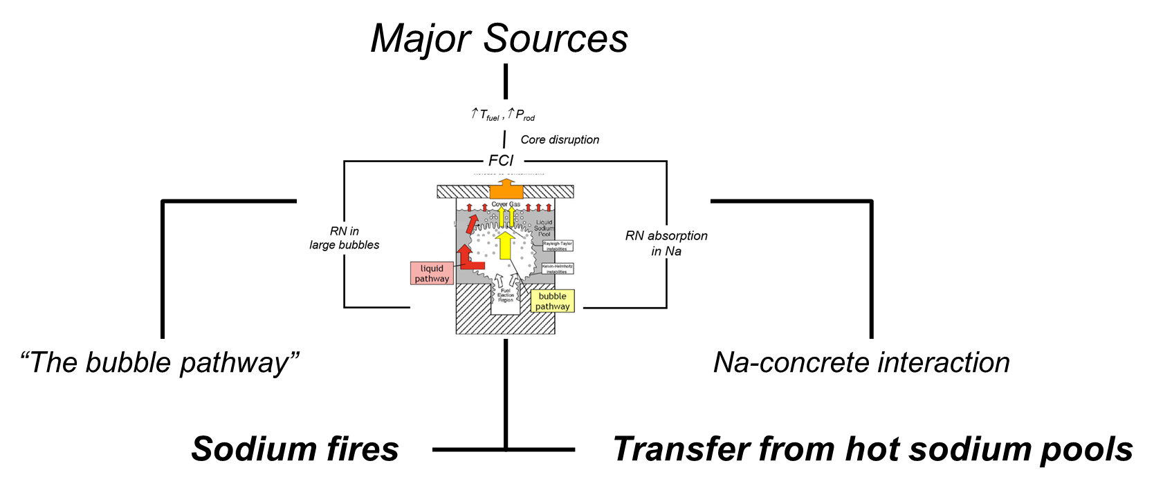
SFRs
Transfer from hot sodium pools
Sodium fires

Slide 11
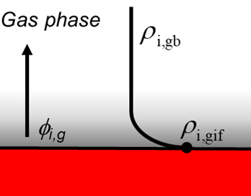
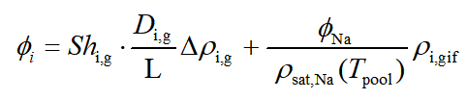



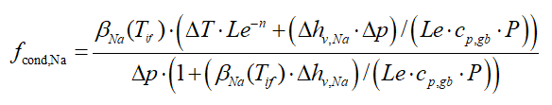

SFRs
FPs release model from hot-Na pools
Diffusion
Entrainment
Fink, J.K., Leibowitz, L., 1995 (No. ANL/RE--95/2, 94649)
Sauter, H., Schütz, W., 1980 (NUREG/CR-1724 ORNL/NUREG/TM-404 CSNI-45)
Tashiro, S., Sagawa, N., 2001 (https://doi.org/10.1080/18811248.2001.9715066)
HMT analogy
Raoult’s law
Nucleation φ_{Na}

Slide 12
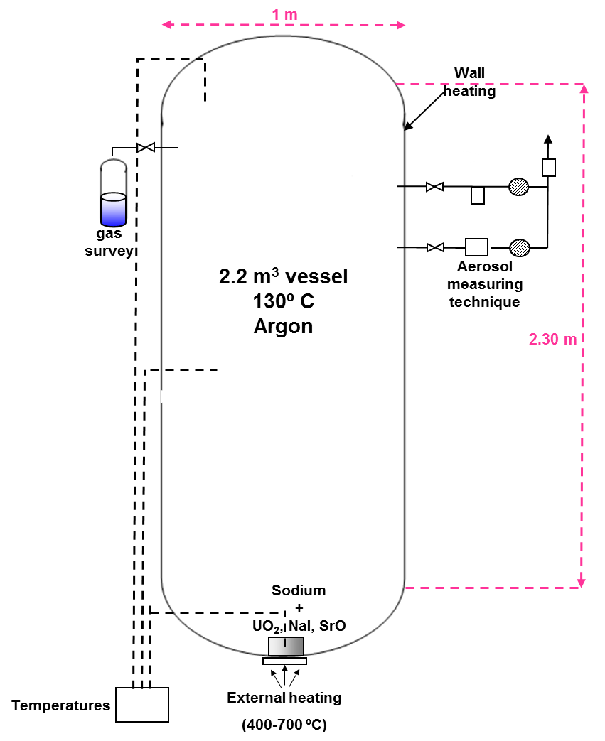
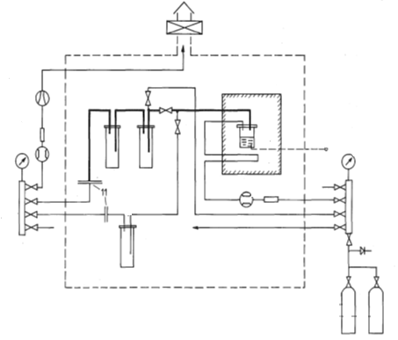
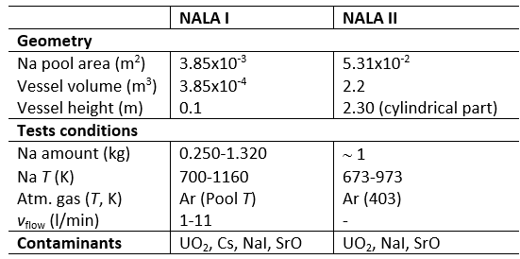
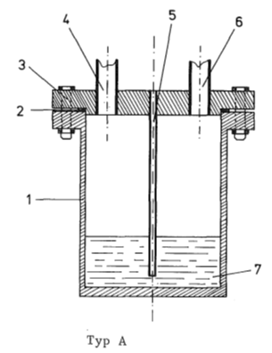
SFRs
FPs release model from hot-Na pools
NALA I
NALA II

Slide 13
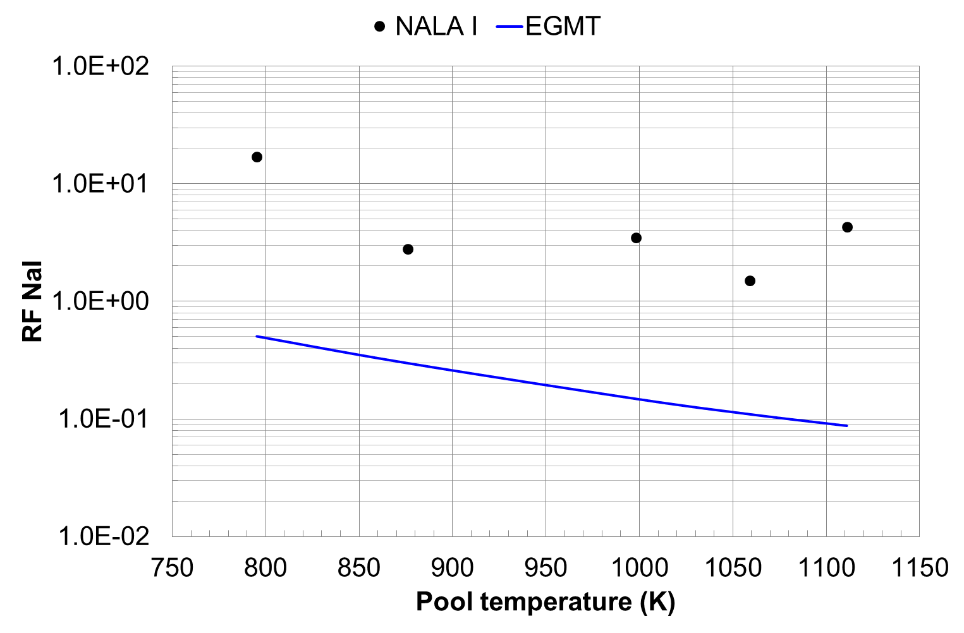
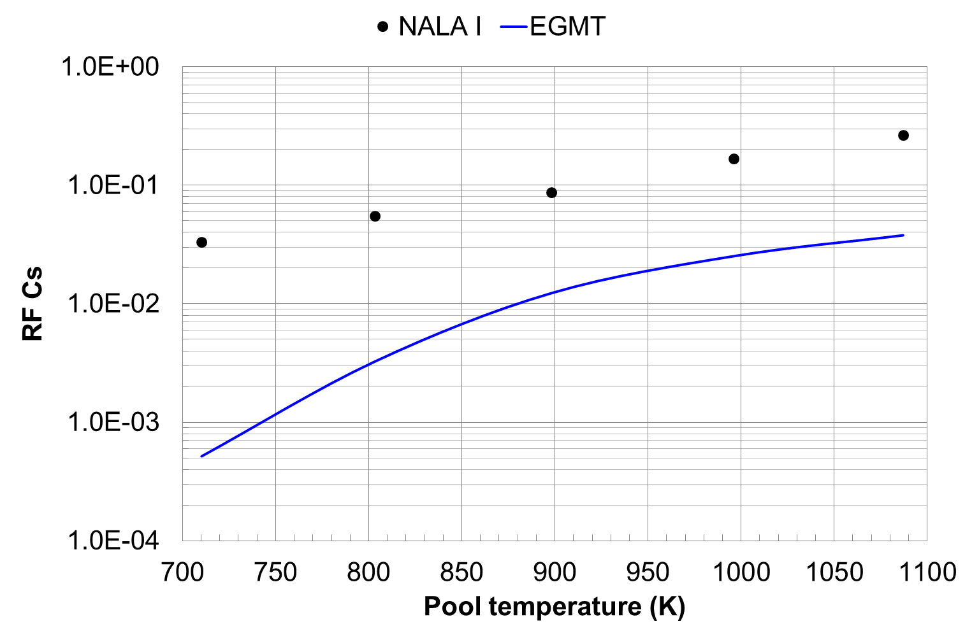
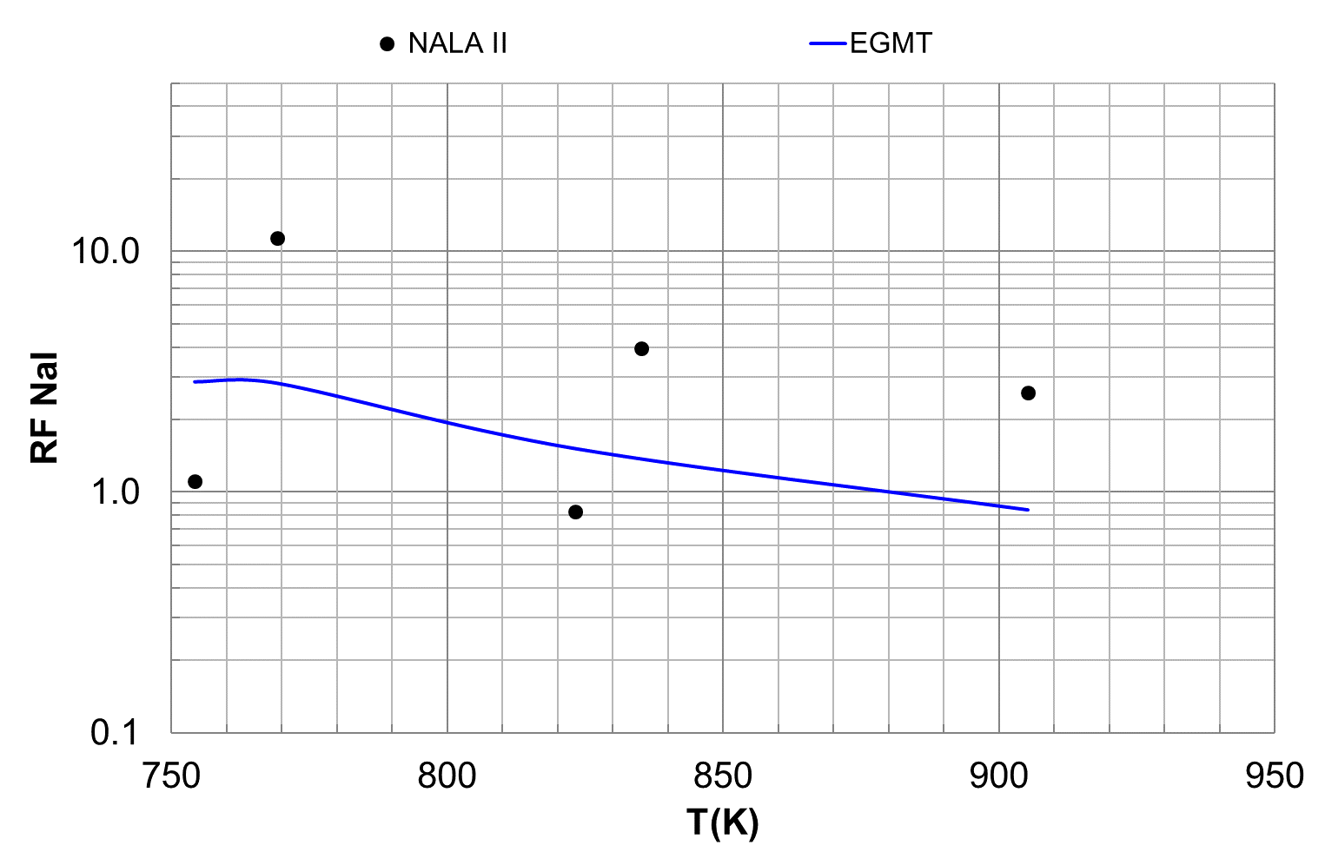
SFRs
FPs release model from hot-Na pools
RF underestimation (as a consequence of the smaller sodium evaporation rates predicted)
RF underestimation => Conservative nature

Slide 14
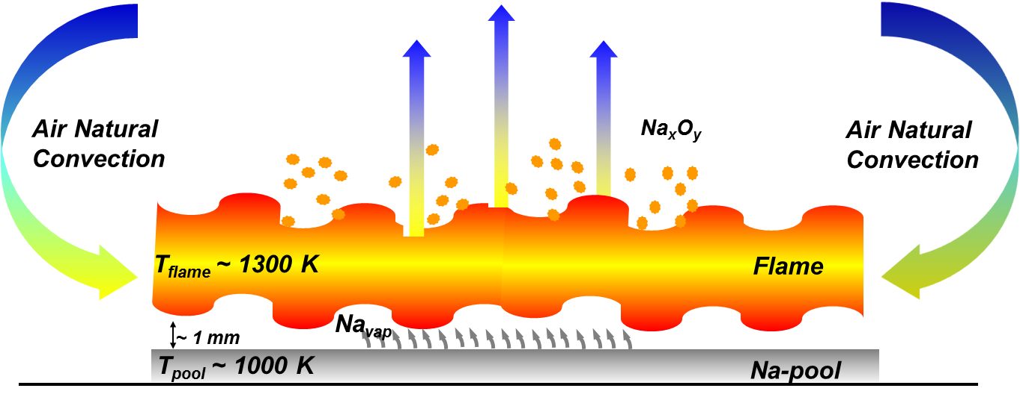
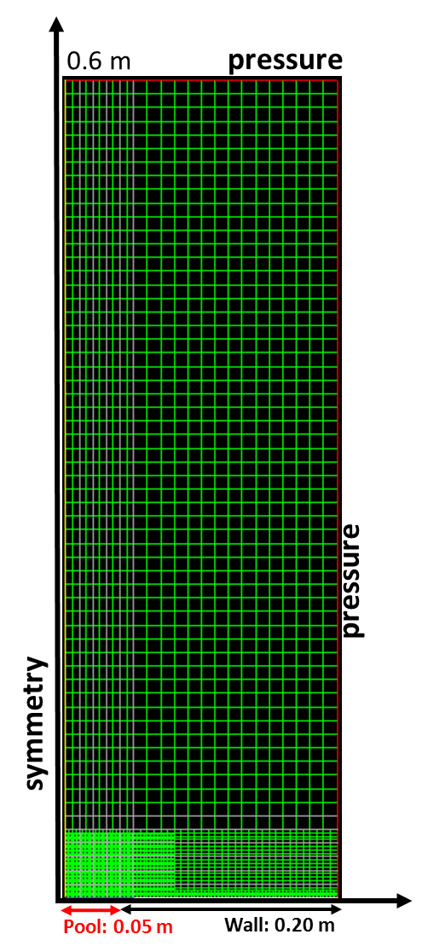
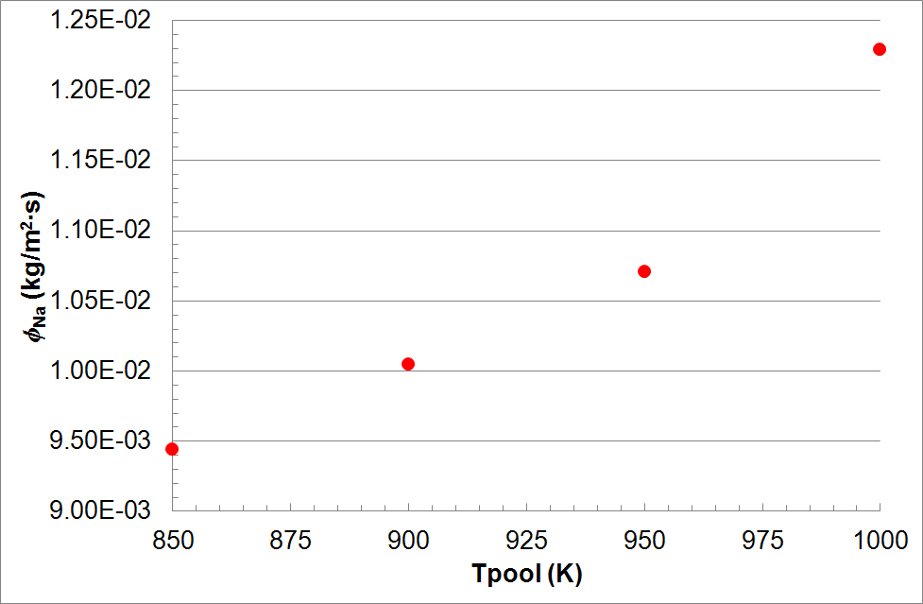
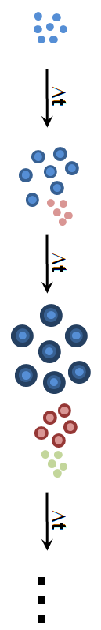
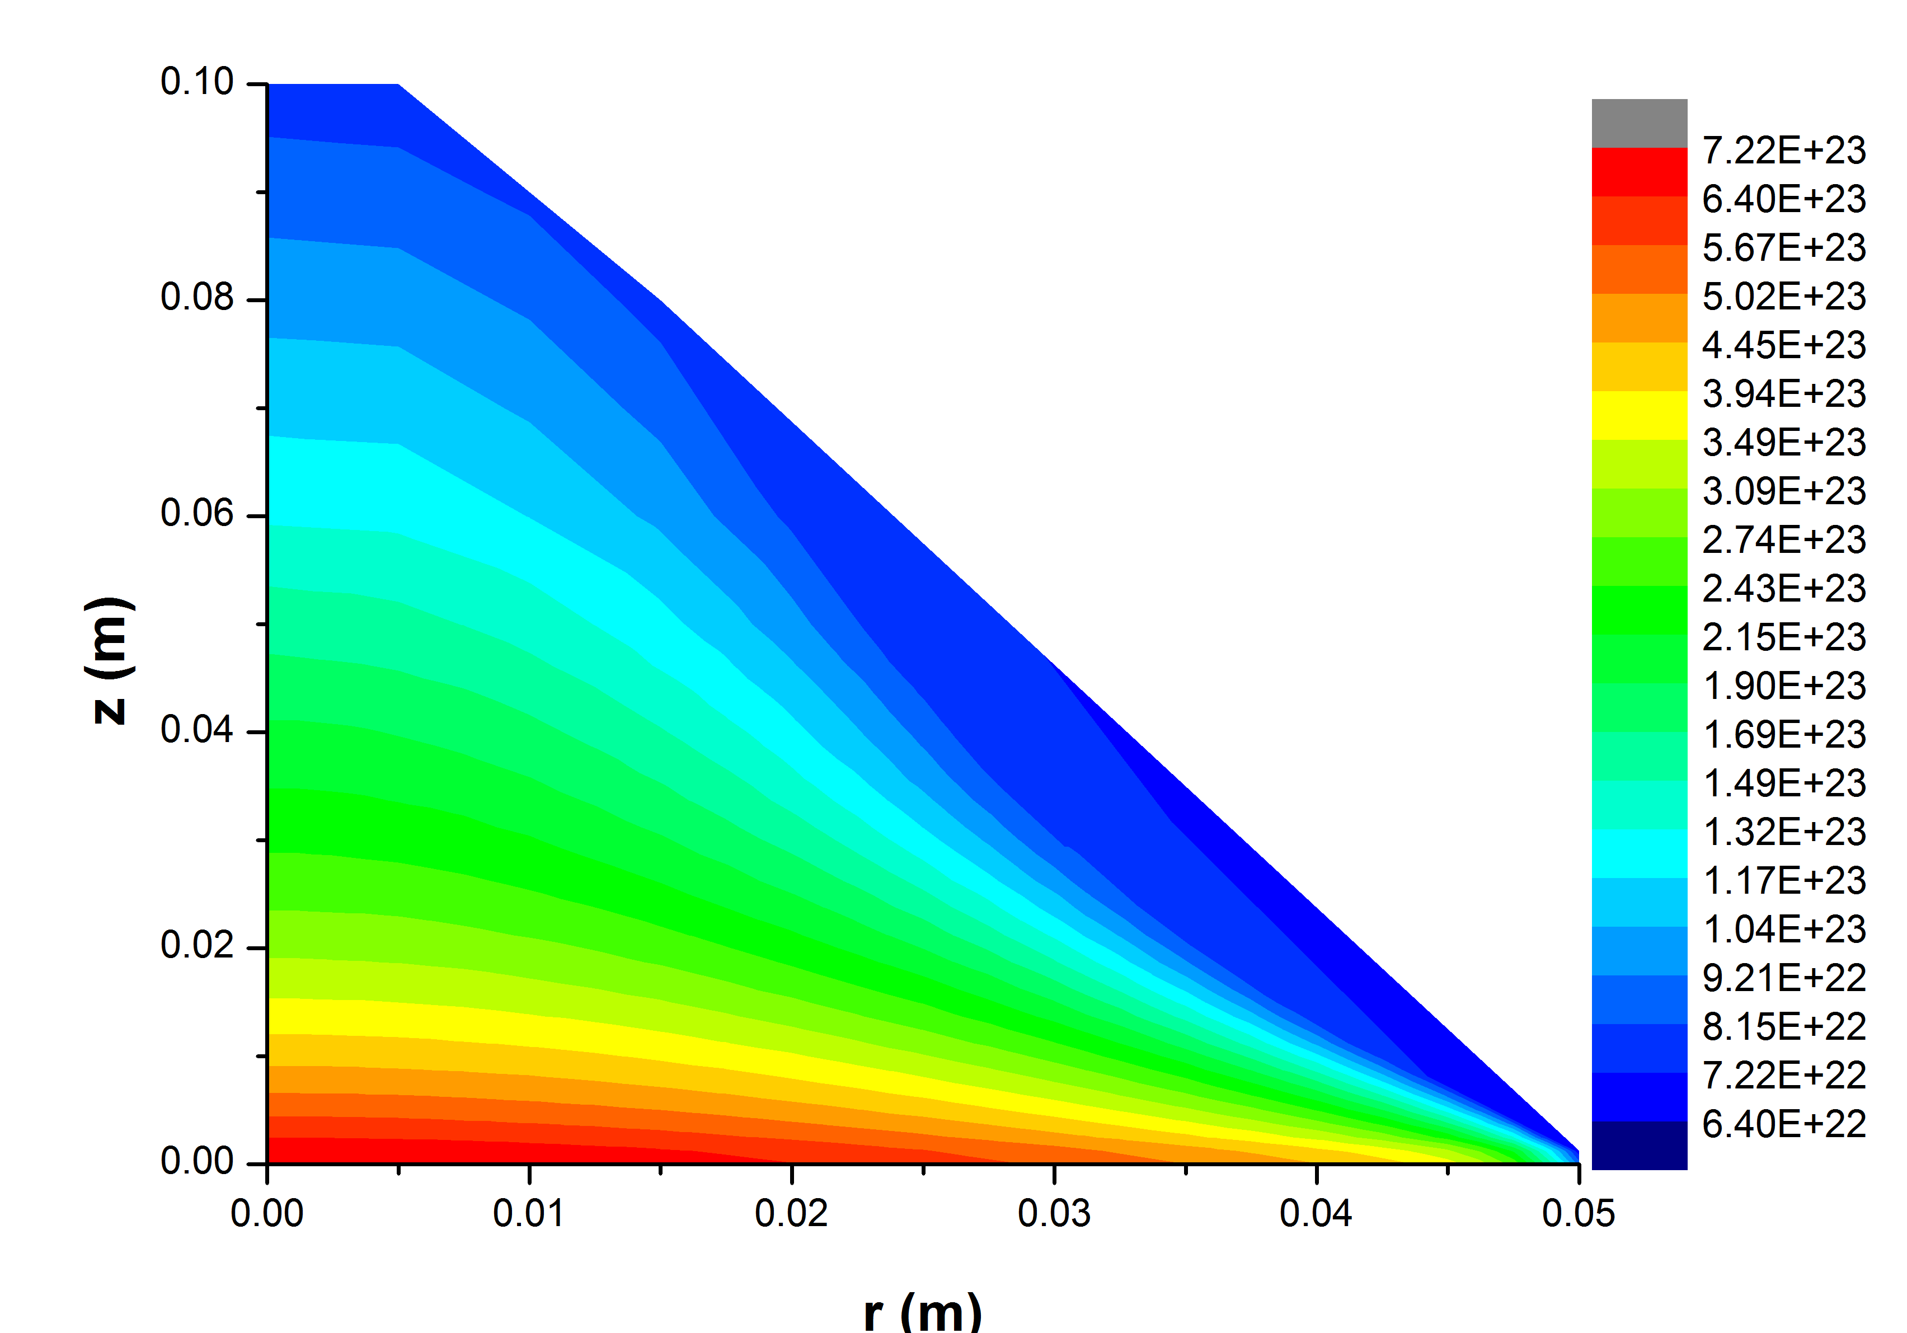
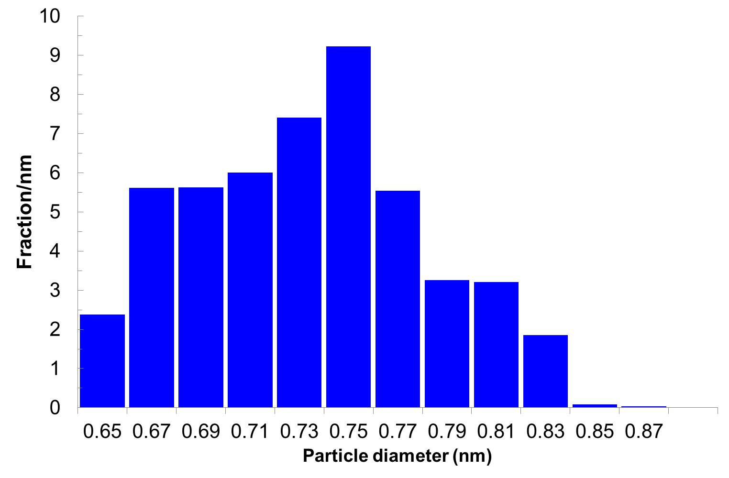
SFRs
FPs release model from Na-pool fires
Na Supply
(Evaporation Model)
O₂ Supply
(3D Convective Modeling)
Formation of Na_{x}O_{y} Vapors
(Na – O₂ chemical reactions)
Generation of Primary Particles
(Nucleation & Growth models)
Garcia et al., 2016; Herranz et al., 2018; Herranz et al., 2017.

Slide 15
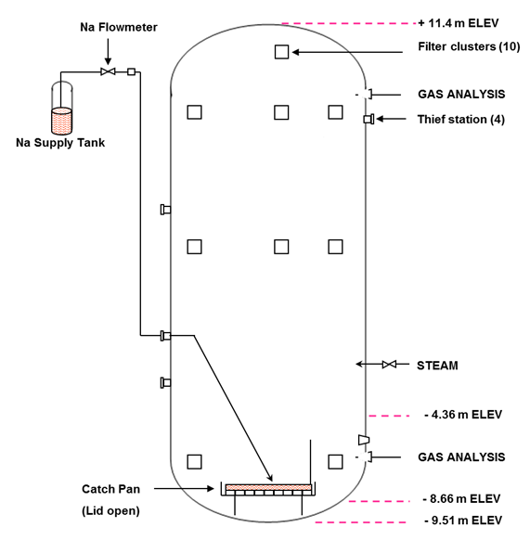
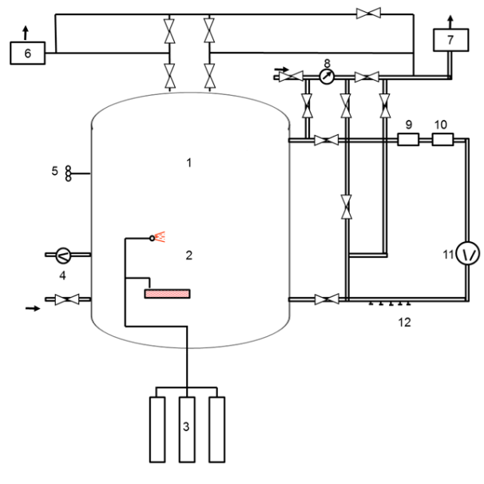
SFRs
FPs release model from Na-pool fires
 | AB1 | AB2 | F2
Geometry
Type | Cylindrical | Cylindrical | Cylindrical
V (m³) | 852 | 852 | 220
Initial Cond.
O₂ (%) | 19.8 | 20.9 | 17-25
T (K) | 299.65 | 293.65 | 298.15
RH (%) | 35.5 | 43.3 | -
Steam Addition | NO | YES | NO
Sodium Spill
Initial Na T (K) | 873.15 | 873.15 | 773.15
Burning A (m²) | 4.4 | 4.4 | 2
Fire duration (s) | 3600 | 3600 | 12600
ABCOVE
FAUNA

Slide 16
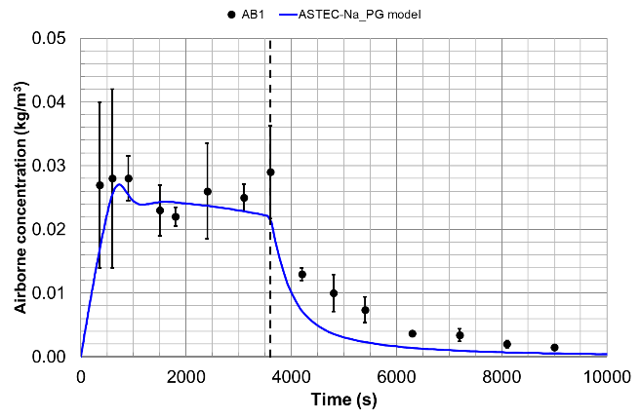
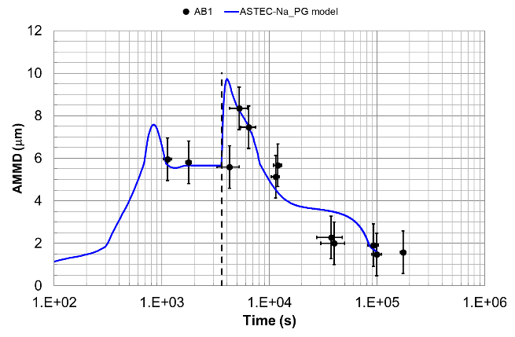
SFRs
FPs release model from Na-pool fires
Analytical correlations based on 3D mechanistic modeling and compatible with LPC formulation derived and tested.
Predictions in the same order of magnitude.
Experimental trends well captured.

Slide 17
LW-SMRs
2007
2008
2009
2010
2011
2012
2013
2014
2015
2016
2017
2018
2019
2020
2021
2022
2023
2024
2025
2026
PBMR
PBMR-CIEMAT agreement
01/06/2007 – 31/10/2007
03/06/2008 – 31/12/2009
RAPHAEL
FP6-EURATOM-NUCTECH
15/04/2005 – 14/04/2010
CP-ESFR
FP7-EURATOM-FISSION
01/01/2009 – 30/06/2013
JASMIN
FP7-EURATOM-FISSION
01/12/2011 – 31/05/2016
ESFR-SMART
EURATOM
01/09/2017 – 31/08/2022
SASPAM-SA
EURATOM
01/10/2022 – 30/09/2026

Slide 18
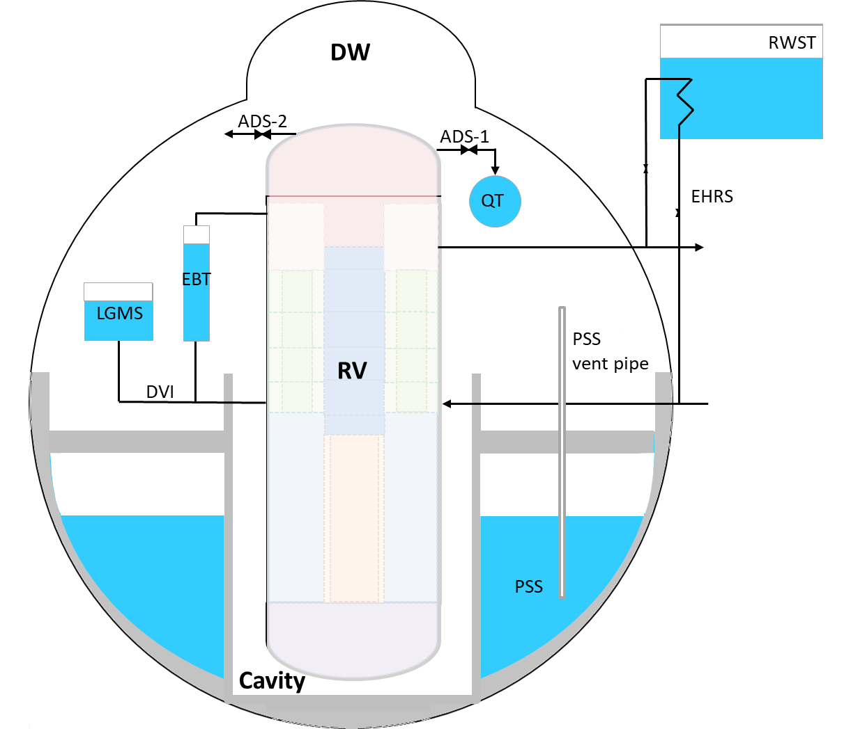
LW-SMRs
Assessment of SA scenarios (D2; MELCOR 2.2)
LWSMR
300 MWe iPWR design
17x17 XL fuel assembly W design
Cylindrical RPV (6 m diameter x 21 m height)
Spherical dry containment (25 m diameter)
Passive SSs (EHRS, ADS, EBT, LGMS, PSS)

Slide 19
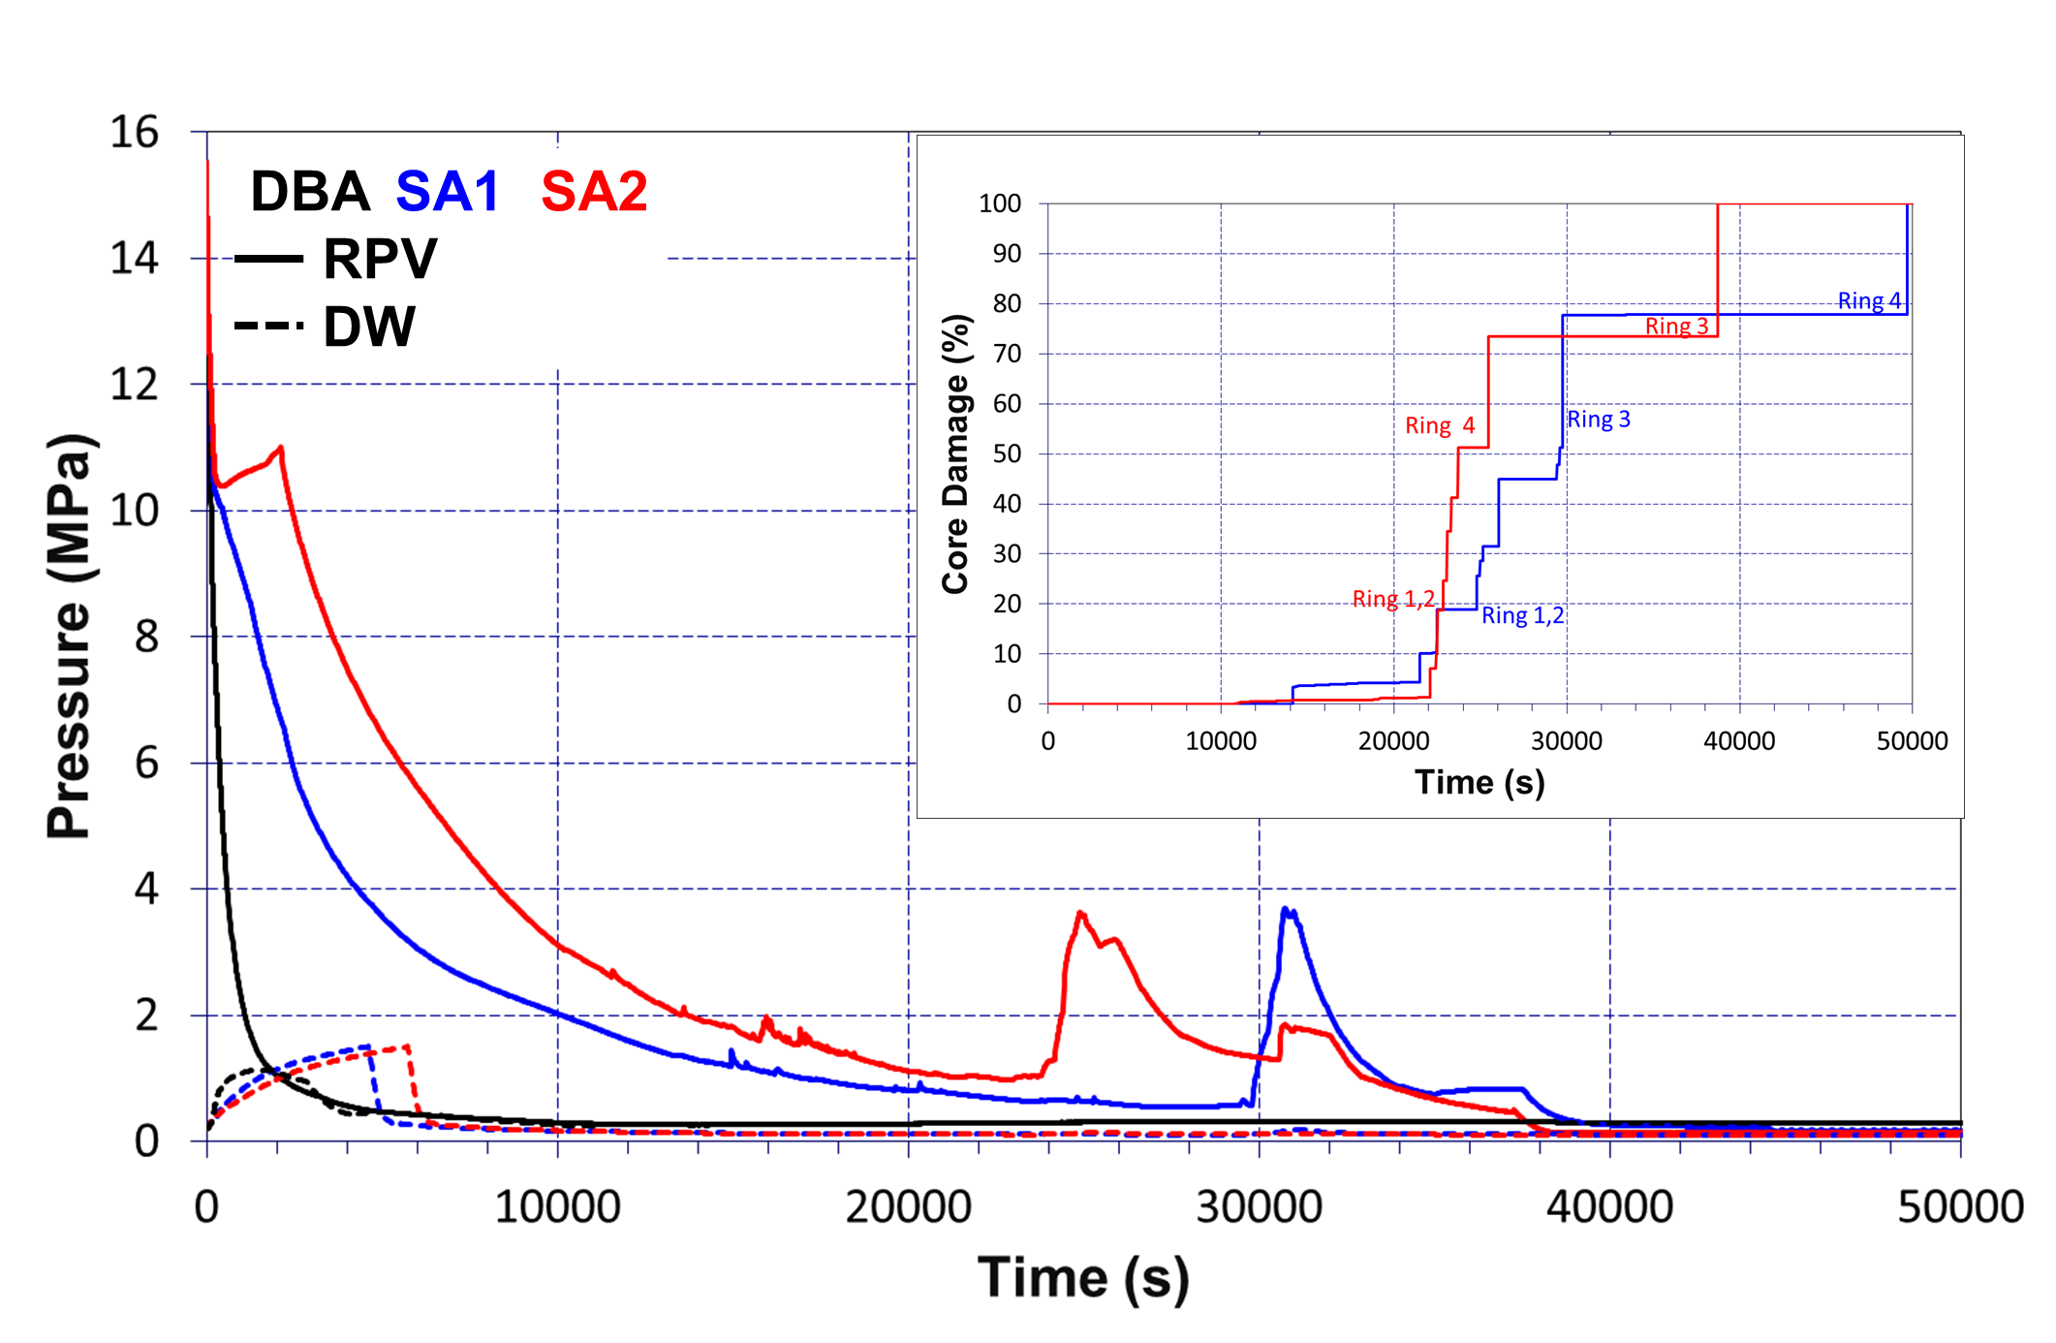
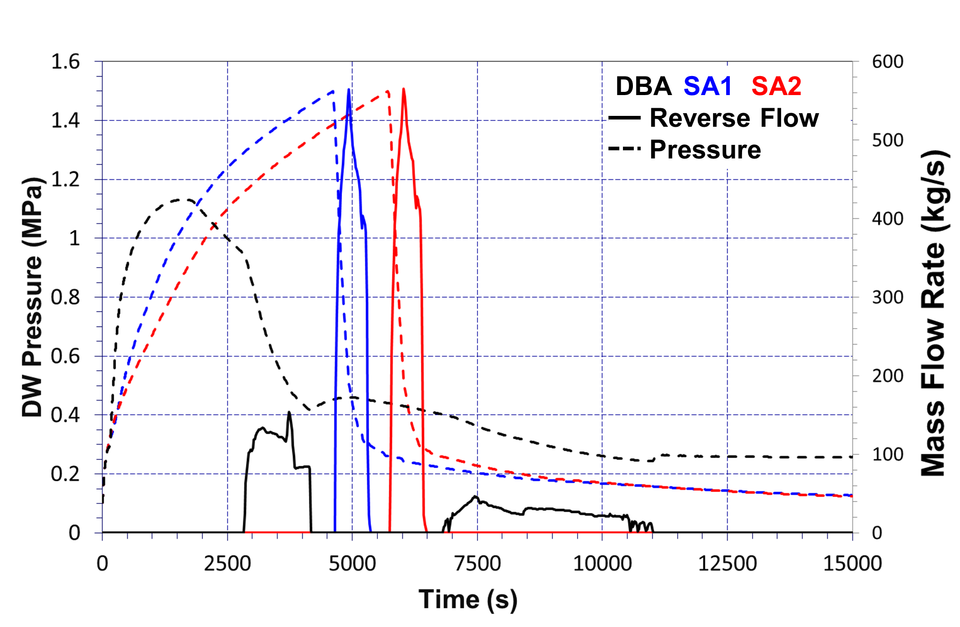
LW-SMRs
Assessment of SA scenarios (D2; MELCOR 2.2)
DBA
Small LOCA (DVI line)
All SSs available
SA1
Small LOCA (DVI line)
No EHRS, ADS-st1
SA2
Small LOCA (DVI line)
No SSs available
Need for a deeper analysis of the nodalization impact on results.
High pressure containment failure at very short times since the accident onset.
Flow reversal should be paid attention in all regards (timing; intensity; consequences on FPs distribution).
Confirmation of RPV-integrity should be intended, as this is a major finding for the scenarios analyzed.

Slide 20
Conclusions
The reliability of passive systems under all accidental conditions foreseen should be proved.
High-Temperature Gas-Cooled Reactors
The high integrity of fuel TRISO particles would allow considering a filtered confinement as third barrier.
Water traps would provide additional safety features.
Sodium Fast Reactors
Any extrapolation from water-cooled reactors to sodium is impossible (large differences in the coolant properties).
Coolant – FP interaction model needs basic properties (i.e mass transport properties) and considering oxidizing environments (i.e., pool and sprays Na fires).
Light Water - SMRs
SMR Implementation opportunity needs research to address safety related open issues.
Research might identify prevailing boundary conditions and characterize the safety systems response.

Slide 21
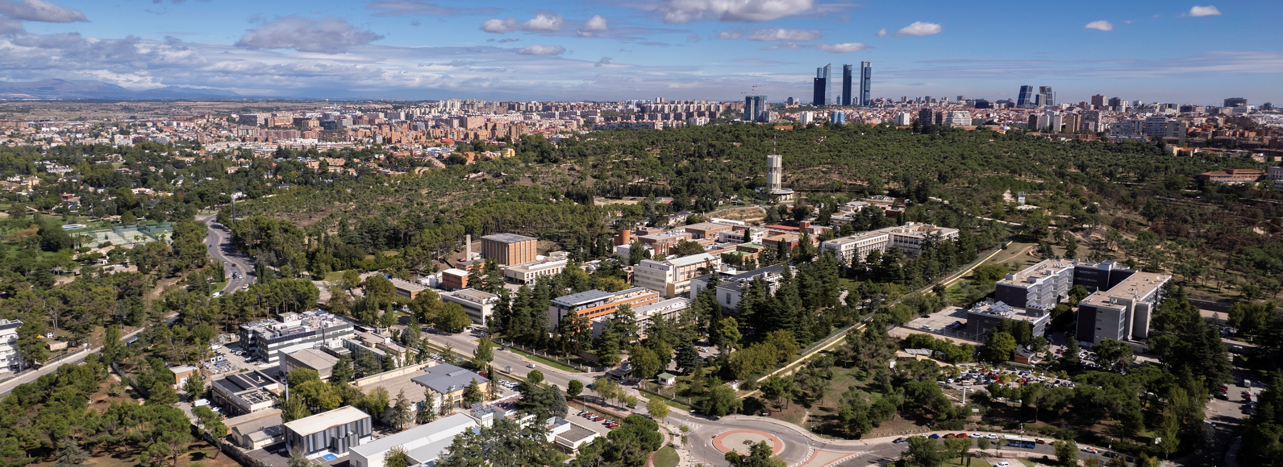
Thank you for your attention
Unit of Nuclear Safety Research
Department of Nuclear Fission
CIEMAT
luisen.herranz@ciemat.es

