Slide 1
Reactor Designer Lessons Learned on the Approach to Safeguards by Design for Small Modular Reactors:
Opportunities and Challenges
Jessica M. Levy, P.E.

Slide 2
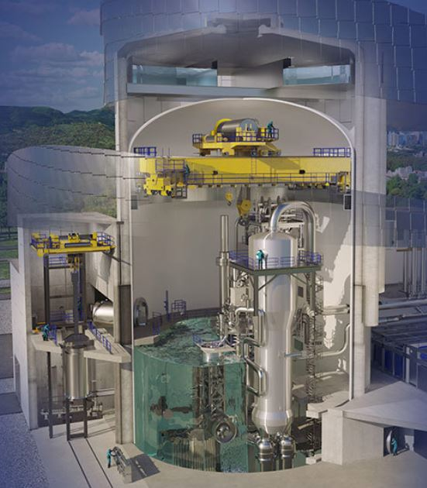
Westinghouse AP300™ Design
Pressurized Water Reactor (PWR) based upon proven AP1000™ technology
  Utilizes the same passive safety features and reliable technology
Implementation of Nuclear Material Safeguards systems in the AP300 presents new challenges
  Smaller footprint results in less available space for Nuclear Material Safeguards implementation

Slide 3
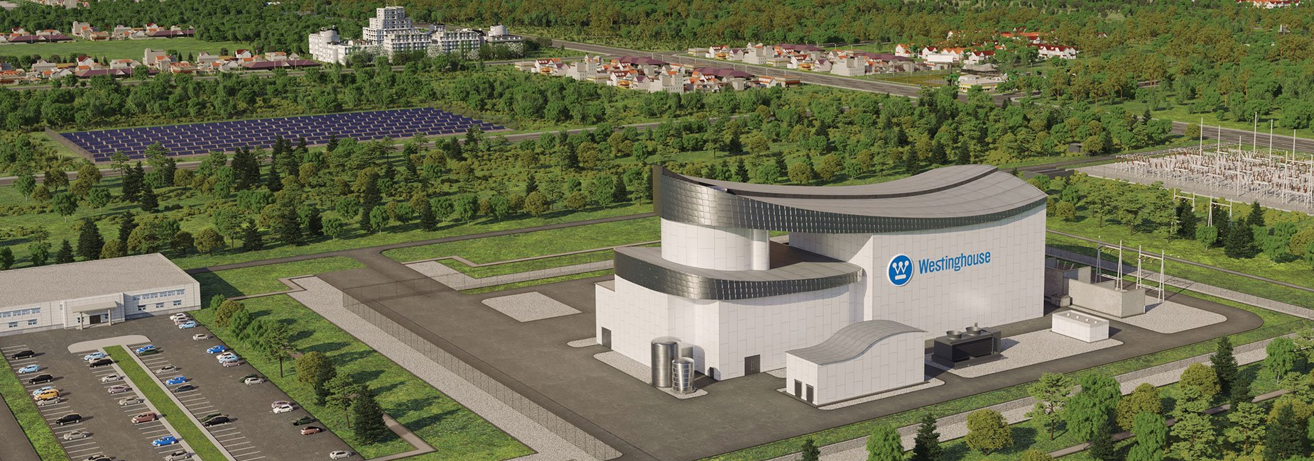
Major Challenges & Potential Solutions to the Implementation of Safeguards-by-Design (SBD) in the AP300 Plant Design
Main areas for potential optimization and efficiency in the implementation of SBD in SMR design:
  Synchronization of Regulations and Policies Across States
  Detailed Guidance and Processes for the Implementation of Safeguards
  Reactor Designer Training for Cross Functional Disciplines

Slide 4
Synchronization of Regulations & Policies Across States
Safeguards regulations and policies can vary across States, whereas reactor vendors desire to make a standard plant safeguards system
Coordination between reactor designer, Owner, State, and the IAEA & Euratom is controlled by policies & procedures
  Currently limited interface with reactor vendors, delaying SBD processes
    Traditional safeguards process work in the back end of the design process
  Opportunity for informal communication and meetings to expedite SBD processes with reactor vendors

Slide 5
Detailed Guidance and Processes for SBD Implementation
General guidance vs. detailed technical requirements
Requirements for inspections
Interface with security equipment
Westinghouse experience has shown reactor designer involvement begins after submittal of the DIQ
  Need for earlier, informal involvement

Slide 6
Reactor Designer Training for Cross-Functional Disciplines
Safeguards requires coordination across wide variety of engineering disciplines involved in design
  Collaborative process for the implementation of SBD
  Requires both organizational & individual training on SBD
Opportunities for overlap of disciplines & their coordination
Engagement of reactor designers
  Receive feedback and raise concerns regarding safeguards implementation

