Slide 2


Implementation of 3S by Design in INPRO
[International Project on Innovative Nuclear Reactors and Fuel Cycles]
Presenter: Ms Carolynn P. Scherer
Co-author: Ms Nilormi Das
International Project on Innovative Nuclear Reactors and Fuel Cycles (INPRO)
International Atomic Energy Agency (IAEA)

Slide 3
Overview
INPRO concept of sustainable development
INPRO methodology
Overlay of INPRO on concept of 3S
  Safety
  Safeguards – Proliferation Resistance
  Security – Infrastructure, Physical Protection, Proliferation Resistance
Summary

Slide 4
GOALS OF 3S
Harmonize 3S interfaces
Applying 3S to innovative reactors and nuclear energy systems
Proposing INPRO methodology to support 3S in early design phases, especially for innovative systems

Slide 5








UN Concept of Sustainable Development
Economical
Environmental
Societal
Political/ Institutional
Environmental Impact
Safety
Proliferation Resistance
Economics
Waste Management
Infrastructure
INPRO Sustainable Nuclear Energy

Slide 6
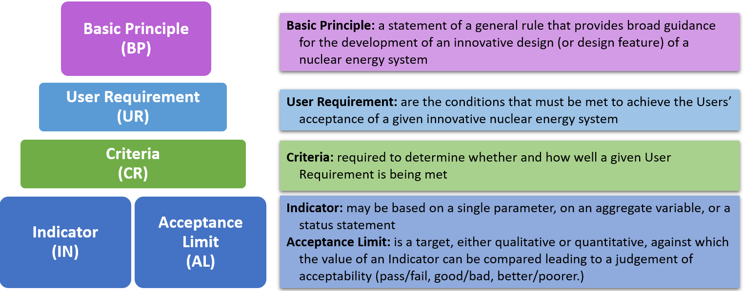
INPRO Methodology Hierarchy​
Notes:
In 2003 INPRO published its initial methodology, providing guidance for the evaluation of innovative nuclear reactors and fuel cycles. The methodology is hierarchical and consists of a basic principle (BP), user requirement (UR) and criterion (CR). The criterion consists of Indicators and Acceptance Limits. Figure 1 shows the hierarchy of the methodology along with a description of each of the elements .
An assessment covers the sustainability of the nuclear energy system (NES) over their lifetime, from conceptual design through decommissioning. The NES encompasses the range of nuclear facilities and associated institutional measures

Slide 7
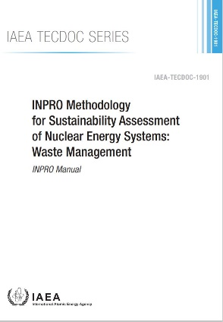
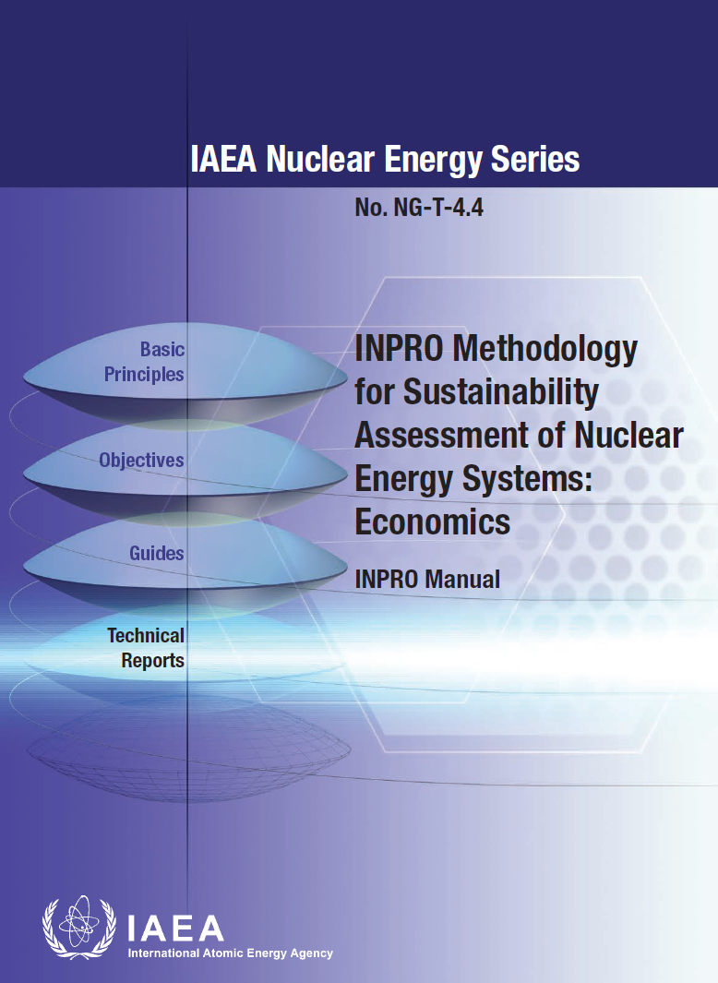

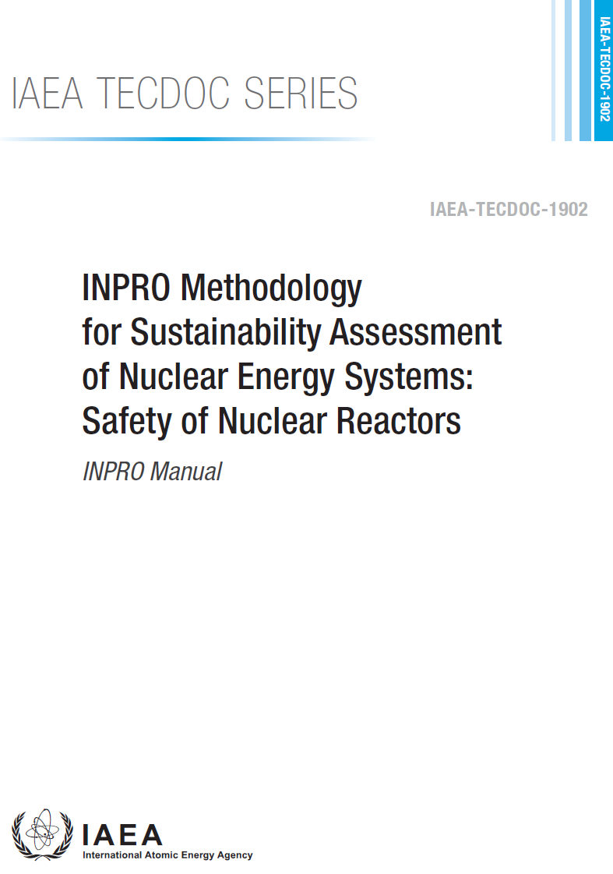
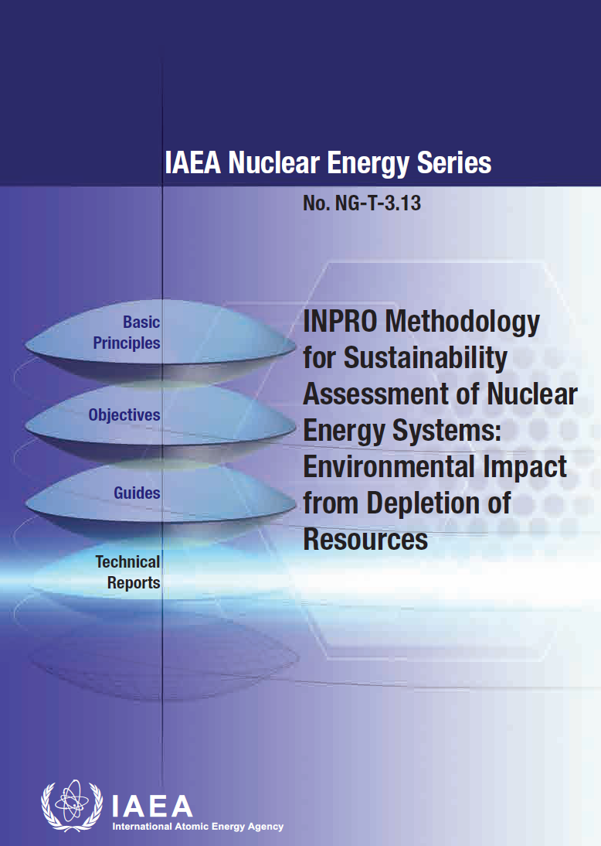
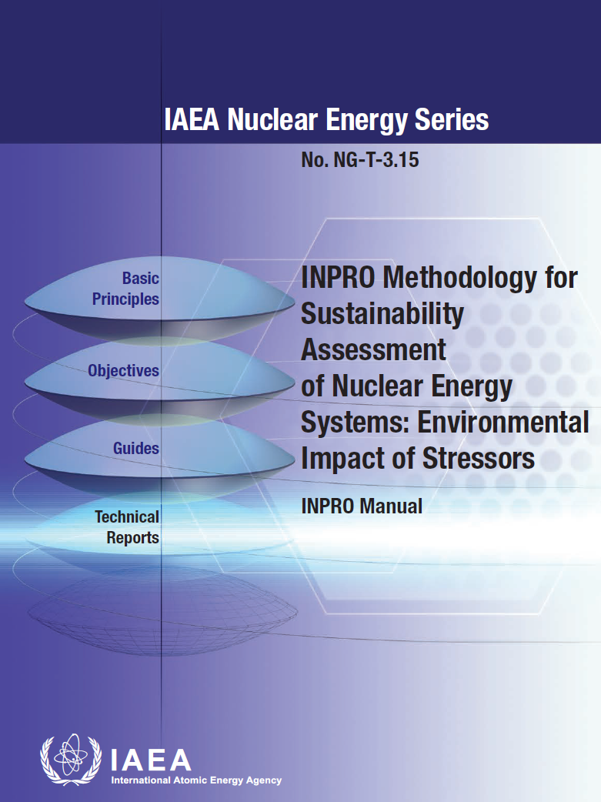
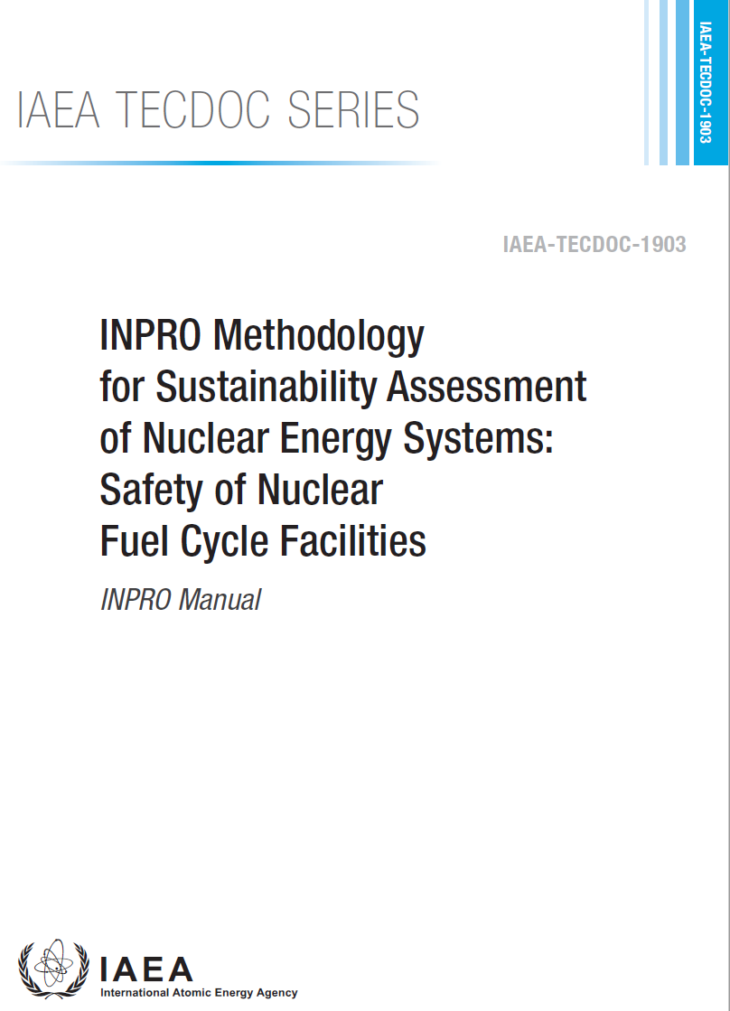
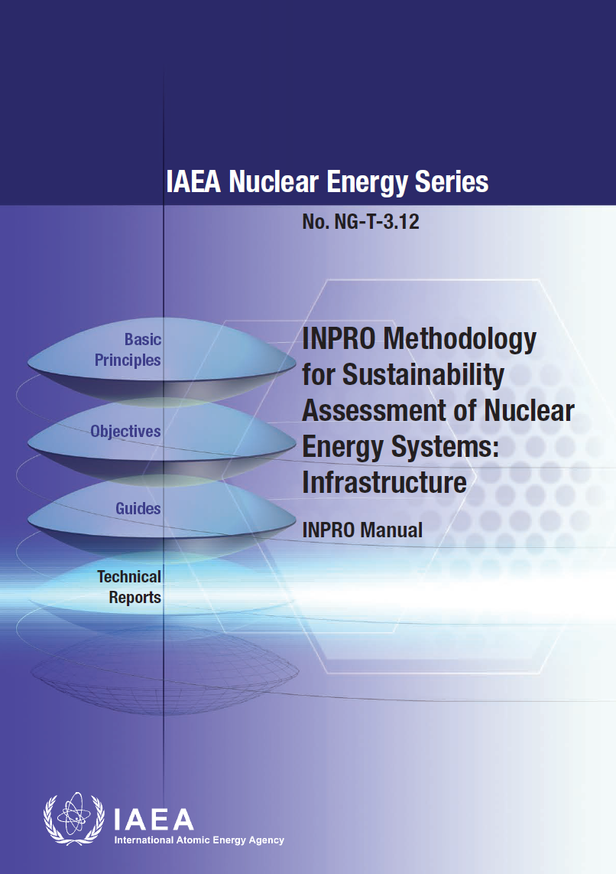
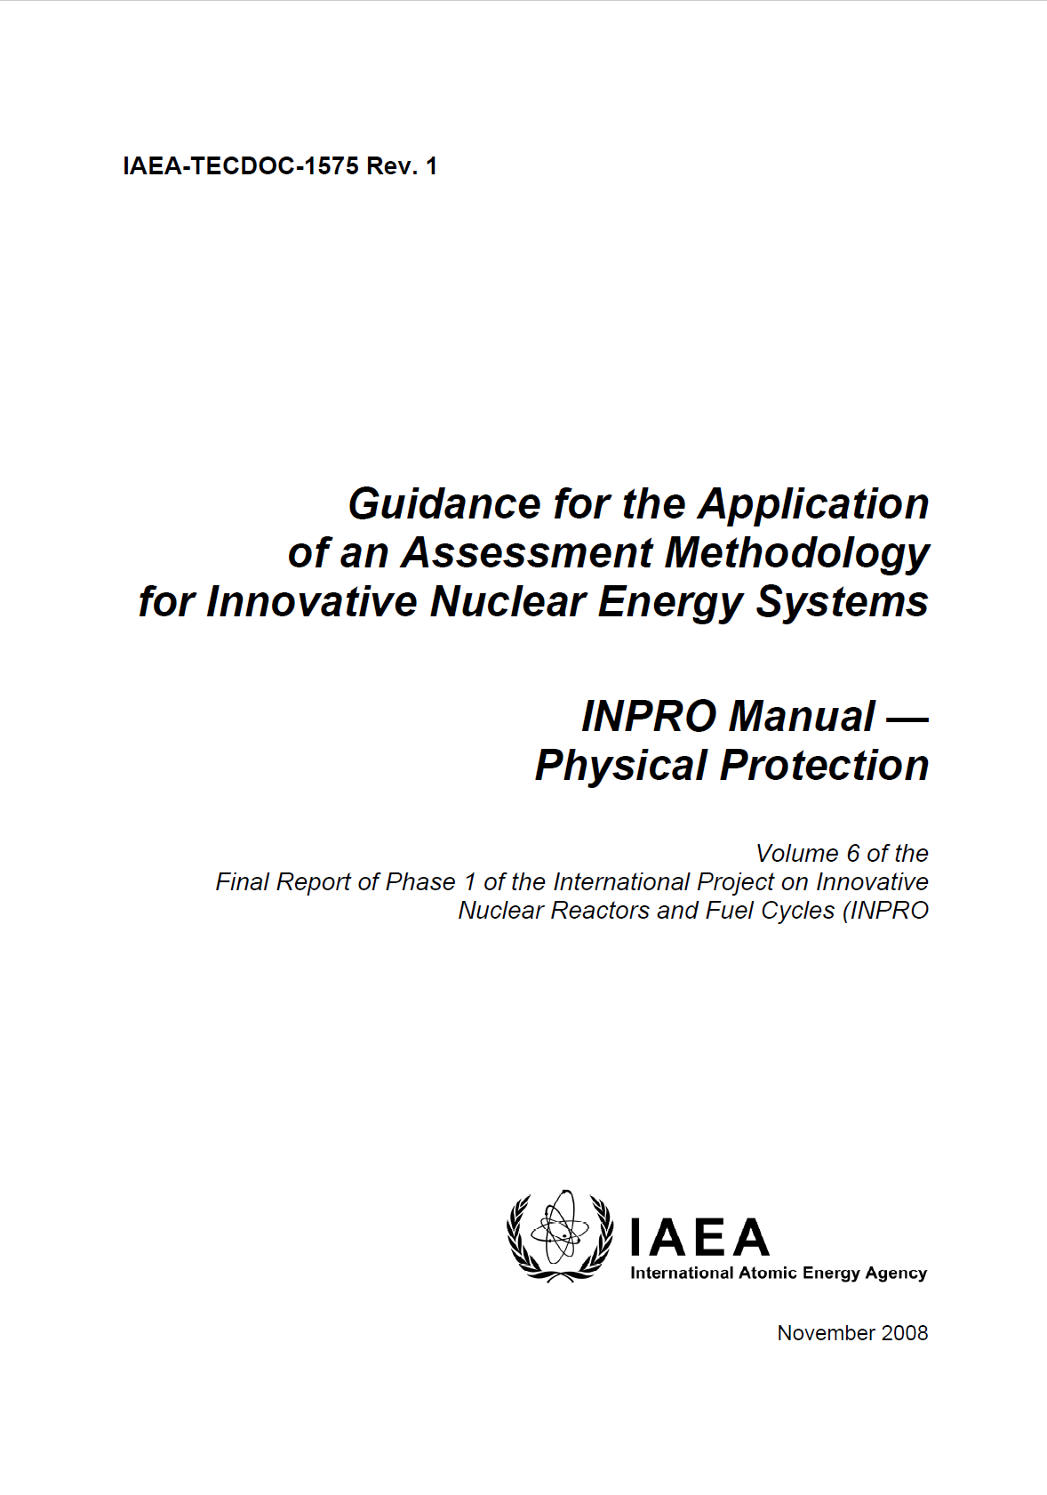
INPRO NESA Manuals for 3S
IAEA Nuclear Energy Series
  Economics: NG-T-4.4 (2014)
  Infrastructure: NG-T-3.12 (2014)
  Environmental Impact (2015, 2016)
  from Depletion of Resources: NG-T-3.13
  of Stressors: NG-T-3.13
  Proliferation Resistance: NG-T-3.26 (new)
IAEA TECDOC Series
  Waste Management: 1901 (2020)
  Safety: of Nuclear Reactors: 1902 (2020)
  of Nuclear Fuel Cycle Facilities: 1903 (2020)
  Physical Protection: 1575 Vol. 6 (2008, retired)
Security
Safety
Safety
Safeguards
Security
New: NG-T-3.26
Proliferation Resistance
INPRO Manual
7
Notes:
Support documents in each NESA area. Also on line or e-learning course available

Slide 8
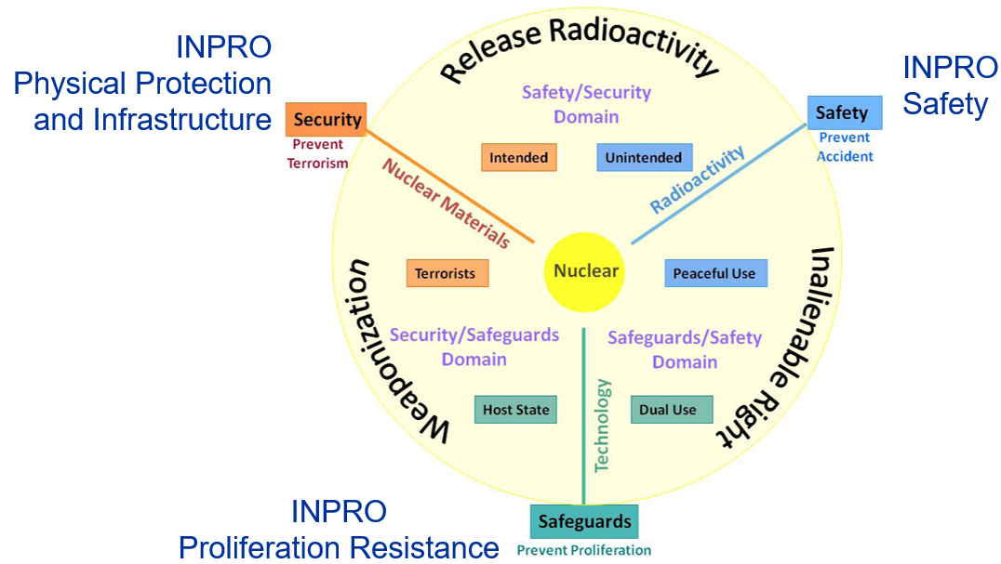
Alignment of 3s Concept and INPRO
CHOI, J., “Success Through Safety, Security and Safeguards by Design (3SBD); From Concept to Application", University of New Mexico (2013).

Slide 9
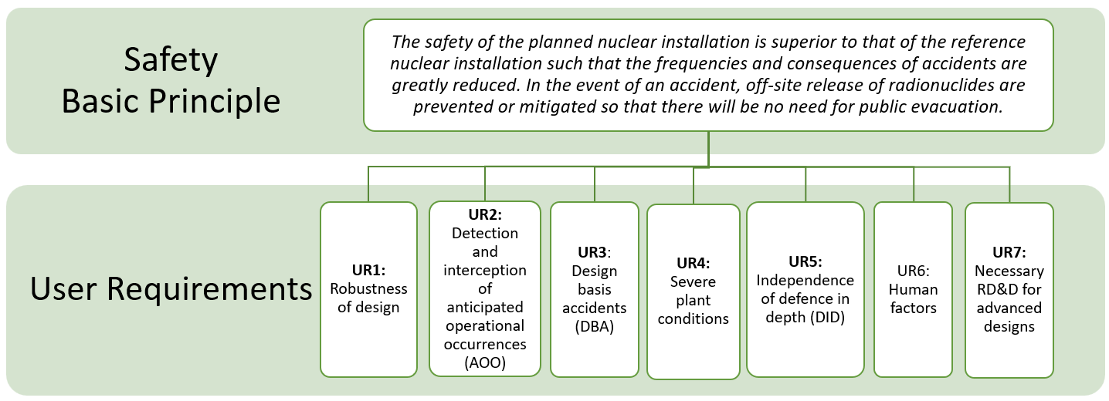
INPRO Safety Assessment
Not a Safety Analysis
7 UR
28 CR (criteria)
Reduce frequency of accidents
Mitigate release of radionuclides
Prevent need for public evacuation

Slide 10
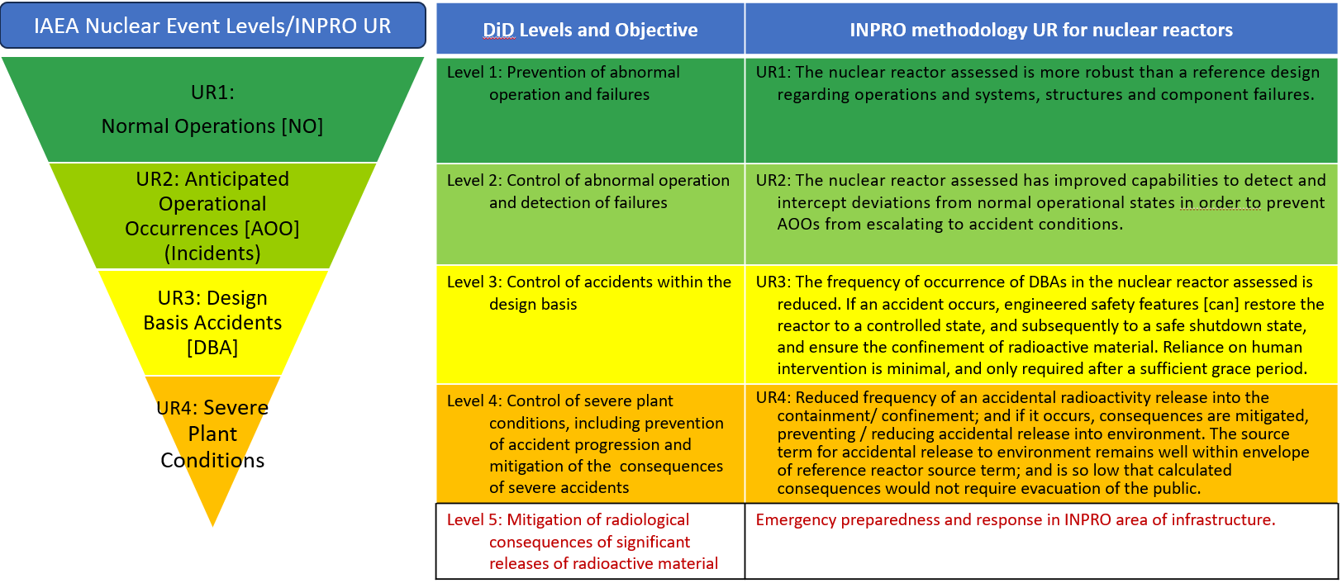
UR1-5 Map to Safety Defence in Depth

Slide 11
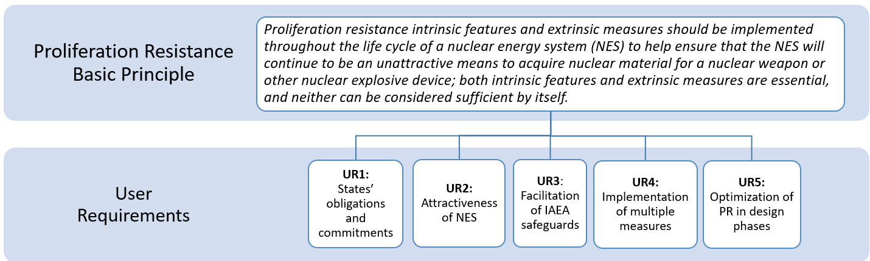
INPRO Proliferation Resistance Assessment

Slide 12
UR3: Facilitation of IAEA Safeguards
UR3: The NES should have intrinsic features and implement extrinsic measures
that readily facilitate IAEA safeguards.
CR3.1: Effective safeguards
CR3.2: Efficient safeguards
IN3.1: Detectable diversion of nuclear material and misuse of facilities
AL3.1: The IAEA can readily achieve technical objectives for safeguards
IN3.2: Efficient execution of safeguards activities
AL3.2: The IAEA can thoroughly implement and execute without undue delay all foreseen safeguards activities
Notes:
UR3: The NES should have intrinsic features and implement extrinsic measures that readily facilitate IAEA safeguards.
CR3.1: Effective safeguards
IN3.1: Detectable diversion
AL3.1: The IAEA can readily achieve technical objectives for safeguards
CR3.2: Efficient safeguards
IN3.2: Efficient execution of SG
AL3.2: The IAEA can thoroughly implement and execute without undue delay all foreseen safeguards activities
Addresses safeguardability

Slide 13
UR5: Optimisation of PR in the NES
UR5: The combination of intrinsic features and extrinsic measures,
compatible with other design considerations,
should be optimized (in the design/engineering phases)
to provide effective and efficient proliferation resistance,
which is acceptable to the operator and approved by the State.
CR5.1:
Inclusion of PR in all
NES design phases
IN5.1: Incorporation PR in design and life cycle of NES
AL5.1: Designer/operator included PR in all design phases, and it covers the life cycle of the NES
IN5.2: Proliferation resistance of NES for operator
AL5.2: Implementation of PR intrinsic features and extrinsic measures is effective and efficient for the operator
CR5.3:
State approves
PR measures
IN5.3: Proliferation resistance of NES for State
AL5.3: State approves the implementation of PR in the NES, and it meets requirements
CR5.2:
PR is effective and efficient for operator
Notes:
IN5.1: Incorporation PR in design and life cycle of NES
AL5.1: Designer/operator included PR in all design phases, and it covers the life cycle of the NES
from design through decommissioning
IN5.2: Proliferation resistance of NES for operator
AL5.2: Implementation of PR intrinsic features and extrinsic measures is effective and efficient for the operator
IN5.3: Proliferation resistance of NES for State
AL5.3: State approves the implementation of PR in the NES, and it meets requirements

Slide 14
UR5: Evaluation Parameters
CR5.2: PR is Effective and Efficient for Operator
5.2.1: Operator approves the effectiveness of PR in the NES
5.2.4: Operator approves the efficiency for incorporating PR
5.2.3: PIT meets SSAC requirements without undue burden
5.2.2: Nuclear material accounting system meets SSAC requirements
IN5.2: Proliferation resistance of NES for operator
AL5.2: Implementation of PR intrinsic features and extrinsic measures is effective and efficient for the operator
CR5.2
Notes:
CR/AL5.1: Evaluation parameters look at covering PR in
All design phases
Throughout the lifecycle of NES
IN5.2/AL5.2: PR effective and efficient for the operator / Similar to U3, but for operator
PR measures are effective for operator
NM accounting meets States Sys Accounting & Control
NMAC does not have undue burden on operator
Operator finds incorporating PR efficient
IN5.3/AL5.3: EP: State approves the PR measures in the NES

Slide 15
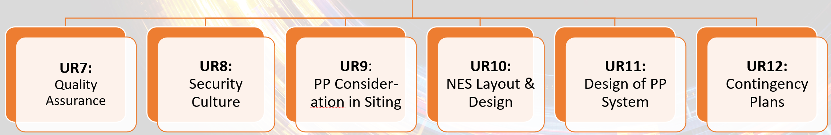
INPRO Manual: Physical Protection 2008
Physical Protection BP: A physical protection regime shall be effectively and efficiently implemented for the full lifecycle of an NES.
UR1:
Legislative and Regulatory Framework
UR2:
Integration of PP throughout INPRO areas
UR3:
Trust-worthiness
UR4:
Confi-dentiality
UR5:
Threat
UR6:
Graded Approach
Notes:
This BP has 12 UR. A country should be able to ensure an adequate pp Regime for the full lifecycle of the NES.
BP States: A physical protection regime shall be effectively and efficiently implemented for the full lifecycle of the NES
Manual uses old acronym for NES INS (innovative nuclear system)
Go over quickly first 6 UR

Slide 16
Physical Protection Structure​
​
Basic Principle (BP)
UR2
UR3
UR4
UR5
UR6
UR7
UR8
UR9
UR10
UR11
UR12
UR1
CR1.1
CR1.2
CR1.3
CR2.1
CR2.2
CR2.3
CR3.1
CR4.1
CR4.2
CR5.1
CR5.2
CR5.3
CR5.4
CR6.1
CR6.2
CR7.1
CR8.1
CR9.1
CR9.2
CR9.3
CR10.1
CR10.2
CR11.1
CR11.2
CR11.3
CR12.1
CR12.2
CR12.3
UR: 12
CR: 28
Area 1
Area 2
Area 2
Area 2
Area 3
Area 3
Area 3
Area 4
Area 5
Area 5
Area 5
Area 5
Notes:
The updated manuals worked to streamline the assessment. Fewer UR and CR; better organized
This assessment structure is a little overwhelming.
We have it divided into 5 key areas for reviewing the assessment concepts

Slide 17
Mapping INPRO UR to Security
INPRO Manuals
Infrastructure Manual – requires States to have a Regulatory Authority
Physical Protection Manual [Old] – 12 UR and 28 CR
Proliferation Resistance – in UR5 NMAC
New: NG-T-3.26
Proliferation Resistance
INPRO Manual

Slide 18
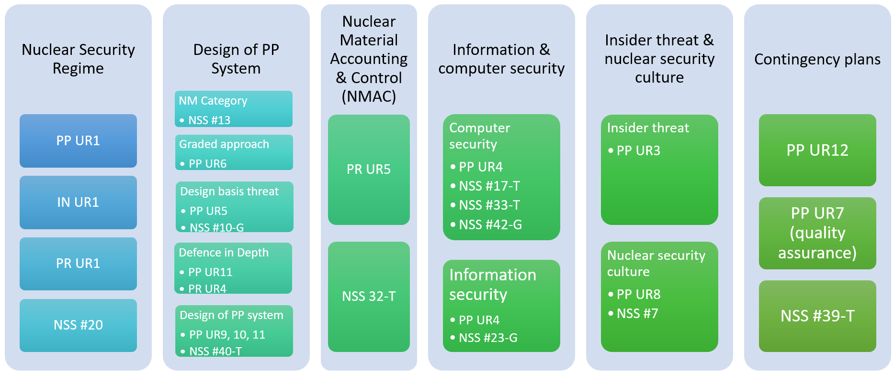
Mapping INPRO Methodology to Nuclear Security
Notes:
Infrastructure Manual
legally binding areas of physical protection (PP) are the Convention on the Physical Protection of Nuclear Material (CPPNM) and the Amendment to the CPPNM

Slide 19
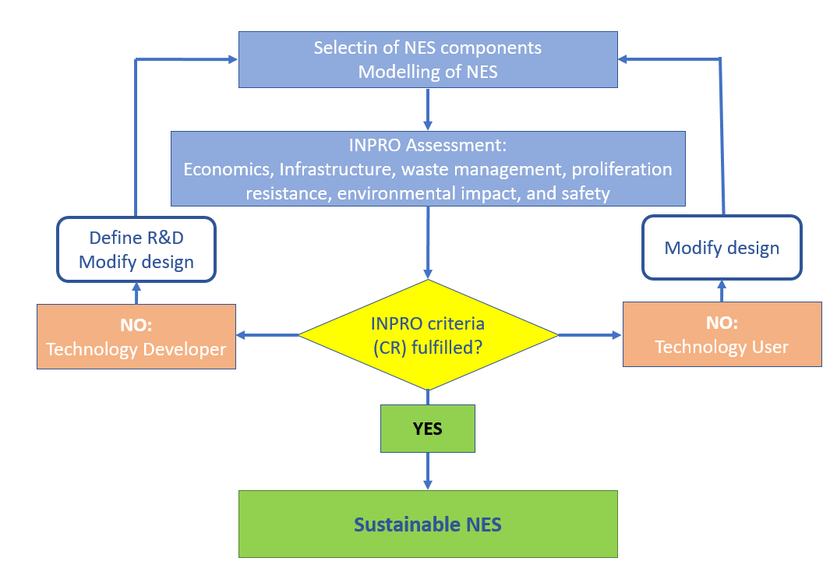
Nuclear Energy System Assessment (NESA)
Criteria Fulfilled?
Yes - sustainable
No
  Identifies gaps and
  improvement areas
  Modify design OR
  Define areas for R&D
Reassess
Confirmation of NES Sustainability

Slide 20
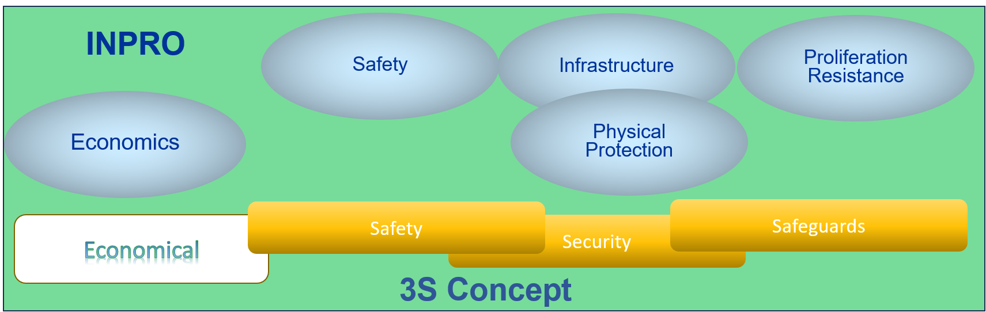
INPRO Application of 3S by Design

Slide 21

Thank You
c.scherer@iaea.org
Contact INPRO:
INPRO.Contact-Point@iaea.org

