Slide 1
Safeguards by Design process of LDR-50 concept with consideration of safety and security.
Tapani Honkamaa

Slide 2
In this presentation:
LDR-50 Design and implementation plans
What and why Safeguards-by-Design (SBD)
Our SBD process
Considerations
  Design integration
  Technological solutions
  Regulatory framework
  International collaboration
Conclusion

Slide 3
Authors and roles
Authors:
  Tapani Honkamaa, STUK (Regulatory Authority, Finnish Support Programme Coordinator to the IAEA safeguards)
  Marko Hämäläinen, Olli Okko, Ville Peri STUK (Regulatory Authority, safeguards)
  Jaakko Leppänen, Technical Research Centre of Finland, Ltd, (Plant Designer)
Special thanks goes to:
  Paula Karhu, STUK (Regulatory Authority, security)
  IAEA SGCP-team involved (Safeguards Concepts and Planning)
  Juho Vierimaa, Steady Energy (designer, constructor, operator)

Slide 4
About regulator-designer/operator interface and roles
Safety: Regulator oversees that the facility is designed and operated in safe manner
  ”Opponent”: Laws of physics. (No flexibility)
Security: Regulator oversees that the facility is designed and operated in the manner that malicious acts are effectively prevented
  Opponent : Perpetrator with malicious motives. (No chance for collaboration)
Safeguards: Regulator oversees that the facility is designed and operated in the manner that IAEA can draw credible conclusions about the peaceful nature of the activity (common goal for the IAEA as well).
  Opponent : IAEA safeguars department (something you can negotiate and cooperate with!)
”Opponent”
?
Oversight
Regulator
Designer/Operator

Slide 5
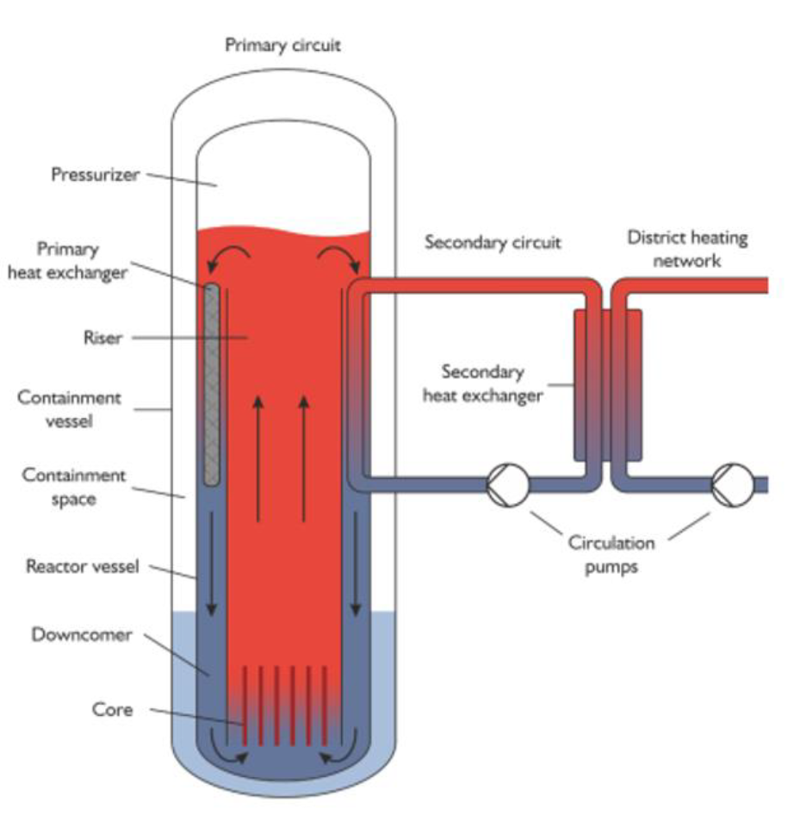
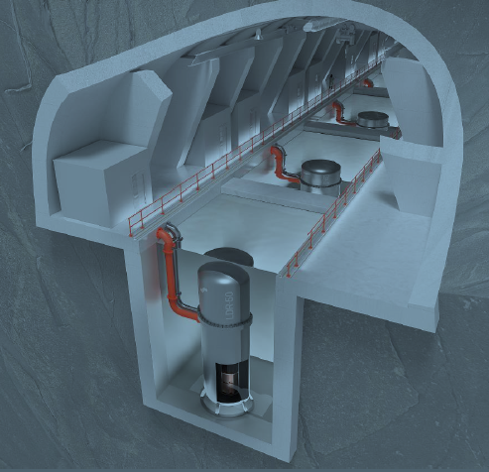
LDR-50 Design and implementation plans
(all info and pics by www.steadyenergy.com and other public sources)
LWR, low pressure&temperature
For district heating purpose only!
Thermal power 50 MW per reactor, possibility for load follow
Multi-unit operation considered
Standard BWR fuel design
  37 assembly core
Adjacent fuel pools
Boron-free operation
Underground & urban siting
Goals: energy production in 2030’s tens of units operating by 2040.

Slide 6
Sadeguards by Design
An approach whereby early consideration of international safeguards is included in the (pre-)design process of a nuclear facility
  SBD is not just for new facility designs! Safeguards considerations have to be taken into account during the construction, the operation and the decommissioning phases.
SBD also means awareness within the nuclear community, including designers of components and installations, of the need to consider international safeguards as early as possible
understanding of the potential impacts design decisions might have on safeguards implementation.
SBD allows informed design choices that are the optimum confluence of economic, operational, safety and security factors, and of course of international safeguards.

Slide 7

Why Safeguards by Design?
“Well designed is half done!”
Enables efficient and effective safeguards implementation
  Operational and economical benefits for all
    Designer
    Constructor
    Operator
    Owner
    Regulator
    the IAEA safeguards

Slide 8
Our SBD process in LDR-50 case so far
IAEA safeguards support programme mechanism
  Task proposal by the IAEA – Finland accepted
  FIN came with two conceptual designs: LDR-50 (VTT) and LUTHER (Lappeenranta University)
Steps:
  Provision of the initial information of the design to the IAEA, 2021
  Development of model Design Information Questionnaire (DIQ), 2021-2022
  Discussion on safeguards approaches with the IAEA, 2023
    The IAEA’s needs were taken note of.
  Deeper discussions as necessary 2024-
    Involving IAEA safeguards operations and European commission
    In STUK: gradual shift to regulatory oversight

Slide 9

Considerations: Design Integration
Small reactor units, many units, low turnover/unit
  Small savings can become economically significant
Reactor may be remote controlled and unattended without any operational staff (if regulatory framework permits)
  Can we combine datastreams to serve safety, security and safeguards (challenge and opportunity)?
  This requires close collaboration with the IAEA and the designer in early phase.

Slide 10

Considerations. Technological solutions
It is important that the designer gets “small” things right. The list contains for instance:
    Minimum number of access ways into rooms where fresh or spent fuel is handled or stored.
    The fuel transfer and transport routes, which are easy to monitor.
    Possibility to seal fuel routes and fuel storages (casks, pool covers).
    Accessibility to electricity and necessary data network cables for surveillance equipment.
    Separation of surveillance equipment from the rest of the plant systems, if required.
    Accessibility to the surveillance devices for maintenance.
    Verification of the fuel shall be made possible.
    …
The IAEA has criteria about inspection frequency (SQ>1).
  New safeguards unattended instrumentation and concepts is being discussed and developed.
    Robots can be used to reduce inspections
    Concept of remote inspections over authenticated video stream?

Slide 11
Considerations: Regulatory framework
§
  Revision of Finnish nuclear legislation is in process.
  Some open positions:
    potential urban siting,
    emergency planning zone definition,
    remote operation
    security response.
  Need to be considered from 3S point of view. It is important to consider the interfaces between different S’s. Current regulatory framework has no major flaws, but the 3S interface management could be improved.
  Finnish Nuclear Energy Act §63 stipulates that STUK shall be present at all inspections performed by the IAEA or EC inspectors.
    In the era of remote or robotized inspections this stipulation should be reviewed.
  International collaboration

Slide 12
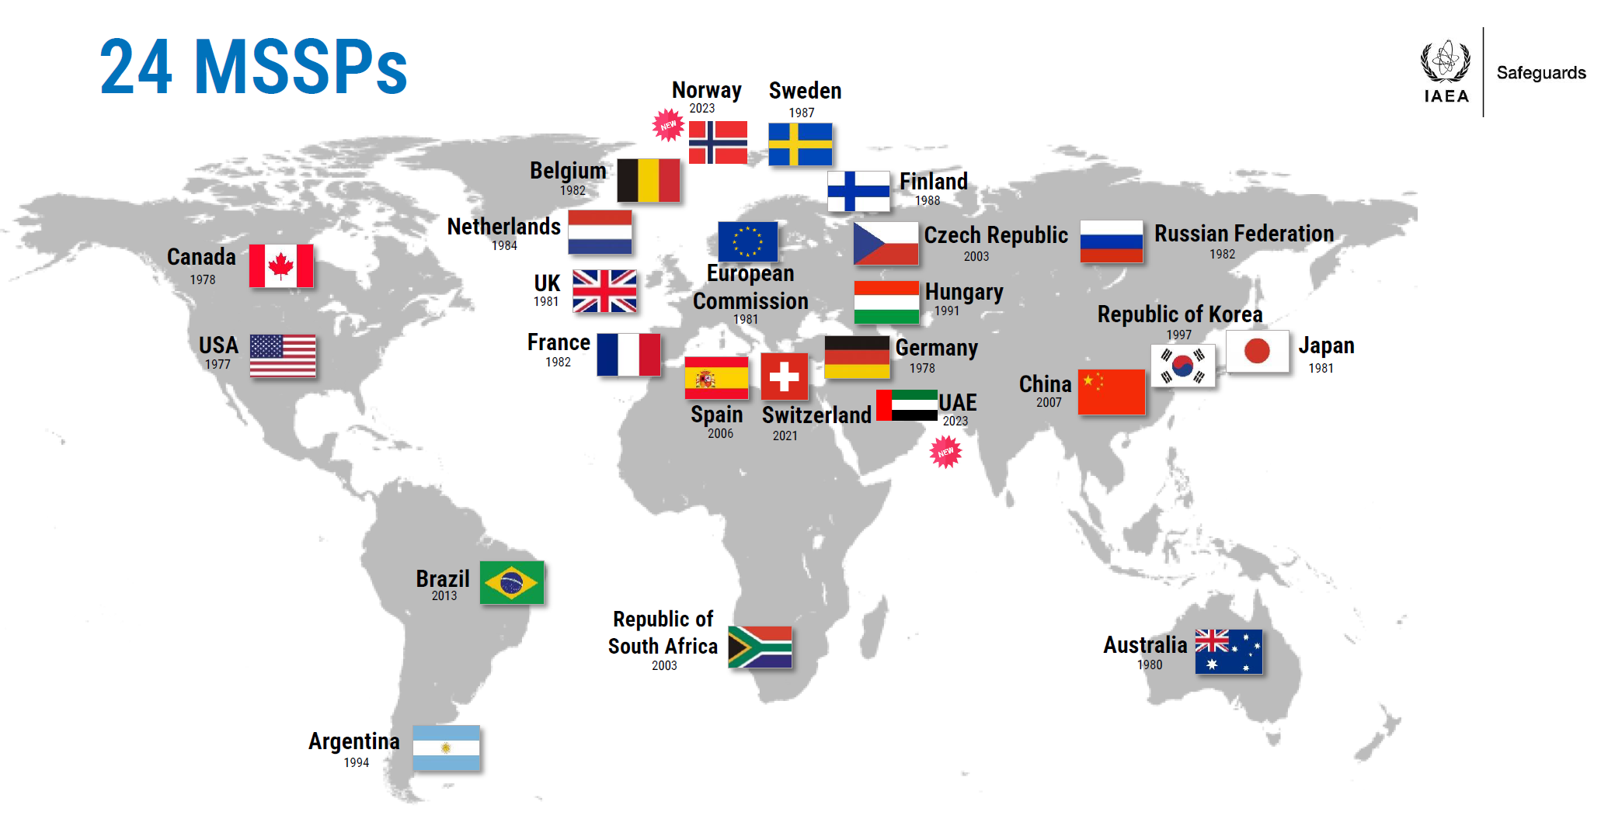
Considerations: International collaboration
SBD process described in this paper has been conducted under the Membership Support Programme (MSSP) task “SBD for Small Modular Reactors”.
The task has provided LDR-50 plant designers direct access to discuss with IAEA safeguards experts, which is an exceptional opportunity
If designer has no access to MSSP mechanism, another way to communicate with the IAEA would be useful.
Picture: IAEA

Slide 13
Considerations: International collaboration
Considerations: International collaboration
The work plan of the task:
  Provision of the initial information of the design to the IAEA
    Design Information Questionnaire template (DIQ)¹ was developed.
    In the task IAEA’s already existing DIQ template for Research Reactors was used. We have observed that it serves the purpose almost fully for LDR-50 case.
  We have discussed about IAEA’s expected safeguards implementation for LDR-50. The IAEA’s needs were taken note of. The process is iterative.
1: DIQ is an official document, which the State shall submit to the IAEA in accordance with Comprehensive Safeguards Agreement. DIQ consists of questions, and appropriate answers should provide all relevant information required by the IAEA for the purpose of planning safeguards implementation in the facility.

Slide 14
Conclusions
When and how to start SDB process – very good question!
  IAEA Safeguards can officially start when Member State provides information to the IAEA
  SDB is voluntary, it can (and should) start earlier (in most cases)
  When: MSSP tasks tries to provide answers to that
    Depends on the SMR design in question
  How: Regulatory Authority has the key role here. IAEA SBD guidance exists (10y old).
Technological&conceptual developments and design integration can be beneficial for all
  Necessitates early communication in the spirit of 3SBD
Regulatory framework shall be enabling, not restricting

