Slide 1
3S INTERFACE IDENTIFICATION AND CHARACTERISATION IN GENERATION IV ADVANCED MODULAR REACTORS
A Generation IV International Forum Case Study
L. Ammirabile,¹
L. Cheng, C. Chwasz, B. Cipiti, G.G.M. Cojazzi,
D. Hummel, G. Renda, R. Stewart, B. van der Ende
on behalf of the GIF PRPPWG/RSWG/VHTR SCC 3S subgroup
¹ European Commission Joint Research Centre
International Conference on Small Modular Reactors and their Applications
Vienna, 21-25 October 2024

Slide 2
Safety, Security and Safeguards (3S) Interactions:
Looking for synergies among multiple players with conflicting hats
SAFETY
Prevention / mitigation of radioactive releases from authorized activities due to system failure, human error, natural disasters
! How to ensure synergies and sharing of information and equipment with players with conflicting hats?
! Neglecting the needs of one regime
might have unintended consequences
also on the other two
Designed by: Developer
Adversary: none
Verified by: State
3S
SECURITY
SAFEGUARDS
Prevention / detection / response to
sabotage and nuclear material theft
by individuals / sub-national groups
Prevention / detection of diversion
of nuclear material / misuse of nuclear processes by states for acquiring nuclear weapons
Designed by: Operator
Adversary: Sub-national group
Verified by: State
Designed by: Inspectorate
Adversary: State
Verified by: Inspectorate

Slide 3
PRPPWG/RSWG/VHTR SSC Collaboration on 3S for Gen IV Reactors
Design: Generic Pebble-bed Very High Temperature Reactor (SMR).
Output: Bottom-up pilot application → limited scope exercise, concentrating on 2/3S interfaces
The bottom-up approach will treat each “S” regime (safety, security, safeguards) distinctly and identify attributes of each “S” regime that have linkage to the other “S” regimes, in the context of a chosen NES reference design.
The scope of the practical exercise influenced by the availability of data.
Outcome: Joint VHTR-SSC/RSWG/PRPPWG white paper on VHTR 2/3S interface assessment.
RSWG: GIF Risk & Safety Working Group
VHTR-SSC: GIF Very High Temperature Reactor System Steering Committee
PRPPWG: GIF Proliferation Resistance & Physical Protection Working Group

Slide 4
Why a Pebble-bed Very High Temperature Small Modular Reactor?
Online-fueled, with a very large amount of small items and a non-static inventory
  From a safeguards perspective: quasi-bulk-handling facility instead of an item facility
  Its quasi-bulk-handling nature has the potential to influence how the nuclear material accounting and control (NMAC) system of the facility – a security-safeguards interface – will be designed and operated
No pebble-bed reactors in commercial operation today
  Operational experience in safeguards and security for these systems is fairly limited compared to traditional designs, BUT
  Studied for many years, there is some past operational experience on demonstrators
  HTR-PM demonstrator recently started operations
Running on tri-structural isotropic (TRISO) fuel
  Potential to be designed to be walk-away safe, BUT
  Walk-away safety does not imply walk-away security! Nonetheless the safety-security interfaces will be influenced and potentially reduced

Slide 5
PRPPWG/RSWG/VHTR SSC Collaboration on 3S for Gen IV Reactors
Progress so far
Collected relevant existing documentation on System description and existing info/studies on safety, security and safeguards
Identified and reviewed main documents in terms of relevance
Drafted preliminary safety functions, provisions, initiators (RSWG)
Drafted a system description (VHTR SSC)
Drafted security description (PRPPWG)
Reviewed existing information against a Safeguards Design Information Questionnaire (DIQ) (PRPPWG)
Ongoing 3x2S interfaces identification

Slide 6
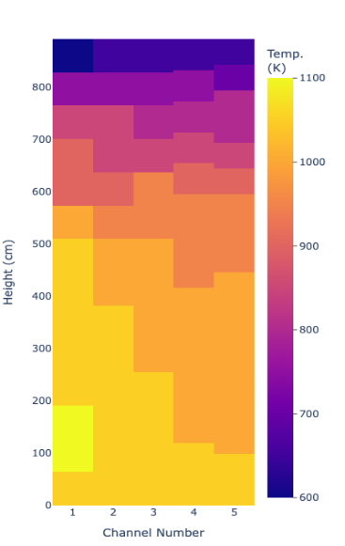
The System: GPBR-200
Design by Idaho National Lab
Pebble bed reactor (PBR)
Power: 200 MWth
Primary System Pressure: 6MPa
Helium-cooled
TRISO fuel pebbles, ca. 200k per core
Enrichment (equilibrium): 15.5-wt%
Core radius: 1.2m
Core active height: 8.93m

Slide 7
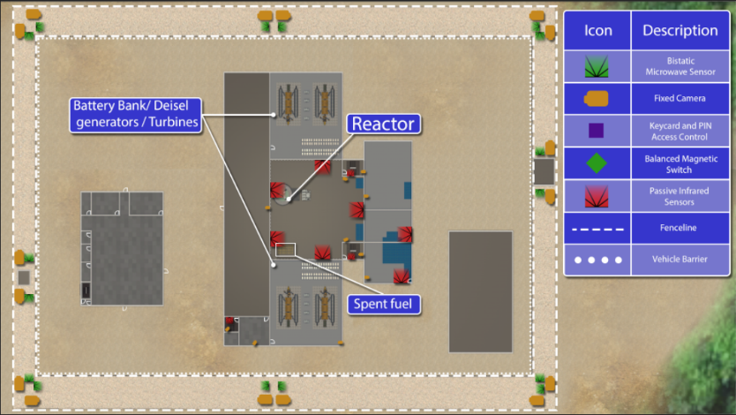
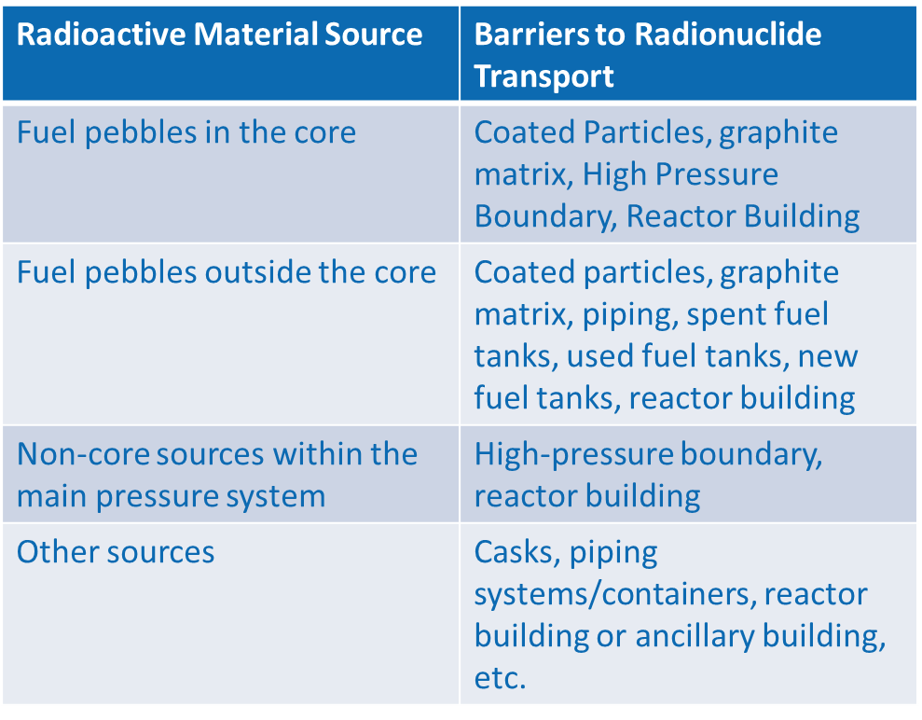
Safety, Security and Safeguards Descriptions – some Examples
Notes:
A full-scope assessment was beyond the objective of the study
The 3S descriptions address the identification of the key aspects needed to identify the interfaces between safety, security and safeguards
Open literature survey of pebble-bed VHTR reactors safety, security and safeguards formed the basis for a tailoring to the GPBR-200 design features.
Past Safety and PR&PP assessments of the GIF VHTR system were also leveraged

Slide 8
Exploring the 3S Interfaces
Reactor designers have a strong safety culture, developed over several decades of experience, lessons learned, and regulatory requirements
Security is much less considered at early design stages, and a safeguards are even less taken into account
A systems engineering, holistic approach to 3SbD not a realistic paradigm shift for systems currently under design
Leverage on the existing safety by design culture and complement it with a PR&PP culture that could be introduced via bilateral interfaces with the better-known safety domain:
  Introduce the security and safeguards needs in terms of relationship with the safety ones, through a 3x2S exercise
  An additional analysis would allow the identification of the ones that are proper 3S interfaces

Slide 9
Exploring the Interfaces: Safety-Security (preliminary)
Provisions and Interfaces | In GPBR-200
Safety Systems and Physical Security: Need to protect safety systems. | All safety systems are inside the reactor building, effective denial of access . Few energetic mechanisms that can be exploited for sabotage. Effective passive cooling for decay heat removal.
Safety Systems and Cybersecurity: Cyber-physical interface. | Not enough details. Strong reliance on passive safety systems should guarantee strong robustness to potential misuse.
Timeline Analysis and Response Force Strategy: How does enhanced safety affect security approach. | Longer timelines before core damage if loss of cooling. Longer response times in case of attack due to passive safety and intrinsic characteristics. Need to protect intentional sabotage not mitigated by intrinsic and/or engineered safety features.
Effect of Radiation Dose on Responders: Need to minimize dose to responders in normal and emergency operations. | Below-grade siting helps to reduce dose to responders in the building.
Emergency Exits: Tension between the two S’s. | Highly automated process minimizing human presence in vital areas. Shark cages or mantraps can be used on all entries and exits.

Slide 10
Exploring the Interfaces: Safety-Safeguards (preliminary)
Provisions and Interfaces | In GPBR-200
Retrofitting: Adding safeguards equipment later may affect safety. | Central role of Fuel Handling System for both S’s: Early discussion around FHS role will reduce later modifications.
Fuel Movement during Accidents or Safeguards Inspections: Effects on both S’s. | Highly automatized fuel handling process. Material in storage enclosed in canisters. Stability of TRISO kernels and fuel pebbles enhances fuel integrity.
Access Restrictions: Reduce access for safety versus access for inspections. | Nuclear material almost always in “difficult to access” areas: Heavy reliance on dual C/S systems and remote means to restore continuity of knowledge in case of C/S failures.
Equipment Failure: Shared equipment fail affects both S’s. | Many potential shared equipment: Need of reliability analyses to ensure that no safeguards-induced damage might end up in a safety-relevant situation.
Inherent Safety Characteristics: May reduce possible diversion or misuse strategies. | Low-power density. Huge amount of fuel items. Tiny amount of NM per item.

Slide 11
Exploring the Interfaces: Security-Safeguards (preliminary)
Provisions and Interfaces | In GPBR-200
Pebble Handling System and C/S: Diversion pathway analysis crosses both S’s. | Accountancy foreseen on canisters as opposed to individual pebbles: Need to ensure no loss of pebbles. Diversion pathway analysis to determine ways to remove pebbles and to provide mitigation measures.
Proliferation Resistant Materials: Material attractiveness for both S’s. | Fuel pebbles are harder to reprocess. Large number of pebbles to reach 1SQ of SNM. Items hard to move due to high-burnup and related barrier.
Remote Data Transmission: Data collection impact on physical and cybersecurity. | In principle not different from any other nuclear facility subject to safeguards relevant remote data transmission.
Surveillance Systems: Needs in both domains. | Not enough information at this stage. In principle the difficult to access inventory might benefit from innovative spatial awareness techniques.
Domestic MC&A and International Safeguards: Different overlaps with physical protection. | Several potential synergies for making use of shared signals from the operator while maintaining independent verification capabilities.

Slide 12
Exploring the Interfaces: Safety-Security-Safeguards (preliminary)
Provisions and Interfaces | In GPBR-200
Cyberinfrastructure: Common potential entry point for disruptions. | High potential for signal sharing between S’s: Remote data transmission requires careful design of the cyberinfrastructure.
Nuclear Material Containment and Access: Tensions and synergies among needs. | Most of nuclear material inventory in difficult to access areas Vast amount of items in the reactor building in a non-static configuration. High level of automation should facilitate access regulation and safety/security needs Effective dual-C/S systems shared signals might support safeguards needs.
Plant Operations: Needs and impact on all S’s. | High level of automation and strong systems integration: Opportunities to define plant operation to be synergistic with 3S needs.

Slide 13
Takeaways
The GIF 3S sub-group set up a bottom-up case study to start investigating the interfaces between safety, security and safeguards in Gen IV reactor technologies.
The final aim is to provide some guidance to designers and vendors wishing to apply a 3SbD approach to the development of a Gen IV AMR.
The process highlighted that the concept of 3SbD and PR&PP by design are not new.
Among designers there is the need to foster a security and safeguards by design to integrate the already existing safety by design culture.
The ultimate goal of a 3SbD culture among designers could be achieved in a smother and quicker way, through an intermediate 3x2S analysis of the existing interfaces.
While a tighter 3S integration would be beneficial for all new reactor systems, it will be particularly relevant for small and advanced modular reactors (SMR/AMRs).
Notes:
3x2S, potentially allowing the industry to profit from the window of opportunity represented by AMRs
AMRs provide opportunities to take a more integrated approach to the design of 3S systems:

Slide 14
Thank You!
All current reports can be obtained at:
https://www.gen-4.org/gif/

Slide 15
Safety, Security and Safeguards Descriptions
A full-scope assessment was beyond the objective of the study
The 3S descriptions address the identification of the key aspects needed to identify the interfaces between safety, security and safeguards
Open literature survey of pebble-bed VHTR reactors safety, security and safeguards formed the basis for a tailoring to the GPBR-200 design features.
Past Safety and PR&PP assessments of the GIF VHTR system were also leveraged

Slide 16
Progress Update
PRPPWG/RSWG/VHTR SSC Collaboration on 3S for Gen IV Reactors
Safety-Security Interface
Safety-Safeguards Interface
Security-Safeguards Interface
Safety Systems and Physical Security (need to protect safety systems)
Safety Systems and Cybersecurity (cyber-physical interface)
Timeline Analysis and Response Force Strategy (how does enhanced safety affect security approach)
Effect of Radiation Dose on Responders
Emergency Exits (tension between the two S’s)
Retrofitting (adding safeguards equipment later may affect safety)
Fuel Movement during Accidents for Safeguards Inspections (effects on both S’s)
Access Restrictions (reduce access for safety versus access for inspections)
Equipment Failure (shared equipment may impact both S’s)
Inherent Safety Characteristics (may reduce possible diversion or misuse strategies)
Pebble Handling System and C/S (diversion pathway analysis crosses both S’s)
Proliferation Resistant Materials (material attractiveness)
Remote Data Transmission (data collection impact on physical and cybersecurity)
Surveillance Systems (needs in both domains)
Domestic MC&A and International Safeguards (different overlaps with physical protection)
16

Slide 17
Exploring the Interfaces: Safety-Security (preliminary)
Provisions and Interfaces | In GPBR-200
Safety Systems and Physical Security: Safety and Control Systems should be in protected areas. The adversary path within the building should avoid generating more vulnerable targets. Decay heat removal systems should avoid being easy targets for an outside adversary. | All safety systems are inside the reactor building, effective denial of access . Not many energetic mechanisms that can be exploited for sabotage. Effective passive cooling for decay heat removal.
Safety Systems and Cybersecurity: Control systems should be appropriately protected. If remotely operated, potential security and safety critical vulnerabilty. | Not enough details to analyse the interface. Strong reliance on passive safety systems should guarantee strong robustness to potential misuse.
Timeline Analysis and Response Force Strategy: Walk-away safe does not mean walk-away secure. Even when some accidental progressions are practically eliminated, the system needs to be protected against intentional damage. Remote locations exacerbate this need. | Longer timelines before core damage or other problems occur in the event of loss of cooling systems. Strong reliance on passive safety and intrinsic characteristics ensure longer than usual response times in case of attack. Need to protect intentional sabotage sabotage not mitigated by intrinsic and/or engineered safety features.
Effect of Radiation Dose on Responders: Need to minimize dose to responders in normal and emergency operations | Below grade siting helps to reduce dose to responders in the building.
Emergency Exits: any entrance/exit to/from vital areas needs to be adequately protected even during emergencies. | Highly automated process minimizing human presence in vital areas. Additional delay features like shark cages or mantraps can be used on all entries and exits.

Slide 18
Exploring the Interfaces: Safety-Safeguards (preliminary)
Provisions and Interfaces | In GPBR-200
Retrofitting: costly retrofits may need to be made to accommodate safeguards equipment and inspectors. any such modification may have safety implications for the facility, which will need to be investigated before changes are allowed, costing the operator time and money. | Given the centrality of the Fuel Handling System, it is likely some form of safeguards measurements will focus around that system. Discussing what these measurements early on may prevent needing to make changes later in the design phase.
Fuel Movement during Accidents or Safeguards Inspections: In the event of a beyond design basis accident, some form of fuel movement, such as through melting, may occur. Such movement has both safety and safeguards implications. Nuclear material moved for safeguards measures might be damaged creating safety-relevant situations. | The fuel handling process is highly automatized and material in storage is enclosed in canisters, giving no major possibilities to inspector to manually move fuel. The stability of TRISO kernels and fuel pebbles makes major losses of fuel integrity very unlikely.
Access Restrictions: As a result of minimal down time, some areas where elevated radiation fields are present during reactor operations may be inaccessible due to safety reasons for extended periods of time. | Nuclear material in the GPBR-200 is almost always in “difficult to access” areas. This will require dual C/S systems and remote means to restore continuity of knowledge in case of C/S failures.
Equipment Failure: Shared use of equipment can fail in safeguards and/or safety relevant ways. | It is expected to see many shared equipment in this types of reactors, requiring extensive reliability analyses to ensure that no safeguards-induced damage might end up in a safety-relevant situation.
Inherent Safety Characteristics: some intrinsic features that enhance safety have the potential to reduce possible diversion and misuse strategies. | Low-power density, huge amount of fuel items with tiny amount of NM per item increase Proliferation Resistance.

Slide 19
Exploring the Interfaces: Security-Safeguards (preliminary)
Provisions and Interfaces | In GPBR-200
Pebble Handling System and C/S: an operator-controlled system that helps to count total numbers of pebbles but does not track or identify specific pebbles. | For MC&A, accountancy is foreseen on canisters as opposed to individual pebbles. However, even the loss of one pebble is a security-relevant event. Diversion pathway analysis may be utilized to determine ways to remove pebbles and to provide mitigation measures.
Proliferation Resistant Materials: The use of proliferation resistant materials may serve to simultaneously enhance the unattractiveness of nuclear materials for proliferators and thieves. | Fuel pebbles are harder to reprocess and require that a large number of pebbles to reach 1SQ of SNM. Items may also be more dangerous to move due to high burnup and related barriers.
Remote Data Transmission: Efforts should be made to see if data can be collected and transmitted in a way that is beneficial to safeguards while minimizing or eliminating any security concerns that remote data transmission generates. | The GPBR-200 in principle does not present difficulties different from any other nuclear facility subject to safeguards relevant remote data transmission.
Surveillance Systems: The system needs to accommodate both security and safeguards surveillance systems. | Not enough information at this stage. In principle the difficult to access inventory might benefit from innovative spatial awareness techniques.
Domestic MC&A and International Safeguards:While domestic MC&A can utilize the physical protection system, international safeguards cannot. Additional, independent verification measurements will need to be added to the system to ensure that the host state is not diverting material for clandestine uses. | The preliminary design analysis seems to highlight several potential synergies for making use of shared signals from the operator while maintaining independent verification capabilities.

Slide 20
Exploring the Interfaces: Safety-Security-Safeguards (preliminary)
Provisions and Interfaces | In GPBR-200
Cyberinfrastructure: potential hacking of one system could cascade across platforms and lead to the compromising of other, unrelated systems. Need of a robust cyber infrastructure and response capability to ensure there are no weak points in one regime that could lead to compromises in the other. | The high potential for signal sharing between safety, security and safeguards and remote data transmission desiderata require careful design of the cyberinfrastructure.
Nuclear Material Containment and Access: All three regimes are also concerned about the location of nuclear material, how it can be accessed, and who can access it. Potential conflicts can arise in terms of accessibility to safety systems, vital areas and nuclear material. | Most of the nuclear material inventory is in difficult to access areas, with a vast amount of items in the reactor building in a non-static configuration. The high level of automation of the facility should in principle facilitate the access regulation and needs arising from safety and security. Effective dual-C/S systems and smart use of shared signals have the potential to support safeguards needs.
Plant Operations: Planned operational programs should consider security and safeguards in the design of the procedures. Operational procedures should not impact aspects of the security and safeguards systems. Design and operational considerations can also lower security and safeguards relevant situations. | The high level of automation of the facility, coupled with the strong systems integration offer opportunities to define plant operation to be synergistic with safety, security and safeguards needs.

