Slide 2
ACHIEVING RESILIENCE THROUGH THE
PRESERVATION OF FUNCTIONS
Safety and security working together
IAEA-CN-374/238

Slide 3


The authors
Mike StJohn-Green CEng FIET
Mitchell Hewes, IAEA
Notes:
Timeslot is 12-15 minutes including questions
Need to get through the slides in 8 or 9 minutes

Slide 4
Why this subject, why now?
This is the latest in a series of papers about safety and security.
Security should defend the functions not the assets.
  Current thinking jumps too quickly to defending the I&C technology.
Safety and security risks should be managed together.
  Currently, risks can go untreated or treatments may conflict.
A Systems Engineering approach can provide the framework.
  Create high-level security objectives, copy from safety.
SMR I&C development needs this new thinking.
  Innovative use of new digital technology in I&C will create new risks.
Currently, despite our best intentions, we may be delivering fragmented and ineffective security. This can lead to a false confidence in security and gaps that could undermine safety.
Notes:
Conventional approaches to information security and computer security have often focused on, or have been interpreted as, securing individual systems, digital assets and the information they process through a set of discrete measures rather than defining and then meeting overarching security objectives to defend critical functions, such as reactor protection in a reactor [1]. This paper will illustrate how a system-centric view can lead to a fragmented and ineffective security posture, as it fails to consider the broader context in which these systems operate, the complex interdependencies between them, and the interweaving with other objectives such as nuclear safety.

Slide 5
What could go wrong today?
A simple thought experiment about security
Imagine if security is unaware of the safety requirement to maintain independence between two digital assets.
Security defends the assets to the
required security level
That allows the addition of a
common security device,
undermining their independence.
Reactor protection system #1
Reactor protection system #2
Digital asset at Security Level x
Digital asset at Security Level x
Added common security device
What if the security objectives were aligned with the Preservation of the Function(s)?
Security requirements would inherit independence requirements and this would be prohibited.
Notes:
The requirements for independence of the two digital technology systems would be derived from the high-level requirements for the reliability and availability of the reactor protection function. These high-level requirements would flow to the security design team in parallel with the safety design team and the engineering design team. Those teams may not even be teams but a single, multi-disciplinary team. The architecture for the digital systems performing the reactor protection function would be tested against all the requirements, including those for integrity and availability of the function. The network architecture would be designed to maintain a high degree of separation between the two RPS and this would extend to using different maintenance laptops and other forms of diversity. This analysis would drive the security architecture.

Slide 6
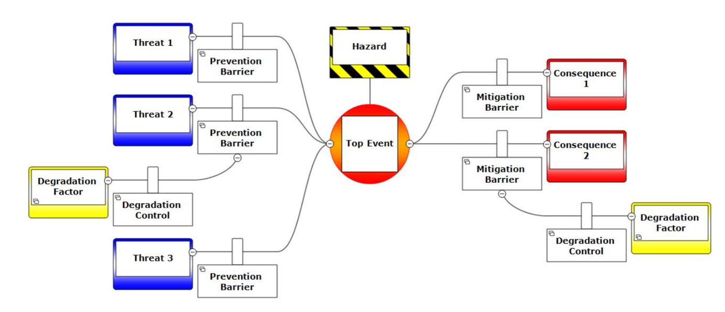
What could go wrong today?
A simple thought experiment about safety Bowtie diagrams
Security is tasked to defend these barriers / defend the assets
Language confusion
But a malicious actor can ADD functionality to the system!
Then, we have the wrong system description!
Image from https://www.rssb.co.uk/safety-and-health/guidance-and-good-practice/bowties
Notes:
The challenge with this example is that the attack scenario assumes that the adversary changes the system, therefore any safety analysis must be reviewed in light of those assumed changes. This is unlikely to happen, given the current level of interaction between the safety and security processes. Moreover, there may be additional adversary paths made possible by the properties that emerge, such as by the additional functionality introduced by the adversary. A systems engineering approach, incorporating Secure-by-Design, will consider the effects of the assumed attack scenarios on the initial design of the digital system. Where those scenarios assume modifications to the system, such as by introducing malicious code or hardware, the final design should demonstrate how the security functionality will Protect-Detect-Respond quickly enough

Slide 7
High level cyber security objectives
NSS 20 says:
  2.1. The objective of a State’s nuclear security regime is to protect persons, property, society, and the environment from harmful consequences of a nuclear security event.
  2.2. With the aim of achieving this objective, States should establish, implement, maintain and sustain an effective and appropriate nuclear security regime to prevent, detect and respond to such nuclear security events.
Cyber security should take proportionate steps to preserve the functions important to the Nuclear Security Regime by reducing the risks arising from malicious action against digital technology. We may also choose to preserve the functions of Resilience of Generation, financial, reputational and other objectives.
NIST Framework (and others) can break this down into sub-objectives, with the following general shape:
Identify – Protect – Detect – Respond – Recover
---------------------- GOVERN ---------------------------
The implementation of security objectives, with security measures/controls must be considered from initial design and verified throughout the system lifetime, ideally within a Systems Engineering framework.
Notes:
As digital technology becomes more complex, such as anticipated with SMRs, the historic approach of additive security becomes less and less efficient and effective. This is because computer security measures will increasingly demand changes to the digital architecture itself. To avoid this, safety and security requirements should feed into the systems engineering processes and those requirements be maintained throughout the system lifecycle.
These requirements should be traceable back to the functions that the system delivers, in order to assure that the function has sufficient resilience against all kinds of faults, failures and malicious action, throughout the system’s entire lifecycle. This requires a different mind-set, particularly for the security team, to work within a systems engineering regime, using a functional basis for managing requirements. It may also call for a different approach from the safety team, recognising that security cannot be additive, designed and applied as a layer around an existing design.

Slide 8
Summary
ACHIEVING RESILIENCE THROUGH
THE PRESERVATION OF FUNCTIONS
Safety and security working together
Thought experiments illustrate what can go wrong today with security and safety
We need a paradigm shift towards unified risk management for safety and security
Analysis should derive high level objectives for security, to deliver resilience through the Preservation of Functions, within a Systems Engineering approach.
Security should not jump so directly to defending the digital assets against attacks
This challenge is also an opportunity to manage new risks arising from advanced technology, necessary for SMRs in the future ' global marketplace’ for advanced nuclear technologies.

