Slide 2


3S APPROACH FOR ADVANCED SMR DESIGNS IN BELGIUM
I.G. SANDA, Belgian Nuclear Research Center SCK CEN
F. VERMEERSCH, Belgian Nuclear Research Center SCK CEN
W. M'RAD DALI, Belgian Federal Agency for Nuclear Control

Slide 3
Content
The Belgian regulatory context for 3S
The importance of early 3S integration for an advanced SMR
The Belgian pre-licensing process for an advanced SMR
Conclusions

Slide 4
The Belgian regulatory context for 3S

Slide 5
In Belgium, the law of 15th of April 1994, sets the basis for Safety, Security and Safeguards, each of the “S” has its own legal and regulatory texts;
Requirements for Class I facilities are detailed in the royal decree of 30 November 2011 on Safety of Nuclear Installations.
For nuclear safety:
  A construction and operating license is required for each activity involving sources of ionising radiation;
  Class I facilities are the facilities with the highest risk such as nuclear power plants and research reactors;
  Requirements for Class I facilities are detailed in the royal decree SRNI-2011;
  SRNI-2011 includes a specific chapter based on the WENRA Safety Reference Levels for research reactors which is expected to be applicable to the SMR-LFR demonstrator project;
For nuclear security:
An operator applies, at the same time with the construction and operating license, for approval of the physical protection system;
Four royal decrees of 17th of October 2011 include:
    provisions regarding the categorization and the definition of nuclear security areas;
    the physical protection prescriptive and performance-based approach provisions;
    the handling of nuclear sensitive documents;
    trustworthiness.

Slide 6
For nuclear safeguards:
The operator is asked to inform Euratom and IAEA as soon as possible of the intention to build a new nuclear facility and to provide, to Euratom the so-called Basic Technical Characteristics (BTC);
The laws of 20th of July 1978 and 1st of June 2005 set basic provisions regarding:
  accountancy obligations;
  verification activities and inspections;
  reporting obligations.
  The R302/2005 constitutes also the backbone of the safeguards regime in Belgium in line with the Comprehensive Safeguards Agreement INFCIRC/193 and the Additional Protocol INFCIRC/193/Add.8.
  FANC has issued an internal note “The 3S Approach and the Safety Security interface in Class I facilities” in which it presents the vision of the FANC with regard to the 3S approach and the Safety-Security interface approach. FANC describes what it is expected from the operators, how the interfaces are handled within the national regulatory body, and what role is to be played by the technical support organization, Bel V, in this regard.

Slide 7
For safety by design, security by design and safeguards by design:
FANC offers the possibility for (future) operators of new nuclear projects to launch pre-licensing projects;
The pre-licensing process allows for early interaction of the regulatory body with the future operator and contribute to better address 3S by design concerns and opportunities;
A pre-licensing strategy has been chosen for the MYRRHA project and is currently ongoing;
FANC delivered to the attention of the future operator an explanatory note regarding the Design Options and Provisions File (DOPF) which is the main document to be provided by the operator at this stage.
Through the explanatory note the future operator can identify:
  what are the main concepts and ideas that have to be taken into account from the pre-design stage;
  what are the early analysis to be conducted;
  what are the information to be provided to the regulatory body for the conduct of the process.
In parallel to the DOPF, the stakeholders also agreed on specific safety, security and safeguards focus points that should be further addressed and analyzed during the pre-licensing stage.

Slide 8
For the pre-licensing and licensing stages of any future advanced SMR design the regulatory body will define an approach that might need a revision of laws and decrees applicable for safety, security and safeguards;
Following the Belgian Government decision of 23th of December 2021 to invest in research on SMR technologies, FANC developed an Action Plan on SMRs with the following goals:
  To get sufficient understanding and knowledge about potential relevant stakeholders.
  To get sufficient understanding of available sources of knowledge and information.
  To get sufficient general knowledge to determine what specific knowledge per relevant SMR concept is necessary for its assessment.
  To get sufficient knowledge to develop a legal and regulatory framework suitable for a specific SMR concept depending on the needs.
  To get in-house and/or external sufficient specific knowledge to be able to fully assess an SMR concept depending on the needs.
  It is foreseen, as it was the case for the MYRRHA project, to address all the 3S at the same pace and to identify and address, in the framework of this Action Plan, the positive and negative interfaces.

Slide 9
The importance of early 3S integration for an advanced SMR

Slide 10
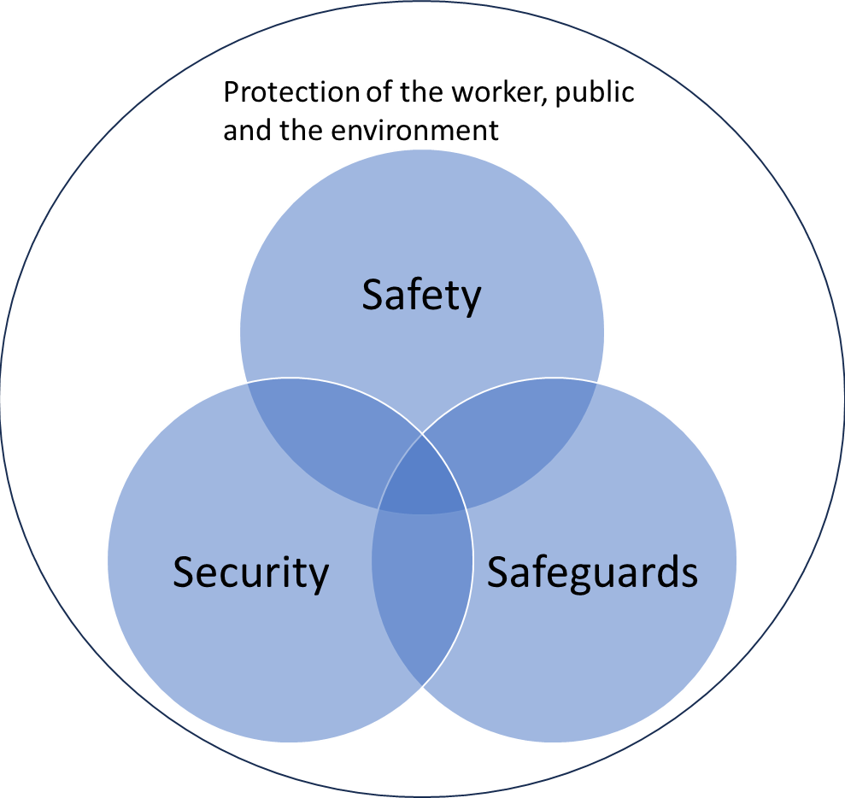
For an advanced non-water cooled SMR, finding the optimal design solutions that meets the 3S requirements is essential but also challenging since most requirements and standards are focused on water-cooled designs.
The interpretation and integration of 3S requirements must start early and, be discussed with the regulatory body early in the design phase of new advanced technologies.

Slide 11
SCK CEN and the Belgian regulatory body have experience in interacting, through pre-licensing, on the implementation of 3S in the design of MYRRHA Lead-bismuth cooled Accelerator Driven System developed by SCK CEN.
Challenges of early integration of 3S in the design on an SMR-LFR are:
  Interpreting the existing requirements to address the specificities of an advanced SMR-LFR technology;
  Keeping up with the extensive international work to update the existing standards and develop new SMR standards;
  The need, if any, to adapt the legal and regulatory framework to tackle the specificities of an advanced SMR technology;
  R&D needed to comply with some of the 3S requirements;

Slide 12
Challenges of early integration of 3S in the design on an SMR-LFR are:
  The digitalization of the I&C systems and the possibility to remotely operate the reactors;
  Timely interaction with the international inspectorates, IAEA and EURATOM, to address the safeguards requirements needed as an input in the design process;
  Working with complex interdisciplinary teams and the development of the safety, security and safeguards cultures in the teams
  Promoting the importance of integrating all 3S requirements rather than focusing on individual areas of expertise;
  Managing the iteration and modification process in design that encompasses the 3S needs;
  Reaching out to new non-traditional stakeholders who are not always aware of the rules and concepts governing the nuclear industry.

Slide 13
  Benefits of an early integration of 3S in the design on an SMR-LFR are:
    Optimizing the position, the orientation and the layout of the reactor facility on the nuclear site considering simultaneously the 3S requirements/concerns e.g. the safety and security stand-off distances and acquisition/diversion pathways. Safeguards associated reflexions are considered at an early stage;
    The ability to establish the optimal material workflows;
    For reactors constructed on existing sites, the ability to position the installation such that fulfilment of the 3S requirements of all other installations on the site are not impacted;
    Identifying early any areas that might require R&D to validate technical solutions e.g. for safeguards instruments ability to operating in opaque coolant and consideration of new sabotage scenarios and accidental conditions.
    Selecting the optimal routing of support systems (the shortest distance with the minimal number of bends and wall penetrations) considering safety requirements as well as security constraints;

Slide 14
  Benefits of an early integration of 3S in the design on an SMR-LFR are:
    Foreseeing the adequate space in the design for the necessary security and safeguards equipment in the reactor building and in and around the fuel manipulation areas;
    Defining the operational and maintenance periods of the reactor according to the needs for safety and security controls and inspections, and safeguards surveillance activities;
    Designing the radiation protections zones in sync with the security zoning to optimize space.
    Designing dedicated areas for safeguards activities considering together the type and frequency of inspections and safety, security and radiation protection requirements.
    Designing ways of accessing all areas that might need to be inspected by safeguards;
    Optimizing the design of dedicated security areas for the control of access and deliveries.
    Designing the electrical power supply system considering the UPS needs for security and safeguards equipment;
    Fostering the safety, security and safeguards cultures in the project and encourage a holistic approach to the design.

Slide 15
The Belgian pre-licensing process for an advanced SMR

Slide 16
  SCK CEN, as a major centre of excellence of HLM technology, will develop and construct a lead cooled fast Technology Demonstrator in support for lead cooled fast SMR’s (SMR-LFR) in collaboration with an international consortium with relevant knowledge in reactor design and specific experience in SMR-LFR;
  The MYRRHA reactor programme with its associated R&D and pre-licensing experience can support the development of SMR;
  The strategy for the development of the concept design of the demonstrator is to integrate the 3S requirements from the start of the design process;
  During pre-licensing we will define:
    the requirements and standards to be applied to the design
    the key areas of R&D that need to be addressed.

Slide 17
  During the pre-licensing process periodic interactions between the operator and the regulator will ensure a common understanding of the results obtained and asses the progress made;
  The regulatory body defines the expected format and content of the pre-licensing deliverables in consultation with the applicant;
  The process ends with a report from the regulatory body indicating the degree to which the concept design meets the 3S framework and potential areas where further work is needed;
  Any opinions provided by the regulatory body during the pre-licensing does not constitute a guarantee for future licensing of the facility.

Slide 18
Conclusions

Slide 19
  The implementation of 3S in an early stage of an advanced SMR design is a challenging process but it has multiple benefits in reducing the number of design iterations and ensuring optimal solutions.
  To be able to adequately implement 3S requirements in the design of an advance SMR, early interactions with the IAEA and EURATOM have to be foreseen.
  The 3S approach allows to identify early on, areas where future R&D is necessary to comply with the national requirements and international obligations.
  The pre-licensing process is a good practice that supports the applicants in the interpretation and integration of 3S in the concept design.
  The pre-licensing is an opportunity to align views between the applicant and the regulatory body and to promote the safety, security and safeguards cultures in the project.

Slide 20
Thank you!

