Slide 2



Recommendations for Design-Stage Safety and Security Probabilistic Risk Assessment (PRA) Co-development
October 23rd, 2024
Dr. Alexander J. Huning, Oak Ridge National Laboratory
Mr. Steve J. Reed, Oak Ridge National Laboratory
2

Slide 3
ORNL International Nuclear Security (INS): Recent and Ongoing Projects related to Security-by-Design (SeBD) and PRA
Investigation of PRA Methods for SeBD
  “Methods for the Enhancement of Security Probabilistic Risk Assessments,” Oak Ridge National Laboratory, ORNL/TM-2021/2034, (March 2021).
  White Paper on Hazard Analysis Methods for SeBD (June 2022)
SeBD Tabletop and Business Case (2024)
Target Set and Vital Area Assessment Methodology Comparison (2024)
Please contact for more information and references
3

Slide 4
SeBD + PRA = Harmony
SeBD is broadly defined as:
In the US, SeBD will be loosely required (e.g., Part 53):
PRA is also generally required and has advantages for Target Set Identification (Vital Area)
“…the system-level incorporation of the PPS into a new nuclear power plant or nuclear facility resulting in a PPS design that minimizes the risk of malicious acts leading to nuclear material theft; nuclear material sabotage; and facility sabotage as much as possible through features inhere in (or intrinsic to) the design of the facility”
ENABLE viability (economics) not be a hindrance !!
“Safety and security must be considered together in the design process such that, where possible, security issues are effectively resolved through design and engineered security features”.
4

Slide 5
Objective
How to effectively develop a safety PRA which will also be used to support security design, planning, and requirement development?
What security features need to be included in the development of PRA technical elements?
How to best or most effectively implement those features in the design-stage?
5

Slide 6
2S PRA Development Methodology
(i.e., Target Set Identification)
6

Slide 7
Quick definition break
The NRC defines Target Sets as:
IAEA NSS No.13 defines a Vital Area as:
The minimum combination of equipment or operator actions which, if all are prevented from performing their intended safety function or prevented from being accomplished, would likely result in significant core damage…or a loss of spent fuel pool coolant inventory and exposure of spent fuel, barring extraordinary actions by plant operations.
An area inside a protected area containing equipment, systems or devices, or nuclear material, the sabotage of which could directly or indirectly lead to high radiological consequences.
7

Slide 8



2S Design Cycle
4. Response Planning and Physical Protection System Design
1. Pathway Analysis
2. SSC Desirability Assignment
3. Quantify 2S PRA, Rank Cutsets
Complete
2S PRA Development
Risk tolerance evaluation, with uncertainties
Target Sets
Change Design
OR
Refine 2S Model
8

Slide 9
What security features go in a PRA/PSA?
Plant Operating State Analyses
Initiating Event Analysis
Event Sequence Analysis
Success Criteria
Hazard Analysis
Unexpected changes to plant operating states
Include non-core sources which may not be included in a full power model
Initiating events of malicious origin (IEMOs) not included in PRA system models
Don’t screen events based on frequency
Changes to human operator actions
Timing and phenomenological impacts
Verify no inherently eliminated or screened events that a sabotage could introduce
Consider or include potential fire sources in all areas of the plant
Consider all “other” intentionally introduced hazards which may be relevant for failure of systems relied upon for safety
Uncertainty and Risk Integration
Systems, Data, Quantification
Next slides
Consider impacts of changes to SSC desirability values
Assess feasibility of adversary actions, results from tabletop exercises, force-on-force modeling (not all PRA/PSA security feature additions may be possible)
Investigate any new safety insights from security event sequence quantifications
Source Term and Consequence
9

Slide 10
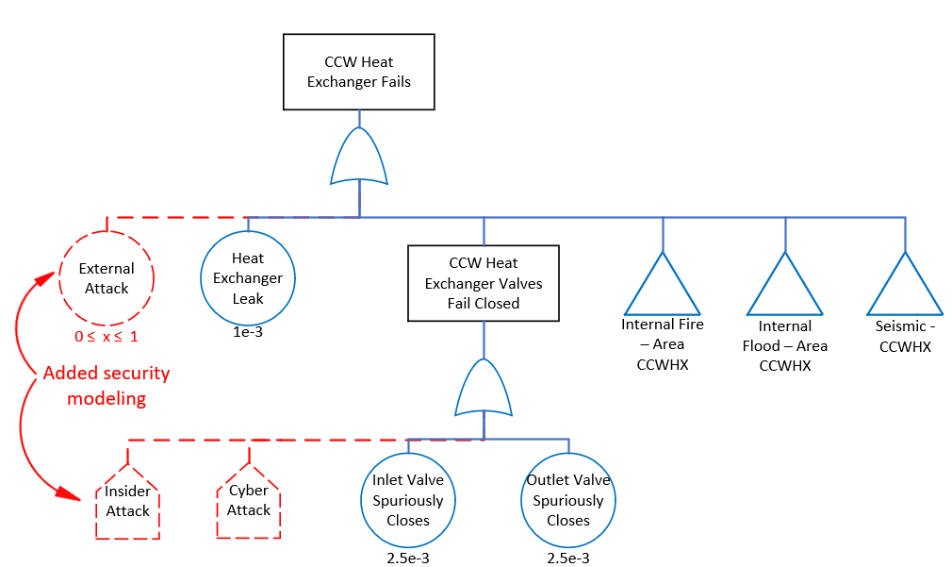
System and Data Recommendations
Add flags for security related events
  = 0 for reliability, accident sequences
  = 1 for sabotage events
Add basic events, under those flags, for desirability at their appropriate level (e.g., is the valve connected to the pump or are they in separate locations which would need their own event during an attack scenario?)
  = 1, initially
  0 < x < 1, as security insights are incorporated
Ensure reliability data can be easily switched on/off for sabotage scenarios
Ensure truncation and quantification limits don’t exclude security scenarios
10

Slide 11
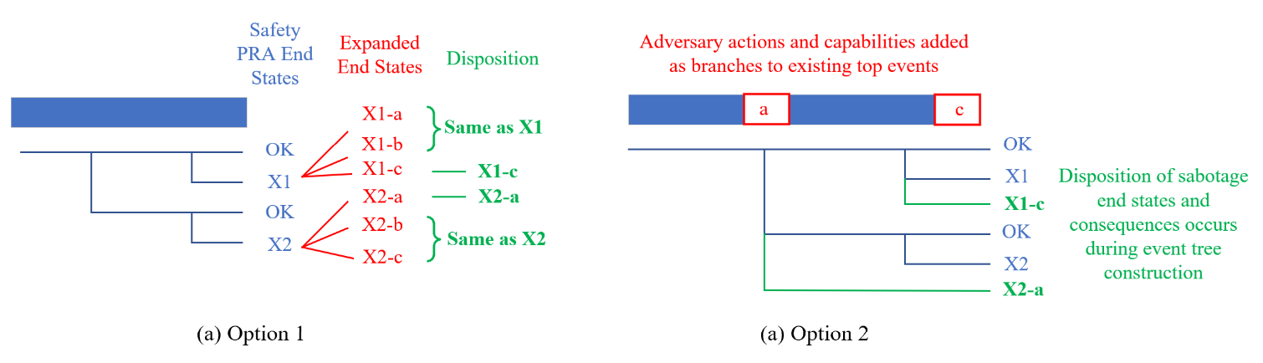
Source Term and Consequence Assessment Recommendations
Adversary actions could enhance the radiological release for a similar event sequence identified in the safety PRA
Two options for incorporating enhanced security consequences
  (1) Investigate each branch and end state, and select the “worst case” when considering effects from sabotage
  (2) Add new branches for differing adversary actions that result in similar plant response, but have differing consequences
11

Slide 12
Options for aiding developers in their safety and security risk assessment models
Federal regulatory guide or standard – NRC, IAEA, etc., publishes direct guidance on acceptable methods and approaches
Industrial codes and standards – some have suggested or proposed building a standard (similar to the ASME/ANS PRA standards) for nuclear security
Industrial guidance document – independent stakeholder or agency could capture these types of recommendations and modifications in a formal publication
Continue with existing approach – specialized support on an as needed basis for interested companies and applications
Impact
Ease of Implementation
12

Slide 13
Thank you and Questions

