Slide 2
A PATH TOWARD LEVERAGING THE
BENEFITS OF SAFETY, SECURITY, AND
(INTERNATIONAL) SAFEGUARDS (3S)
FOR ADVANCED & SMALL MODULAR
REACTORS(A/SMRS):
Summary of the Institute of Nuclear Materials Management’s Workshop on Advanced Reactor 3S
Paper 215 | Session 10.2 | 23 October 2024
A.D. WILLIAMS, K. LAWRENCE, M. SCHANFEIN, T. HERNANDEZ
Institute of Nuclear Materials Management
*SAND2024-07671C. Sandia National Laboratories is a multimission laboratory managed and operated by National Technology and Engineering Solutions of Sandia, LLC., a wholly owned subsidiary of Honeywell International, Inc., for the U.S. Department of Energy’s National Nuclear Security Administration under contract DE-NA-0003525.

Slide 3
Roadmap
Introduction
3S Workshop Logistics & Data Collection
3S Workshop Data Analysis
A 3S Path Forward for INMM
Insights for Radical Collaboration between INMM & IAEA

Slide 4

What is INMM?
Vision
Global peace, security, and prosperity through the responsible stewardship of nuclear and other radioactive materials and related technologies
Mission
The INMM advances scientific knowledge, technical skills, policies and best practices related to the responsible stewardship of nuclear and other radioactive materials and related technologies
Divisions
Facility Operations
International Safeguards
Materials Control and Accountability
Nonproliferation and Arms Control
Security & Protection
Packaging, Transportation and Disposition

Slide 5
Introduction
Event Dates | Event Name | Host Org.
Oct. 2024 | International Conference on Small Modular Reactors & their Applications (Group C) | IAEA
Feb. 2024 | Advanced Reactor 3S (Safety, Security, and Safeguards) Workshop^{B} | INMM
Dec. 2023 | 3S Workshop: Advanced Reactors and Fuel Fabrication | NRC
Sep. 2023 | Interregional Workshop on 3S by Design in Small Modular Reactors | IAEA
With many SMRs still being in an early design stage, there is a unique opportunity to comprehensively integrate all three elements of safety, security and safeguards – the so-called 3S concept – in the design of innovative reactors
Lydie Evrard
IAEA Deputy Director General and Head of the Department for Nuclear Safety and Security

Slide 6
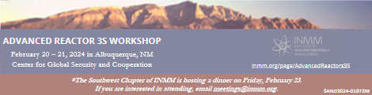
3S Workshop Logistics
Session I: Safety/Security
Orgs: Sandia, UNM, Enercon
Session II: Security/Safeguards
Keynote: DOE/NA211
Orgs: Sandia, Rhinocorps, Los Alamos
Session III: Safeguards/Safety
Keynote: DOE/NA241
Orgs: Sandia, Oak Ridge
Keynote: DOE/NE
Session IV: 3S Integration
Keynote: USG ANSWER
Orgs: Sandia, IAEA, Idaho, ACU
Summary stats: 2 days, 75+ participants, 4 keynote speakers, 20 expert presenters

Slide 7
3S Data Collection
Session [Interfaces] | Representative Data Set 1 | Representative Data Set 2 (raw count/total session responses)
I [Safety/ Security] | “Risk-informed applications have improved safety…by focusing on what matters most” | Potential Advantage: reduced costs (4/22)
II [Security/ Safeguards] | “[we need] deep and early conversations on interactions…more than a one hour talk” | Likely Opportunities: by-design options (3/13)
III [Safeguards/ Safety] | “[3S] is all tradeoffs… things will be missed by prioritizing individual perspectives” | Interesting Opportunities: new data types (2/4)
IV [Safety/ Security/ Safeguards] | “if we do each ‘2S’ well, we will get 3S as a by-product | Obstacles: (lack of) regulations (4/11)

Slide 8
3S Data Analysis
Focus → realistic, objective, & empirical opportunities
Goal → foundational, practical, & regulatory 3S solutions
Data Set I:
  Need for mutually congruent metrics of 2S or 3S performance & operations
  “by-design” efforts to bring 2S/3S from concept to practice
  “if we do each ‘2S’ well, we will get 3S as a by-product”
Data Set II:
  Biggest obstacle: lack of interface regulations [8/22; 4/11]
  Biggest opportunity: incorporate 2S/3S earlier [3/22, 3/13, 3/11]

Slide 9
3S Path Forward for INMM
Key insights:
  Interfaces = key roles for A/SMRs
  Emphasize & understand tradeoffs
  2S success → 3S success (?)
Key Questions:
  Interface impacts on risk?
  Regulatory synergy for interfaces?
  Overcome lack of 2S/3S-relevant data?
Elements of a new framework:
  “connected concepts”
  “bring balance” to interfaces
  “radical collaboration

Slide 10
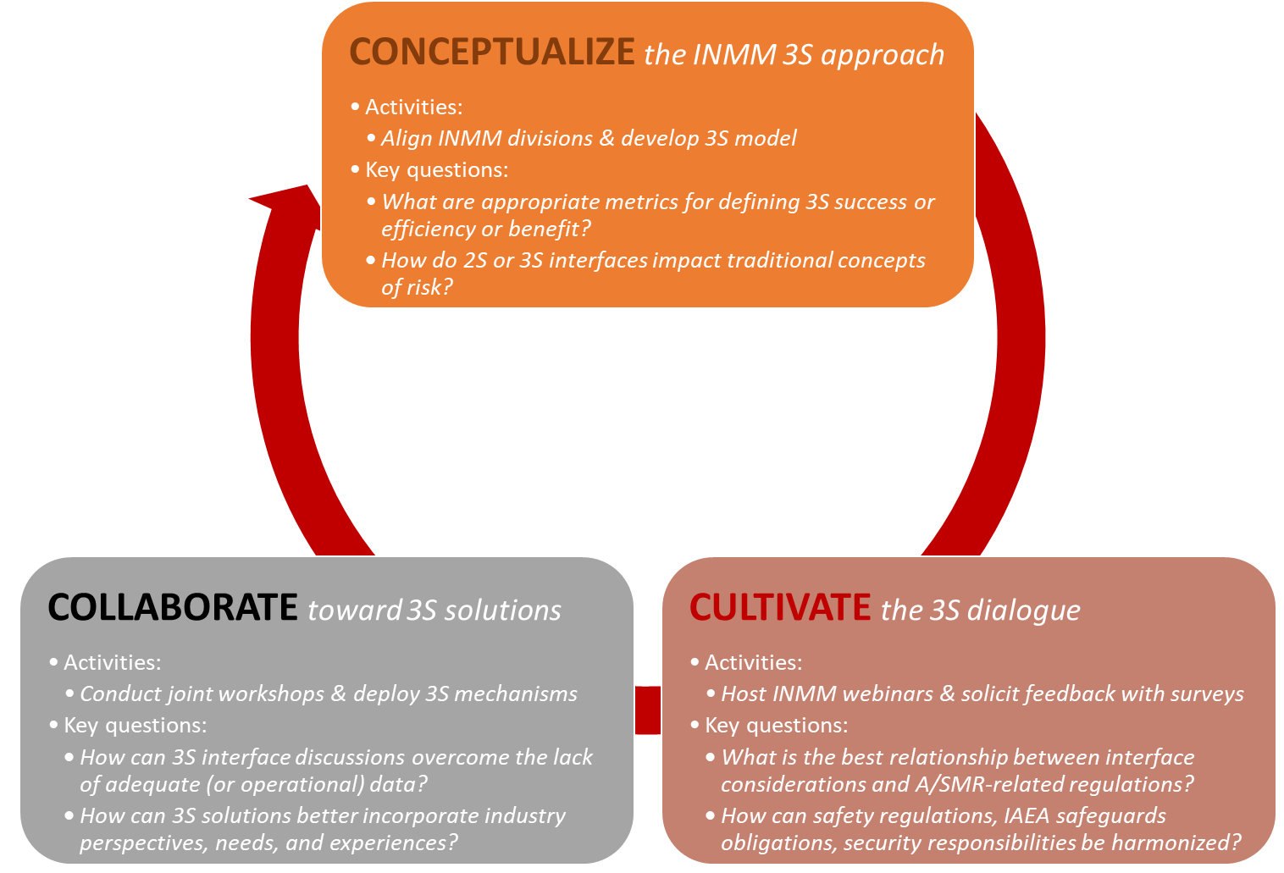
3S Path Forward for INMM

Slide 11
3S Path Forward for INMM
NNSA/ INSTAR
NNSA/ PRO-AR & FC
NNSA/ ARISE
DOE/ ARSS
NRC/ DANU
DOS/ FIRST

Slide 12
Radical Collaboration
INMM → “safe, secure and effective stewardship of nuclear and other radioactive materials and related technologies”
IAEA → “planning for and using nuclear science and technology for various peaceful purposes”
Mutual participation in 3S-related events
  Ex: Continued participation in each other’s webinars, workshops, or meetings
Informal dialogues on 2S or 3S interface issues
  Ex: Focused discussions by experts toward meaningful steps forward
IAEA shares global 3S perspective with INMM
  Ex: Keynote speakers at INMM events
INMM host workshops on IAEA 3S recommendations
  Ex: INMM events as structured brainstorming on interface implementation issues

Slide 13
QUESTIONS???
Adam Williams | Chair, Security & Protection Division | INMM
adwilli@sandia.gov

