Slide 1
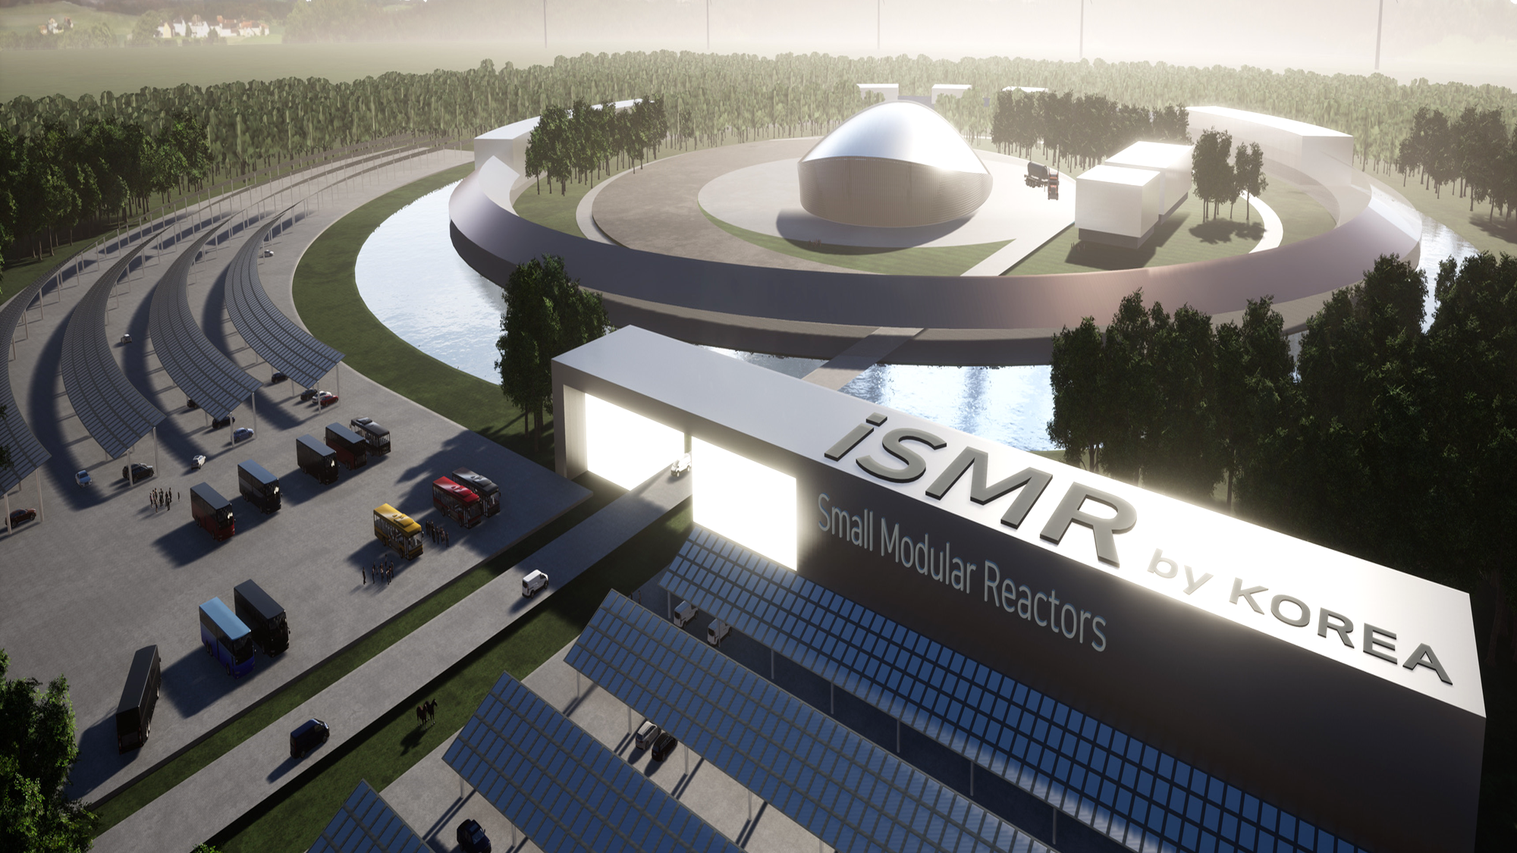


Regulatory Gap Analysis for i-SMR*
*Innovative Small Modular Reactor
Seok Jong Yoon
25rd October. 2024
SMR NSSS Design Group
Notes:
Hello, I’m seok jong yoon.
I am working for KHNP Central Research Institute.
In my company, I am a mechanical engineer for designing NSSS of i-SMR and passive safety system.

Slide 2
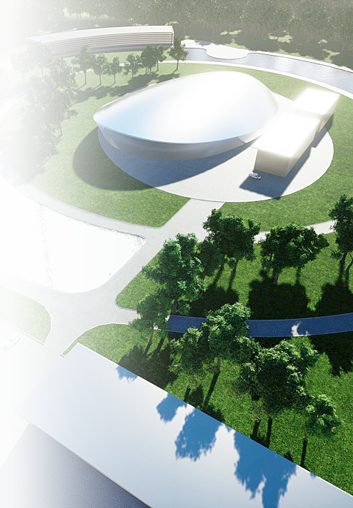
Contents
Introduction
Current Safety Standards in KOREA
- Safety regulation infrastructure for NPP
3. Gap Analysis Results
- Deviation between i-SMR design
and regulatory requirements
4. Conclusion
Notes:
This is the contents of my presentation.
First is about introduction of SMR and second, I will introduce the current safety standards in KOREA, especially safety regulation infrastructure for NPP.
Next, Gap Analysis results will be followed for deviation between iSMR design and regulatory requirements.
Finally, I will wrap up my presentation with conclusion.

Slide 3
Introduction
Current Safety Standards in KOREA
- Safety regulation infrastructure for NPP
3. Gap Analysis Results
- Deviation between i-SMR design
and regulatory requirements
4. Conclusion
Notes:
Let’s start with introduction.

Slide 4
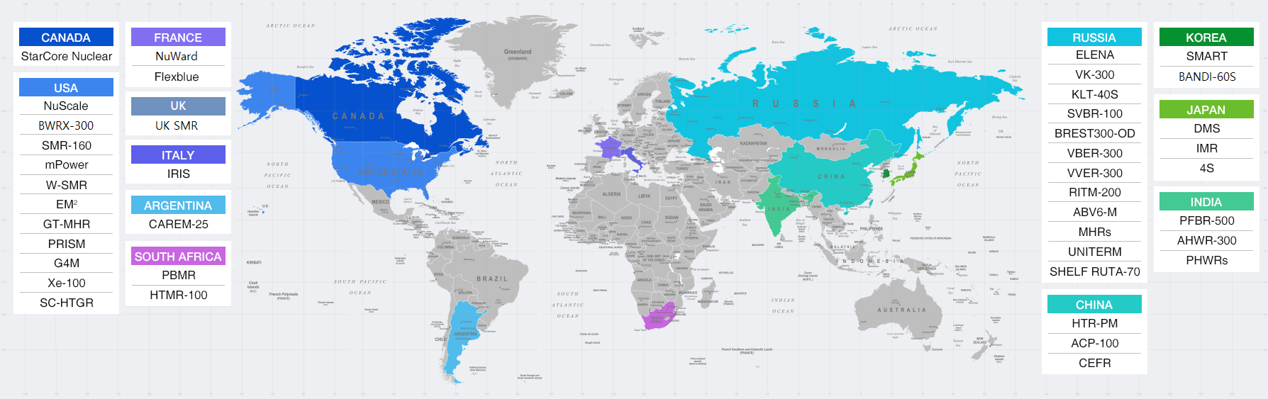
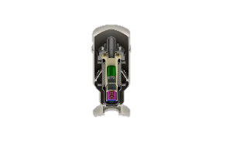
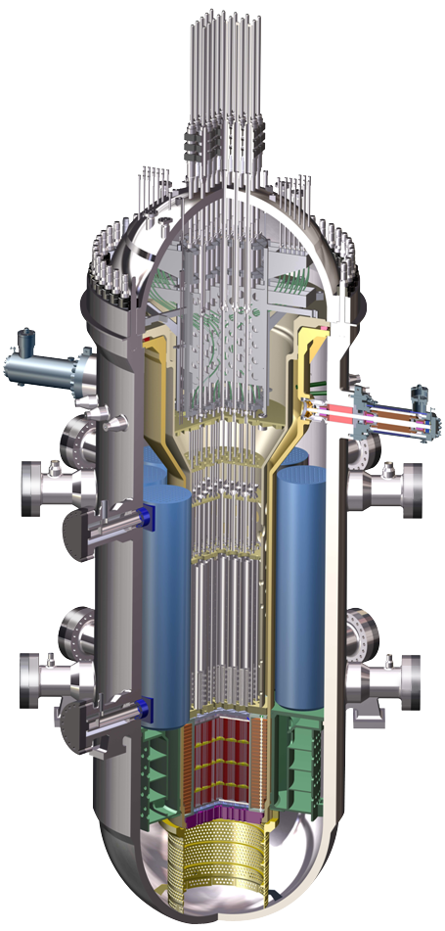
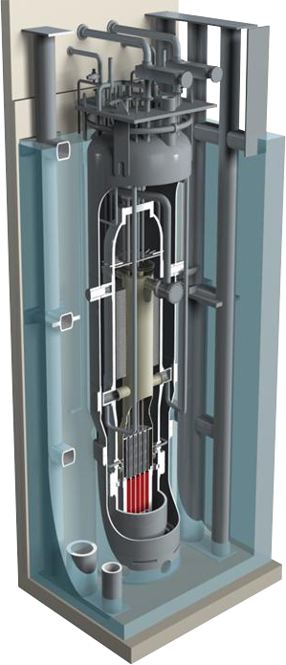
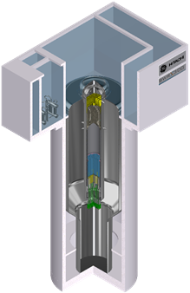
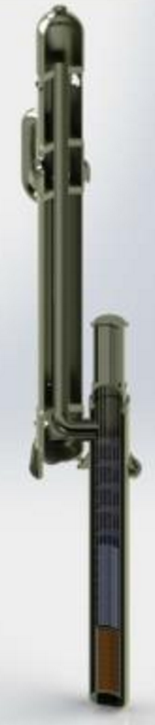
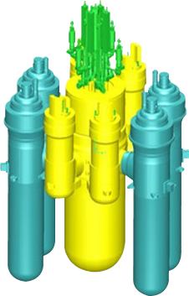
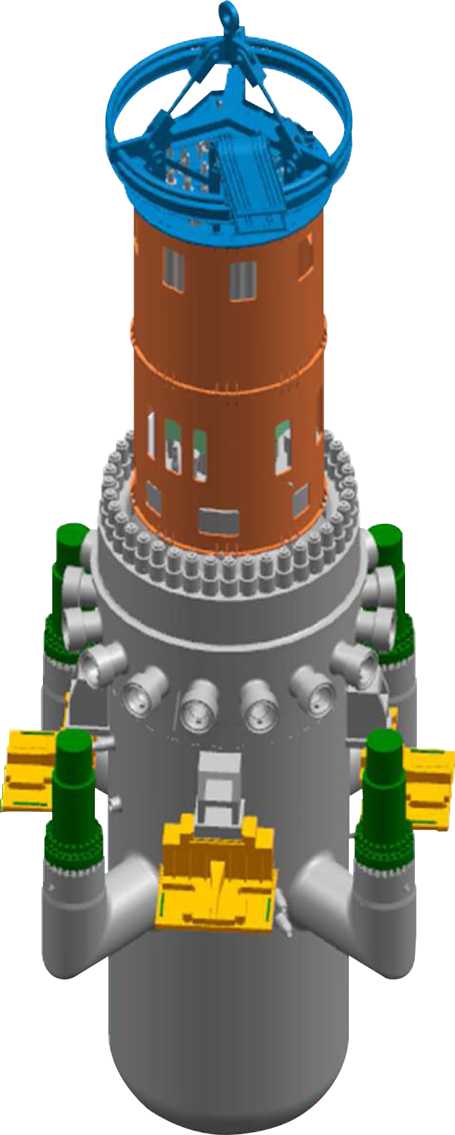
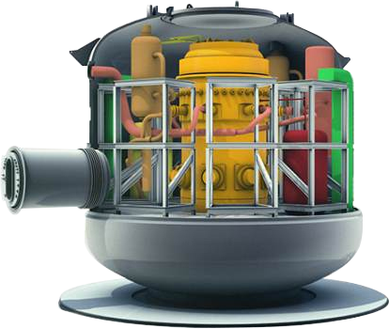
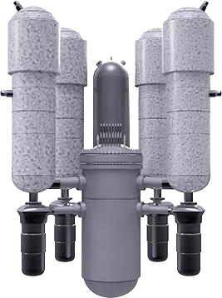
1. Introduction
SMR Models
More than 70 SMRs are being developed worldwide
※ Source : Advances in Small Modular Reactor Technology Developments (2020), IAEA
KOREA
Other Countries
i-SMR*
SMART
NuScale
BWRX-300
SMR-160
KLT-40S
ACP-100
NuWard
UK SMR
KHNP
KAERI
NuScale (US)
GE-Hitachi (US)
Holtec (US)
OKBM (RUS)
CNNC (CNA)
EDF (FRA)
Rolls-Royce (ENG)
Under Development
(Since, 2020)
Design Certification
(July. 2012)
Natural Circulation
NRC DC (2020)
BWR
Cons. Planning (CAN)
Block Type
NRC Pre-review (ing)
Offshore Floating
Operating (2019)
Site-Permit
Constructing (2021)
Conceptual Design
Con. Plan (2030)
440MWe, Loop Type
Con. Plan (2030)
*Innovative - SMR
Notes:
Nowadays, more than 70 SMRs are being developed worldwide.
Especially in KOREA, SMART is the first type of SMR which achieved safety standard design approval by KOREA regulatory body, recently.
Recently, innovative-SMR which called i-SMR has been under developing by leading of KHNP since 2020.

Slide 5
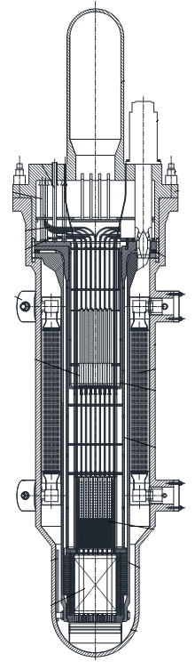
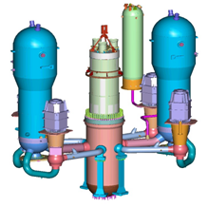
1. Introduction
i-SMR has Strength that conventional (large) NPPs doesn’t have
Arranged all Reactor Coolant Structures in an Integrated Reactor Vessel(IRV)
Eliminated Large Pipe (Large Commercial Reactor) → Eliminated inherently LBLOCA(i-SMR)
PZR
i-SMR design features meet to Safety, Economy, and Flexibility
Key design features | Soluble boron free operation In-Vessel Control Element Drive Mechanism Top-mounted ICI Fully passive safety systems Canned-motor RCPs In-Vessel Pressurizer In-Vessel Steam Generator Compact steel containment vessel Automatic load following
SG
RCP
Core
Conventional NPP
i-SMR
Notes:
This slide shows you the strength of i-SMR that conventional large NPPs doesn’t have.
In i-SMR, all Reactor coolant structures are arranged in an Integrated Reactor Vessel.
As shown in this figure, PZR, SG, RCP in conventional NPP are allocated in an integrated vessel in i-SMR, so we can eliminate large pipe to eliminate inherently LBLOCA
In addition, i-SMR design features meet to safety, economy, and flexibility.
The main design features of i-SMR are soluble boron free operation, In vessel CEDM, top mounted ICI,
Fully passive safety systems, canned motor RCPs and automatic load following.

Slide 6



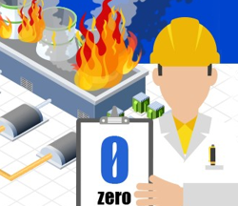
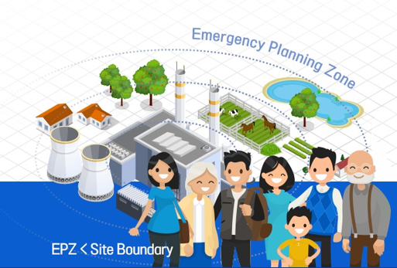
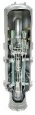









1. Introduction
The directions of i-SMR technology development
- Representative items of expected regulatory issues
Safety system without safety- 1E electricity | Robust seismic design | Passive Safety System | No Severe Accident | No need for Evacuation (EPZ)
Improved Safety
Reduced construction cost | Modularization, factory manufacturing, inland transportation | Digital Twin Program & Diagonosis | Competitive Cost | Reduction in operators for multiple modules
Enhanced Economics
Hydrogen production for industrial use | Desalination/Process heat supply | Flexible operation | Complementing renewable energy | Coping with climate change
Increased Flexibility
Notes:
In this slide, the directions of i-SMR technology development are presented.
For achieving improved safety, enhanced economics and increased flexibility, it is expected that some items have regulatory issues as shown in this picture.
The representative items are safety system without safety class electricity, passive safety system, no severe accident, no need for evacuation, digital twin program and diagonisis,
Reduction in operators for multiple modules etc.

Slide 7
Introduction
Current Safety Standards in KOREA
- Safety regulation infrastructure for NPP
3. Gap Analysis Results
- Deviation between i-SMR design
and regulatory requirements
4. Conclusion
Notes:
Let’s review the current safety standards in KOREA, especially safety regulation infrastructure for NPP.

Slide 8
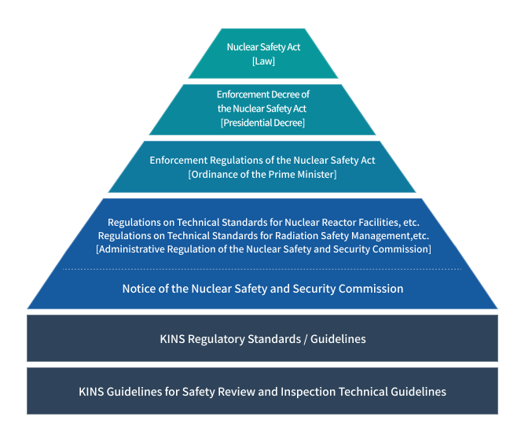
2. Current Safety Standards in KOREA
Safety regulation infrastructure systems in Korea
  Most of the current regulatory standards are focused on Large Nuclear Power Plant
  Difficult to meet the safety standards for Innovative design characteristics of i-SMR
  Necessary to analyze the gap between
  i-SMR design and regulatory requirements
  Analysis and comparison with safety standards are conducted based on
  TTR(Top-Tier Requirement),
  PDD(Plant Design Description) of i-SMR
  in this presentation
  New technology-inclusive regulatory framework will be needed
Notes:
This figure shows the safety regulation infrastructure systems in KOREA.
Nuclear safety act (law) has the top priority of all this systems. And regulations on technical standards and guidelines are followed.
Most of the current regulatory standards are focused on large NPP. So it is difficult to meet the safety standards for innovative design characteristics of i-SMR.
Therefore, it is necessary to analyze the gap between i-SMR design and regulatory requirements.
In this presentation, analysis and comparison with safety standards are conducted based on TTR, PDD of i-SMR.
At the end of my presentation, I will suggest new technology-inclusive regulatory framework will be needed.

Slide 9
Introduction
Current Safety Standards in KOREA
- Safety regulation infrastructure for NPP
3. Gap Analysis Results
- Deviation between i-SMR design
and regulatory requirements
4. Conclusion
Notes:
Let’s move on to gap analysis results, deviation between i-SMR design and regulatory requirements.

Slide 10
3. Gap Analysis Results
Classification of Topics by Gap Analysis
  KHNP derives “16 Gaps” inappropriate with the existing regulation and technical guideline
  Details of the gap is classified into system improvement(2), safety standard design(14)
Group |  | Classification by gap
System improvement (2) |  | 1.Multiple utilization
 |  | 2.Exemption or specification of application an alternative regulations
Safety standard gap by design (14) | Common designs (5) | 1.Safety class
 |  | 2.Multiple failure accidents
 |  | 3. Construction of Multiple Units
 |  | 4.Emergency Planning Zone
 |  | 5.Alternative radioactive source
 | System designs (9) | 6.Independent reactivity control system
 |  | 7.Leakage reactor coolant pressure boundary
 |  | 8.Measurement control
 |  | 9.Power supply system
 |  | 10.Multi-module integrated MCR and operators
 |  | 11.Diverse protection system
 |  | 12.Steel containment vessel
 |  | 13.Surveillance specimen
 |  | 14.Passive safety system
Notes:
This slide shows the classification of topics by gap analysis.
The KHNP derives 16 gaps inappropriate with the existing regulation and technical guideline.
The details of the gap is classified into two system improvement, and fourteen safety standard design.

Slide 11
3. Gap Analysis Results
Deviation with Nuclear Safety Act [Law]
  1. Number of operators in MCR
  (Law) Each nuclear reactor module requires at least one SRO and RO licensed person
  (i-SMR) Four nuclear reactor module can be operated by three operators in an integrated MCR
  2. Defining the EPZ* in the site boundary
  (Law) Precautionary action zone and urgent protective action planning zone are within a maximum radius of 30 km
  (i-SMR) EPZ would be set within the site boundary
*Emergency Planning Zone
Reduction of
operators
EPZ
< site boundary
Integrated MCR
Notes:
Let’s briefly touch the main gap analysis results start with deviation with nuclear safety act (law).
First gap is about the number of operators in MCR.
Following the law, each nuclear reactor module requires at least one SRO and RO licensed person.
But in i-SMR, four nuclear reactor module can be operated by three operators in an integrated MCR as shown in this figure.
Second gap is defining the EPZ in the site boundary.
Following the law, EPZ are within a maximum radius of 30km from NPP.
But in i-SMR, EPZ would be set within the site boundary by reducing radioactive material release.

Slide 12
3. Gap Analysis Results
Deviation with Regulation on Technical standards for nuclear reactor facilities [Regulation]
  1. Limitation on Location
  (Regulation) Nuclear reactor facilities could be located away from the populated areas
  (i-SMR) For multipurpose utilization, located near demand areas
  2. Construction of Multiple Units
  (Regulation) If two or more nuclear facilities are installed on the same site, each nuclear reactor does not affect the safety each other
  (i-SMR) Four reactor modules are adjacent each other
Located near demand areas
4 modules are adjacent
Notes:
Next deviation is about the regulation on technical standards for nuclear reactor facilities.
First gap is about the limitation on location.
Following regulation, nuclear reactor facilities could be located away from the populated areas.
In i-SMR, for multipurpose utilization like hydrogen production, it can be located near demand areas.
Second is about the construction of multiple units.
If two or more nuclear facilities are installed on the same site, each nuclear reactor does not affect the safety each other following the regulation.
In i-SMR, four reactor modules are adjacent each other in one power plant, so it can be the gap.

Slide 13
3. Gap Analysis Results
Deviation with Regulation on Technical standards for nuclear reactor facilities [Regulation]
  3. Instrument and Control system
  (Regulation) Twelve physical monitor variables are need to be measured (For reliable, safe operation of NPP)
  (i-SMR) Some measurement variables cannot be measured or unnecessary
  ※ Boric acid concentration(Boron free), hydrogen concentration(Vacuum state)
  4. Electric Power System
  (Regulation) Onsite and offsite electric power systems which are important to safety shall be provided
  (i-SMR) Adopts fully passive safety system without power supply system.
  All power systems are designed to a non-safety class, no need to install an AC power
Inherent Safety for no severe accident
Safety system without safety- 1E electricity
Notes:
Instrument and control system is the third gap analysis result.
Following regulation, for reliable and safe operation of NPP, twelve physical monitor variables are need to be measured.
But in i-SMR, some measurement variables including boric acid concentration, hydrogen concentration can not be measured or unnecessary.
Next gap is about the electric power system.
Onsite and offsite electric power systems which are important to safety shall be provided following the regulation.
The i-SMR adopts fully passive safety system without power supply, so all power systems are designed to a non-safety class and no need to install an AC power.

Slide 14
3. Gap Analysis Results
Deviation with Regulation on Technical standards for nuclear reactor facilities [Regulation]
  5. Diverse Protection System
  (Regulation) Have a diversity protection system in preparation for the possibility of ATWS
  (i-SMR) Design to reduce software common cause failure, and applies heterogeneous platforms to design diversity
  6. Reactivity Control System
  (Regulation) Requires two independent reactivity control system with different design principles
  (i-SMR) Adopts boric acid-free, designing only utilize burnable poison material
  7. Residual Heat Removal system
  (Regulation) Maintain safety even under the assumption of single power and single failure
  (i-SMR) Adopts fully passive safety system without electricity.
Notes:
This is the last page of gap analysis results.
Diverse protection system is the fifth gap.
The regulation requires diversity protection system in preparation for the possibility of ATWS.
But the design of i-SMR will reduce software common cause failure, and applies heterogeneous platforms to design diversity.
Reactivity control system requires two independent reactivity control system with different design principles.
The i-SMR adopts boric acid free design, so it only utilize burnable poison material. So it can be the deviation with design and regulation.
The last gap is about the residual heat removal system.
Following the regulation, NPP maintain safety level under the assumption of single power and single failure conditions.
The i-SMR safety system will be designed fully passive safety system without electricity.
So it can be the argument point.

Slide 15
Introduction
Current Safety Standards in KOREA
- Safety regulation infrastructure for NPP
3. Gap Analysis Results
- Deviation between i-SMR design
and regulatory requirements
4. Conclusion
Notes:
Finally, I will wrap up my presentation.

Slide 16
4. Conclusion
For achieving successful i-SMR standard design approval, gap analysis assessment is required due to the difference characteristics of i-SMR and Large NPP
In this presentation, the results of the gap analysis assessment are summarized
  Detail review of Korea nuclear safety laws are performed
  KHNP derives “16 gaps” inappropriate with the existing regulations and i-SMR design
The KHNP had published the gap analysis report
Notes:
For achieving successful i-SMR standard design approval, gap analysis assessment is required due to difference characteristic of i-SMR and Large NPP.
In this paper, the results of the gap analysis assessment are summarized.
First, Detail review of korea nuclear safety laws are performed.
Second, KHNP derives 16 gaps inappropriate with the existing regulations and i-SMR design.

Slide 17


4. Conclusion - Future plan
KHNP requested PDR (Pre-Design Review) and approval from Korea regulatory body
Objective of PDR is to identify;
  Major technical issues, (2) Resolution plan for technical issues
Related documents had been submitted ;
  Gap Analysis Report
  Plant Design Description
  14 Technical Reports (Ex, LOCA/Non-LOCA methodology, Passive Safety System)
Also, KHNP are planning to receive vendor design review from Canada nuclear regulatory body for expected technical issues during the standard design approval
Notes:
The last slide is about the future plan of KHNP for licensing i-SMR.
KHNP requested PDR and approval from Korea regulatory body.
The objective of PDR is to identify major technical issues and resolution plan for technical issues.
Related documents including gap analysis report, plant design description, 14 technical reports had been submitted.
Also, KHNP are planning to receive vendor design review from Canada nuclear regulatory body for expected technical issues
during the standard design approval of i-SMR.

Slide 18
THINK SAFETY
Thank you

