Slide 1
Small Modular Reactors: A Regulatory Perspective
Khalil Ur Rahman (Mr / Dr)
Principal Engineer,
Pakistan Nuclear Regulatory Authority
Email: khalil.rahman@pnra.org

Slide 2
Outline
Introduction
Safety Aspects: Views from IAEA and other organizations;
Potential Regulatory Challenges
SMR Licensing Process
PNRA Approach
Way Forward towards Regulating SMRs
Notes:
I have a very short presentation and will try to keep it short and crisp to consume. Content is flashed on the screen

Slide 3
Introduction
  PNRA has ample experience of regulating NPPs through robust nuclear regulatory framework
    Siting, design evaluation, construction commissioning, operation and decommissioning;
  Small Modular Reactors (SMRs) may be considered as future option considering energy mix of Pakistan;
  PNRA constituted a Working Group (WG) to perform literature study related to regulatory challenges in licensing of SMRs including IAEA and academia.
  Aim is to identify areas of amendments in national regulatory framework.

Slide 4
Safety Aspects – Design Safety
Specific Areas | Existing Status | Proposed
Control Rooms | Control Room (Requirement 65 (6.39 – 6.40A) | Specific design requirements of MCR for SMRs with focus on controlling multimodules and separate panels for each module in an integrated control room.
Multi-Module Interactions, Dependencies and common systems | No existing requirement | Design safety requirements related to multi-module units, Interconnections among the reactor modules, Function of control and protection systems of each module or integrated for all (one command or action to shutdown all modules.)
Extension of power through installation of new module at same site | No existing requirement | Capacity enhancement by addition of future modules, plant lay-out, construction and provision for additional panels; Safety consideration to install modules in different phases (e.g. one module is in operation and other is in commissioning).
Containment structure and containment systems | Requirements 57 (6.25-6.26) are related to access to containment. | Degradation mechanisms of submerged containments and underground construction; Human access during operational states and accident conditions (for sealed containment with no Or small doors or equipment access hatches;

Slide 5
Safety Aspects – Manufacturing & Transport
Safety of Manufacturing Equipment, Components and Modules
  Requirements for regulatory review and inspection of organizational capability for in-factory manufacturing and on/off-site commissioning of modules;
Transport Safety:
  Transportation of SMRs designed to be relocated geographically for manufacturing, assembling and final transportation to destiny for installation;
  Transportation of commissioned or operating pseudo mobile SMR;
  Revision of International legal instruments governing nuclear safety to cover floating type.

Slide 6
Safety Aspects: Commissioning and Operation
Operator qualification and training of personnel
Performance of safety related activities
Control of plant configuration
Fire and explosion hazard safety
Commissioning of SMRs: Offsite / onsite
Control rooms and equipment control operations:
SMR specific programs
Refueling outage management

Slide 7
Safety Aspects - Emergency Management and Decommissioning
Emergency Management
  Building confidence on claims of designers to have low LPZ;
  Conducting a coordinated regulatory research to verify the claims to revise requirements of emergency management for SMRs;
Decommissioning
  Mechanism or Strategy of decommissioning of SMRs
  Decommissioning of modules in phases
  In-situ decommissioning and offsite decommissioning

Slide 8
Regulatory Challenges for SMR Licensing
Regulatory Challenges:
    More cost and longer licensing process due to capacity building needed for confirmatory safety analysis, less familiarization with design,
  Lack of availability of appropriate regulatory framework,
  Insufficient experience in regulatory oversight,
  Review and assessment.

Slide 9
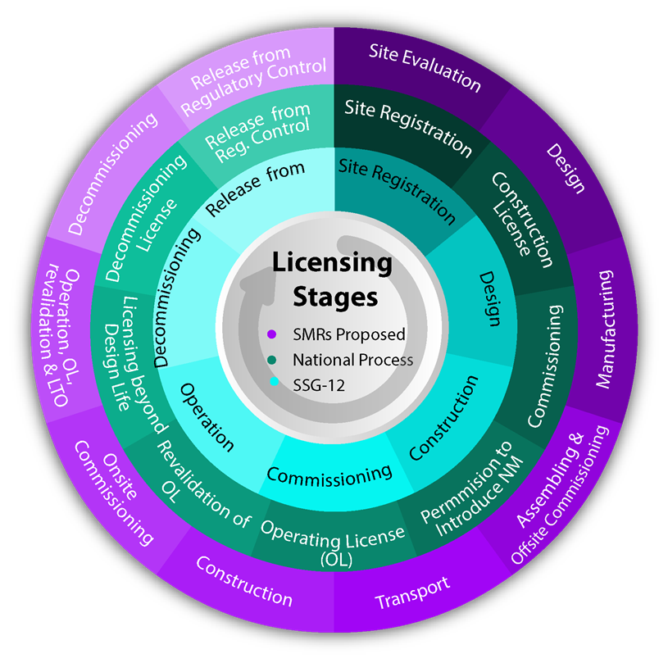
Licensing Process: A Proposal for SMR
Licensing considerations in IAEA – SSG-12,
National Process for licensing of nuclear installations,
Proposed licensing process for SMRs

Slide 10
PNRA Approach
National regulations for design, operation and licensing may change in order to make their applicability for SMRs,
Additional licensing stages, submission requirements may be incorporated in regulations,
Periodic reviews and validity of license in case of SMRs may need to be reconsidered in national licensing process defined in regulations for licensing of nuclear installations.

Slide 11
Way Forward for Regulating SMRs
Regulatory bodies need to engage in early interaction with different stakeholders (utility, designers, and vendor) to familiarize with design, perform safety analysis, identify the issues for timely resolution and ensure smooth licensing;
Joint regulatory research activities among regulatory bodies for capacity building of regulatory staff for licensing and regulatory oversight of SMRs;
Capacity building of RBs in special areas such as (i) cyber security requirements for SMRs as most part of SMRs is expected to be digitized (man- independent), (ii) waste management consideration and emergency preparedness & response for SMRs and (iii) civil liability for transportable type of SMRs need to be focused.
Notes:
For example safety analysis such as accident analysis, multi-module probabilistic safety assessment (PSA), EPZ, review of advanced fuel, etc.

Slide 12
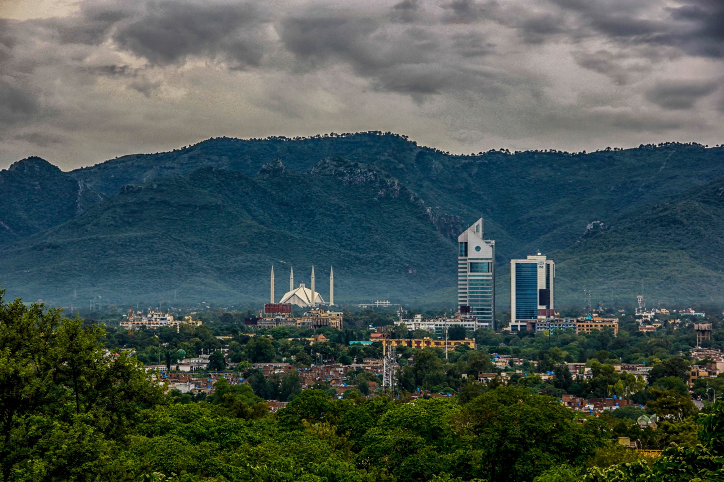
Coordination with COPB
COPB is the PoC for all correspondences with SPD
PNRA refers all cases to COPB for:
  Approval of regulations (as per directives of SPD)
  Policy matters, ROSS approval
  Approval for holding various events such as workshop/training courses, etc in Pakistan involving foreign experts
  Clearance of research papers for publication
  International interactions (arrangements with foreign countries, data sharing, issuance of NOC for visits abroad), etc.
Thank You

