Slide 1
Notes:
International Conference on Small Modular Reactors and their applications
21-25 October 2024, Vienna, Austria

Slide 2


Preparation of Regulatory Framework for SMR Deployment in Ukraine
Presenter: Oleksii Dybach (SSTC NRS)
Co-authors:
SNRIU - A. Shepitchak, O. Horodnicha
SSTC NRS - І. Shevchenko, O. Pecherytsia, O. Zhabin

Slide 3
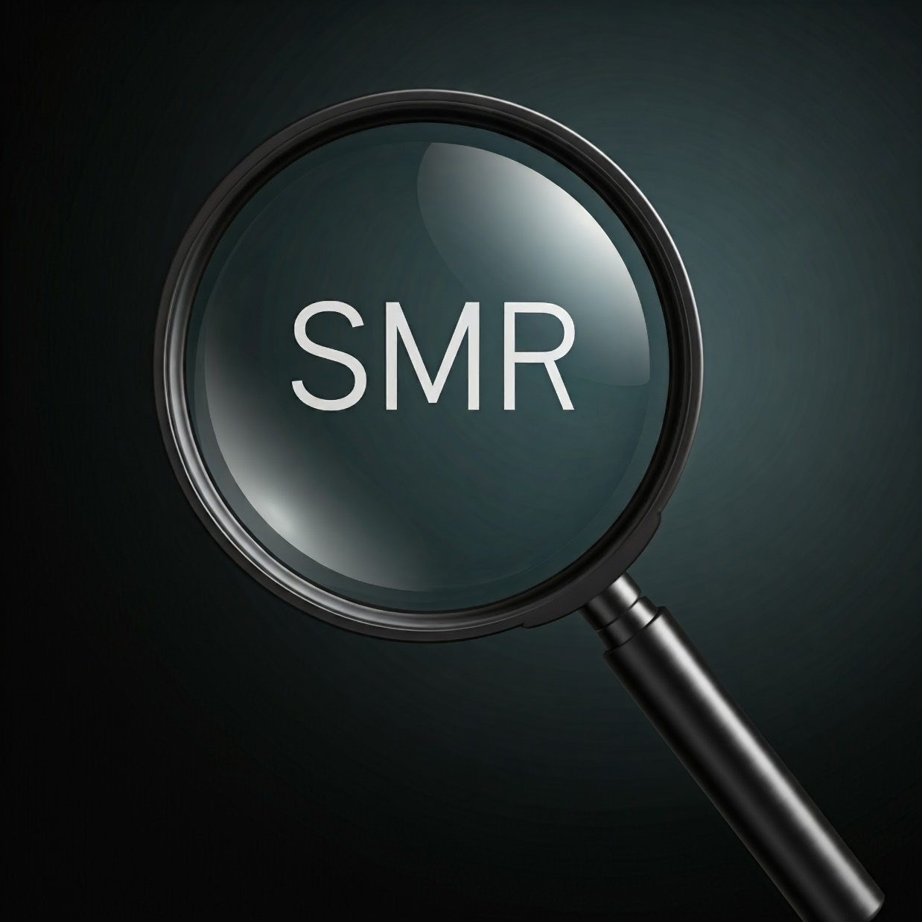
Contents
National Context for the SMR Deployment
Developments in the Regulatory Framework
Pre-licensing Review Guidance
First Insights from the Pre-licensing Review Guidance Application
Conclusions

Slide 4
1. National Context for the SMR Deployment
The Energy Strategy of Ukraine until 2050 sets ambitious targets for increasing nuclear energy capacity
Ukraine joined 22 countries to triple global nuclear energy by 2050 (COP28)
National nuclear operator and companies exploring SMR technologies
SMRs considered for decentralizing the national power system, adding load-following capacity and increasing the electricity grid's resilience to external disturbances and military impacts

Slide 5
2. Developments in the Regulatory Framework
SNRIU, Ukraine’s national regulator, supported by SSTC NRS (TSO), is preparing a framework for SMRs licensing to streamline processes for safe deployment of novel technologies avoiding regulatory burdens
Two principal aspects are defined for development of the regulatory framework:
further revising the national regulations (making them technology-neutral and performance-based, harmonized with WENRA RLs and based on the current IAEA safety standards)
capacity building to ensure the qualified staff for regulatory functions on SMR deployment

Slide 6
2. Developments in the Regulatory Framework
New revision of the basic regulations NP 306.2.245-2024 "General Provisions on Nuclear Power Plants Safety" was put in force in 2024
Key updates include:
Formal introduction of practical elimination of large and early radioactive releases concept
Requirements on fail-safe design, addressing cliff-edge effects, multi-unit consideration etc.
Increased flexibility for adopting new technical solutions based on justified research and experimental programs
Allow the use of international codes and standards when appropriately justified

Slide 7
2. Developments in the Regulatory Framework
On October 19, 2023, SNRIU introduced the pre-licensing review process, approving a guidance document titled “Provisions for Pre-Licensing Review of Nuclear Facility Designs” by the SNRIU Board
Pre-licensing review is not a part of the licensing process and does not affect SNRIU decision regarding the issuance of a license
Main objective of pre-licensing review is to identify in a timely manner the potential issues related to the nuclear facility design, particularly the issues that may require significant changes to the design, methodology of safety justification and may significantly complicate or completely preclude licensing of construction and commissioning of the nuclear facility of this design

Slide 8
2. Developments in the Regulatory Framework
Key features of the pre-licensing review :
optional (at a choice of the applicant: vendor/utility)
related to a conceptual/generic design (several subsequent review steps may occur with each new step requiring higher completeness level of design documentation and safety justifications)
19 technical review areas, covering all principal safety related aspects
not addressing site specific issues

Slide 9
3. Pre-licensing Review Guidance
The Guidance establishes the goal, procedure, review criteria and technical areas for the pre-licensing review
There are three stages of the pre-licensing review:
Evaluation of the conceptual design of the nuclear facility
General evaluation of the nuclear facility design
Detailed evaluation of the nuclear facility design in specific areas
Increasing
of design details
and safety justification
scope

Slide 10
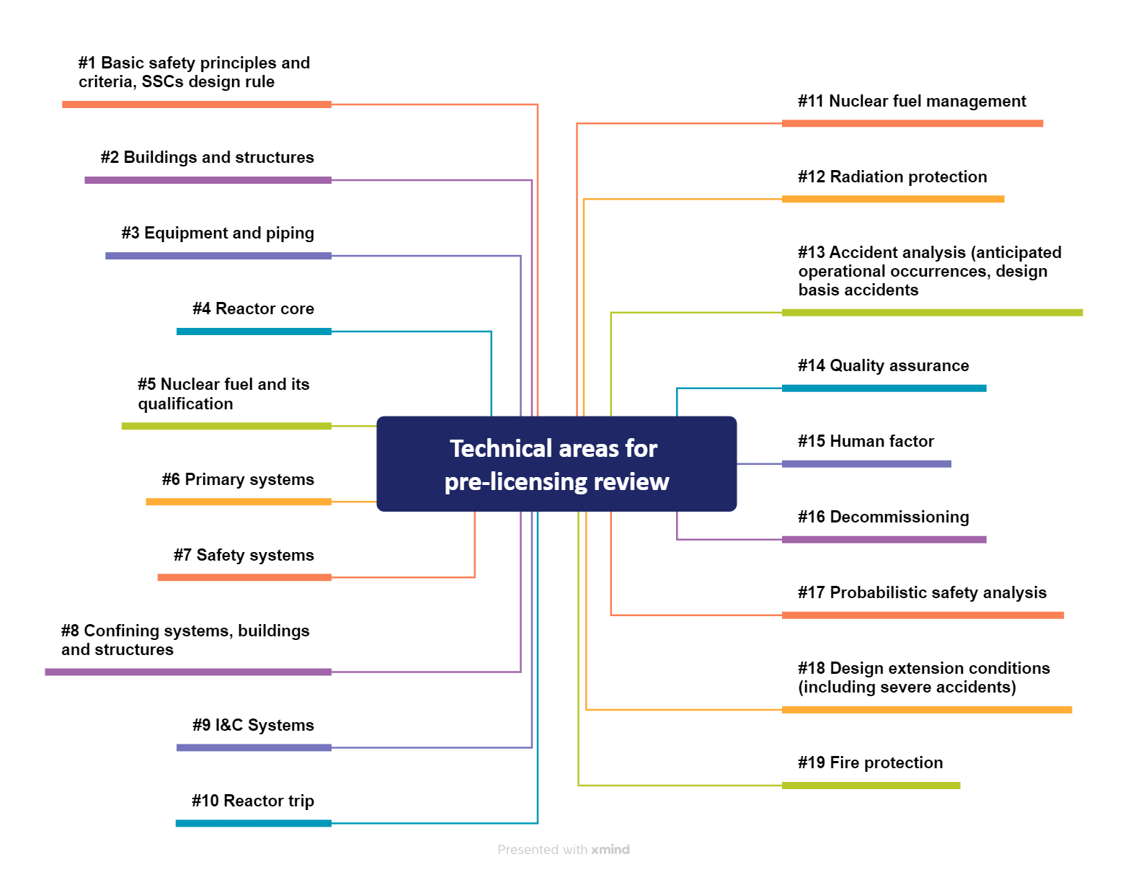
3. Pre-licensing Review Guidance
Technical areas for the pre-licensing review according to “Provisions for Pre-Licensing Review of Nuclear Facility Designs”

Slide 11
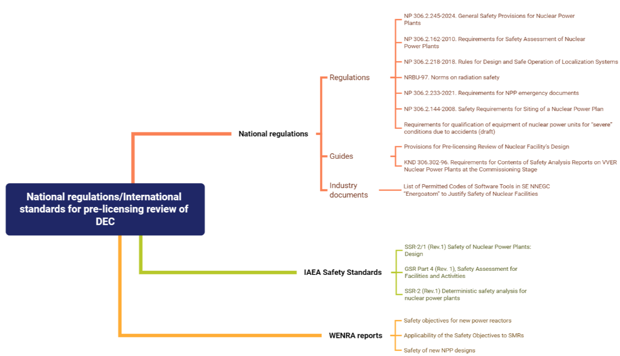
3. Pre-licensing Review Guidance
Example of the review criteria for the DECs - Technical Area # 18

Slide 12
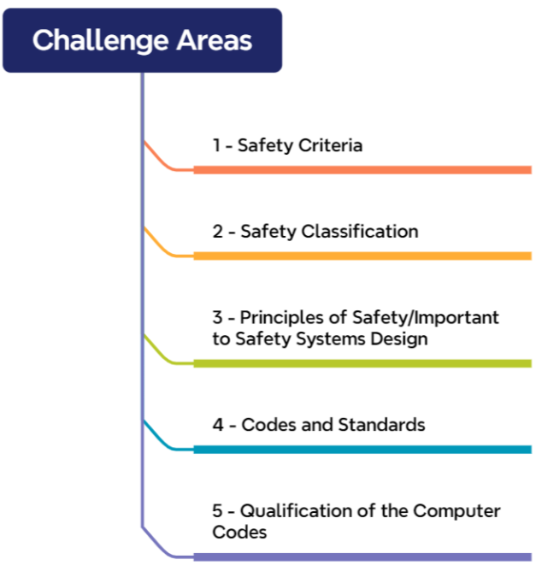

4. First Insights from the Pre-licensing Review
As part of international cooperation, pilot review activities are being performed uncovering several challenge areas for further consideration in SMR licensing

Slide 13
4. First Insights from the Pre-licensing Review
Safety
Criteria
National regulations include two principal groups of the safety criteria – probabilistic and deterministic:
(1) The probabilistic safety criteria are established in terms of integral (total) core damage frequency and large release frequency referring to the full scope PSA (internal and external events, full power and shutdown operating modes).
International practice shows that there may be differences in required PSA scope, risk aggregation methods, definition of large releases, etc. that need to be considered when comparing with established probabilistic criteria.
(2) Radiological safety criteria, serve as acceptance criteria for deterministic safety analysis, are established in alignment with national radiation protection norms. For the design extension conditions these criteria are based on adverse doses for prompt and long-term protective measures ensuring practical elimination of early and large radioactive releases.
International practices reveal variations in dose boundaries across different accident categories, underscoring the importance of properly accounting for these differences when justifying compliance with safety criteria.

Slide 14
4. First Insights from the Pre-licensing Review
Safety Classification
The difference in approaches used for classification of SSCs by technology supplier and Ukraine regulations could have an impact on SMR design and equipment supply.
For existing NPPs, Ukrainian regulations establish a classification system based on the deterministic judgments of SSCs impact on safety with categorization into 4 Safety Classes.
For new NPPs, the recently updated version NP 306.2.245-2024 accounts Requirement 22 IAEA SSR-2/1 (Rev.1) and allows application of probabilistic method, where appropriate.
Approach used for SSCs classification needs to be justified by the operating organization and agreed upon with the regulatory body.

Slide 15
4. First Insights from the Pre-licensing Review
Design principles for systems
important to safety
National regulations require the application of set of principles in design of safety systems: diversity, redundancy, physical separation and functional independence, single failure. Also, the concept of fail-safe design shall be incorporated, as appropriate, into the design of systems important to safety.
International practices reveal that vendors may apply these principles differently, taking into account the specifics of the technology. This variability in application can require additional justifications.
Codes and
Standards
The codes and standards contribute to prove that safety related SSCs will perform their safety functions with a required level of reliability.
There is a national system of codes and standards and set of non-binding guides, developed by the state operating organization. The utilization of international or vendor country codes and standards needs to be justified by the licensee.

Slide 16
5. Conclusions
SNRIU prepares the regulatory framework for SMR deployment in Ukraine establishing the pre-licensing review process and strengthening capability in review and assessment of the emerging SMR designs
National regulations for nuclear power plants are considered to be adequate and applicable for near-term deployment SMR (LWR-designs)
Conducting pre-licensing reviews of SMR designs helps identify potential issues early, making it easier to provide additional justifications and anticipate regulatory concerns

Slide 17
Thank you for your attention!
International Conference on Small Modular Reactors and their Applications

