Slide 2


DESIGN OF A REUSABLE MATERIALS IRRADIATION DEVICE (MIDI) IN THE HIGH FLUX REACTOR
FOR TESTING AND QUALIFICATION OF SMR MATERIALS
The content within this document is classified with the code European dual use code (EU DuC) = N. Goods labelled with an EU DuC (European Dual-use Codification) not equal to ‘N’ are subject to European and national export authorization when exported from the EU and may be subject to national export authorization when exported to another EU country as well. No rights may be derived from the specified EU DuC or absence of an EU DuC."

Slide 3
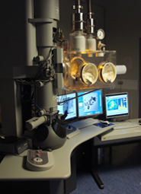
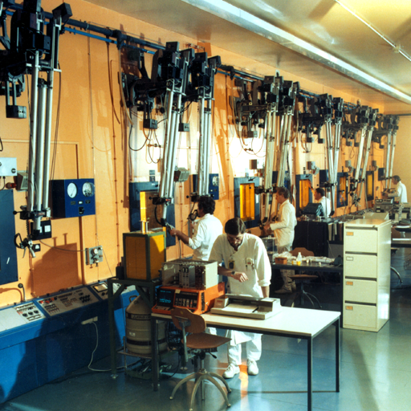
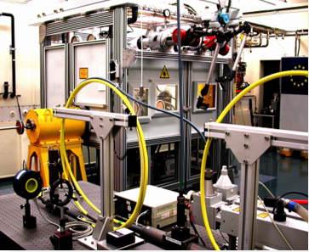
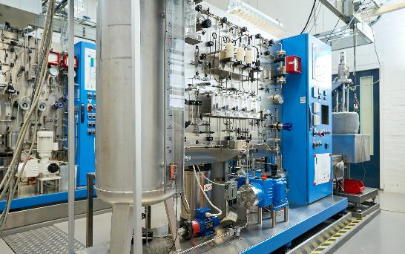
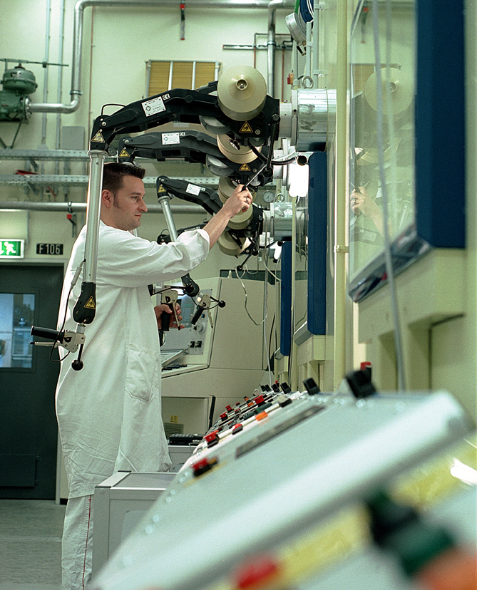
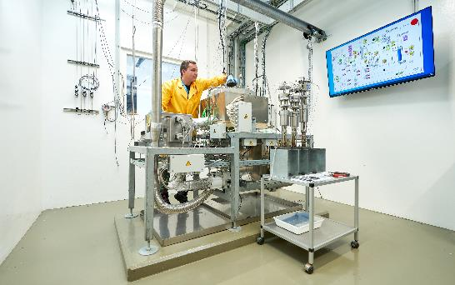
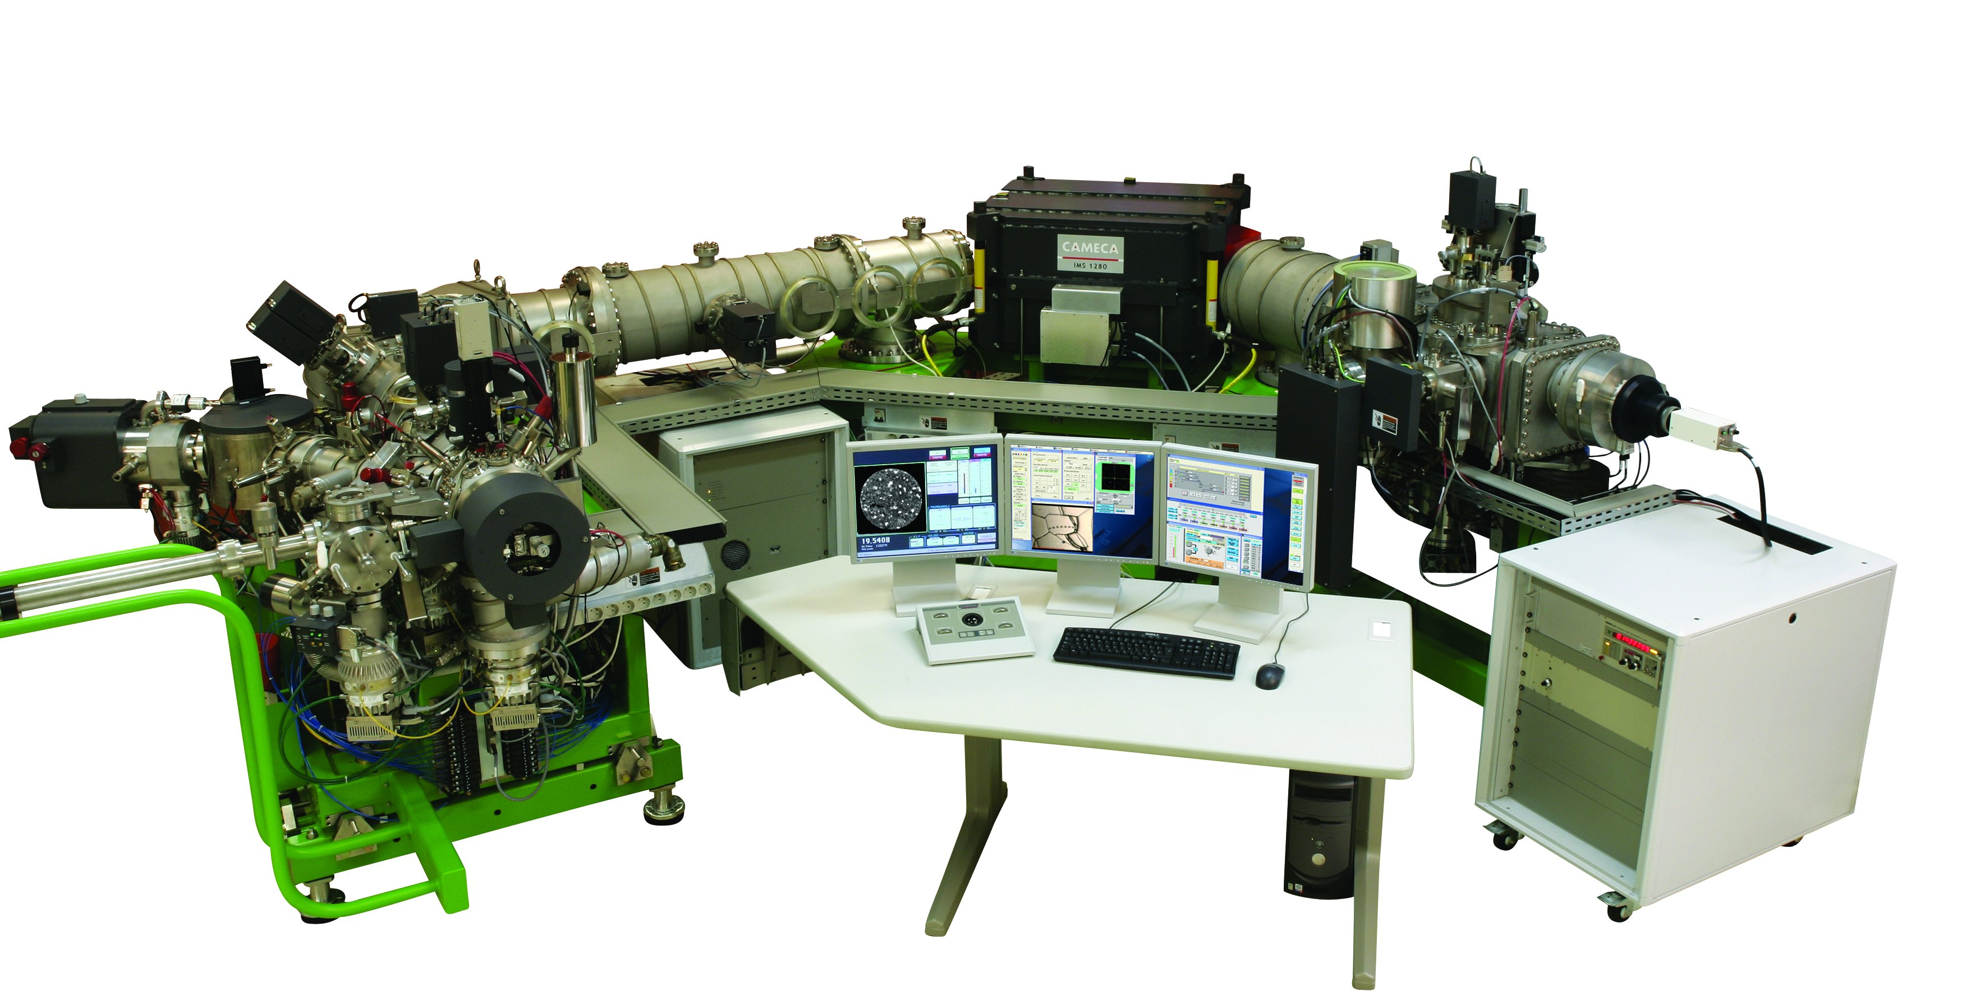
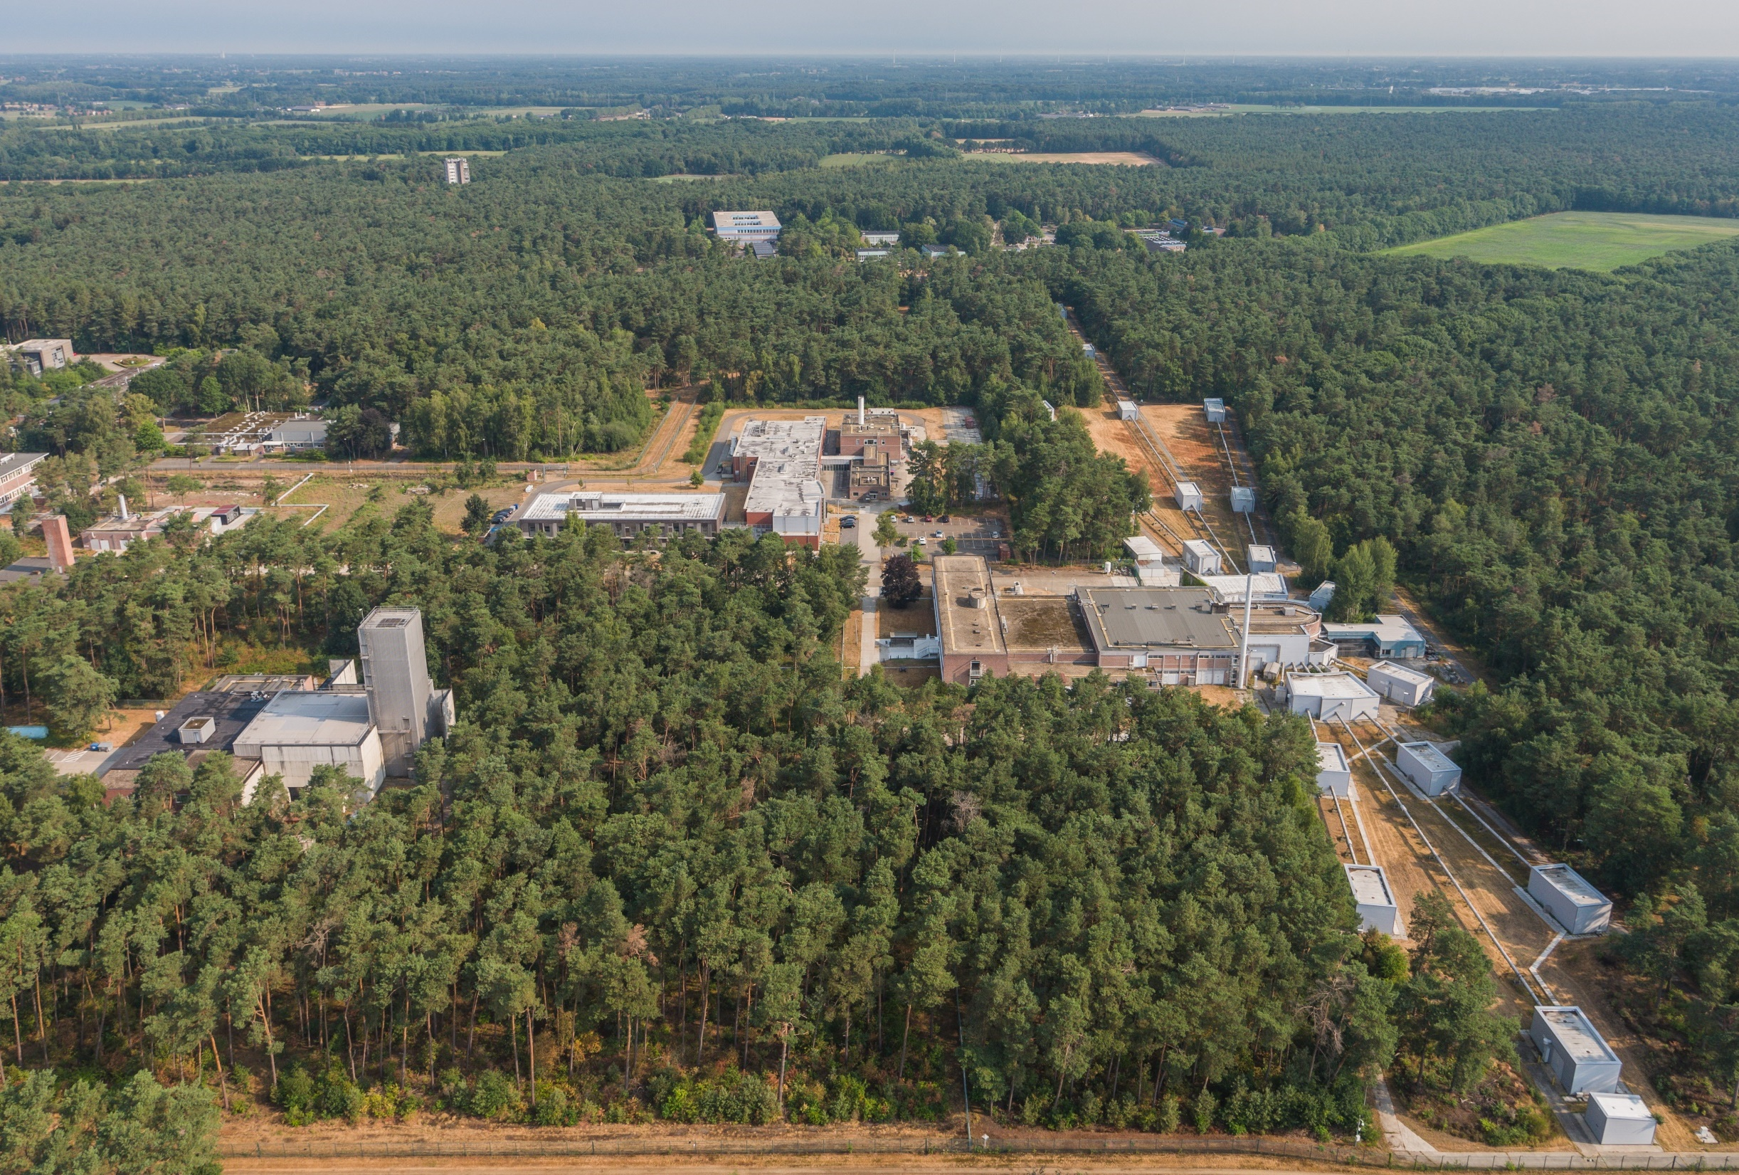
Nuclear R&D at EC-JRC
AMALIA – water corrosion loop
Hot cells labs
Thermophysical & thermodynamics: Laserflash
TEM & SEM
MONNET
GELINA
Neutron facility
LILLA – Lead corrosion loop
Large geometry SIMS
Minor Actinide Lab

Slide 4
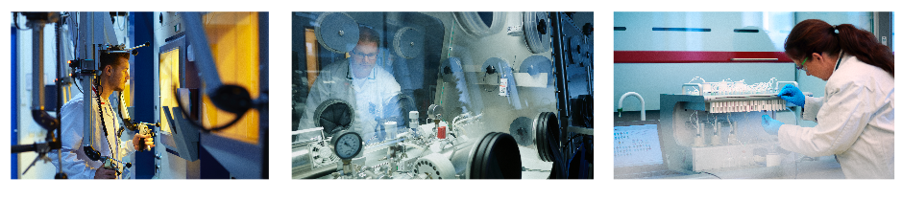
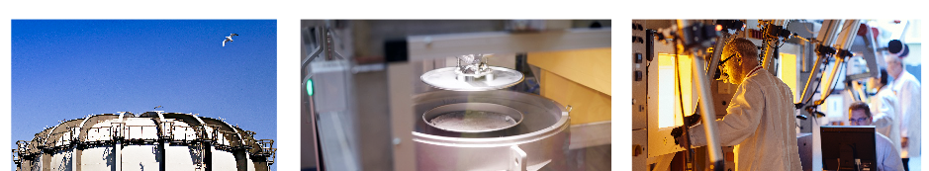
NRG-PALLAS
Molybdenum production facility
Radiological laboratory (fuel & materials)
Radiological laboratory (nuclear medicine)
High Flux Reactor
Waste Management Facilities
Hot Cell Laboratories

Slide 5
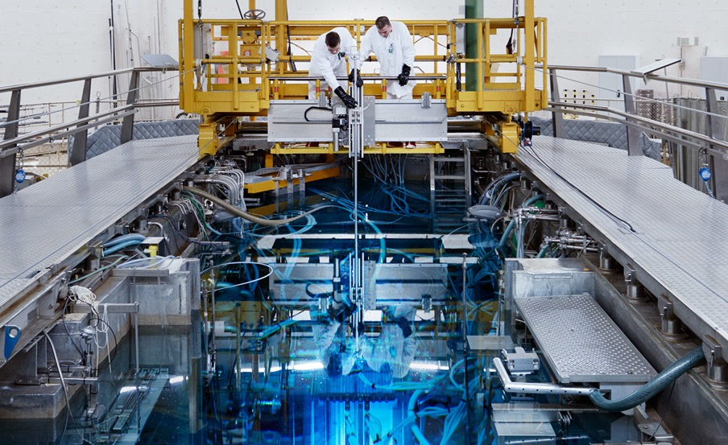
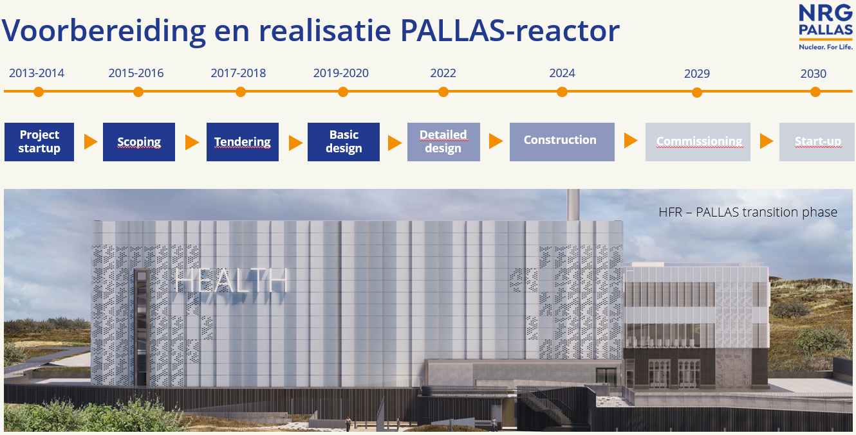
Neutron irradiation capabilities
HFR is a multipurpose reactor designed for nuclear energy research and optimised to produce medical isotopes.
PALLAS reactor will follow
Notes:
HFR has operated since 1961 with 9 ‘cycles’ per year.

Slide 6
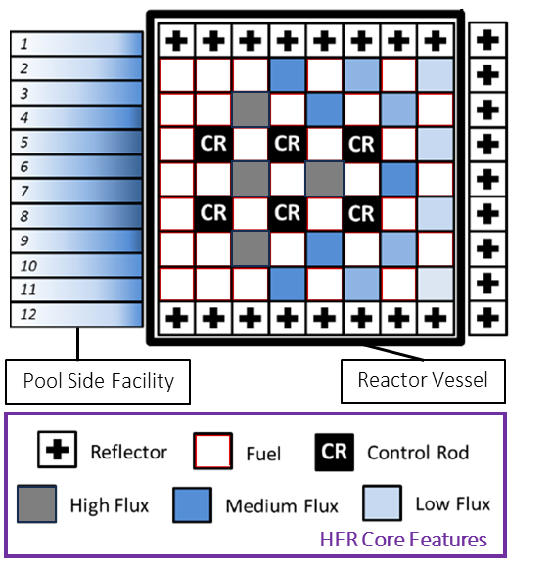
HFR Fuel & Material Irradiations
Name | Irradiations | Name | Irradiations
CONFIRM | Nitride fuels | CIWI | BWR core shroud welds
EFFTRA | Transmutation | ENICKMA | Ni-alloys for MSRs
Fuel CREEP | Online fuel creep measurement | EXTREMAT | High temperature advanced materials
HELIOS | Minor actinide fuels & targets | EXOTIC | Solid tritium breeder materials
INET | HTR-PM fuel qualification | HICU | Breeder materials for fusion
MARIOS | Minor actinide fuels | IBIS | Material(s) in LBE
SMART | Nitride fuels | INNOGRAPH | HTR graphite
OTTO | Once through Pu transmutation | LYRA | Reactor Pressure Vessel Steels
FUJI | Breeder reactor fuels | PYCASSO | HTR surrogate particles
THORIUM CYCLE | Thorium fuel | SPICES | RAFM steel
TRABANT | Fast breeder annular MOX | SOSIA | 9Cr creep and creep fatigue
SALIENT-1 | Molten Salt (LiF-ThF₄) Irradiation | STROBO | Stress relaxation of bolt materials
SPHERE | Minor actinide sphere-pac fuel | SUMO | 9Cr steels and joints
Notes:
High flux in combination with instrumentation allows (accelerated) testing of materials and fuels under controlled conditions
Annual DPA can reach up to 8 dpa per year for materials in a high-flux in-core position, with linear heating rates of up to 700 W/cm also possible.

Slide 7
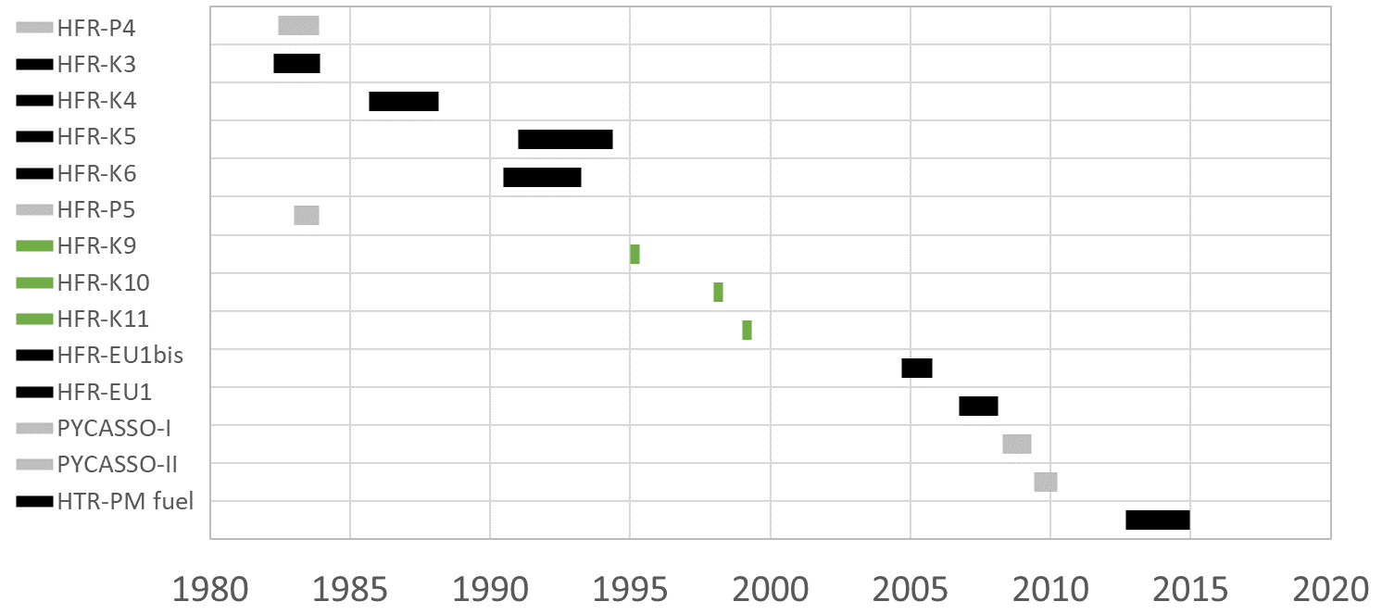
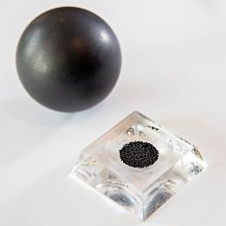
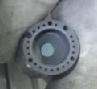
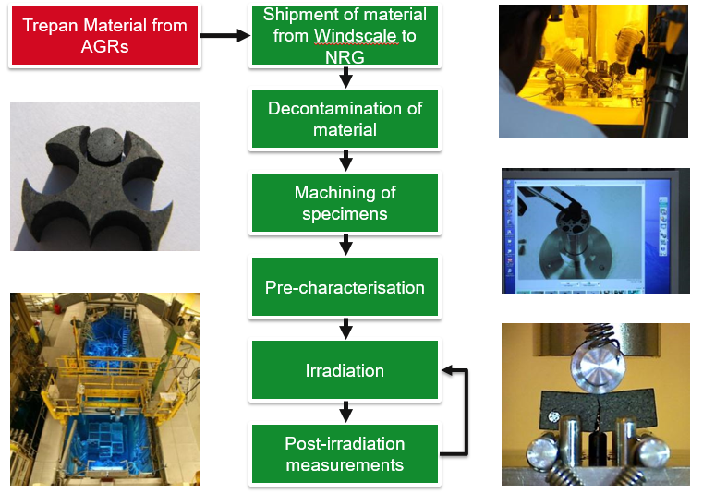
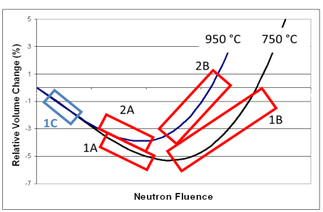
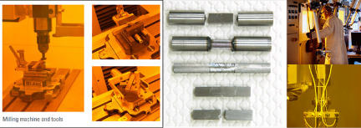
Fuel & Material R&D at NRG
Molten Salt Irradiation
Selected TRISO irradiations & activities conducted by NRG (1980-2019)
In-cell material machining and re-assembly capabilities
INNOGRAPH & BLACKSTONE summaries

Slide 8
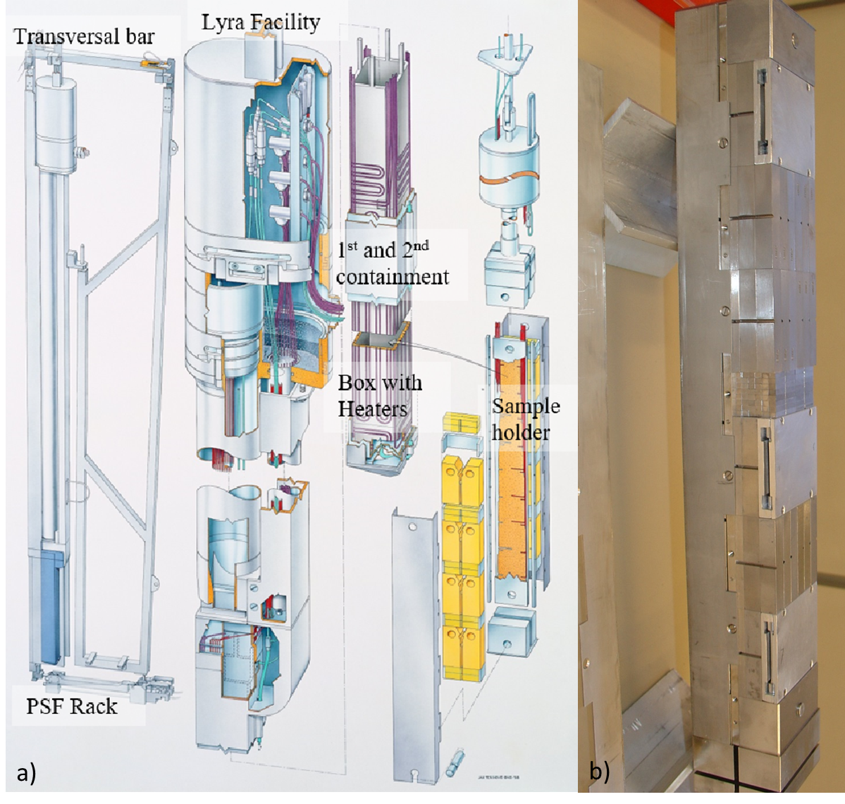
Structural Material Irradiations
The re-usable LYRA facility
  LYRA-1,-2,-3 provided irradiated material for REFEREE, RESQUE and MODELL ALLOY projects
  LYRA-4 featured in the FRAME project (FRActure MEchanics based Embrittlement trend curves)
  LYRA-8 irradiated HTGR structural materials
  LYRA-10 irradiated over 600 specimens* of PWR RPV steels for LTO studies (STUMAT-LTO)
*comprising: tensile, KLST, full-size Charpy, half-Charpy and slices for microscopy
Notes:
LYRA operated between 1997 and 2018.
Irradiation temperatures ranged from 200°C to 400°C, through the inclusion of heaters within the facility.
A key research facility of the Ageing Materials European Strategy (AMES) Network

Slide 9
The need for the MIDI facility
Advanced Manufacturing
Long Term Operation
Innovative Materials for SMRs
Flexible operation
A new R&D irradiation facility is need for structural materials
Base Requirements:
  Nominal irradiation temperature 280-310°C with higher possible
  Minimum fluence (E>1 MeV) 6 x 10¹⁹ n/cm²
  Inert atmosphere irradiation
  Contains thermocouples and monitor sets for data analysis
  Loadable with reference and pre-irradiated samples
Notes:
Development, screening and irradiation testing of new materials for SMR. Both innovative materials given the demands they may face, as well as more traditional materials that may face additional challenges due to proximity of structural materials like RPV to the core.
Outside nuclear, alternative manufacturing methods have reduced the time, cost and wastage associated with fabrication of complex components

Slide 10
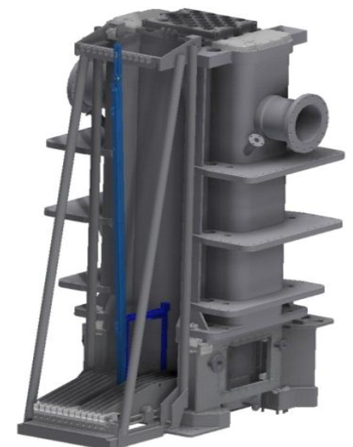
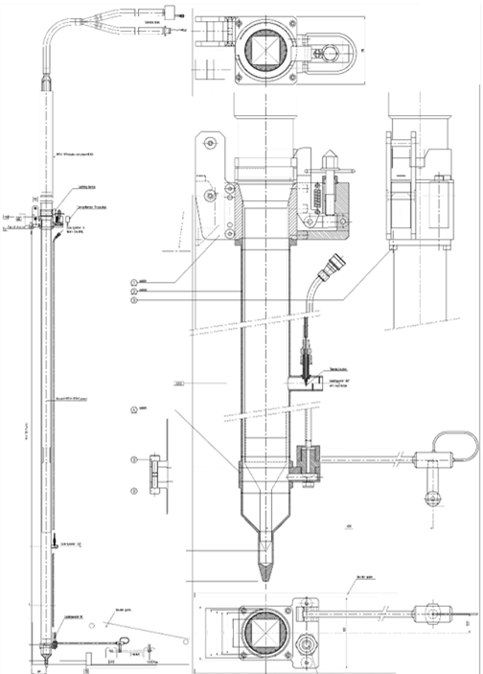
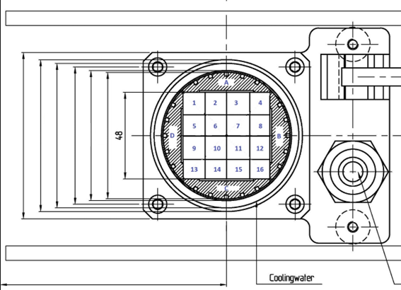
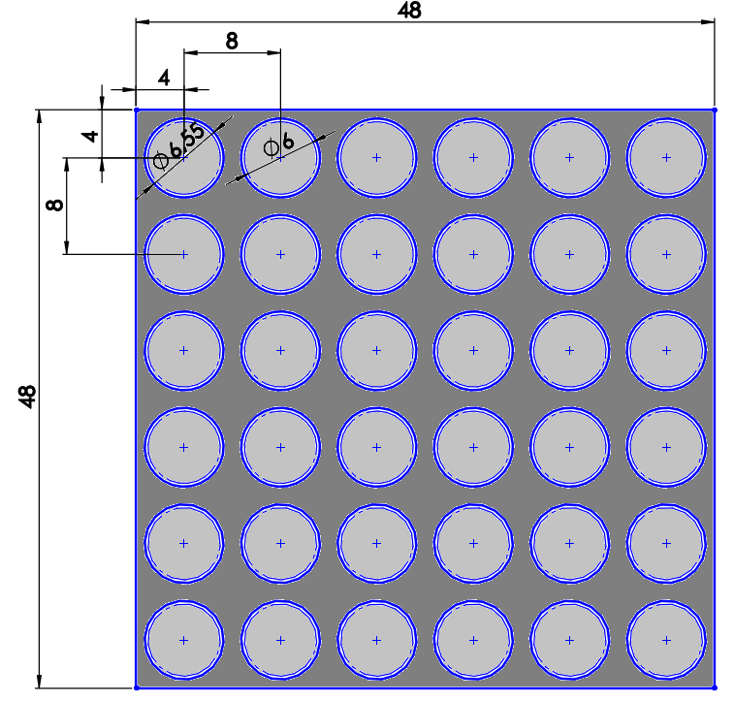
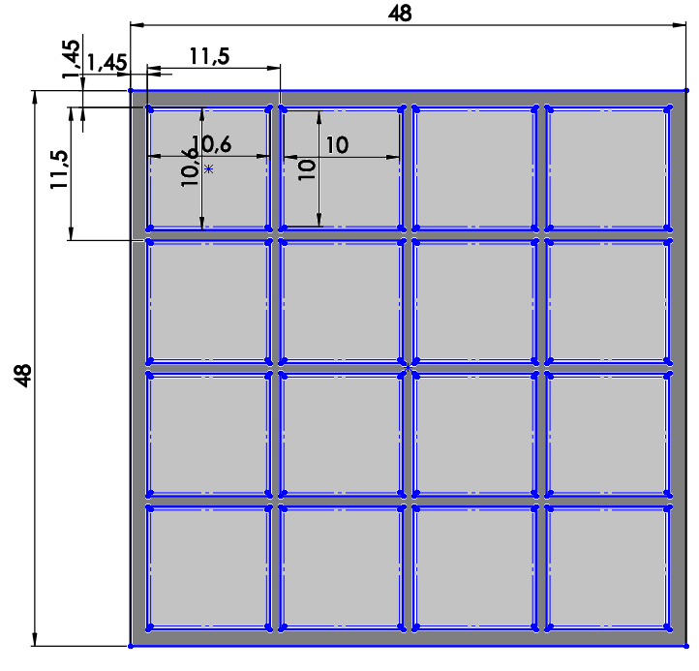
MIDI design

Slide 11
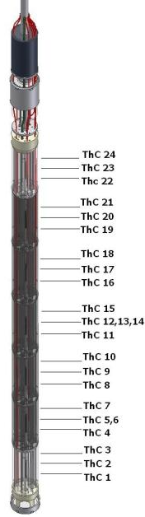
MIDI status
2024
2025
2026
2027
H2
H1
H2
H1
H2
H1
H2
Finalise Partners, Materials
Partners
Materials
Dissemination & knowledge
Conferences, Publications, Workshops
Design, Fabrication, Irradiation
Concept
Detailed
Manufacture
Irradiation
Characterisation
Pre-IE
PIE
MIDI located in the pool-side facility provides neutronic potential akin to LYRA facility
Nuclear heat supplemented by heaters to give
  Predicted w/g of 0.46 to 1.66 at 573 K (300°C)
Opportunity to engage with the project as collaborator
  HEA/FeCrAl/AFA
  Additive Manufacture, e-beam weld, HIP, etc…

Slide 12
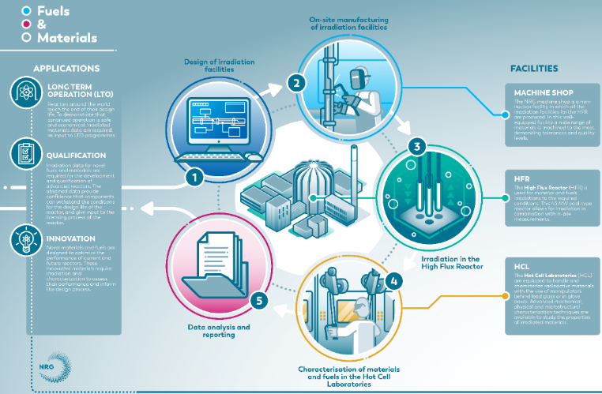
Conclusion
Proven irradiation experience
  Fuel & materials in helium, liquid metal and molten salt
New re-usable MIDI facility underdevelopment
  Advanced Manufacturing
  Innovative Materials
  Flexible Operations
First structural material research irradiation late-2026
  Research collaborations possible
Bespoke irradiations possible
  Engage with us!

