Slide 2
Research on Digital Intelligent Operation and Maintenance Technology for SMR
Chen Zhiwen, Xu Weizu, Liu Yang, Yang Panyun
China / Hainan Nuclear Power Co.,Ltd
International Conference on small modular reactors and their applications 21-25 October 2024, Vienna, Austria Paper No.158 2

Slide 3
CONTENTS
BACKGROUND
PROJECT REQUIREMENTS
SOLUTION
SUMMARIZING
International Conference on small modular reactors and their applications 21-25 October 2024, Vienna, Austria Paper No.158 3

Slide 4

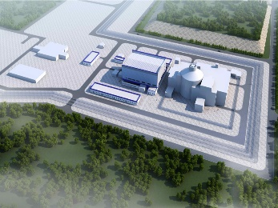
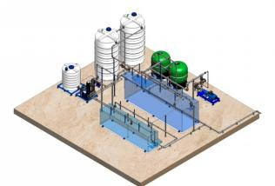
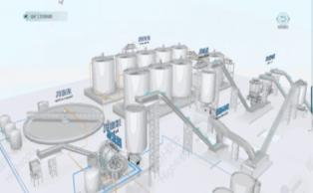

1. BACKGROUND
power、heat addition
desalination
mining and metallurgy
Big data and cloud
Due to its inherent safety, flexible deployment, and wide range of applications, Small Modular Reactor (SMR) have garnered continuous attention and follow-ups from both domestic and international markets. With the power scale of SMR and their suitability for deployment in remote areas like islands and mountainous regions, integrating intelligent operation control, monitoring and diagnosis, inspection and surveillance, and maintenance management technologies can further enhance the automation and intelligence levels of SMR. This can lead to reduced operation and maintenance costs and address the demands and challenges of global advanced energy development by offering higher safety and economic efficiency.
inherent safety
flexible deployment
wide range of applications
。。。。。。
International Conference on small modular reactors and their applications 21-25 October 2024, Vienna, Austria Paper No.158 4

Slide 5
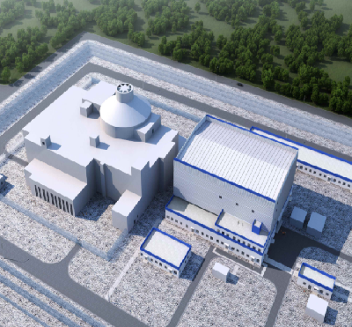
2. PROJECT REQUIREMENTS
Data processing
Intelligent early warning, fault diagnosis and predictive maintenance based on the mechanism model and data analysis.
Real-time
Real-time monitoring of operation status, trend prediction, early warning analysis, fault diagnosis and positioning, and decision-making optimization.
01
03
Unmanned monitoring
Less manned operation
Digital twin
Large-scale multi-modal data acquisition, virtual and real mapping and real-time interaction, digital twin AI applications.
Effect target
Improve the safety and economy of SMR, and explore the structure of SMR digital management during the whole life.
02
04
International Conference on small modular reactors and their applications 21-25 October 2024, Vienna, Austria Paper No.158 5

Slide 6

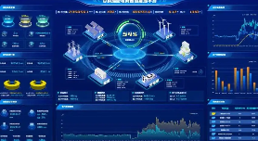
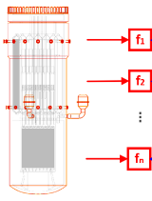
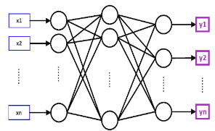
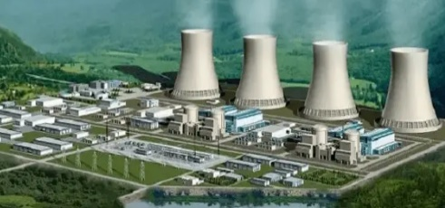
3. SOLUTION
3.1 Overall Technical Architecture
Multi-model fusion
Reactor physics, thermal and hydraulic forces, structural mechanics, electric power distribution
Data interaction platform
Digital control system, real-time data acquisition system, intelligent diagnosis and early warning system, remote monitoring and operating system
SMR Digital twin
Virtual reality mapping
Operating status, operating parameters, design parameters, and simulated trend data
Applying extensions
Equipment, system and structure of the entire nuclear power plant;Commissioning, operation, and overhaul
International Conference on small modular reactors and their applications 21-25 October 2024, Vienna, Austria Paper No.158 6

Slide 7
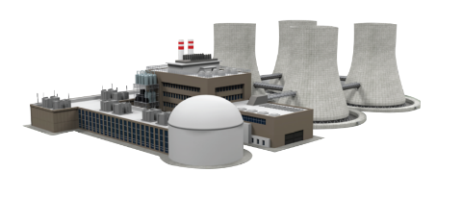
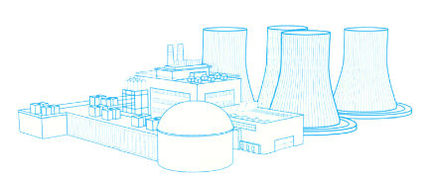
3. SOLUTION
3.2 Applications
3.2.1 Digital Delivery, Physical Factory Twin Application
Real nuclear power plant
  Objective
  Scope of delivery and content of delivery
  The organization unit of the delivery
  Delivery plan
  Delivery standards and requirements
  Information receiving system
  Submit delivery content
  Virus information granularity
  Data level
  Data format
  Quality requirement
  Time of the delivery method
Requirement
  Review of the project operation and maintenance stages
  Determine the data requirements
Effect
  Process traceability
  Quality control
Information
Support
Strategy
Scheme
Digital twin of nuclear power plants
International Conference on small modular reactors and their applications 21-25 October 2024, Vienna, Austria Paper No.158 7

Slide 8





3. SOLUTION
3.2 Applications
3.2.2 Equipment Twin, Process Twin, Terminal twin
Digital running
Process model
Digital design
Digital operation
Historical information
Intelligent monitoring
Intelligent vision
Real-time data
Digital space
Equipment twin
Process Twin
Terminal twin
Real equipment
Design verification
Digital maintenance
AI
Operational monitoring
Intelligent robot
Intelligent auxiliary
International Conference on small modular reactors and their applications 21-25 October 2024, Vienna, Austria Paper No.158 8

Slide 9
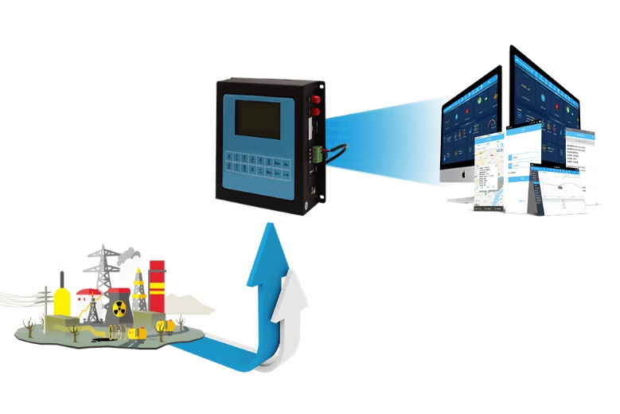
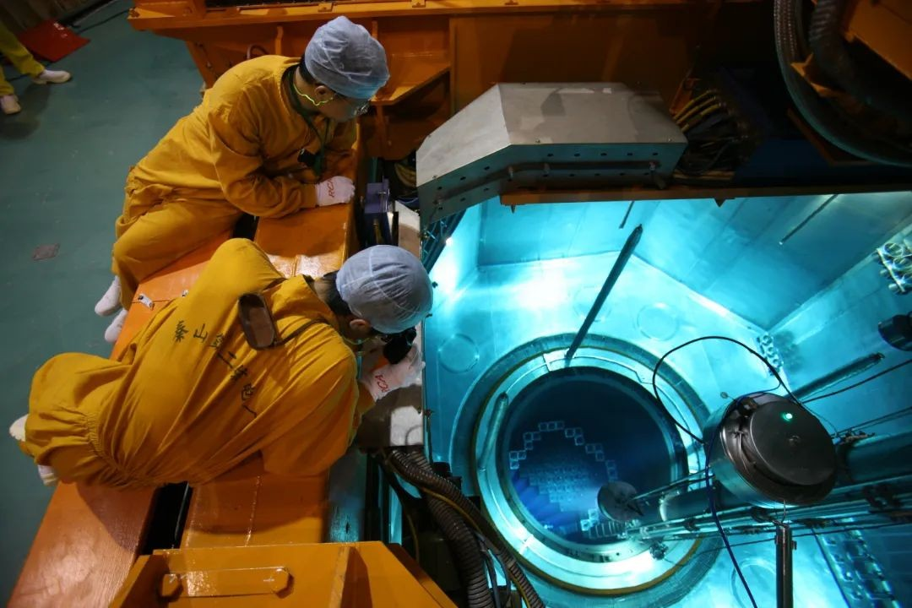
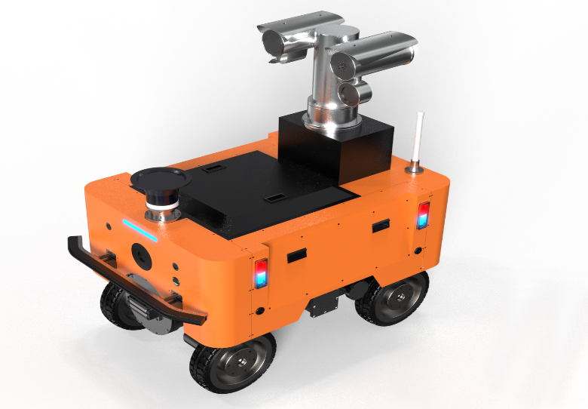

3. SOLUTION
3.3 Scene
3.3.1 Real-time monitoring module of equipment/system operation status
Sensors and the data acquisition devices
Restricted space monitoring
Intelligent inspection robot
Intelligent patrol inspection system platform
International Conference on small modular reactors and their applications 21-25 October 2024, Vienna, Austria Paper No.158 9

Slide 10

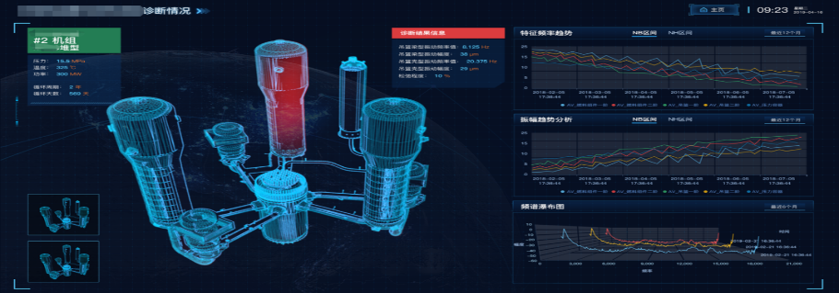
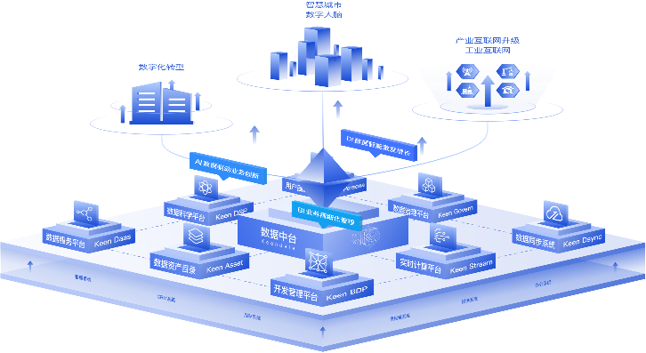
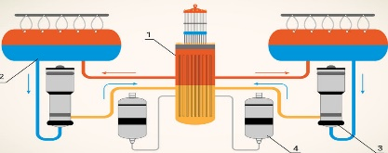

3. SOLUTION
3.3 Scene
3.3.2 Operation digital scenario
Data base
Intelligent operation platform
big data
modelling by mechanism
Intelligent operation-assisted decision-making
Intelligent control optimization
Intelligent early warning and diagnosis
Intelligent procedures, knowledge and experience management
Machine vision algorithm
International Conference on small modular reactors and their applications 21-25 October 2024, Vienna, Austria Paper No.158 10

Slide 11







3. SOLUTION
3.3 Scene
3.3.3 Maintenance digital scenario
Intelligent operation and maintenance technology platform
big data
Internet of things
Performance detection
artificial intelligence
historical analysis
Maintenance decision
International Conference on small modular reactors and their applications 21-25 October 2024, Vienna, Austria Paper No.158 11

Slide 12
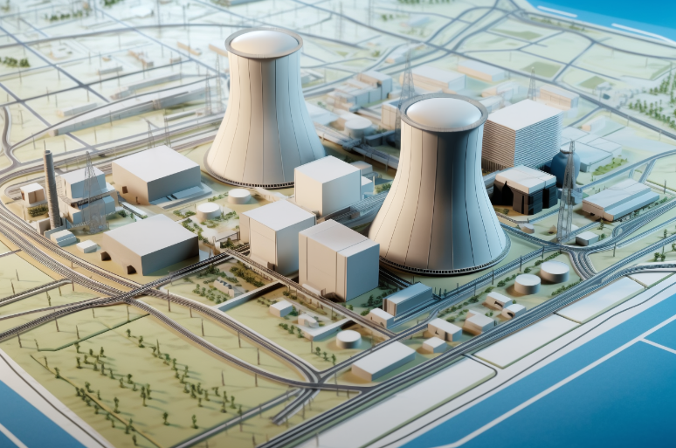
3. SOLUTION
3.4 Technology
3.4.1 Digital Twin Base Construction
Based on data architecture and information model analysis
Digital technologies for the entire process of handover and production transfer for SMR
Multi-source heterogeneous data and 3D lightweight visualization technology
In-depth research on the application scenarios of digital twin technologies in various business areas
International Conference on small modular reactors and their applications 21-25 October 2024, Vienna, Austria Paper No.158 12

Slide 13
3. SOLUTION
3.4 Technology
3.4.2 Intelligent Operation
Multi-dimensional operation health assessment
Mechanism, data and knowledge integration diagnosis technology
Automated operation procedure technology
Nuclear power plant control optimization technology
Nuclear-specific robotics technology
Experience feedback system
International Conference on small modular reactors and their applications 21-25 October 2024, Vienna, Austria Paper No.158 13

Slide 14
3. SOLUTION
3.4 Technology
3.4.3 Intelligent Maintenance
Multi-dimensional data fusion technology for system equipment operation and maintenance
Feature selection
Early warning of critical system/equipment and self-diagnosis technology for faults
Intelligent equipment monitoring
Intelligent inspection technology under complex operating conditions
Intelligent inspection robot automatic inspection
Effective integration of multi-source data
Develop data fusion methods based on weight, probability, or fuzzy logic
Equipment predimension strategy management is intelligent
Equipment fault identification and classification
Equipment remaining life and fault assessment
Multi-system interconnection, intelligent and automatic fault reminder process
International Conference on small modular reactors and their applications 21-25 October 2024, Vienna, Austria Paper No.158 14

Slide 15
3. SOLUTION
3.5 Platform
Digital twin platform with “unified standards, unified models, and unified services”.
Equipment system intelligent operation and maintenance canter platform with "integrated monitoring, intelligent analysis, and unified management".
Real-time data collection and monitoring system for equipment system operation.
Virtual Reality or Augmented Reality technology-supported remote cooperation and maintenance guidance platform.
Intelligent operation platform.
The robot that meets the requirements of the radiation environment is capable of fast component plug-ins, visual recognition, audio analysis, infrared analysis, and robotic arm operation.
Large model based on feedback training from nuclear power plant experience, with intelligent voice interaction capability.
。。。。。。
International Conference on small modular reactors and their applications 21-25 October 2024, Vienna, Austria Paper No.158 15

Slide 16
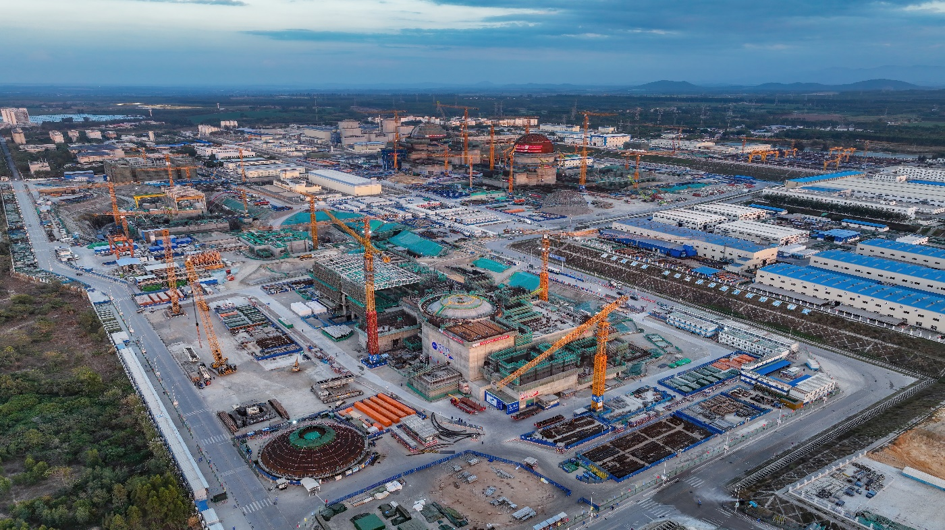
4. SUMMARY
Labor cost has a great impact on the economic benefits of SMR operation and maintenance stage. Too much reliance on manual operation is not conducive to the deployment of SMR in remote areas, and it is difficult to avoid human error.
The digital intelligent technology discussed in this paper can improve the automation and intelligence level of SMR operation and maintenance, help to reduce manual operation, reduce human error, reduce labor costs, and improve the security and economic benefits of SMR operation and maintenance.
International Conference on small modular reactors and their applications 21-25 October 2024, Vienna, Austria Paper No.158 16

Slide 17
Thank you!
Chen Zhiwen
Email: chenzw01@cnnp.com.cn
China / Hainan Nuclear Power Co.,Ltd
International Conference on small modular reactors and their applications 21-25 October 2024, Vienna, Austria Paper No.158 17

