Slide 1
Facilitating SMR fuel fabrication from HALEU UF₆
Dr. Marina Sokcic-Kostic

Slide 2
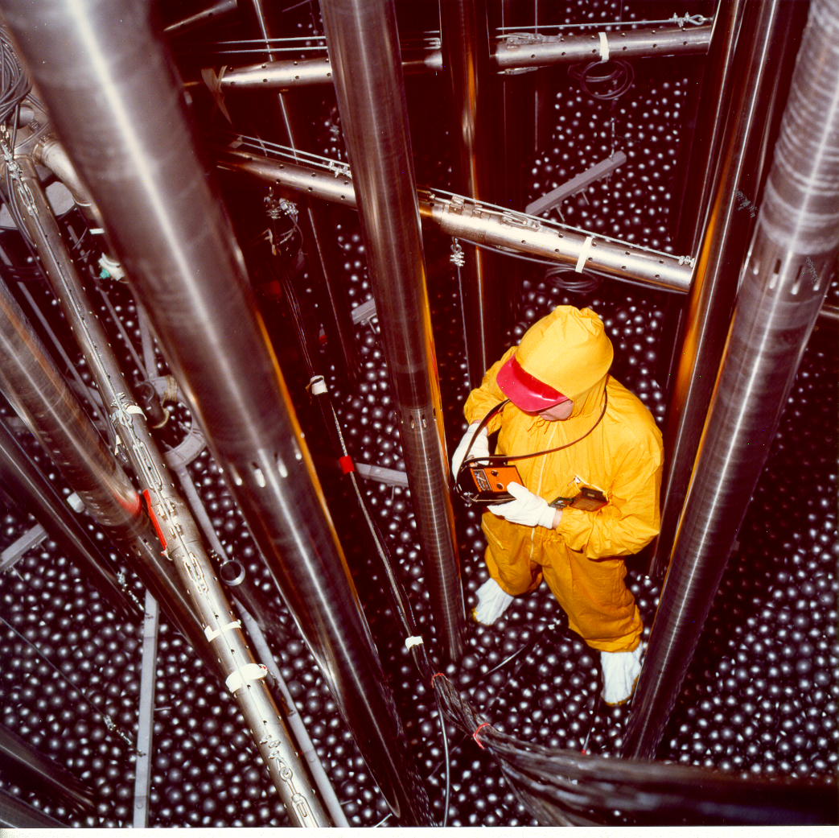
Overview
  NUKEM’s fuel production history
  Major SMR concepts and their fuel
  SMR fuels from HALEU UF₆ deconversion
  Metallic uranium vs. HTR TRISO fuel production route
  High temperature Small Modular Reactors (HT-SMRs)
THTR-300, Hamm-Uentrop

Slide 3
1. NUKEM’s Fuel Production History:
UO₂ and U metal
  NUKEM/Siemens Fuel plant (RBU, Reaktor Brennelement Union) in Hanau Wolfgang (Germany)
    1950’s: Fuel assemblies from U-metal, FR2 (Karlsruhe), ECO (ISPRA)
    1960’s: UAl_{x} in Al, up to 93% U-235 (HEU), FA for material test reactors (MTR)
    1970’s: AUC pilot plant, 93% U-235 (HEU), for Oxide based (UO₂) FA, production route for all German power reactors
  1980’s-2000’s: AUC/U metal plant (BATAN, Indonesia)
    for MTR by Siemens
    HALEU, up to 20% U-235
    Rework/recycling included

Slide 4
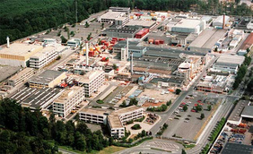
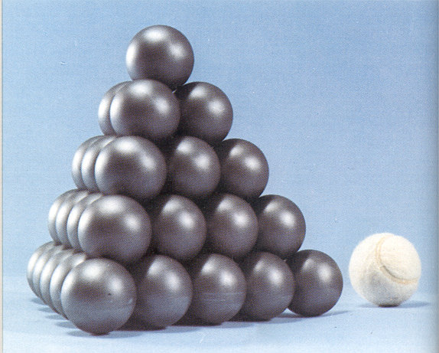
1. NUKEM’s Fuel Production History:
HTR fuel
  1960’s: German HTR program
    NUKEM’s responsibility: Fuel specifications, Fuel element design and manufacturing process
  1970’s: HTR fuel plant (HOBEG) in Hanau (Germany)
    250 000 Fuel Spheres for experimental AVR, Jülich
    1 000 000 Fuel Spheres for THTR-300, Hamm-Uentrop
  2000’s: PBMR Project in South Africa (PBMR Pty. Lt.)
    Basic, Detail And Procurement Design
    Unfortunately stopped during procurement phase due to financial reasons
  2010’s: Laboratory-scale facilities
    Indonesia
    South Korea

Slide 5
1. The Spherical HTR Fuel Element

Slide 6
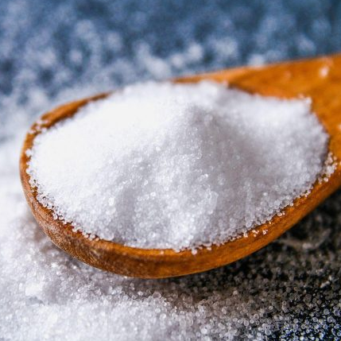
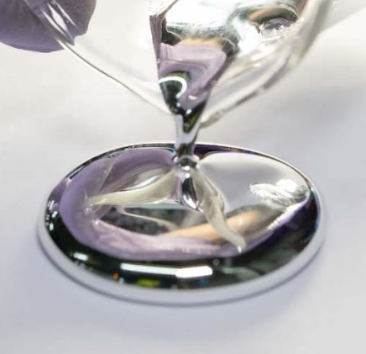
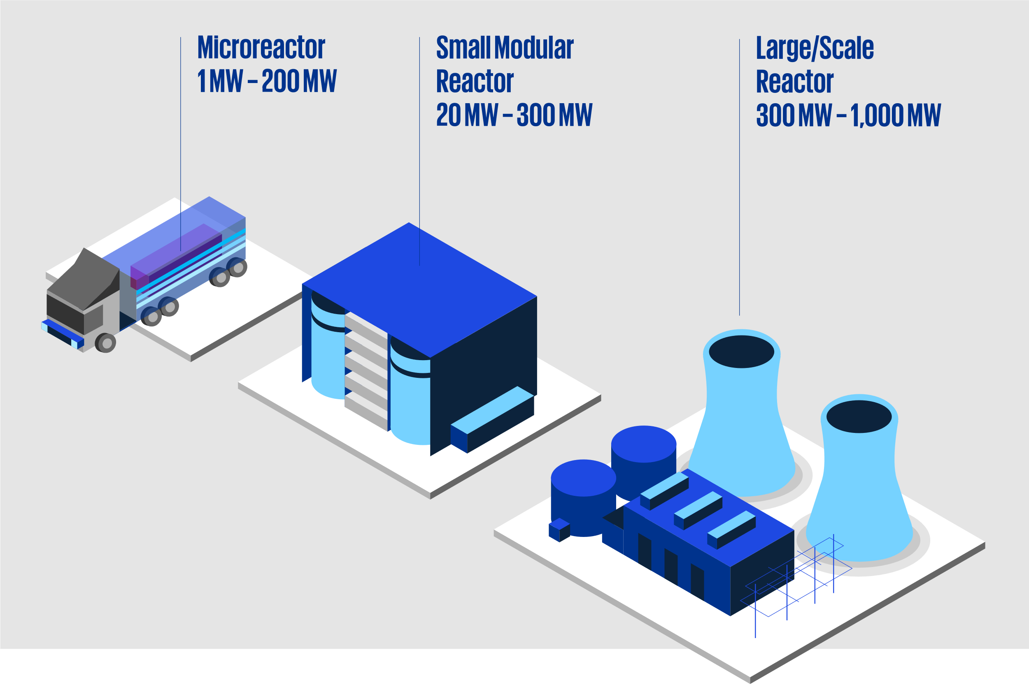


2. Major SMR concepts and their fuel
Liquid-metal cooled SMR
Fuel | U metal alloy MOX (low fissile) Pu and DU
Neutrons | fast (mainly)
Coolant | Na, Hg, Pb, Sn, …
Example | Sodium-cooled fast reactor (SFR)
Small Modular Reactors (SMR)
IAEA definition:
Advanced reactor up to 300 MW_{e} per module
Molten-salt SMR
Fuel | UF₄ in molten salt also, with Pu (or Th)
Neutrons | fast or thermal
Coolant | Molten salt (F⁻, Li⁺, Be⁺)
Example | Molten salt fast reactor (MSFR)
Water-cooled SMR
Fuel | UO₂ pellets MOX (high fissile)
Neutrons | thermal
Coolant | Light water
Example | Pressurized water reactor (PWR)
Gas-cooled SMR
Fuel | UO₂ TRISO particles
Neutrons | thermal
Coolant | He
Example | High temperature gas-cooled reactor (HTGR)

Slide 7
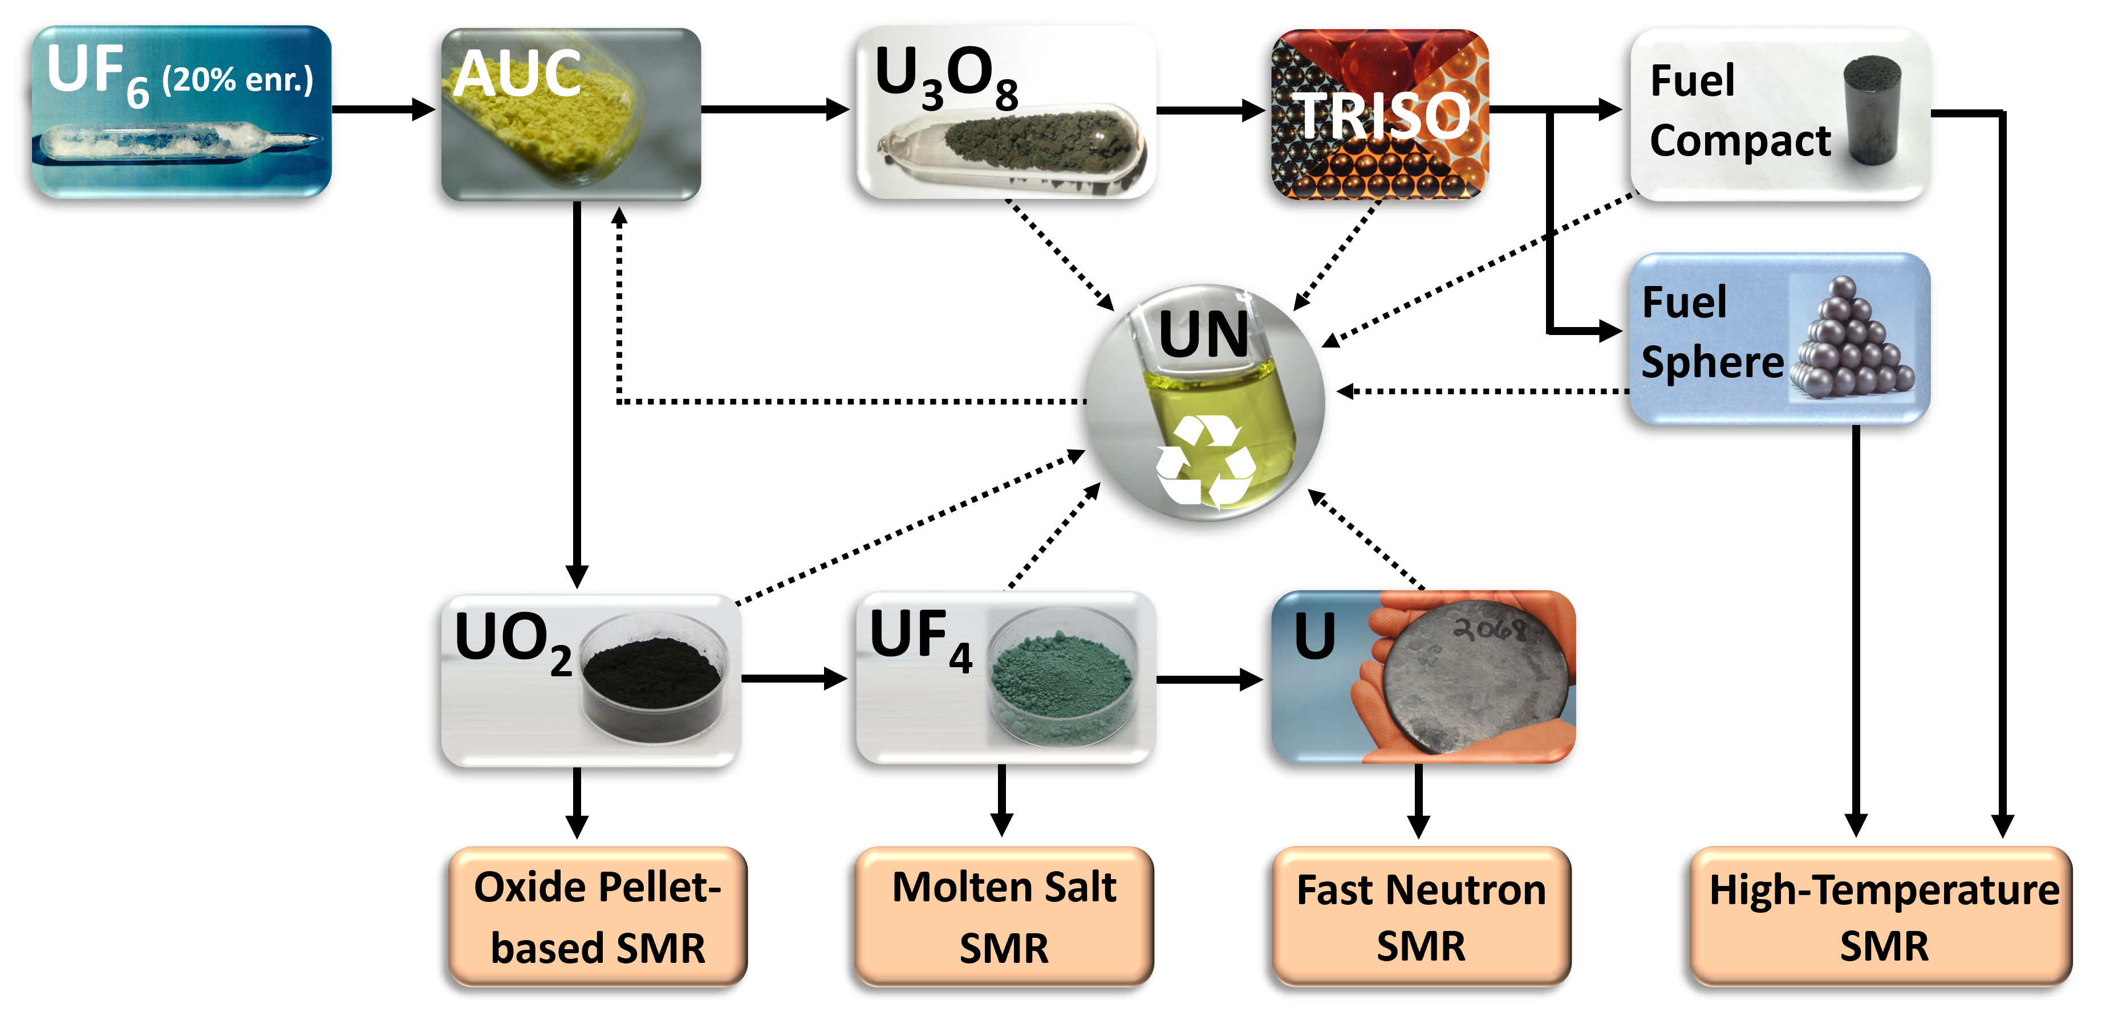
3. SMR fuels from HALEU UF₆ deconversion

Slide 8
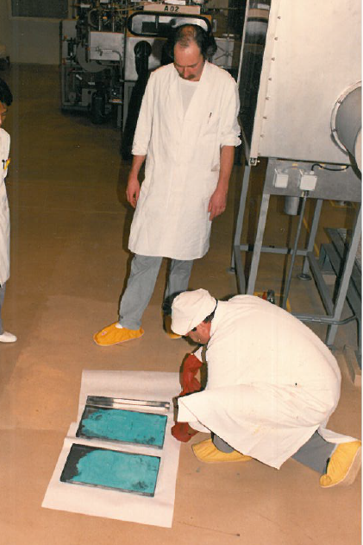
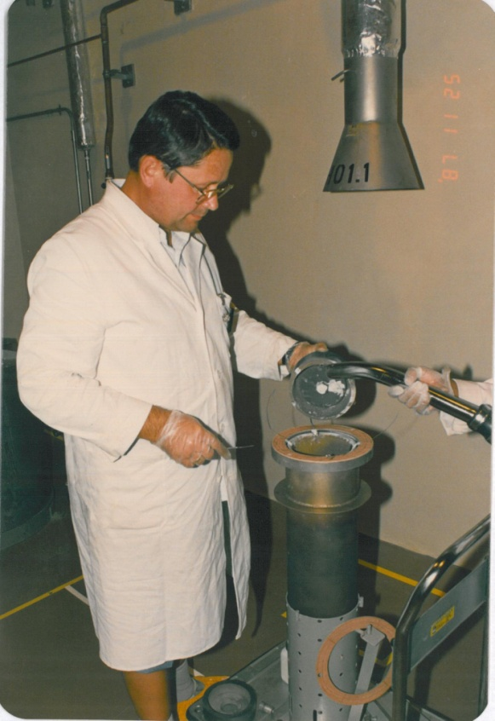
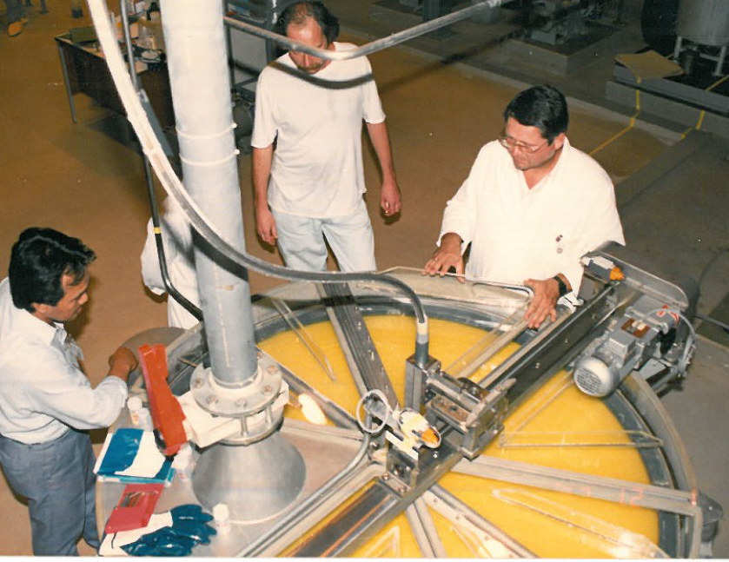
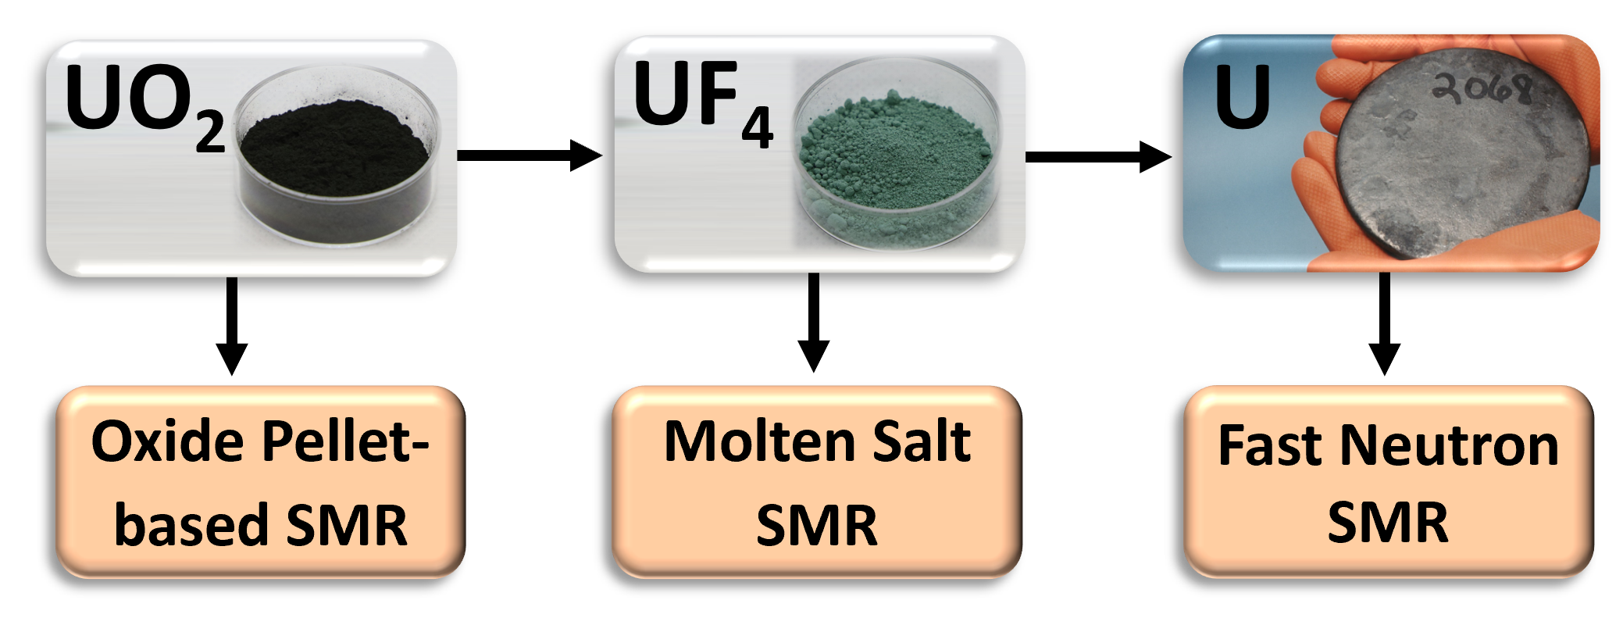
4. Metallic Uranium Fuel Production Route
      U metal production
      UF₆ + (H₂O/CO₂/NH₃) → AUC + (NH₄F)
      AUC + (H₂) → UO₂ + (NH₃/CO₂/H₂O)
      UO₂ + 4HF → UF₄ + (4H₂O)
      UF₄ + 2Ca → U + (2CaF₂)
      Calciothermic reduction (4.)
Inside graphite crucible
Filled with UF₄/Ca mixture (5 kg U)
Heating up to ignition
Regulus with more than 90% yield
Scrap recycled via recovery
AUC

Slide 9
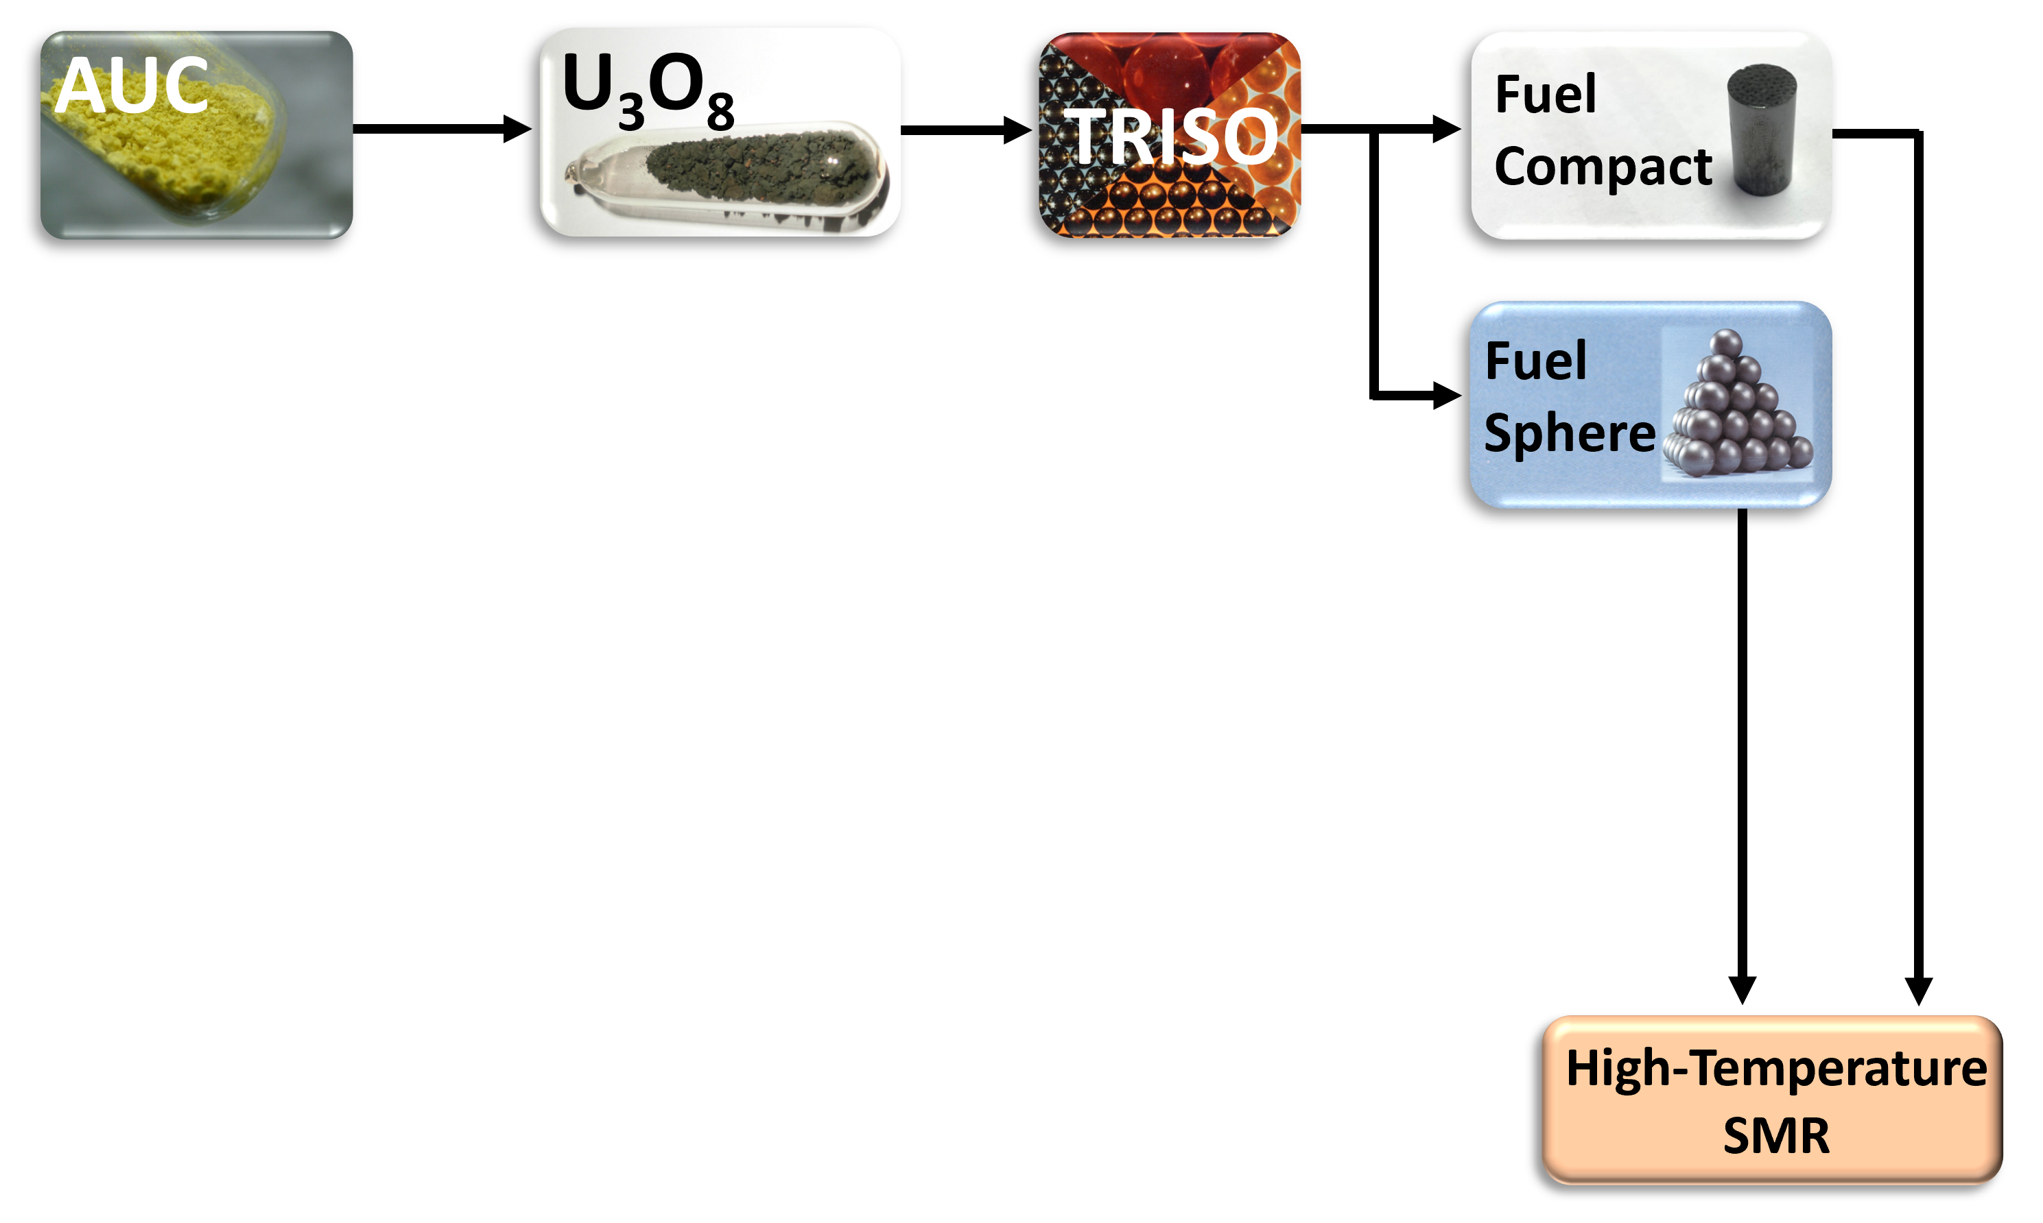
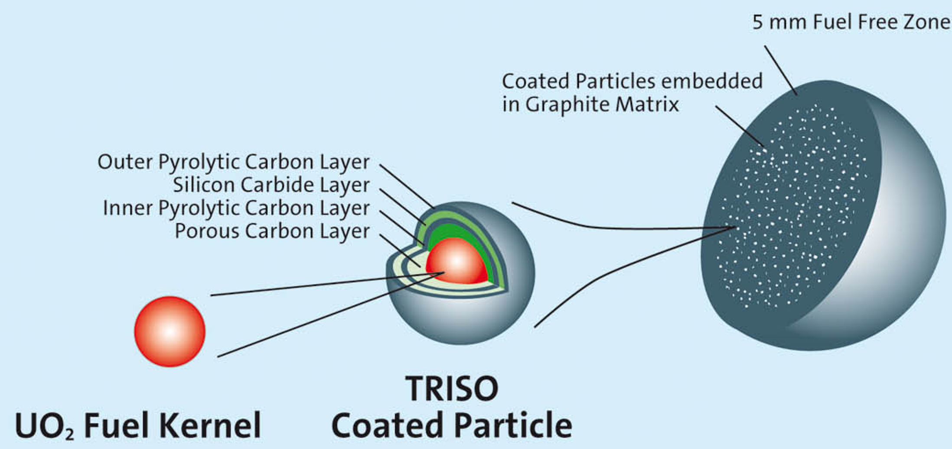
4. HTR TRISO Fuel Production Route

Slide 10
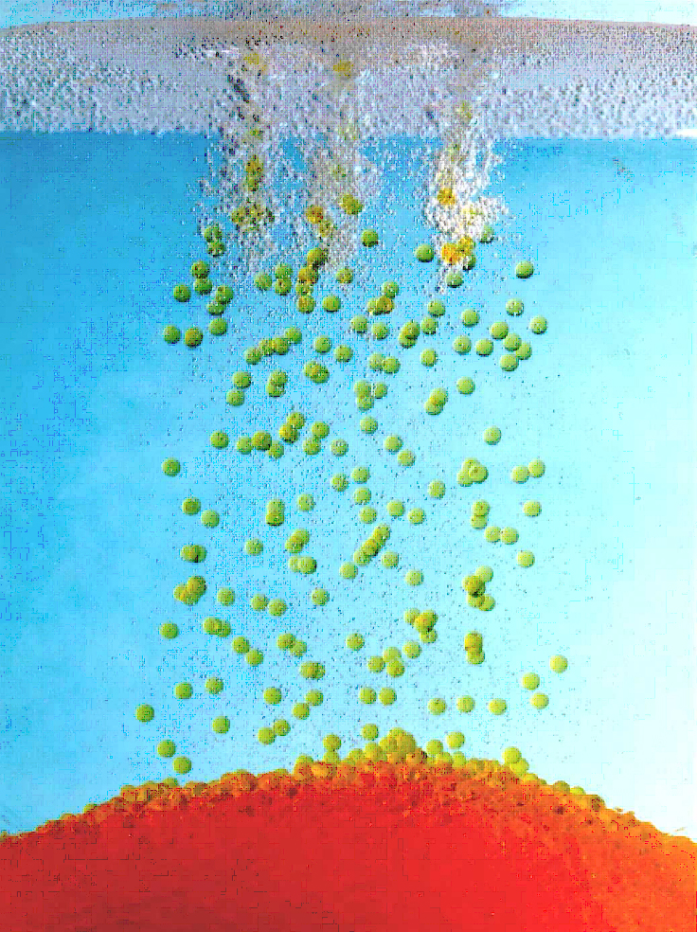
4. HTR Fuel Production – Kernels
  Kernel Casting
    Drip casting of Kernels
    ADU Precipitation from Uranyl nitrate and additives
    UO₂ or UCO-based

Slide 11
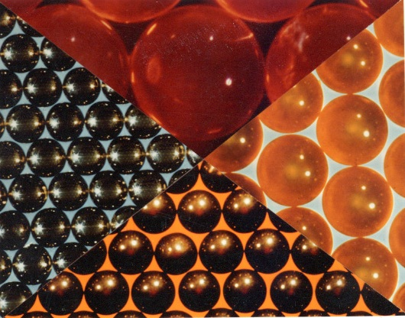
4. HTR Fuel Production – Kernels
vibro-dropped
  Kernel Casting
  Ageing, Washing, Drying (AWD)
  Calcining
  Sintering
  Sieving, Sorting, Sampling and Portioning (SSSP)
sintered
dried
calcined

Slide 12
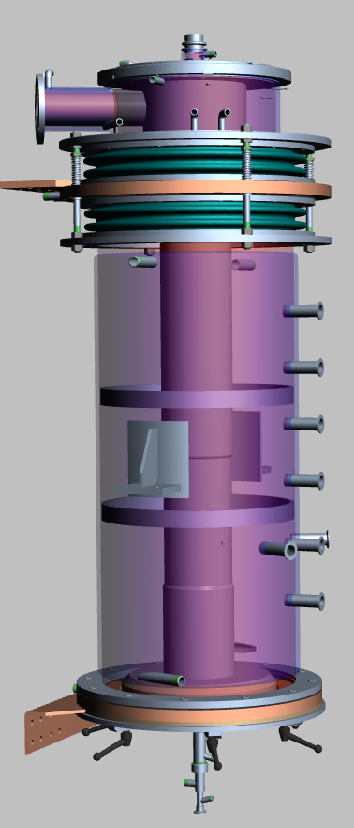
4. HTR Fuel Production – Coating Facility
  NUKEM Coater
  Key equipment to achieve standard quality fuel
  Chemical Vapor Deposition (CVD) Coating with Acetylene, Propylene and MTS
  Sieving, Sorting, Sampling and Portioning (SSSP)
CVD Off-Gas Exhaust
Graphite Heating Element
Water Cooling Jacket
Temperature Sensors
Fluidized Bed Nozzle

Slide 13

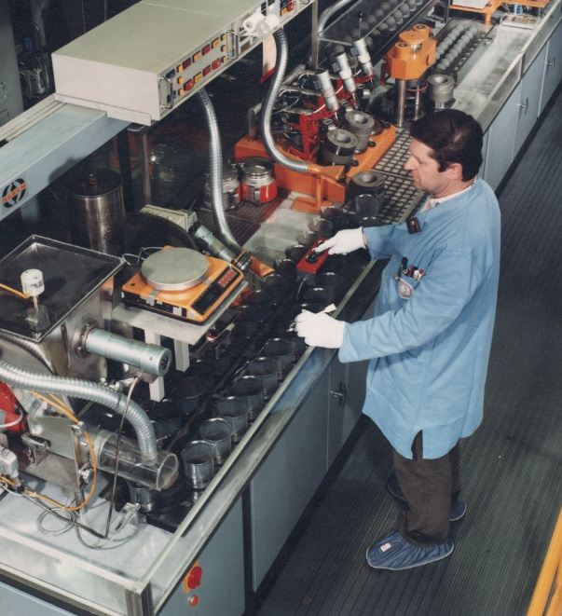
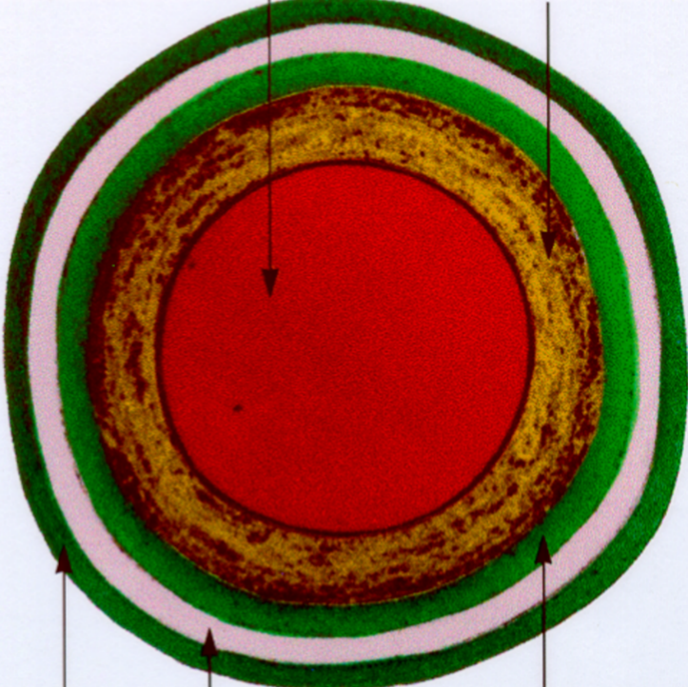
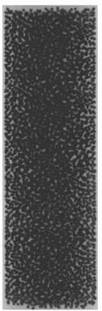
4. HTR Fuel Production – Fuel Facility
Fuel Compacts
Fuel Spheres
  Fuel Compact or Fuel Sphere Pressing
  OCPs are filled into pressing moulds
CP
MGP
OCP
Fuel Sphere Pressing Line,
(NUKEM HOBEG, Hanau, Germany)

Slide 14
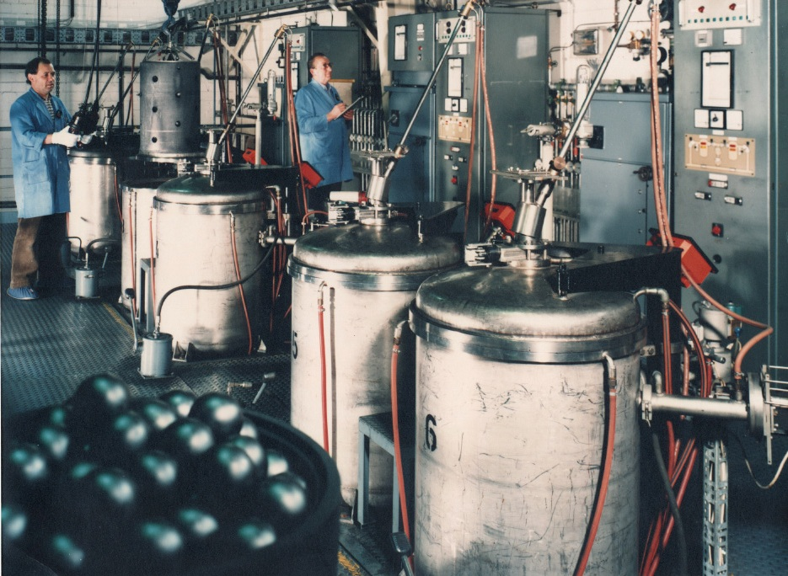
4. HTR Fuel Production – Fuel Facility
Fuel Spheres
  Carbonizing (800 °C)
  Annealing (1900 °C)
  Final Quality Control
Fuel Sphere Pressing Line
(NUKEM HOBEG, Hanau, Germany)

Slide 15
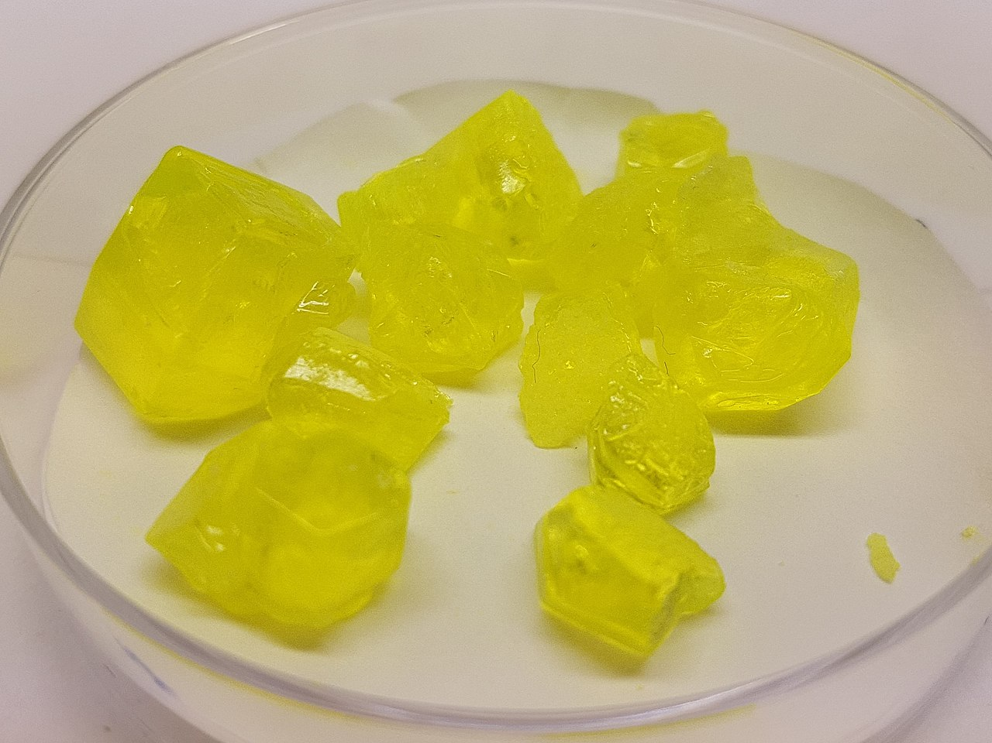
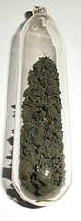
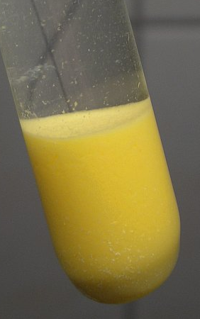
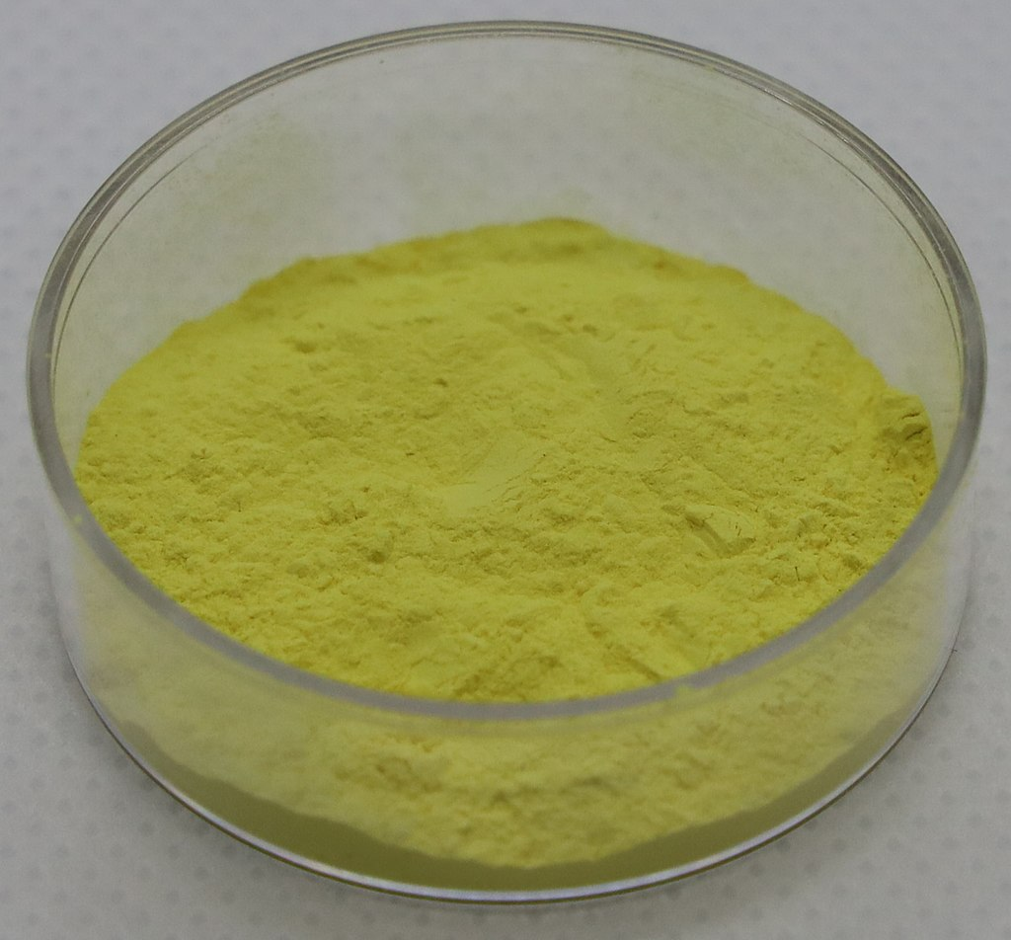
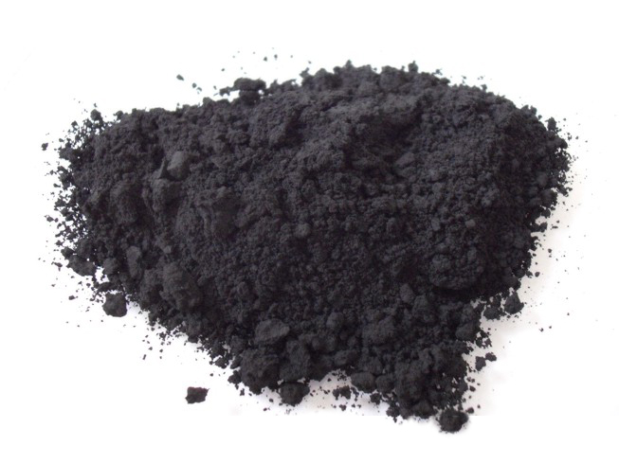
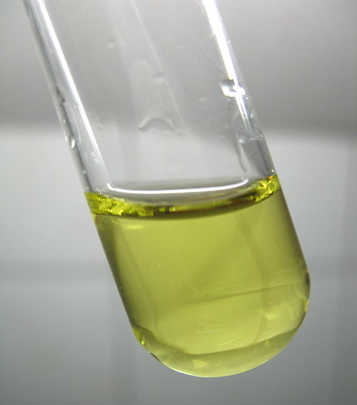
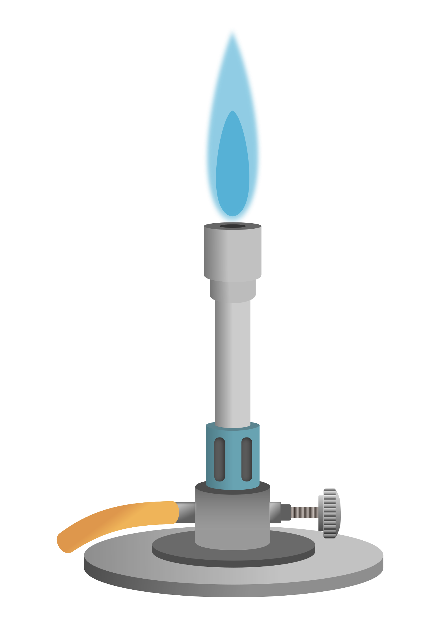
4. HTR Fuel Plant - Uranium Recovery
Dissolution in HNO₃
Particle Filtering
Precipitation
NH₄OH/H₂O₂
and
Filtration
ADU
Calcining
U₃O₈
UO₂(NO₃)₂ + C
Clean UO₂(NO₃)₂
UP
Add H₂O₂
NG U₃O₈
Carbon particles
Wet UO₄ ∙ H₂O precipitate
Dirty U₃O₈
UO₂(NO₃)₂ (aq.)
Clean U₃O₈
Source: Leiem, wikipedia.org, CC BY-SA 3.0
Source: Chemolunatic, wikipedia.org, CC BY-SA 4.0;
woelen.homescience.net

Slide 16
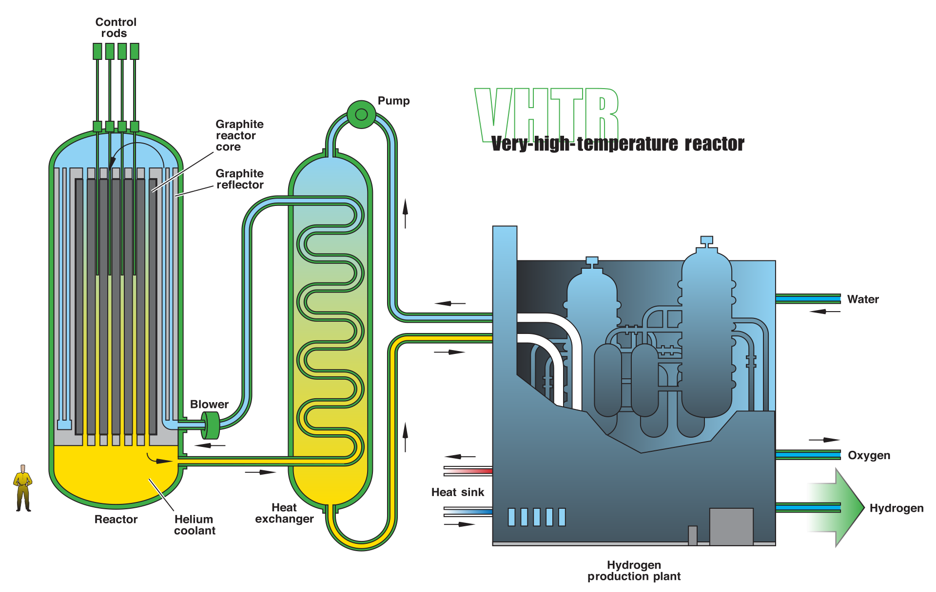
5. High temperature SMRs
  Nearly all reactor designs (established to Gen IV) can be designed as SMR
  Common HTR concepts:
    High-temperature gas-cooled reactor (HTR), outlet: 750 °C
    Very-High-Temperature Reactor (VHTR), outlet: 1000 °C
  Advantages of high temperatures:
    Replacing fossil fuel generated process heat
    e.g., synchronous electricity and hydrogen production via high-temperature water electrolysis
    High thermal conversion efficiency
Source: Wikipedia, https://en.wikipedia.org/wiki/High-temperature_gas_reactor#/media/File:Very_High_Temperature_Reactor.svg

Slide 17
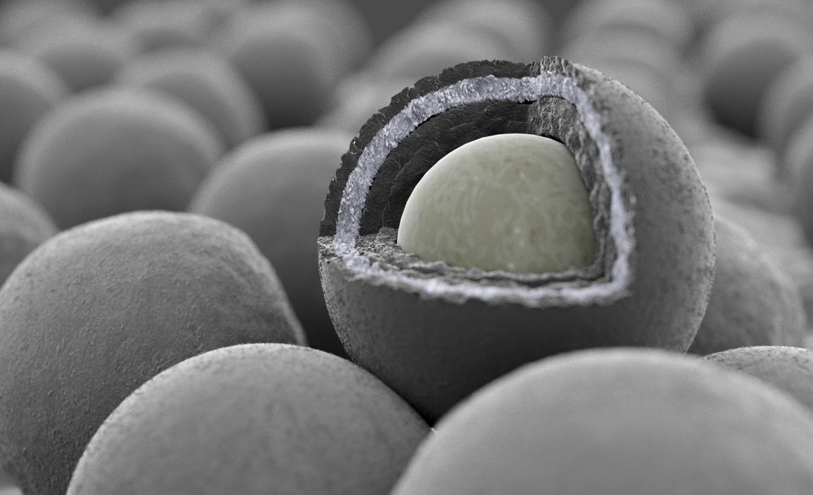
5. High temperature SMRs
  Advantages of the SMR concept:
    Less fissile material increases safety
    Standardisation of components
    Design integration to reduce complexity
    Flexible application in industrial cluster areas: less grid restrictions
  Inherent safety features of the HTR concept:
    Retention of fission products (TRISO fuel)
    Core meltdown impossible: heat can always passively dissipate even without an active helium cooling circuit
    Small core power density (compared to PWR)
    Large heat capacity and temperature stability of graphite-based reactor cores

Slide 18
Questions?

Slide 19
Content slide

Slide 20
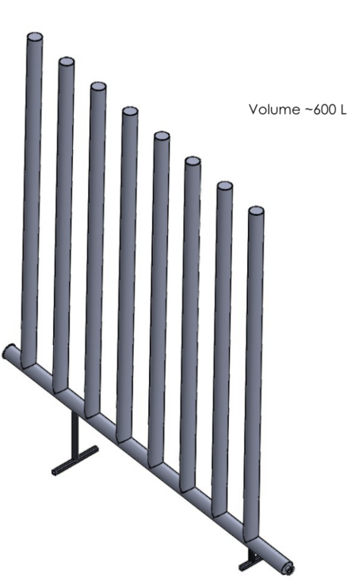
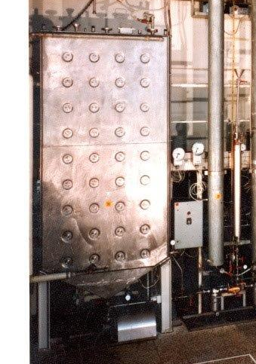
Criticality Safety - Practice
Slab Tank
Tube Array Tank
  Safe Mass principle is avoided wherever feasible

Slide 21

Criticality Safety - Principles
  Safe Mass
  Safe Volume
  Safe Cylinder Diameter
  Safe Slab Thickness
  Assumptions:
    Optimal moderation
    Worst-case reflection

Slide 22
Area K – Kernel Production
U₃O₈
Fresh and Area R
Dissolution in HNO₃
and
Pre-neutralisation
Casting Solution
PVA, THFA, Carbon Black, DI Water
Utilities and Area E
Uranyl Nitrate sol.
DI Water, NH₄OH, HNO₃
Utilities
UO₂(NO₃)₂(aq.)
Drip Casting
UNOH
NH₄OH, NH₃
Utilities and Area E
Ageing, Washing, Drying
Water, IPA
Utilities and Area E
ADU ~(NH₄)₂U₂O₇
Evaporate NH₄OH
Rinse with
H₂O
Used Water, IPA
Area E
Remove
H₂O by IPA
Off-Spec UCO Kernels
Area R
Calcining
up to 430 °C
Air, Ar, N₂
Sintering
up to 1890 °C
Ar, H₂, CO/Ar
UO₂/UC/UC₂
Sieving, Sorting, Sampling and Portioning
ADU
UO₃/C
PVA
Oxidation
UO₃ → UO₂
Reduction
ADU decomposition
UO₂ + 4C → UC₂ + 2CO
Carbotherm. Red.
UCO Kernels
Area C
2023-01-18

