Slide 1
Regulatory Agility
Regulatory agility through use of performance-based regulations
Sean Belyea
Senior Project Officer
Canadian Nuclear Safety Commission
International Conference on SMRs and their Applications
21–25 October 2024
Vienna, Austria

Slide 2
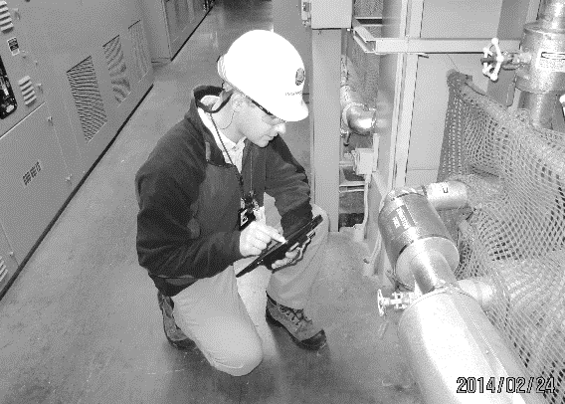
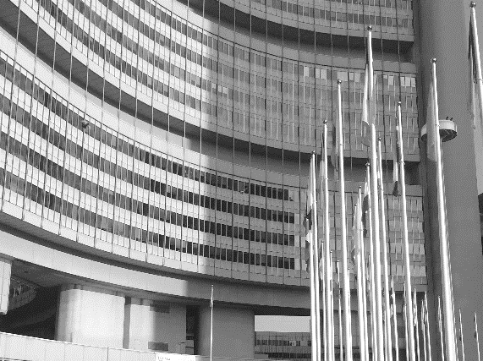
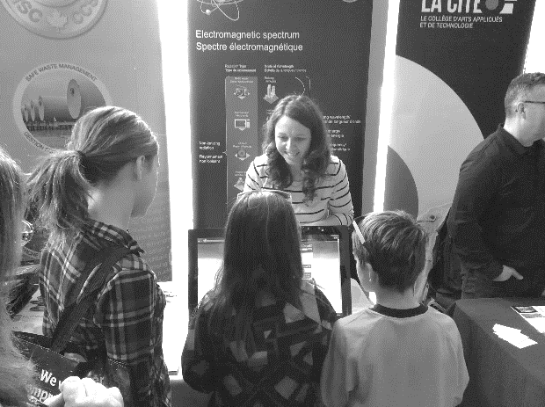
Canadian Nuclear Safety Commission
REGULATE
the use of nuclear energy and materials to protect health, safety, and security and the environment
IMPLEMENT
Canada's international commitments on the peaceful use of nuclear energy
DISSEMINATE
objective scientific, technical and regulatory information to the public
Over 75 years of regulatory experience
2

Slide 3
CNSC Regulatory Framework
Nuclear Safety and Control Act (NSCA)
Enabling legislation
Regulations
High-level and generally applicable requirements
Licences, licence conditions handbooks, certificates
Facility- and/or activity-specific requirements
Regulatory documents
Requirement details and guidance
Act
Regulations
Licences and certificates
Regulatory documents

Slide 4
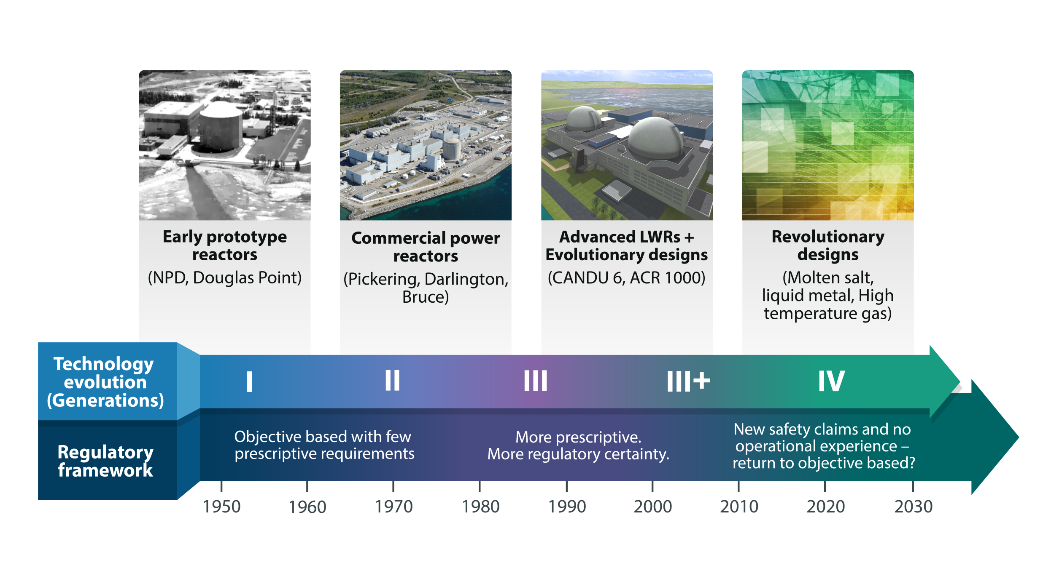
Technology and Regulatory Evolution

Slide 5
CNSC and use of a Graded Approach
Proponents must demonstrate how their outcomes meet regulatory requirements and fundamental safety functions; defence-in-depth; and provide information to support appropriate safety margins
Safety margins include:
  design features such as thicker pipe walls or additional instrumentation; and
  operational approaches such as increased inspection frequency, staffing levels and qualifications of staff or a more restricted operating envelope
Supporting evidence will play a major role in making a regulatory decision
  Evidence needs to be relevant, credible and of appropriate quality
The Graded Approach can result in more stringent requirements

Slide 6


Non-Nuclear Example of a Graded Approach
Fundamental Safety Objective:
Restrain occupants to manage collision energy away from humans and mitigate injuries
Versus

Slide 7
Alternative Approach
REGDOC-2.5.2 Scope
It is recognized that specific technologies may use alternative approaches
If a design other than a water-cooled reactor is to be considered for licensing in Canada, the design is subject to:
  the safety objectives,
  high-level safety concepts and
  safety management requirements associated with this regulatory document
Supported by IAEA Safety Guide SSR-2/1, Safety of Nuclear Power Plants: Design:
  “Safety Guides provide recommendations and guidance on how to comply with the safety requirements, indicating an international consensus that it is necessary to take the measures recommended (or equivalent alternative measures).”

Slide 8
Alternative Approach (contd.)
Section 9 of REGDOC-2.5.2, Design of Reactor Facilities
The CNSC will consider alternative approaches to the requirements in this document where:
  the alternative approach would result in an equivalent or superior level of safety
  the application of the requirements in this document conflicts with other rules or requirements
  the application of the requirements in this document would not serve the underlying purpose, or is not necessary to achieve the underlying purpose
Any alternative approach shall demonstrate equivalence to the outcomes associated with the use of the requirements set out in this regulatory document

Slide 9
Assessment of Applications: Fundamental Principles
  Assessment of a safety case for a proposed activity is carried out to assure:
    regulatory requirements are met
    safety objectives are met
    fundamental safety functions of “control, cool, contain” are met
  While demonstrating appropriate:
    defence-in-depth
    safety margins in view of the uncertainties in the safety case and specific hazards over the lifecycle of the facility
Risk is demonstrated to be at a reasonable level
9

Slide 10
Characteristics of Suitable Information
Facts and data derived through validated and quality assured (i.e., traceable and repeatable) scientific and engineering processes, such as:
  experimental or field-derived data
  operating experience
  computer modelling
Uncertainties have been characterized and accounted for
Information is demonstrated to be relevant to the specific proposal
The greater the uncertainty or safety significance, the greater the burden of evidence needed to support a proposal
10

Slide 11
Regulatory Flexibility when Leveraging Information
Leveraging in this case refers to a regulatory body who wants to leverage information from an existing assessment already performed by another regulatory body
Regulatory flexibility (graded / alternative approaches) may allow a regulator to make better use of an evaluation performed against a different regulatory framework for its own use.
Leveraging information is one of the topics covered by the Nuclear Harmonization and Standards Initiative
  https://www.iaea.org/services/key-programmes/smr-platforms-nhsi

Slide 12
Examples of Alternative Approaches
Emergency Core Cooling
Containment
12

Slide 13
Emergency Core Cooling
Water has traditionally been used for Emergency Core Cooling purposes
For some SMR designs, vendors claim that nuclear residual heat from the reactor unit can be removed passively (by thermal conduction, thermal radiation and natural convection) during normal operation, anticipated operational occurrences, design-basis accidents and beyond-design-basis accidents
Some vendors claim that no emergency core cooling system (ECCS) in the traditional water‐cooled reactor sense is required to ensure nuclear safety of the plant

Slide 14
Emergency Core Cooling (cont’d)
As part of supporting these claims, vendors and/or applicants must:
Demonstrate the effectiveness of the means for emergency core cooling
  Effectiveness can be demonstrated by safety analysis to confirm with high confidence that the safety limits of fuel and other SSCs important to safety are not exceeded such the dose limits and safety objectives are being met
Understand the safety functions performed by the ECCS (e.g., cooling the fuel, the reactor core and other SSCs important to safety following a loss of reactor coolant that exceeds the make-up capability) and demonstrate that the design has adequate means to preform these safety functions
Meet the fundamental attributes (e.g., reliability, safety classification, diversity) as required by relevant regulatory expectations
Example - Exposing a sodium cooled reactor to water for emergency core cooling can be very dangerous. An alternative is expected.

Slide 15
Containment
Concept of functional containment instead of a concrete containment structure is proposed
High Temperature Gas Reactors claim that functional containment uses:
  the TRISO fuel matrix and coating to provide reliable confinement of radionuclides for all plant states
  the reactor building controls release(s) during normal operation through pressure zones and filtering
  direct venting during accidents and that doses meet regulatory limits

Slide 16
Containment (cont’d)
As part of demonstrating acceptability:
  provide evidence of fission product retention within the TRISO particles through its fuel qualification program
  address generation of radionuclides outside the TRISO fuel particles
Required to meet containment safety objective of ensuring dose at site boundary for postulated accidents meets regulatory limits.

Slide 17
Prescriptive or Performance Based?
17

Slide 18
Pros/Cons of Prescriptive Regulation
Provides detailed specifications of rules and standards which must be followed and met
Prescriptive rules tend to be based on real-world operational experience
  History as to why that rule exists
Regulations coded in law are very slow to change (must go through legislative process)
  Provides a measure of certainty for industry
The state-of-the-art evolves with ongoing R&D
  Difficult to adapt coded regulations to reflect these changes (takes years to catch-up)

Slide 19
Pros/Cons of Performance-based Regulation
Focuses on desired, measurable outcomes, rather than prescriptive processes, techniques, or procedures.
Rules are higher level and rarely need to be changed
  Still based on real-world experience
Allows one to achieve a performance objective via different means including newer ones that are well supported
  Aids in the ability to leverage information between nations
Potential for regulatory uncertainty is higher for industry
  Question becomes what is the regulator “likely” to accept?

Slide 20
Summary
Allowing the use of alternatives helps regulators remain flexible in their approach to licensing nuclear technology
Without impacting safety, regulatory flexibility allows for:
    Innovation
    leveraging information between countries
    continual improvement
  No matter the regulatory philosophy used, high level safety objectives and principles must continue to be met:
    Control, cool, contain
    Defence-in-depth (including independence, diversity, separation, redundancy)
    Adequate safety margins
    As Low as Reasonably Achievable (ALARA)
Safety case to be supported by suitable information
20

Slide 21
Thank you
Stay connected!

