Slide 1
Ingenuity.
Imagination.
Insight.
October 21-25, 2024
Designing
small modular reactors for a circular economy
Kristina Gillin,
Principal Consultant

Slide 2

Introduction
In striving for sustainability, interest is
growing in:
New reactors – particularly SMRs
The circular economy concept –
which is enabled through design
Now is a window of opportunity to ensure that future reactors are designed for a circular economy.

Slide 3
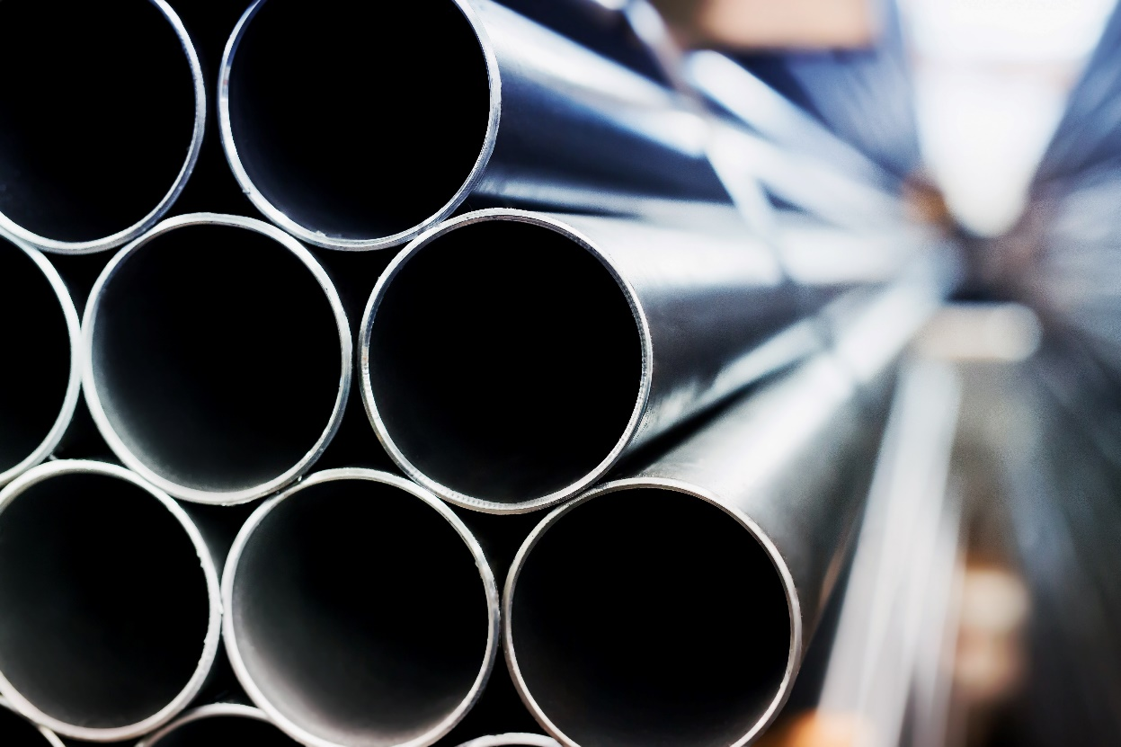
What is a circular economy?
Focuses on resources and promotes using:
  As little as possible
  As long as possible
Not the same as the waste hierarchy
Cannot be achieved by one
organization alone – hence requires
circular supply chains
Emerging field, mainly focused on:
  Products that are transportable
  Conventional built environment

Slide 4
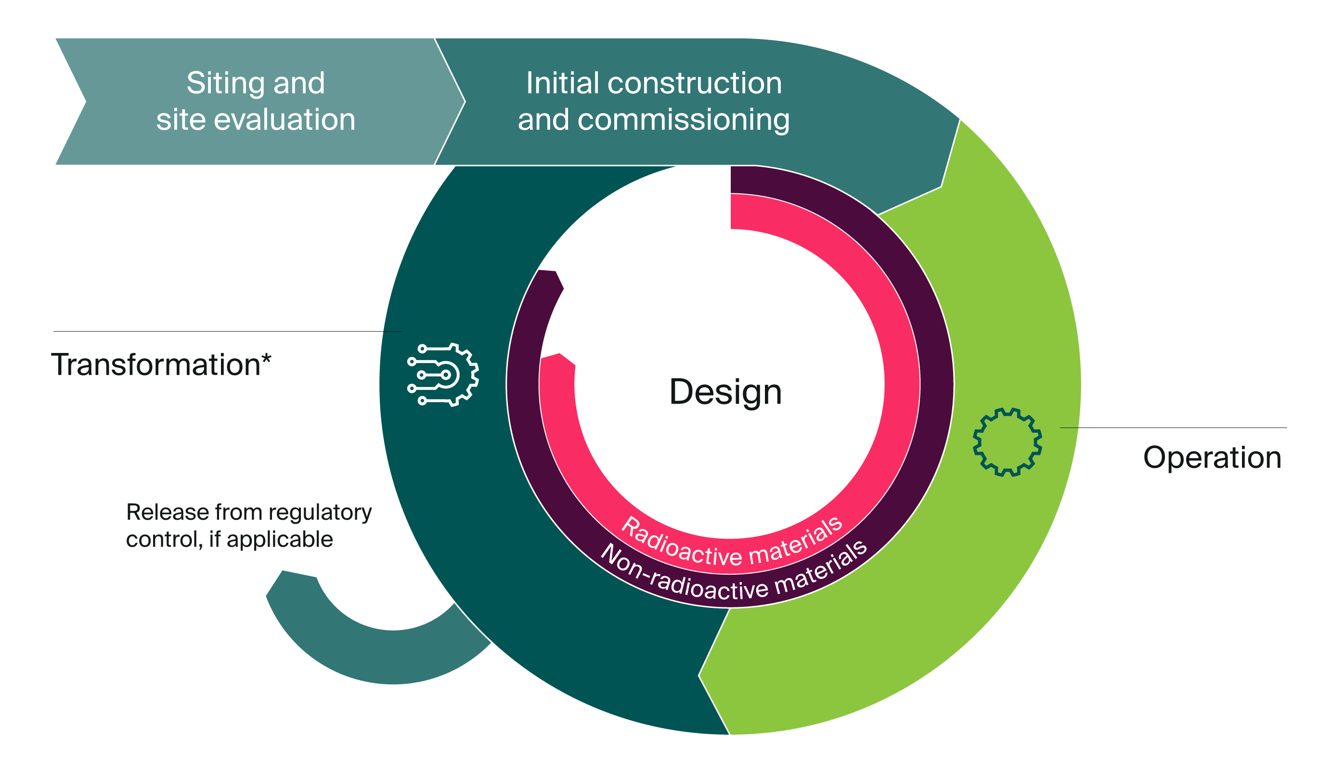
Conceptual model for circularity of a nuclear site
* Includes decommissioning, preparation for release from regulatory control, and construction and commissioning for the next operation stage, as applicable.

Slide 5




Approach for deriving design principles for a circular economy
Defining three levels of resources:
  Site and facility (incl. structures that are not easily transportable)
  Systems and components (incl. structures that are easily transportable)
  Materials
Assessing each level against four supply chain resource loops:
  Narrowing Slowing Intensifying Closing
Considering the lifecycle phases of a nuclear facility

Slide 6
Narrowing loop
Reducing the input of resources that enable usage, i.e., needing less to make something ready for use.
Site and facility
Minimize physical footprint of the site and the facility. Minimize duration of construction and commissioning.
Systems and components
Minimize need for replacement of systems and components.
Materials
Minimize amount of material needed during construction and commissioning; operation; and decommissioning, respectively.

Slide 7
Slowing loop
Extending the time period of usage, i.e., using something longer.
Site and facility
Maximize design life of buildings and other structures. Maximize duration of planned operation. Facilitate life extension, refurbishment and recommissioning.
Systems and components
Maximize design life of systems and components. Facilitate repair of systems and components. Enable usage of applicable systems and components during decommissioning.
Materials
Use material that degrades minimally under the relevant environmental conditions.

Slide 8
Intensifying loop
Increasing the degree of usage, i.e.,
using something by more, for more, and with less disruptions, etc.
Site and facility
Facilitate colocation with other nuclear and non-nuclear facilities. Utilize multiple outputs (power, heat, radioisotopes, etc). Minimize number and duration of planned and unplanned outages. Facilitate power uprating. Facilitate addition of adjacent reactors. Facilitate permanent shutdown and decommissioning of adjacent reactors.
Systems and components
Minimize number of different system and component types. Minimize need for maintenance of systems and components. Maximize shared use of systems and components between different reactors on the site (unless it has a negative impact on safety).
Materials
Minimize number of different material types. Minimize amount of material that is expected to become irradiated or contaminated.

Slide 9
Closing loop
Ensuring that resources are recovered after a period of usage; i.e., enabling something to be used again.
Site and facility
Reuse or repurpose existing structures on the site during construction and operation. Facilitate reuse and repurposing of structures after operation has ceased. Minimize duration of decommissioning.
Systems and components
Consider opportunities for reuse or repurposing of systems and components no longer of use in the facility or other facilities. Facilitate reuse and repurposing of systems and components. Consider opportunities for remanufacturing of systems and components.
Materials
Consider opportunities for use of material that has been discarded elsewhere. Facilitate clearance and recycling of material. Consider opportunities for reuse and recycling of material that will be above clearance levels.

Slide 10

Conclusions
Many common practices already consistent with circularity but not recognized as such
Design principles for circular SMRs need to be established – if nuclear is to fully contribute to sustainability
The framework and design principles derived in this paper can be used:
  To spark discussion on that reality
  By early adopters who want to ensure that their SMR designs are aligned with circularity principles at high level
  As starting point for further work

Slide 11
Thank you
Kristina Gillin,
Principal Consultant
Email: kristina.gillin@vysusgroup.com

