Slide 1


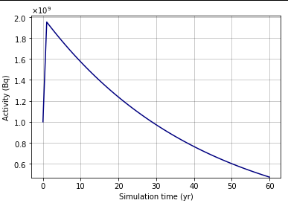
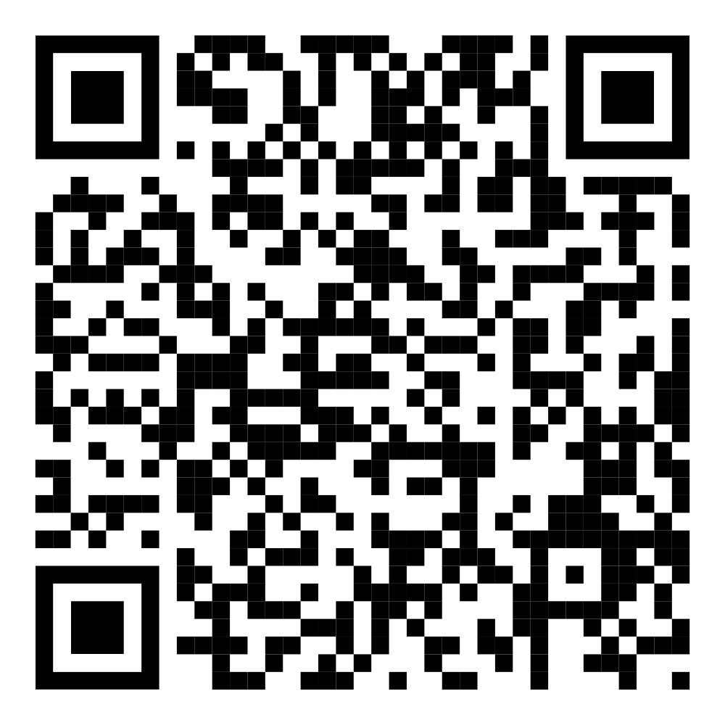

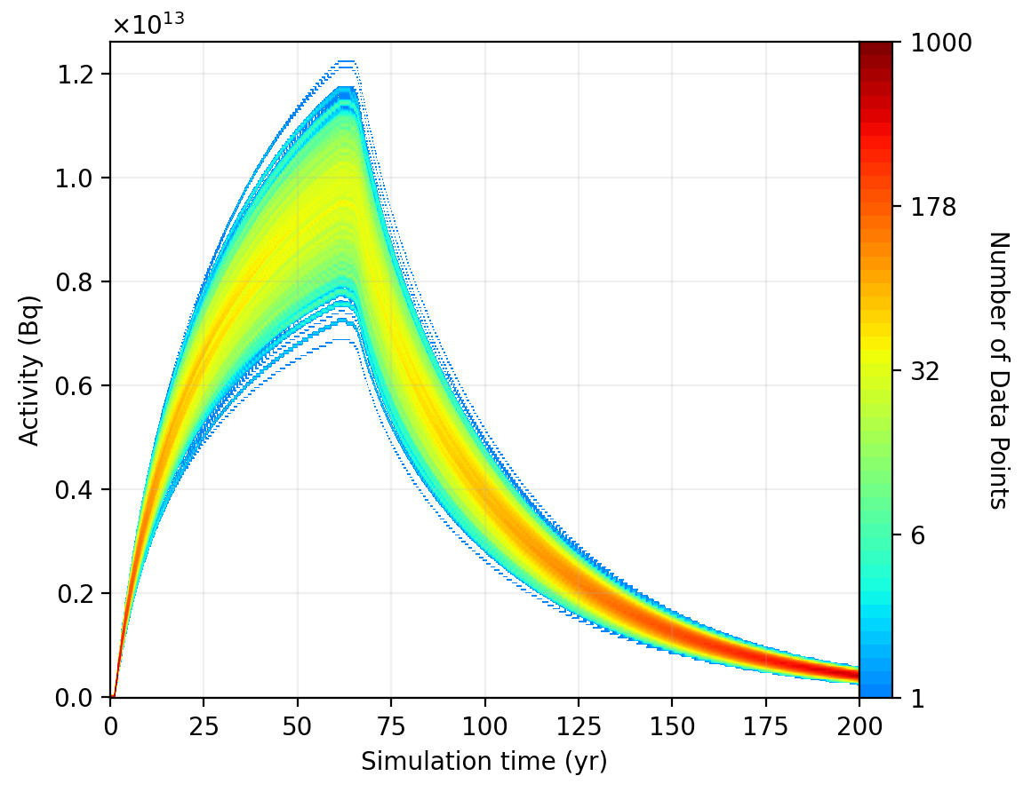
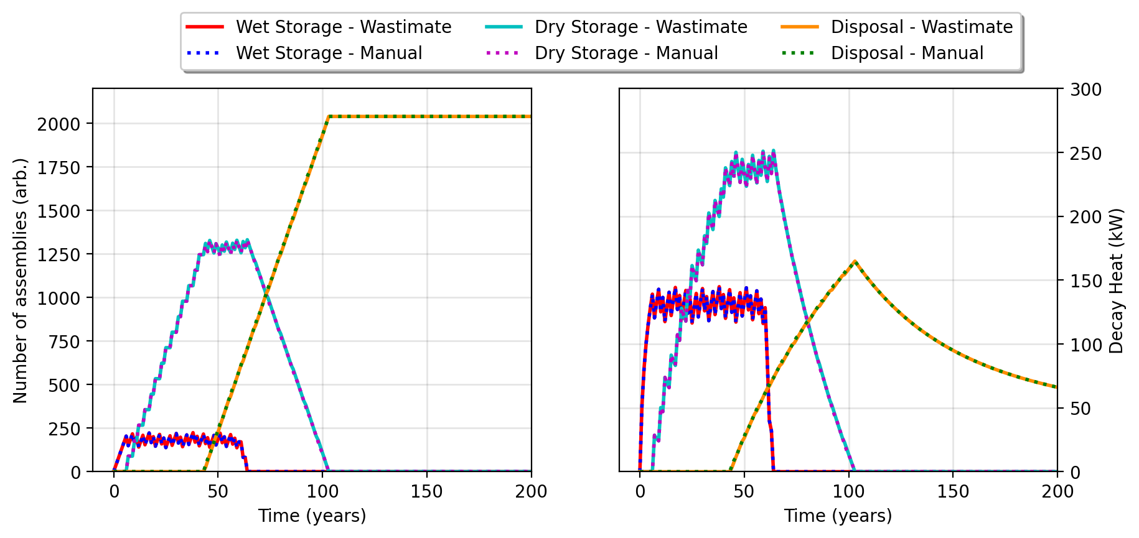







Empowering Emerging Nuclear Nations:
Wastimate’s Approach for Small Modular Reactor
Radioactive Waste Management
IAEA-CN-327-134
Hando Tohver^{1,2*}; Siiri Salupere¹; Marti Jeltsov³
¹University of Tartu, Institute of Physics, W. Ostwaldi 1 50411 Tartu
²Ministry of Climate, Suur-Ameerika 1, 10122 Tallinn
³National Institute of Chemical Physics and Biophysics, Akadeemia tee 23, 12618 Tallinn
* Corresponding author, hando.tohver@ut.ee
Wastimate – what it is and what can it do?
For nuclear newcomer nations, early planning of the nuclear fuel cycle is critical.
One solution to address the challenges of early planning
- Wastimate!
    Purpose: Tracks movement and decay of radioactive materials in waste management systems.
    Open-Source: Written in Python for ease of use and installation.
    No GUI: Uses a modular, class-based approach for creating and running simulations.
“Hello World!” of Wastimate
WastePackage = Package(Mass=1, Inventory={"Sr90":1e9}, mode="activity")
DisposalNode = Node([WastePackage])
ModelUniverse = Universe(stepsize=1*60*60*24*365) + DisposalNode
ModelUniverse.simulate(timesteps=60)
ModelUniverse.plot(DisposalNode, variable="activity", time_units="yr")
Sudden increase in the activity in the first model step:
  Ingrowth of Sr-90 daughter nuclide Y-90, activity doubles
Fig. 1: Activity of WastePackage in time as generated by the “Hello World!” Wastimate prompt.
SNF benchmark
To verify Wastimate and demonstrate the basic functionality, two benchmarks were used:
LLW benchmark
300 MWe BWR
34 bundles per year
Burnup of 50 GWd/tU
Spent fuel pool
Maximum pool capacity of 8 operational years
Dry storage cask
Decay heat limit of 1.5 kW per package (12 bundles)
Geological disposal
Decay heat limit of 40 kW per canister (89 bundles)
Wastimate requires waste production rates and isotopic composition as an input. For spent nuclear fuel, OpenMC¹ depletion module was used to estimate the isotopic description of the SNF.
SNF model was created by replicating the OECD/NEA’s “Burn-up Credit Criticality Safety Benchmark Phase III-C” study².
LLW benchmark demonstrated the modeling of continuous waste quantities using two built-in Wastimate methods:
Combine: Merges packages into larger collections.
Separate: Homogenizes node contents and moves a fraction to a new node.
Nuclide concentrations can be inputted as statistical distributions using SciPy³.
300 MWe BWR
61 m³ of concentrated sludges per year
Liquid Storage Tank
Waste processing rate-based limit
Near-surface disposal
Activity-based radionuclide release criteria
Waste package release
Transportation-based radionuclide activity limits
Movement of packages can be limited based on mass, inventory, activity, dose, or heat of the package or node. Technical criteria are set by the waste package requirements or applicable legislation.
Modeling results in node and package mass, activity, or decay heat distribution in time.
Fig. 3: Activity distribution of the near-surface disposal node in time over 1000 simulations.
Wastimate calculations were verified by manually tracking individual packages and comparing the results.
Results - Estimated design-based criteria
SNF benchmark summary
LLW benchmark summary
Waste volume in tank: ~320 m³ by end of reactor cycle.
Disposal facility capacity: 3660 m³ of liquids or 2925 grouted waste packages.
First package meets clearance criteria after 550 years
Release activities delayed due to Cs-137, followed by Sr-90.
First transfer: 89 assemblies to dry storage after 7 years.
Wet storage capacity: 250 assemblies + entire reactor core
Dry storage: 15 canisters for 89 assemblies (total 1335).
Packaging rate: 3 packages of 12 assemblies/year.
Fig. 2: SNF quantity and total decay heat output of wet, dry storage and final disposal node.
References
¹ ROMANO, P. K., HORELIK, N. E., HERMAN, B. R., NELSON, A. G., FORGET, B., et al., OpenMC: A State-of-the-Art Monte Carlo Code for Research and Development, Annals of Nuclear Energy 82 (2015) 90–97
² Burn-up Credit Criticality Safety Benchmark Phase III-C, Nuclear Science NEA/NSC/R(2015)6, OECD (2016)
³ VIRTANEN, P., GOMMERS, R., OLIPHANT, T. E., HABERLAND, M., REDDY, T., et al., SciPy 1.0: Fundamental Algorithms for Scientific Computing in Python. Nature Methods 17(3) (2020) 261-272.

