Slide 1
Novel Organizational Models for Advanced Reactors’ Operations: the Implementation of A/CPPNM Obligations in the BOO(T) Models
International Conference on Small Modular Reactors and Their Applications
Vienna, 21-25 October 2024
Madalina Man, Pegah Eftekhari
PNNL-SA-204729

Slide 2
Overview
Problem statement
A/SMR deployments under BOO and BOOT models
Jurisdiction to prescribe and jurisdiction to enforce
Implementation of A/CPPNM obligations in the context of A/SMR deployments under the BOO and BOOT
  Implementation of A/CPPNM Article 2A
  Implementation of A/CPPNM Article 5

Slide 3
Problem Statement
In a Build-Own-Operate (BOO) or Build-Own-Operate-Transfer (BOOT) model, foreign ownership and operation of a Small Modular Reactor (SMR) by State B on the territory of State A adds a layer of complexity in relation to the effective implementation of State’s A obligations under the Convention on the Physical Protection of Nuclear Material (CPPNM) and its Amendment (A/CPPNM).
This paper explores legal, regulatory, and administrative arrangements that may have to be made for the effective implementation of A/CPPNM Articles 2A and Article 5.

Slide 4
Attributes of Small Modular Reactors (SMRs)
ATTRIBUTES
Serial production, largely in factories;
Smaller power output;
Installed module by module with multiple units on the same site;
Applicability to countries with smaller grids;
Ability to remove reactor module or in-situ decommissioning at the end of lifecycle;
Smaller source term which allows for a less demanding infrastructure, in particular for emergency preparedness and response
POTENTIAL SECURITY CHALLENGES
May warrant adaptation of security protocols at the sire or during transport;
Physical security difficulties incurrent by remote siting and transportation;
Increased production, conveyance and storage of HALEU;
Increased dependence on automated systems increasing cybersecurity risks;

Slide 5
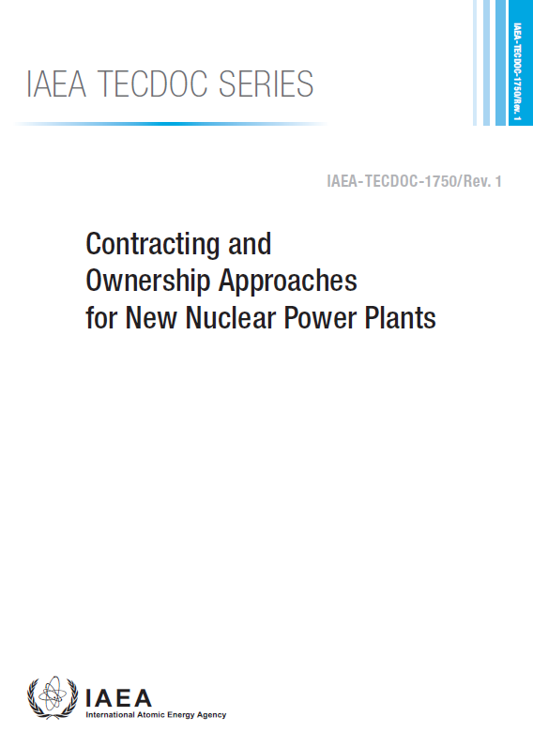
BOO and BOOT Models
“a private or non-private entity is granted the right by the host country to develop finance, build, own, operate, and maintain a facility for a specified period, during which the entity retains the revenue and associated risks. Under the BOOT model, at the end of the designated period, ownership of the facility is transferred to the host country.”
For the purpose of this paper: we assume the developer is the supplier State and the owner of the A/SMR (hereinafter ‘the operator’).
The host country is responsible for the “adoption, within its national legal system of such legislation, regulations and other standards and measures as may be necessary to fulfil its national responsibilities and international obligations effectively, and for the establishment of an independent regulatory body.
The developer will be responsible for all licensing aspects of the project

Slide 6
Considerations
The developer will have to:
  Become familiar with applicable laws and regulations in the host State implementing the A/CPPNM to identify the relevant requirements, incl. Security-by-Design (SeBD) and licensing requirements
  Establish adequate arrangements with the host State to discuss threat assessment and design basis threat (DBT) related information
  Establish arrangements in relation to physical protection and response considerations at the site, incl. response to sabotage and threat of sabotage, or to nuclear material that may be lost or stolen.

Slide 7
Jurisdiction
Jurisdiction to prescribe: country’s ability to make its law applicable to persons, conduct, relations, or interests
Jurisdiction to enforce: a country’s ability to induce or compel compliance or to punish noncompliance with its laws or regulations
A/CPPNM Implementation:
  Which laws and regulations would apply in order to meet the obligations in A/CPPNM Article 2A paragraph 2?
  What legal and regulatory arrangements may have to be made for a country’s A/CPPNM POC to effectively discharge his/her responsibilities in relation to matters within the scope of this Convention?
  What legal and regulatory arrangements may have to be made for the effective implementation of A/CPPNM Article 5 paragraphs 2 and 3?

Slide 8
Implementation of A/CPPNM Article 2A
The jurisdiction to prescribe and the jurisdiction to enforce of the host State remain unimpaired:
  Laws and regulations for nuclear security of the host State apply
  The licensing framework of the host State applies
  The competent authority of the host State will exercise inspection and enforcement functions
  Regulations would typically place on the operator the prime responsibility for security
Potential challenges:
  Confidentiality policies may impair the ability of the host State to share the DBT with the operator
    Need for legal arrangements for the sharing of confidential information
    Requirements for SeBD may help in considering security in the design phase and establish a physical protection system in line with DBT considerations

Slide 9
Implementation of A/CPPNM Article 5
The jurisdiction to prescribe and the jurisdiction to enforce of the host State remain unimpaired:
  The A/CPPNM POC would represent an agency in the host State (typically regulator)
  The Host State will make arrangements for cooperation, assistance, and information exchange, with other A/CPPNM States Parties in the context of response to scenarios of theft and sabotage
Potential challenges:
  Potential communication and coordination challenges between the A/CPPNM POC (e.g. regulatory body) and the operator in relation to nuclear security events that may trigger the application of article 5
    Need for clear response plans outlining roles and responsibilities and coordination between the operator and off-site response
    Need for regulatory requirements obligating the operator to report to the regulatory body on nuclear security events
  Potential confidentiality issues

Slide 10
Conclusions and Recommendations
Arrangements between the developer and the host State are necessary to clearly describe responsibilities in relation to physical protection, including the authority of the host State’s regulatory body, to subject the A/SMR developer to the host State’s licensing, inspection, and enforcement requirement.
The authors recommend further analysis of nuclear security legal and regulatory considerations in relation to BOO(T) approaches beyond the confines of a conference paper, including the effective integration of SeBD into regulatory frameworks and modalities to harmonize such frameworks

