Slide 2
APPLICABILITY OF KENYA’S LEGAL FRAMEWORK TO SUPPORT THE DEPLOYMENT OF SMALL MODULAR REACTOR.
Track 6: International and National Legal Frameworks and SMRs (B.6)
AUTHOR | CO-AUTHOR
COLLINS OWINO JUMA | JOE MWANGI MBURU
1

Slide 3
INTRODUCTION
Kenya is in phase II and adopted the IAEA milestone approach for the development and implementation of its NPProg.
Kenya plans to introduce about 300 MWe to its national grid by 2034 and two (2) additional similar sized units to be added in subsequent years.
Kenya is targeting SMR technologies that will be commercially available in the next 3 - 5 years.
Why SMRs? Suitability for non-electric application (desalination), Scalability, Site flexibility and ease for deployment in smaller electricity grids
1

Slide 4
INTRO…CONT’
Legal Framework
Nuclear Regulator Act 2019 (NRA)
Kenya has ratified/signed various international legal instruments, treaties and conventions on peaceful application of nuclear science and technology.
Pending international legal instruments, treaties and conventions, in the areas of nuclear safety, security, safeguards, and civil liability for nuclear damage.
Provides for a comprehensive framework for the regulation of safe, secure and peaceful utilization of atomic energy and nuclear technology; the production and use of radiation sources and the management of radioactive waste.
2

Slide 5
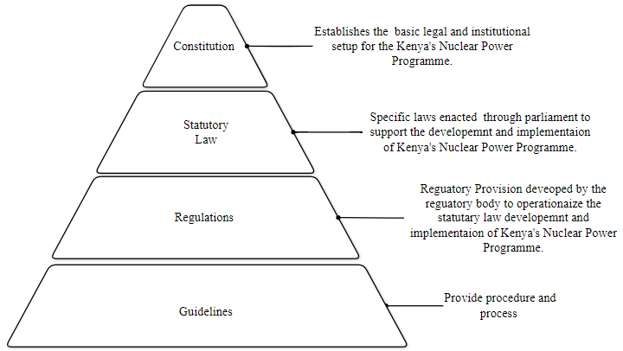
METHODOLOGY
SMR Unique Xtic
Legal Framework (NRA)
Siting
Licensing
EPR
Nuclear security
Decommissioning
Safeguards
RWM (SNF)
Remarks/recommendation
Nuclear Regulator Act of 2019
3

Slide 6
SMR UNIQUE ASPECTS
ASPECT | EXPLANATION
Siting | SMR designs presents unconventional siting from conventional large NPPs. (underground, Marine- based )
Licensing | Typical licensing process for nuclear installations - site selection, design, manufacturing, construction, commissioning, operation and decommissioning. Licensing process of SMRs may also require additional considerations such as manufacturing of SMR modules, their offsite commissioning and transportation, onsite commissioning of multiple reactor types at one project site, different operating concepts of SMRs, and onsite & offsite decommissioning.
EPZ | SMR technologies feature a smaller/no EPZ compared to conventional large NPPs, making them advantageous for placement near densely populated areas. Reduce the burden on the population living in the vicinity of an SMR allowing, at the same time, SMRs to be located closer to the end-users.
4

Slide 7
SMR UNIQUE ASPECTS…CONT,
Nuclear Security | Deployment of SMRs might have fewer nuclear security needs compared to their larger counterparts given that SMR incorporates the concept of security by design. Security challenges may arise based on the SMRs’ design, transportability, potential siting and deployment.
Decommissioning | SMRs offer the option of both onsite and offsite decommissioning. Offsite decommissioning offers a viable approach to managing the end-of-life phase of these reactors, leveraging specialized facilities and expertise to enhance safety and efficiency.
Safeguards | Most of the SMR designs, that are still at conceptual or under design stage, incorporate various safeguards features by design. SMR technologies incorporated factory-fuelled reactor cores in their designs..
RWM & SNF | Most of the LWR SMRs use the same fuel as their conventional counterparts, hence they will generate spent fuel and radioactive waste. Management of RW and SNF from the Non-LWR differs from the conventional NPPs
5

Slide 8
LEGAL FRAMEWORK…NRA
EMERGENCY PREPAREDNESS & RESPONSE
NUCLEAR SECURITY & PHYSICAL
PROTECTION
Emergency preparedness and response.
Implementation of EPR plan.
Trans-boundary nuclear or radiological emergency.
Information to public about plan
Threat assessment processes.
Primary responsibility for physical protection.
International cooperation and assistance
Protection of confidential information.
SAFETY OF NUCLEAR FACILITIES & DECOMMISSIONING
Authorization of nuclear facilities.
Responsibility for safety of facilities and activities
Site evaluation.
Authorization for construction and operations.
Decommissioning
6

Slide 9
LEGAL FRAMEWORK…NRA
RW AND SF MANAGEMENT
SAFEGUARDS
Peaceful uses.
Application of safeguards.
Safeguard inspections.
Designation of inspectors.
State system of accounting and control for nuclear material.
Information requirements for research and development activities related to the nuclear fuel cycle.
Scope of RW and SF management.
Responsibility for ROW and SF management.
Classification of RW.
Waste management plan.
Collection, segregation and characterization of RW.
Discharge of RW.
7

Slide 10
RESULTS AND DISCUSSION
ISSUE | APPLICABILITY |  |  | REMARKS
 | FULLY | PARTLY | NO
Siting | 🗹 |  |  | No action Required. (except if target technology id FNPP)
Licensing |  | 🗹 |  | Action required: to address the off-site licensing activities
EPZ | 🗹 |  |  | No action Required. ( regulations have to be develop for the EPZ)
Nuclear Security |  | 🗹 |  | Action Required- review the legal framework on nuclear security that is proportionate and specific to the circumstances.
Decommissioning |  | 🗹 |  | Action Required: Inclusion of the provisions on off site decommissioning in the legal and regulatory framework.
Safeguards |  | 🗹 |  | Action Required: Enhancing the framework on safeguard
RWM & SNF |  | 🗹 |  | Action Required: Develop regulations for radioactive waste, including fuel leasing, export for reprocessing of spent fuel, waste management plan establishment.
8

Slide 11
CONCLUSION
SMR technology provides an avenue for clean reliable electricity that requires legal and regulatory infrastructure to be developed in advance in preparation for future bids of acquiring the technology in Kenya
The development of Kenya's legal and regulatory framework (Nuclear Regulatory Act) focused on supporting the deployment of a large nuclear power plant.
Most of the provision stipulate by the NRA support the deployment of SMRs technology in Kenya with minimal revisions (LWRs, for Non-LWR might necessitate extensive revision of the framework)
It is vital to take into consideration technology neutrality to ensure the legal framework will support LWR or Non-LWR SMR
9

Slide 12
THANK YOU
CONTACT
Email: cowino@nuclear.co.ke
jmburu@nuclear.co.ke

