Slide 2
SMRS TO DECARBONISE THE INDUSTRY
The impact of nuclear liability
Issues to have in mind when developing such projects

Slide 3
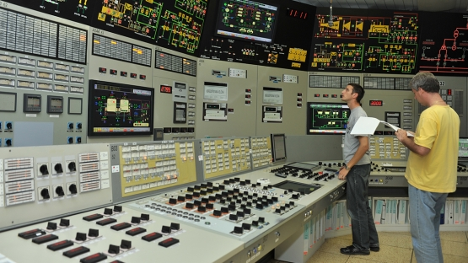
Determining the “Nuclear Operator”
Nuclear operator is strictly and exclusively liable for nuclear damage caused by a nuclear incident occurring at a nuclear installation
« Person designated or recognised by the competent public authority as the operator of [the] nuclear installation »
Need to have the financial, technical and human resources to operate the reactor
If nuclear damage gives rise to [nuclear] liability of more than one operator […], the liability of these operators shall be joint and several” if the damage attributable to each operator is not reasonably separable
Photo: D. Calma/IAEA

Slide 4
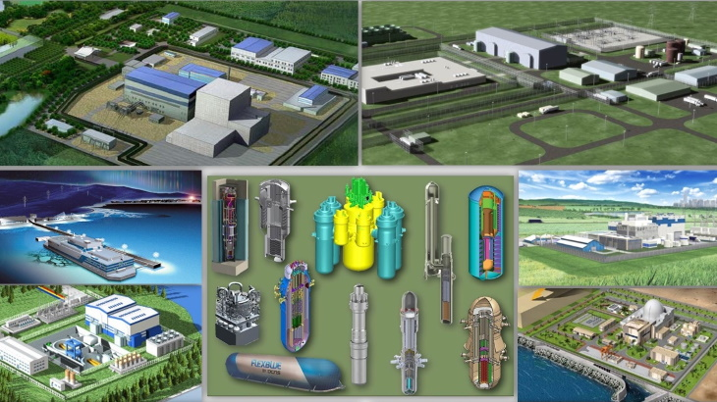
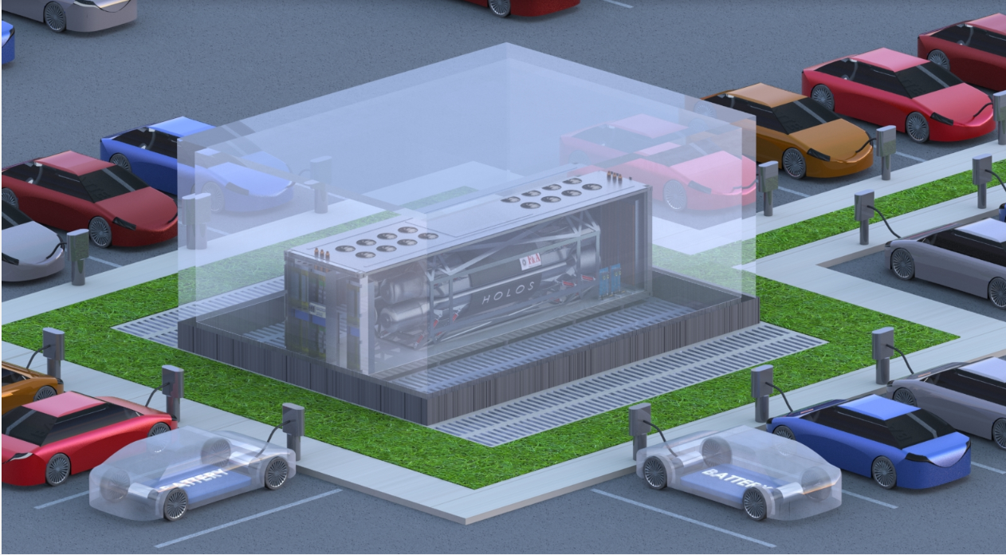
Determining the “Nuclear Installation”
Defining the “nuclear site” is critical:
  Nuclear operator compensates third parties / off-site damage
  Nuclear operator bears losses caused by damage to the nuclear installation itself and any property on that same site which is used or to be used in connection with the installation (including spent fuel and radioactive waste storage facilities)
  Nuclear operator bears the costs of preventive measures
  Distance between the “nuclear site” and the industrial site to fulfill safety/security requirements of both industries
Image: IAEA
HolosGen HOLOS-QUAD 10 MWe HTGR

Slide 5
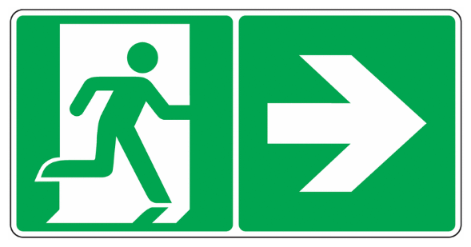
Impact of a “Nuclear Incident”
An event that causes « nuclear damage »: damage arising out of or resulting from ionising radiation emitted by any source of radiation
Emergency Planning Zone: operator liable for the costs of preventive measures and related loss or damage in case of evacuation
If nuclear damage is caused jointly by a nuclear incident and by another non-nuclear incident: the part of the damage that is not reasonably separable from the nuclear damage will be compensated by the nuclear operator under the nuclear liability regime

Slide 6
Nuclear liability in amount & Insurance
Having regard to the nature of the nuclear substances involved and to the likely consequences of a nuclear incident originating therefrom, a State may establish a lower nuclear liability amount, provided that in no event shall any amount be less than the amounts provided in the international nuclear liability conventions
To avoid burdening the nuclear operators with unjustified insurance or financial security costs
A safety assessment will need to be made. If compensation amounts exceed the lower nuclear liability amount established by the State, the later will have to provide public funds up to the nuclear liability amount applicable to large nuclear power plants
Interest and costs awarded by a court are in addition to the amounts for which the operator is liable for nuclear damage
 | Paris Convention | Vienna Convention | Revised Vienna Convention | Convention on Supplementary Compensation
Large nuclear power plants | € 700 million | US$ 5 million, based on US$ gold value on 29 April 1963 | SDR 300 million | SDR 300 million
Low risk installations | € 70 million | / | 5 million SDRs | 5 million SDRs

Slide 7
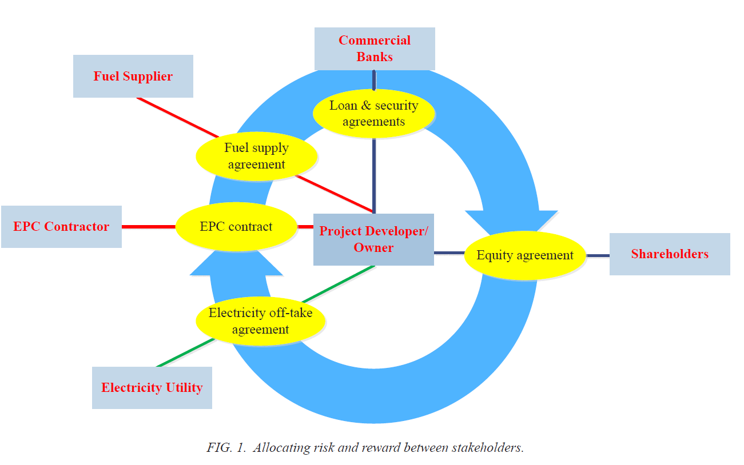
Structuring and Financing a project
SMRs could be excluded from the scope of the international nuclear liability conventions, but is it worth it?
Nuclear liability and nuclear safety/regulatory issues impact / structure the corporate and financial aspects of the project
From a project finance perspective, the allocation of risks and certainty are key
What about the Nuclear Operator ?
IAEA – Managing the Financial Risk Associated with the Financing of New NPP Projects

Slide 8

Ximena Vásquez-Maignan
  Counsel, Paris
  White & Case
    E ximena.vasquez-maignan@whitecase.com
    LinkedIn

