Slide 1


Mapping Ghana’s Hydrogen Economy: The strategic contribution of Small Modular Reactors
Festus Brew Quansah (BSc. MSc. MBA)
Financial Analyst , Nuclear Power Institute-Ghana Atomic Energy Commission
Presentation for the International conference on small modular reactors and their applications 2024
(21-25 October 2024), vienna, austria

Slide 2
Presentation Outline
Introduction
Scope and Justification of paper
Small Modular Reactor Deployment in Ghana
Ghana’s Nuclear Power Programme
Cogeneration Opportunities (going beyond electricity)
Hydrogen in perspective
Mapping the hydrogen Economy in Ghana
Demand for Hydrogen in Ghana
Benefits of hydrogen to the National economy
Systems analysis towards a future hydrogen economy
Transition to the hydrogen economy (A phased framework)
A policy focus for Ghana (Benchmarking experiences)
Building hydrogen infrastructure in Ghana
Conclusion

Slide 3

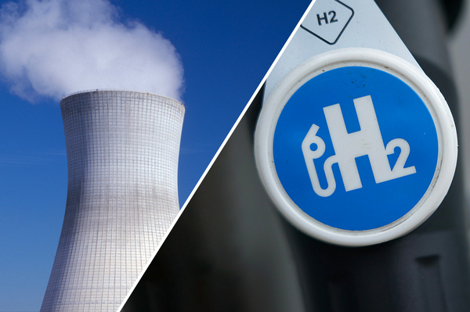

Introduction
Importance of decarbonising energy systems
Coevolution of decarbonisation trends and the interest in hydrogen
The rise of the hydrogen economy
Ghana’s context

Slide 4



Scope and Justification
The emergence of hydrogen as an energy alternative
The strategic contributions of Small Modular Reactor technology through cogeneration systems
Key elements to focus on, analyse and develop towards a hydrogen economy in Ghana
Systems analysis
Phased framework

Slide 5
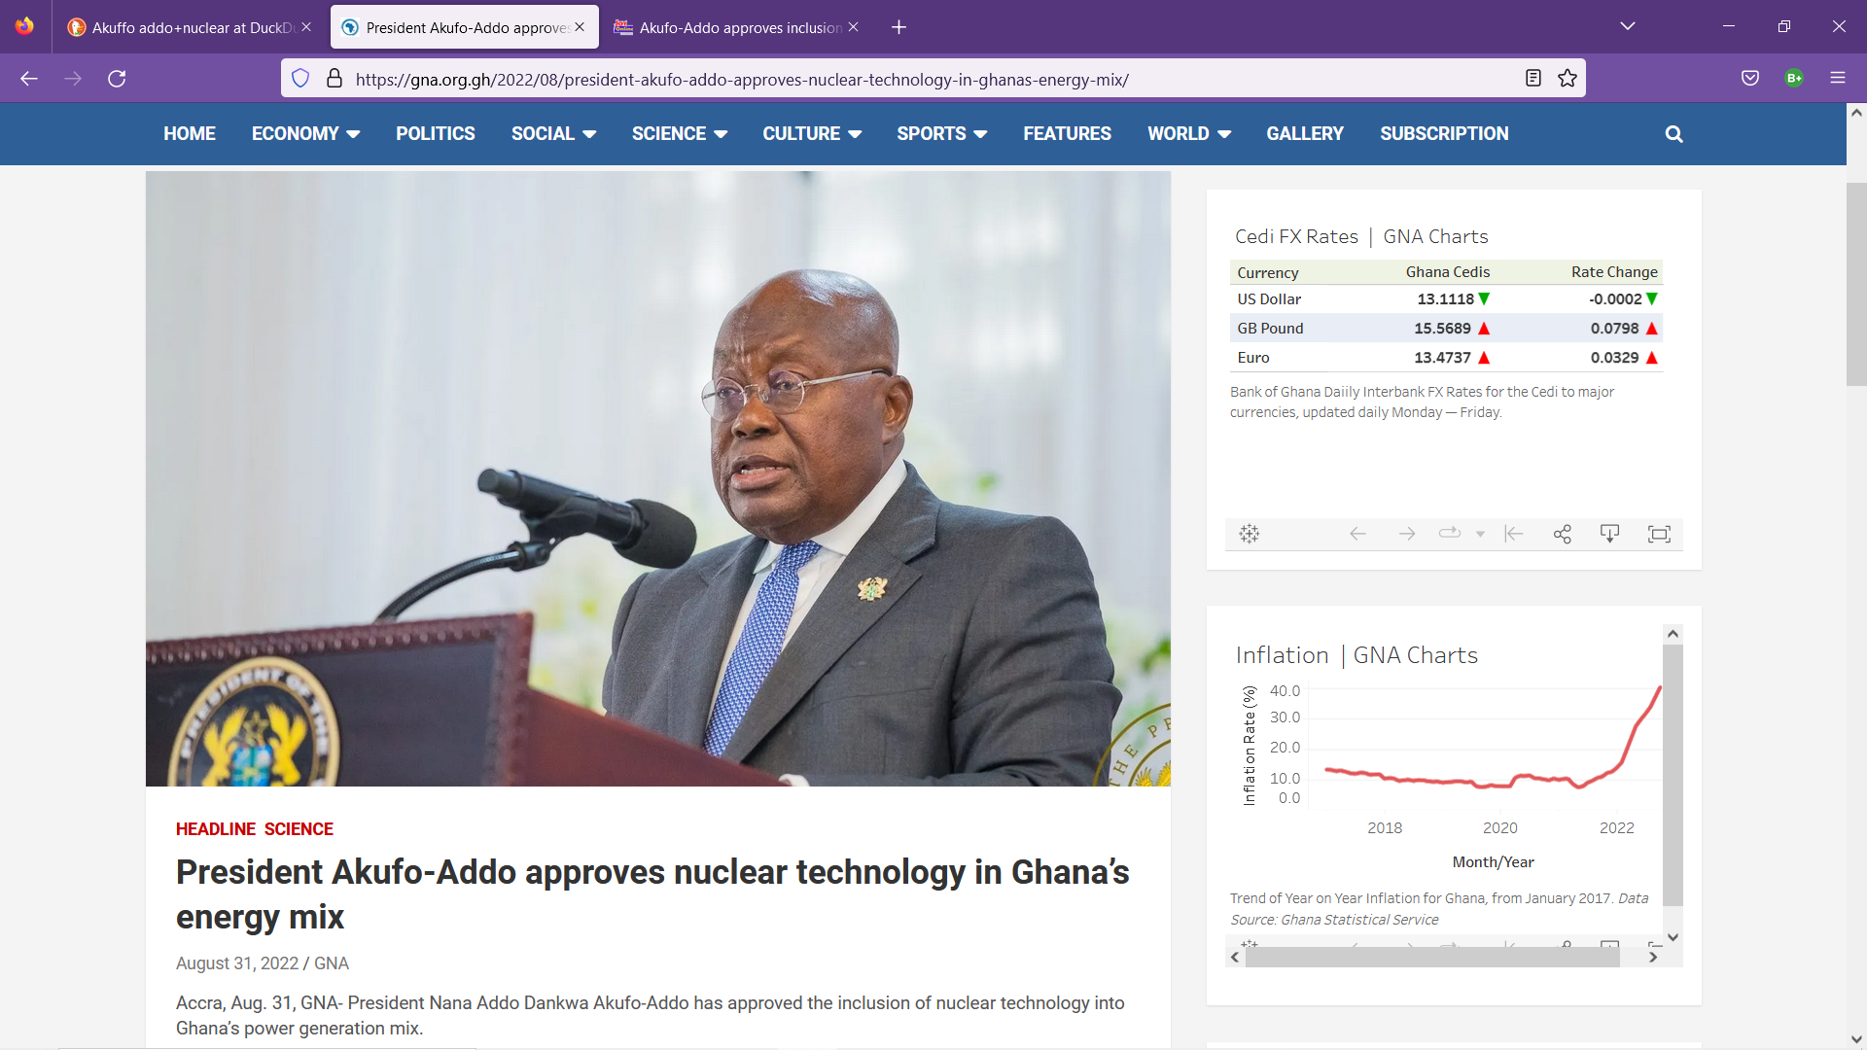
Small Modular Reactor deployment in Ghana [1](Ghana’s Nuclear Power Programme)
Several drivers have influenced this policy direction.
Ghana’s long term economic vision
limited hydro and gas resources and
energy diversification
Status
President announced Ghana will continue its nuclear programme development based on Programme Comprehensive Report
Request for Information issued by Government through the Ministry of Energy
Evaluation and Submission to Government for a decision
Ghana to continue stakeholder engagement
Preferred Site selected for first nuclear plant
Other deliverables at the end of phase 2 to include site approval, technology selection, feasibility reports
https://gna.org.gh/2022/08/president-akufo-addo-approves-nuclear-technology-in-ghanas-energy-mix/

Slide 6
Small Modular Reactor deployment in Ghana [2] –Cogeneration opportunities (going beyond electricity)
Cogeneration products such hydrogen show prospects in Ghana as the trend toward energy diversification intensifies
In the foreseeable future, demand for hydrogen could increase from sectors such as transportation and manufacturing
An assessment of Ghana’s potential for green hydrogen production based on wind and solar energy has been conducted
in this evolving energy outlook, the strategic contribution of nuclear hydrogen through Small Modular Reactors cannot be underestimated. SMRs offer a direct way of producing clean hydrogen with the added benefit of being placed where needed
For large-scale hydrogen production, with no greenhouse emissions, nuclear energy is particularly seen as well suited.

Slide 7
Hydrogen in perspective [1]
Hydrogen is the lightest, most basic, and most plentiful of all chemical elements in the universe. However, it occurs only in combination with other elements, primarily with oxygen in water and with carbon, nitrogen and oxygen in living materials and fossil fuels.
Although it is not a primary source of energy, it becomes an attractive energy carrier when split from these other elements by using a source of energy
as a carrier, it is not just a clean source of energy, but its method of production is clean
Several methods of hydrogen production are under different stages of demonstration.
These range from conventional technologies that process fossil fuels and includes the methods of hydrocarbon reforming and pyrolysis with chemical techniques such as steam reforming, partial oxidation and autothermal steam reforming
, to methods of production from renewable methods (either from water or biomass) with thermochemical methods such as pyrolysis, gasification, combustion and liquefaction, and
major biological processes such as direct and indirect bio-photolysis, dark fermentation, photo-fermentation and sequential dark and photo-fermentation.
A second category of renewable technologies regards the methods, which can produce hydrogen through water-splitting processes such as electrolysis, thermolysis and photo-electrolysis, utilizing water as the only material input

Slide 8
Hydrogen in perspective [2]
It has been technically demonstrated that hydrogen can be used for transportation, heating, and power generation, and it could replace current fuels in all their present uses.
The hydrogen fuel cell has been heralded as the most promising energy conversion device especially in transportation
The economic infrastructure based on hydrogen energy carrier is called the hydrogen economy, which is composed of three functional steps, production, storage, and transportation, and use in all aspects of the economy
Production
- Renewable (solar, wind hydroelectrolysis and thermochemical processes)
- Nuclear electrolysis and thermochemical processes
-Biological and bio-inspired water decomposition
-Fossil fuel reforming+ carbon capture
Storage and transport
Compressed gas, liquefied H2, Hybrid storage
Use
-Automotive fuel cell
-Consumer electronics
-Stationary electricity and heat generation
Figure -Key features of the hydrogen economy

Slide 9
Mapping the hydrogen economy in Ghana [1]
Demand for hydrogen in Ghana
Fuel for transportation, particularly in the context of decarbonizing the transport sector.
Fuel cell-based power generation systems to provide clean and reliable electricity for off-grid and remote communities
Industrial processes, including steel and cement production, where it can serve as a low-carbon alternative to traditional fossil fuels
By integrating cogeneration systems with hydrogen production facilities, Ghana can maximize energy efficiency and reduce greenhouse gas emissions in key industrial sectors through nuclear technology
Benefits of hydrogen to the National economy
Economic Impact
Huge
Cross-sectoral
Benefits
Direct
Indirect
Jobs
Engineers
Technicians
Induced
Finance experts etc.

Slide 10
Mapping the hydrogen economy in Ghana [2]
Systems analysis towards a future hydrogen economy
These elements or issues identified are critical to structuring and formalising a hydrogen economy:
1, Innovations in transport sector: Adoption of fuel-cell cars
2, Hydrogen Infrastructure: for storage, transportation and distribution
3, Scientific innovation
4, Cost competitiveness: Economics of hydrogen production
5, Macroeconomic impacts: benefits to National economy
6, Policy direction: Roadmap to National mainstreaming and complimentary policies not specific to hydrogen
7, Fiscal incentivization: economic levers towards competitiveness including a low and flexible taxation system
8, Market requirements: competitive pricing regime

Slide 11
Mapping the hydrogen economy in Ghana [2]
9, Sustainability and climate requirements- aligning political objectives and legislation of
Hydrogen with sustainability and climate targets
10, Technology development requirements- mass market for hydrogen backed by
reduced cost of cars and fueling stations
11, Macroeconomic environment -state of economy and long-term scenarios
12, Research and Development programmes
13, Social acceptance
14, Financing and Economic feasibilities – cost mitigation mechanisms to drive
investment and reduce risks
15, Regulation and standards - Integrated regulatory frameworks
16, Skills and Education

Slide 12
Mapping the hydrogen economy in Ghana [3]
TECHNICAL
REGULATORY
SOCIAL
Technical dimension.: all issues directly related to the hydrogen technology and its production.
Social dimension: all behavioral, social and economic issues that must be addressed to drive the hydrogen economy.
Regulatory dimension: all issues that optimises the macro-environment (economic, regulatory, legal, political etc.) for the hydrogen economy to thrive.
In line with systems thinking, issues could be viewed as socio-technical, techno-regulatory, or socio-regulatory as they often overlap in practice.

Slide 13
Mapping the hydrogen economy in Ghana [3]
Technical dimension | Social dimension | Regulatory dimension
Innovations in transport sector Hydrogen Infrastructure: storage, transportation and distribution Scientific innovation Technology development requirements Skills and Education Research and Development programmes | Macroeconomic impact Assessments Cost competitiveness Market requirements Social acceptance | Policy direction Fiscal incentivization Sustainability and climate requirements Macroeconomic environment Financing and Economic feasibilities Regulation and standards

Slide 14
Transition to the hydrogen economy (A phased framework)[1]
Preparing to mainstream hydrogen
Phase 1 (Short term)
Strategic objective is to set the macro-environment to mainstream Hydrogen production,storage and transportation and use.
Mainstreaming hydrogen
Phase 2 (Medium term)
Strategic objective is to mainstream Hydrogen production, storage and transportation and use
Optimising hydogen
Phase 3 (Long-term)
Strategic objective is optimise Hydrogen production, storage and transportation, and use.

Slide 15
Transition to the hydrogen economy (A phased framework)[2]
Phase 1(Preparing to mainstream hydrogen)
Policy direction
Phase 2 (Mainstreaming hydrogen)
Financing and Economic feasibilities
Phase 3 (Optimising hydrogen)
Fiscal incentivization
Hydrogen Infrastructure
Regulation and standards
Sustainability and climate requirements
Macroeconomic stability
Skills and Education
Social acceptance
Cost competitiveness
Macroeconomic impacts
Scientific innovation
Innovations in Transport sector
Research and Development programmes
Market requirements
Technology development requirements

Slide 16
Policy focus for Ghana (Benchmarking experiences) [1]
By the beginning of 2021, over 30 countries globally had created hydrogen roadmaps or strategies at a national level
At continental level, policies and cooperation among various blocs have been identified as a vital tool to facilitate the deployment of hydrogen
In Ghana, the National Energy Transition Plan envisions promoting the use of hydrogen to diversify the fuel mix in Ghana. A key scenario in this plan shows that by 2070 all road and rail mobilities should be electricity and hydrogen fuelled
Although the Ministry of Energy envisions that hydrogen will play a key role in Ghana’s energy sector especially through the transport sector by 2050, as at 2024, Ghana has not officially began production. Ghana’s potential for producing hydrogen is seen as enormous. However, an omnibus hydrogen policy or initiative has not yet been structured at national level
Need to benchmark

Slide 17
Policy focus for Ghana (Benchmarking experiences) [2]
Canada
Canada’s Hydrogen Strategy was developed in 2020 as a call to action intended to catalyse investment.
While the strategy places an emphasis on renewable energy sources as feedstocks for hydrogen, nuclear
pathways to producing hydrogen receive less attention. Key recommendations have been made. These include
recommendations for:
-policies that support nuclear-based pathways while supporting non-nuclear supporting pathways
-policies that increase end-use demand for clean hydrogen while mitigating investment risks
-promote research and development and evidenced based policy
With regards to nuclear, the federal government’s 2018 SMR Roadmap connects partners from different industries across the country as they work to introduce SMRs into Canada’s hydrogen future.
Nuclear energy is seen as key to producing clean hydrogen; however, continued Research and Development is required for SMRs and their role in the hydrogen economy

Slide 18
Policy focus for Ghana (Benchmarking experiences) [3]
Brazil
Brazil is one of the most competitive places in the world to produce green hydrogen. Although Brazil has been developing hydrogen-related policies for over 20 years
recently has the fuel been looked at from a more strategic standpoint. In 2002, the Ministry of Science and Technology launched the Brazilian hydrogen and fuel cell System Program
In 2005, this program was renamed, becoming the Science, Technology and Innovation program for the hydrogen economy. In the same year, the Ministry of Mines and Energy coordinated the “Roadmap to structure the hydrogen economy in Brazil”, a study drafted with the Ministry of Science and Technology, focusing on valuing different technological routes in which the country could have competitive advantages, such as electrolysis and the use of ethanol and other biomass fuel
In 2021, the Brazilian national council for energy policy established hydrogen as a priority area for R and D resources and tasks the ministry of mines and energy, in collaboration with other entities, to prepare guidelines for a National Hydrogen Program
In 2022, the Brazil national program was formally established, and it constituted a committee to manage the program. Given the cross sectoral nature of the subject, the PNH2 management committee provided for the participation of various government entities, as well as created five thematic committees with the purpose of discussing and analysing, developing studies and writing technical reports on their respective topic on:
1, Scientific-technological strengthening
2, Human resources training
3, Energy planning
4, legal and regulatory framework
5, market opening, growth and competitiveness
The thematic committees were requested to prepare a 3-year plan, the triennial work plan of the national hydrogen program (2023-2025) which will guide the federal government’s actions in the development of the hydrogen sector in the years to come

Slide 19
Policy focus for Ghana (Benchmarking experiences) [4]
European Union
The interplay and integration of different policies with a hydrogen policy must be emphasized. In the European Union, a noteworthy area of policy focus is the linkage of a green industrial policy with hydrogen economy development.
An empirical example can be found in Europe where In July 2020, A hydrogen strategy for a climate-neutral Europe was adopted, demonstrating a clear path for the hydrogen economy’s development.to install 40 GW of renewable hydrogen electrolysers by 2030 founded on five objectives:
1, increasing the EU investment for hydrogen.
2, boosting demand for and scaling up hydrogen production.
3, designing an enabling and supportive legal and regulatory framework.
4, promoting research and innovation in hydrogen and fuel cell technologies.
5, developing international cooperation andalliances.
On the other hand, The Green Deal Industrial Plan for a net zero age recognises the significance of renewable hydrogen as a storage medium, fuel, and feedstock for the net-zero energy transition.

Slide 20
Policy focus for Ghana (Benchmarking experiences) [5]
United States of America
In the United States of America’s national clean hydrogen strategy and roadmap, the importance of robust and transparent analysis and modelling through collaborations between national laboratories, industry, and academia has been highlighted
All analyses are used to inform R&D activities and real-world data from technical demonstrations are fed back into foundational models to improve assessments in the future.
Again, efficient and effective collaboration has been emphasized. Agencies have already been coordinating with each other, and with industry, states, and numerous stakeholders to execute hydrogen related activities. Several opportunities exist across agencies, building on activities underway over more than a decade to accelerate progress aligned with the National Clean Hydrogen Strategy and Roadmap

Slide 21
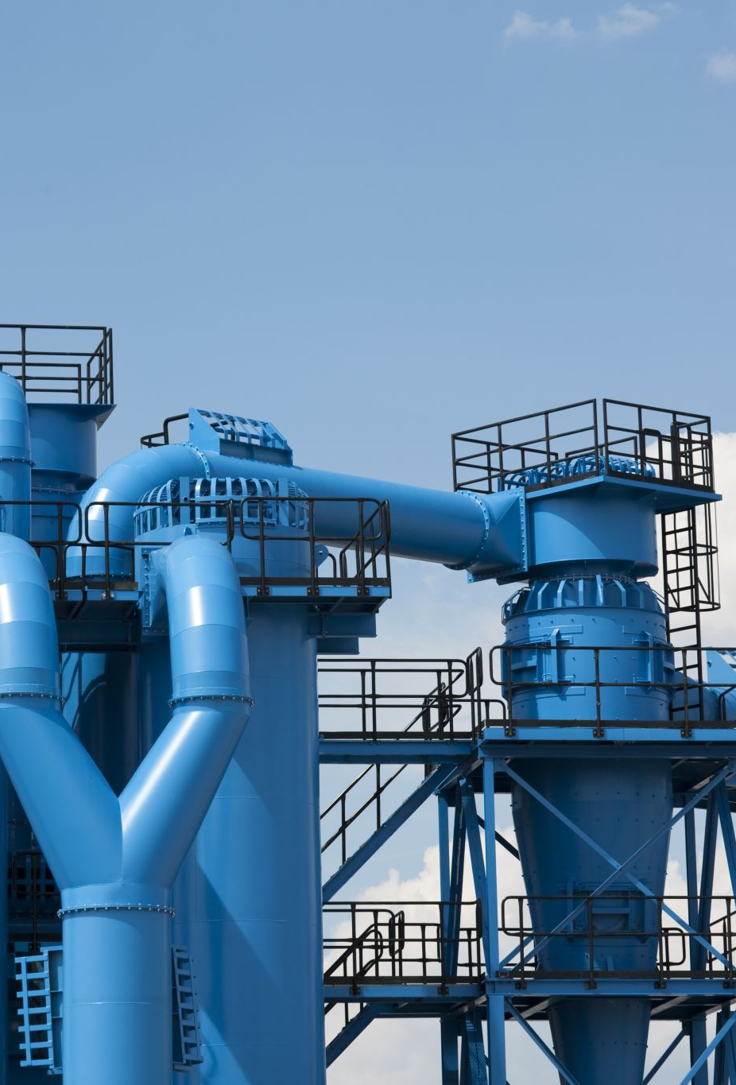
Building hydrogen infrastructure in Ghana
A hydrogen energy infrastructure is the system needed to produce hydrogen, store it, and deliver it to users
This includes hydrogen production systems (for converting primary-energy sources or other energy carriers to hydrogen), hydrogen storage capacity (needed to match time-varying fuel demands to production output), long-distance transmission systems (if hydrogen is to be transported long distances from the production site to users), local pipeline distribution systems (analogous to a system of natural gas utility pipes), and equipment for dispensing hydrogen to users (for example, hydrogen compressors and dispensers at vehicle refueling stations
To build such an infrastructure heavily depends upon investment, which often is the other barrier to achieving a sustainable hydrogen fuel system
Hydrogen infrastructure should be adequately robust. Such infrastructure must meet requirements of safety, energy efficiency, and cost-effectiveness.
Again, a hydrogen fuel delivery infrastructure must ensure the correct balance between production locations and delivery options, considering the availability of feedstocks and the proximity of use centers. Hence, the type and size of market (urban, ru­ral, cross-border) will affect the delivery infrastructure.

Slide 22
Conclusion [1]
a maiden effort to map a hydrogen economy in Ghana’s context
As Ghana pursues a nuclear power programme and with the emergence of Small Modular Reactors, it is important now more than ever, catalyse discussions towards setting up the policy frameworks, strategies and actions towards this hydrogen economy
The policy approaches of some countries have also been benchmarked. Key insights can be drawn:
Ghana’s hydrogen policy must evolve with key strategic objectives such as competitiveness at its heart (the Brazilian case)
From the outset, it is important to align nuclear energy policy with hydrogen policy in Ghana (the Canadian case)
Ghana’s industrial policy should be adequately linked to its future hydrogen policies and strategies (the European union experience)
Ghana’s hydrogen policy should be backed by robust modeling and tools and effective collaborations between national agencies and institutions (the American experience)

Slide 23
Conclusion [2]
Finally, transitioning to a hydrogen economy in Ghana will require a robust hydrogen infrastructure which meets requirements of safety, energy efficiency, and cost-effectiveness and further ensures the correct balance between production locations and delivery options,
This mapping effort provides a high-level point de depart towards a hydrogen policy in Ghana and further places nuclear hydrogen in perspective as Ghana progresses with its nuclear power programme and begins to consider SMRs as they emerge. Future studies could address key themes such as:
assessing the economic impact of hydrogen adoption in Ghana (ie. quantitatively)
analysis of regulatory frameworks required in Ghana to transition into a hydrogen economy
financial feasibility assessments in projects in the hydrogen economy
assessing human resource requirements of Ghana’s hydrogen economy.
The words of Jeremy Rifkin cannot be truer; “We are on the cusp of a third industrial revolution and a new energy era. Hydrogen is our common future.

Slide 24
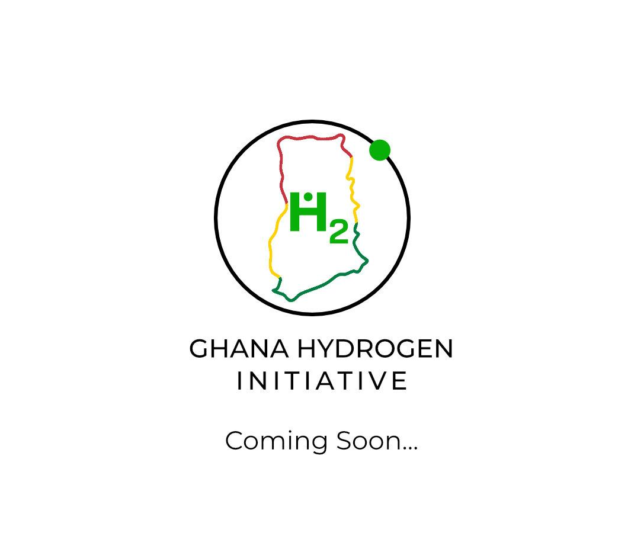
GHANA HYDROGEN INITIATIVE
Foster research and dialogue
Knowledge creation and sharing
Inform policy discussion
Support Ghana’s transition to a Hydrogen economy

Slide 25
      THANK YOU FOR YOUR ATTENTION

