Slide 2

FORCE: A modeling approach to increase the value proposition for SMRs in non-electric applications
Aaron Epiney (Aaron.Epiney@inl.gov)
Integrated Energy Systems Modeling and Simulation
Paul Talbot, Rami Saeed, Daniel Mikkelson, Todd Knighton

Slide 3
Overview
Posing the problem: Energy Demand and Supply
A possible solution: Integrated Nuclear-Renewable Energy Systems
How to make predictions: Modeling Tools
Nuclear Cogeneration & Integrated Systems—Examples in Action

Slide 4
Energy Demand and Supply

Slide 5
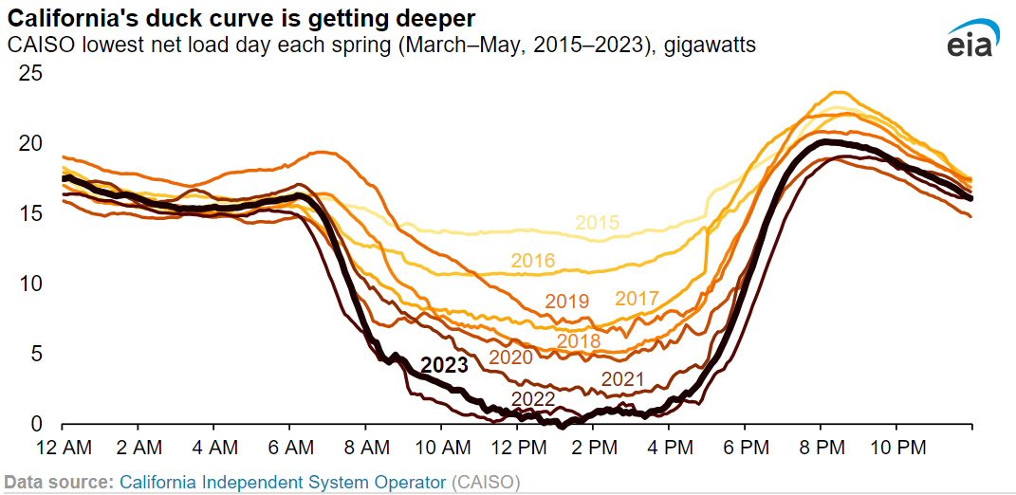
Variable Renewable Generators in Electricity Markets
Need for grid stability and reliability
Example: Impact on demand of solar generation assets
Peak generation ≠ peak demand
Requires additional components and approaches to maintain stable, reliable grid
  Energy storage
    Within day, but also seasonal
  Curtailment
Energy storage is Needed for shift excess generation to evening
Figure developed by INL.
Thermal power plants will be curtailed unless the energy can be used for non-electricity production

Slide 6
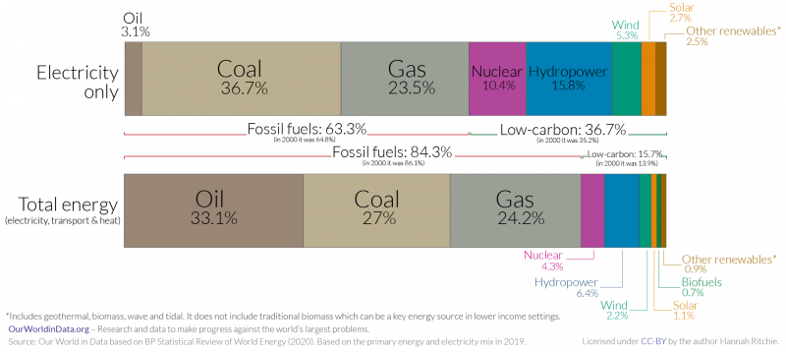
The global challenge:
Decarbonizing electricity and total energy sources (2019)

Slide 7
Integrated Nuclear-Renewable Energy Systems

Slide 8
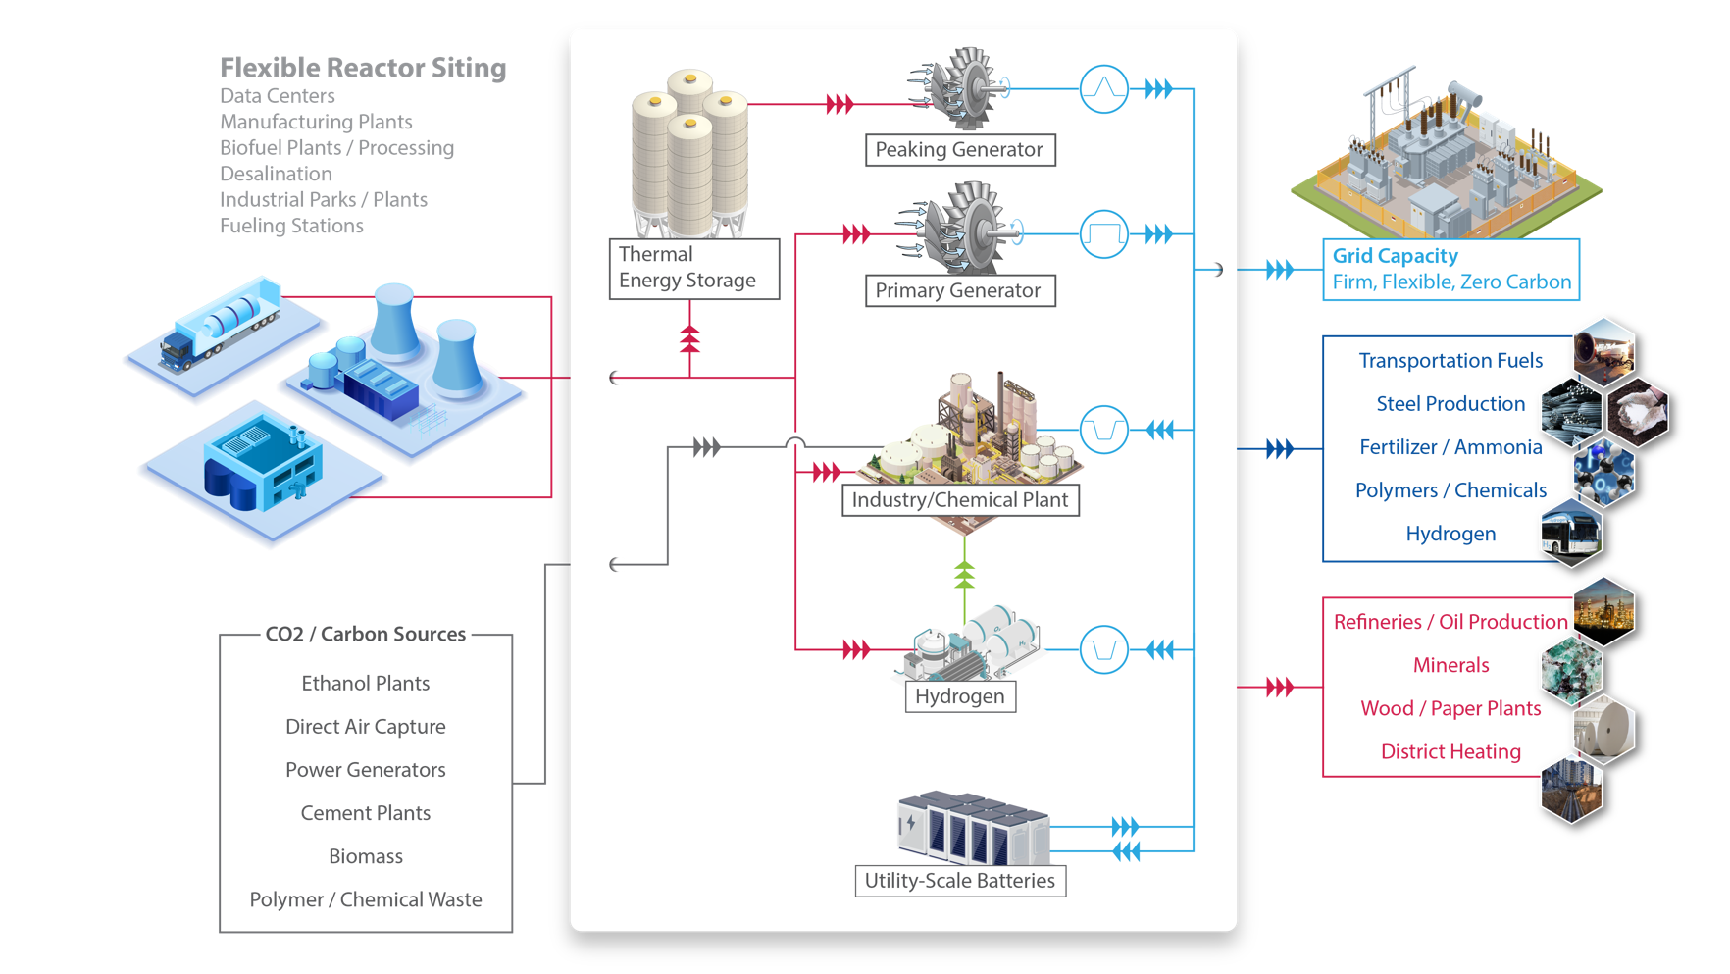
Integrated Nuclear-Renewable Energy Systems

Slide 9
Advanced Nuclear Energy Pathways by Sector
Future Nuclear Energy Currencies are Chemical Feedstocks (Syngas, FT liquids, Methanol, H2).
Hydrogen is THE key chemical feedstock.
ELECTRICITY SECTOR
Thermal Energy Storage
Nuclear Plant
Paper/Pulp Industrial heat
District Heating
Minerals
INDUSTRIAL / COMMERCIAL SECTORS
Flexible Dispatch
H2 Storage
H2
Biomass
Bioprocess
Refineries*
Syngas
CO₂ Utilization
Fertilizer/Ammonia *
NG Power plants
Ethanol plants
Ammonia (conventional)
DAC
Methanol
Iron/Steel*
Polymers / Chemicals
Fischer Tropsch / Refining
MTD MTG
SNG
Fuels to Industry
Significant additional electricity use not shown to simplify diagram
Biofuel
Jet
diesel
gas
Methanol
H₂
TRANSPORTATION FUELS

Slide 10
Modeling Tools

Slide 11
IES Modeling Guiding Questions
What are economically and technically viable options for integrated energy system (IES) coupling to nuclear power plants in specific grid energy systems?
What is the statistically ideal mix for Nuclear-IES within various markets?
What are driving economic factors that existing and future nuclear technology can leverage though IES production coupling?
What are optimal coupling strategies between IES technologies and nuclear power plants? Safety?
What is the governing control scheme for IES?

Slide 12
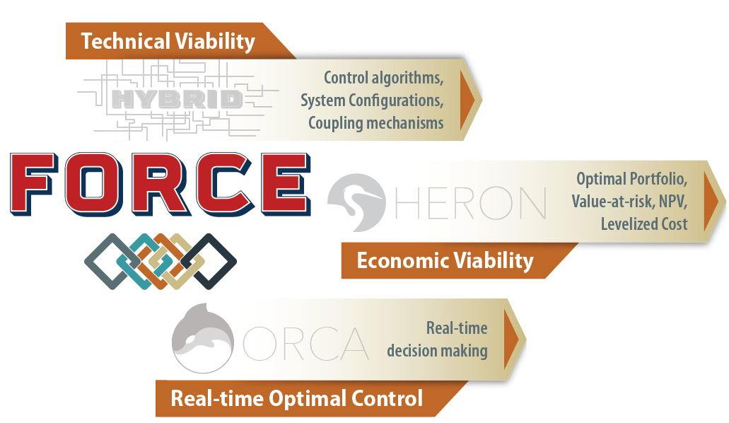
Three Analysis Paths
https://github.com/idaholab/HYBRID
https://github.com/idaholab/HERON
https://github.com/idaholab/ORCA

Slide 13
Nuclear Cogeneration & Integrated Systems—Solutions and paths forward

Slide 14
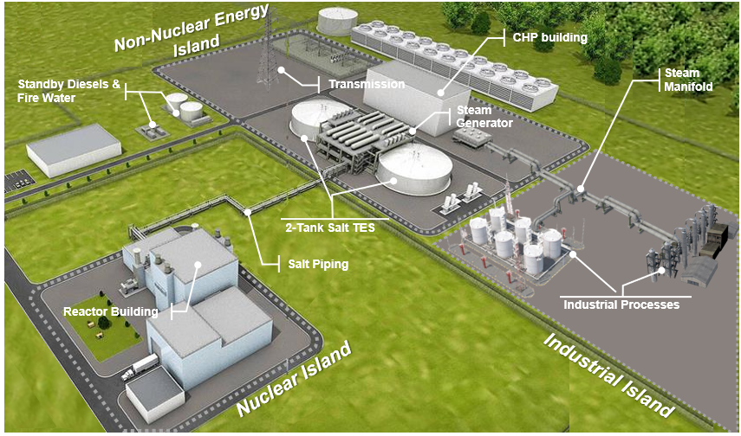
Supplying Industries with Clean Heat and Power Through a New Nuclear Thermal Island Design
Most industries require heat, which is usually supplied by gas/coal fired boilers and combined heat and power (CHP) systems.
INL researchers study the technical feasibility of an alternative, conceptual nuclear thermal island design to deliver clean heat & power.
  An advanced nuclear reactor and an industrial energy park are coupled via salt thermal energy storage (TES) and CHP system.
  Various industrial settings (chemical plants, oil refineries, iron & steel, and methanol production) are studied
  Dynamic heat and power demands from industrial processes are met by a synchronized and flexible nuclear TES-CHP system.
Preliminary results show promising decarbonization potential:
  The TES+CHP island fully de-couples the nuclear from the energy and industrial islands, while addressing siting/licensing challenges.
  The system can supply all the heat and power for industries with stable energy demands (e.g., petroleum refining) – with the possibility to export excess power to the grid for energy arbitrage – and nearly all of it for industries with dynamic & fluctuating demand (e.g., chemicals production).
Conceptual rendering of an advanced reactor with a two-tank molten salt system, decoupling the nuclear island from the energy and industrial Islands.
Credit: modified rendering of the Natrium plant edited by the INL team.

Slide 15
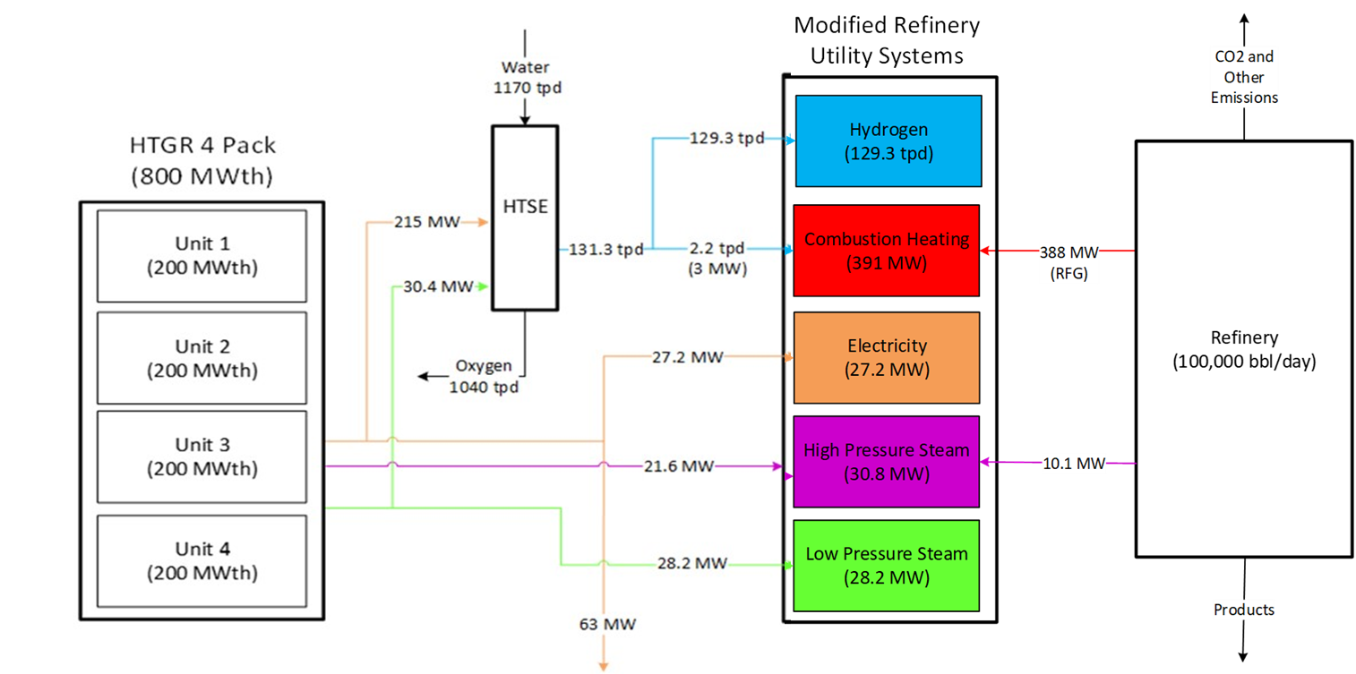
Preliminary Small Modular Nuclear Reactor Integration with a Petroleum Refinery
Completed integration of refinery with high temperature gas cooled reactor model.
Developed an integration configuration of HTSE and SMNR for the refinery based on the PRELIM and Aspen models.
Showed that:
  A four-pack of 200 MWth HTGRs can fully satisfy the refinery’s demand for electricity, high- and low-pressure steam, and H2.
  Over 50% of refinery emissions result from combustion of fossil fuel to supply thermal heat demands and to produce hydrogen.
  100% of H2 from SMR using natural gas can be replaced by clean hydrogen produced through HTSE integrated with a SMNR.
  4-pack of 200 MWth HTGR can fully replace high-medium-low pressure steam, H2 and electricity generated from fossil fuel combustion.
  Clean hydrogen can reduce refinery emissions by blending it with or replacing fossil fuels combusted in process furnaces.
Determined that 4 SMNR modules are required to supply heat, power and hydrogen supply for the reference refinery.
SMNR integration with Refinery
Refinery
tpd: Tons per day
bbl: Oil barrel
HTSE: High temperature steam electrolysis
SMNR: Small modular nuclear reactor
PRELIM: Petroleum Refinery Life Cycle Inventory Model

Slide 16
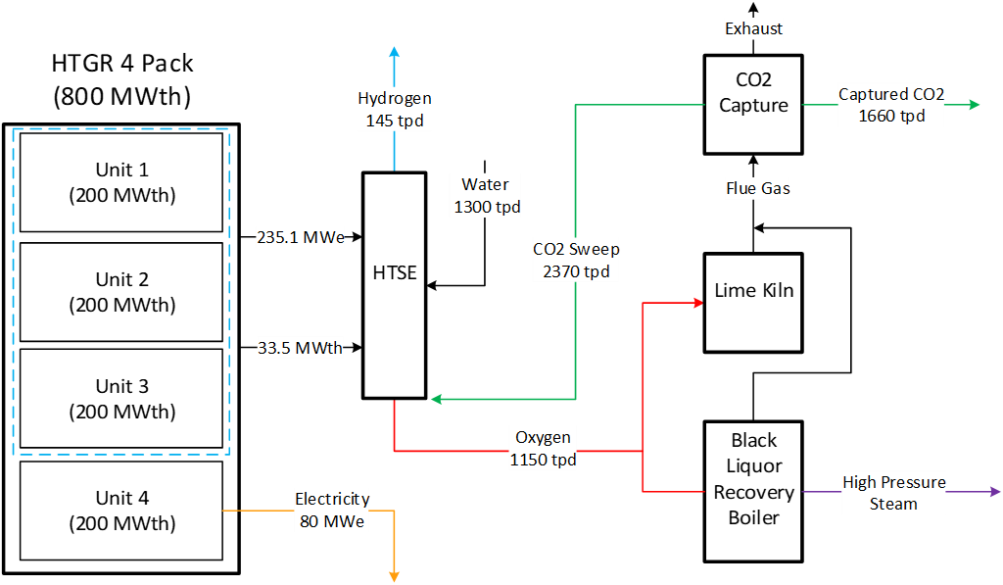
Preliminary Small Modular Nuclear Reactor Integration with a Pulp and Paper Plant
Reference facility chosen was an integrated Kraft pulp mill.
Pulp mills are nearly energy self-sufficient from energy recovery in the black liquor boiler and hog boiler. But there are still decarbonization opportunities:
  O₂ from nuclear-integrated HTSE can be used for oxy-firing the lime kiln and recovery boiler leading to more efficient CO₂ capture and potential for syngas to power other systems.
  Reduce natural gas usage in the lime kiln replacing it with a hydrogen fuel blend or with nuclear electricity in an electric kiln.
  SMNR could replace low-pressure steam and electricity generated from wood waste and additional fuel burning, allowing lignin and bark to be processed into bio-based chemicals or fuel instead.
SMNR integration with P&P
tpd: Tons per day

Slide 17
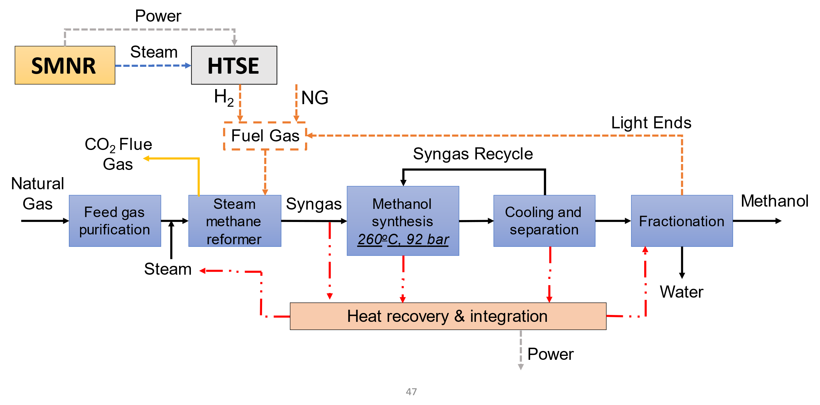
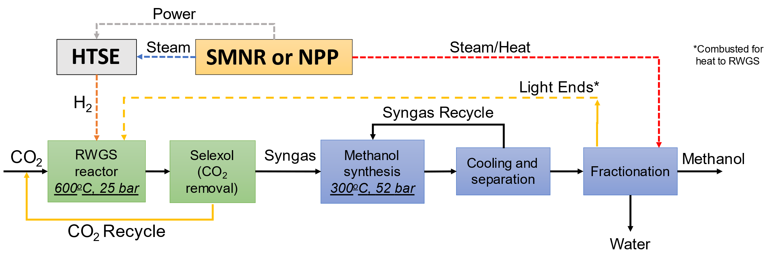
Preliminary Small Modular Nuclear Reactor Integration with a Methanol Plant
Completed an ASPEN-based model for a methanol plant with a SMNR + Autothermal reforming (ATR) syngas production configuration.
Showed that:
  Methanol plants are well integrated to recover and utilize their own heat generated by chemical processes. Hence, nuclear-supplied heat cannot be used to directly decarbonize an existing SMR methanol plant.
  Methanol synthesis requires the presence of both H₂ and CO₂. CO₂ reduction could be achieved from stack gas scrubbing, hydrogen to fuel, or alternative syngas or methanol production processes.
  64% reduction in plant emissions by eliminating the NG import for SMR furnace, replaced by nuclear H2 blending (top diagram)
    National scale: 1 MMT/year of CO2 emission reduction
  RWGS would reduce emissions by 90%
    National scale: 1.4 MMT/year of CO2 emission reduction
Developed less-carbon-intensive methanol conversion process flow by replacing the SMR with a Reverse Water Gas Shift (RWGS) reactor.
Standard Methanol Synthesis via Steam Methane Reforming (SMR) with HTSE and use of H₂ for Fuel Substitution
Methanol plant with RWGS
NG: Natural Gas
NPP: Nuclear Power Plant

Slide 18







WWW.INL.GOV

