Slide 2
Techno-Economic Analysis of SMR Cogeneration with Desalination: A Case Study in Türkiye
Osman Yücehan Kutlu
Turkish Energy Nuclear and Mineral Research Agency
(TENMAK)

Slide 3
Outline
Introduction
Deployment Locations
System Overview
Analysis
Results
Conclusion

Slide 4
Introduction
Turkiye experienced several droughts in recent years.
The year 2020 was the driest in the past five years, especially due to a significant lack of rainfall in the second half of the year. Between July 2020 to January 2021, most provinces in Turkey have experienced below-average rainfall almost every month. From October to December, the country’s precipitation was 48 percent lower than the average recorded from 1981 to 2010.
The map illustrates shallow groundwater storage as of January 11, 2021, using data from the Gravity Recovery and Climate Experiment Follow On (GRACE-FO) satellites. The colors represent the wetness percentile, indicating how current groundwater levels compare to long-term records from 1948 to 2010.
Source: https://earthobservatory.nasa.gov/images/147811/turkey-experiences-intense-drought

Slide 5
Introduction
Desalination technologies emerge as viable solution for world potable water need.
Nuclear heat can replace the use of fossil fuels in energy requirement of the desalination process.
Small modular reactors (SMRs) as a carbon free, reliable source of nuclear energy are attracting attention in transition of fossil fuel energy sources.
The research considers different coupling options for the selected SMR type and assesses the potential locations for the deployment in Türkiye with regard to water production cost.

Slide 6
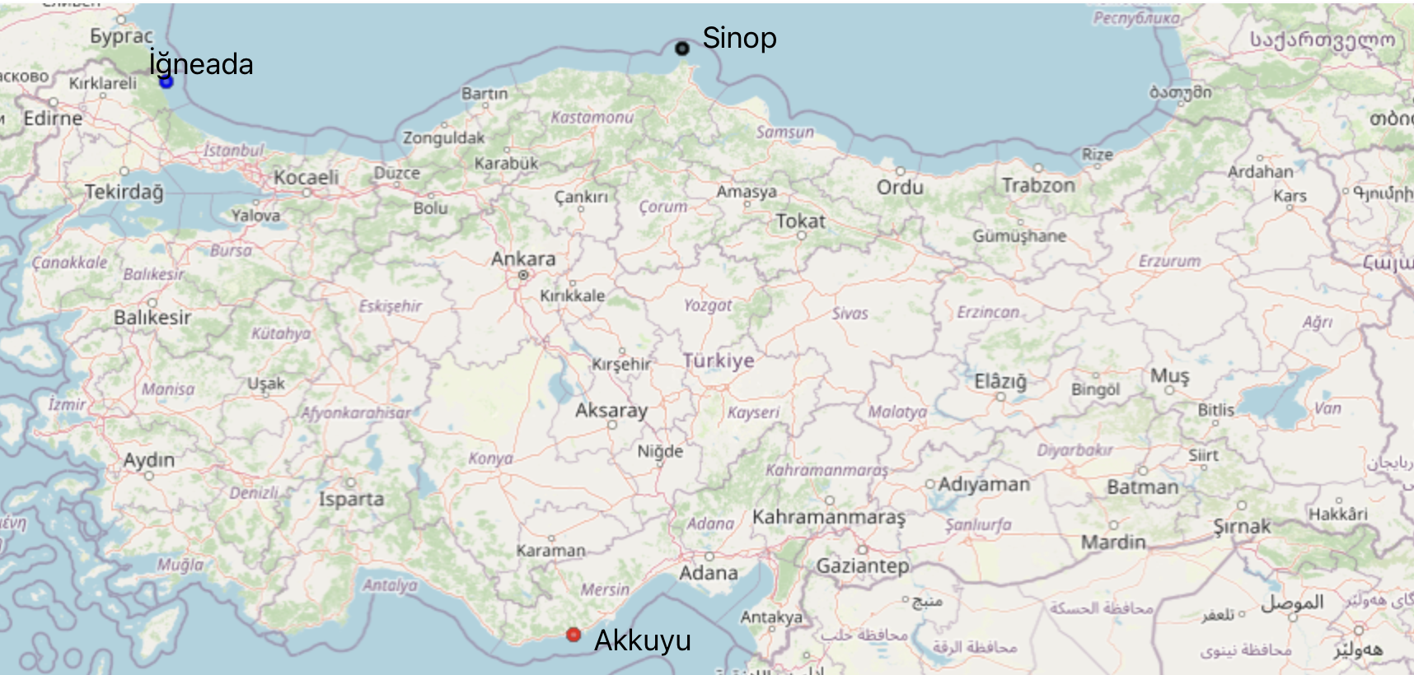
Desalination Locations
Akkuyu, Sinop and Igneada are the nuclear power plant locations in consideration at Türkiye.
Akkuyu site has already housing a VVER-1200 nuclear power plant close to commissioning, Sinop site is already licensed for NPP and discussions for Igneada are in progress.

Slide 7
Water Properties at Desalination Locations
Table: Yearly Averages
Average seawater temperature and salinity distributions of these locations are retrieved from NASA satellite image system with using Google earth engine (gee).
Each location has a different temperature but salinity values are nearly constant during the year. Mediterranean Sea is a salty sea and seawater at Akkuyu coast is quite salty comparing the seawater at other locations.
Efficiency of Desalination can be affected by sea water salinity and temperature of the site. For instance, energy intensity of membrane process can be decreased by high water temperatures and low water salinity
Fig: Distribution of daily averages

Slide 8
System Configuration
  System Integrated Modular Advanced Reactor (SMART) is selected regarding its availability to multi-purpose applications including seawater desalination.
  SMART already implemented 4 MED-TVC units in design.
Ref: Keung et al., SMART First Licensed Advance Integral Reactor (2014)

Slide 9
System Configuration
Multi-stage flash (MSF) and multi-effect distillation (MED) plants for evaporative desalination and reverse osmosis (RO) plant for membrane desalination integrated with SMART SMR.

Slide 10
Analysis
Thermodynamic and economic analysis conducted with using IAEA Desalination Economic Evaluation Program (DEEP version 5.1).
The DEEP program has both nuclear and fossil power options, heating and power plants and also heat-only plants can be coupled with distillation processes of MSF and MED and membrane process of RO in DEEP software and for each case the performance and economic evaluation is made automatically for selected desalination technology.
MSF and MED systems connected with thermal and power lines. RO is connected electrically.

Slide 11
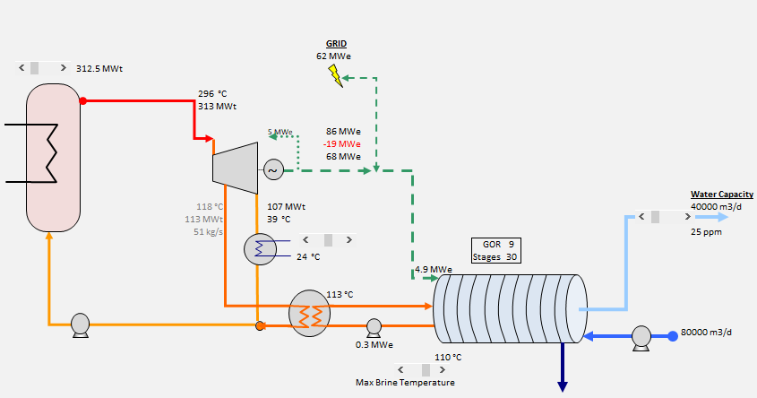
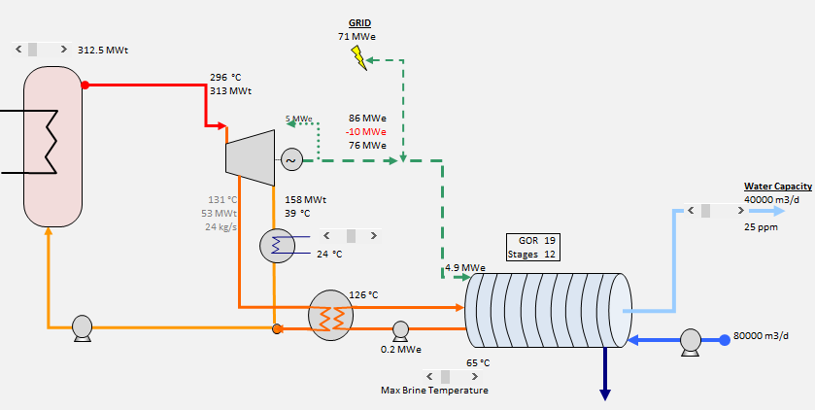
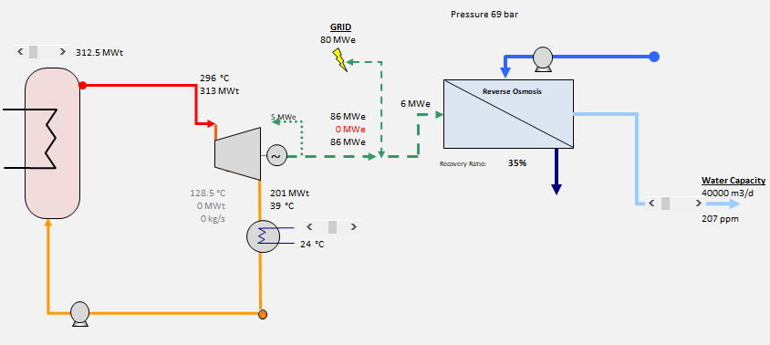
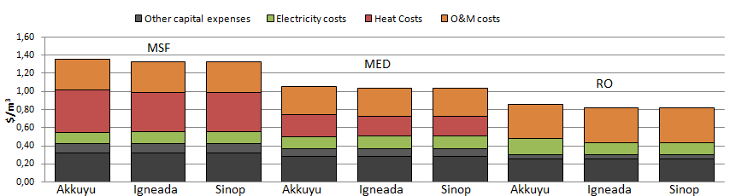
Analysis
MSF Coupling
MED Coupling
RO Coupling
Costs

Slide 12
Results

Slide 13
Conclusion
Aim of the study was to find best option for desalination with SMR at NPP site locations in Türkiye.
Igneada and Sinop both has a coast on the Black Sea, whereas Akkuyu is located near the Mediterranean Sea, which has a much higher salinity compared to the Black Sea.
Mediterranean seawater is also hotter than Black Sea water which instead comes handy in desalination process. But analysis showed us that the advantage of using hot water in desalination is low against the salinity value of the seawater. Salty seawater of Akkuyu caused higher costs for water desalination in all desalination plants. Therefore Black Sea region offers a more advantageous seawater for the desalination in Türkiye.
RO offered the minimum cost in the analysis. Cost of electricity is an important factor in determination of cost of water thus the water cost in RO would be more sensitive to changes in electricity prices. Consequently a careful analysis must be made by also considering special agreements for electricity market when making the decision about desalination plant technology selection

Slide 14
Thank you for your attention

