Slide 1
U.S.-UK Bilateral Cooperation on a Safeguards Analysis for a Nominal Molten Salt Reactor Design
Ruth Smith| National Nuclear Security Administration
Seddon Atkinson| National Nuclear Laboratory
25 October 2024

Slide 2

Great Opportunity, but Significant Challenge
Commitment to triple nuclear capacity by 2050
GW scale, SMRs, Gen IV – more diverse set of reactor designs
Increasing pressure on the IAEA
Traditional methods might not be effective for novel fuel cycles
Future sustainability relies on effectiveness and efficiency

Slide 3

Our Collaboration
Years of experience on development, R&D, and operations
Several U.S. and UK domestic MSRs in development
Shared drive to incorporate safeguards by design
Engineer connection, embrace discomfort, execute imperfectly

Slide 4
Safeguards Objectives
Detect diversion of declared nuclear material
Detect undeclared nuclear material or activities
Detect undeclared production or processing of nuclear material at declared facilities (misuse)

Slide 5
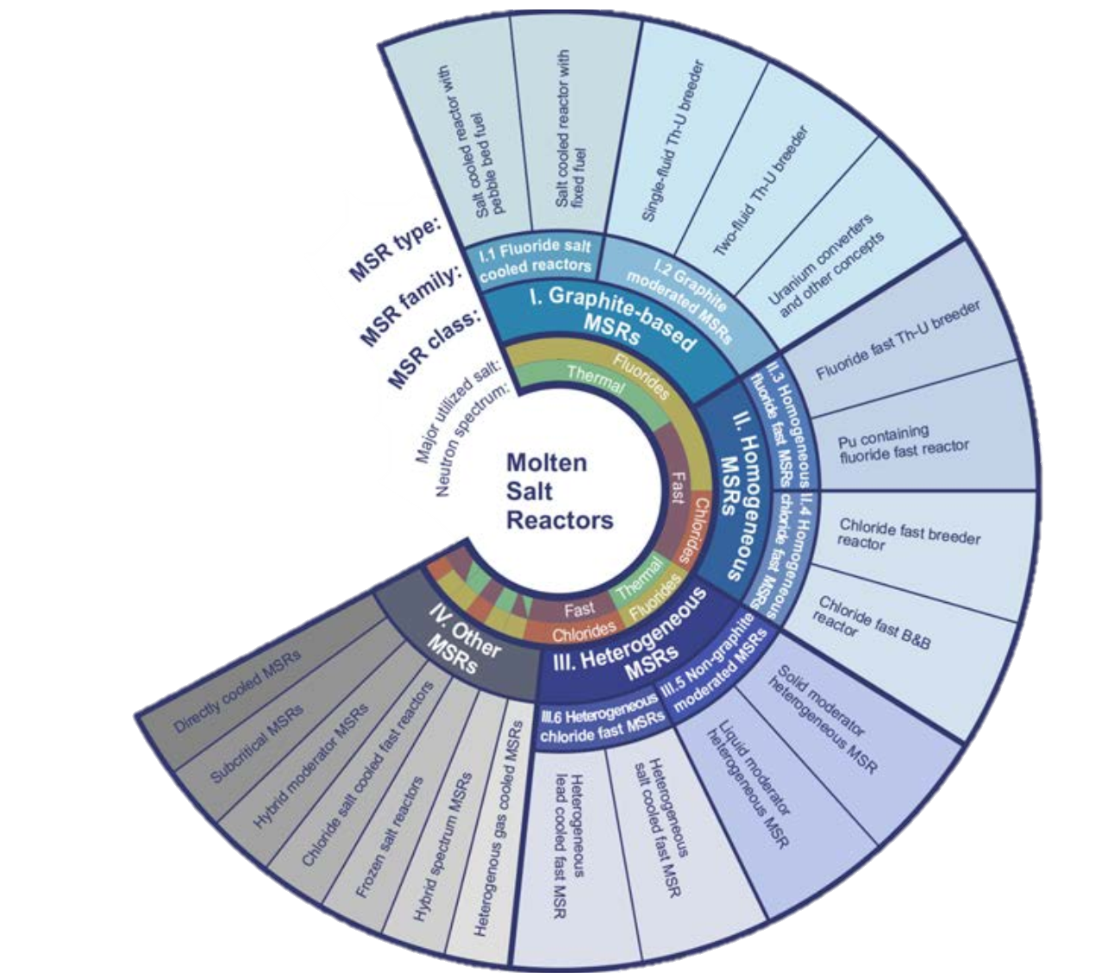
Motivated by MSR Design Variations
Wide variety of designs
Rapid innovation
No single solution
Safeguards must keep step
Aim to demonstrate a widely applicable, objectives-based, systems-level approach
TECHNICAL REPORTS SERIES No. 489
STATUS OF MOLTEN SALT REACTOR TECHNOLOGY
INTERNATIONAL ATOMIC ENERGY AGENCY
VIENNA, 2023

Slide 6
Nominal MSR System
Liquid fuelled with LEU
Fluoride-compounded salt
Thermal spectrum with graphite moderator
Single, primary loop
No online chemical processing
Simplified once through off-gas system
C. Primary Fuel Circuit
D. Off Gas System
B. Reactor Core
E. Irradiated Fuel Salt
A. Fresh Fuel Supply

Slide 7
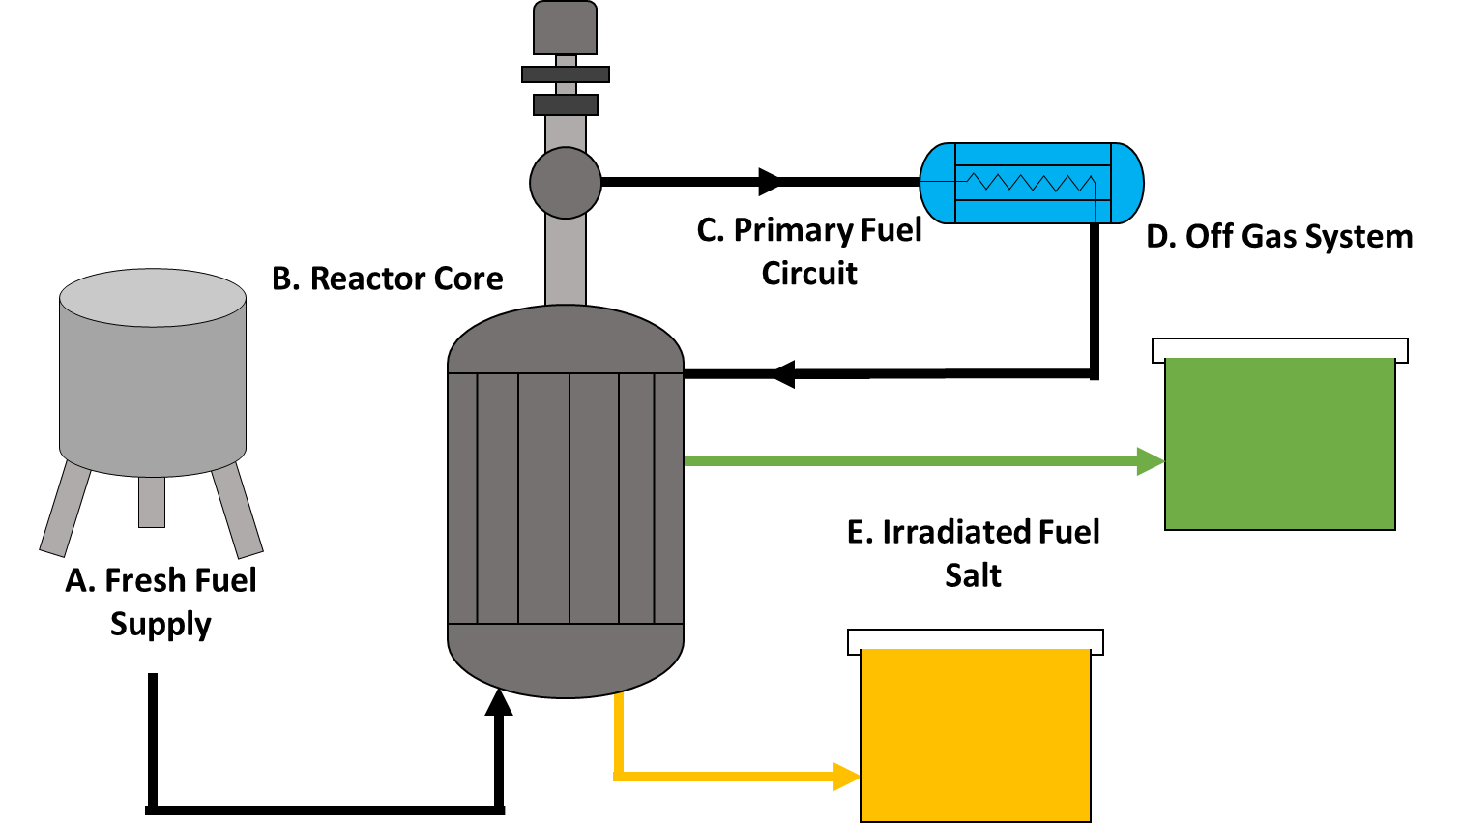
Systems Approach, Assumptions, and Methodology
We are not solving safeguards for all MSRs.
We are using our nominal MSR to demonstrate a systems approach.
This method could be applied to any reactor system, but allows for a systems-based, objective focused, less prescriptive safeguards approach.
Step 1
Define system, sub-systems, material flow and boundary conditions
Jointly agreed terminology
Step 2
Identify misuse scenarios and diversion pathways
Step 3
Design effective, efficient and achievable safeguards measures to meet safeguards objectives
Identify gaps
B. Reactor Core

Slide 8
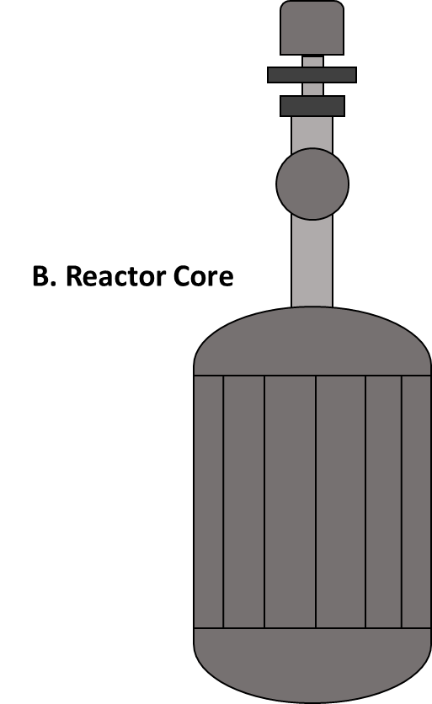

Safeguards Approach Methodology
Sub-System
Deep Dive
Vulnerability
Assessment
Fuel-Salt Loading
Reactor Core
Primary Fuel Salt Loop
Irradiated Fuel Salt Tank
Off-Gas Subsystem
Sub-components
Material flow
Chemical/ mechanical alterations
Boundary conditions
Misuse scenarios
Diversion pathways
System
Definition

Slide 9



Next Steps for Collaboration
This is intended to be a multi-year project
2024
Define a nominal MSR and critical sub-systems
Develop jointly agreed terminology
Establish safeguards approach methodology
2025
Sub-system “deep dive” analyses
Sub-system coupled analyses
2026
Vulnerability analysis
System-level safeguards
approach

Slide 10
Thank You
Ruth Smith
National Nuclear Security Administration
ruth.smith@nnsa.doe.gov
Seddon Atkinson
National Nuclear Laboratory
seddon.atkinson@uknnl.com

Slide 11
Back Up Slides & Graphics

Slide 12

Nominal MSR Flow Sheet
$${\dot{m}}_{B → C, out}={\dot{m}}_{C, in}$$
C
${\dot{m}}_{C, out}$ = ${\dot{m}}_{C →B, in}$
$${\dot{m}}_{A, out}={\dot{m}}_{A →B, in}$$
D
$${\dot{m}}_{B →D, out}={\dot{m}}_{D, in}$$
A
B
E
$${\dot{m}}_{B →E, out}={\dot{m}}_{E, in}$$

