Slide 1
Safeguards
Canada’s Safeguards Readiness for Small Modular and Advanced Reactors
Michael Kent
Senior Safeguards Advisor
Canadian Nuclear Safety Commission
International Conference on SMRs and their Applications
21–25 October 2024
Vienna, Austria

Slide 2

Setting the Canadian Scene
Long-standing history of supporting the peaceful uses of nuclear energy dating to the Three-Power Declaration on Atomic Energy (1945)
Made a commitment under the Treaty on the Non-Proliferation of Nuclear Weapons (NPT) in 1970 to accept international safeguards
Brought into force a comprehensive safeguards agreement (1972) with the IAEA and an Additional Protocol (2000)
First achieved the IAEA’s broader conclusion in 2005 and have maintained it every year since
Implementing the IAEA’s revised State-level approach for Canada since 2016
Photo: IAEA Headquarters in Vienna, Austria.
Source: IAEA

Slide 3
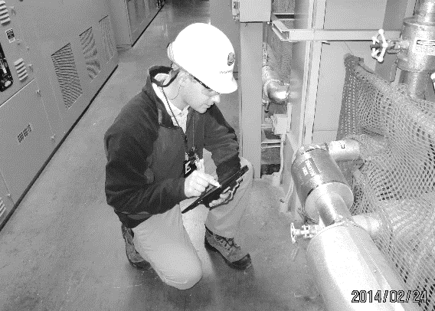
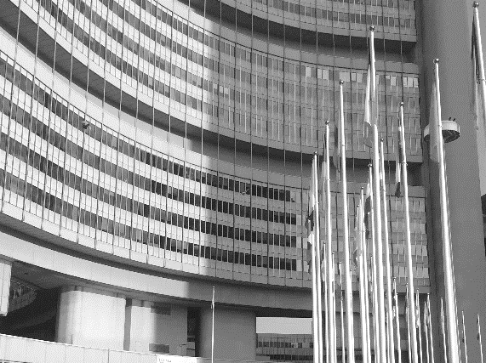
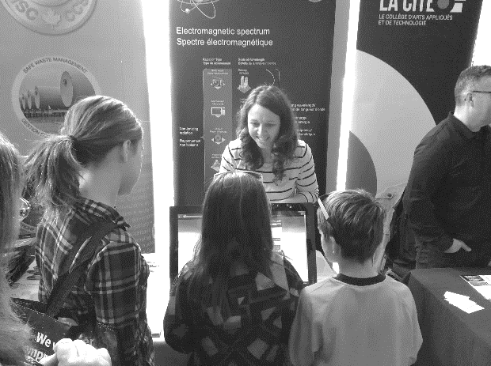
Canadian Nuclear Safety Commission
REGULATE
the use of nuclear energy and materials to protect health, safety, and security and the environment
IMPLEMENT
Canada's international commitments on the peaceful use of nuclear energy
DISSEMINATE
objective scientific, technical and regulatory information to the public
Over 75 years of regulatory experience
3

Slide 4
CNSC Regulatory Framework
Nuclear Safety and Control Act (NSCA)
Enabling legislation
Regulate nuclear energy to: “achieve conformity with measures of control and international obligations to which Canada has agreed”
Regulations
High-level and generally applicable requirements
Every licensee shall: “take all necessary measures to facilitate Canada’s compliance with any applicable safeguards agreement”
Licences, licence conditions handbooks, certificates
Facility- and/or activity-specific requirements
“The licensee shall implement and maintain a safeguards program”
Regulatory documents
Requirement details and guidance
REGDOC-2.13.1, Safeguards and Nuclear Material Accountancy
Act
Regulations
Licences and certificates
Regulatory documents

Slide 5
IAEA’s Safeguards Approach for Canada
The IAEA’s approach is based on several State-specific factors
The IAEA spent 606 person-days of inspection (PDIs) in Canada in 2022 to perform:
  32 physical inventory verifications
  34 design information verifications
  56 short-notice random and unannounced inspections
  42 interim inventory verifications
  14 complementary accesses
Additional inspections for sealing activities and further technical activities for the installation, maintenance and repair of IAEA equipment
Existing safeguards measures continue to evolve to strengthen efficiency and effectiveness

Slide 6
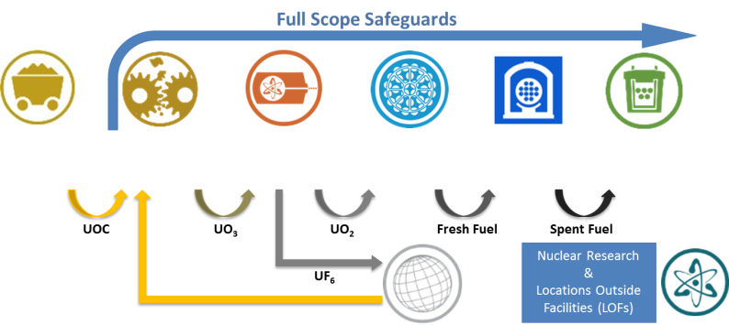
Canada’s nuclear fuel cycle
Mining and milling
Refining
Conversion
Fuel Fabrication
Nuclear Power Generation
Waste Storage

Slide 7
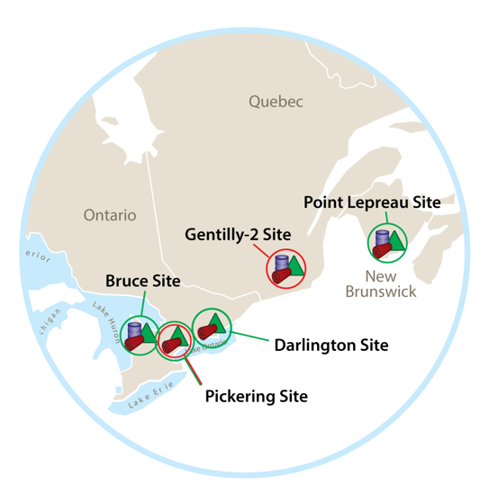
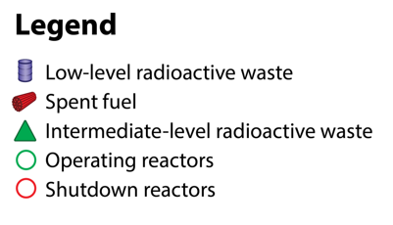
Canadian CANDUs
Sixteen operating CANDU pressurized heavy-water reactors across four sites in two provinces
Generate ~15% of Canada’s electricity
Overview:
Item facility with fresh, core and spent fuel
Online refueling with natural uranium bundles
Onsite storage for wet and dry irradiated fuel
IAEA equipment for the unattended and remote monitoring of spent fuel movement
Annual, short notice, and unannounced inspections
The CANDU design and the IAEA’s approach have evolved during the implementation of safeguards

Slide 8
Future Canadian Nuclear Landscape?
Current Projects
Potential Projects
OPG DARLINGTON SMR PROJECT
  Construction application for a GE-H BWRX-300
  Construction application hearing Part 1 held October 2024
  Proposed operation by 2029
NB POWER ARC-100 PROJECT
  Site preparation application for an ARC-100 SMR
  Provincial environmental impact assessment
  Proposed operation by 2030
  BRUCE C PROJECT
  Planning Phase of Impact Assessment
  Plan for up to 4,800 MWe
DARLINGTON SMRs
Application for BWRX-300 units 2-4
  SASKPOWER
Assessing two potential sites for nuclear power
  SRC NUCLEAR
  Microreactors for off-grid applications
  CANDU REFURBISHMENTS
  Bruce, Darlington and Pickering B
  ADDITIONAL PROJECTS

Slide 9
Challenges & Opportunities
Any proposed design will likely depart significantly from the safeguards at the existing CANDU facilities.
Novel designs and fuels pose a challenge to implementing existing safeguards measures and techniques.
Novel methods of deploying and using these types of reactors pose a challenge to implementing existing safeguards approaches.
Applying Canadian safeguards experience with CANDU reactors and bulk handling facilities to new reactor designs.
Potential need for the development of new safeguards equipment through the Canadian Safeguards Support Program.
Early engagement with the IAEA and vendors on safeguards as part of the design phase.

Slide 10
CNSC Vendor Design Reviews
As an optional service, the CNSC is able to engage with vendors prior to the licensing processes.
Opportunity to confirm that the vendor, through its design documentation, understands Canadian requirements and CNSC expectations, as applicable to novel conditions or novel technologies.
Carried out in up to 3 phases, with each phase representing an increasing level of detail in the design.
The CNSC provides structured feedback to vendors on Canadian requirements without a regulatory decision.
Enables CNSC staff to engage in technical discussions.
Encourages early consideration of safeguards into the design and its integration with security and safety.

Slide 11
CNSC’s Vendor Design Reviews (VDR)
Current VDRs
ARC’s ARC-100, liquid sodium reactor (Phase 2 ongoing)
Westinghouse’s eVinci microreactor (Phase 2 ongoing)
Completed VDRs
Phase 1
USNC MMR
ARC ARC-100
Moltex SSR-W300
Holtec SMR-160
ATMEA1
Phases 1 and 2
TEI IMSR-400
GE-H BWRX-300
X-Energy Xe-100
Westinghouse AP-1000
Phases 1, 2 and 3
CANDU Energy EC6
AECL ACR-1000

Slide 12
Safeguards-by-Design (SBD) in Canada
Canada has successfully considered safeguards aspects in the design of new – or modification of existing – facilities for decades.
SBD is the integration of safeguards considerations into the design process for new or existing facilities from initial planning through the design, construction, operation, and decommissioning phases.
The absence of early safeguards considerations can result in cost increases, timeline extensions and additional human resources demands.
Voluntary process for both the vendor and the State.
Requires engagement between the IAEA, the CNSC, and the vendor/licensee.

Slide 13
CSSP Task on SBD for SMRs
Canada is engaging the IAEA on SBD for SMRs through its Canadian Safeguards Support Program (CSSP)
Task aims to identify the key technical challenges for safeguards implementation involving SMRs, and the steps that can be taken to support incorporating safeguards-by-design principles into the designs.
Current designs under discussion with the IAEA:
X-Energy Xe-100 high-temperature gas cooled reactor
Moltex Energy SSR-W300 molten salt reactor
Terrestrial Energy IMSR integral molten salt reactor
“Canada’s Experience in Safeguards-by-Design” – IAEA Safeguards Symposium, 2022

Slide 14
Next Steps in Safeguards Readiness
Update to the CNSC’s regulatory framework
  Discussion paper on proposed amendments to REGDOC-2.13.1, Safeguards and Nuclear Material Accountancy (April 2024).
  Incorporate lessons learned and experienced gained, ensure safeguards requirements are technology neutral, provide guidance for all licensing phases.
Prioritization of tasks and challenges
  When to engage with industry and the IAEA on the development of new safeguards measures and equipment.
  How to identify short- versus long-term priorities.
Collaboration and Cooperation
  More engagement with industry on safeguards requirements and expectations.
  Continued cooperation with other regulators and international groups on safeguards.

Slide 15
Concluding remarks
Canada continues to support the peaceful uses of nuclear energy and remains committed to the implementation of safeguards.
Long history of safeguards implementation with challenges and opportunities.
The IAEA safeguards system continues to evolve to adapt to new issues and new technologies.
Remain engaged with vendors to promote safeguards-by-design throughout the design process.
Support collaboration with partners and other regulators on safeguards implementation.

Slide 16
Thank you
Stay connected!

