Slide 1
Safeguards by design:
Preparing for small modular reactors
Jeremy Whitlock
Senior Technical Advisor (SBD), Dept. of Safeguards
International Atomic Energy Agency
J.Whitlock@iaea.org
International Conference on Small Modular Reactors
October 21-25, 2024 – Vienna, Austria

Slide 2




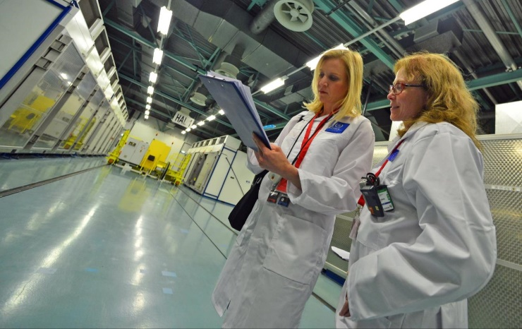

The challenge:
Any new nuclear facility in a non-nuclear-weapon State (NNWS) will need to be safeguarded by the IAEA when deployed
regardless of size, complexity, accessibility, owner/operator or supplier
Many vendors are unaware of the significance of this end-user requirement
lack of awareness of IAEA safeguards, or perception of not impacting design
Advanced reactors may require advanced safeguards (requires R&D…+ time)
  new core/fuel designs, plant layouts, fuel management, fuel cycle facilities
Enhanced security and ‘inherent’ proliferation resistance
do not necessarily mean simpler safeguards
  ‘safeguardability’: often overlooked external component of PR

Slide 3
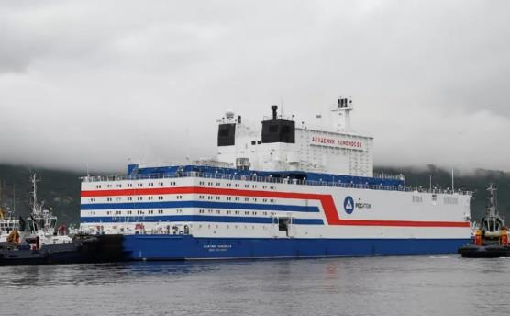
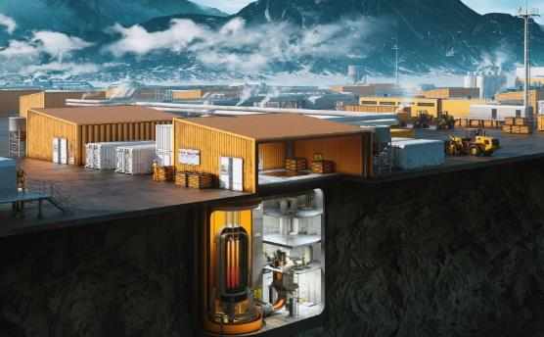
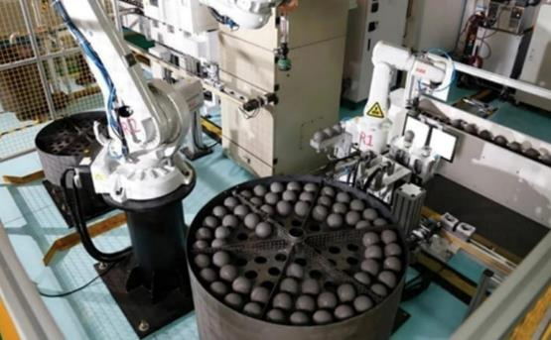
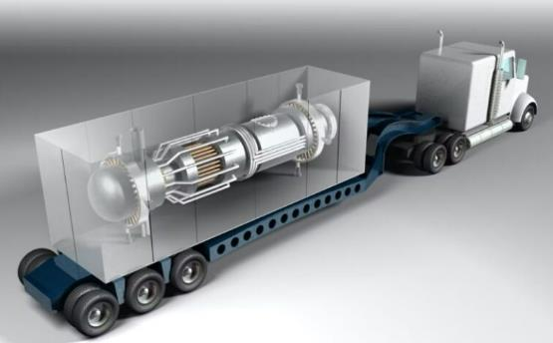
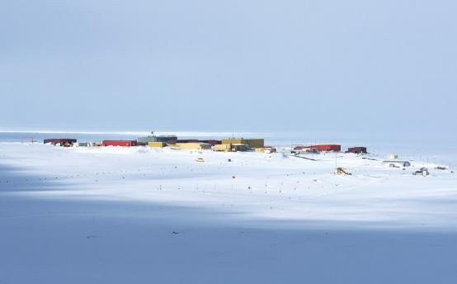


We must be ready to safeguard these
Marine deployment
Fleet deployment
Innovative fuel cycles
Transportable cores
Remote locations
Industrial applications
New safeguards approaches and arrangements will be needed
to support timely deployment of advanced reactors

Slide 4
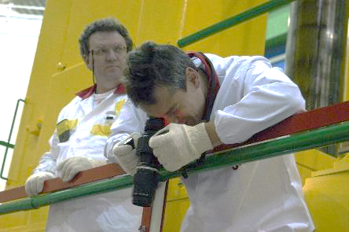
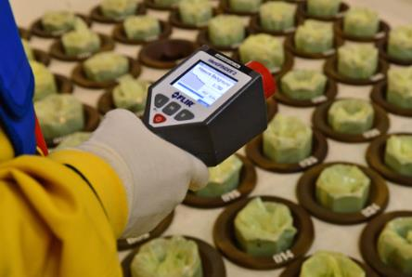
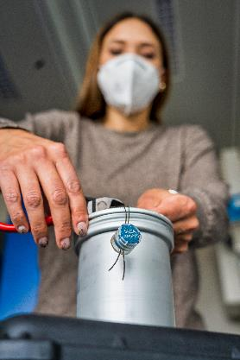
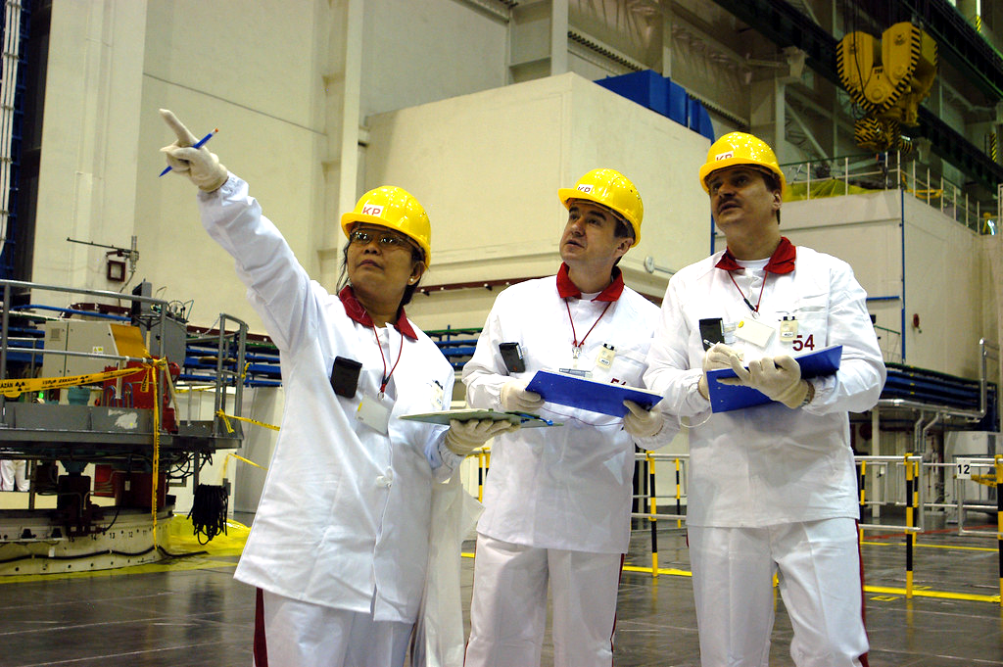
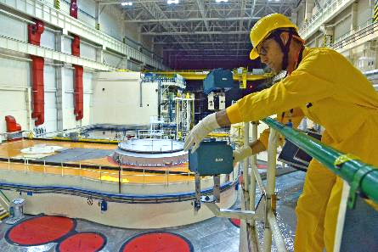
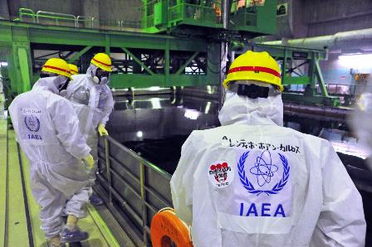
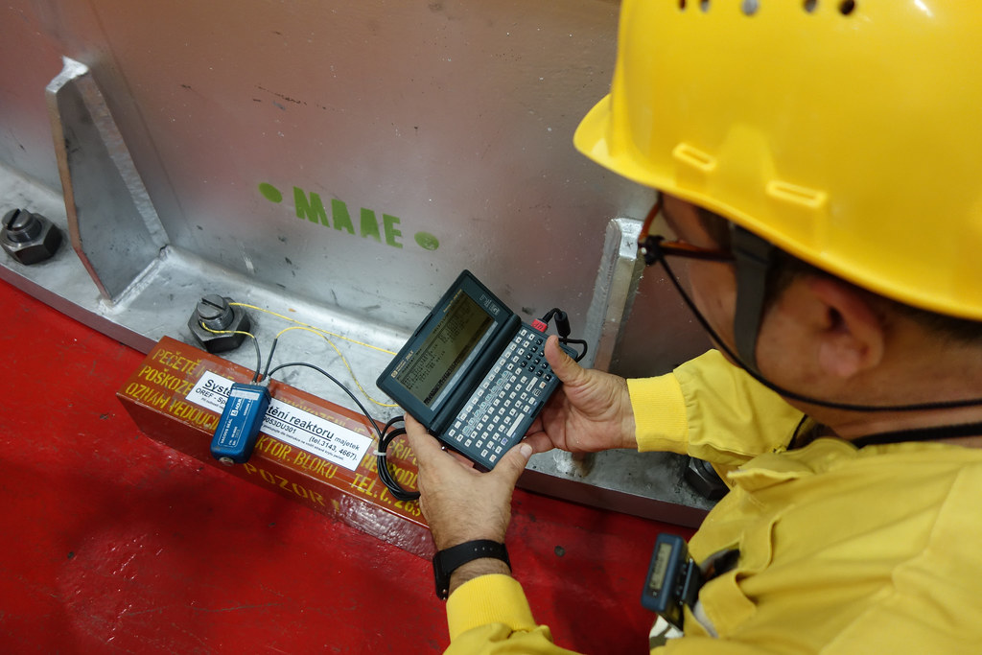
How can design impact safeguards efficiency?
  Verification of Nuclear Material Accountancy
    To verify State’s declaration of nuclear material inventory and flow
  Containment and Surveillance
    To maintain continuity-of-knowledge between inspections
  Design Information Verification
    To verify State’s declared facility design (from construction to decommissioning)
  Environmental Sampling, and Complementary Access
    To assure “completeness” of declaration (absence of undeclared nuclear material or activities)

Slide 5
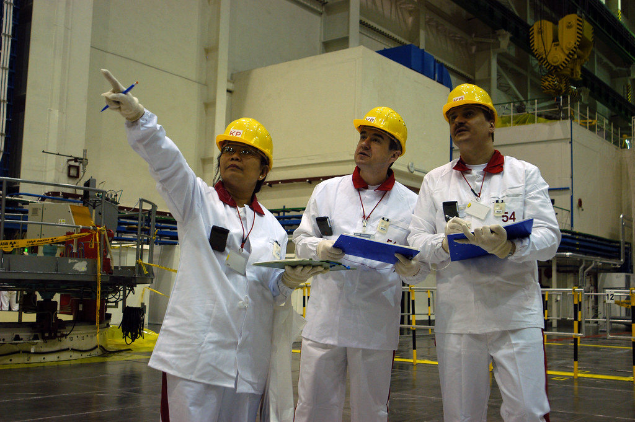
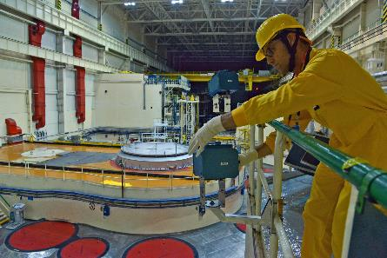
How can design impact safeguards efficiency?
  Verification of Nuclear Material Accountancy
    To verify State’s declaration of nuclear material inventory and flow
  Containment and Surveillance
    To maintain continuity-of-knowledge between inspections
  Design Information Verification
    To verify State’s declared facility design (from construction to decommissioning)
  Environmental Sampling, and Complementary Access
    To assure “completeness” of declaration (absence of undeclared nuclear material or activities)
physical access around facility
fuel storage configuration
complexity of fuel movement
health & safety issues
potential use of unattended equipment (or shared operator data),
accommodation of IAEA monitoring (lighting, HVAC, power, security, etc.)
accommodation of IAEA seals, cameras, instruments (brackets, power, lighting, conduits, penetrations, HVAC)
number and size of hatches, environmental conditions
physical access around facility,
complexity of layout
health & safety

Slide 6
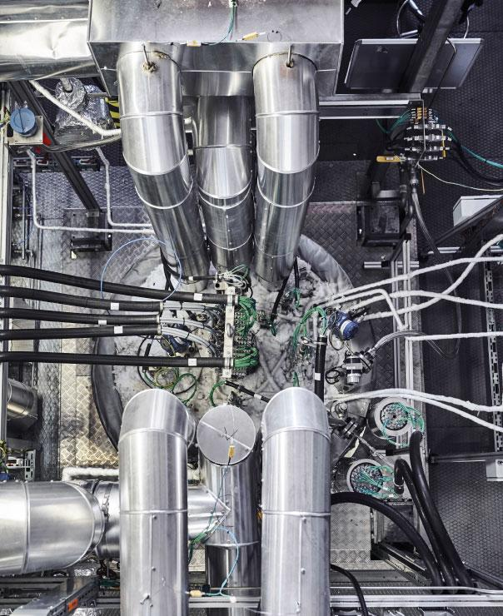
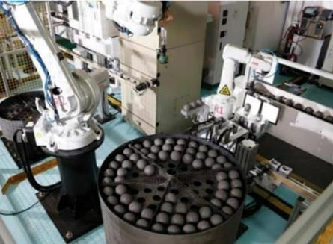
Safeguards challenges for SMRs
Advanced fuels and
fuel cycles
HALEU, pyroprocessing, Th/Pu MOX, …
Advanced reactor designs
molten salt, fast reactors, pebble bed, …
Longer operation
cycles
continuity of knowledge between refuelling, high excess reactivity of core (target accommodation)
New supply arrangements
factory sealed cores, transportable reactors, transnational DIV arrangements
New spent fuel management
storage configurations, waste forms
(cont’d)

Slide 7
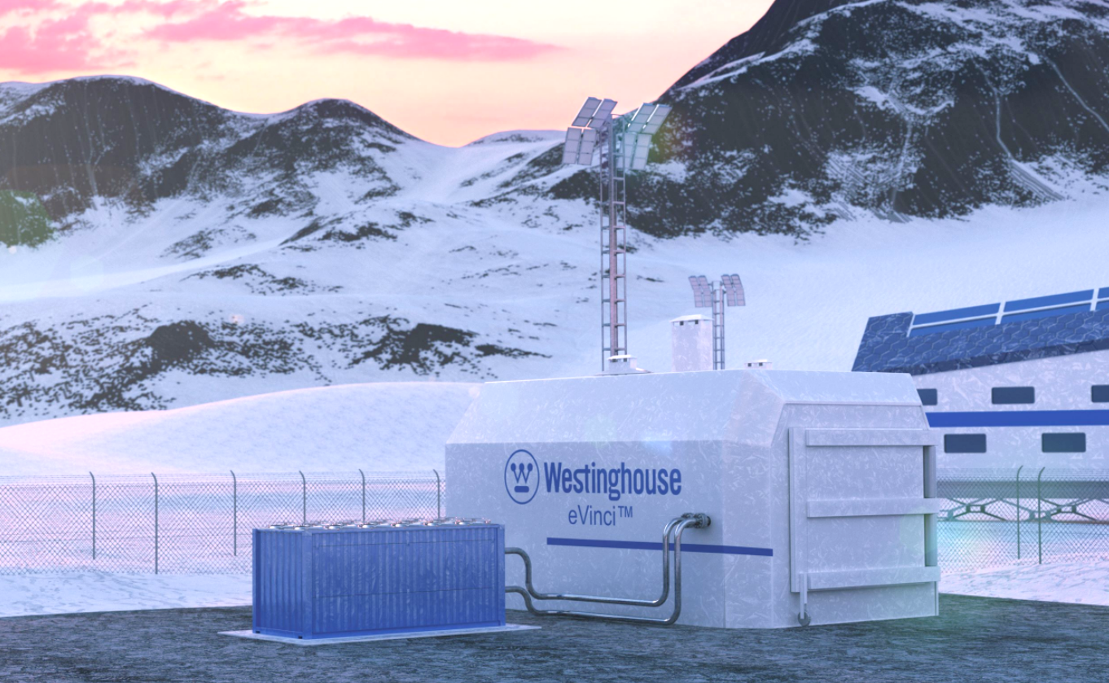
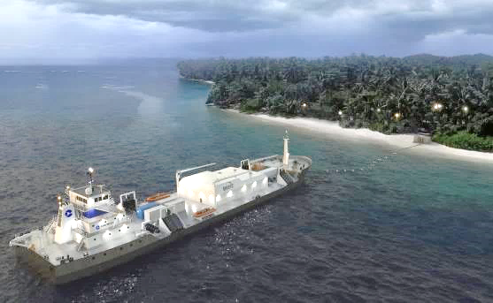
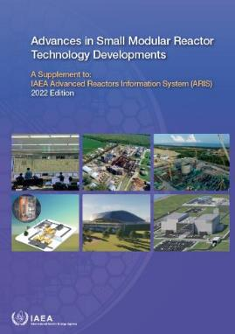
Safeguards challenges for SMRs (cont’d)
Small footprint
access, design verification
Diverse operational roles
district heating, desalination, hydrogen + electricity
Remote, distributed locations
access issues, cost-benefit issues
Multiple-module plants
continuity of knowledge, resource issues
Sheer number of designs!
>80 in IAEA 2022 guide
Lack of safeguards awareness
In design community
Both IAEA and State safeguards capabilities must be ready

Slide 8
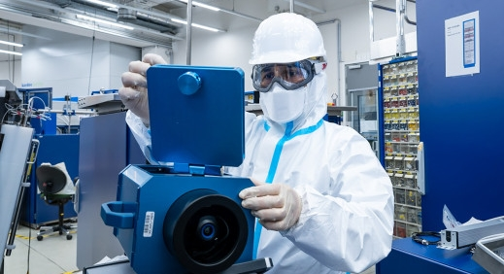
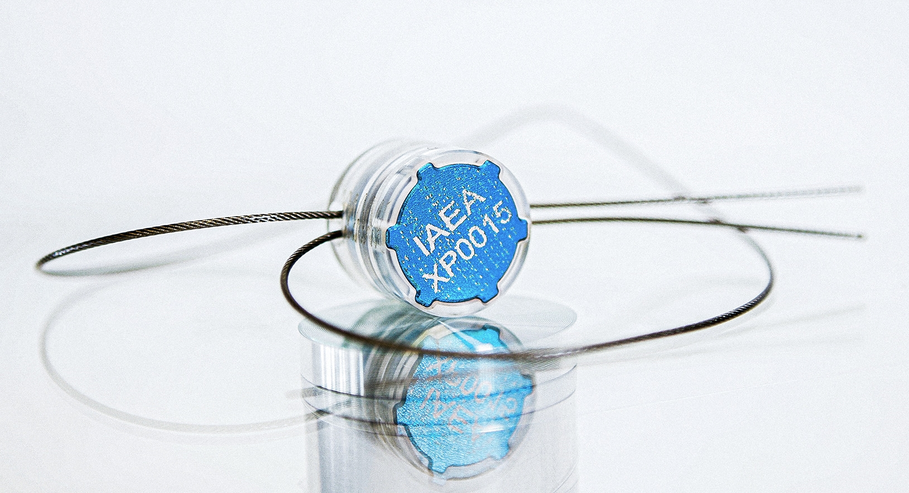
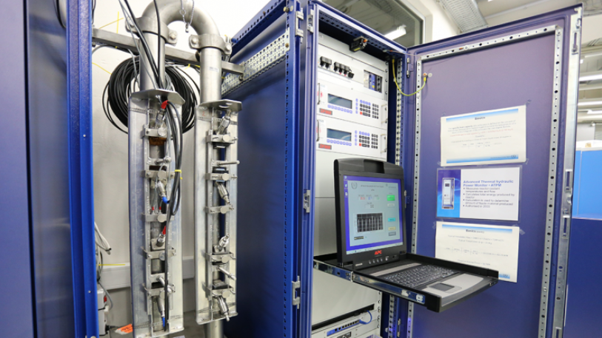
…Therefore: safeguards considerations for SMRs:
Unattended monitoring systems and remote data transmission
Digital connectivity for remote coverage (reliable, high bandwidth, secure)
Safeguards seals on factory-sealed, transportable cores
Design verification, particularly under transnational supply arrangements
New safeguards approaches, including possibility for customized Agency
or joint-use instrumentation (e.g., thermal power monitor for
microreactors, process monitoring for MSRs)
State-level issues: e.g., managing effective/efficient safeguards for a
fleet of small, remote facilities
Training for safeguards authorities in emerging nuclear energy States
New safeguards approaches need time to develop:
Safeguards by Design (SBD) will be critical

Slide 9

SBD: IAEA/vendor engagement
‘SBD for SMRs’ project under Member State Support Programme (MSSP)
MSSP tasks: Russia, RoK, US, Canada, Finland, France,
China, UK, Belgium, Sweden
Technologies include FNPP, TNPP, integral PWR, MSR,
PB-HTR, LFR
Goal is to work with Member States to:
  evaluate design aspects that impact safeguards
  investigate safeguards implementation strategies
  develop internal IAEA document to inform future safeguards development
Safeguards by Design: collaborative risk management

Slide 10
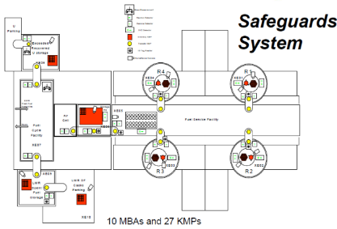
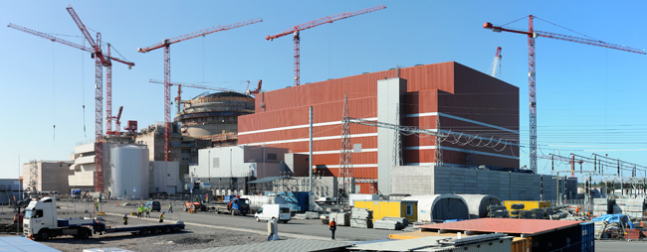
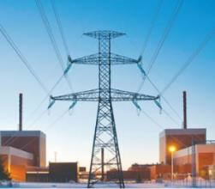
SBD: stakeholder interactions
?
Conceptual design
Engineering design
Construction & commissioning
Operation
Mode of
interaction:
MSSP
‘SBD for
SMRs’ task
Bilateral
engagement
outside MSSP
General
outreach,
workshops, etc.
Consultation with relevant
IAEA SG Operations division / country officer
(per safeguards agreement)
IAEA
participants:
Led by SG Concepts and Planning division
supported as needed by other Divisions
Led by relevant SG Operations division
supported as needed by SG technical Divisions
“DECISION TO CONSTRUCT”
State
participants:
Led (voluntarily) by nuclear designer/vendor
supported as needed by State resources
(e.g., State authority, national SMEs)
Led by State authority
supported as needed by State resources
(e.g., operator, supplier, national SMEs)
OUTCOME:
Preliminary safeguards SBD report
New or modified safeguards approach

Slide 11
SBD: lessons learned
Protection of design information paramount – possibly including destruction of design information afterwards (if requested)
Perceived risks by industry of stranded R&D investment, should safeguards requirements change – need for clear communication with stakeholders:
  Commonality of safeguards regime across States
  Value proposition for technology that is designed ‘ready for safeguards’
Broad engagement of industry and R&D community can be as useful as direct vendor engagement (e.g., US support programme)
Direct IAEA/vendor engagement outside of MSSP programme is possible – with appropriate transparency and agreed terms of reference (incl. NDA)
cont’d…

Slide 12
SBD: lessons learned (cont’d)
IAEA resources for SBD engagements currently appropriate – re-assessment needed should demand increase (incl. ‘triaging’ by TRL, and response time of IAEA internal processes)
Regulatory pre-licensing reviews that include SBD are useful for preparing both vendor and regulator (safeguards authority)
Potential for standardization across industry on generic SBD best practices and concepts (e.g., NHSI, SMR Regulators Forum)
Some MS confusion on scope of safety/security/safeguards integrated assessments: need better communication (i.e., purely engineering-design best practice with no bearing on governing legal frameworks)

Slide 13
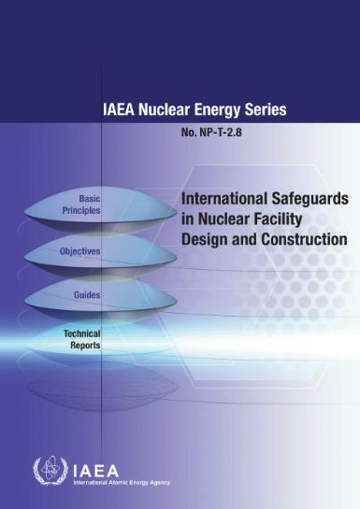
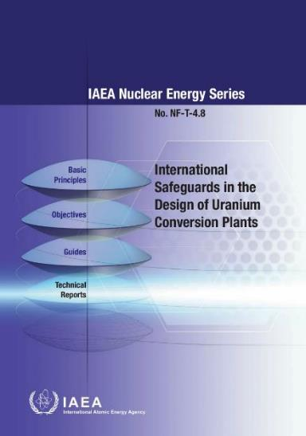
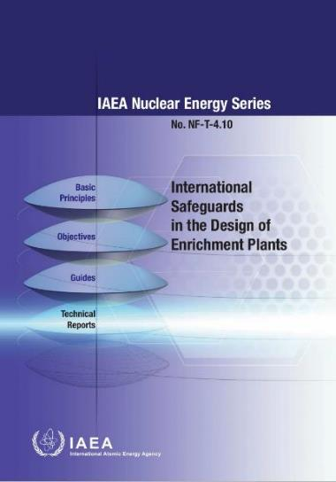

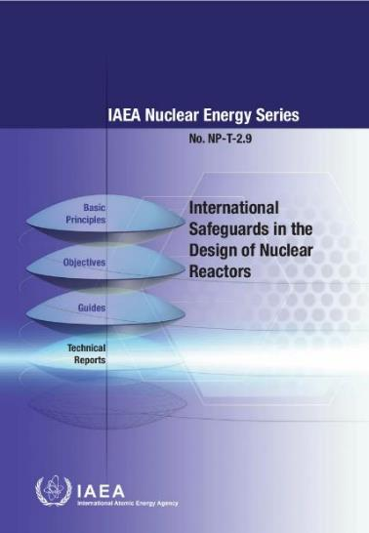
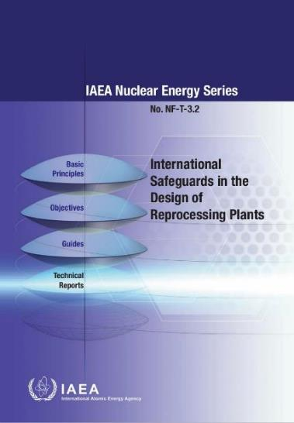
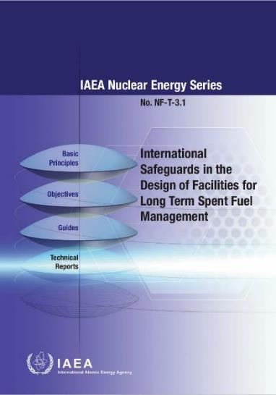
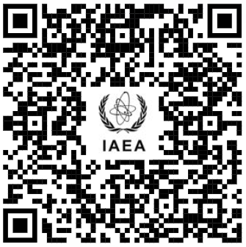
SBD: IAEA guidance
www.iaea.org/topics/assistance-for-states/safeguards-by-design

Slide 14
Thank you!
Jeremy Whitlock
J.Whitlock@iaea.org

Slide 15

Dr. Jeremy Whitlock is a Senior Technical Advisor in the Department of Safeguards at the IAEA, with three decades’ experience as a scientist and manager in the Canadian and international nuclear community. Prior to moving to the IAEA in 2017 he spent 22 years at Canadian Nuclear Laboratories as a reactor physicist and manager of non-proliferation R&D.
Dr. Whitlock received a B.Sc. in Physics from the University of Waterloo (1988), and an M.Eng. and PhD in Engineering Physics (reactor physics) from McMaster University (1995).
Dr. Whitlock is a Past President, Fellow, and former Communications Director of the Canadian Nuclear Society. Since 1997 he has maintained The Canadian Nuclear FAQ (www.nuclearfaq.ca), a personal website of frequently-asked questions (FAQs) on Canadian nuclear technology.
Dr. Whitlock lives in Vienna, Austria, and feels that canoes are the closest humans have come to inventing a perfect machine.
J.Whitlock@iaea.org
jeremyjwhitlock@gmail.com

