Slide 1

Overview of Safeguards Challenges and Opportunities for Small Modular Reactor Technology
THAQAL M. ALHUZAYMI and THAAR M. ALJUWAYA
King Abdulaziz City for Science and Technology (KACST), Riyadh, Saudi Arabia
10/23/2024

Slide 2

CONTENT:
Overview of SMR Technology
Advantages of SMR Technology
Importance of Nuclear Safeguards for SMR Implementation
Safeguards Challenges and Opportunities.
Conclusions and Remarks.

Slide 3

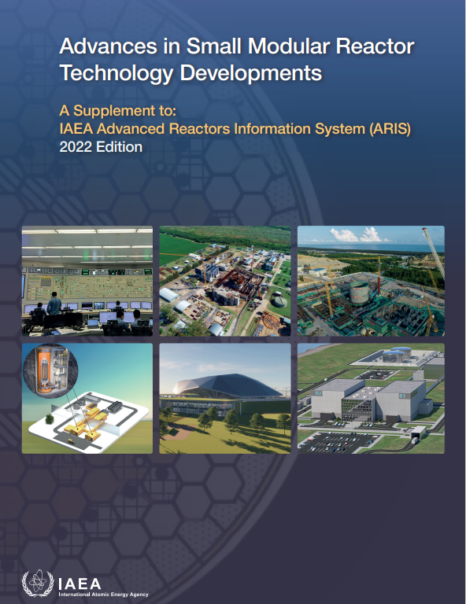
Overview of SMR Technology
SMRs are compact, adaptable nuclear power systems that can be pre-fabricated and transported, leading to cost savings through standardized design and mass production.
The concept of SMRs emerged from the early era of nuclear energy but regained attention in the 21st century due to the demand for flexible and cost-effective solutions.
SMRs typically generate less than 300 MWe, making them suitable for areas with limited grid capacity and electricity demand compared to larger nuclear reactors.
Source: SMR_booklet_2022.pdf (iaea.org)
3
3

Slide 4
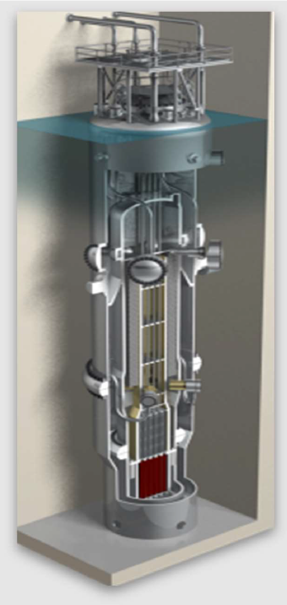
Overview of SMR Technology
Several SMR designs have received licensing or are nearing the completion of the licensing process, and a few have been built and are operational. Below is a list of some of these SMR designs:
NuScale Power Module (USA):
  1st SMR to receive design certification from the US Nuclear Regulatory Commission (NRC).
  The NuScale Power Module is a 77 MWe pressurized water reactor (PWR).
  The first NuScale plant, consisting of 12 modules for a total capacity of 924 MWe, is projected to be operational at the Idaho National Laboratory site by the mid-2020s.
NuScale
4
4
Notes:
Extra talking points can be added to the above Slide:

Slide 5
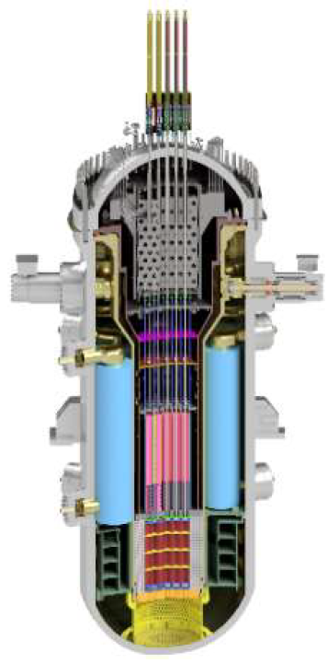
Overview of SMR Technology
Several SMR designs have received licensing or are nearing the completion of the licensing process, and a few have been built and are operational. Below is a list of some of these SMR designs:
SMART (South Korea):
  The System-Integrated Modular Advanced Reactor (SMART) is a 100 MWe PWR designed by the Korea Atomic Energy Research Institute (KAERI).
  The primary application of this design is for desalination and district heating.
  The design received standard design approval from the Korean regulator in 2012.
SMART
5
5
Notes:
Extra talking points can be added to the above Slide:

Slide 6
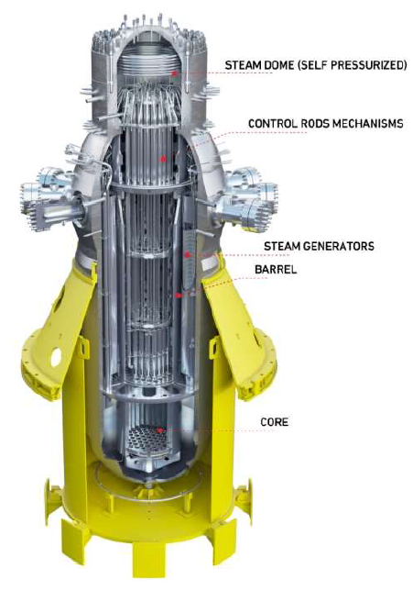
Overview of SMR Technology
Several SMR designs have received licensing or are nearing the completion of the licensing process, and a few have been built and are operational. Below is a list of some of these SMR designs:
CAREM (Argentina):
  The Central Argentina de Elementos Modulares (CAREM) is a 25 MWe PWR currently under construction by Argentina's national atomic energy commission.
  The 1st unit is undergoing construction at the Atucha site in Argentina.
CAREM
6
6
Notes:
Extra talking points can be added to the above Slide:

Slide 7

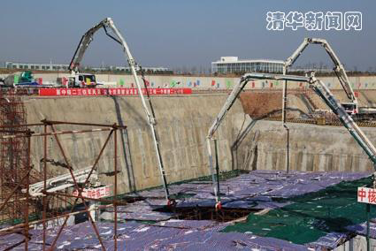
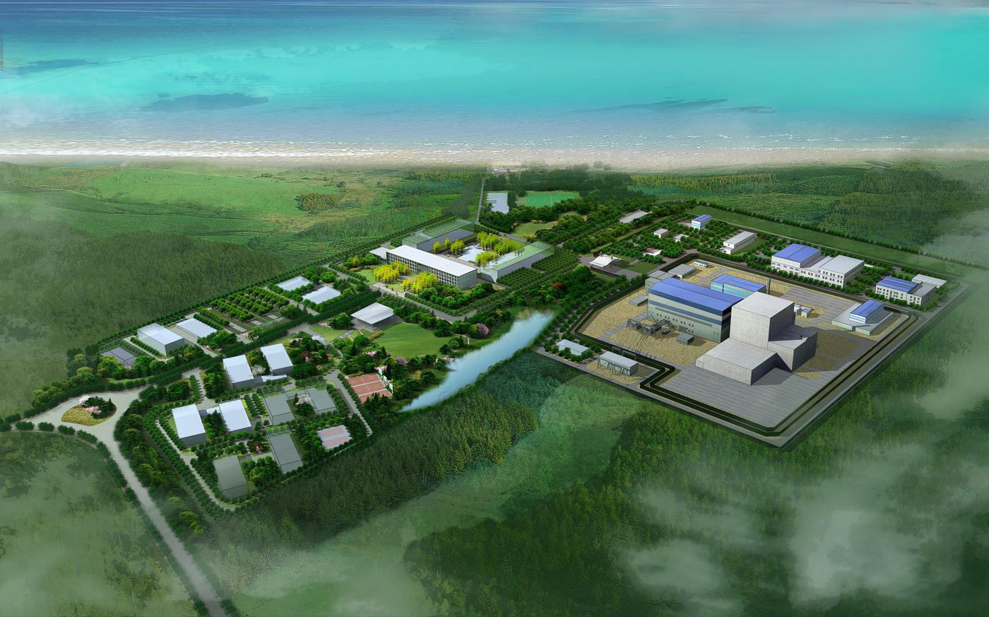
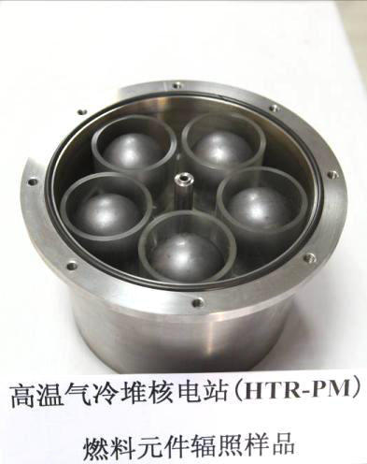
Overview of SMR Technology
4. Chinese HTR-PM demonstration plant is under operation
Pebble bed core, 750 °C outlet temperature, steam cycle, 40% efficiency
  Two 250 MWt NSSS modules for 210 MWe electricity
  First Concrete in December 2012
  Reaches full power at December 2022
HTRs have the highest operating temperatures of all existing reactor types.
The only reactors that can provide very high-temperature process heat
The Shidao Bay nuclear power plant is a joint venture by China Huaneng Group, China Nuclear Engineering & Construction Group, and Tsinghua University.
HTR-PM Reactor & SG Side by side
Fuel Samples for Irradiation in Patten
7
7
Notes:
Extra talking points can be added to the above Slide:

Slide 8
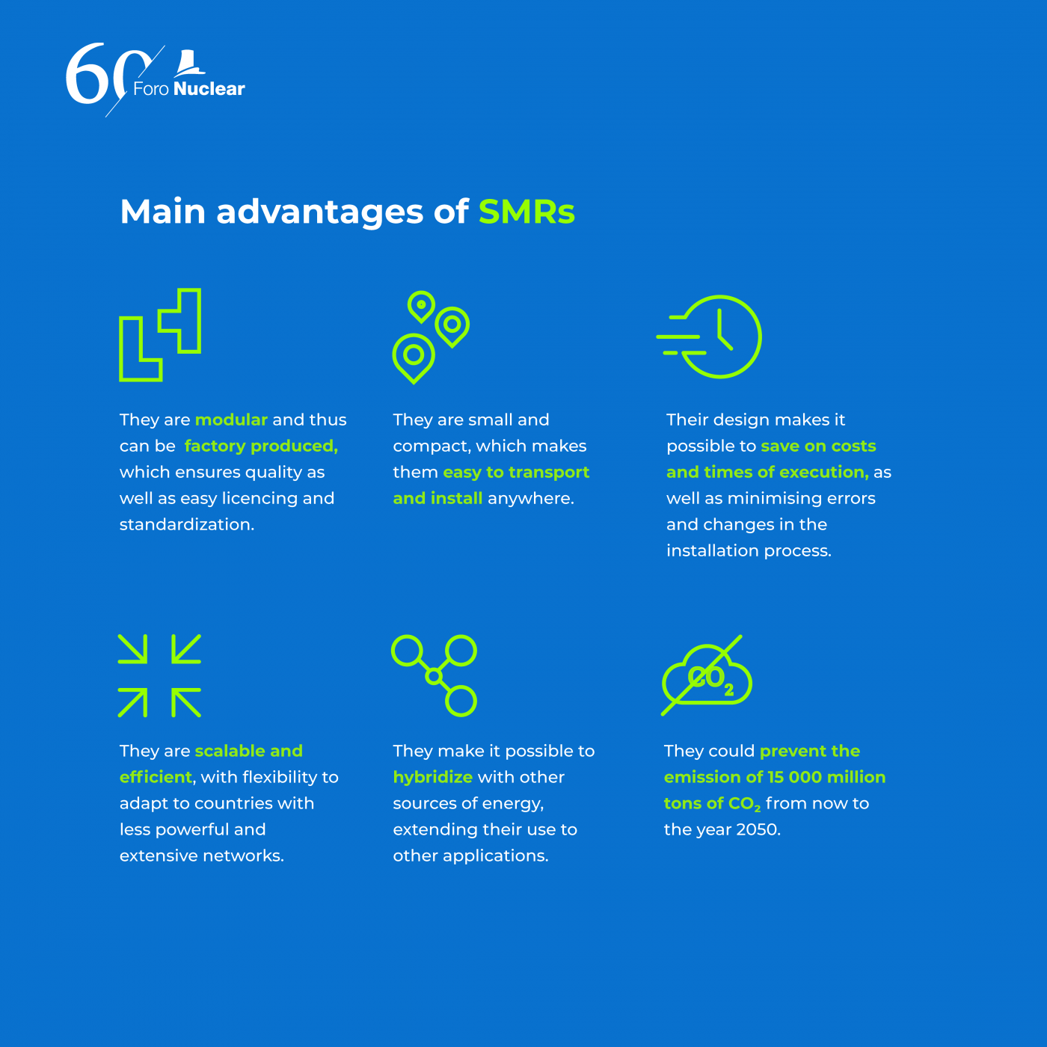
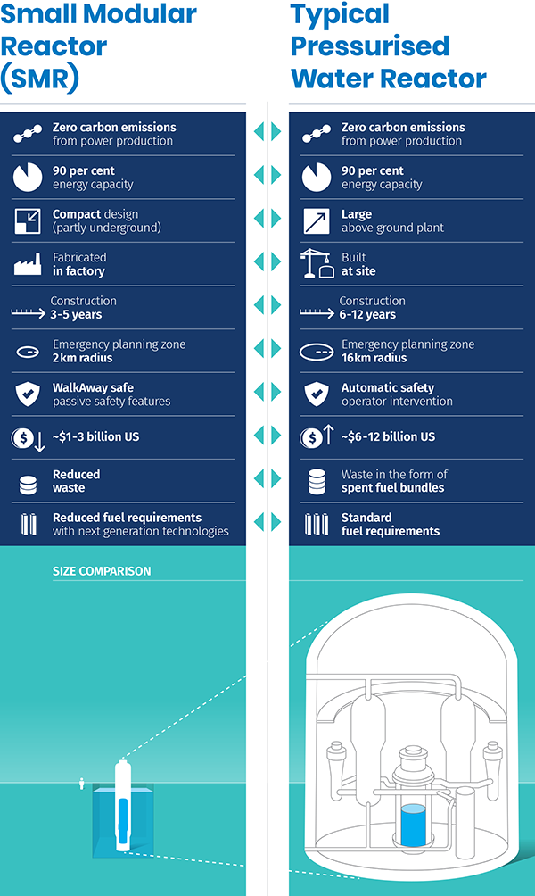
Advantages of SMR Technology
Main Advantages of SMR:
SMR vs. PWR
  T
  T
  T
  T
8
8
Notes:
Talking points:
1. SMR technology's unique advantages over large-scale nuclear reactors, including scalability, advanced safety measures, and economic feasibility, have sparked significant interest.
2. SMRs' smaller size, generating less than 300 MWe, allows for adaptable and flexible deployment, either individually or in multiples, avoiding overcapacity.
3. SMRs employ sophisticated safety measures, such as passive systems based on natural physical phenomena, enhancing safety compared to traditional reactors. Compact designs and improved containment structures further contribute to safety.
4. The economic feasibility of SMRs stems from their mass-manufacturability and transportability, resulting in cost savings through economies of scale. This enhances affordability and accessibility, particularly in developing nations.
5. SMRs have shorter construction timelines than large-scale reactors, reducing the risk of cost overruns and enabling more predictable budgeting. While traditional reactors take years to construct, SMRs can be built within a few years.
6. SMRs represent a promising future for nuclear energy, offering scalability, advanced safety features, and economic advantages that address diverse energy needs.

Slide 9

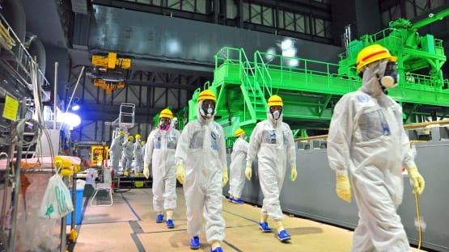
Importance of Nuclear Safeguards for SMR Implementation
Crucial for ensuring nuclear control and security.
Preventing the diversion or misuse of nuclear materials.
Maintaining public confidence in nuclear technologies.
Facilitating international collaboration.
Promoting regulatory adherence.
9
9
Notes:
Talking Points:
1. Advanced nuclear technologies, including Small Modular Reactors (SMRs), offer potential for flexible, efficient, and carbon-neutral power, alongside the responsibility of ensuring nuclear security and non-proliferation.
2. Crucial for global security and stability, nuclear safeguards encompass technical and institutional measures that prevent the misuse of nuclear materials for non-peaceful purposes.
3. Non-proliferation assurance justifies the critical role of nuclear safeguards in SMR deployment, necessitating stringent control, inspections, and reporting to prevent diversion and misuse of nuclear materials.
4. Maintaining public confidence in nuclear energy relies on the effectiveness of nuclear safeguards, providing reassurance of safety and responsible use of nuclear technology, including SMRs.
5. Nuclear safeguards facilitate international collaboration by assuring countries without nuclear weapons that cooperation in sharing nuclear technology for peaceful purposes is supported by effective safeguards. This enables accelerated progress and broader access to SMR benefits.
6. Essential for promoting regulatory adherence, nuclear safeguards align with international regulations and national laws, requiring stringent safeguards for any nuclear power initiative. Given the potential deployment of SMRs in diverse locations, these safeguards assume even greater significance.

Slide 10
Safeguards Challenges and Opportunities for SMR Technology
The unique attributes of SMRs present several challenges and opportunities.
The goal of this work are to:
  Emphasize and integrate the recurrent challenges and prospects related to safeguards, subjects that have been rigorously examined within the nuclear scientific community.
  Shed light on the process of converting these challenges into advantageous opportunities, thereby enhancing the safeguarding mechanisms of SMR technology.
10
10

Slide 11
Safeguards Challenges and Opportunities for SMR Technology
Table 1 present a list of safeguards challenges and opportunities for SMR technology
# | SMR Technology
 | Safeguards Challenges | Safeguards Opportunities
1 | Increasing proliferation risk | Inherent proliferation resistance
2 | Safeguards implementation | Remote monitoring and data analysis
3 | Emergent technologies and designs | Innovation in safeguards technologies
4 | Resource constraints | Economies of scale
5 | Adaption of existing safeguards frameworks | International cooperation
11
11
Notes:
Talking point:
The principal aim of Table 1, delineating the safeguards challenges and opportunities inherent to SMR technology, is to elucidate how each perceived challenge may, in fact, represent a potential opportunity for strengthening and bolstering the safeguards measures specifically tailored to SMR technology.

Slide 12
Safeguards Challenges and Opportunities for SMR Technology
Increasing proliferation risk vs. Inherent proliferation resistance
SMR technology poses a proliferation risk.
SMRs' size and transportability attract potential proliferators.
Addressing this risk demands robust safeguards.
Some of the SMR designs incorporate features to resist proliferation threats, such as sealed cores and low-enriched uranium.
Collaborative efforts, especially from regulatory entities, are needed to establish robust standards for SMR proliferation resistance during licensing and construction.
Strengthening standards ensures SMRs' long-term viability and material security.
12
12
Notes:
Talking points:
Increasing proliferation risk:
A significant challenge linked to SMR technology is the increased risk of nuclear proliferation.
The smaller size and transportability of SMRs make them attractive to non-state actors or nations with covert intentions of developing nuclear weapons.
Effectively addressing this proliferation risk and preventing the diversion of nuclear materials for illicit purposes poses a substantial challenge that requires robust safeguard measures.
Inherent proliferation resistance:
Certain SMR designs have inherent features that enhance resistance to proliferation threats, such as sealed reactor cores, extended fuel cycles, and the use of low-enriched uranium. These design attributes have the potential to reduce the risk of nuclear material diversion and enhance the proliferation resistance of SMRs.
It is crucial for the nuclear community, especially nuclear regulatory bodies, to collaborate and establish robust standards to strengthen the proliferation resistance of SMR technology during the early stages of licensing and construction.
Amalgamating efforts to establish appropriate standards will help ensure the long-term viability and security of SMRs, mitigating proliferation risks and maintaining the integrity of nuclear materials.

Slide 13


Safeguards Challenges and Opportunities for SMR Technology
Safeguards implementation vs. Remote monitoring and data analysis
Some of the SMR design complexity poses monitoring challenges for nuclear safeguards.
Innovative strategies are needed to address these challenges effectively.
SMR attributes offer opportunities for remote monitoring and data analysis.
This approach reduces inspector burden and enhances safeguards effectiveness.
13
13
Notes:
Talking points:
The distinctive design of SMRs poses a challenge for monitoring and verification due to their compact and integrated nature, deviating from conventional large-scale reactors.
Innovative strategies and techniques are necessary to address this challenge and ensure effective implementation of nuclear safeguards for SMRs.
The unique attributes of SMRs offer opportunities for remote monitoring and data analysis, leveraging advanced technologies and analytics to monitor operations, verify compliance, and detect any irregular activities.
This approach can alleviate the burden on safeguard inspectors, enhance overall effectiveness, and improve the ability to detect potential misuse of nuclear technology or materials.

Slide 14
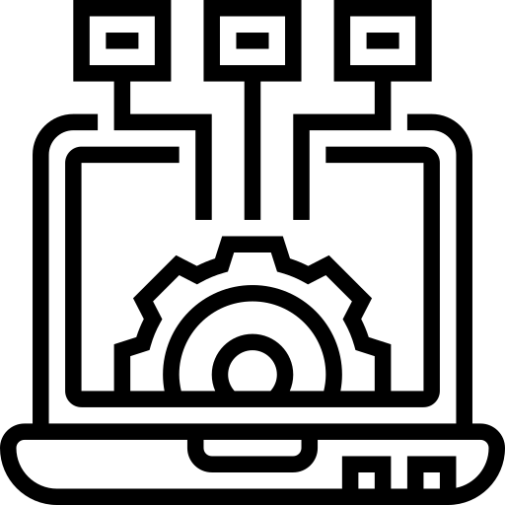
Safeguards Challenges and Opportunities for SMR Technology
Emergent technologies and designs vs. Innovation in safeguards technologies
SMRs introduce new technologies absent in traditional reactors, potentially impacting existing safeguard approaches.
Continuous research is necessary to understand SMR technologies and develop appropriate safeguard measures.
SMR challenges can drive innovation in safeguards technologies and methodologies.
Developing new technologies and methods for monitoring SMRs can enhance safeguards effectiveness and promote peaceful nuclear technology use.
14
14

Slide 15

Safeguards Challenges and Opportunities for SMR Technology
Resource constraints vs. Economies of scale
Wide SMR deployment strains regulatory resources for safeguard inspections.
Meeting demand without compromising effectiveness requires more funding, personnel, and equipment.
SMR modularity enables standardized safeguards across multiple facilities.
Scalability enhances efficiency, effectiveness, and may reduce implementation costs.
15
15

Slide 16

Safeguards Challenges and Opportunities for SMR Technology
Adaption of existing safeguards frameworks vs. International cooperation
Existing nuclear safeguard frameworks are tailored to large-scale facilities, requiring modifications for SMRs.
Adapting frameworks to SMRs is complex, requiring careful consideration of efficacy and operational efficiency.
SMR development offers an opportunity for increased international cooperation on safeguards.
Collaboration can result in effective approaches, shared practices, and enhanced global nuclear security.
16
16

Slide 17
Conclusions and Remarks
SMRs offer scalability, safety, and economic advantages in nuclear power.
Challenges and opportunities exist in nuclear safeguards for SMRs.
Addressing proliferation risks, implementation complexities, emergent technologies, resource constraints, and adaptation of safeguards frameworks is crucial.
Challenges provide opportunities for proliferation resistance, remote monitoring, innovation, economies of scale, and international cooperation.
Establishing robust standards is paramount for safe and peaceful SMR use and enhancing safeguards effectiveness.
17
17

Slide 18

Thank You

