Slide 2
Decarbonizing refining processes
SMR deployment paving the way to synthetic fuels
Eleonora Lambridis, Head of Innovation Lab
Vienna, 24th October 2024

Slide 3
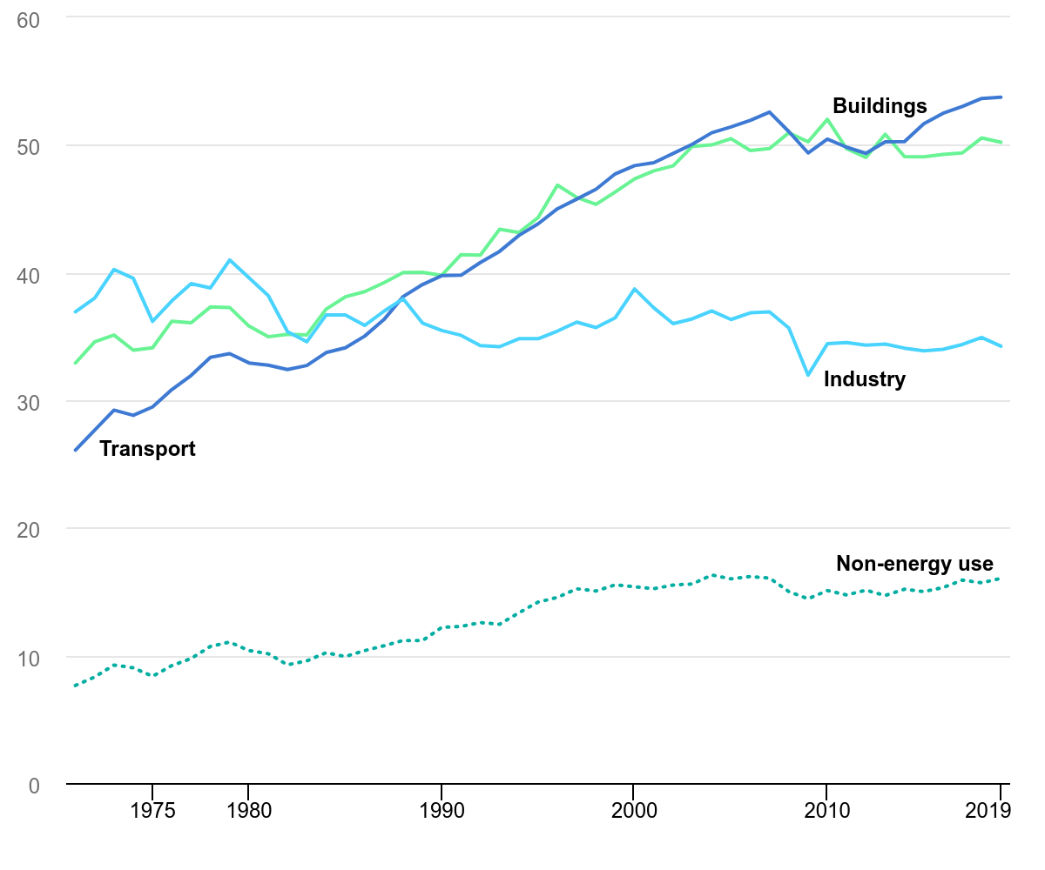
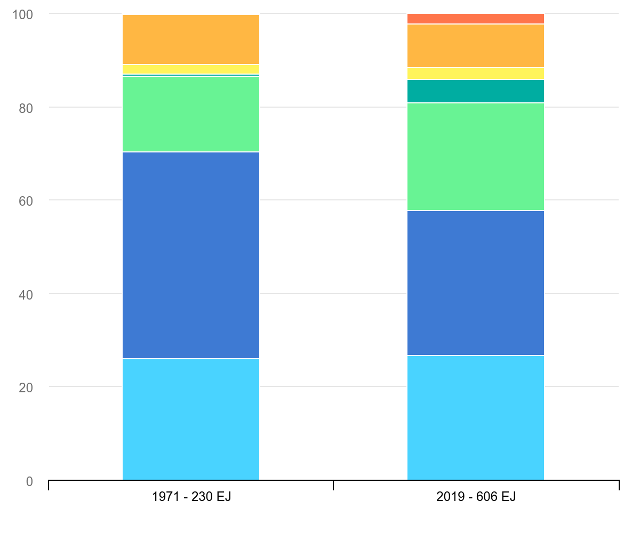
Global reliance on fossil fuels
Other renewables
Biofuels
Nuclear
Hydro
Natural gas
Oil
Coal
Main non-energy uses: lubricants, asphalt, waxes, naphtha, surface coating, resins, foams, fibres, plastics,…
IEA (2021), Total primary energy supply by fuel, 1971 and 2019, IEA, Paris https://www.iea.org/data-and-statistics/charts/total-primary-energy-supply-by-fuel-1971-and-2019, Licence: CC BY 4.0

Slide 4
Compatibility of SMRs with industrial heat
Caption
District Heating
Max
process temperature
Current Gen early adopters
>40 GWth
Next Gen early adopter
>20 GWth
Atomistic
Next Gen late adopter
>10 GWth
Opportunistic
<10 GWth
Paper
<250°C
Light Water Reactor compatible
Refineries
<550°C
Molten salt, Liquid metal
compatible
Ammonia
Hydrogen low t°
Soda ash
(Petro)chemical clusters
<1000°C
Very High Temperature Gas
compatible
Steel
Aluminium
Hydrogen high t°
>1000°C
Top-up heat
required or via syngas production
Glass
Ceramic
Lime
Cu, Ni
Cement
Reengineering
Top-up heat
Part supply
On-site retrofit
Plug-in
Coupling
complexity

Slide 5
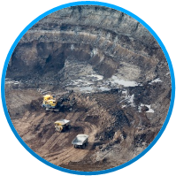
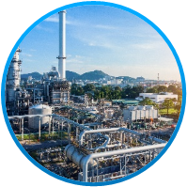


Lifecycle of Petroleum Products
Extraction and production of crude oil
Refining
Energy needs:
Few 10MWe
100-1000 MWth
Transportation
End-use
Crude oil derivatives (fuels) used in transportation sector

Slide 6
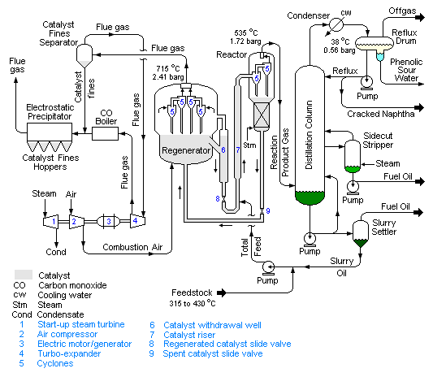
Complexity of installations
Main opportunities to decarbonise the process at the level of inputs and outputs:
Decarbonising the steam production
Acting on exhaust gases
Source: Wikipedia

Slide 7
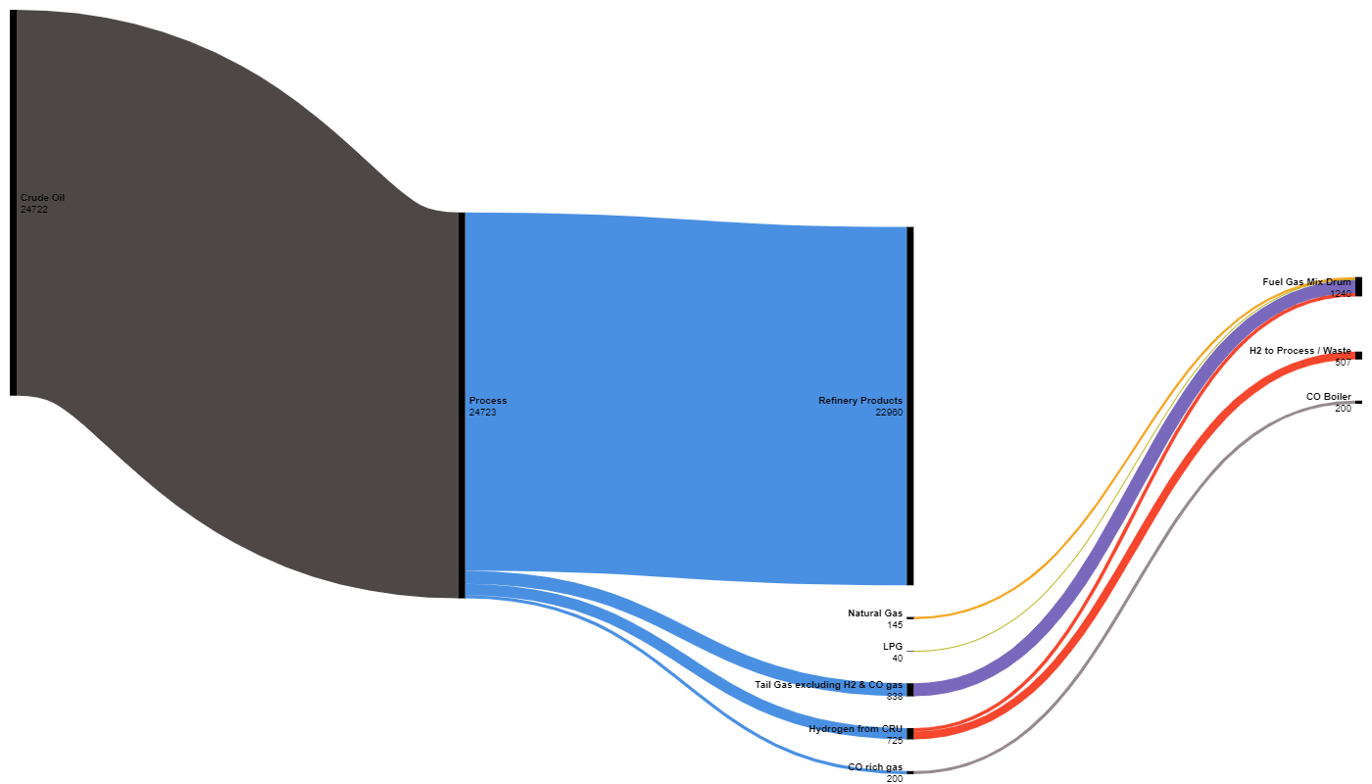
Energy balance
Crude Oil
Refinery Products
Fuel Gas Mix Drum
H₂ to process / Waste
CO Gas to Boiler
Natural Gas
LPG
Tail gas
H₂ from CRU
CO gas

Slide 8
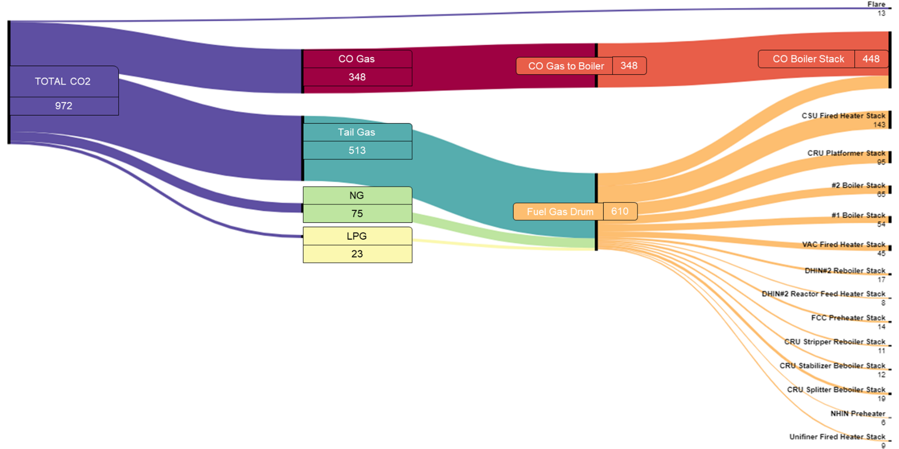
CO₂ mass balance
Stacks from different units

Slide 9
Premises & key principles
Nuclear energy is a new technology to be introduced within a refinery ecosystem, hence the “path of least resistance” principle should be applied, meaning that:
The planification of energy assets transition should be graded as to leave room for “learning by doing”;
Priority should be put on the conversion of assets requiring few to no re-engineering as to minimize complexity and capex investment;
With the disruption of the current Product & Energy balance, applications bringing additional value (new cash-flow streams) should be prioritized.
As crude oil derivatives market is changing and uncertain (e.g. expected decrease of gasoline consumption vs. expected increased demand for Sustainable Aviation Fuel), special attention should be put on: scalability, options and exit doors.
Conversion
<
<
Investment

Slide 10

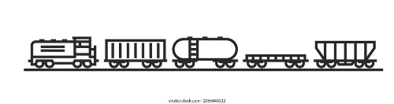
Electrolysis
Fluid Catalytic Cracking
Regenerator
Power
O₂
CO₂
Reverse Water Gas Shift
H₂
CO
Membrane
Fischer-Tropsch
Exhaust Gas
H₂
C₁₀H₂₂ | Crude
C₁-C₅
Pyrolysis
H₂
Power
C_{(s)}

Slide 11
Key takeaway on hazard assessment
Safety analysis have concluded that external hazards from H₂ (Jet fire, Fire ball, Explosion) is not a showstopper for close co-localization (~100m required)

Slide 12
Conclusion
Refineries need to undergo a deep and thorough conversion process in order to make the 4th industrial revolution reliant on carbon-neutral energy sources.
A major challenge is imposed by the need for reliable and abundant energy supply, where Small Modular Reactors can be a major solution.
Tractebel’s investigation of existing assets revealed no technical or regulatory obstacles to integrating SMRs with refineries.
Such transformation process should follow the “path of least resistance”.

Slide 13






Unfolding the vision of advanced nuclear
Notes:
With the roadmap for BE

