Slide 2
Nuclear Hydrogen Production Analysis for
GT-MHR using HEEP Software
Walid Dridi PhD & Eng
National Centre of Nuclear Science and Technology (CNSTN), Tunisia
TRACK A.5 – SESSION 5.3: Non-Electric Applications for SMR

Slide 3
Outline
Scope
Hydrogen production methods
GT-MHR applications
HEEP : INPUT Parameters and Assumptions
Results and discussion
Conclusion

Slide 4
Scope
The framework of the Coordinated Research Economic Appraisal of Small Modular Reactors Projects: Methodologies and Applications project (2020-2024).
Participation with research project : Economic and financial case study on High Temperature Gas Cooled SMR in Tunisia
In this project our team (from CNSTN and Engineering schools) is proposing to conduct a technical and economical feasibility studies for the implementation of small modular reactors (SMR).
The size of the grid and the desalination needs of the country make the SMR technology highly suitable for Tunisia for both electricity generation, water desalination, Hydrogen production.
It is conducted the investigation to estimate the cost of electricity and desalinated water productions for various scenarios.
  Technical study (optimizing the nuclear desalination plants and Hydrogen production process cycle coupling)
  Economical assessment (using DEEP5.1 and HEEP)

Slide 5
Hydrogen advantages
Hydrogen is expected by many energy experts and stakeholders to become
  The most important fuel for solving energy and
  Environmental problems
Hydrogen has gained attention as a potential energy source and fuel due to its various benefits across different industries.
Clean Energy Source: hydrogen produces only water as a byproduct, making it a zero-emission energy carrier.
Versatility: Hydrogen can be used in multiple sectors, including transportation, industrial processes, and heating.
Energy Density: Hydrogen has a high energy-to-weight ratio, it can store more energy per unit mass compared to other fuels,
Long-term Energy Storage: hydrogen can store large amounts of energy for longer periods. useful for balancing supply and demand in energy grids
Decarbonization Potential: Hydrogen offers a pathway to decarbonize hard-to-electrify sectors like heavy industry
Reduction of Air Pollution: Replacing fossil fuels in transportation and industry, reduce pollutants : nitrogen oxides, sulfur oxides (SOx)

Slide 6
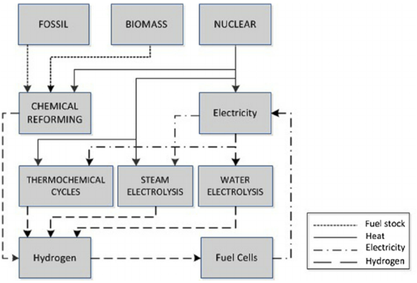
Hydrogen Production Methods
Hydrogen exists in abundance in nature in the form of water,
  Not alone which brings a need to produce it
  Use in a sustainable and environmentally friendly manner.
There are several methods of achieving this, including
  Steam reforming of natural gas,
  Coal gasification,
  Water electrolysis and
  Thermochemical water decomposition.
The main methods for production of hydrogen from various energy sources
Nuclear hydrogen production can be made by :
Low temperature electrolysis,
High-temperature electrolysis,
Thermochemical, and
Hybrid processes.

Slide 7
Hydrogen Production Methods
Low temperature electrolysis is simply splitting water into hydrogen and oxygen
  using electrical power which possesses a high amount of electricity consumption (~1.23 V/molH₂O).
High-temperature electrolysis, or steam electrolysis,
  It is a method to split steam into hydrogen and oxygen.
  Electrical energy requirement for splitting steam is lower than that of liquid water
  This method is not yet commercially (Lab scale) in INL : solid oxide electrolysis cell
3. Thermochemical processes : Series of some chemical reactions to split water into hydrogen
  These processes seem to be using only heat as the energy source
  Electrical power or electrolytic processes are required for additional.
  The original Sulfur-Iodine (SI) process : proposed by General Atomics (GA) and 75 L/h production.
  Japan Atomic Energy Agency (JAEA) : SI process with a plan to construct a 2 tons/day hydrogen by Nuclear.
4. Hybrid Sulfur Cycle (HyS) is a two-step process, working around 800°C.
  A modified HyS has been introduced in Japan, to decrease temperature to (500-700 °C).
  The hybrid copper-chlorine (Cu-Cl) cycle, medium temperature, 3 to 5 steps, like thermochemical and electrochemical.
  Led by ANL, Atomic Energy of Canada Ltd (AECL), and Atomic Energy Commission (CEA)

Slide 8
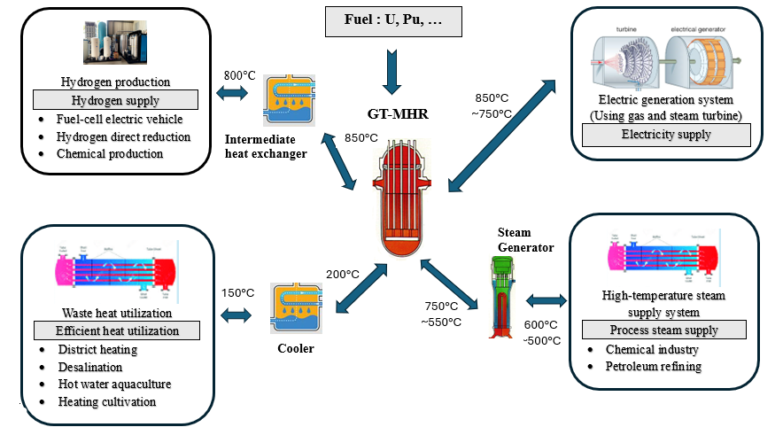
GT-MHR applications
The gas turbine modular helium reactor (GT-MHR) couples a HTGR with a Brayton power conversion cycle to produce electricity at high efficiency.
GT-MHR is expected for many applications taking advantage of their high temperature helium coolant of maximum 850 °C.
  Electricity generation,
  Hydrogen production,
  Process steam supply,
  Waste heat utilization (various temperature ranges).
As the reactor unit can produce high coolant outlet temperatures, the modular helium reactor system can also efficiently produce hydrogen, e.g. by high temperature electrolysis or thermochemical water splitting.

Slide 9
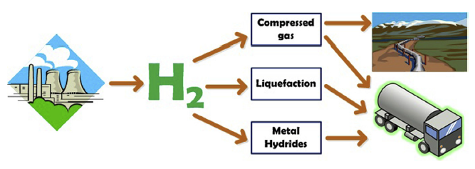
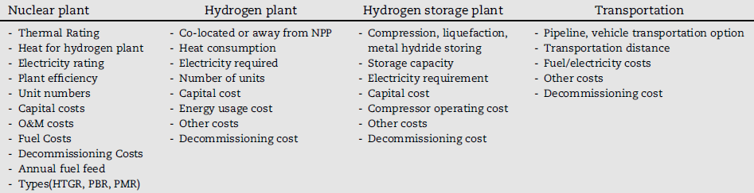
HEEP : Hydrogen Economic Evaluation Program
The HEEP software package, developed by the IAEA, is a released tool for evaluating the economic aspects of large-scale nuclear hydrogen production, including storage and transportation options.
It can assess various hydrogen production methods, such as low and high-temperature electrolysis, thermo-electro-chemical hydrogen production, and steam methane reforming, in terms of their economic viability.
The software includes details such as capacities, total capital cost, initial and annual fuel costs for cost estimation.
The technical and economical details and specific case studies about the HEEP software package, including cost items (capital or fixed cost, operational costs, decommissioning cost), and an execution module for levelized costs of hydrogen production.
Technical features of HEEP

Slide 10
Configuration of Nuclear Hydrogen Production
The nuclear hydrogen production system consists of four major sub-systems as explained below.
1. Nuclear Heat Supply System (NHSS)
  NHSS is a GT-MHR reactor with a core outlet temperature higher than 850°C,
  which transfers energy in the form of either heat or electricity to the hydrogen production plant.
2. Power Conversion System (PCS)
  PCS is a system that produces electricity from the high temperature heat from the reactor.
  PCS produces electricity using reactor high heat with gas turbine or steam turbine.
3. Heat Transport System (HTS)
  The thermal heat generated from GT-MHR should be transported to the SI process to be used directly in hydrogen production.
  The pressurized helium gas is used as a working fluid to transfer heat from GT-MHR to SI process through the heat transport system.

Slide 11
Configuration of Nuclear Hydrogen Production
4. Hydrogen Production System (HPS)
There are three potential nuclear hydrogen production processes, namely
  SI (Sulfur Iodine) process,
  THE (High Temperature Electrolysis) process, and
  Hybrid Process.
The Sulfur Iodine (SI) process is selected as the candidate hydrogen production method considering
  Its potential to produce hydrogen
  High thermal efficiency from water, which does not emit CO₂
  The IS process consists of the following three chemical reactions.
  H₂O is decomposed thermally into H₂ and O₂ in total; iodine (I) and sulfur (S) compounds cycle.
I₂ + SO₂ + 2H₂O→ H₂SO₄ + 2HI (Bunsen reaction)
    H₂SO₄ → H₂O+ SO₂ + 0.5O₂
    2HI → H₂ + I₂
The highest temperature requirement in the process is 800-900 °C for H₂SO₄ decomposition.
The demand matches the maximum temperature of the GT-MHR helium coolant of 850 °C.

Slide 12
HEEP : INPUT Parameters and Assumptions
Designation | Value
1. Nuclear power plant
Thermal ratting per unit | 600
Number of units | 2
Electricity rating (MWe/unit) | 288
Efficiency (%) | 48
Thermal heat of H₂ plant (MWth/unit) | 340
Max specific capital cost ($/kWe) | 5400
Capital cost (M$) | 1050
O&M cost (% of CC) | 5.8
Fuel cost ($/kg) | 270
Decommissioning cost (% of CC) | 10
2. Hydrogen generation plant (per unit)
Annual hydrogen generation (ton/year) | 32,000
Thermal energy required (MWth)/unit | 340
Electric energy required (MWe)/unit | 25.4
Capital cost (M$/unit) | 209
Energy usage cost (M$) | 13.27
O&M cost (%) | 7.78
Decommissioning cost (%) | 10
Designation | Value
3. Pipelines
Transportation distance (km) | 600
Pipe equivalent radius (mm) | 125
Inlet pressure of hydrogen (bar) | 52.3
Delivery pressure (bar) | 50.0
Temperature of hydrogen (K) | 293
Friction factor | 0.01
Decommissioning cost (%) | 1
O&M cost (%) | 1
4. Storage
Hydrogen storage period, (h) | 168
Unit cost of cooling water for storage ($/ML) | 0.00022
O&M cost for hydrogen storage (%) | 5
Liquefaction
Cooling water flow rate of liquefaction (L/kg H₂) | 209
Daily boil-off rate (%) | 0.1

Slide 13
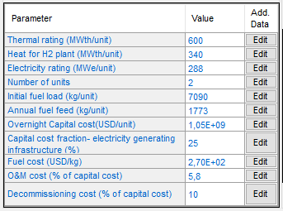
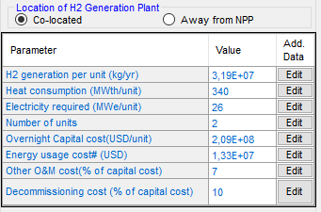
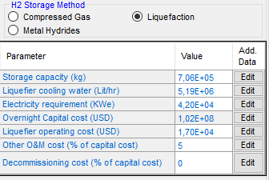
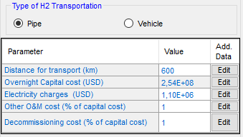
HEEP : INPUT Parameters and Assumptions

Slide 14
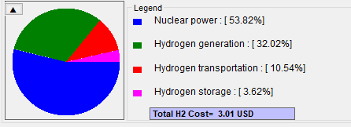
Preliminary Results
 | Capital cost (Debt) | Capital cost (Equity) | O&M + Refurbishment | Decommissioning cost | Facility total
Nuclear Power Plant | 0.3 | 0.22 | 1 | 0.09 | 1.62
Hydrogen Generation | 0.12 | 0.1 | 0.72 | 0.02 | 0.96
Hydrogen storage | 0.06 | 0.05 | 0 | 0 | 0.11
Hydrogen Transportation | 0.14 | 0.13 | 0.04 | 0 | 0.32
Total of all facilities | 0.62 | 0.5 | 1.76 | 0.12 | 3.01

Slide 15
Conclusion
The study is focused to evaluate hydrogen production cost including storage and transportation
Case study : Tunisian Economic data
HEEP : The IAEA software used to perform economic analysis and feasibility studies for hydrogen production
Nuclear Heat Supply System : gas turbine modular helium reactor (GT-MHR)
Hydrogen Production System : The Sulfur Iodine (SI) process
The study is ongoing : The study also highlights the importance of evaluating the sensitivity of capital costs for each facility to determine the levelized cost of hydrogen

Slide 16
Thanks for your Attention

