Slide 2
Development challenges of SMR cogeneration modules
Paweł Gilski
Product Manager in ORLEN Synthos Green Energy
PhD student of Warsaw University of Technology

Slide 3
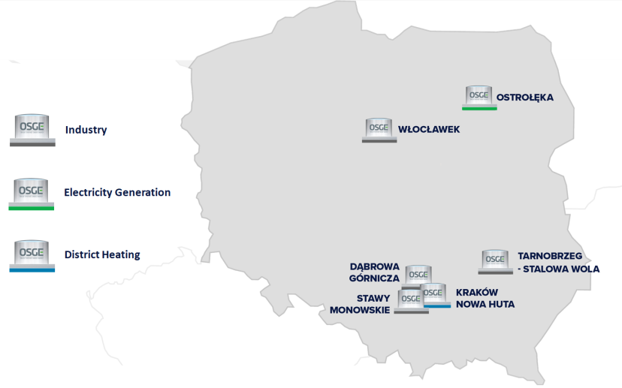
Development challenges of SMR cogeneration modules
Who is OSGE?
ORLEN Synthos Green Energy (OSGE) is a Polish company that is involved in development in Small Modular Reactors (SMR) in Poland.
Our mission is to have a leading role in deployment of a fleet of SMR as an essential component of the efficient transition of energy generation towards Net Zero by 2050.

Slide 4
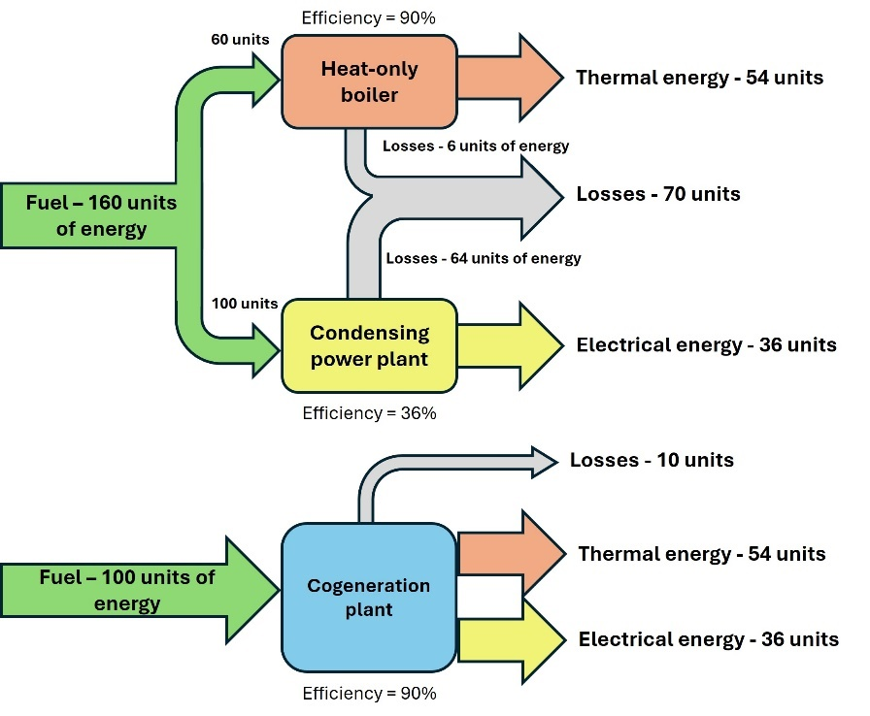
Development challenges of SMR cogeneration modules
What is cogeneration?
Cogeneration, also known as Combined Heat and Power (CHP), is a production of electricity and useful heat at the same time.
Cogeneration is more efficient than separate production of electricity and useful heat.

Slide 5
Development challenges of SMR cogeneration modules
Why nuclear cogeneration should be in the spotlight?
Most of nuclear power plants around the world produce only electricity with an average thermodynamical efficiency around 30%.
The rest of the energy is treated as a waste heat which is discharged to the environment.
There are 416 operable nuclear power reactors in the world with total of 374 GWe installed capacity
If we assume the average Unit Capacity Factor of 79,2% for all those reactors, then roughly estimated 6 054 492 GWh/year (21,8 EJ/year) of thermal energy are emitted to the environment.
This amount of thermal energy is higher than the total heat demand for residential and service sector in European Union from year 2010, which was 15,5 EJ/year.
Utilization of a fraction of this energy would help in decarbonization efforts

Slide 6
Development challenges of SMR cogeneration modules
How many nuclear cogeneration plant are in operation?
Currently, 20 of nuclear power reactors operate in cogeneration.
16 produce heat for district heating networks:
1 in Bulgaria (WWER)
1 in Hungary (WWER)
9 in Russian Federation (RBMK or WWER or LMFR)
1 in Slovakia (WWER)
1 in Switzerland (PWR)
2 in Ukraine (WWER)
1 in Romania (HWR)
4 produce heat for industry:
1 in Canada (HWR)
1 in Germany (PWR)
1 in Switzerland (PWR)
1 in India (HWR)

Slide 7
Development challenges of SMR cogeneration modules
Business challenges
In Poland there are 387 licensed companies which supply heat to the customers.
District heating networks supply heat to 50% of population in Poland.
The amount of energy supplied to the district heating networks in Poland in 2020 was 257 TJ.
The Polish industry consumed additional 200 TJ.
Almost a half of Polish district heating networks have installed capacity up to 50 MWth.
Typically district heating networks in Poland utilize about 5-10% of installed capacity during summer.
Estimated heating output of the BWRX-300 operating in cogeneration for district heating is about 350 MWth.
Cogeneration module for Poland has to be flexible to produce proper amount of heat and be able to switch to condensation mode if there is no heat load.

Slide 8
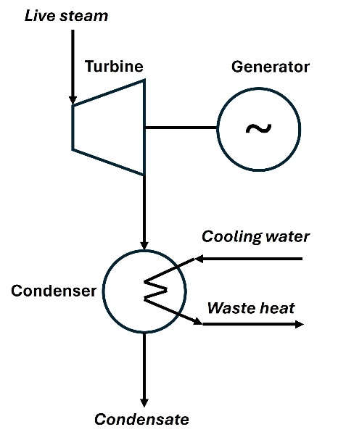
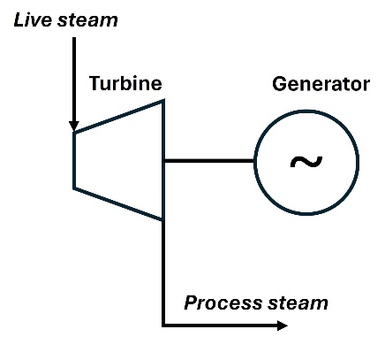
Development challenges of SMR cogeneration modules
Technological challenges
Typical solution used in coal-fired cogeneration plants.
Typical solution used in NPPs.

Slide 9
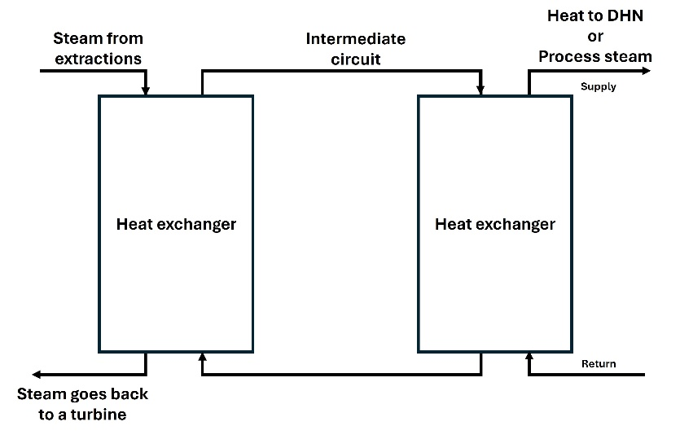
Development challenges of SMR cogeneration modules
Technological challenges
Solution preferred by OSGE, that gives possibility to switch from condensing mode of operation to cogeneration mode of operation.

Slide 10
Development challenges of SMR cogeneration modules
Regulatory challenges
Energy Efficiency Directive defines allowed energy mix in EU for district heating networks that is required to follow in order to have a status of an “efficient district heating system”.
This status is important for Polish district heating operators as it is required in order to connect new clients to the network.
Date | Renewable energy and/ or waste heat | Cogeneration only | Mix (renewable energy + waste heat + cogeneration)
Until 31.12.2027 | 50% | 75% | 50%
From 01.01.2028 | 50% | 80%* | 50% (min 5% renewable)
From 01.01.2035 | 50% | N/A | 80% (min 35% renewable or waste heat)
From 01.01.2040 | 75% | N/A | 95% (min 35% renewable or waste heat)
From 01.01.2045 | 75% | N/A | N/A
From 01.01.2050 | 100% | N/A | N/A
Heat from nuclear reactor is barely mentioned in the Directive and totally omitted in the criteria.
European Parliament and the Council of EU voted to treat the nuclear energy generation equally to renewable energy generation.
The Directive should be updated to reflect this decision.
*high-efficiency cogeneration (defined in detail in the Energy Efficiency Directive)

Slide 11
Development challenges of SMR cogeneration modules
Thank you for your attention!
Paweł Gilski
ORLEN Synthos Green Energy
pawel.gilski@osge.com

